Slide 1
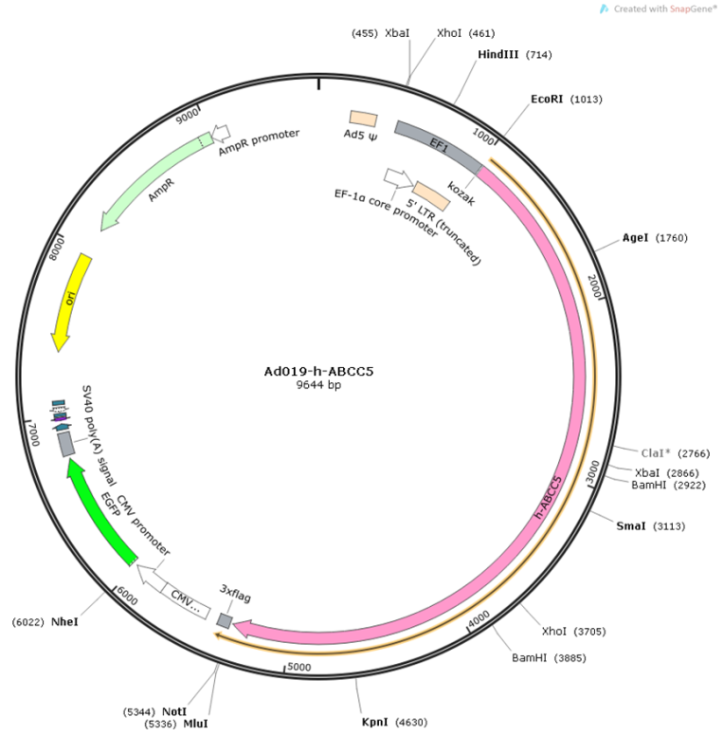
Supplement Fig.1 ABCC5 adenovirus map

Slide 2
Supplement Fig.2 Expression of ABC transporters mRNA in MCF-7 and MCF-7ADR cell lines
The α-tubulin was used for normalizing of cDNA sample. Results are given as mean ± SD from three separate experiments *p<0.05.
10
MCF-7
*
MCF-7-ADR
8
6
*
Expression level of gene (ratio of control)
*
*
4
2
0
ABCC1
ABCC2
ABCC3
ABCC4
ABCC5
ABCC6
ABCC8
ABCC11
ABCC12
ABCB1
ABCG2

Slide 3
Supplement Fig.3 Correlation of IC₅₀ values of MTA and mRNA expression of
ABCC transporters in primary cell lines from patients

