Slide 1
Preprinting a pandemic: trends, dissemination, and regulation of COVID-19 preprints
Jonny A Coates
William Harvey Research Institute, QMUL
preLighter
Jonathon.coates@qmul.ac.uk
@JACoates91

Slide 2
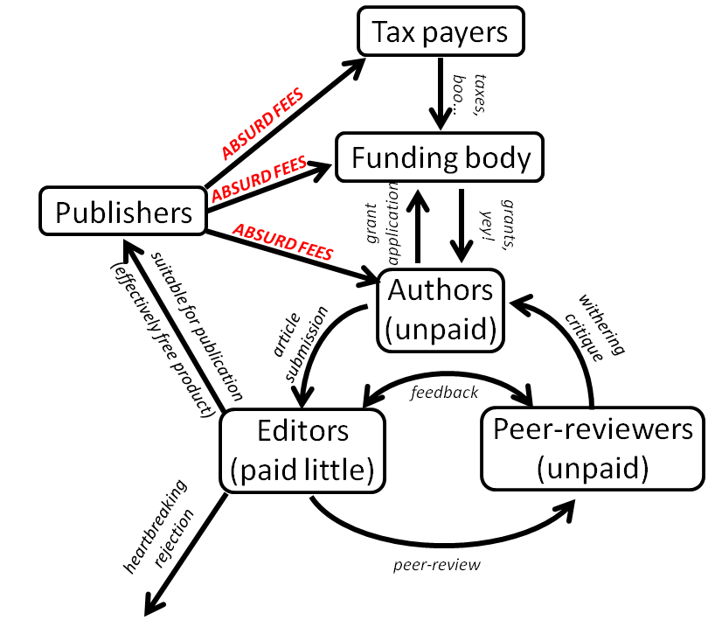
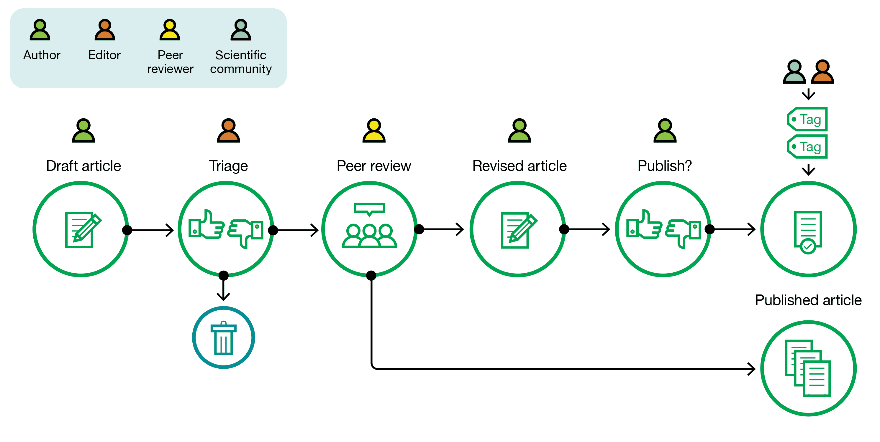
Traditional publishing
https://asapbio.org/digital-age
https://katatrepsis.com/2012/01/28/scientific-publishing-what-a-con/

Slide 3
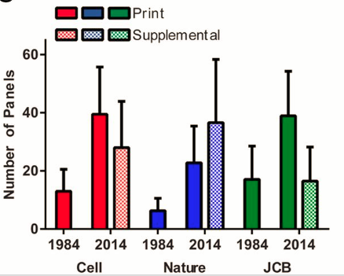
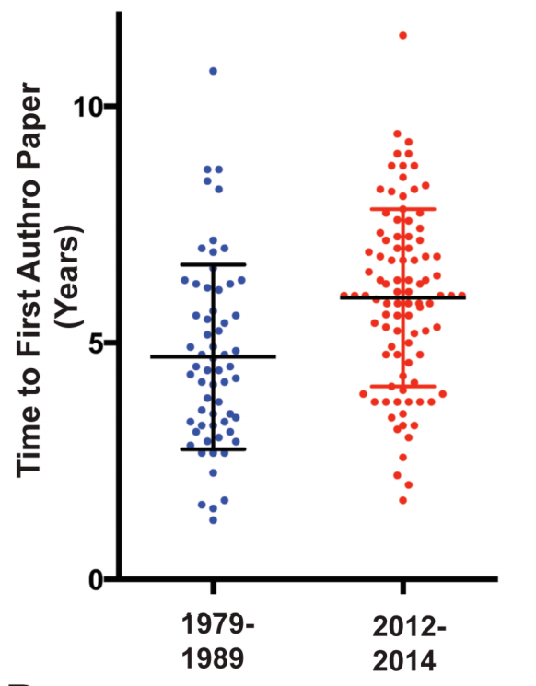
Traditional publishing is slow, requires more data than ever and hinders ECRs
We need to improve speed of knowledge distribution and our means of quality assessment
Ron Vale – bioRxiv & PNAS 2015
http://www.biorxiv.org/content/early/2015/07/11/022368
Sekara et al. PNAS 2018
https://doi.org/10.1073/pnas.1800471115

Slide 4
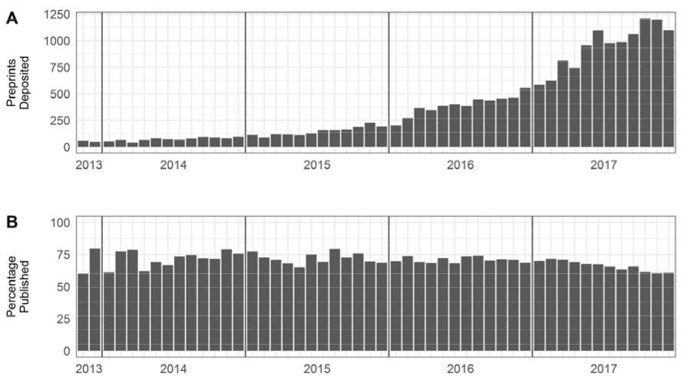
Preprints
Preprints are manuscripts shared online before the completion of journal-organized peer review.
Permanent
Versioned
Citable
Not peer reviewed ≠ poor quality
2020 survey: 42% posted, 81% read
Sources: ASAPbio; Puebla et al, in prep.
Fraser et al, 2019 10.1101/673665v1

Slide 5
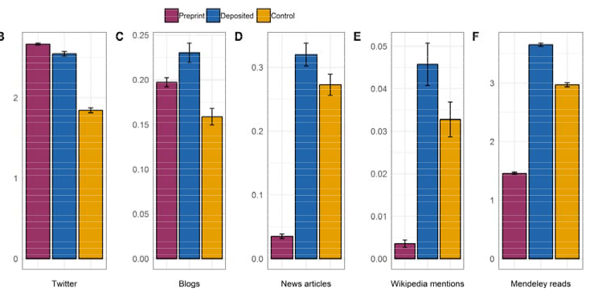
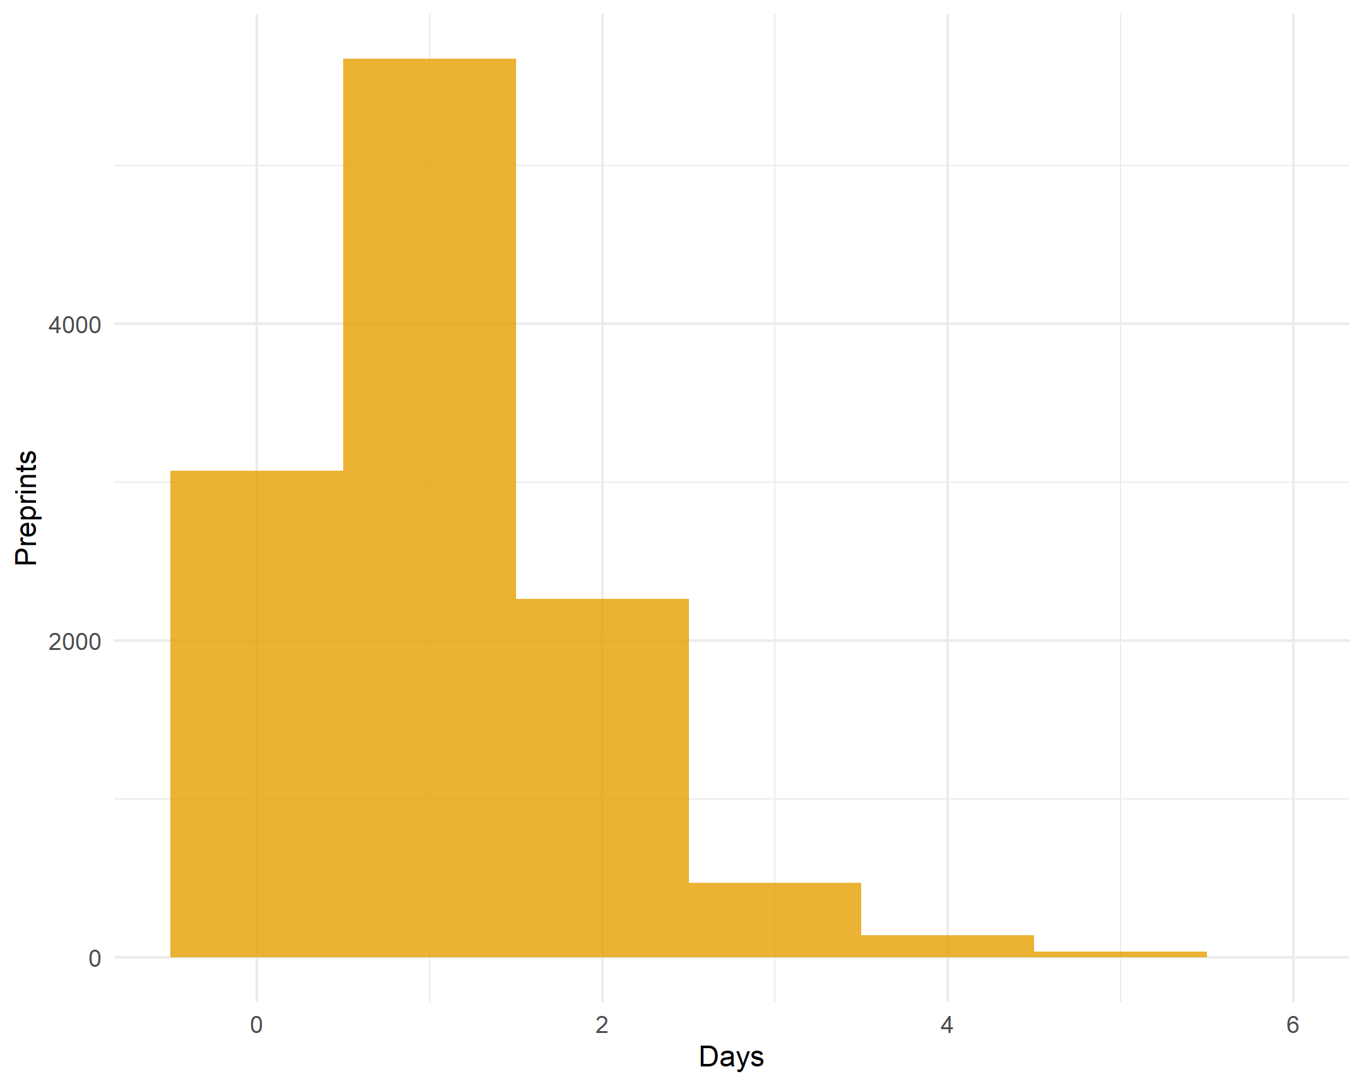
Why preprint?
Gives you more visibility & more citations
Screening takes ~1 day
Fraser et al, 2019 10.1101/673665v1
Steve Royle, https://quantixed.org/2020/03/30/screenager-screening-times-at-biorxiv/
Can use altmetrics in cover letter to journals to show impact
Makes academia more equitable and supports ECRs
Prachee Avasthi
https://ecrlife.org/why-you-should-publish-your-work-as-a-preprint-a-conversation-with-dr-prachee-avasthi/

Slide 6
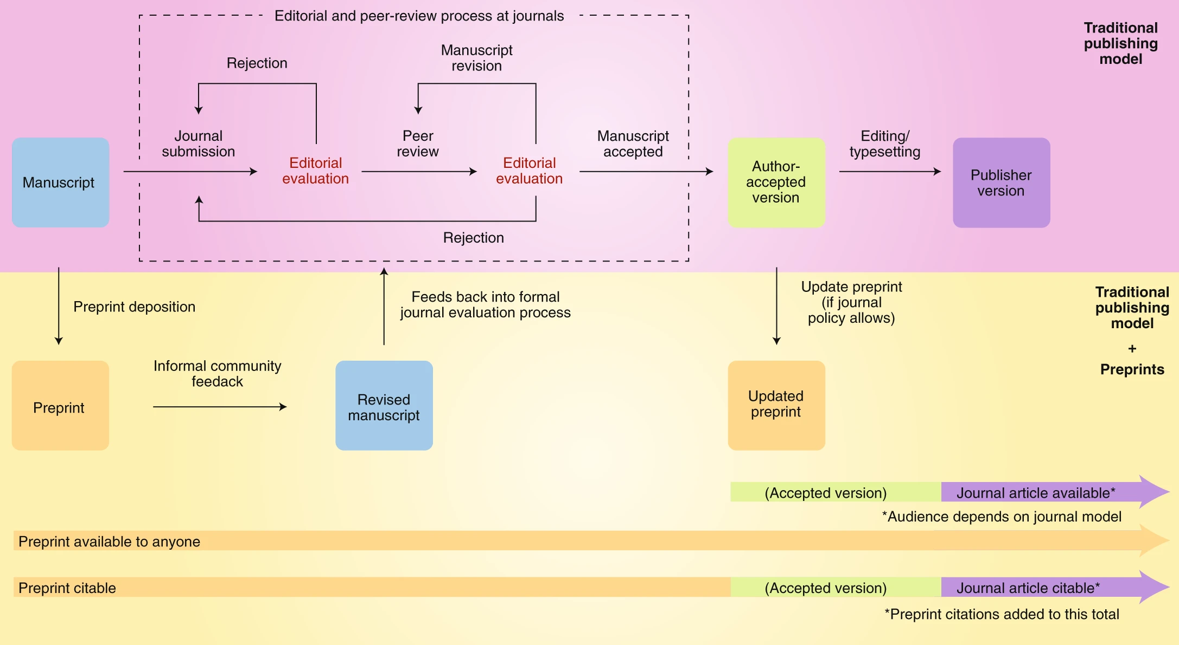

Slide 7
In contrast to the slow, laborious traditional publishing methods
Preprints were almost poised for a pandemic…
Are preprints being used more than normal to communicate COVID-19 science?
What usage are preprint servers experiencing?
What do COVID-19 preprints look like?
How are preprints being shared?
Can we comment on the quality of preprints?

Slide 8
Scientific community has rapidly responded to the pandemic
Are preprints being used more than normal to communicate COVID-19 science?
30,260 COVID-19 preprints
= 25% of all COVID-19 research
10,232 posted to medRxiv + bioRxiv
= 23% of all preprints on medRxiv + bioRxiv

Slide 9
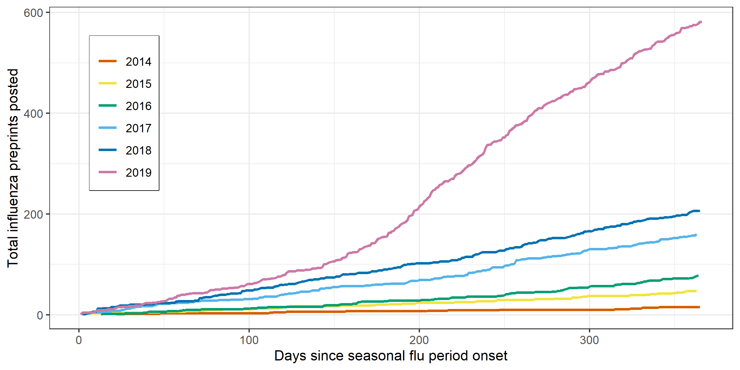
This significant use of preprints is unique to the COVID-19 pandemic
COVID-19 rate: 39.5 preprints/day
Ebola, Zika rates: < 0.3 preprints/day
Brierley. Lancet Planetary Health. 2021;5,e115-e117

Slide 10
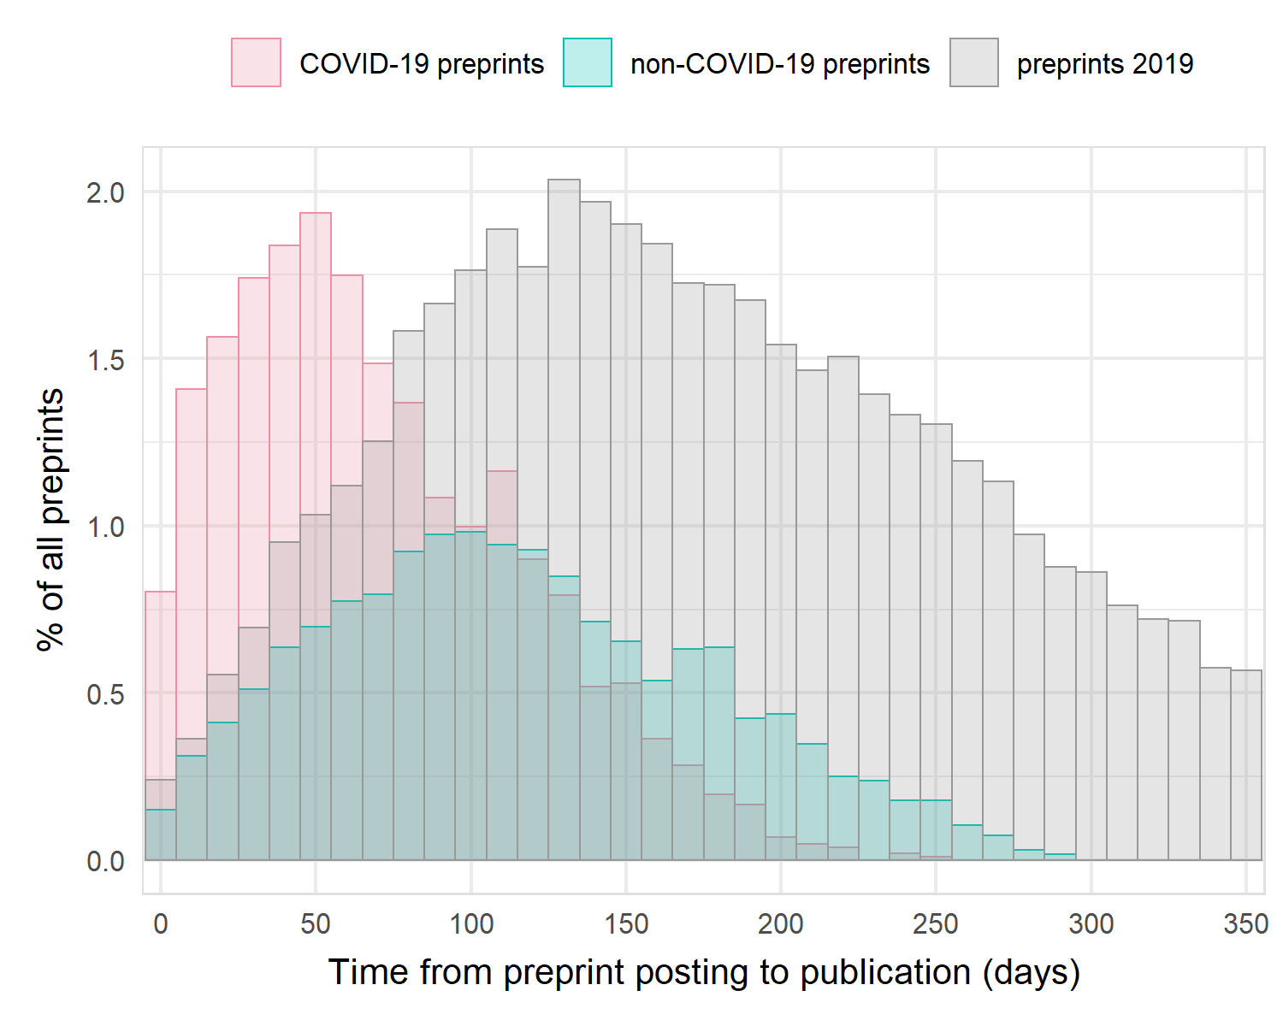
COVID-19 preprints are being published at accelerated rates
More likely to be published (21.1% vs 15.4%) (Chi-square test, p < 0.001)
Published more quickly (median publishing time, 68 days vs 116 days) (Mann-Whitney test, p < 0.001)

Slide 11
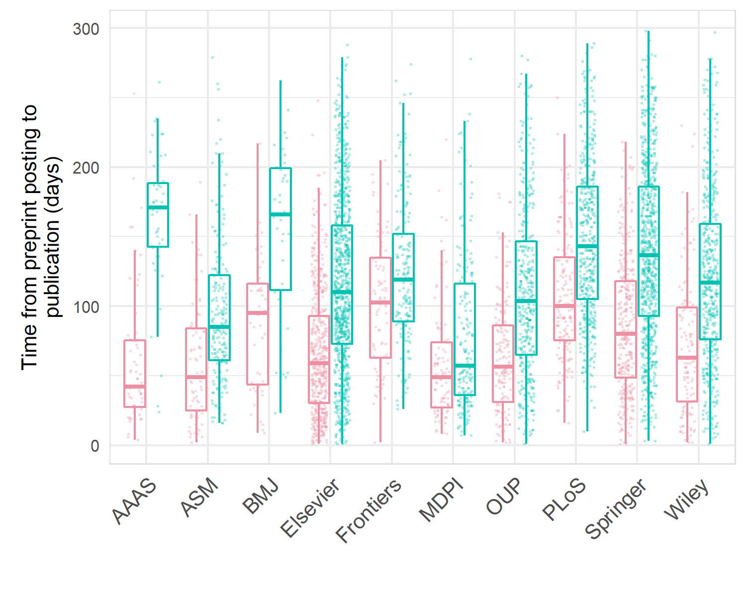
How much more quickly depends on publisher!
Greatest estimated difference for AAAS (Science), = 102 days
(two-way ANOVA, preprint type*publisher interaction, F_{9,5273} = 6.6, p < 0.001)

Slide 12
Summary I
The scientific response to the pandemic was rapid – within 1 month of first case
Preprints represent a significant proportion of the COVID-19 literature
Especially early on….

Slide 13
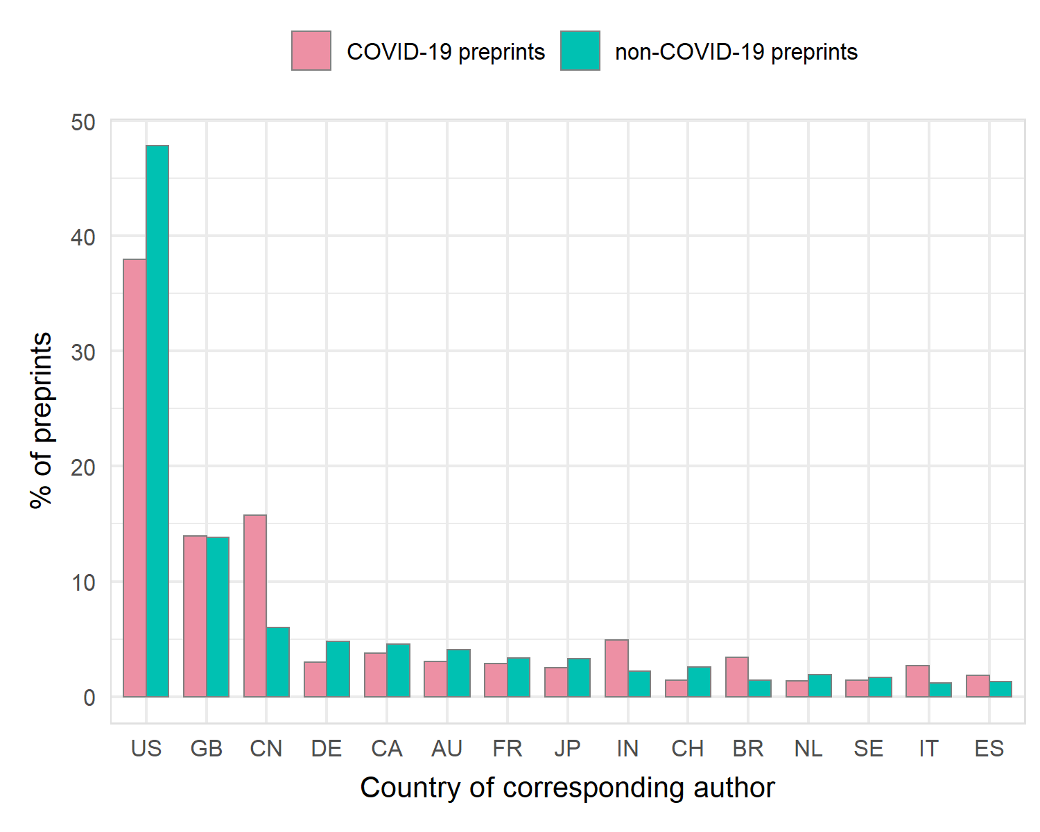
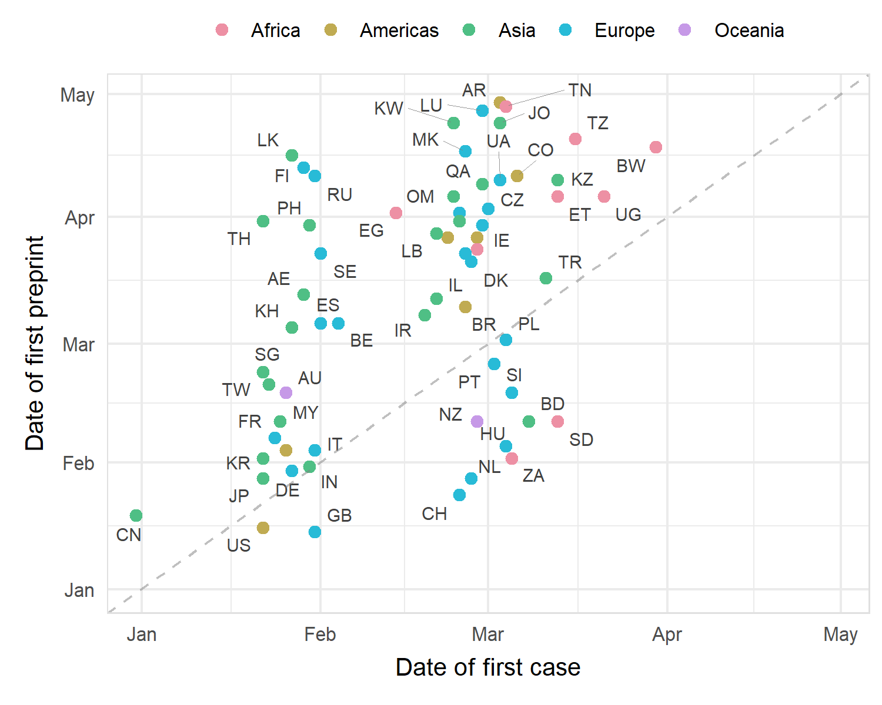
So who is publishing all these preprints?
Most COVID-19 corresponding authors from US, UK or Chinese institutions
First preprints posted close to first cases (Spearman’s rank, rho = 0.54, p < 0.001)

Slide 14
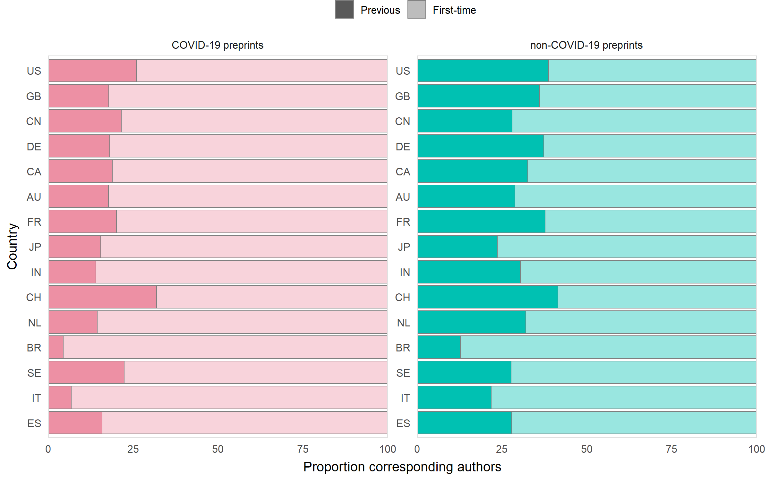
***
***
*
***
**
**
***
**
More authors posting preprint for first time among COVID-19 authors (Bonferroni-adjusted Chi-square tests, *** p < 0.001, ** p < 0.01, * p < 0.05)

Slide 15
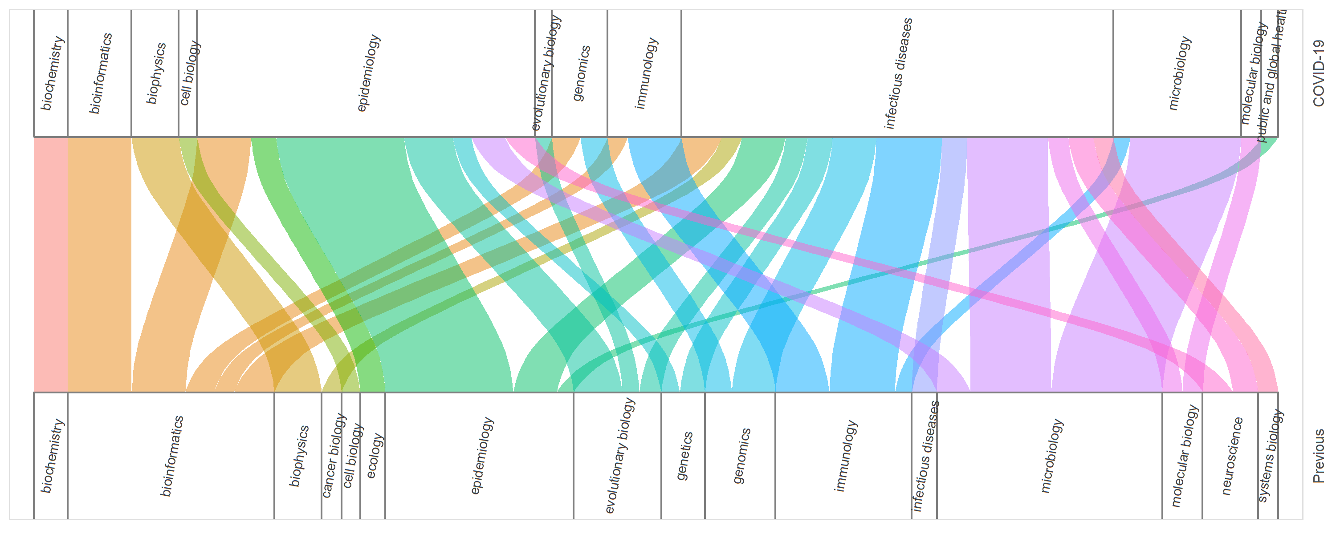
Labs are shifting expertise to best help with pandemic research
Gog. Nature Reviews Physics. 2020;2,274-275

Slide 16
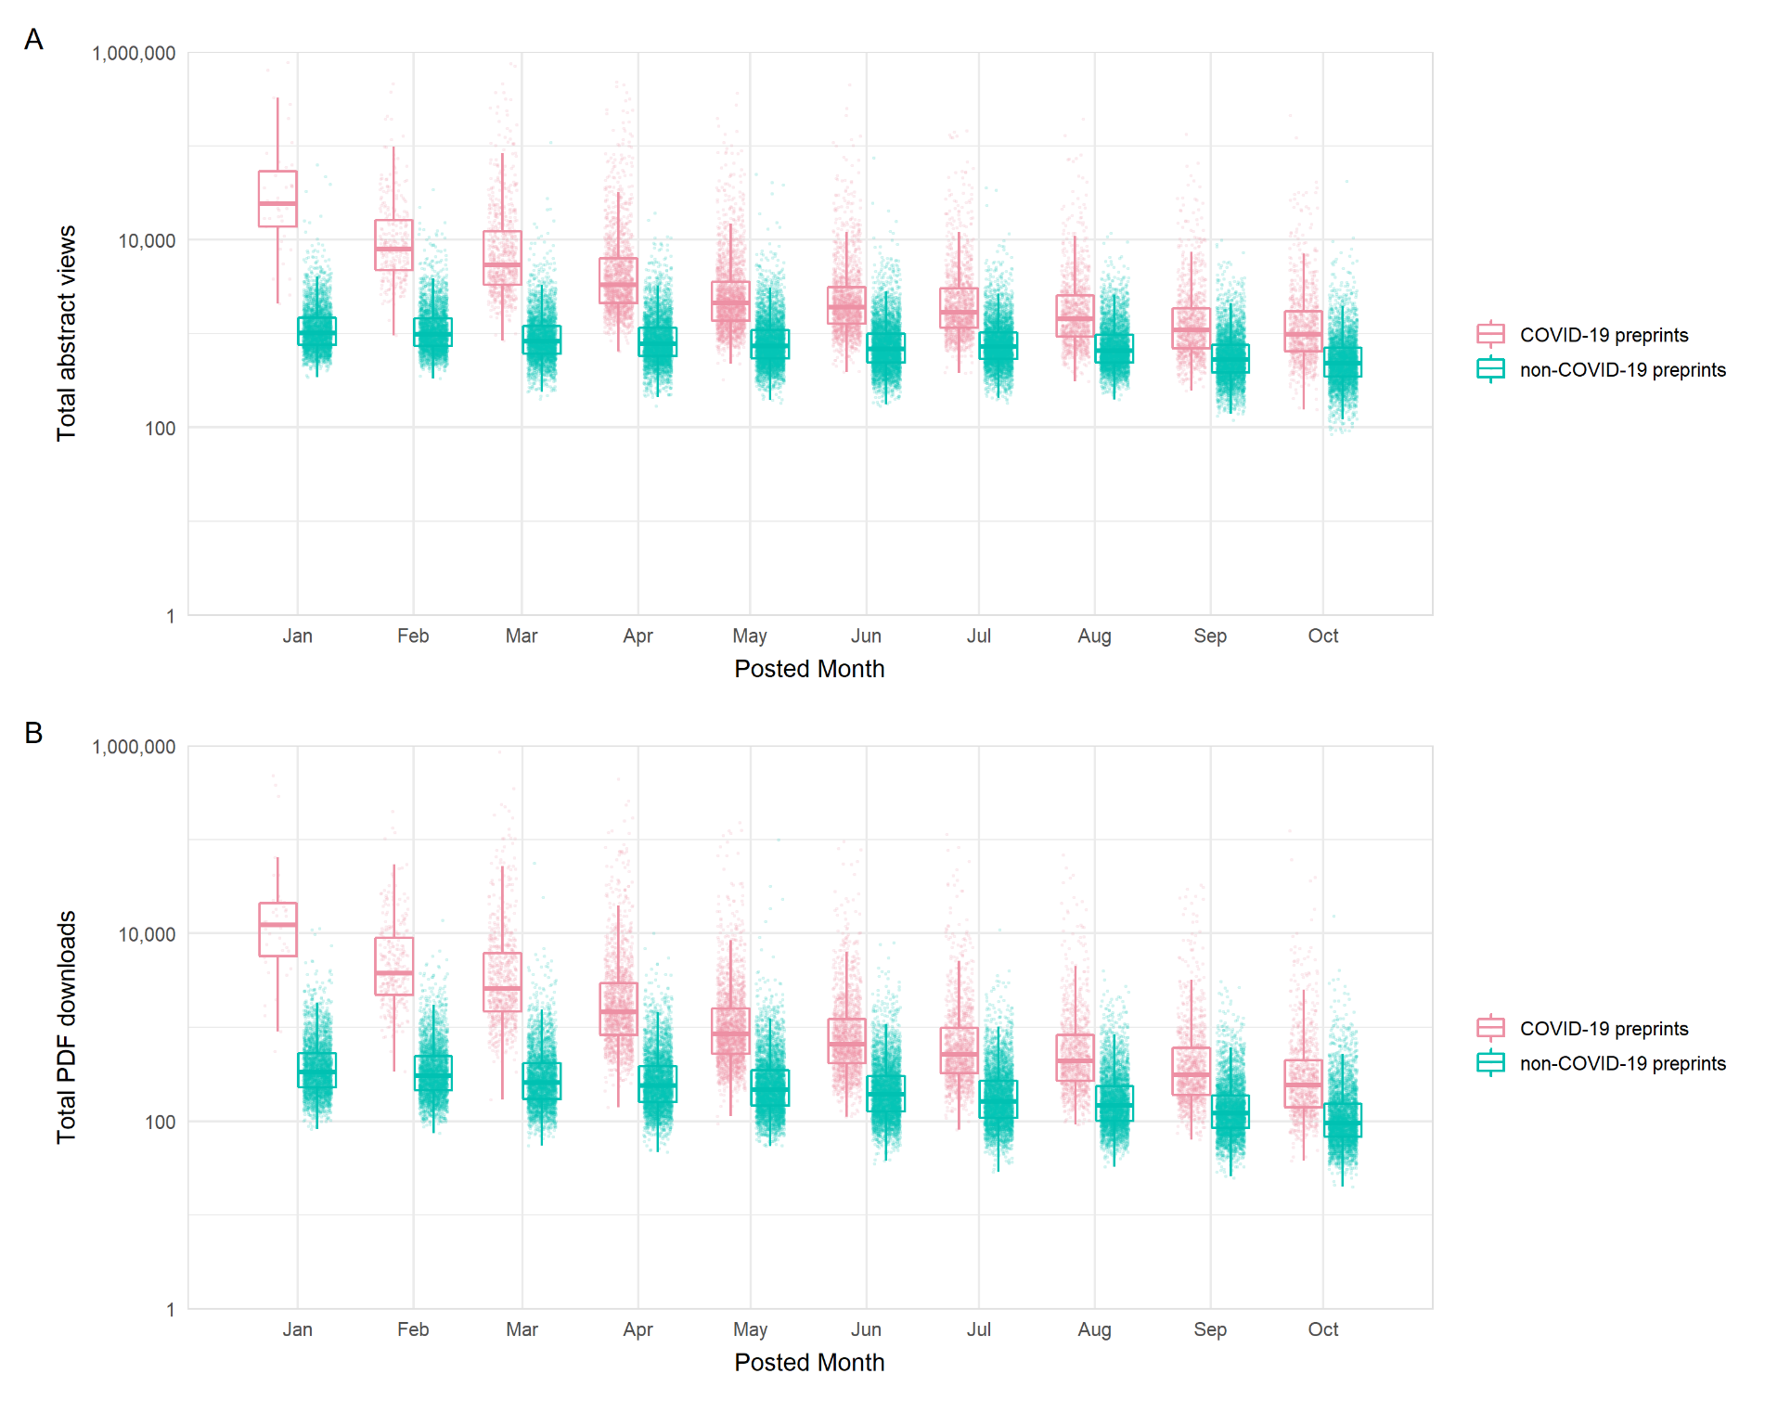
COVID-19 preprints are being accessed and downloaded at unprecedented levels
Early COVID-19 preprints viewed 18.2 times and downloaded 27.1 times more than non-COVID-19 (rate ratios from time-adjusted negative binomial GLMs, p < 0.001)
Did early COVID-19 preprints slowly accumulate usage? Or have less competition?
Or COVID fatigue?

Slide 17
COVID-19 preprints are cited, tweeted and covered by news organisations
How are COVID-19 preprints being shared?

Slide 18
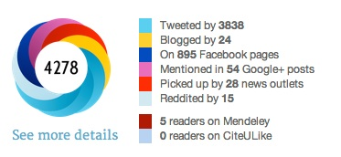
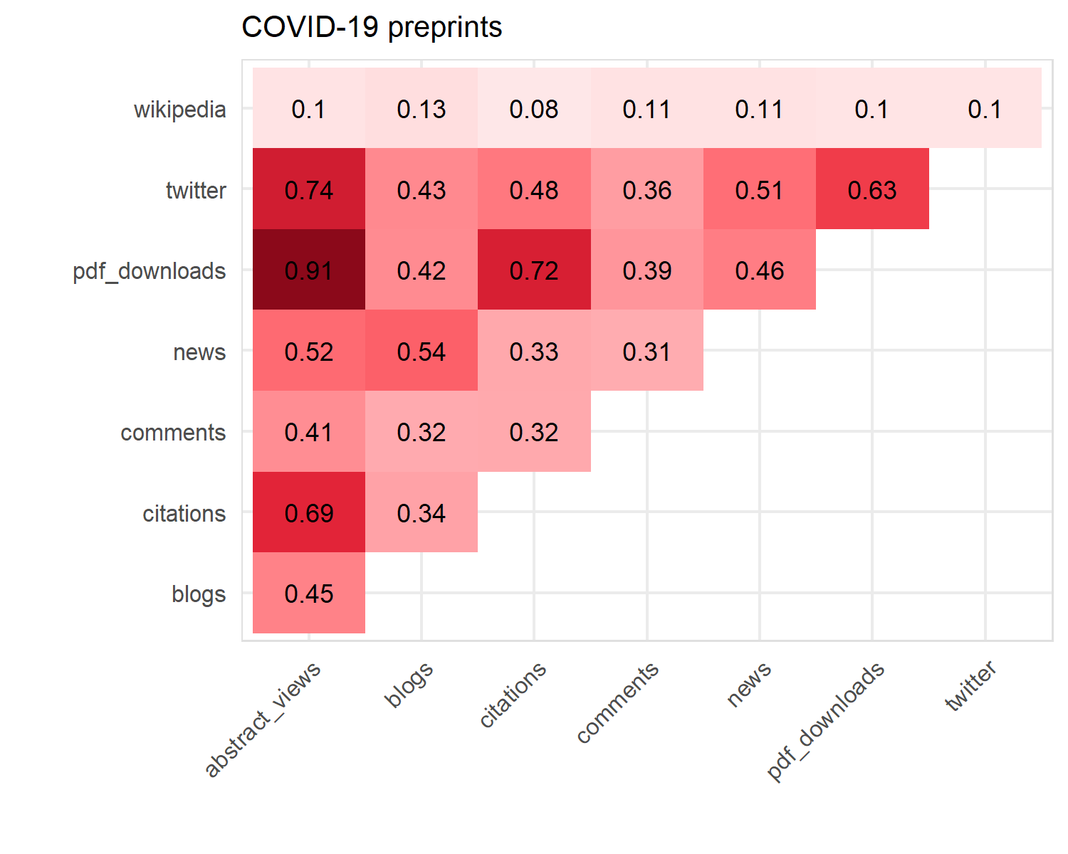
COVID-19 preprints are being widely shared across multiple platforms
usage metric | rate ratio
Blogs | 3.7
Wikipedia articles | 4.5
Tweets | 7.6
Comments | 11.0
Citations | 13.7
News articles | 92.8
(all correlations Spearman’s rank rho estimates)

Slide 19
Summary II
Preprints represent a significant proportion of the COVID-19 literature
Labs are posting preprints for the first time directly as a response to the pandemic
COVID-19 preprints are being accessed, downloaded and shared at unprecedented levels

Slide 20
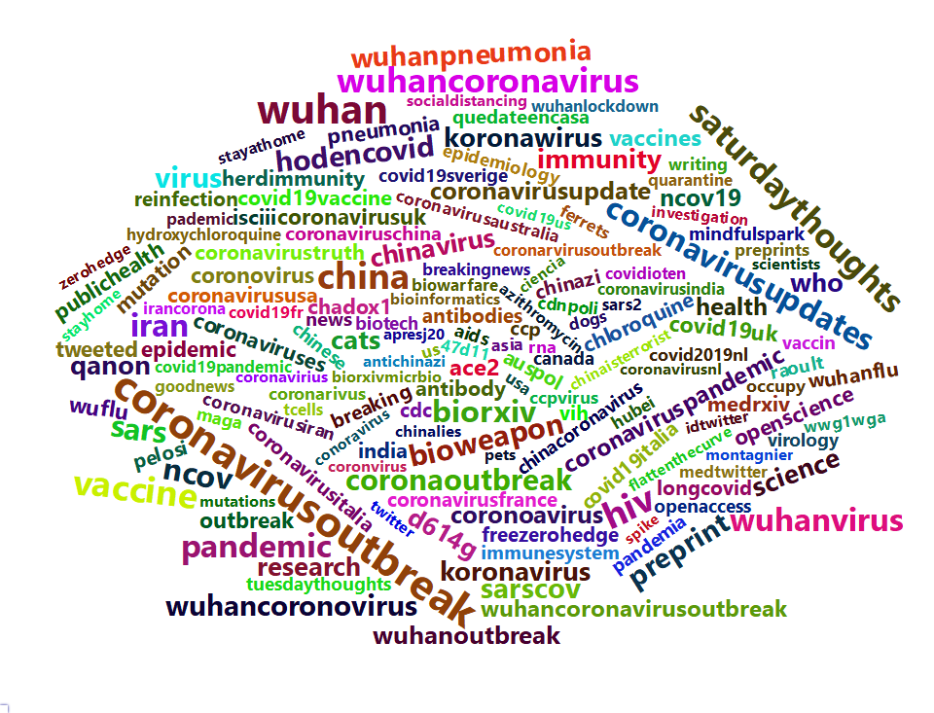
But there is a danger to all this sharing as science is hijacked by right-wing media and conspiracy groups
Top hashtags associated with top 100 most tweeted preprints shows audiences beyond scientific ones – including conspiracy theory and nationalist ideologies

Slide 21
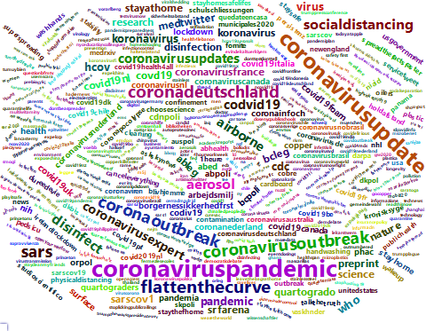
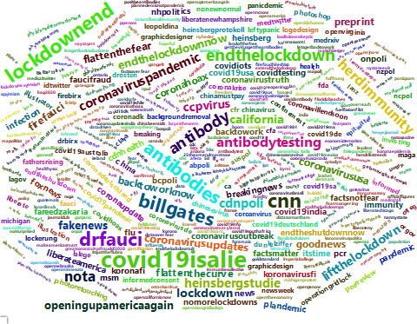
Scientific messages are getting through but significant “hijacking” by right-wing conspiracy groups – and this can be linked to specific preprints
Nb. This data was sampled earlier than the prev slide
Aerosol and surface stability of HCoV-19 (SARS-CoV-2) compared to SARS-CoV-1
COVID-19 Antibody Seroprevalence in Santa Clara County, California

Slide 22
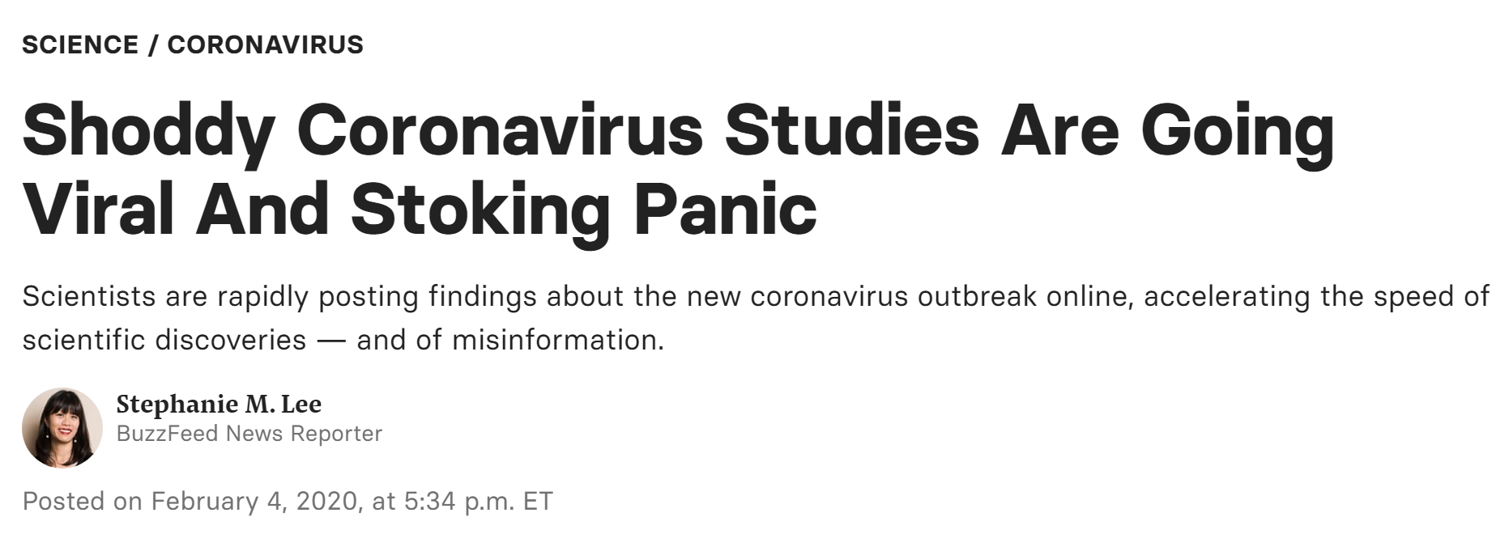
Can we trust preprints?

Slide 23
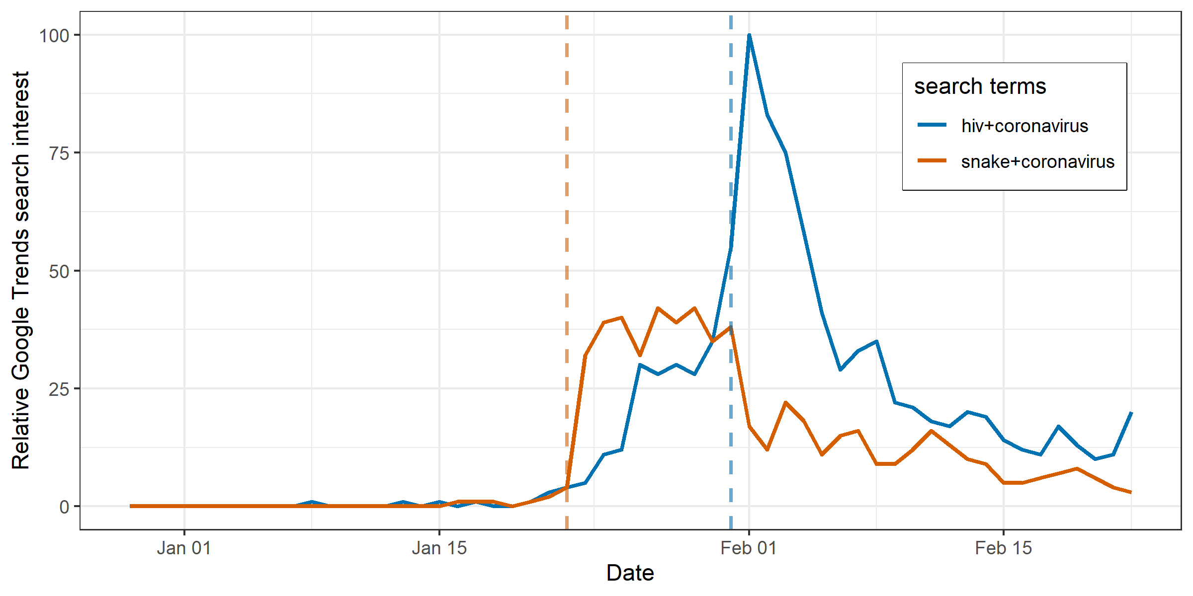
Can we trust preprints? A justified question
Pradhan et al., ‘Uncanny similarity of unique inserts in the 2019-nCoV spike protein to HIV-1 gp120 and Gag’, bioRxiv. Claim: genetic material from HIV is in SARS-CoV-2. Withdrawn after 3 days. (3rd for comments, 4th for tweets)
Ji et al., ‘Homologous recombination within the spike glycoprotein of the newly identified coronavirus may boost cross-species transmission from snake to human’, Journal of Medical Virology. Claim: snakes are a likely origin of SARS-CoV-2.
Brierley. Lancet Planetary Health. 2021;5,e115-e117

Slide 24
What do COVID-19 preprints look like?
COVID-19 preprints are shorter than non-COVID-19 preprints

Slide 25
COVID-19 preprints published more and in wide-array of journals

Slide 26
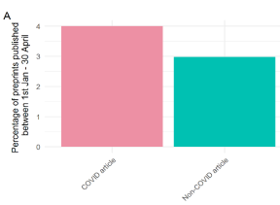
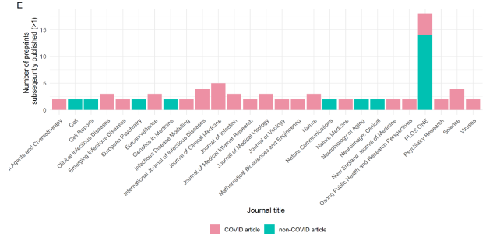
Jan – April 2020 (initial phase of the pandemic)
~100 articles

Slide 27
COVID-19 articles have less data availability and less transparency in peer-review

Slide 28
COVID-19 preprints show little change in figure content upon publication

Slide 29
Over 85% of COVID-19 (>94% of non-COVID-19) abstracts have no significant changes upon publication
6% of non-COVID-19
15% of COVID-19 abstracts undergo a discrete change in key conclusions
Or, phrased differently
94% of non-COVID-19
85% of COVID-19 no discrete change to their conclusions within abstracts

Slide 30
The degree of change is not associated with any specific location or type of change

Slide 31
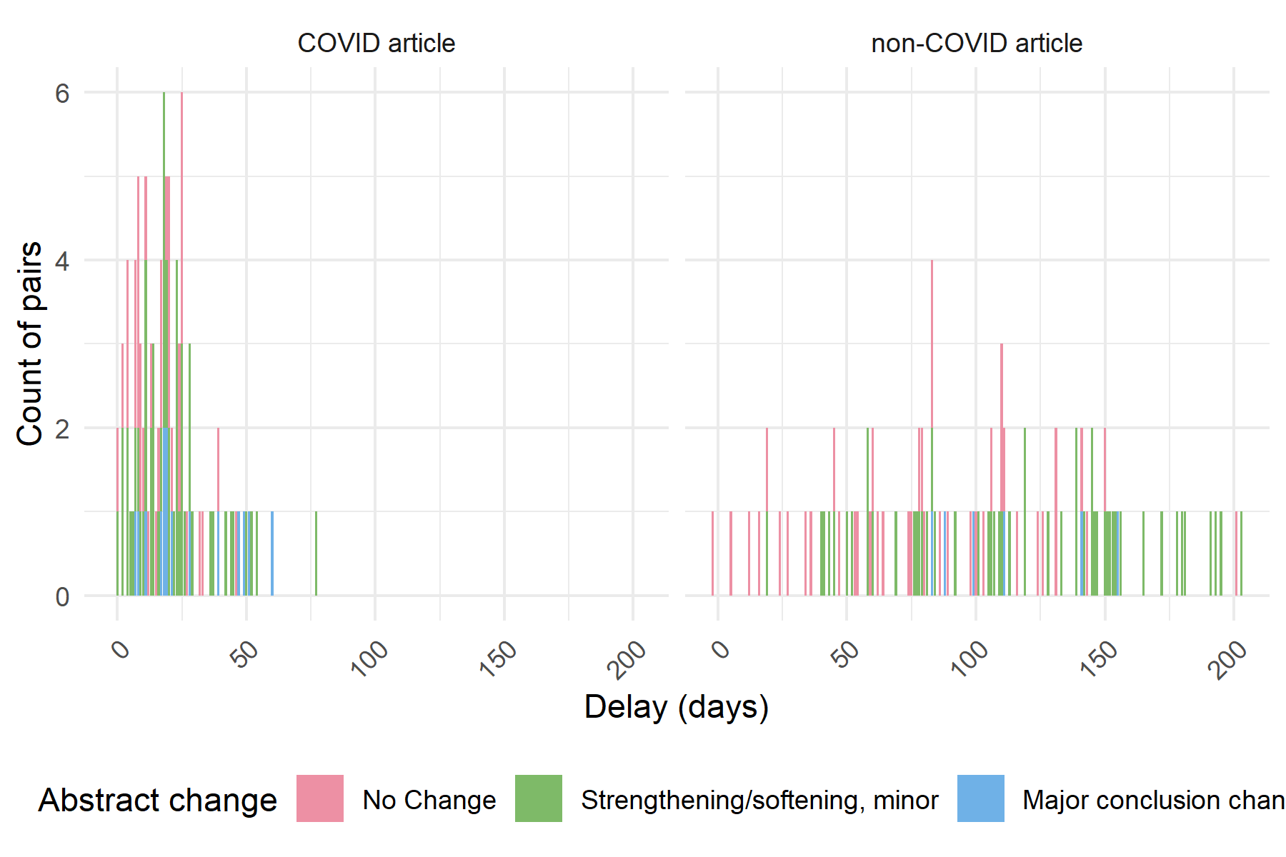
Major conclusion changes do not associate with a longer time to publication

Slide 32
The degree of change does not appear to be impacted by final published journal

Slide 33
Variation is difficult to capture!
Following study of reporting standards¹, examine change in preprint -> publication
Large scale (>30,000) NLP analysis of bioRxiv corpus¹
Separately investigated our subset
Couldn’t readily separate our data from the rest of the corpus – suggesting our dataset is applicable to the wider preprint literature

Slide 34
1. What are the rates of preprint posting?
100 times past epidemics, ¼ of articles
2. Who is posting COVID-19 preprints?
authors from UK, US, China new to preprinting
3. How are COVID-19 preprints accessed and shared?
18 times more views; 27 times more downloads than non-COVID
4. Are COVID-19 preprints sufficient “quality”?
quality not detectably different to non-COVID, >85% have no significant changes to key conclusions
Preprints have experienced a cultural shift during COVID-19
sharing work/code on Twitter can lead to collabs!

Slide 35
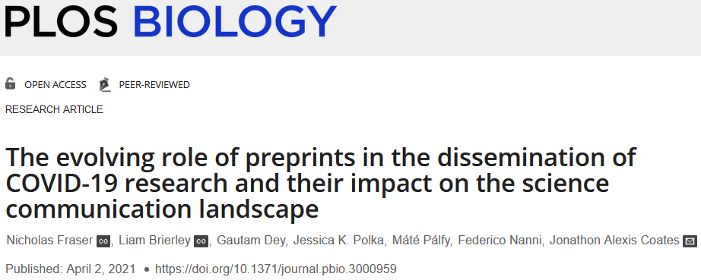
Thanks, Grazie, Gracias, danke, Kiitos, Kea leboga, Merci, ob-ree-gah-doh, Asante
From bottom left clockwise: Dr Nicholas Fraser, Leibniz Information Centre for Economics
Dr Liam Brierley, University of Liverpool
Dr Máté Pálfy, Company of Biologists
Dr Gautam Dey, EMBL
Dr Federico Nanni, Alan Turing Institute
Dr Jessica Polka, ASAPbio

