Slide 1
Christopher Jackson Adventures in Publishing OR Impact Factors and other animals…
@seis_matters

Slide 2
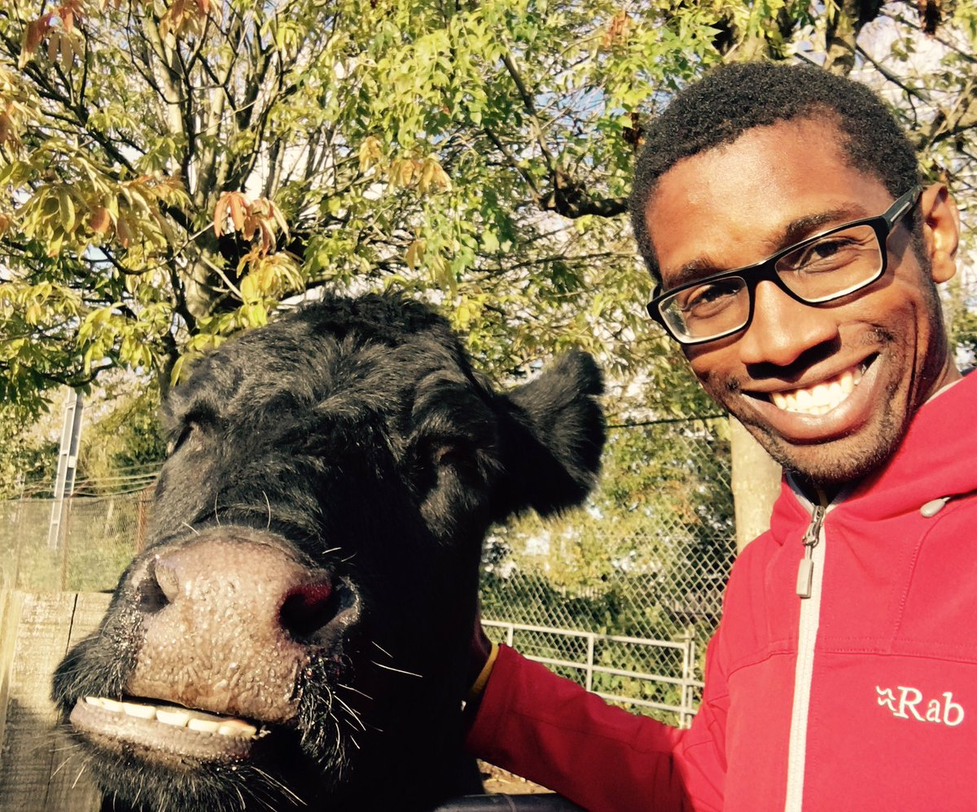
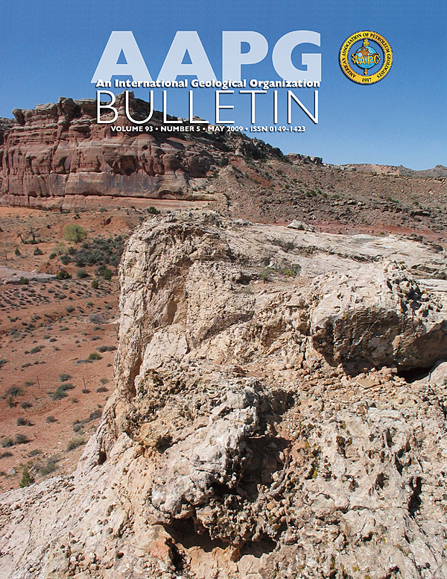
Who Am I?
1998 – BSc Geology (Manchester)
2002 – PhD (Manchester)
2002-2004 – Statoil, Norway
2004-2021 – Imperial College
2021-date - Manchester
c.200
6
1

Slide 3
Notes:
Before I start, a warning...
I am no OA expert; e.g. I have no long history in the underpinning mechanics of scholarly communications
However, I am self-admitted novice, who, crucially, is moderately bright, and wants to learn and educate others
In any case, I am the type of person the messages arising from conferences/groups like this need to engage with...
I’m easier than many others...

Slide 4
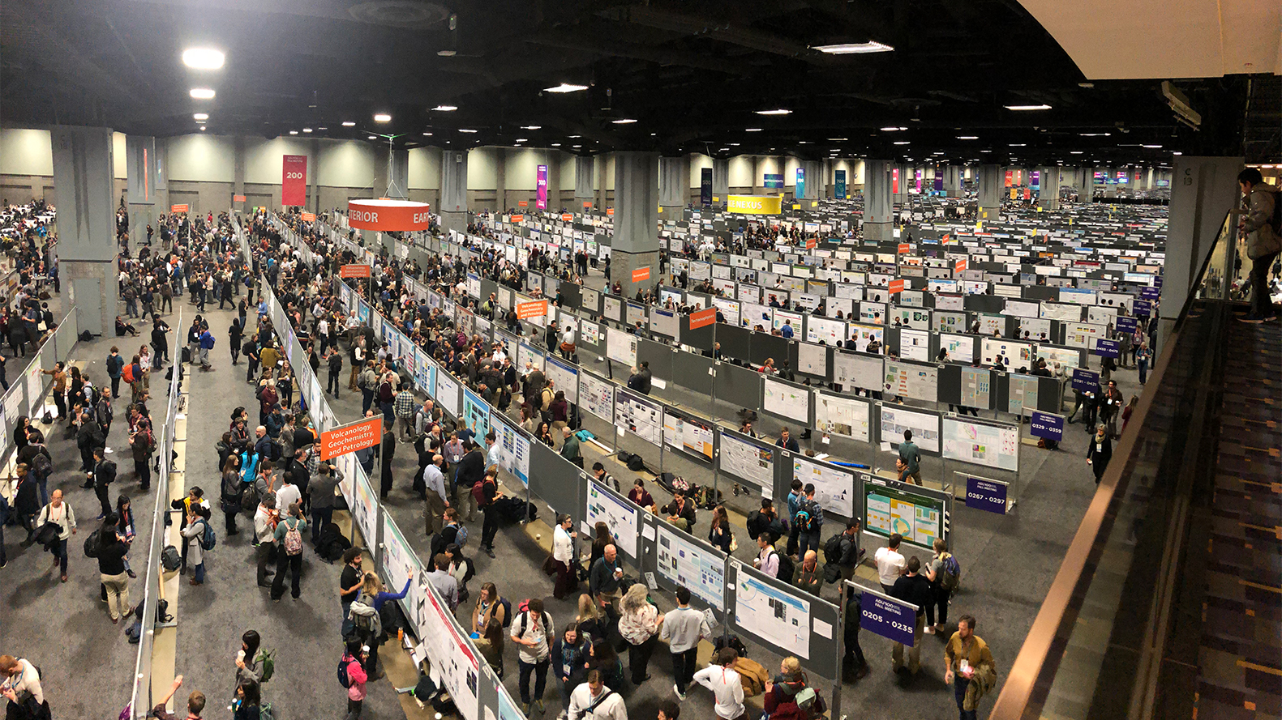
https://dtm.carnegiescience.edu/news/2018-agu-fall-meeting-update-dec-12-13

Slide 5
https://www.careeraddict.com/internal-vs-external-recruitment-what-should-you-use

Slide 6
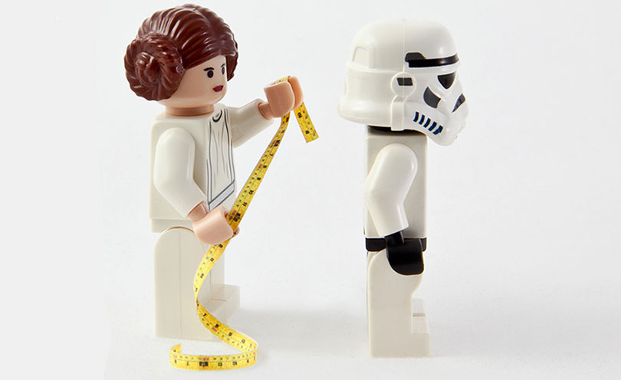
JIF
https://business.linkedin.com/talent-solutions/blog/2014/10/a-7-step-plan-for-measuring-and-improving-quality-of-hire
H
Notes:
Fear of how we are assessed; e.g. inappropriate, over-reliance on metrics, which may penalize those without funds for APCs for prestigious journals, for example

Slide 7
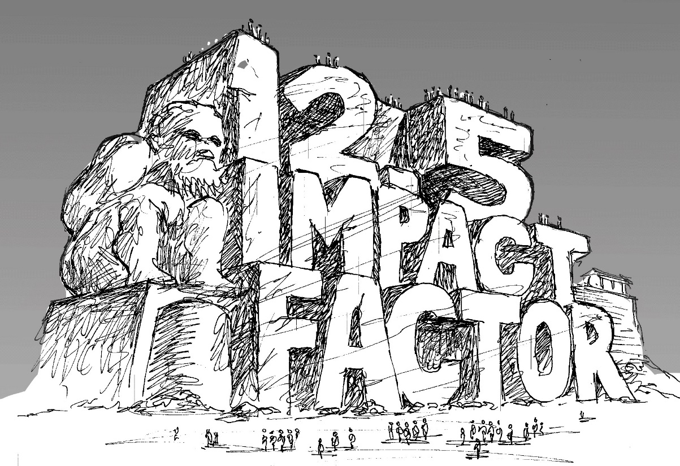

Slide 8
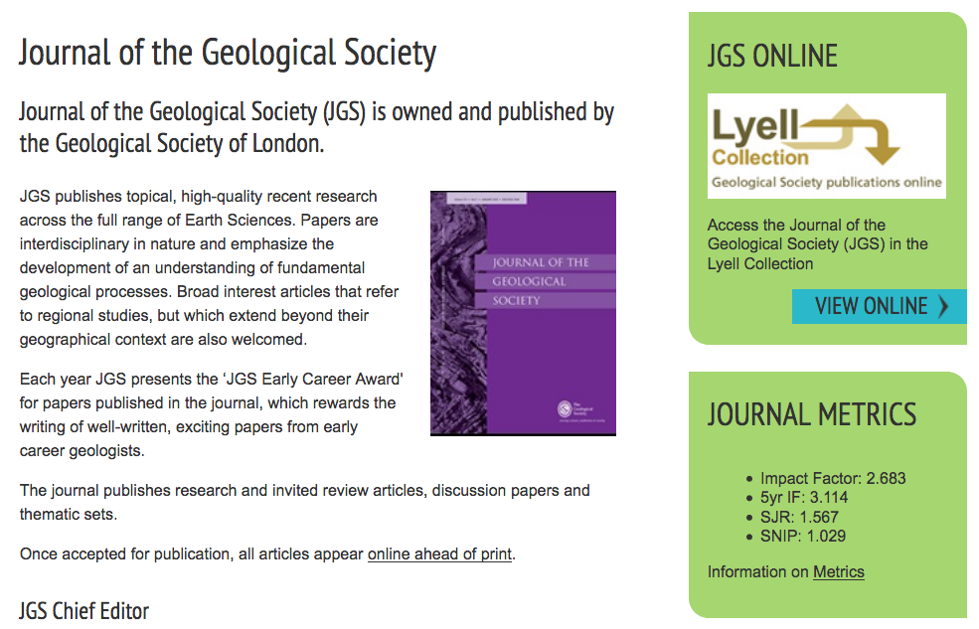
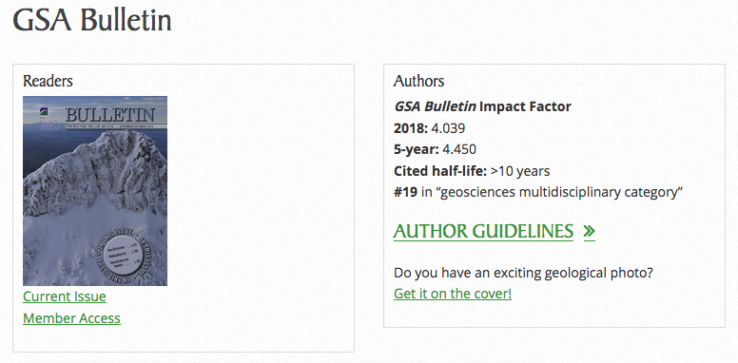
Notes:
But I’ll return to some examples of, in my view, more responsible handling of IFs by society-led journals…
So what is the role of a professional society?

Slide 9
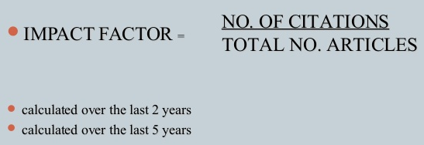
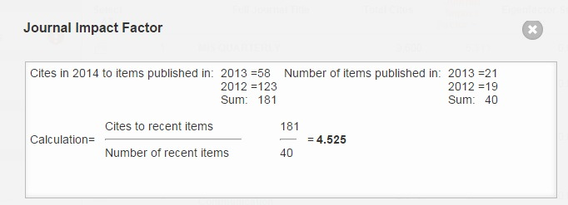

Slide 10
https://www.nature.com/npg_/company_info/journal_metrics.html
Notes:
There are some statistical gremlins; e.g. mean on a strongly skewed distributions, and quoting IF to 3 decimal places…
So what do these numbers even tell us? Well, Lizzie Gadd would suggest it says something about ‘journal visibility’…

Slide 12
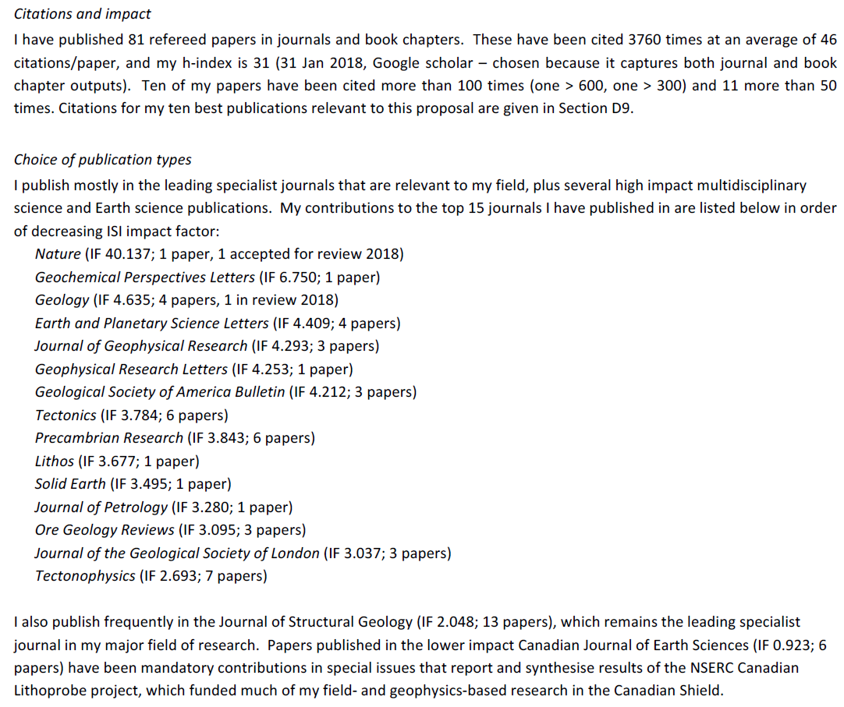

Slide 13
‘People are told the only articles that count are the ones in journals with an IF over an arbitrary value…That’s true even at institutions that have signed DORA…’
‘Most people agree the use of JIF as the sole tool to evaluate research is a bad thing…but no alternative has emerged…the activation energy to find something else is just too high…’
https://www.nature.com/articles/d41586-018-05467-5
Notes:
More recently, and closer to home, this issue has continued…

Slide 14
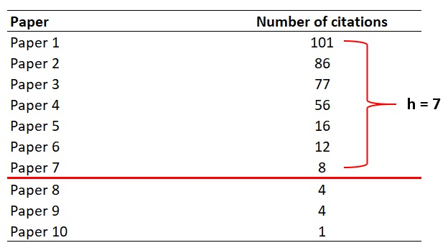

Slide 15
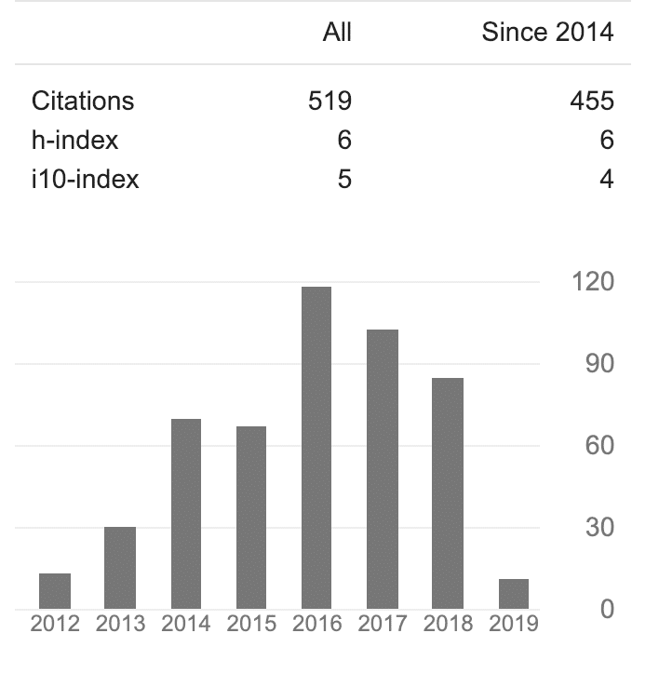

Slide 16
Notes:
Before I start, a warning...
I am no OA expert; e.g. I have no long history in the underpinning mechanics of scholarly communications
However, I am self-admitted novice, who, crucially, is moderately bright, and wants to learn and educate others
In any case, I am the type of person the messages arising from conferences/groups like this need to engage with...
I’m easier than many others...

Slide 17
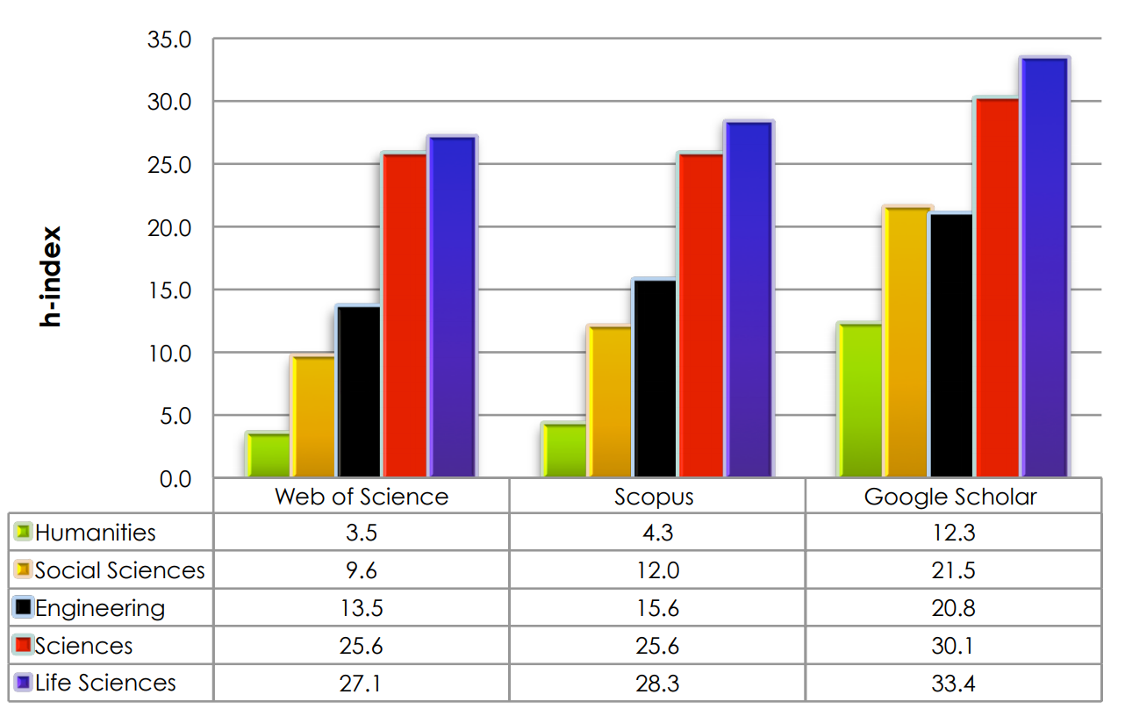
https://harzing.com/download/ahss_morn_comp.pdf

Slide 18
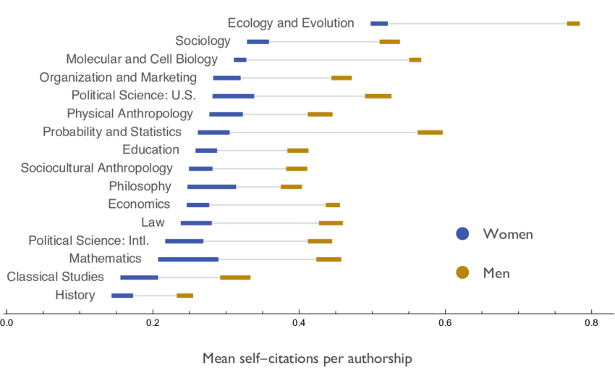
Mean number of men's and women's self-citations per authorship across major fields (based on author-to-author self-citations in JSTOR 1779-2011)
https://www.researchgate.net/publication/304803045_Men_Set_Their_Own_Cites_High_Gender_and_Self-citation_across_Fields_and_over_Time

Slide 19
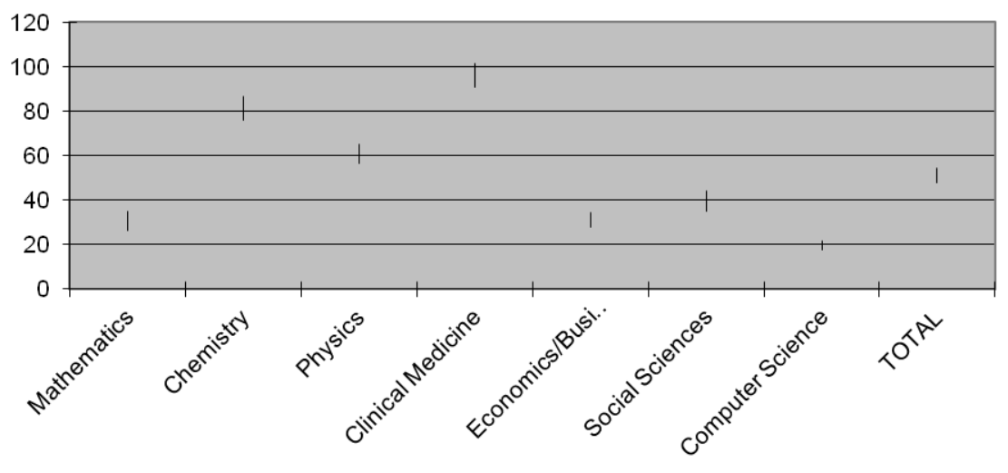
Mean H-index
Malesios & Psarakis (https://arxiv.org/ftp/arxiv/papers/1708/1708.07893.pdf)

Slide 20
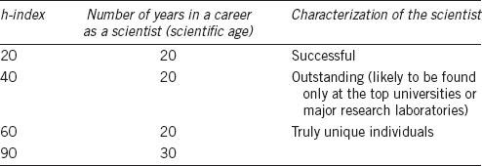
http://www.ajandrology.com/viewimage.asp?img=AsianJAndrol_2016_18_2_296_171582_t7.jpg

Slide 21
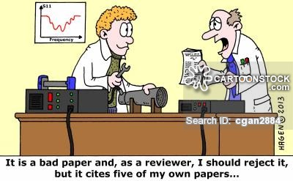
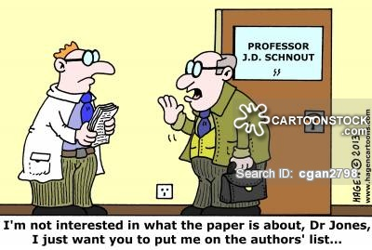
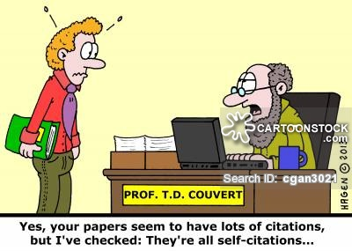
https://www.cartoonstock.com/directory/b/bibliographer.asp
http://www.flickr.com/photos/pierrepo33/8090451693

Slide 22
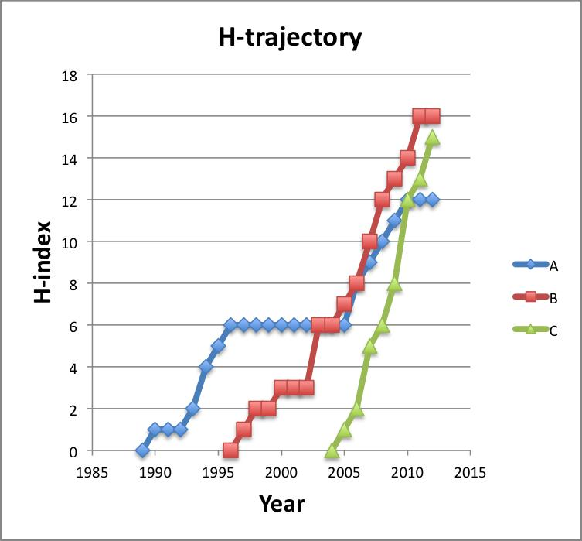
https://blogs.plos.org/biologue/2012/10/19/why-i-love-the-h-index/

Slide 23
https://www.buzzfeed.com/aliciabarron/six-flags-challenges-you-to-stay-in-a-coffin-for-30-hours
H

Slide 24
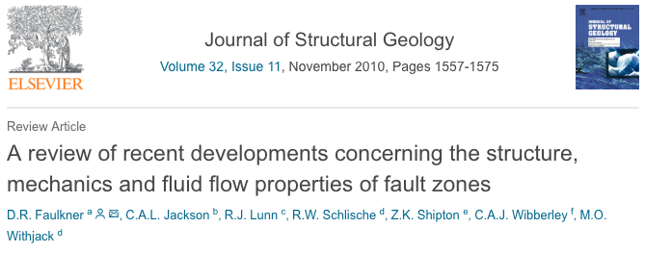
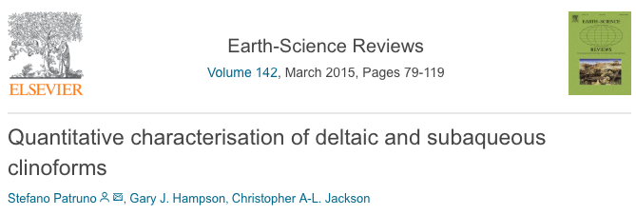
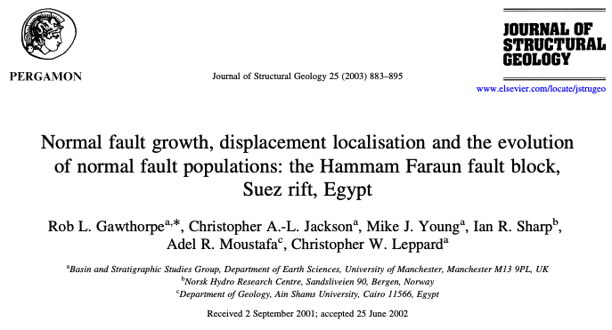
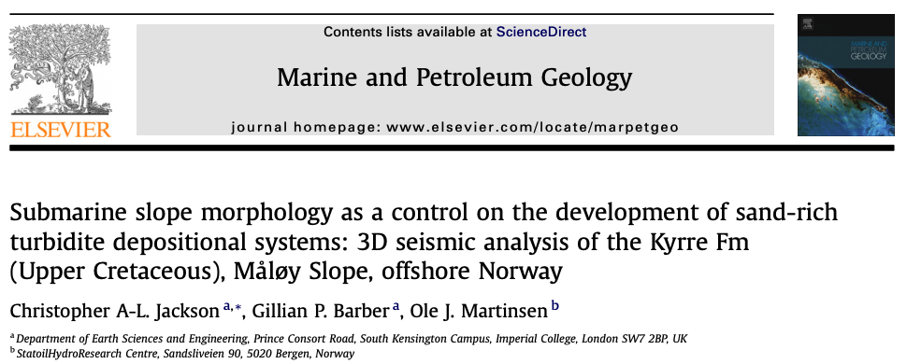
I am not my H-index (or my JIFs) – November 2018
1
3
Key
1
post-conference review paper
Case study paper written by PhD supervisor
Review paper written by PhD student
First-ever paper!
First-ever paper in ‘high-impact’ journal
Paper I am most proud of…*ask me why*
2015/JIF= 7.491/citations=80
2010/JIF= 2.622/citations=582
4
2
number of citations
2002/JIF= 2.683/citations=70
6
5
2
2003/JIF= 2.622/citations=113
3
4
5
6
2011/JIF= 5.073/citations=34
2008/JIF= 3.281/citations=30
paper rank
H-index=31 (GoogleScholar)
H-index=25 (WoS)
produced using Publish or Perish software - https://harzing.com/resources/publish-or-perish
Notes:
One reason is simply to help accrue citations and increase your H-index; this *could* help with securing a job or promotion
However, the link between publishing openly and getting cited more is not clear
Also, metrics such a H-Index and JIF may not fully capture the range of outputs or their likely impact, or the influence of the researcher
So, what are the barriers to being open?

Slide 26
https://www.shutterstock.com/video/clip-30620920-advertisingvacationtime-relax-concept---young-woman-reading

Slide 29
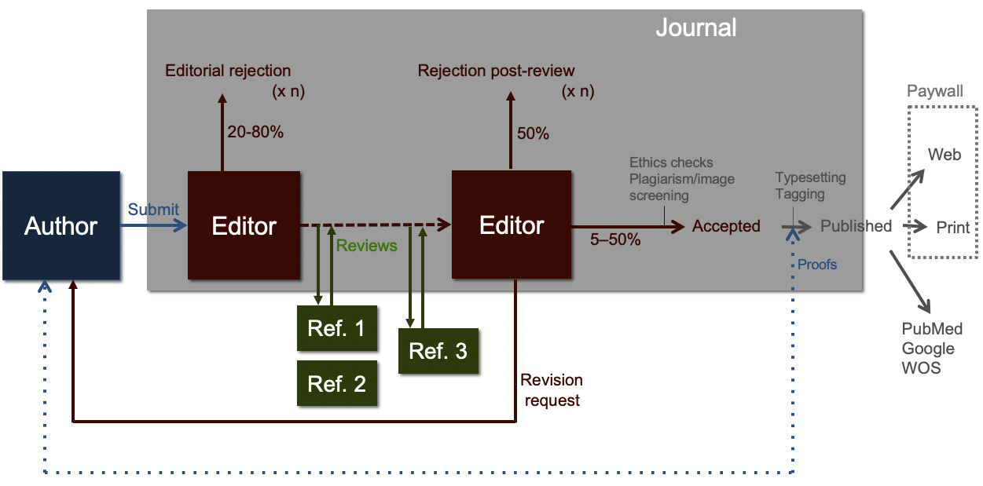
Traditional Publishing…
image courtesy
of Richard Sever

Slide 30
What’s a Preprint anyway?
Preprint (n): an unpublished manuscript yet to be certified by peer
http://asapbio.org/asapbio-attendees-commentary-in-science

Slide 31
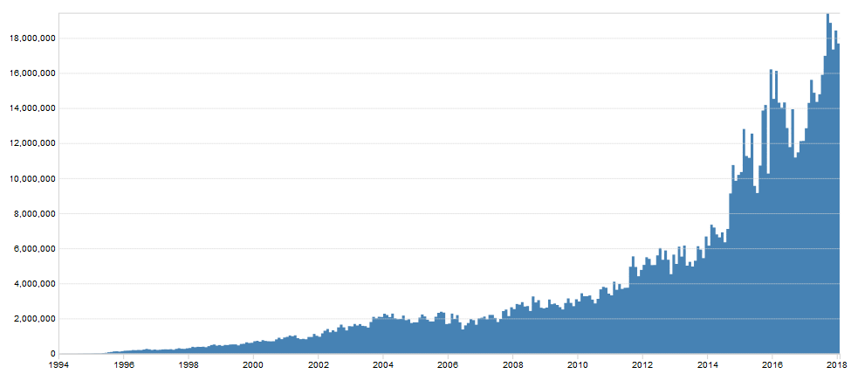
Preprint history –
Started in 1991 by Paul Ginsparg for rapid communication of science
Covers mathematics, physics, astronomy, computer science, quantitative biology, statistics, and quantitative finance
Today: >1.3 million total submissions; >1 billion total downloads; >100,000 publications per year; c. 18 million downloads per month
18,000,000
Monthly downloads
10,000,000
2000
2010
Year

Slide 32
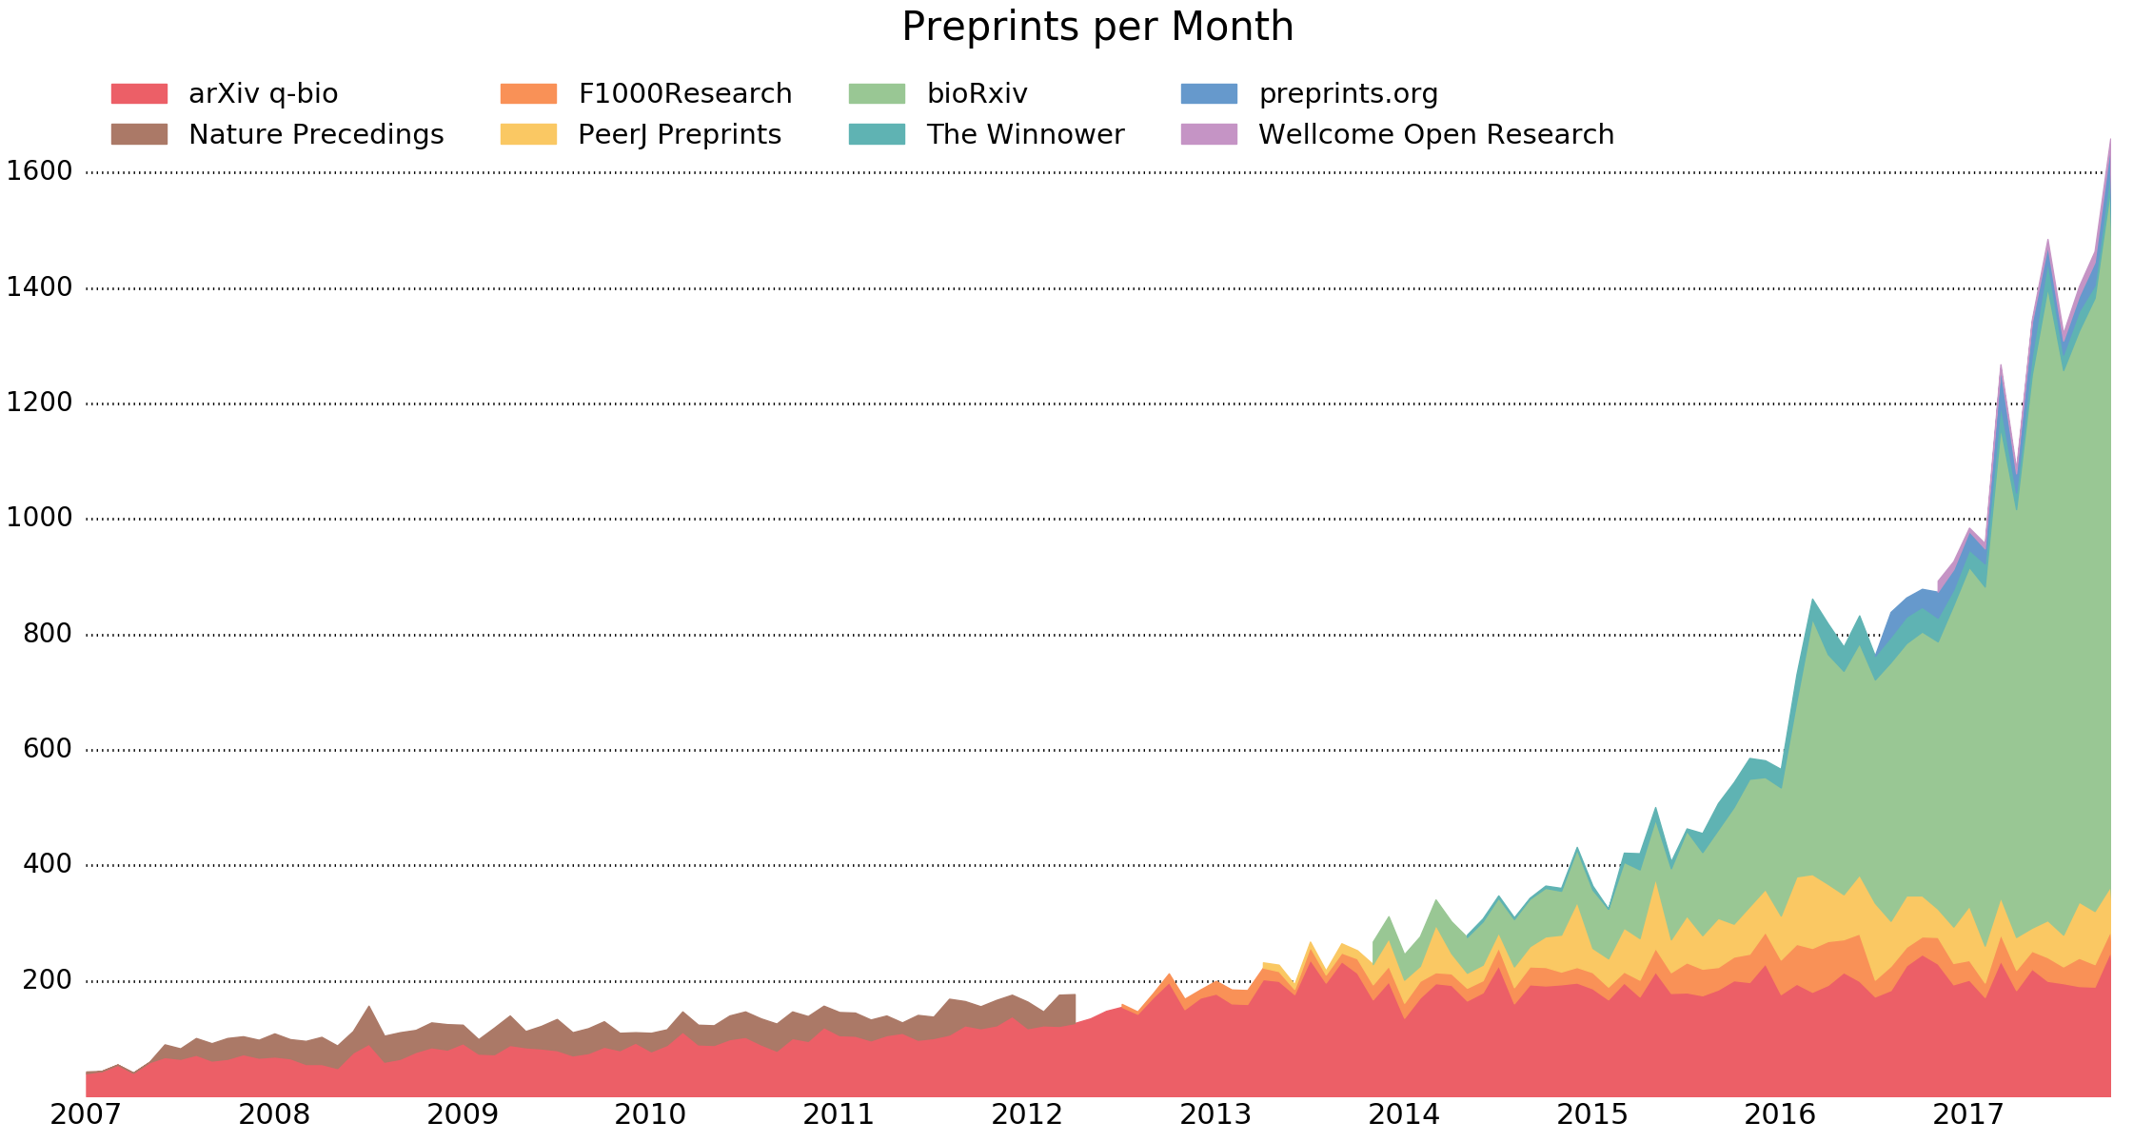
Preprint history
Monthly downloads
Preprints per month
Year
Preprints are not new!
Based on various infrastructure models (e.g. journal- vs. community- vs. funder-led)

Slide 33
It’s not just about biomedical science and health…
Source: https://github.com/OpenScienceMOOC/Module-6-Open-Access-to-Research-Papers/issues/25
Notes:
There are a LOT of preprint servers; maybe as many as >50
Preprint servers can be generic (e.g. preprints.org), or discipline- (e.g. ArXiv, EarthArXiv) or region-specific (e.g. AfricArXiv)
These servers span a huge range of topics, yet much if not all of the discourse relates to biomedical-science related preprints and preprint culture
Maybe the reason for this is obvious; biomedical science feeds into medicine and healthcare, which everyone has an active stake in
And the stakes are high when consider human health…

Slide 34
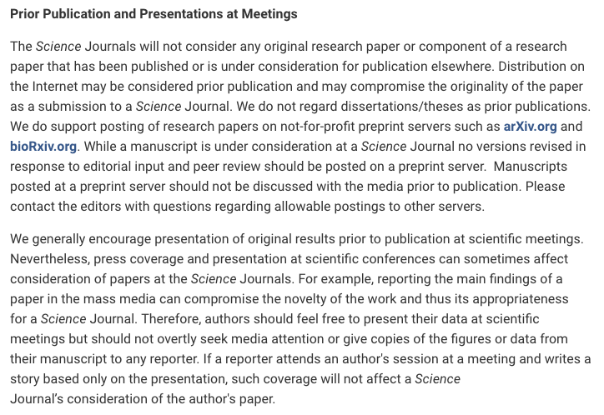
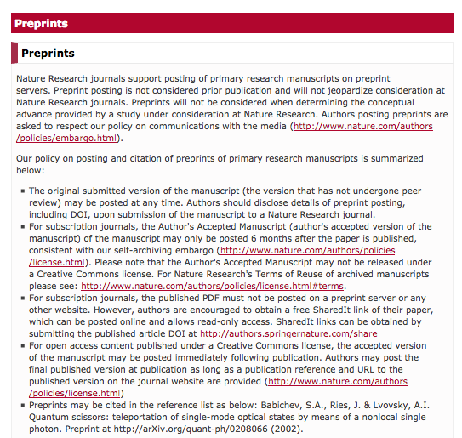
Support from publishers
http://www.sciencemag.org/authors/science-journals-editorial-policies (Friday 6th April 2018)
https://www.nature.com/authors/policies/preprints.html?foxtrotcallback=true (Friday 6th April 2018)
https://www.elsevier.com/about/our-business/policies/sharing (Friday 6th April 2018)

Slide 35
Support from funders

Slide 36
Support from universities

Slide 37
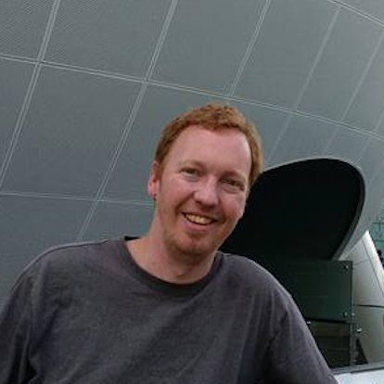

Slide 38
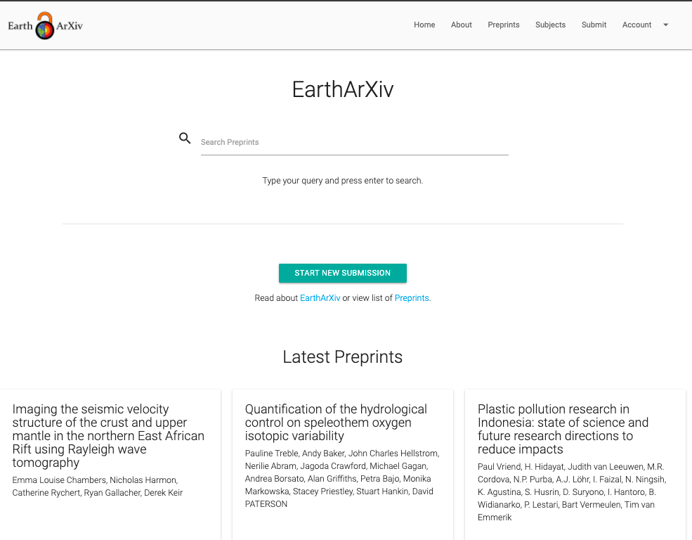
August 2020
Notes:
So, with some infrastructure in place, we set off promoting the service to Earth Scientists and, more generally, educating them as to what preprints are and how they may benefit from their use

Slide 39
EarthArXiv.org
moderation policy
What does EarthArXiv accept?
Research articles
Review papers
Case studies
Technical notes (e.g. new instrumentation or analysis methods)
Confirmatory studies
So-called ‘null’ results (i.e. results that not supporting a hypothesis)
Dataset description papers
What does EarthArXiv not accept?
Papers reading as a personal attack, airing of grievances, or insulting to a group/class of people. Racist and derogatory language will not be tolerated
Commentaries and opinion pieces
Posters (cf. ESSOAr)
Theses and course projects (see www.thesiscommons.org)
Software articles

Slide 40
EarthArXiv.org
moderation policy
Publication and hosting of your paper
Upon moderation, EarthArXiv agrees to publish your paper by assigning a DOI
EarthArXiv is not a journal and does not evaluate the scientific quality of a paper. Once a paper passes moderation and is published, it persists on the system indefinitely. N.B. EarthArXiv reserves the right to remove papers after publication if fraud or plagiarism is identified (see right).
EarthArXiv will provide free online hosting of your paper as long as it is operational
Fraud and Plagiarism
EarthArXiv takes fraud and plagiarism very seriously.
Should the Board deem fraud or plagiarism to have occurred, the paper will be immediately removed from EarthArXiv

Slide 41
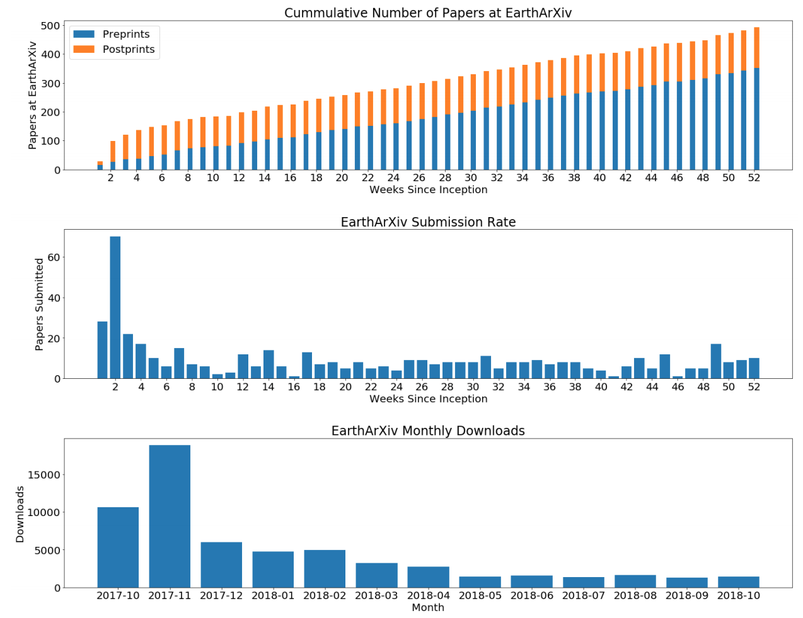
>680 submissions
https://eartharxiv.org/kftsv/
c. 10 submissions
per week
1000 downloads
per week
Notes:
EarthArXiv is one year old and doing very well…

Slide 42
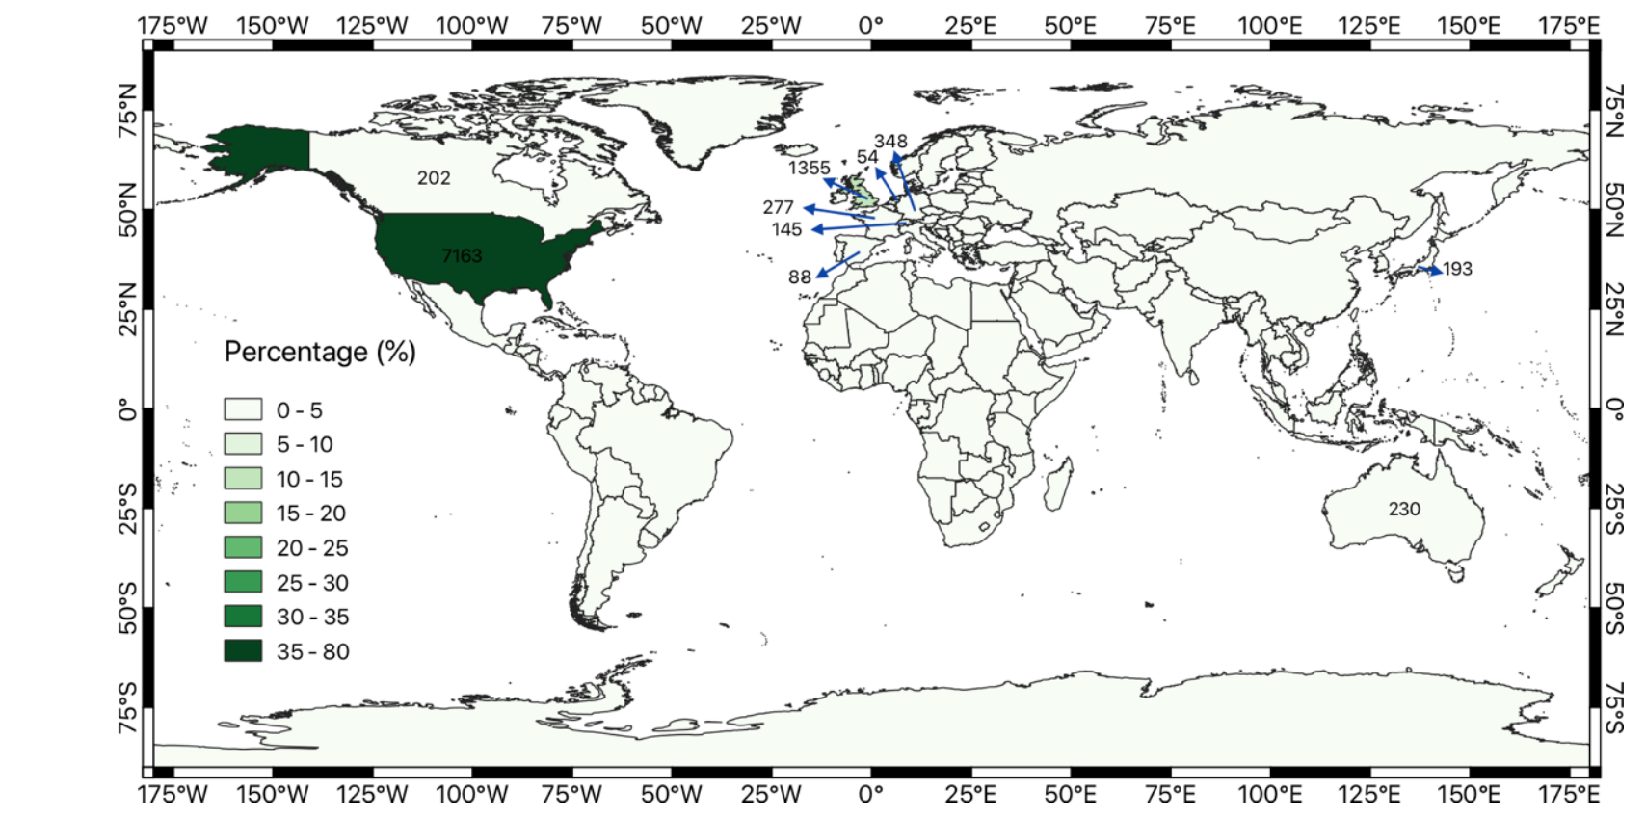
Notes:
Potential for global impact, but it’s important to think about why certain regions are not engaging; i.e. what is their incentive structure for being open?

Slide 43
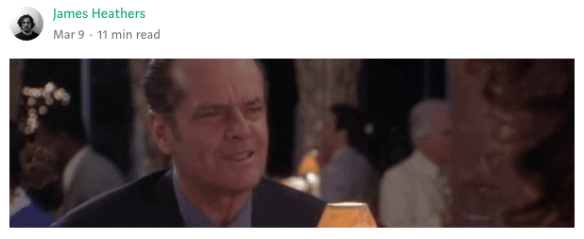
You should consider submitting a preprint if:
You are seeking to communicate your scientific findings without delay
You want everyone to have access to your work
You want feedback on your work from the community
https://medium.com/@jamesheathers/why-i-love-pre-prints-9d727eeb22b8
Publishing pre-prints sends a message I want to send. They say I am willing to talk. They say I want to participate in open culture. Please read my stuff.

Slide 44
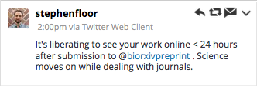
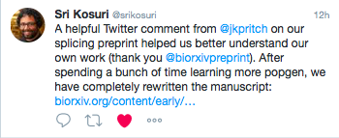

Slide 45
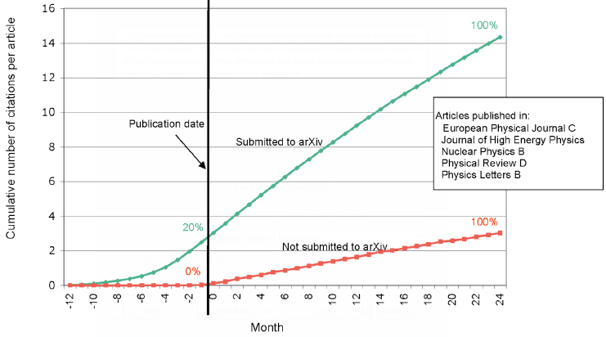
http://whyopenresearch.org/
Notes:
Rapid communication
Greater exposure
More citations, faster

Slide 46
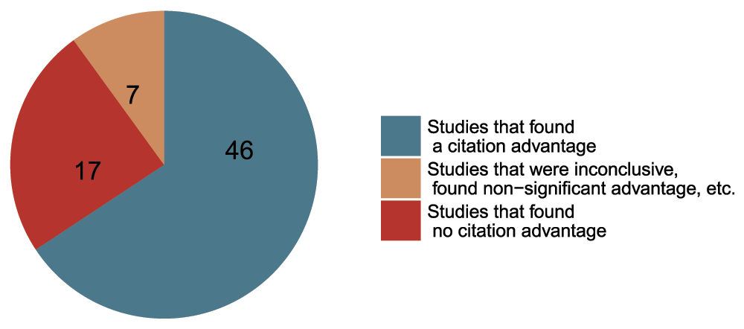
Data from The Open Access Citation Advantage Service, SPARC Europe, accessed March 2016 -http://f1000research.com/articles/5-632/v3
Notes:
Academics are vein, thus appeal to this part of their personalities

Slide 47
Decoupling promotes innovation in peer review

