Slide 1
Combined Effect of ENSO-Like and Atlantic Multidecadal Oscillation SSTAs on the interannual Variability of the East Asian Winter Monsoon
Xin Hao and Shengping He
Hao X., and S. P. He (2017)，combined Effect of ENSO-Like and Atlantic Multidecadal Oscillation SSTAs on the Interannual Variability of the East Asian Winter Monsoon, Journal of Climate, 30, 2697-2716.

Slide 2
1. Introduction
The covariability of the EAWM with Pacific SSTAs has experienced reciprocating changes. The modulation of the PDO on the ENSO–EAWM relationship provided by previous studies are multifarious.
The Atlantic Ocean acts as a pacemaker for the Pacific SST mean state and variability.
Atlantic multidecadal oscillation (AMO) favors a low-frequency variability of winter climate in East Asia that resembles a EAWM-related change in climatic background.

Slide 3
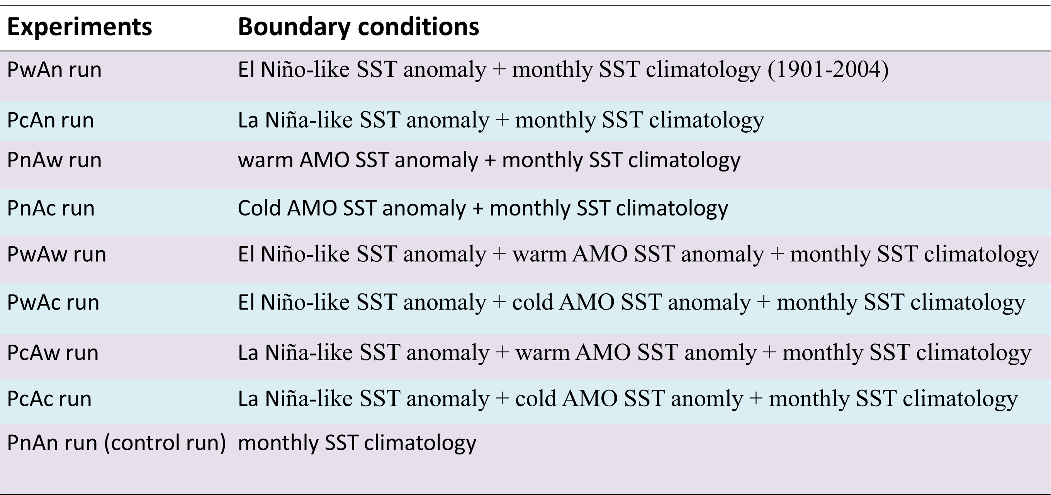
2. Data and Method
Monthly mean observations and reanalysis dataset :
Datasets: CRU TS dataset, NOAA-CIRES Reanalysis dataset, NOAA Extended Reconstructed SST dataset, and Kaplan’s SST dataset.
U.S. CLIVAR Drought Working Group:
Model: GFDL, CCM3, and CAM3.5 (forced by the following SST boundary condition)

Slide 4
3. Results
wAMO
+
wENSO-like
wAMO
+
cENSO-like
cAMO
+
wENSO-like
cAMO
+
cENSO-like
Figure 1 Composite maps of winter surface air temperature

Slide 5
3. Results
Provide a heating source
Figure 2 A schematic diagram for the combined effect

Slide 6
4. Conclusion
Both the reanalysis data and numerical experiments indicate that the out-of-phase relationship between the ENSO-like and the EAWM is significantly intensified when the AMO and ENSO-like are in-phase. In contrast, when the ENSO-like and AMO are out-of-phase, the anomalies related to EAWM tend to exhibit relatively weaker features.
This phenomena may be attributed to the superposition of the influence of the ENSO-like on the EAWM upon the change in background climate in Eurasia caused by the AMO, and the modulation of the AMO on the variability of the Walker circulation.

Slide 7
Thanks!

