Slide 1
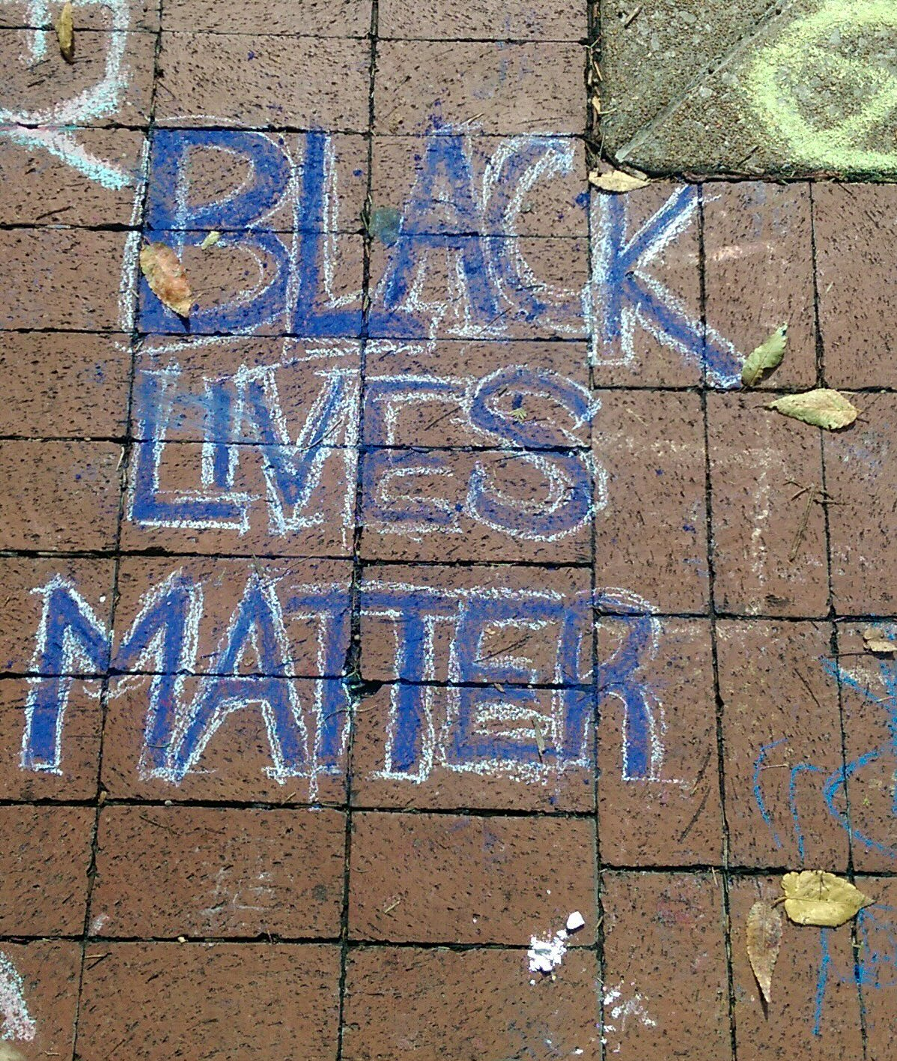
Collection Directions, collaboration, and Pandemic Effects
Versions of this presentation were given at:
Lorcan Dempsey
OCLC
@LorcanD
Mobius Annual Conference 1 June 2020
Orbis Cascade
Webinar 17 June 2020
http://documentingferguson.wustl.edu/omeka/archive/files/330421c03f623cf82bd562f4367c8d72.jpg

Slide 2
Divided into three parts
3
pandemic effects
collection directions accelerated
emerging collection imperatives

Slide 3
3 pandemic effects …
Online a fully online library experience
On mission sharp focus on alignment with evolving institutional priorities
Optimize optimizing services and collections against particular goals
Downward pressure on budget
Alignment
… over the horizon

Slide 4
1. A fully online library experience? The new target?
Final recognition of library (as a service) separate from the library (as a building)?
Value, Identity, Workflow

Slide 5
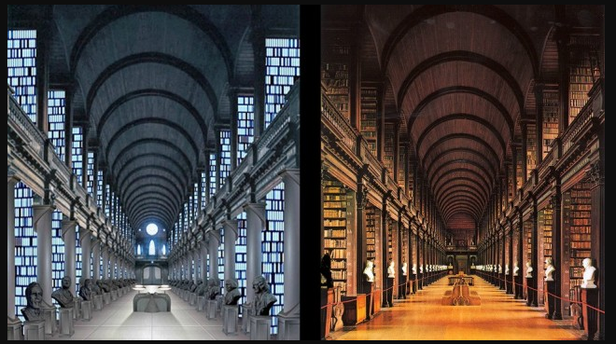
Image credit: Reddit Star Wars Community member U/Megabits http://i.imgur.com/Bm4PXgG.jpg

Slide 6
Deliver full library experience online?
General
Academic
Public
Consultation and expertise?
In the flow and social …
Richer interaction and programming?
Deliver efficiently into the learning process (LMS)?
Substitute for face to face interactions that now support good working relationships?
Integrate and present information services which go beyond the locally acquired collection (facilitated, collective)?
Personal connection (CRM, profile, …)?
Increased digital offering – ebooks, audio, streaming, learning, …

Slide 7
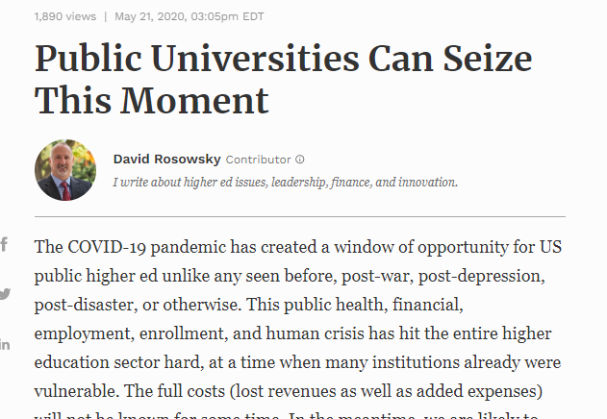
2. On mission
http://culc.ca/cms_lib/CULC%20CV-19%20R&R%20Toolkit%20-%20Infographic.pdf

Slide 8
Balance between three poles

Slide 9
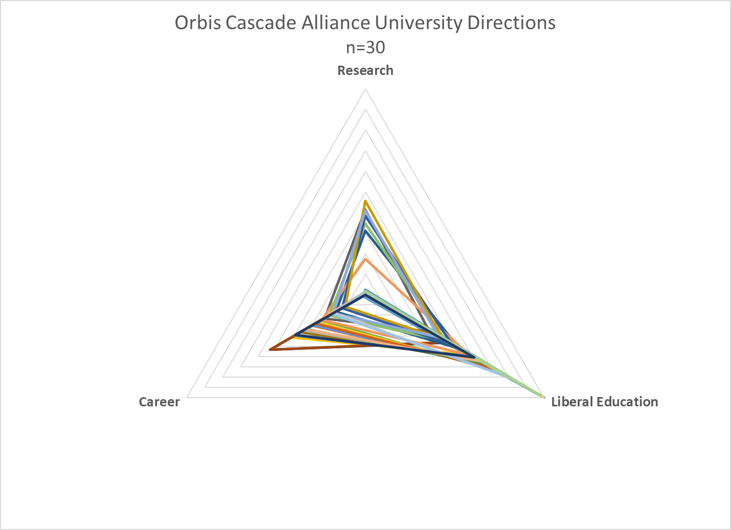
More info: https://doi.org/10.25333/WS5K-DD86

Slide 10
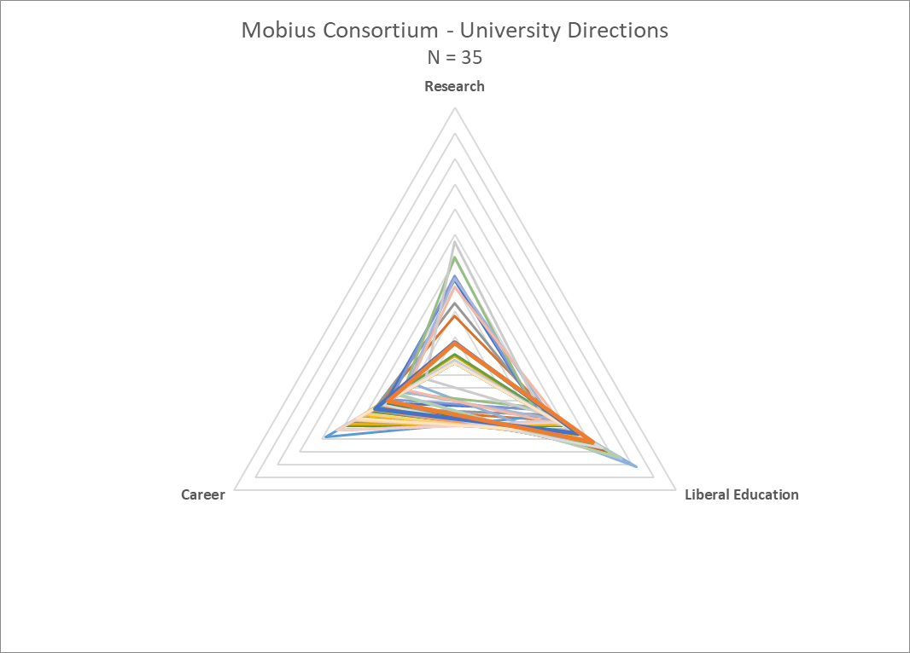
Notes:
There are 78 Mobius member libraries, including academic, special and public libraries.
Our UFLF dataset is limited to academic libraries and covers about 54% of Mobius academics.
As shown, there is a diversity of institutional directions, with a handful of institutions (notably WUSTL) with a pronounced Research orientation. Most members have a strong teaching/learning focus in undergraduate education.
Directional peaks:
Research – WUSTL. Private research university, 52nd in THE world rankings for 2020.
Liberal Education – Truman State University. A public, undergraduate institution focused on student-centered, place-based learning. There are a handful of graduate programs, but the core of the educational enterprise is liberal-arts based undergraduate curriculum. https://www.truman.edu/
Career – Park University. A liberal arts college that has transitioned to being a major provider of career-oriented distance learning programs for working adults, with more than 40 campuses across the US. https://www.park.edu/

Slide 11
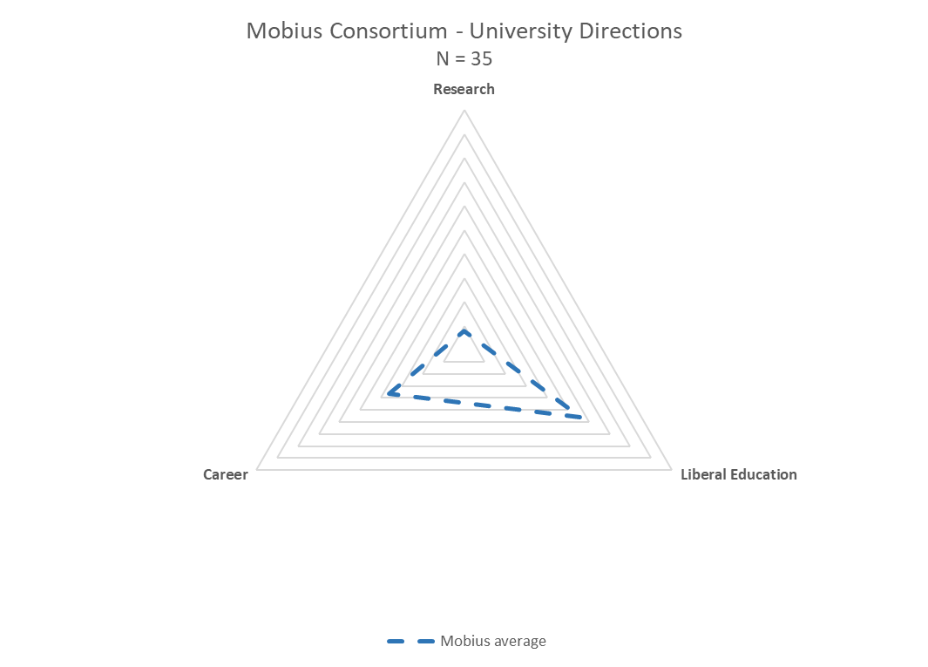
Notes:
If we simplify the view and look at the overall average for the group, we see a clear directional emphasis on interdisciplinary undergraduate education.

Slide 12
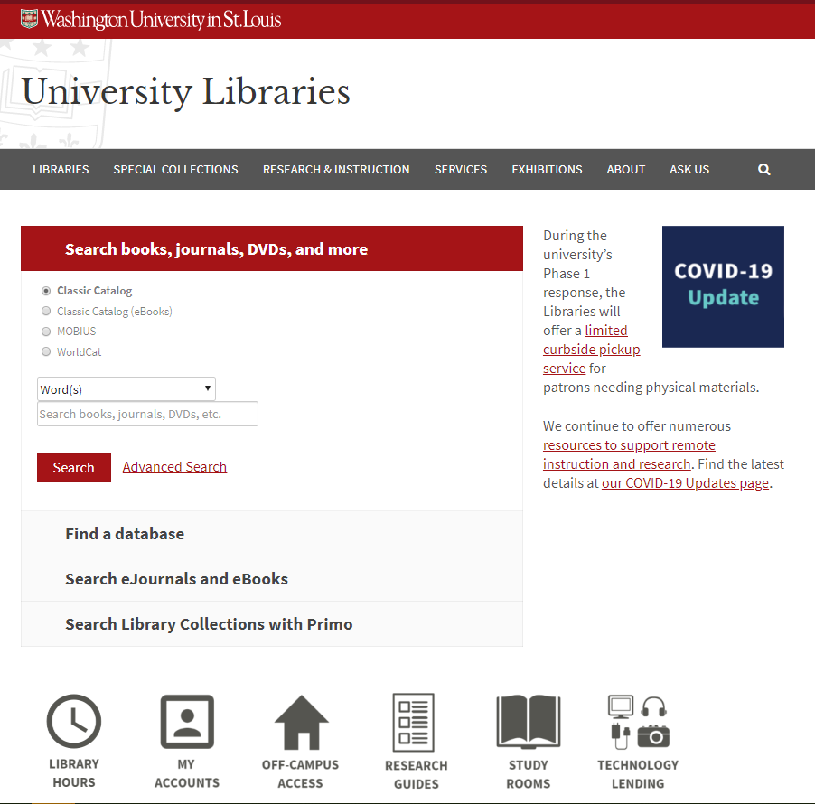
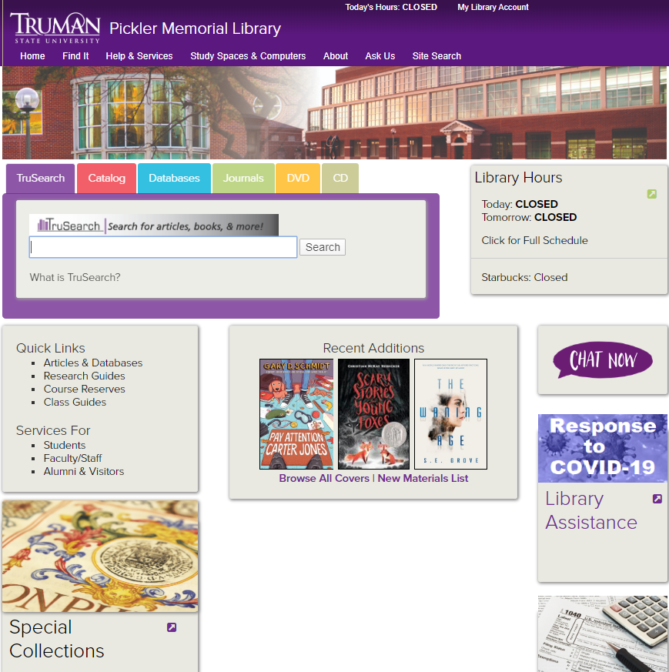
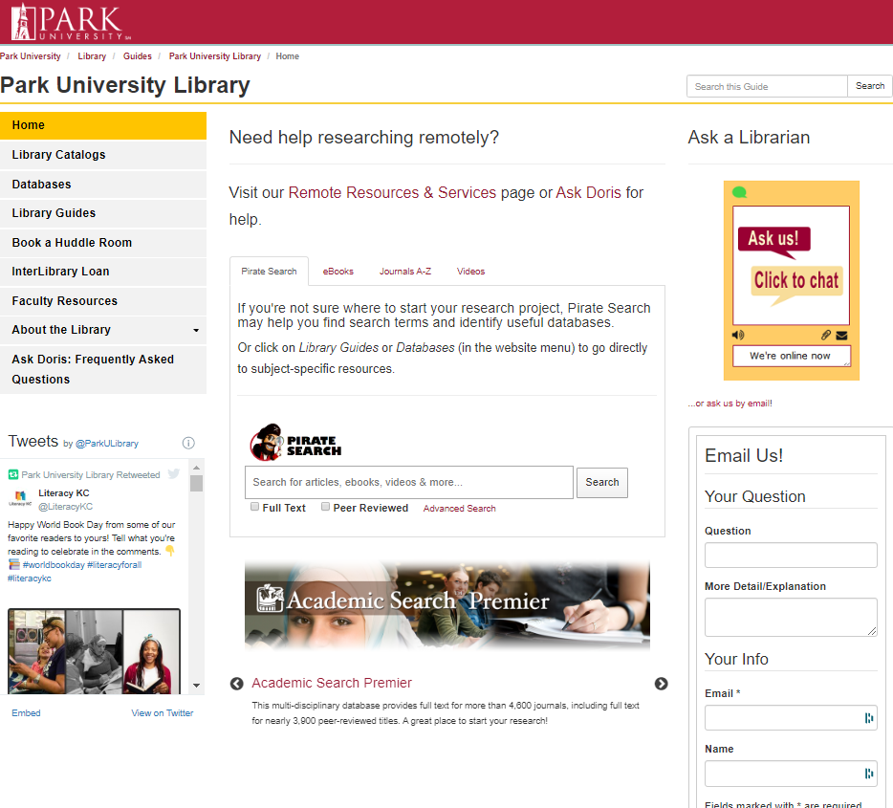
Career preparation
Research
Education
Career success accessibly delivered
.. plus research productivity
Student success and retention
E-portfolios
Company and career research
Training & internship resources
Guided information resources in LMS.
Research data management
Digital scholarship
Text and data analysis services
Instructional design services
Collaboration spaces
Makerspace, FabLab
Presence in LMS.

Slide 13
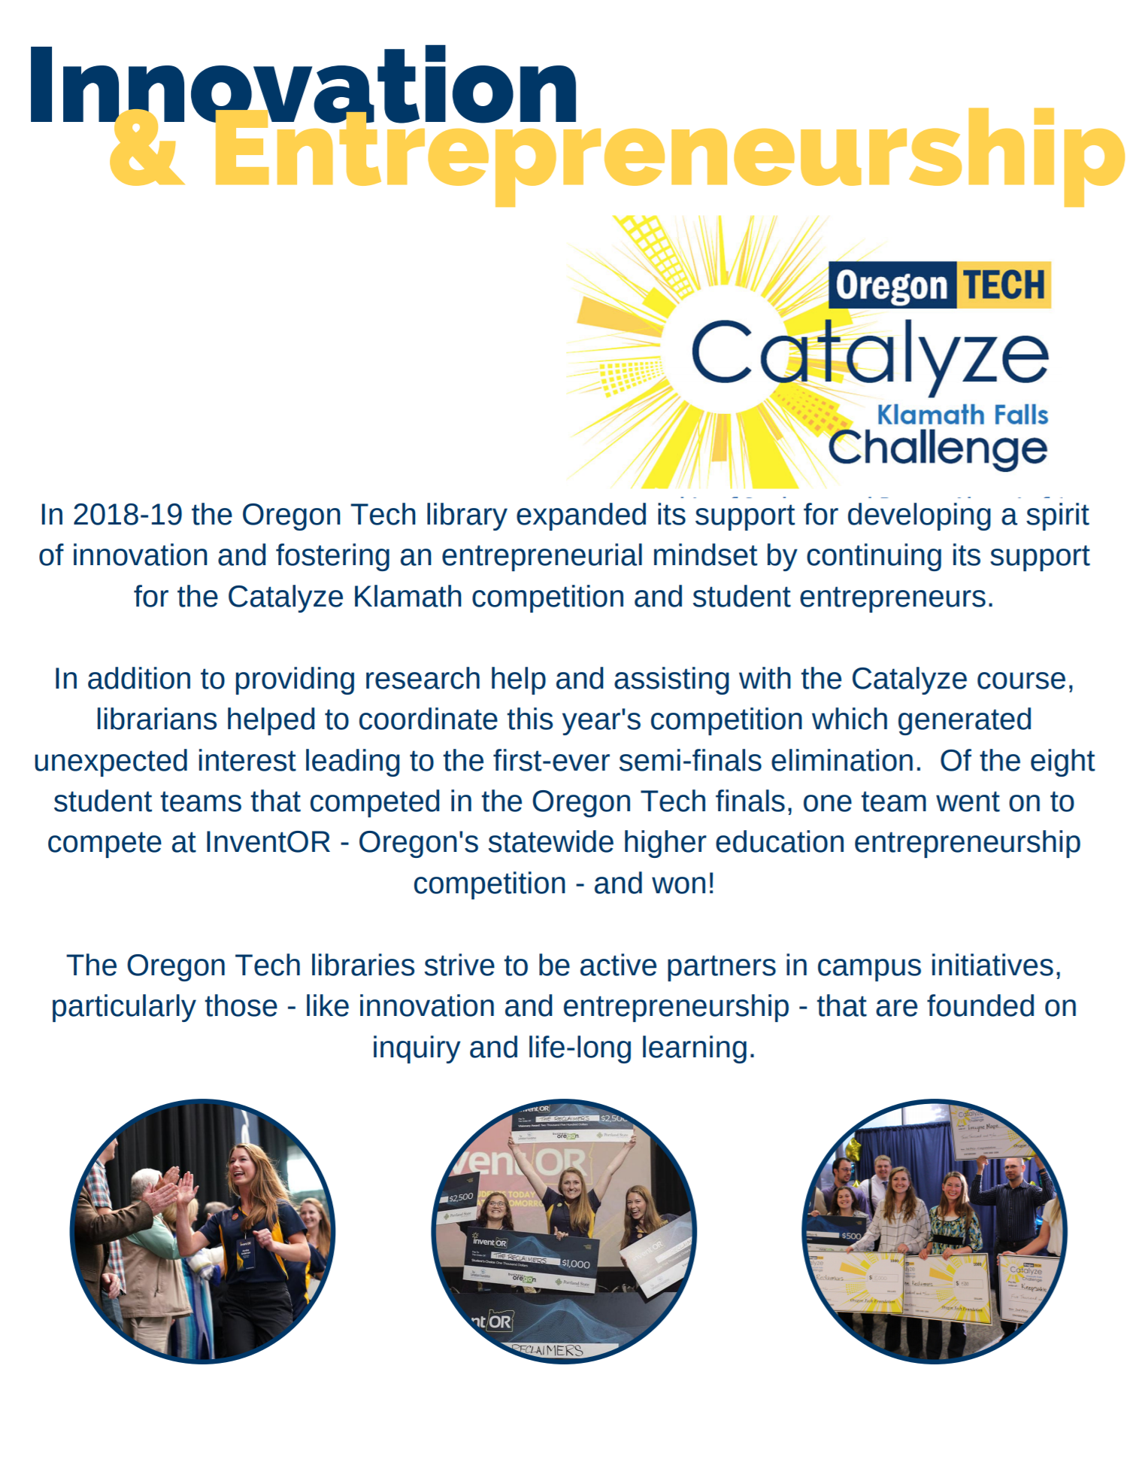
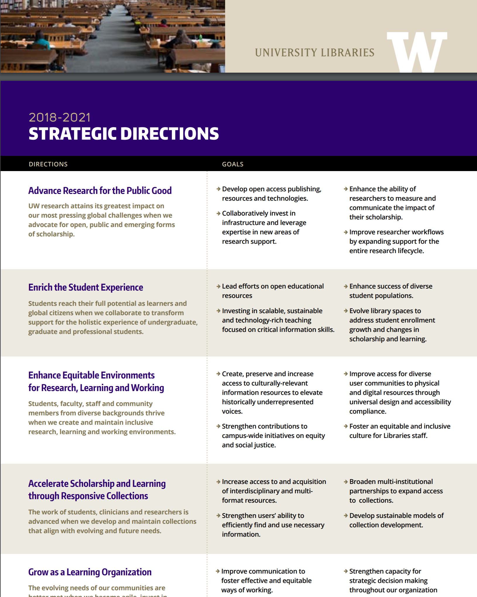
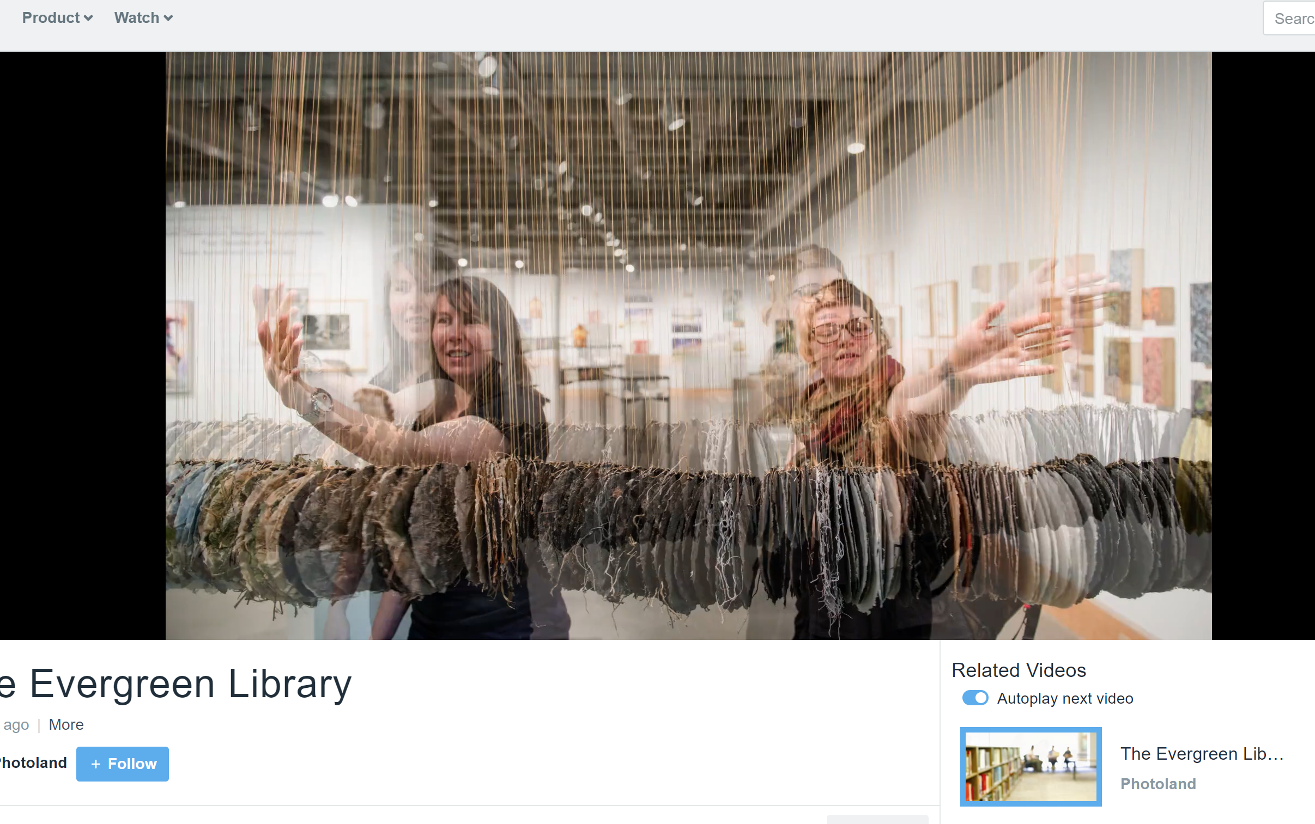
Career preparation
Research
Education
Career success accessibly delivered
.. plus research productivity
Student success and retention
E-portfolios
Company and career research
Training & internship resources
Guided information resources in LMS.
Research data management
Digital scholarship
Text and data analysis services
Instructional design services
Collaboration spaces
Makerspace, FabLab
Presence in LMS.

Slide 14
3. Optimize … strategic choices to meet particular goals
Collection examples
Value (acquire what is needed, use what is acquired)
Open
Curricular support
Regional/local
Collaboration
Plural (respect/represent communities of interest)
Decision support
Tradeoffs

Slide 15
[Example] Optimizing fit of library for online learning
Increase visibility of library resources in LMS
Course reserves
Resource guides
Reading lists
Embed library expertise in LMS
LibAnswers
Library instruction tailored to specific courses
Space as a service in LMS
Book library space
Calendar of events
Notes:
NB: because Mobius is a III-based consortium, they are not a market for Leganto
Screenshot sources:
https://libraryguides.missouri.edu/canvas/readinglist -- Mizzou has implemented EDS Curriculum Builder in Canvas
https://libguides.nwmissouri.edu/faculty/menu -- Northwest Missouri State has embedded library instruction modules within Canvas course pages
http://libcal.mst.edu/reserve/rooms -- although it doesn’t appear that Missouri Science & Technology University has integrated LibCal within their Canvas LMS, this integration is possible.

Slide 16
Divided into three parts
3
pandemic effects
collection directions accelerated
emerging collection imperatives

Slide 17
3 collection directions … accelerated
Collective collections
Facilitated
Inside out

Slide 18
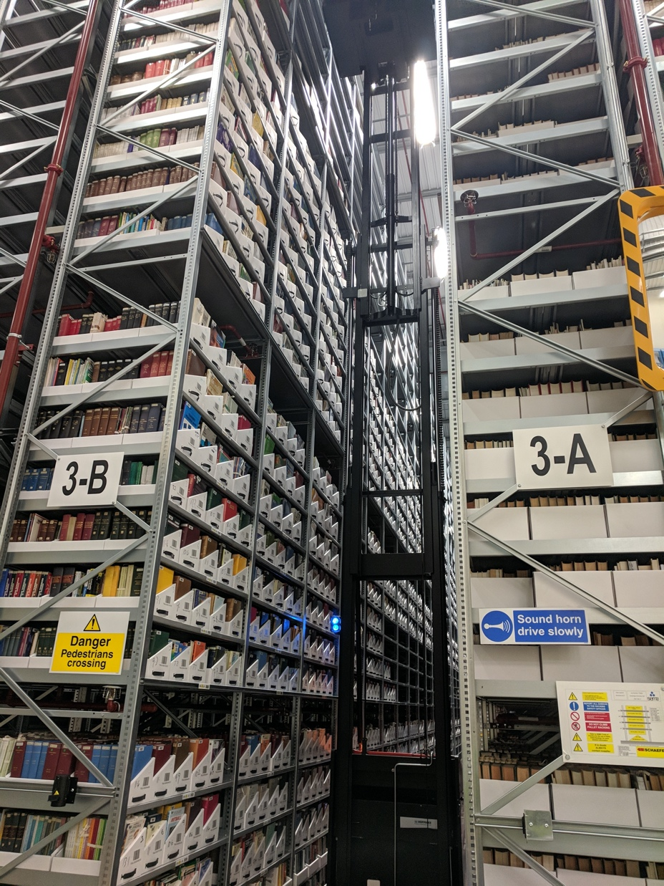
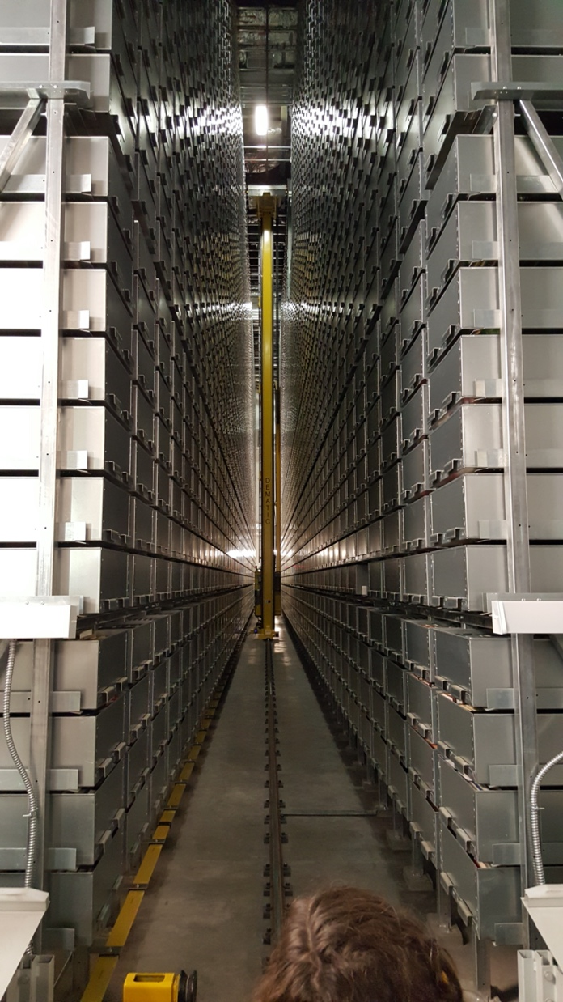
The rise of the collective collection
Increasingly organize collections at the network or systemwide level.

Slide 19
Pivotal moment in licensing
Push online – ebooks, streaming, …
Big deal
Open
Pay to read to pay to publish
Operationalize the collective print collection?
Shared print – optimal distribution
Digitization
Prospective collection coordination
Consolidation
Degrees of coordination: tradeoff between autonomy and consolidation
Autonomy

Slide 20
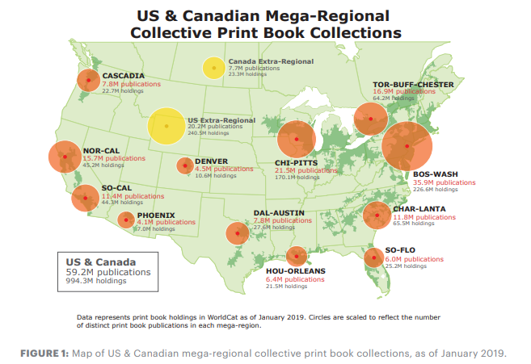
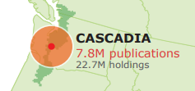

Slide 21
13% of print book titles in North America
Average 2.9 holdings per title in Cascadia region
Regional print book inventory shrank between 2018 and 2019
Duplication in North American inventory is diminishing overall: rate of growth in holdings lags rate of growth in titles
More info: https://doi.org/10.25333/7zjv-jv94

Slide 22
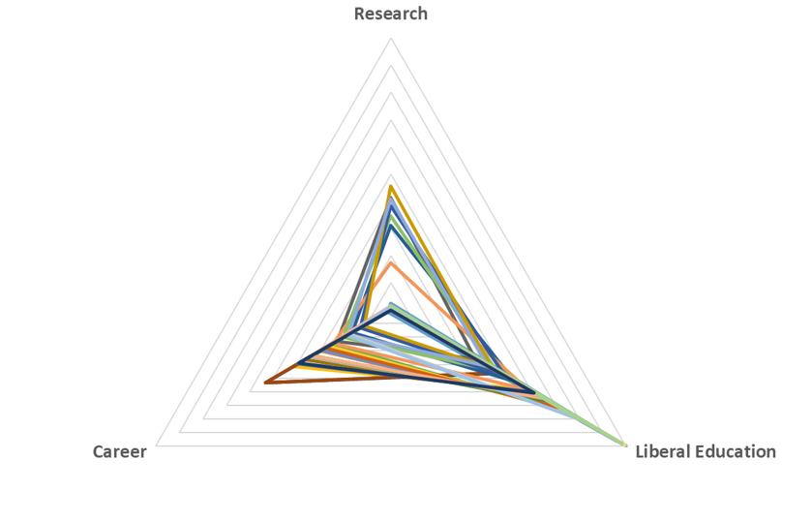
A moment for consortia. Consortia are an integral part of library operations, and are central to the management of collective collections, licensing and other collections-related activities. Consortia can increase both impact and efficiency of library operations. This seems like a moment for libraries to take a much more strongly strategic view of the collective opportunities available to them, recognizing the instrumental value of consortia to advance their goals.
http://orweblog.oclc.org/collection-directions-accelerated/

Slide 23
Facilitated
Collection
Assemble a coordinated mix of local, external and collaborative services around user needs.
Move online accelerates need to provide targeted, relevant resources.

Slide 24
The ‘external’ collection:
Pointing researchers at Google Scholar;
Including freely available ebooks in the catalog;
Providing access to Open Access and Open Educational resources
Creating resource guides for web resources.
The ‘borrowed’ collection
The shared print collection
The shared digital collection
Shared scholarly outputs
Collective collections
A collections spectrum
The ‘owned’ collection
The ‘licensed’ collection
The ‘demand/data-driven’ collection
The ‘facilitated’ collection

Slide 25
The inside out collection
Create, manage and make discoverable evidence, community, memory..

Slide 26
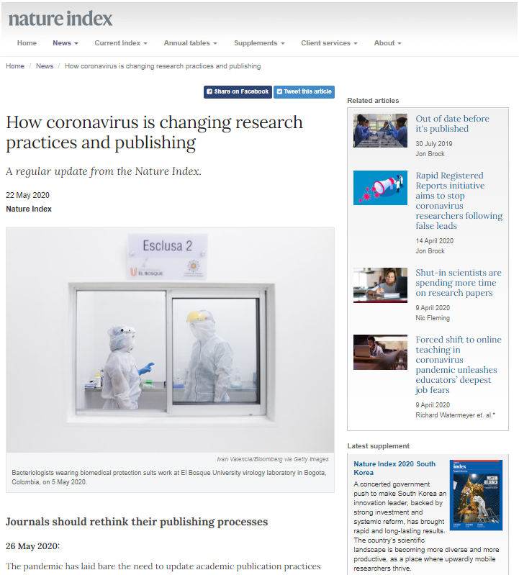
Research libraries will more purposefully partner to curate, manage and make more discoverable research outputs like preprints and research data.

Slide 27
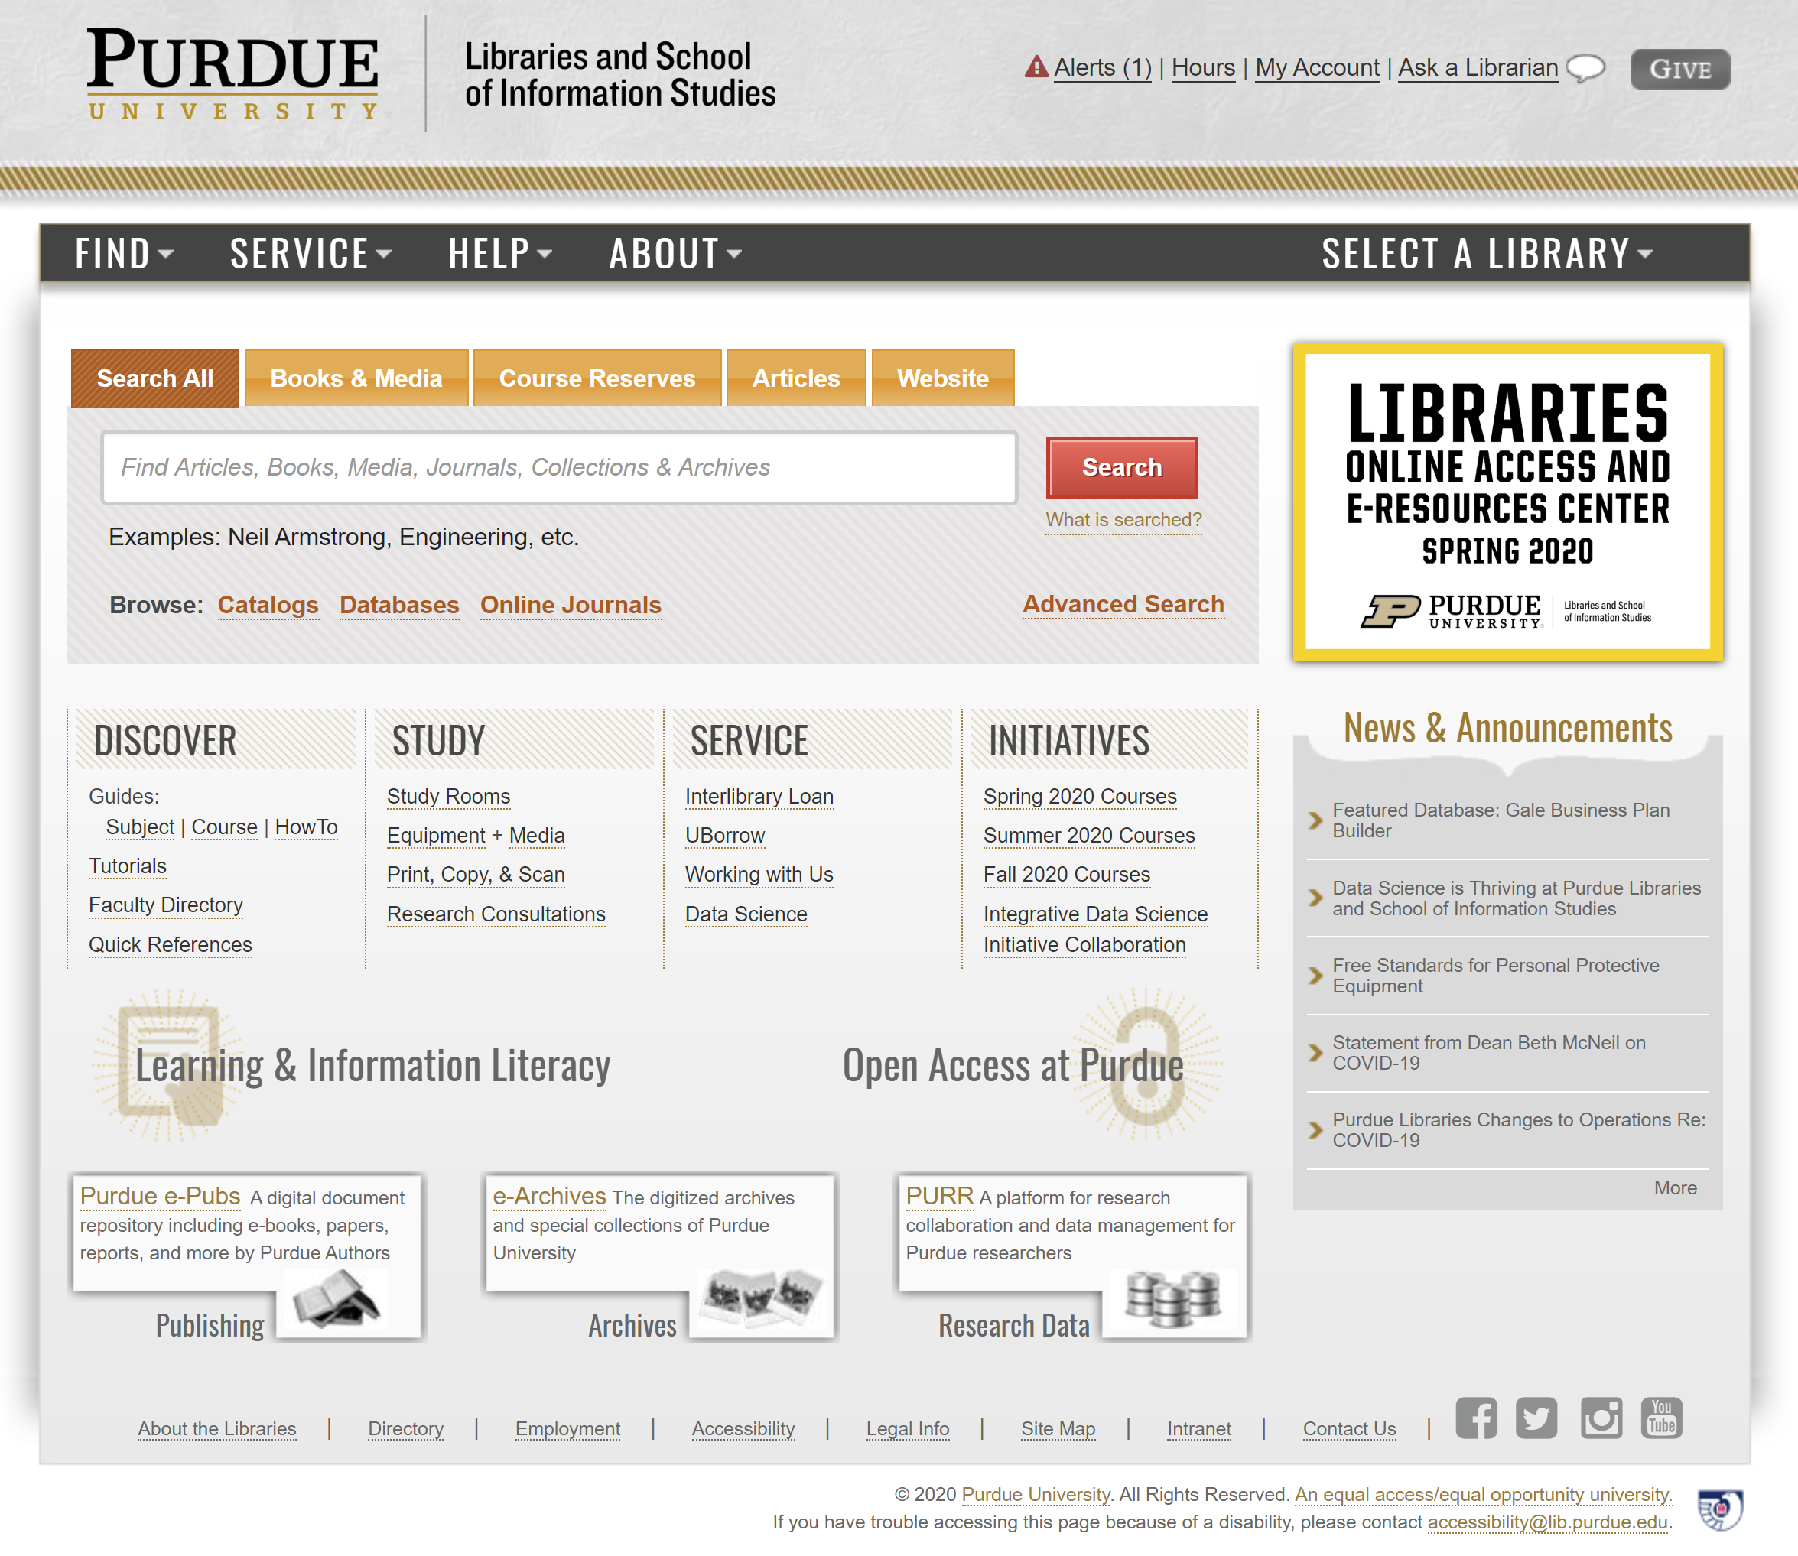
Discoverability of university research outputs and expertise
Inside out library/collections

Slide 28
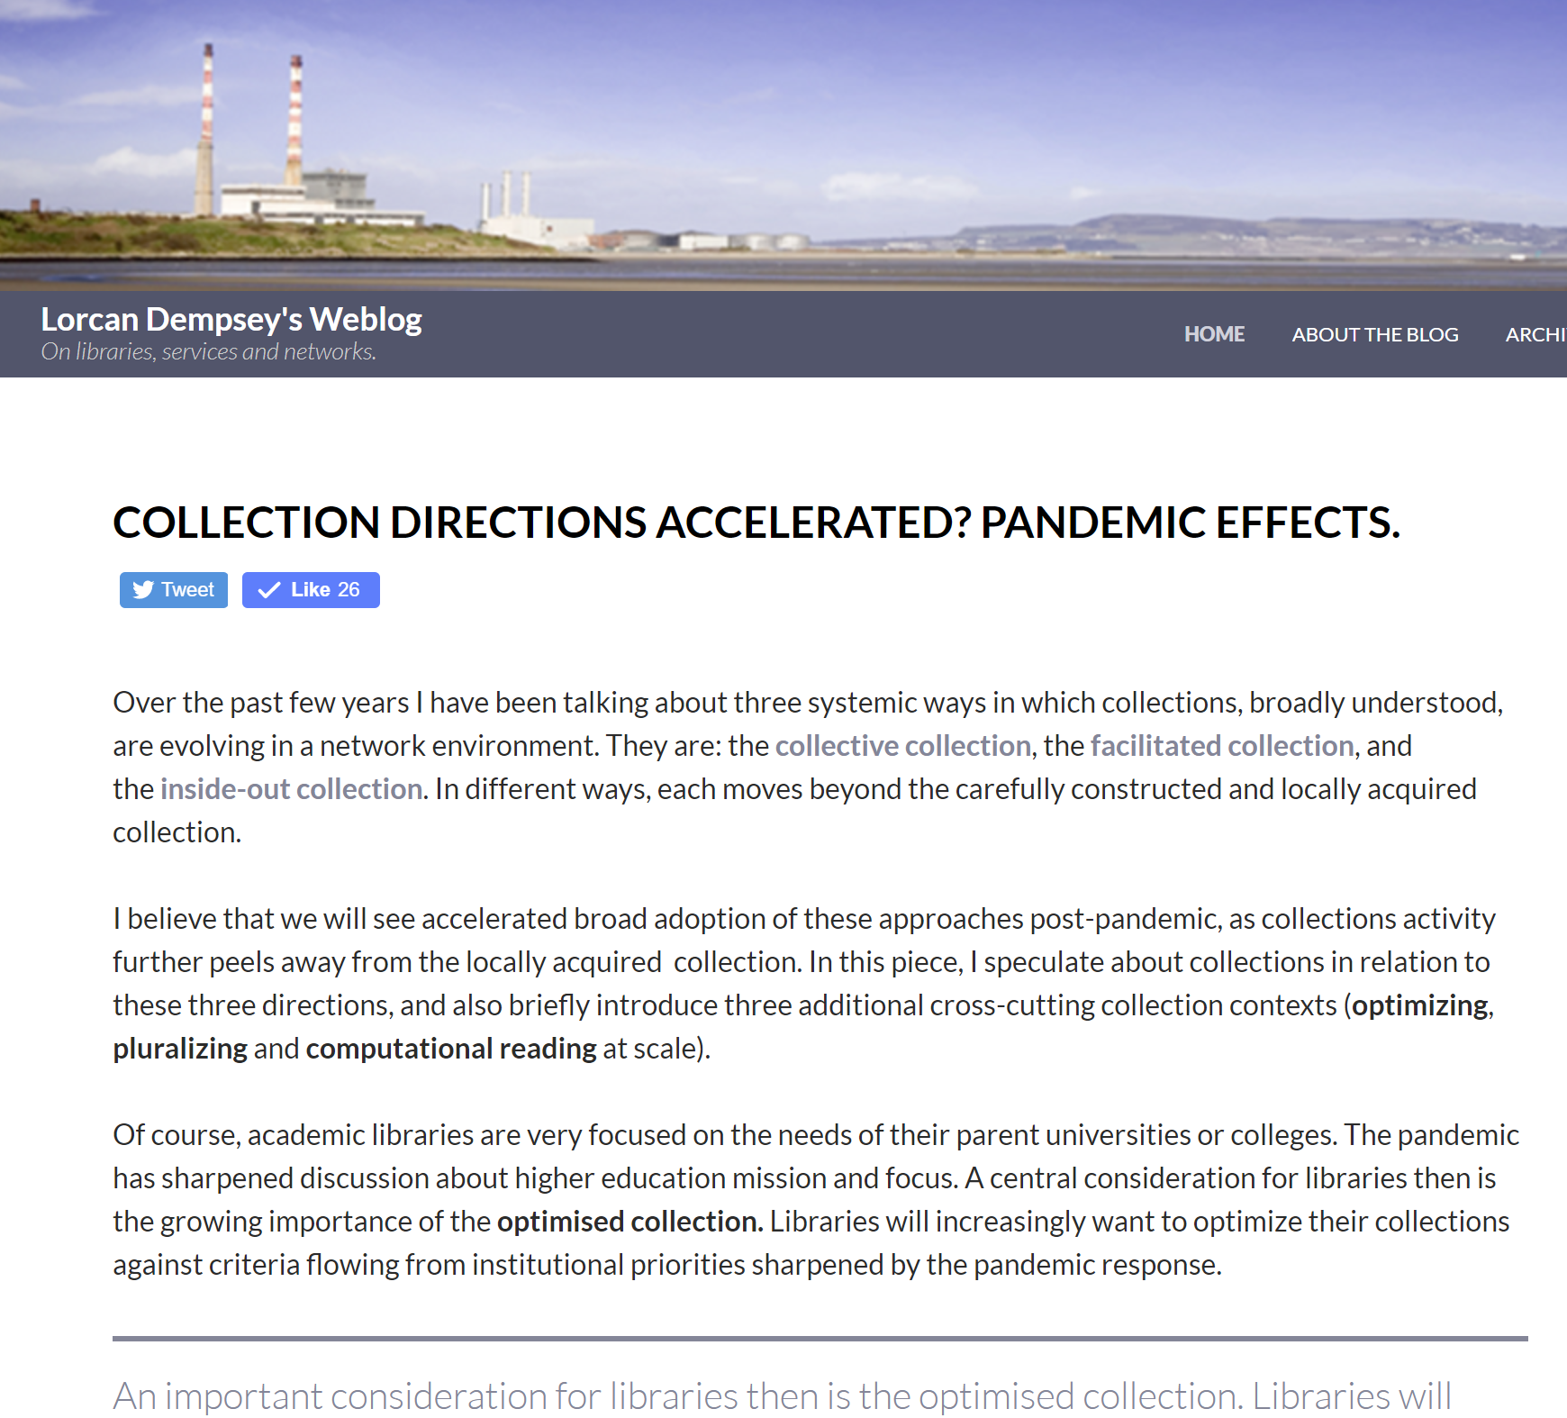
A new relationship to collections: facilitated, collective, just in time ….
Literature search (some locally owned)
Resource guides
Open access, OER, …
Google Scholar, Meta, ….
Demand driven
Then: careful construction of a locally acquired collection.
Now: optimally satisfy research and learning needs from a facilitated network of resources (local, collaborative, open, commercial, etc.).
Spot acquisitions
Smart fulfilment

Slide 29
Divided into three parts
3
pandemic effects
collection directions accelerated
emerging collection imperatives

Slide 30
Optimizing
Libraries have focused on building, managing and sharing collections. Greater attention is now turning to optimizing collections, locally and across groups.

Slide 31
Optimize … strategic choices to meet particular goals
Decision support
Tradeoffs
Rush online <> open
Inside out <> acquired
….

Slide 32
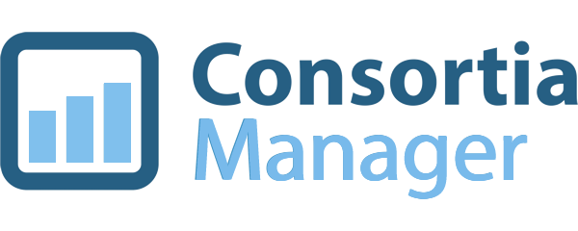
Data driven optimization …

Slide 33
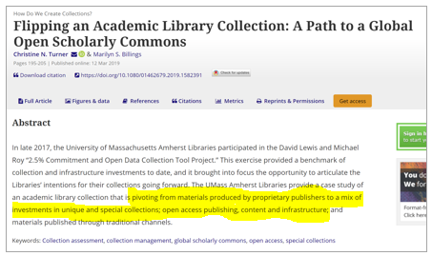
Acquire what you need;
use what you acquire
Specialize

Slide 34
Libraries are pluralizing their collections, services and perspectives – so that all the communities they serve recognize their own knowledges, experiences, voices and memories in library services.
They aim to decenter dominant perspectives and to help give a voice and name to all they serve.
Pluralizing

Slide 36
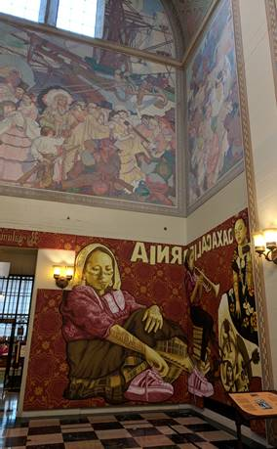
Oaxacan murals in Los Angeles Public Library "The location of the Tlacolulokos murals is a pointed statement unto itself: They hang directly below narrative murals about California’s early history created in 1933 by Dean Cornwell, whose pastel renderings show Native Americans bowing down to European colonialists. Tlacolulokos’ vibrant burgundy and gold hues scream against Cornwell’s quiet palette. The new murals say: “I have a voice. Listen up. I am here.”"
“For the Pride of Your Hometown, the Way of the Elders, and in Memory of the Forgotten” by the Oaxacan artist collective Tlacolulokos.
https://www.latimes.com/entertainment/arts/la-ca-cm-oaxacan-murals-central-library-20170920-htmlstory.html

Slide 37
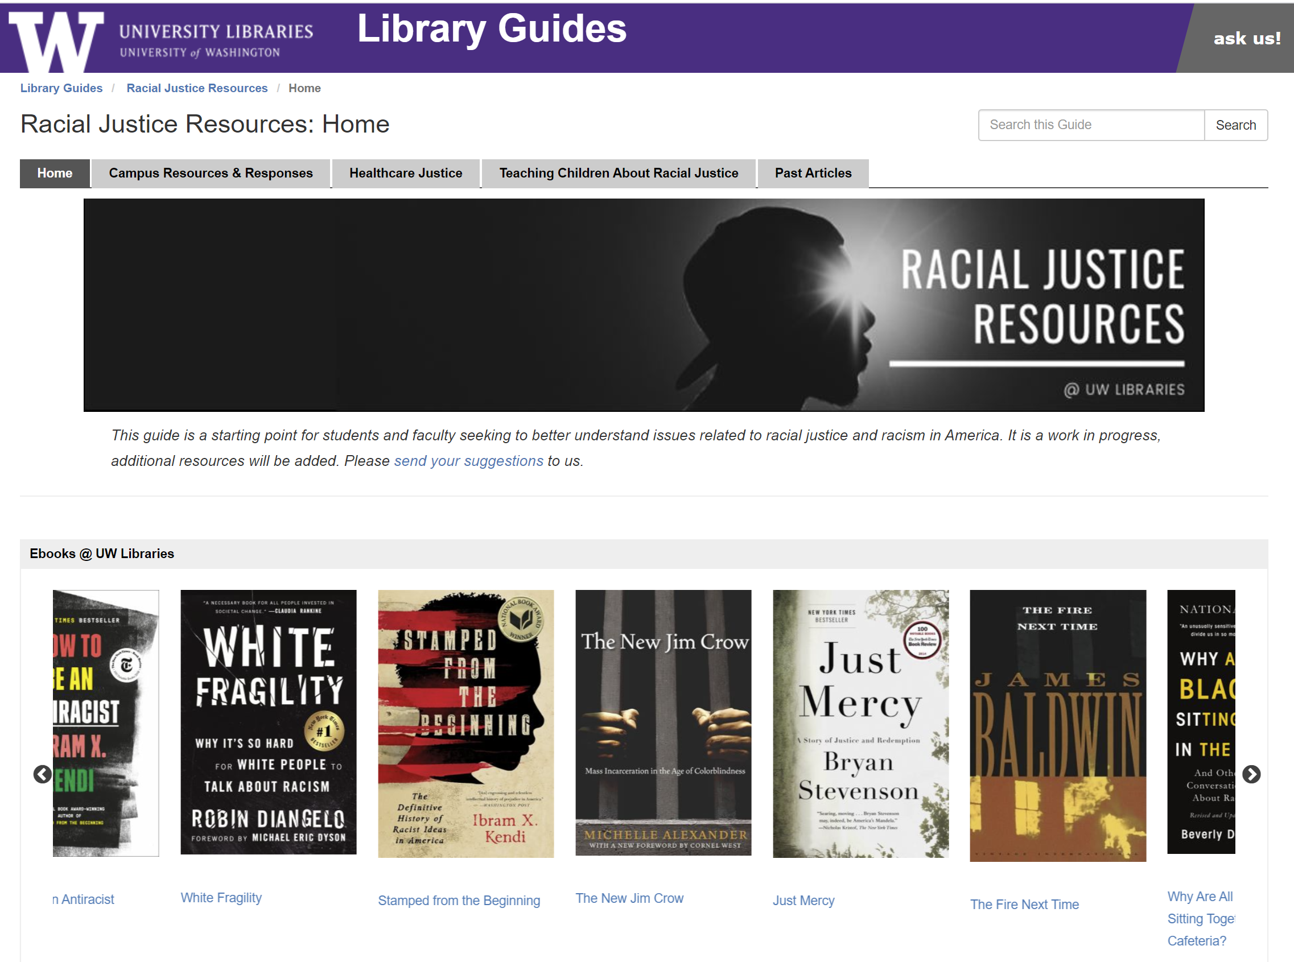

Slide 38
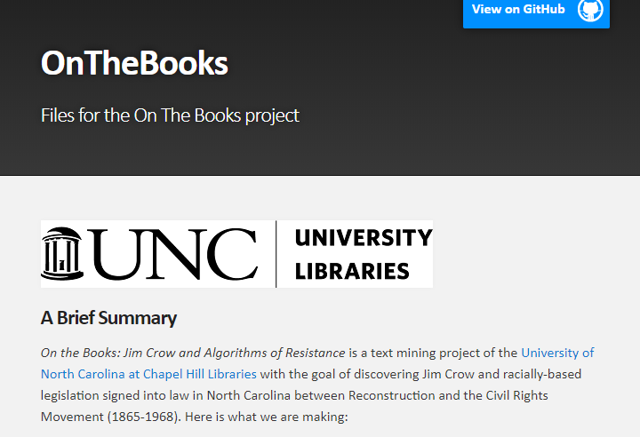
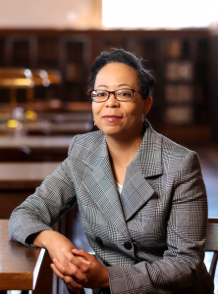
“reckoning”
The University Libraries’ Role in Reckoning with Systemic Racism and Oppression
Computational reading at scale
https://library.unc.edu/2020/06/the-university-libraries-role-in-reckoning-with-systemic-racism-and-oppression/

Slide 39
Lorcan Dempsey
OCLC
@LorcanD
DempseyL@OCLC.org
Thank
you

