Slide 1
MRD Staff Meeting
2/19/20
Lorcan Dempsey, OCLC
@LorcanD
Operationalizing the collective collection: a case study of consolidation vs autonomy

Slide 2
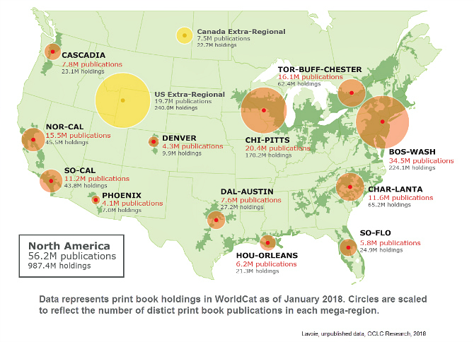
Great Lakes: 21% of world’s surface fresh water
BTAA: 22% of North American print titles

Slide 3
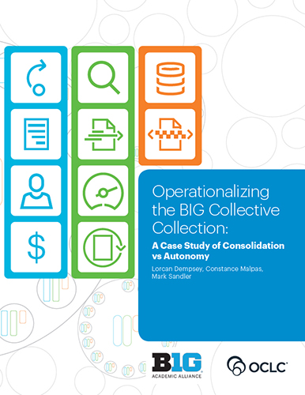

Slide 4
To extend the reach of materials available to users, especially as any individual library is collecting a progressively smaller part of relevant resources,
to make their management more efficient (by sharing costs and responsibilities),
to coordinate collections above the individual library level, allowing individual libraries to specialize and contribute within a defined network of responsibilities
and to collaboratively steward the scholarly and cultural record.
Motivations

Slide 5
“The traditional model of building large stand-alone collections is inefficient and ineffective” D. Way
Retrospective coordination
Prospective coordination
Post hoc coordination of autonomously developed collections.
Believed to be unsustainable but not changing.
Optimal distributed collection. Coordination at the network level.
Believed to be desirable but not happening.
Resource sharing: benefiting from the aggregate.
Shared print: rebalancing collections across libraries and hubs.
Digitization: release the content of books, broaden access, preserve.
Shared collecting responsibilities. Central purchasing/selection.
Libraries focus on distinctive.
Shared description and transaction data for decision support.
Collections/Acquisitions/Resource sharing

Slide 6
Current environment

Slide 7
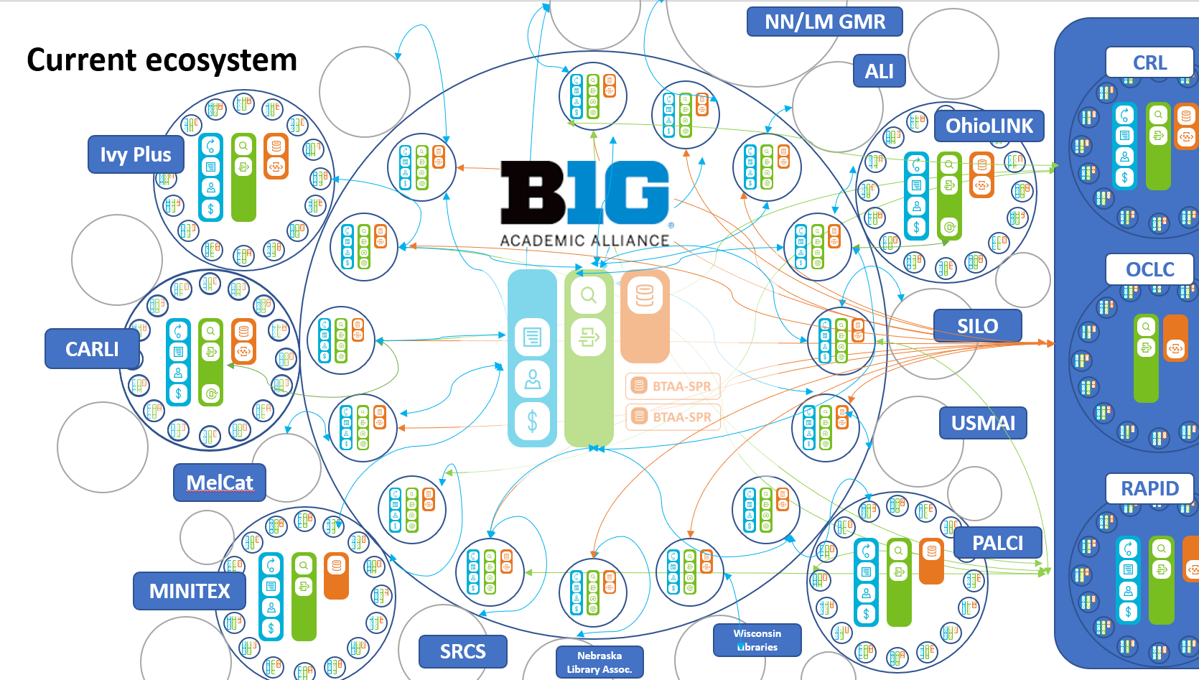
Notes:
OSU is a longtime BTAA member, but also relies on other groups (especially OhioLINK) for discovery and fulfillment services.

Slide 8
Consolidation
Integrated user experience
Ease of management
Reduced coordination costs
Consortial agency
Trade-offs:
Efficiency vs control?
Systemwide vs local optimization?
Integration vs interoperability?
Local optimization
Close to the user
Control of costs
Pragmatic
Institutional agency
Cooperation
(autonomy)
Degrees of coordination: tradeoff between autonomy and consolidation

Slide 9
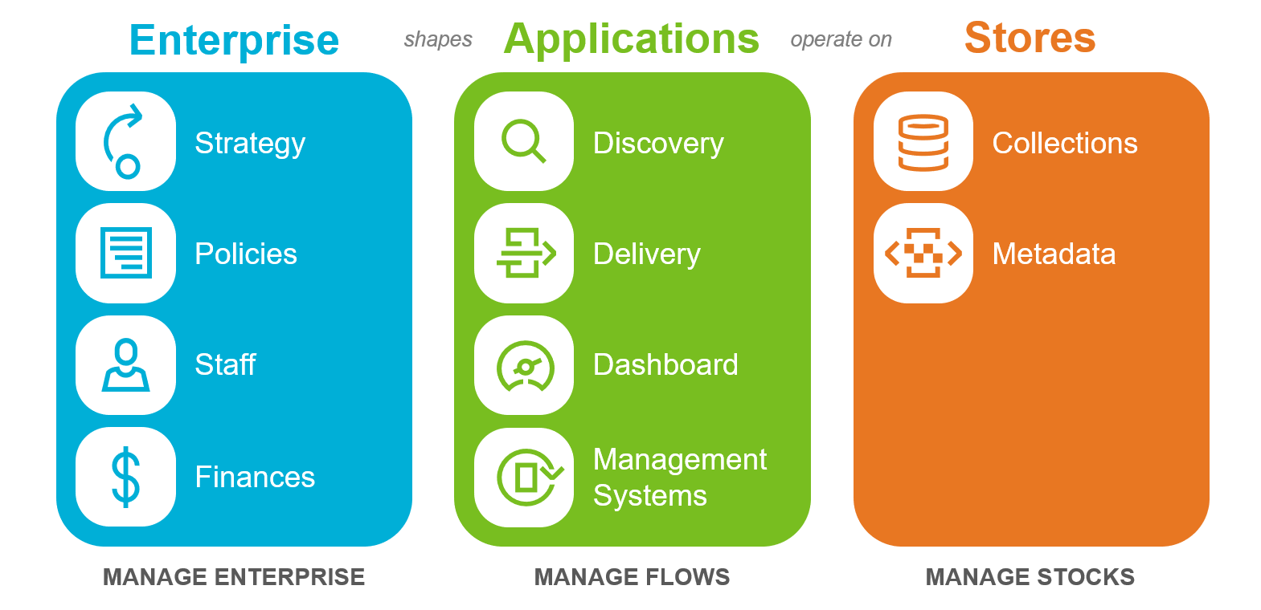
“a coordination explosion at the margins”
3
Vertically integrated stacks. No unified discovery.
Strategy to set expectations?
No systemwide metadata.
No systemwide shared print commitments. No systemwide view of digitized.
Policy regime? Different network practices?
Manual connections.
Multiple working groups. Boards.
Disjointed and limited management information

Slide 10
Recommendations

Slide 11
“conscious coordination”
Optimally distributed collections
Explicit commitments
Collective collections
Systemwide awareness
Efficient network fulfilment

Slide 12
Build
Commit to
Optimally distributed collections
Explicit commitments
More strongly coordinate collections for optimal distribution/creation (prospective collection coordination, shared print, digitization)
… manage, build & share a collective collection for 22% of the US’s books – shared strategy, process and policies.
Collective collections
Share
Systemwide awareness
Efficient network fulfilment
Create stronger systemwide awareness through consolidated metadata management and Dashboard
Improve resource sharing (across networks) and integrate it into the collection dev process

