Slide 1
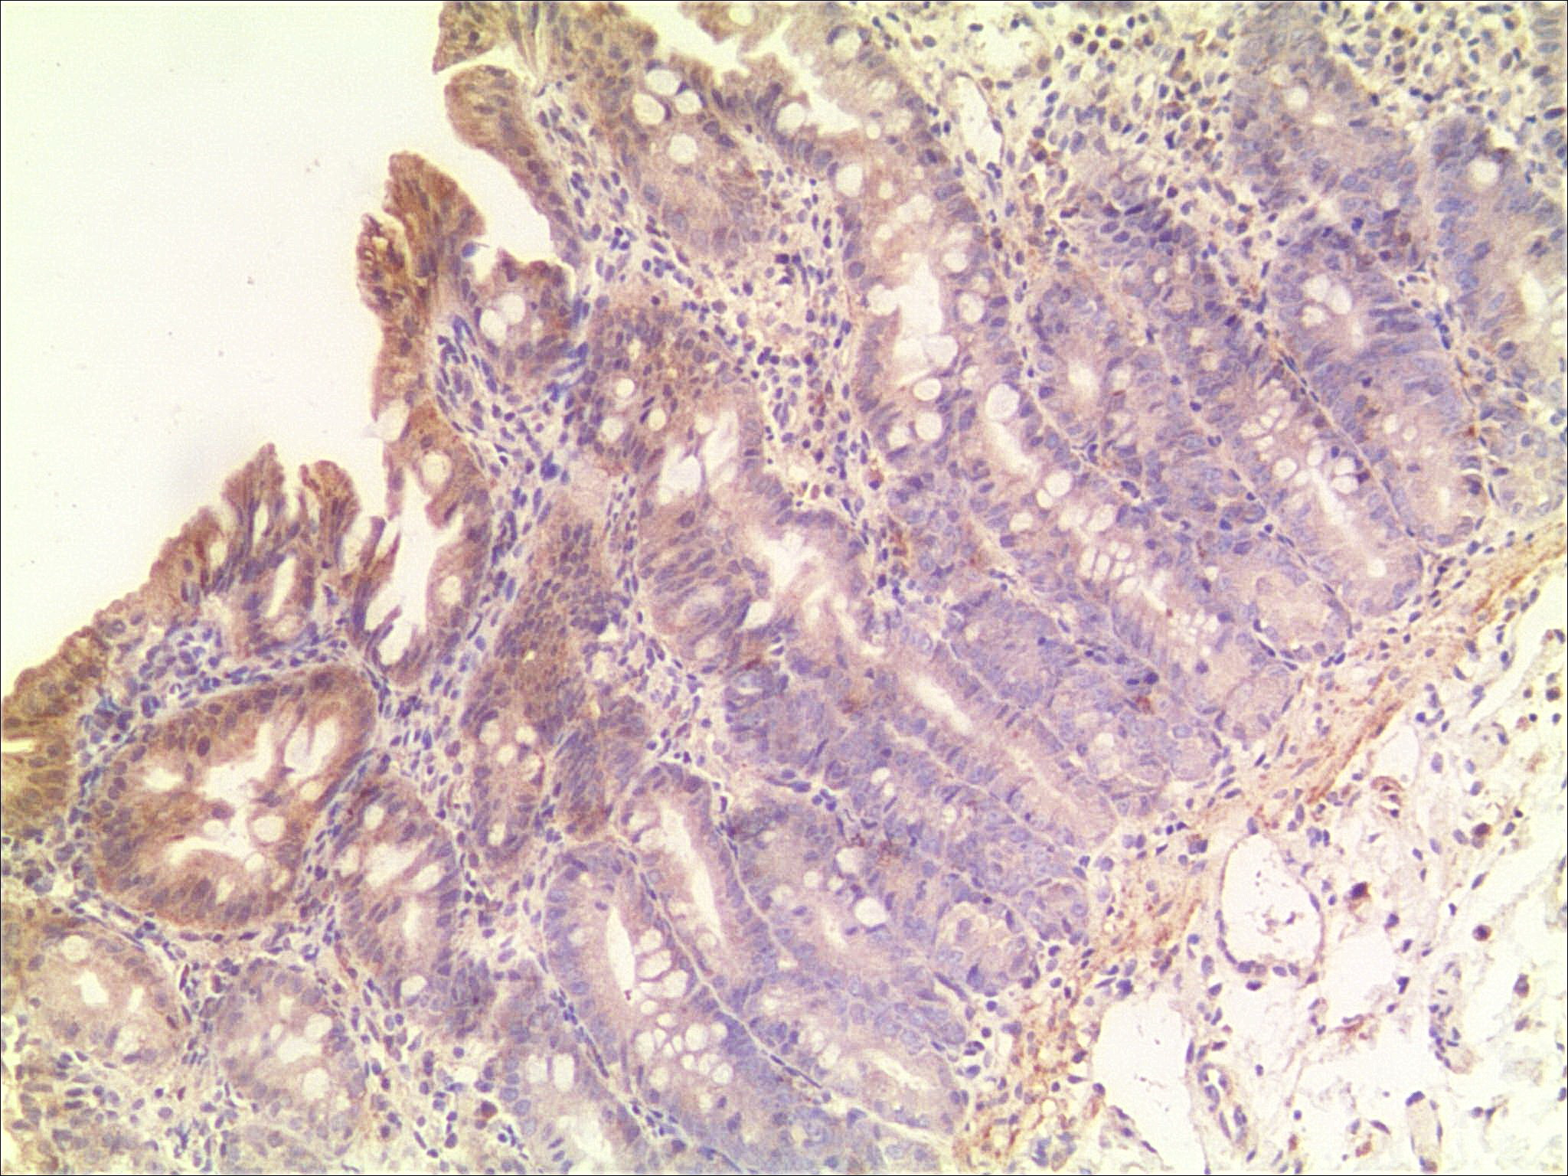
Immunohistochemistry of DGAT1 in proband’s biopsy at the duodenum (×100)
Notes:
Immunohistochemistry of DGAT1 in proband’s biopsy at the duodenum (×100)

Slide 2
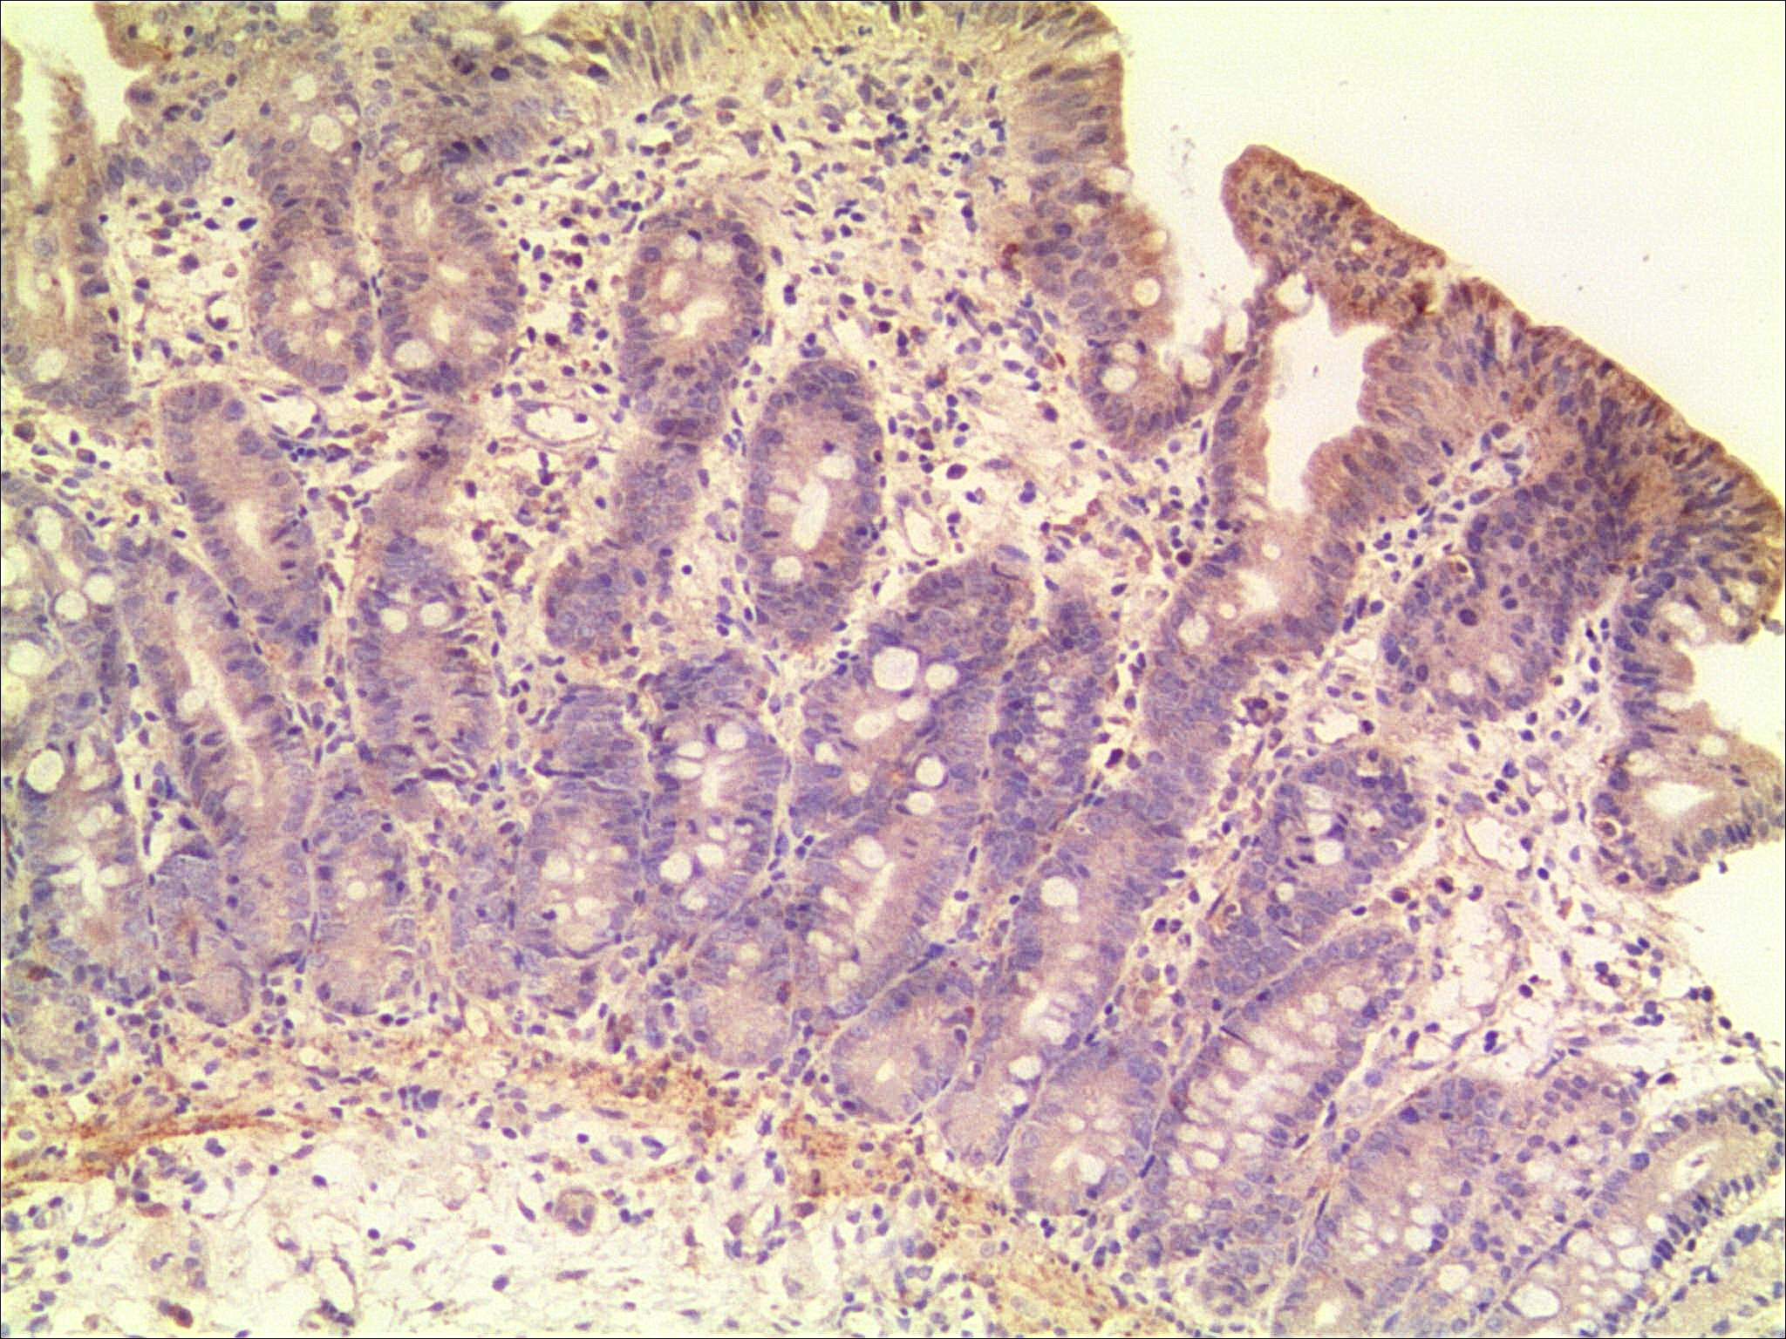
Immunohistochemistry of DGAT1 in proband’s biopsy at the duodenum (×100)
Notes:
Immunohistochemistry of DGAT1 in proband’s biopsy at the duodenum (×100)

Slide 3
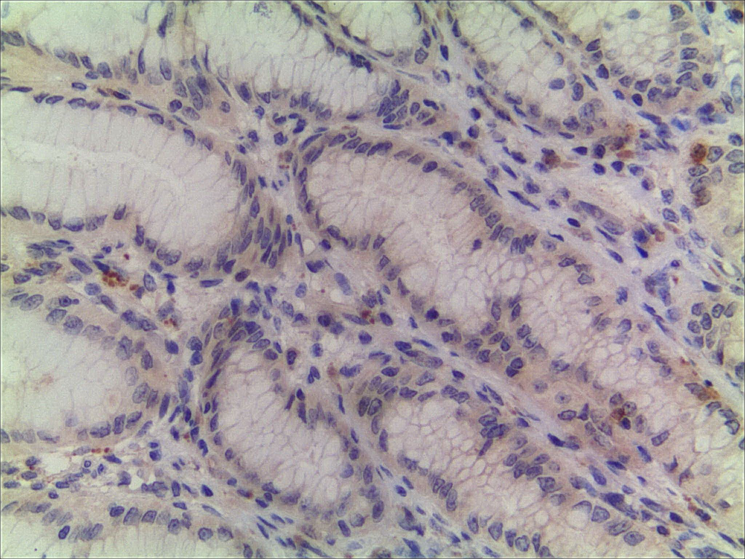
Immunohistochemistry of DGAT1 in proband’s biopsy at the duodenum (×200)
Notes:
Immunohistochemistry of DGAT1 in proband’s biopsy at the duodenum (×200)

Slide 4
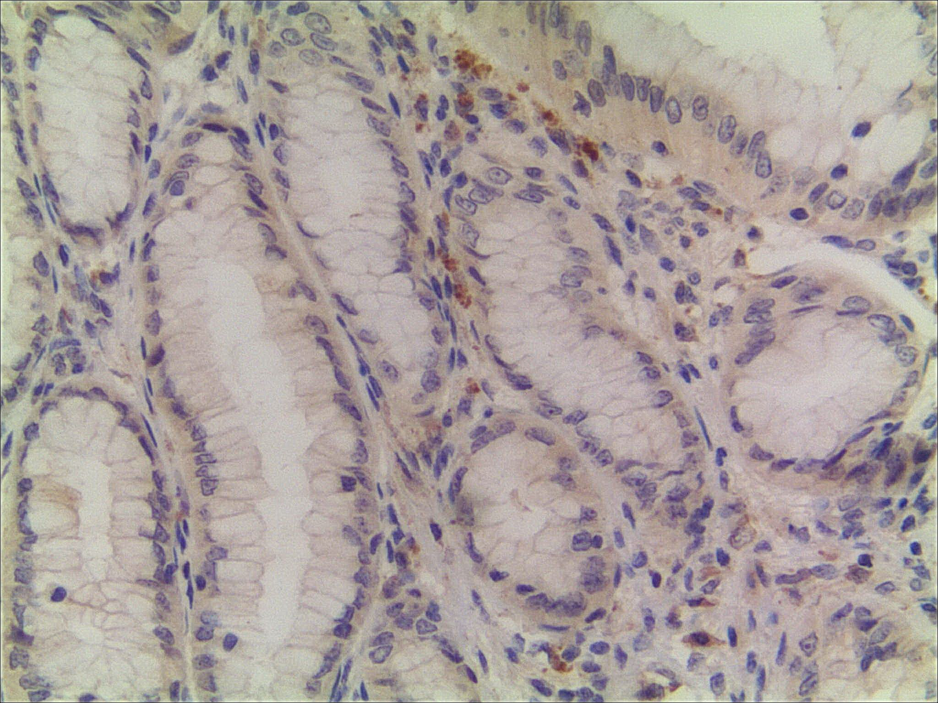
Immunohistochemistry of DGAT1 in proband’s biopsy at the duodenum (×200)
Notes:
Immunohistochemistry of DGAT1 in proband’s biopsy at the duodenum (×200)

