Slide 1
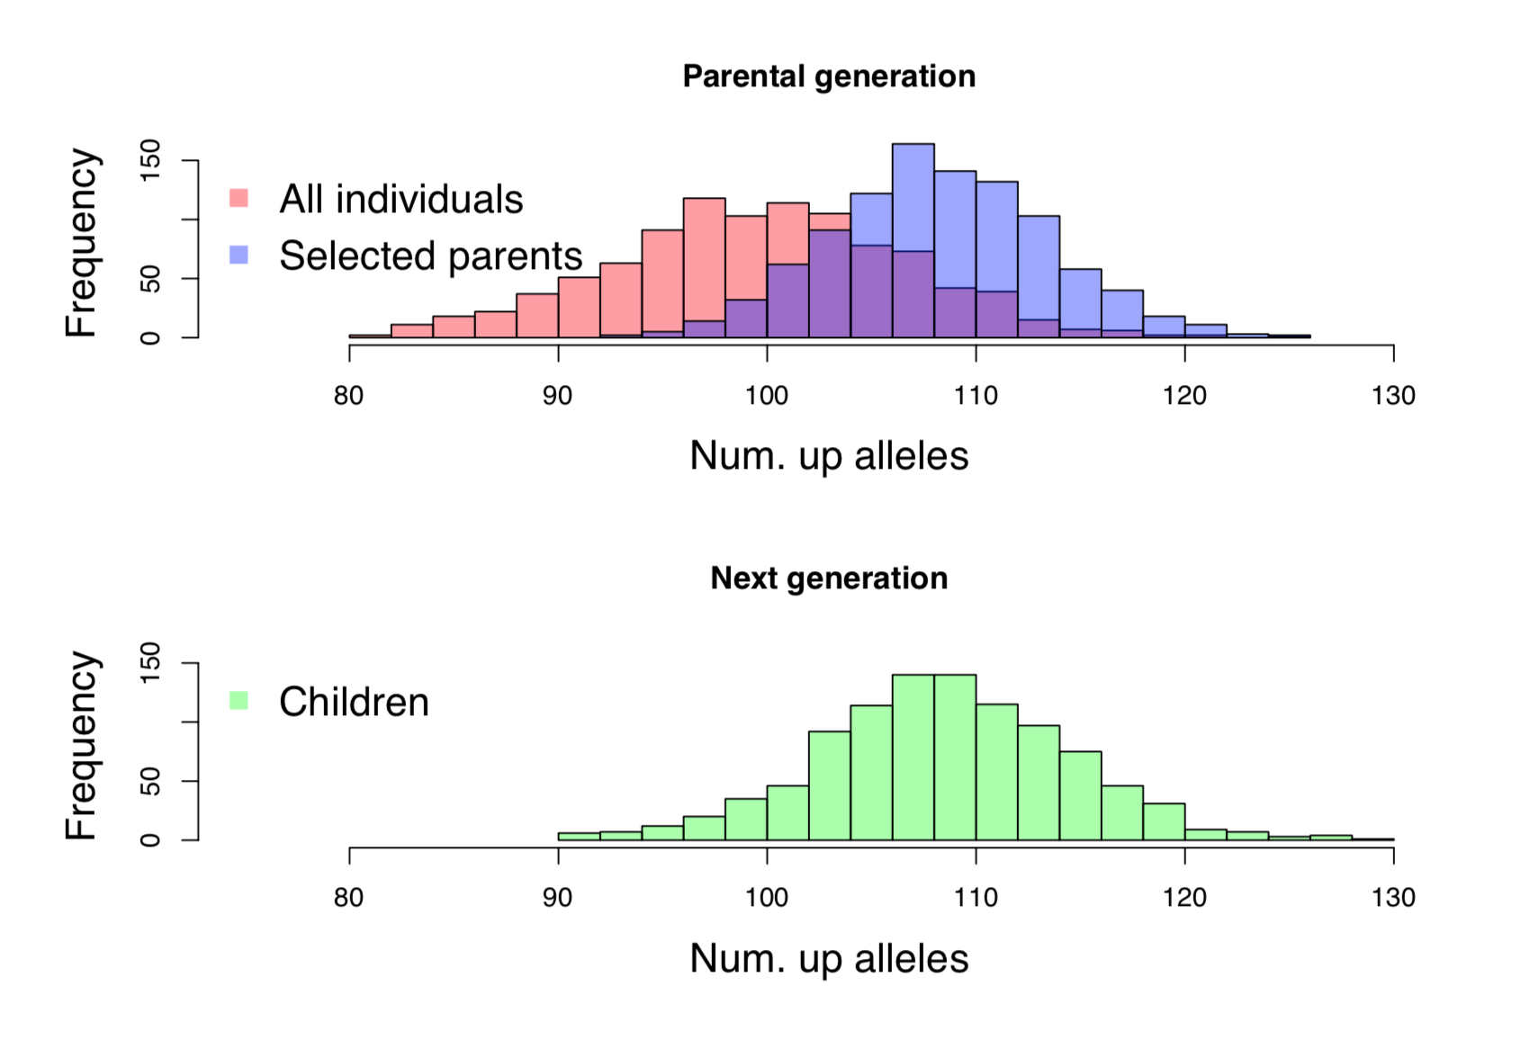
Coop, Chapter 8: Intro.-8.0.1
The Response to Phenotypic Selection

Slide 2
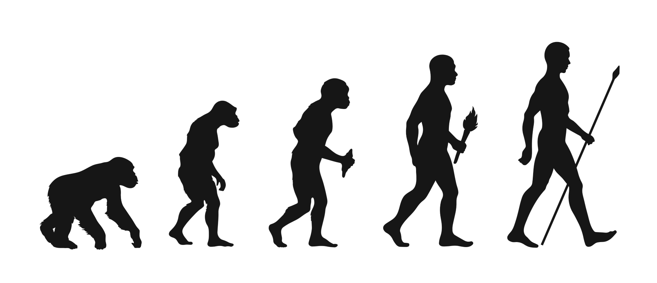
Introduction
Evolution through Natural Selection requires:
There is variation in phenotype
Survival is non-random with respect to phenotype
Phenotypic variation is heritable*
*It is the heritable nature of variation coupled with the effects of natural selection within a generation that allows for evolution across generations

Slide 3
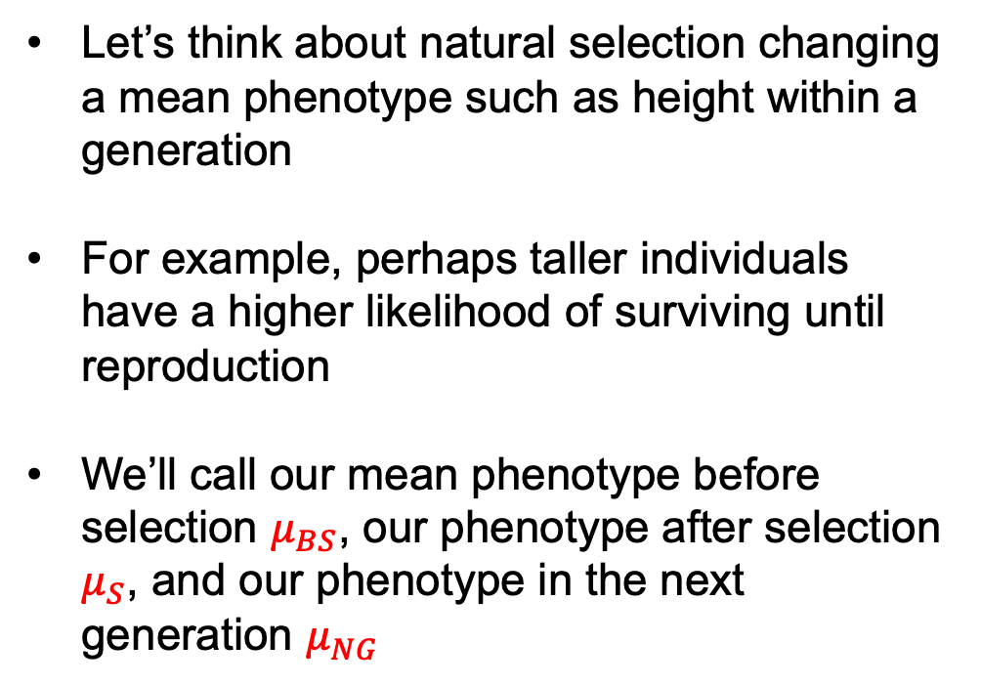



Introduction
$$μ_{BS}$$
Let’s think about natural selection changing a mean phenotype such as height within a generation
For example, perhaps taller individuals have a higher likelihood of surviving until reproduction
We’ll call our mean phenotype before selection $μ_{BS}$, our phenotype after selection $μ_{S}$, and our phenotype in the next generation $μ_{NG}$
$$μ_{S}$$
$$μ_{NG}$$

Slide 4
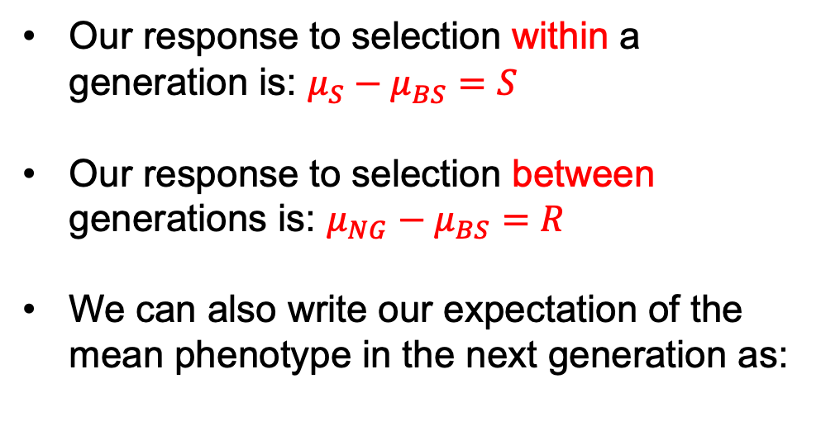
Introduction
$$μ_{BS}$$
Our response to selection within a generation is: $μ_{S}−μ_{BS}=S$
Our response to selection between generations is: $μ_{NG}−μ_{BS}=R$
We can also write our expectation of the mean phenotype in the next generation as:
$$μ_{S}$$
$$μ_{NG}$$
Where the outer expectation is over all randomly mating individuals that survive to reproduce

Slide 5

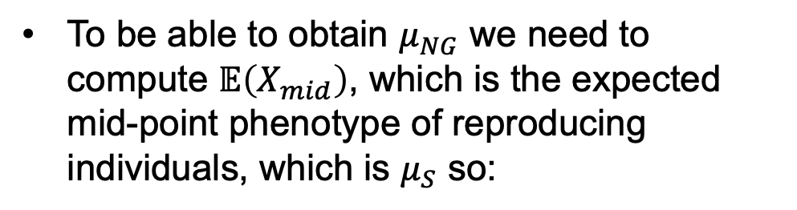
Introduction
$$μ_{BS}$$
We can solve for this expectation by going back to equation 7.14:
$$μ_{S}$$
To be able to obtain $μ_{NG}$ we need to compute $𝔼\left(X_{mid}\right)$, which is the expected mid-point phenotype of reproducing individuals, which is $μ_{S}$ so:
$$μ_{NG}$$
And rearranging a bit:

Slide 6
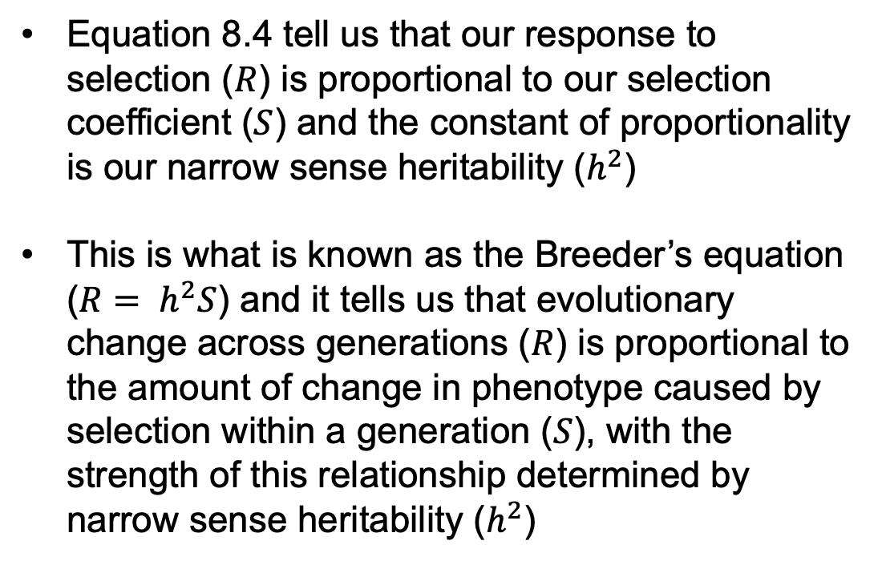
Introduction
$$μ_{BS}$$
Equation 8.4 tell us that our response to selection ($R$) is proportional to our selection coefficient ($S$) and the constant of proportionality is our narrow sense heritability ($h^{2}$)
This is what is known as the Breeder’s equation ($R= h^{2}S$) and it tells us that evolutionary change across generations ($R$) is proportional to the amount of change in phenotype caused by selection within a generation ($S$), with the strength of this relationship determined by narrow sense heritability ($h^{2}$)
$$μ_{S}$$
$$μ_{NG}$$

Slide 7
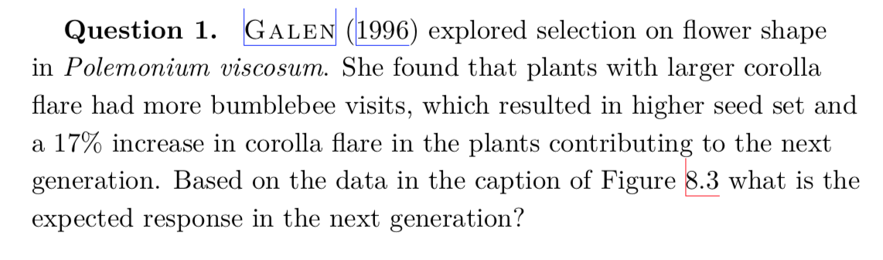
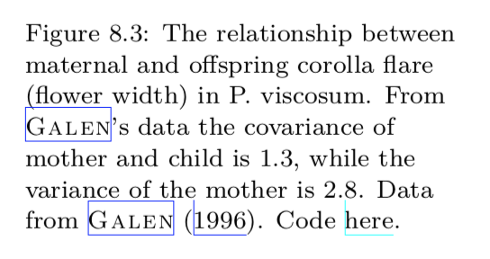
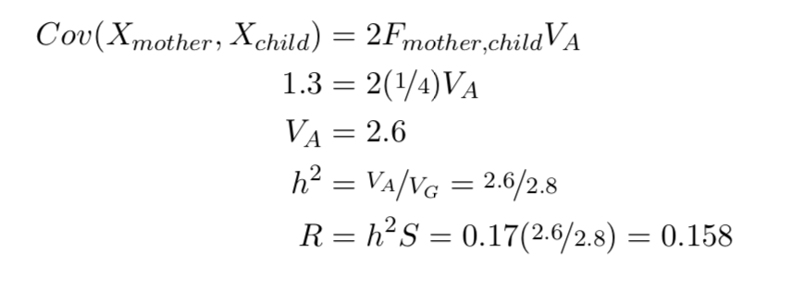
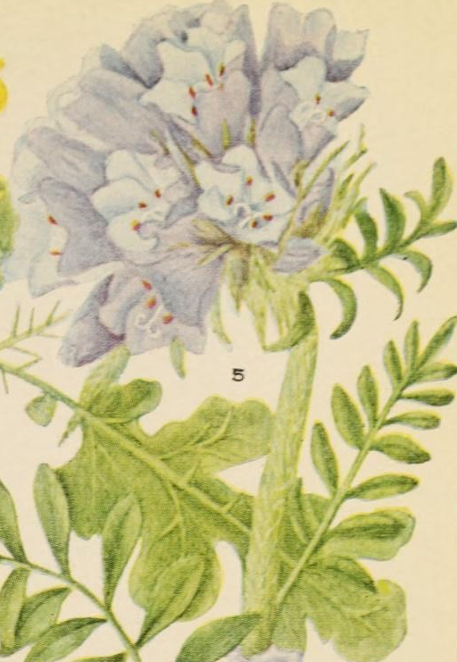
Introduction

Slide 8
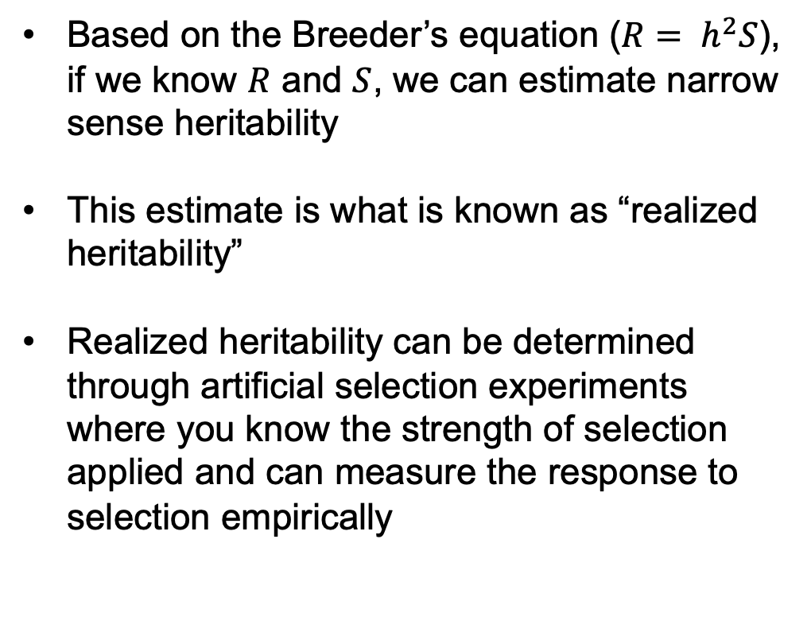
Introduction
Based on the Breeder’s equation ($R= h^{2}S$), if we know $R$ and $S$, we can estimate narrow sense heritability
This estimate is what is known as “realized heritability”
Realized heritability can be determined through artificial selection experiments where you know the strength of selection applied and can measure the response to selection empirically

Slide 9
Introduction
Figure 8.6 helps clarify the genetic basis of the response to selection
All individuals in the population have a mean of 100 “up” alleles
Those that survive to reproduce have a mean of 108 up alleles
The offspring in the next generation have a similar distribution to those reproducing, and plenty of variation remains for ongoing evolution

Slide 10

8.0.1 The Long-term Response to Selection
The dynamics captured in our Breeder’s equation can continue on and on across generations
If we assume that our heritability and selection coefficient are constant across generations, our phenotypic response to selection would be:
This means that, over time, our phenotype can continue to change in a linear fashion, resulting in impressive evolutionary change

Slide 11
8.0.1 The Long-term Response to Selection
The Illinois Long-term Selection Experiment in maize is an excellent example
Selection has been applied for both higher and lower oil content in kernels for over a century
Each generation, seeds in the extreme high or low end of the oil content distribution are chosen for the next generation
The response has been continual, perhaps due to the great genetic diversity in maize

Slide 12
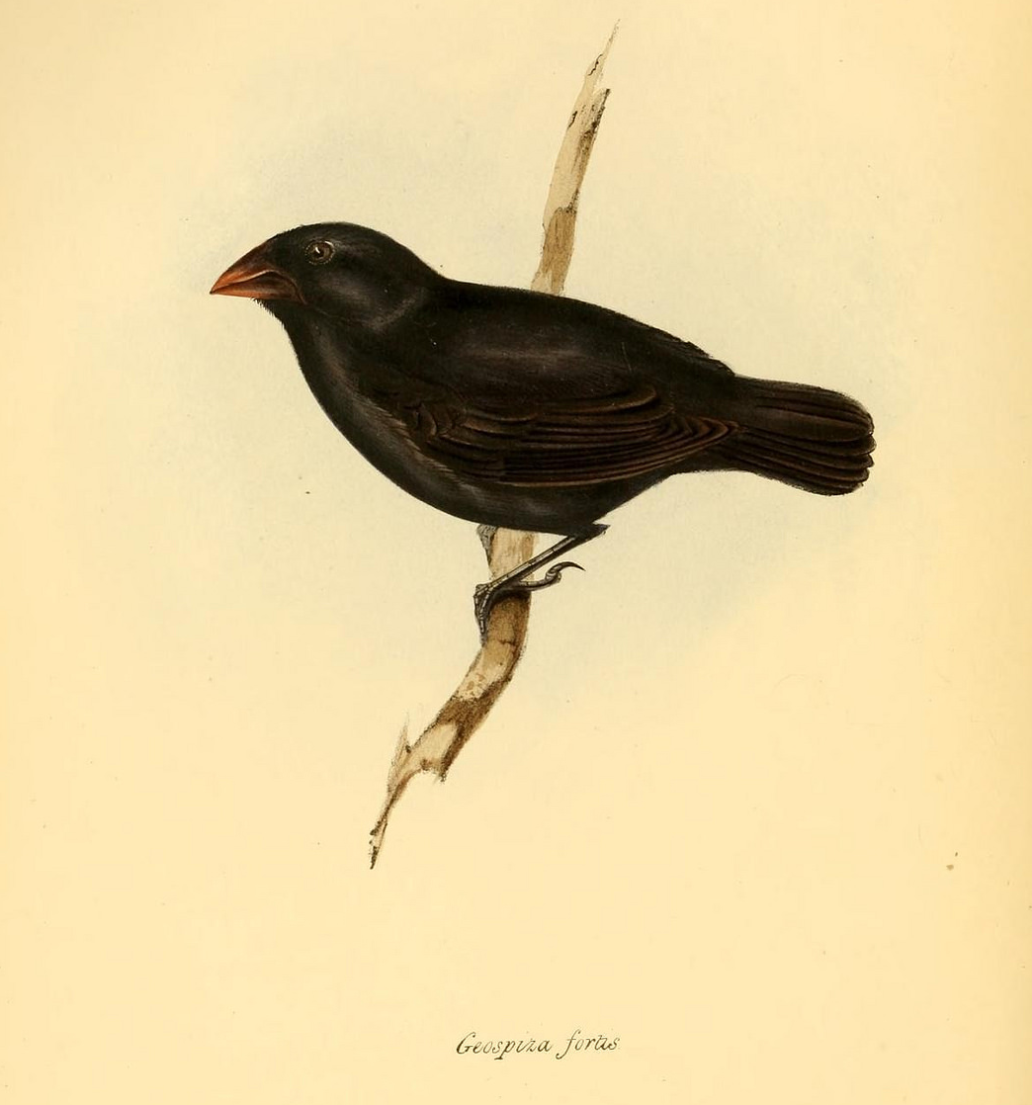
8.0.1 The Long-term Response to Selection
In wild populations, selection coefficients are rarely constant across generations
For example, Peter and Rosemary Grant have been tracking evolution of Darwin’s Finches in the Galapagos Islands for decades
Selection pressure in the Medium ground-finch (Geospiza fortis) has changed multiple times over the course of their observations

Slide 13
8.0.1 The Long-term Response to Selection
We see so much variation in form and function across the diversity of life. Is long-term selection capable of generating this, given rates of evolution we see in the short-term?
To measure the phenotypic change over various time periods we need an estimator of the rate of phenotypic change
Illustration by Färtenleser, licensed under CC-ASA 4.0

Slide 14

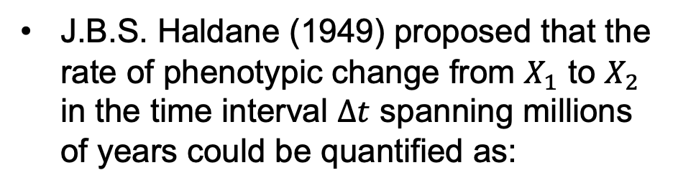
8.0.1 The Long-term Response to Selection
J.B.S. Haldane (1949) proposed that the rate of phenotypic change from $X_{1}$ to $X_{2}$ in the time interval $∆t$ spanning millions of years could be quantified as:
By looking at the log of the ratio, we’re considering the fold change, which is reasonable given a 1cm change in leg length in a mouse is much more profound than in an elephant!

Slide 15
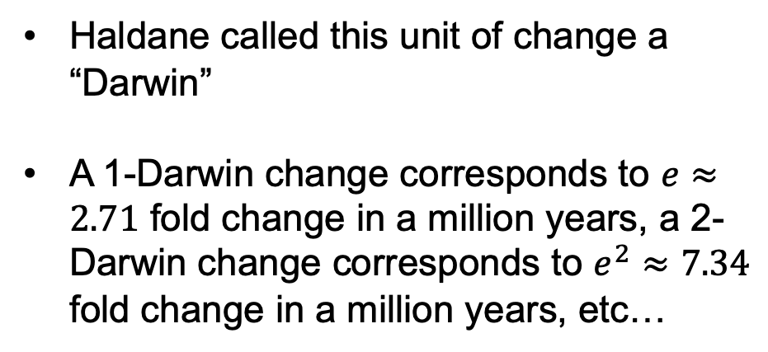
8.0.1 The Long-term Response to Selection
Haldane called this unit of change a “Darwin”
A 1-Darwin change corresponds to $e≈2.71$ fold change in a million years, a 2-Darwin change corresponds to $e^{2}≈7.34$ fold change in a million years, etc…

Slide 16
8.0.1 The Long-term Response to Selection
Gingerich (1983) and later Uyeda (2011) examined the rate of evolutionary change in both field- and fossil-collected data
Each point is an observation of the rate of phenotypic change measure in Darwins between compared populations or species
Over short time spans (i.e., the lefthand side of the plot) we see very rapid phenotypic change

Slide 17
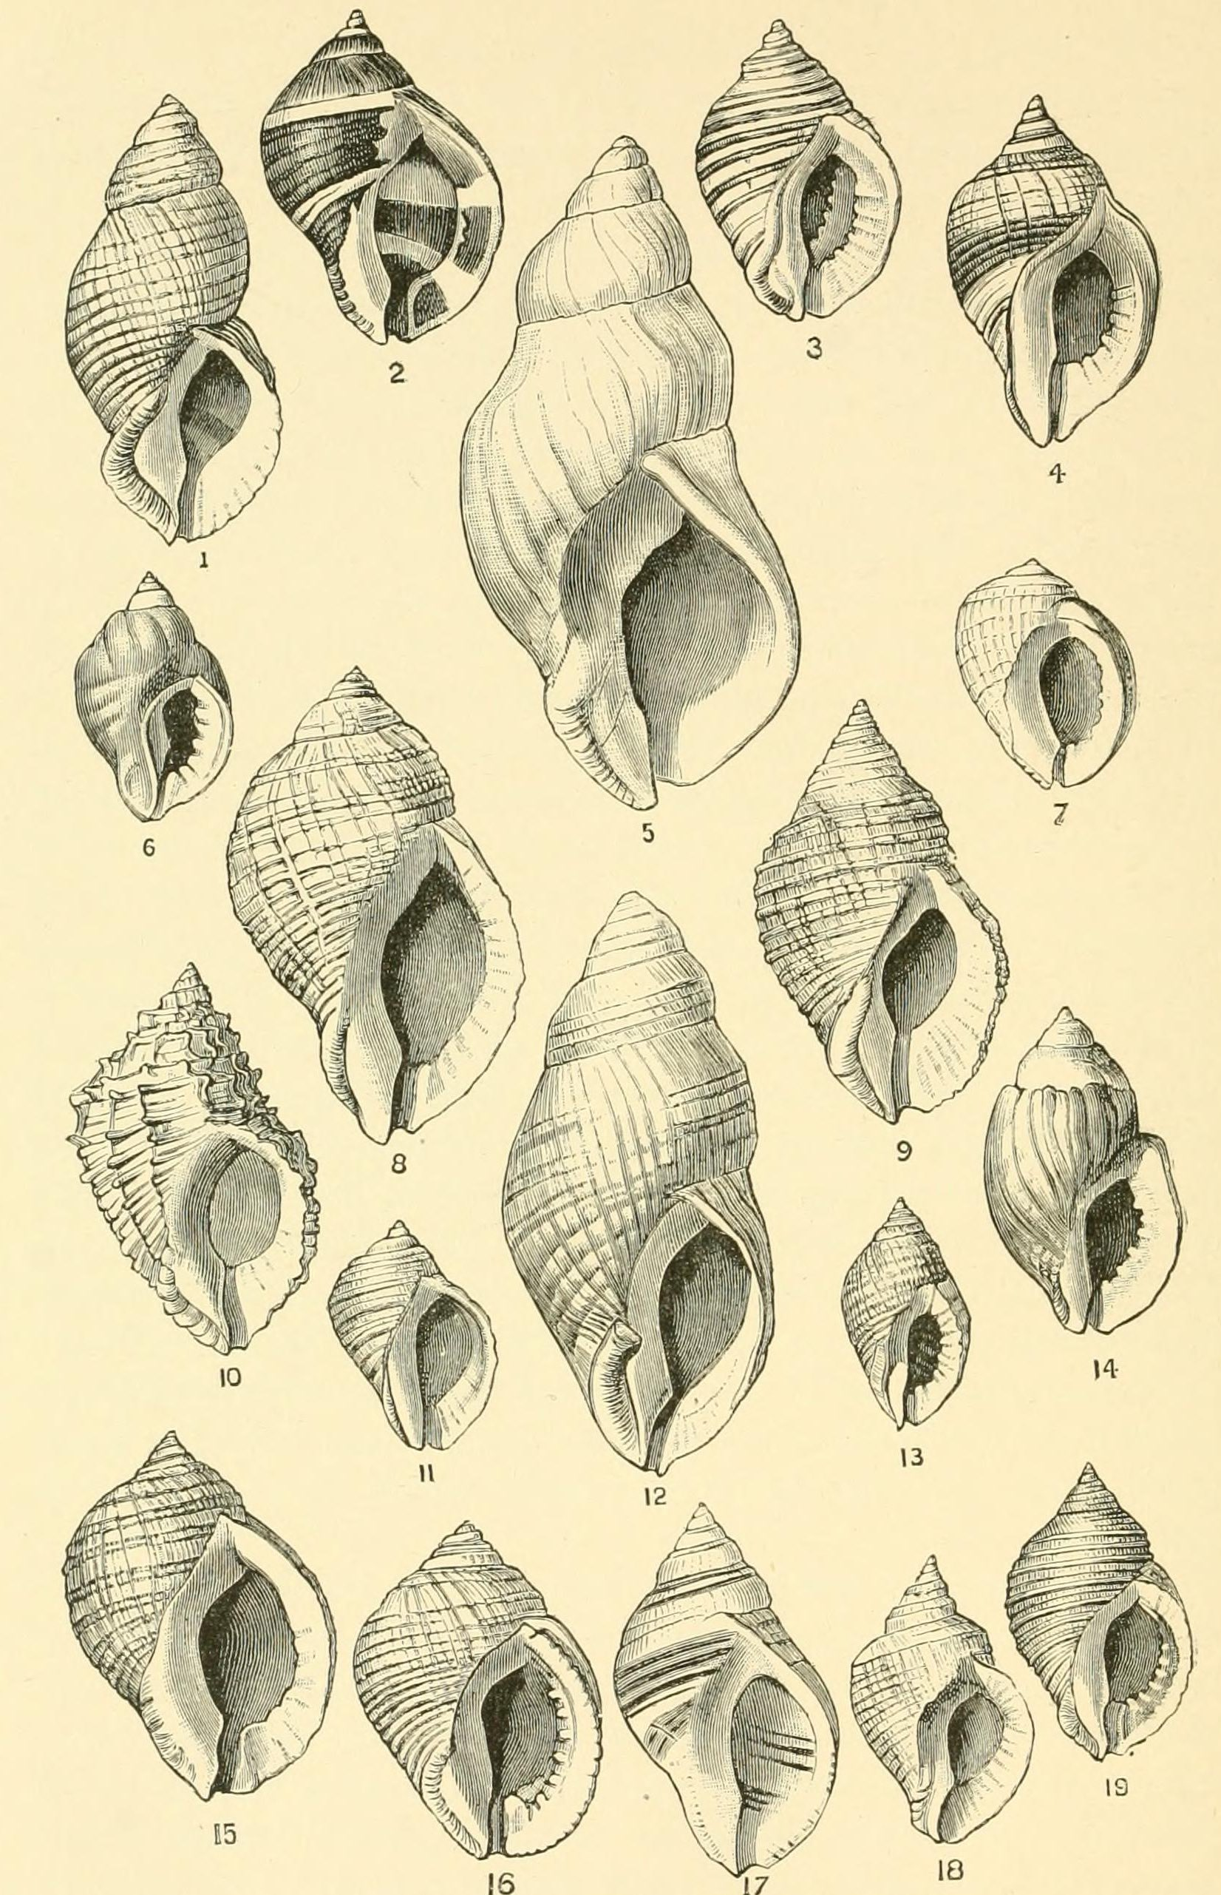
8.0.1 The Long-term Response to Selection
For example, measurements on the decade scale in the dog whelk (a sea snail), showed that their shell lip thickness evolved from 0.94mm to 1.44mm (50% increase) over just 25 years, a rate of 17,060 Darwins!
This rapid evolution is thought to be in response to predation by the invasive green crab that was recently introduced to the East Coast of North America

Slide 18
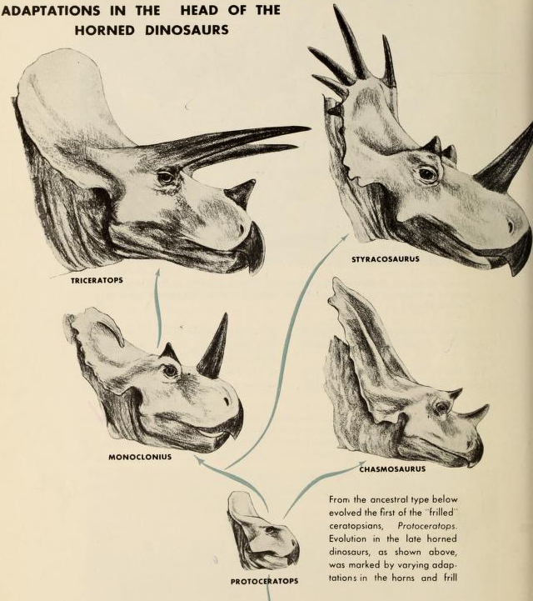
8.0.1 The Long-term Response to Selection
In contrast, over greater time periods, the rate of evolution appears to be much slower
For example, the Triceratops, which was ~30 ft in length, evolved from a species known as Protoceratops, that was roughly the size of a sheep over the course of 7.5 million years
While this may seem substantial, evolution over this long time period is at a rate of 0.143 Darwins
Thus, rates of evolution we see over contemporary timescales are enough to explain the diversity we see in life on Earth

Slide 19
Coop, Chapter 8: 8.1.1-8.1.3
The Response to Phenotypic Selection

Slide 20
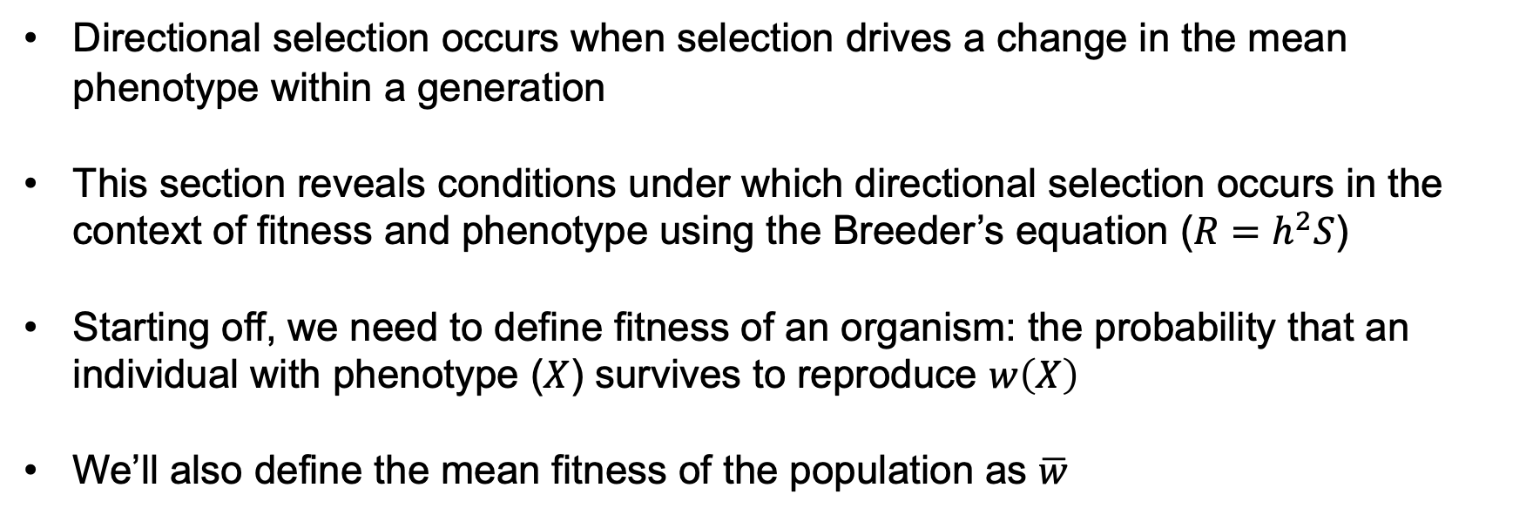
8.1.1 Directional selection as the covariance between fitness and phenotype
Directional selection occurs when selection drives a change in the mean phenotype within a generation
This section reveals conditions under which directional selection occurs in the context of fitness and phenotype using the Breeder’s equation ($R=h^{2}S$)
Starting off, we need to define fitness of an organism: the probability that an individual with phenotype ($X$) survives to reproduce $w\left(X\right)$
We’ll also define the mean fitness of the population as $\overline{w}$

Slide 21

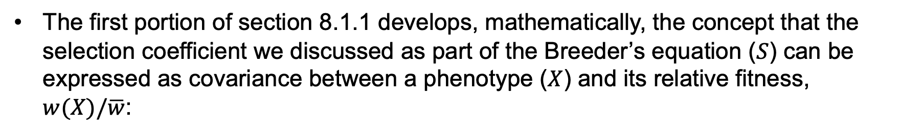
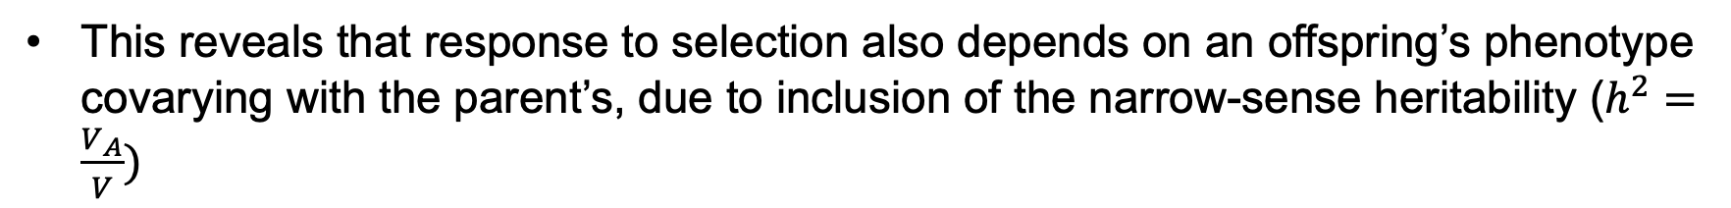
8.1.1 Directional selection as the covariance between fitness and phenotype
The first portion of section 8.1.1 develops, mathematically, the concept that the selection coefficient we discussed as part of the Breeder’s equation ($S$) can be expressed as covariance between a phenotype ($X$) and its relative fitness, $w(X)/\overline{w}$:
Our change in phenotype across generations is therefore a measure of the covariance in phenotype and fitness and the Breeder’s equation can be rewritten as:
This reveals that response to selection also depends on an offspring’s phenotype covarying with the parent’s, due to inclusion of the narrow-sense heritability ($h^{2}=\frac{V_{A}}{V})$

Slide 22
8.1.1 Directional selection as the covariance between fitness and phenotype
To understand this in more detail, let’s consider the regression of an individual $i$’s phenotype ($X_{i}$) on fitness ($w_{i}$):
The slope of this regression ($β$) is called the fitness gradient and is defined as:
So the fitness gradient is therefore the covariance of phenotype and fitness divided by the phenotypic variance

Slide 23
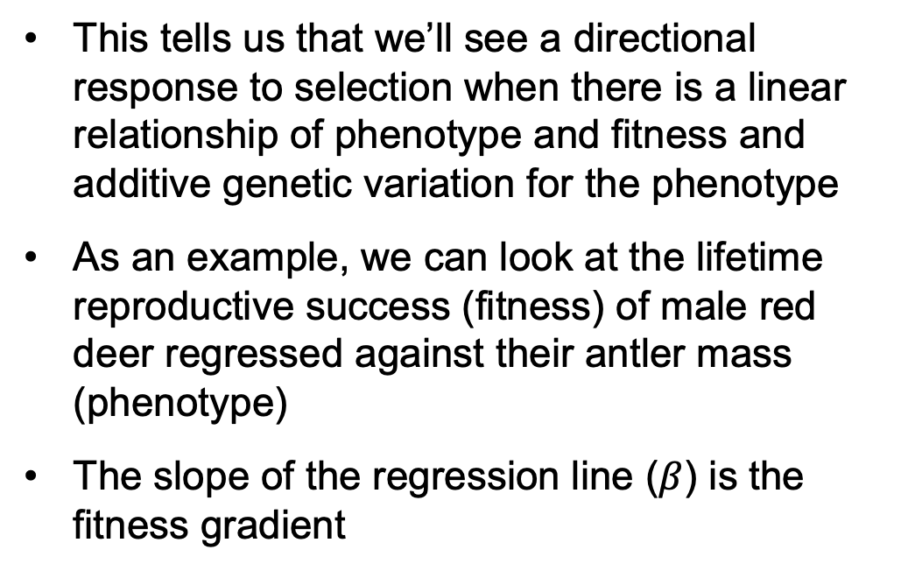
8.1.1 Directional selection as the covariance between fitness and phenotype
We can then rewrite the Breeder’s equation as:
This tells us that we’ll see a directional response to selection when there is a linear relationship of phenotype and fitness and additive genetic variation for the phenotype
As an example, we can look at the lifetime reproductive success (fitness) of male red deer regressed against their antler mass (phenotype)
The slope of the regression line ($β$) is the fitness gradient

Slide 24
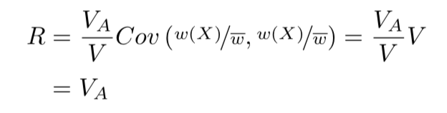
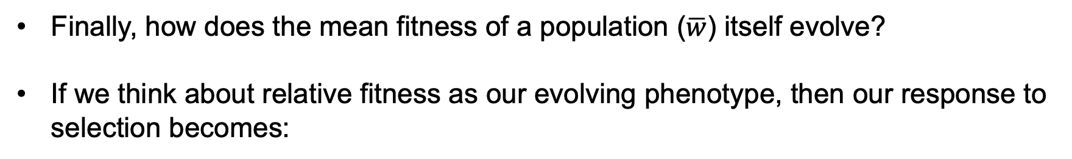
8.1.1 Directional selection as the covariance between fitness and phenotype
Finally, how does the mean fitness of a population ($\overline{w}$) itself evolve?
If we think about relative fitness as our evolving phenotype, then our response to selection becomes:
In other words, response to selection is equal to the additive genetic variance for relative fitness

Slide 25
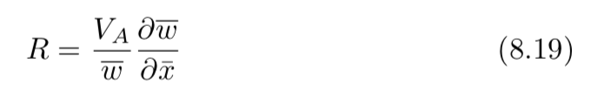
8.1.2 Directional selection on fitness landscapes
One metaphor commonly used to describe evolution is the “adaptive landscape” in which natural selection pushes a population toward higher fitness and ultimately peaks in the landscape
In this context, Lande (1976) further developed the Breeder’s equation showing that the response to selection could be written in terms of the gradient (derivative) of mean fitness of the population as a function of the mean phenotype:

Slide 26
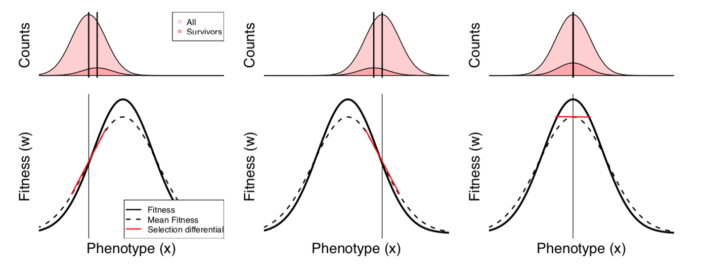
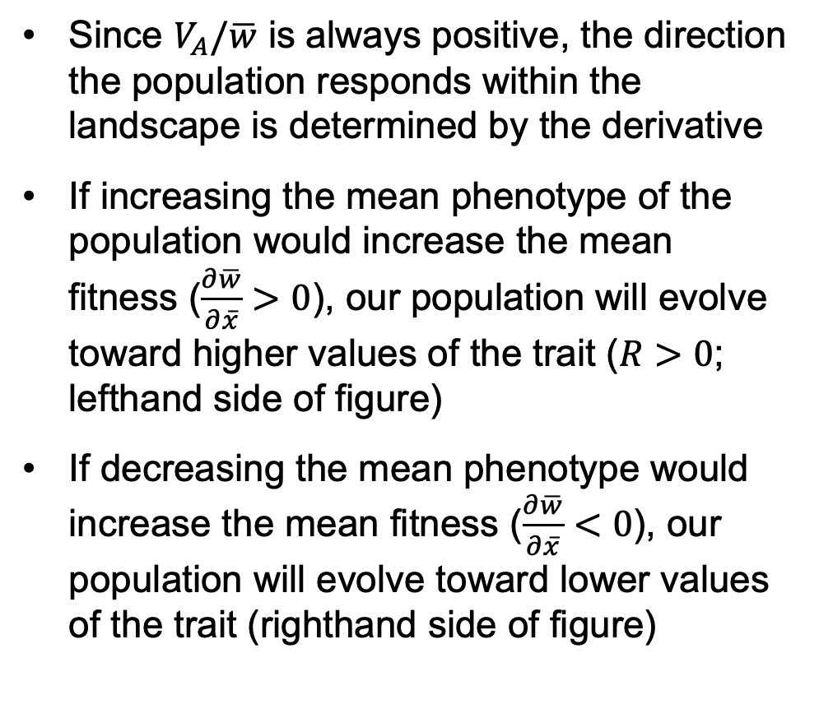
8.1.2 Directional selection on fitness landscapes
Since $V_{A}/\overline{w}$ is always positive, the direction the population responds within the landscape is determined by the derivative
If increasing the mean phenotype of the population would increase the mean fitness ($\frac{∂\overline{w}}{∂\overline{x}}>0$), our population will evolve toward higher values of the trait ($R>0$; lefthand side of figure)
If decreasing the mean phenotype would increase the mean fitness ($\frac{∂\overline{w}}{∂\overline{x}}<0$), our population will evolve toward lower values of the trait (righthand side of figure)

Slide 27
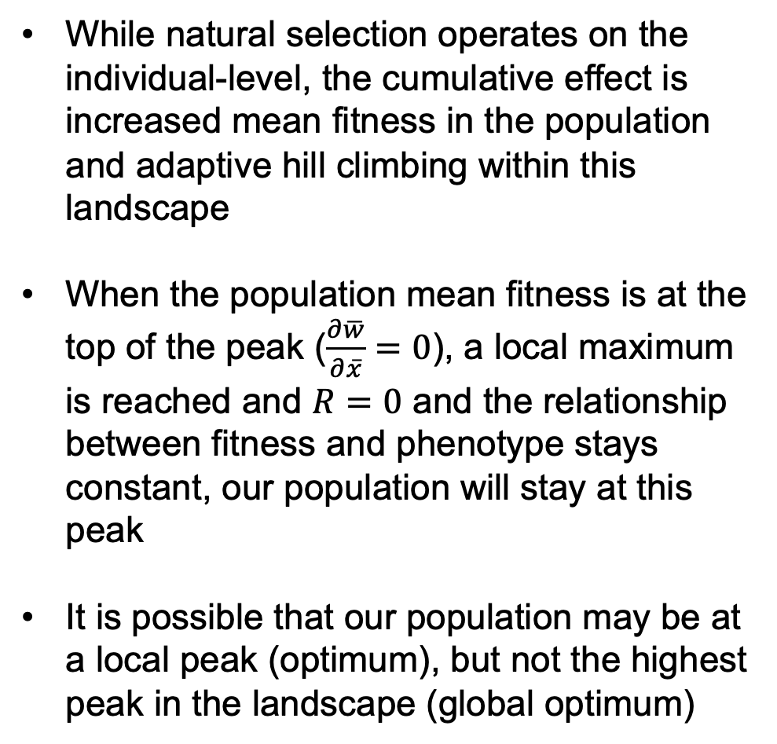
8.1.2 Directional selection on fitness landscapes
While natural selection operates on the individual-level, the cumulative effect is increased mean fitness in the population and adaptive hill climbing within this landscape
When the population mean fitness is at the top of the peak ($\frac{∂\overline{w}}{∂\overline{x}}=0$), a local maximum is reached and $R=0$ and the relationship between fitness and phenotype stays constant, our population will stay at this peak
It is possible that our population may be at a local peak (optimum), but not the highest peak in the landscape (global optimum)

Slide 28
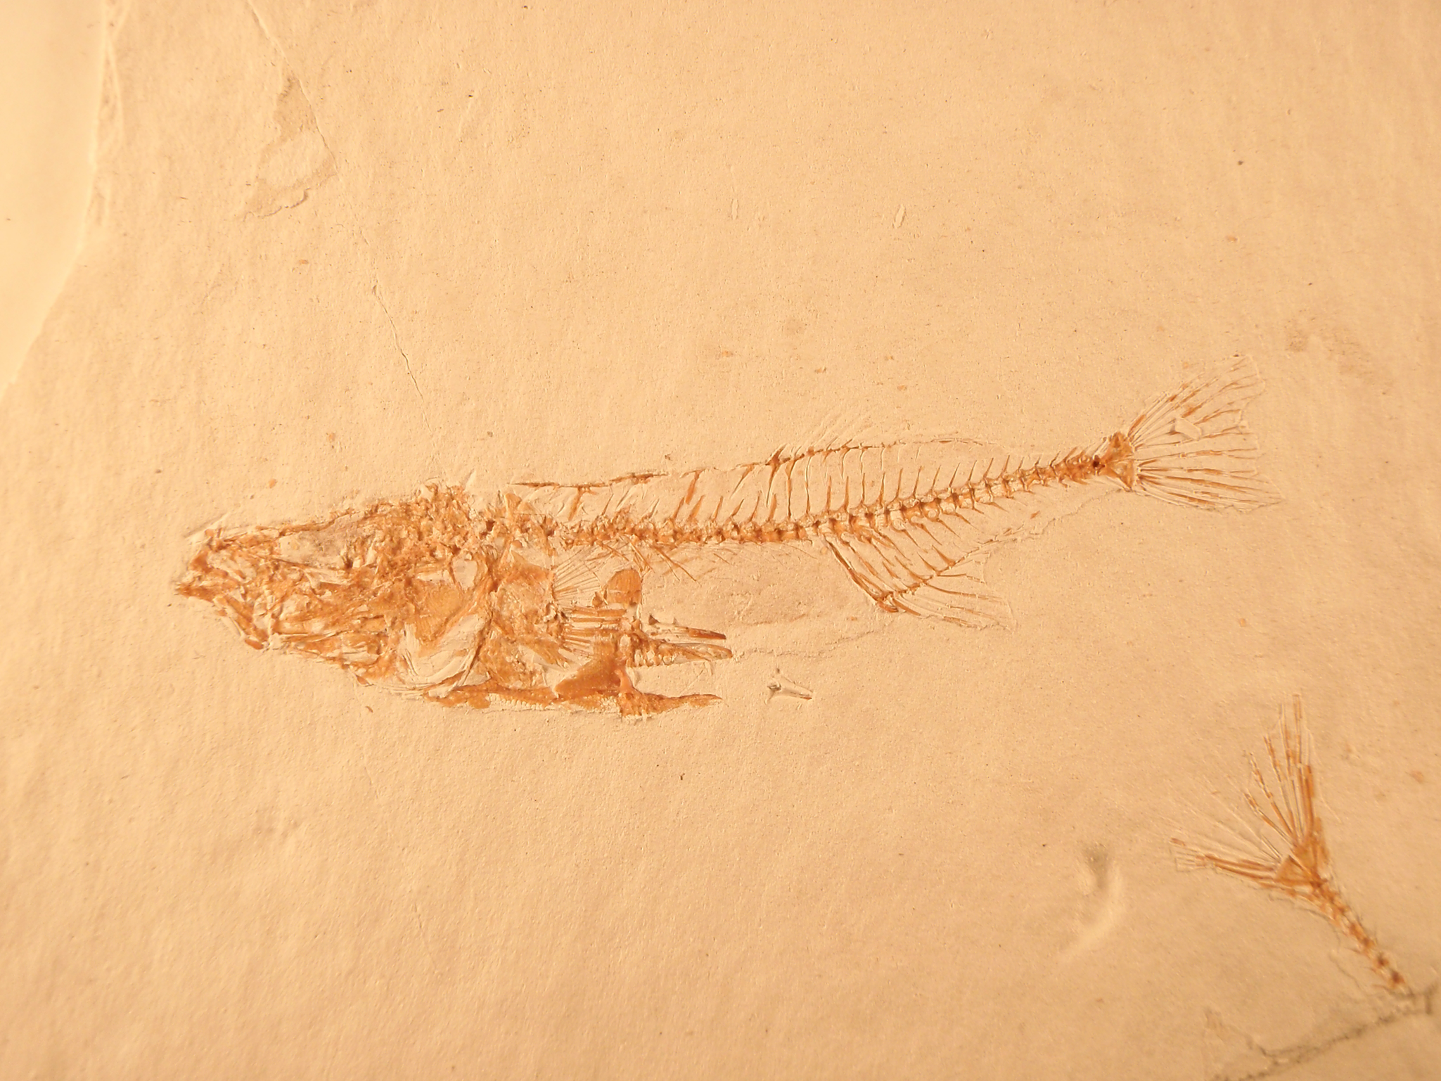
8.1.2 Directional selection on fitness landscapes
One very striking example of a population reaching a new fitness optimum comes from a stickleback fish time series over thousands of years from a fossil lakebed in Nevada (Bell et al. 2006)
Since sediment is laid down yearly, the time series is very detailed
Five thousand measurements were taken, documenting the reduction of armor after the stickleback colonized this lake
“Touching pterygiophores” are a metric of armor and, quickly after colonization, the stickleback showed marked reduction followed by fluctuation around a new value which is presumed to be the new optimum

Slide 29
8.1.2 Directional selection on fitness landscapes
Hunt and colleagues (2008) followed up on this story, constructing the adaptive landscape (lower panel of the figure)
The arrows show the moves made by the population toward the optimum phenotype
The population initially makes large steps toward this optimum and then vacillates around it
The fluctuation around the optimum can be interpreted as genetic drift knocking the population off the optimum, followed by natural selection bringing the population back to the optimum

Slide 30
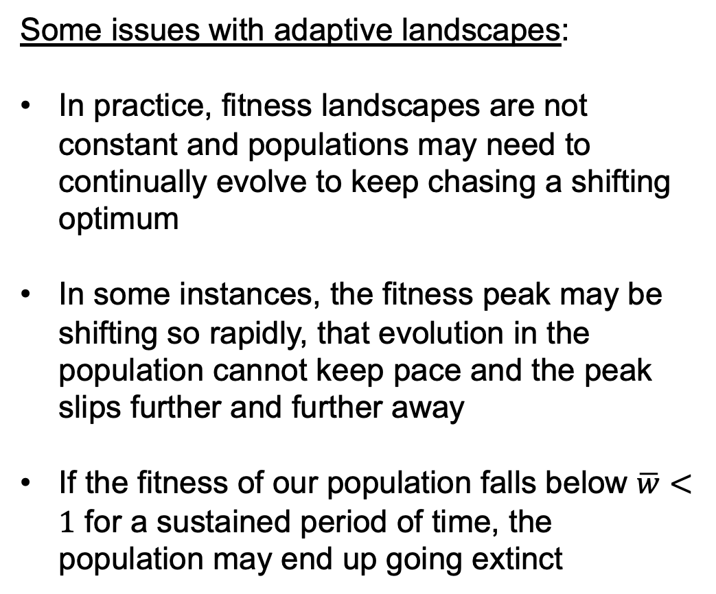
8.1.2 Directional selection on fitness landscapes
Some issues with adaptive landscapes:
In practice, fitness landscapes are not constant and populations may need to continually evolve to keep chasing a shifting optimum
In some instances, the fitness peak may be shifting so rapidly, that evolution in the population cannot keep pace and the peak slips further and further away
If the fitness of our population falls below $\overline{w}<1$ for a sustained period of time, the population may end up going extinct

Slide 31
8.1.2 Directional selection on fitness landscapes
Some issues with adaptive landscapes:
For an adaptive landscape to hold and for a particular organism to reach a fitness peak, the fitness of different phenotypes needs to be independent of each other’s frequency
As an example of positive, frequency-dependent selection, when a butterfly that is toxic to predators reaches high enough frequency, the predator learns its wing coloration pattern and avoids it; wing coloration mimics that lack the toxin are then just as fit as the toxic butterfly

Slide 32
8.1.3 Stabilizing and disruptive selection
With directional selection, we have focused on selection shifting the mean phenotype within a population
Other forms of selection have pronounced effects on the variance of phenotype
For example, selection may disfavor individuals in the tails of the phenotypic distribution, causing a reduction in the variance of phenotype (stabilizing selection)
Alternatively, selection may favor extreme phenotypes, increasing the variance (disruptive selection)
While we saw with directional selection that there was a linear relationship between phenotype and fitness, when selection acts on the variance in phenotype, we see a quadratic relationship between fitness and phenotype

Slide 33

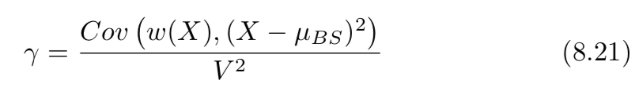
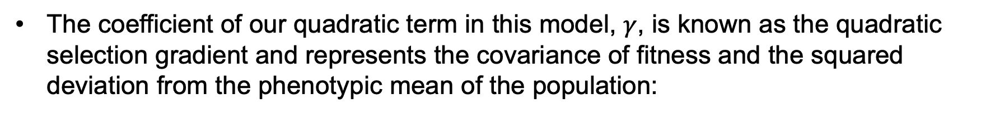
8.1.3 Stabilizing and disruptive selection
Therefore, our regression for these types of selection will include a quadratic term:
The coefficient of our quadratic term in this model, $γ$, is known as the quadratic selection gradient and represents the covariance of fitness and the squared deviation from the phenotypic mean of the population:
Values of $γ<0$ are consistent with stabilizing selection, reducing the variance and values of $γ>0$ are consistent with disruptive selection, increasing the variance

Slide 34
8.1.3 Stabilizing and disruptive selection
A classic example of stabilizing selection, in which selection disfavors phenotypic extremes, is human birth weight
Mary Karn collected birth weight and mortality from ~14,000 pregnancies between 1935-1946
The variance in all births was 1.575lb², whereas the variance in surviving babies was 1.26lb², a 20% reduction in variance due to stabilizing selection

Slide 35
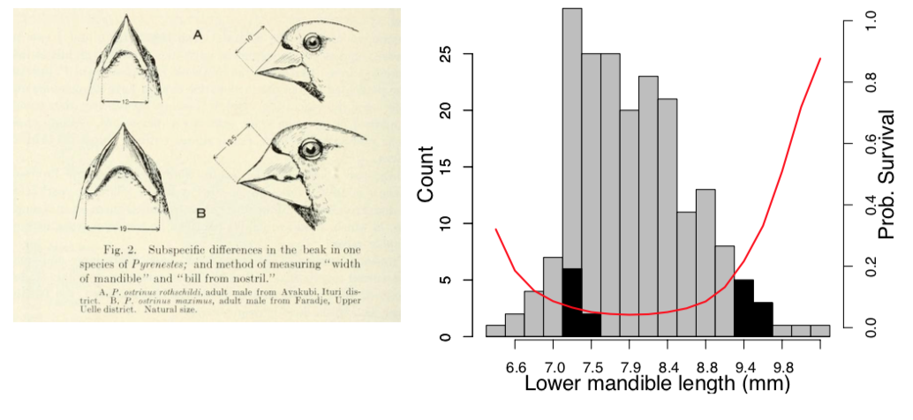
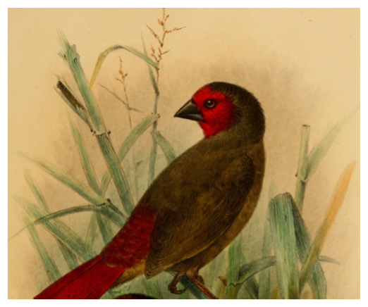
8.1.3 Stabilizing and disruptive selection
A striking example of disruptive selection can be found in the Central African Black-bellied Seedcatcher
Both large-beaked and small-beaked morphs of the bird can be found that have different primary food sources
Small-beaked birds eat soft seeds from a marsh sedge and big-beaked birds eat much harder seeds from a different sedge that require much more force to break open

Slide 36
8.1.3 Stabilizing and disruptive selection
Smith (1993) followed the fate of hundreds of juveniles and found those with intermediate beak sizes had a much lower survival rate because they were not adapted to either food source
This example of disruptive selection shows a negative quadratic term in the regression of fitness on beak size phenotype and increased variance in phenotype in survivors (1.3mm²) versus all juveniles (0.5mm²)

Slide 37
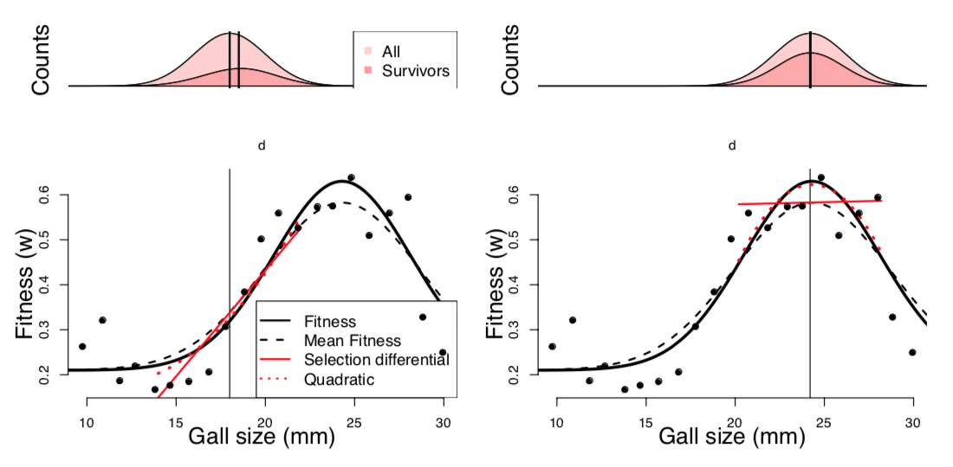
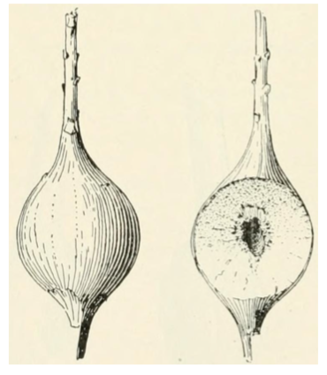
8.1.3 Stabilizing and disruptive selection
Finally, the goldenrod ball gallmaker is an excellent example of the interplay of directional selection and quadratic terms during adaptation
This insect lays its eggs in the goldenrod plant and the larvae release chemicals that cause the plant to build a gall that acts as a home for the larvae as they mature
When small, galls are targeted by parasitoid wasps and if all galls are initially small, directional selection will act linearly to increase gall size

Slide 38
8.1.3 Stabilizing and disruptive selection
When galls are large, they begin to attract the attention of downy woodpeckers and black-capped chickadees and stabilizing selection kicks in
Under stabilizing selection, a quadratic term fits the best in the regression and intermediate gall size is favored
The population will remain at this fitness peak as long as selection pressures remain the same

