Slide 1
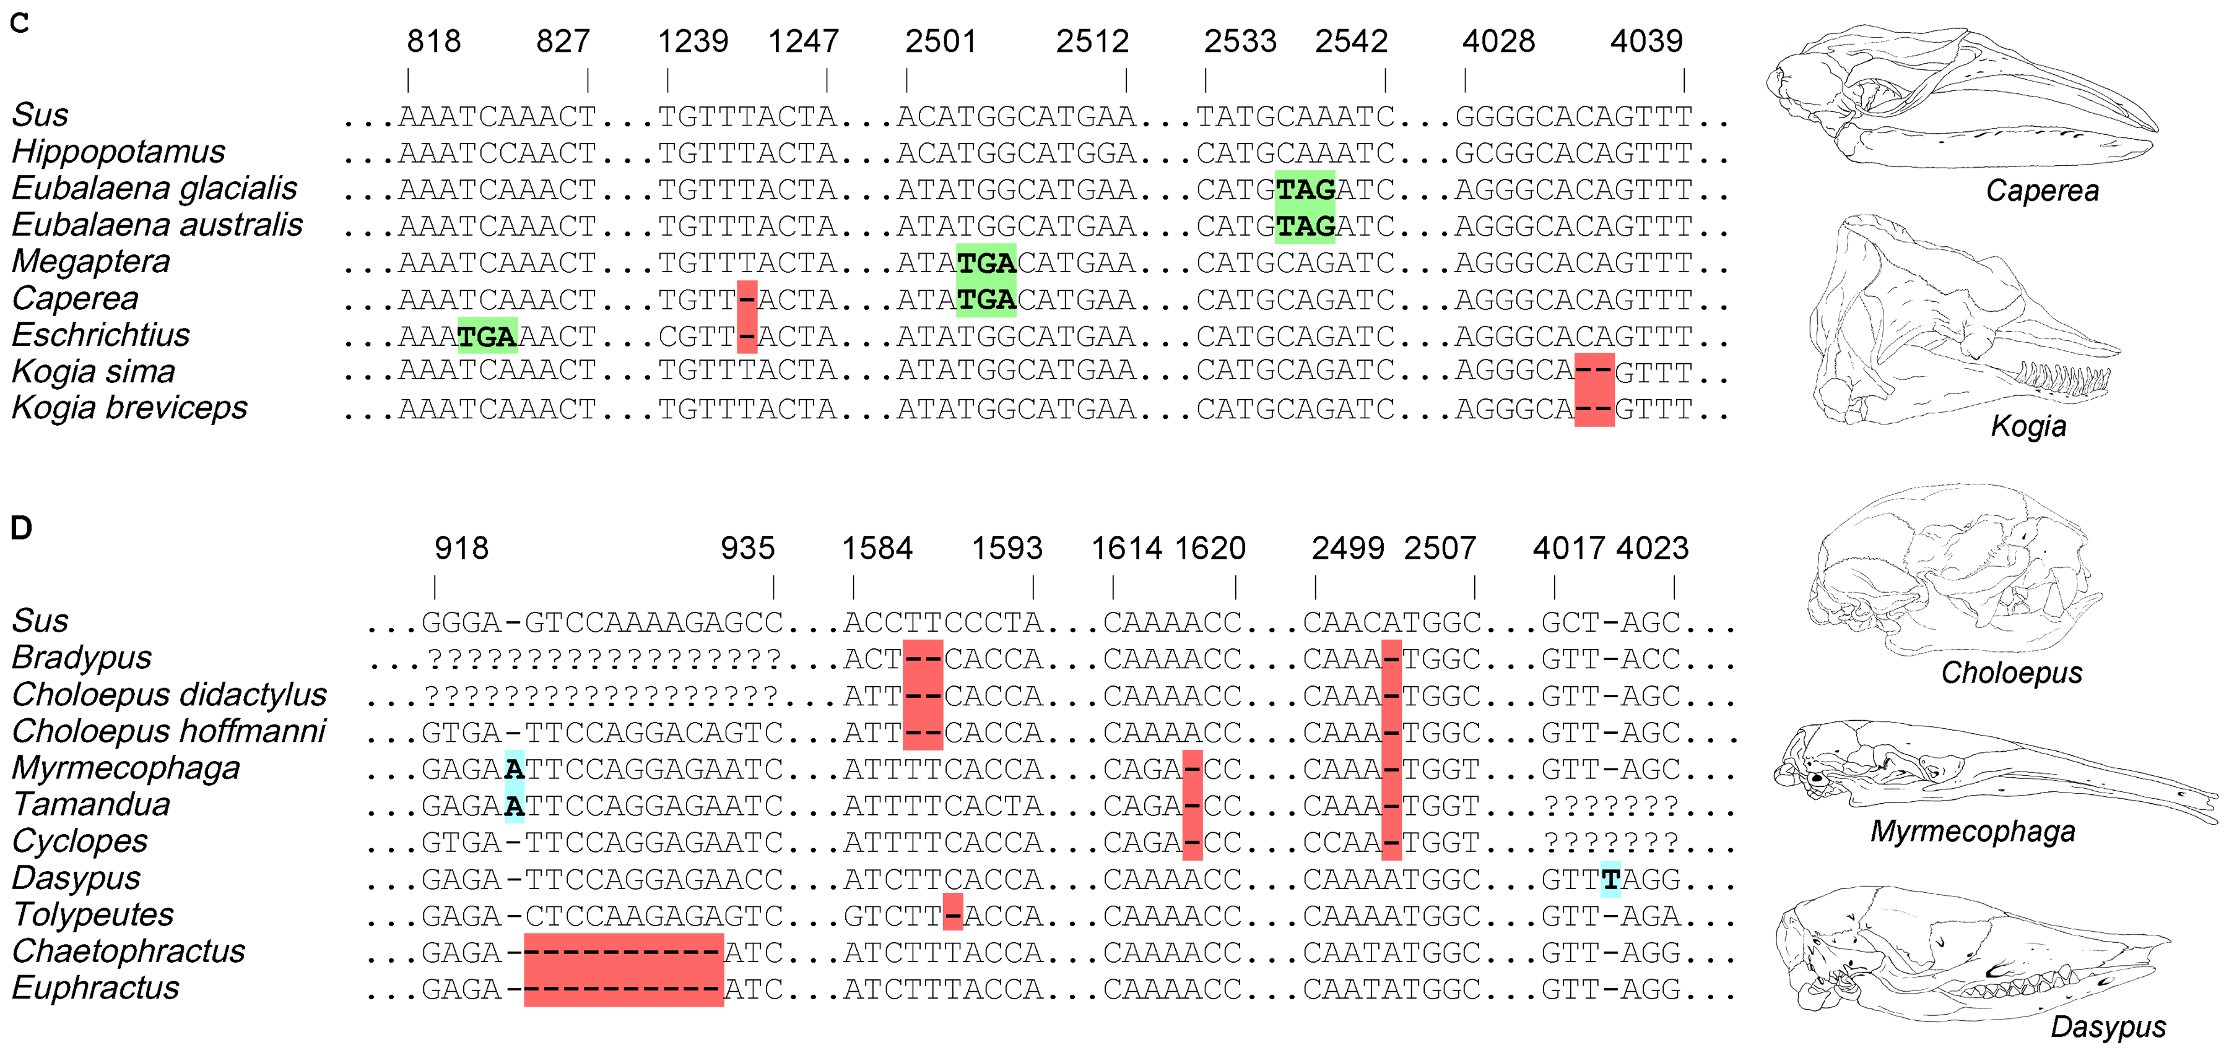
Coop, Chapter 5: Intro-5.1.3
The Population Genetics of Divergence and Molecular Substitution
The neutral substitution process

Slide 2
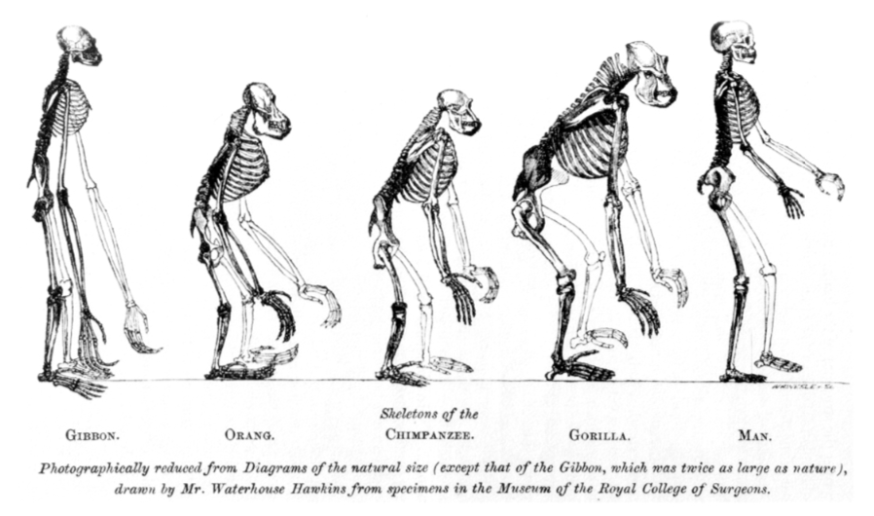
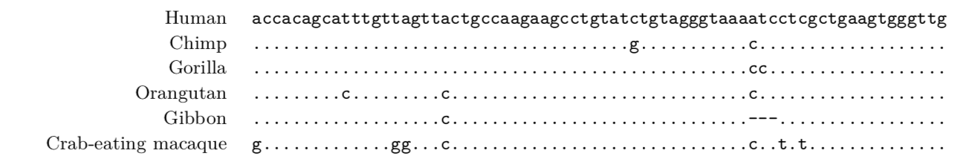
Introduction
Humans and chimpanzees, our most closely related species of the Great Apes, differ consistently (have substitutions) at only 1% of loci across the genome
These changes have arisen through mutation over the last 7 million years
Unique patterns of substitution can be observed across the Great Ape species
Each of these mutations arose as a single mutation within a population, rose in frequency, and fixed

Slide 3
Introduction
What Evolutionary forces drove this process?
Many of these changes were due to adaptive substitutions, new mutations that conferred greater fitness
Many more, however occurred in non-coding DNA and are likely neutral
One major goal in Molecular Evolution is to find the loci that are under constraint or that underlie adaptation on a particular lineage
Expectations under neutrality are a good place to start in working toward this goal

Slide 4
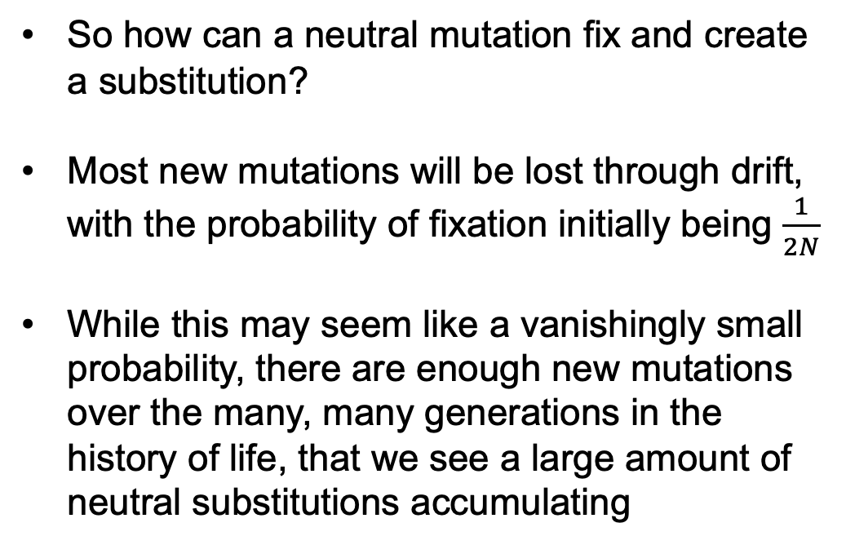
5.1 The Neutral Substitution Process
So how can a neutral mutation fix and create a substitution?
Most new mutations will be lost through drift, with the probability of fixation initially being $\frac{1}{2N}$
While this may seem like a vanishingly small probability, there are enough new mutations over the many, many generations in the history of life, that we see a large amount of neutral substitutions accumulating

Slide 5
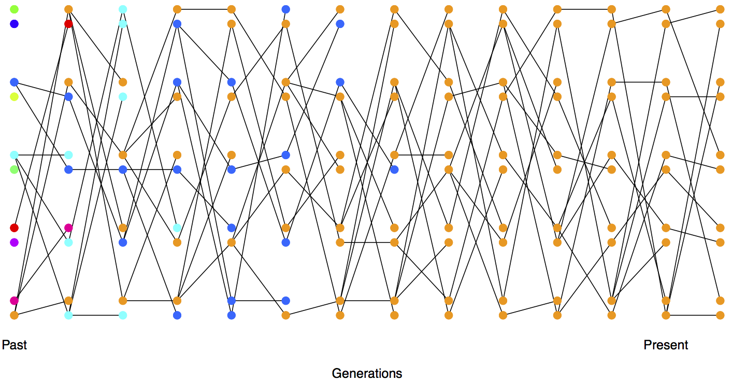
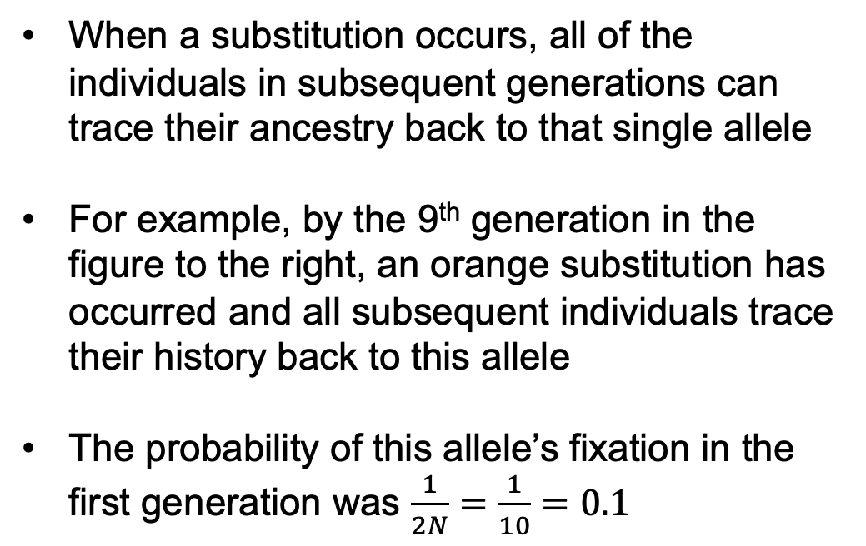
5.1.1 Probability of the eventual fixation of a neutral allele
When a substitution occurs, all of the individuals in subsequent generations can trace their ancestry back to that single allele
For example, by the 9th generation in the figure to the right, an orange substitution has occurred and all subsequent individuals trace their history back to this allele
The probability of this allele’s fixation in the first generation was $\frac{1}{2N}=\frac{1}{10}=0.1$

Slide 6
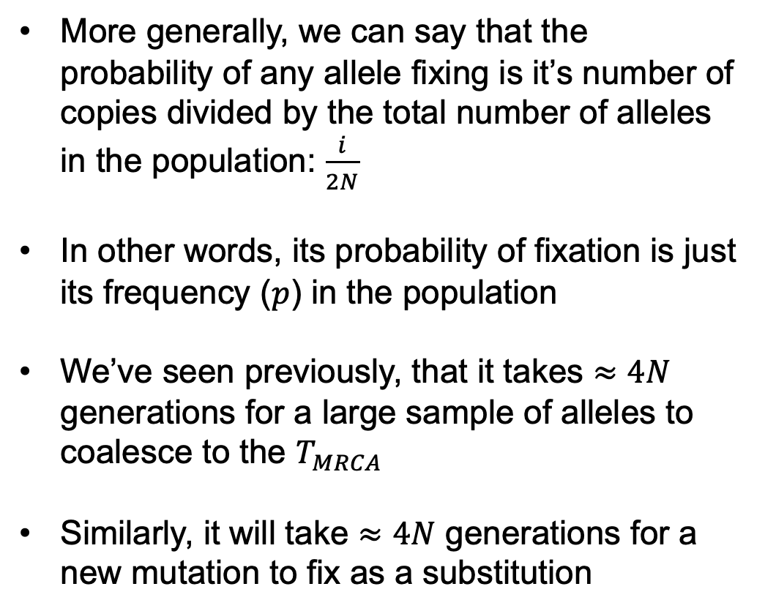
5.1.1 Probability of the eventual fixation of a neutral allele
More generally, we can say that the probability of any allele fixing is it’s number of copies divided by the total number of alleles in the population: $\frac{i}{2N}$
In other words, its probability of fixation is just its frequency ($p$) in the population
We’ve seen previously, that it takes $≈4N$ generations for a large sample of alleles to coalesce to the $T_{MRCA}$
Similarly, it will take $≈4N$ generations for a new mutation to fix as a substitution

Slide 7

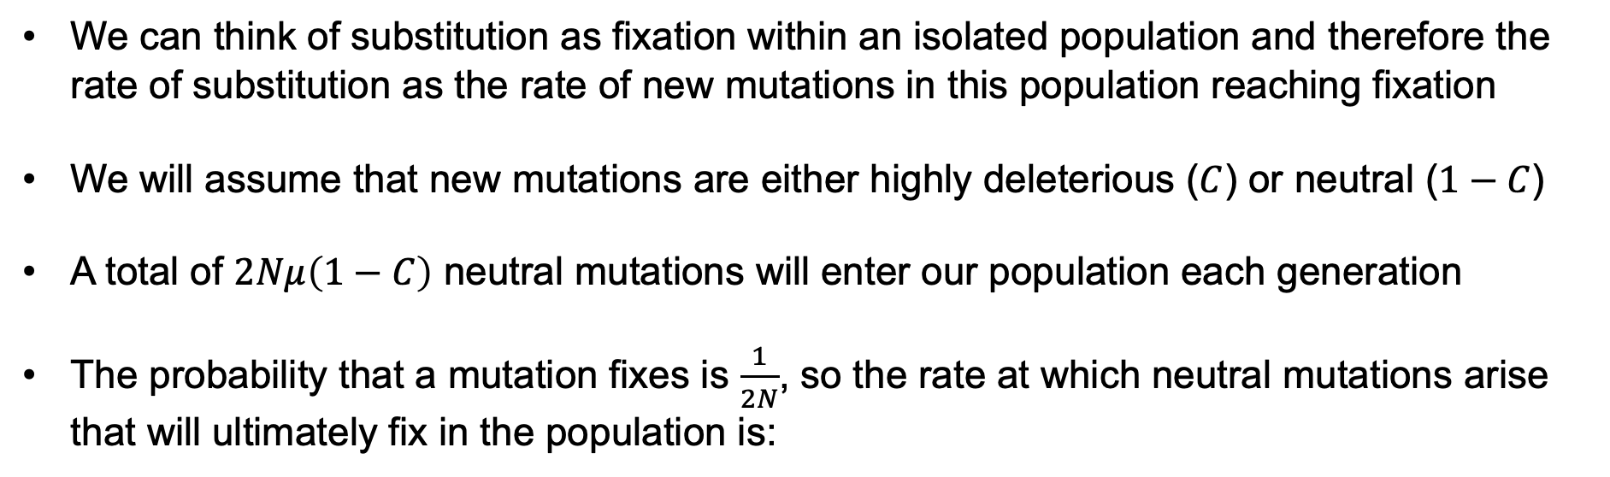
5.1.2 Rate of substitution of neutral alleles
We can think of substitution as fixation within an isolated population and therefore the rate of substitution as the rate of new mutations in this population reaching fixation
We will assume that new mutations are either highly deleterious ($C$) or neutral ($1−C$)
A total of $2Nμ\left(1−C\right)$ neutral mutations will enter our population each generation
The probability that a mutation fixes is $\frac{1}{2N}$, so the rate at which neutral mutations arise that will ultimately fix in the population is:

Slide 8

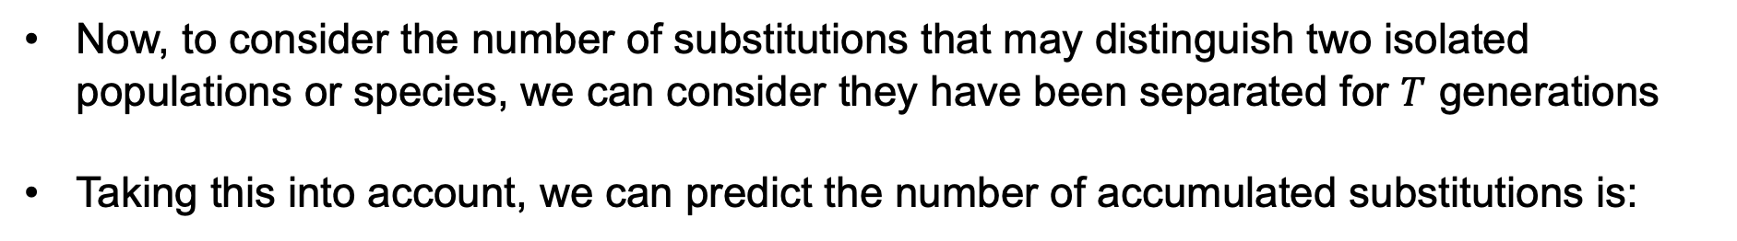
5.1.2 Rate of substitution of neutral alleles
Now, to consider the number of substitutions that may distinguish two isolated populations or species, we can consider they have been separated for $T$ generations
Taking this into account, we can predict the number of accumulated substitutions is:
Conveniently, the population size has cancelled out of the neutral substitution rate

Slide 9
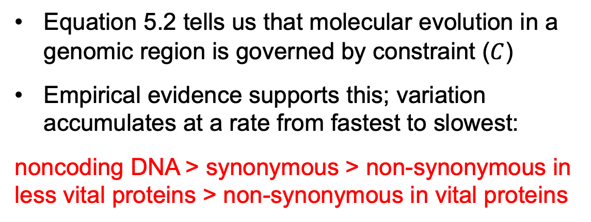
5.1.3 Implications for the Molecular Clock
Equation 5.2 tells us that molecular evolution in a genomic region is governed by constraint ($C$)
Empirical evidence supports this; variation accumulates at a rate from fastest to slowest:
noncoding DNA > synonymous > non-synonymous in less vital proteins > non-synonymous in vital proteins
For example, Fibrinopeptides are less constrained than Cytochrome c
This means that we can look at constraint across the genome, even in non-coding regions, to gauge the functional importance of a region

Slide 10
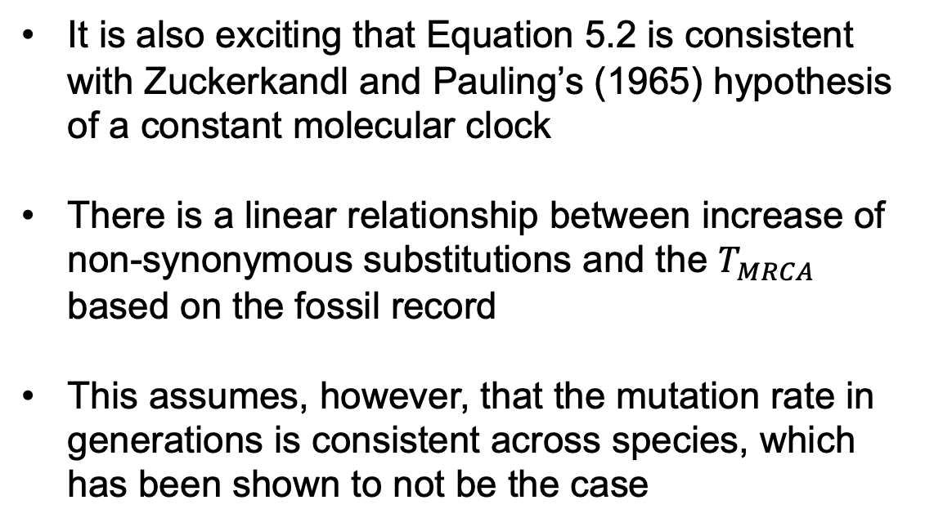
5.1.3 Implications for the Molecular Clock
It is also exciting that Equation 5.2 is consistent with Zuckerkandl and Pauling’s (1965) hypothesis of a constant molecular clock
There is a linear relationship between increase of non-synonymous substitutions and the $T_{MRCA}$ based on the fossil record
This assumes, however, that the mutation rate in generations is consistent across species, which has been shown to not be the case

Slide 11

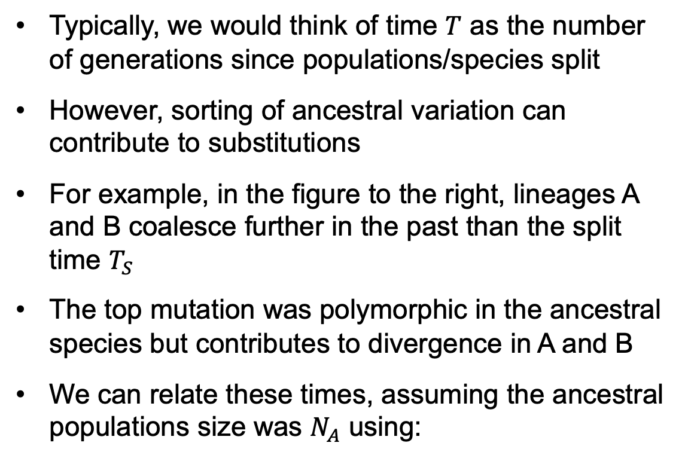
5.1.3 Implications for the Molecular Clock
Typically, we would think of time $T$ as the number of generations since populations/species split
However, sorting of ancestral variation can contribute to substitutions
For example, in the figure to the right, lineages A and B coalesce further in the past than the split time $T_{S}$
The top mutation was polymorphic in the ancestral species but contributes to divergence in A and B
We can relate these times, assuming the ancestral populations size was $N_{A}$ using:

Slide 12
Coop, Chapter 5: 5.2-5.2.1
The Population Genetics of Divergence and Molecular Substitution
Tests of Molecular Evolution

Slide 13
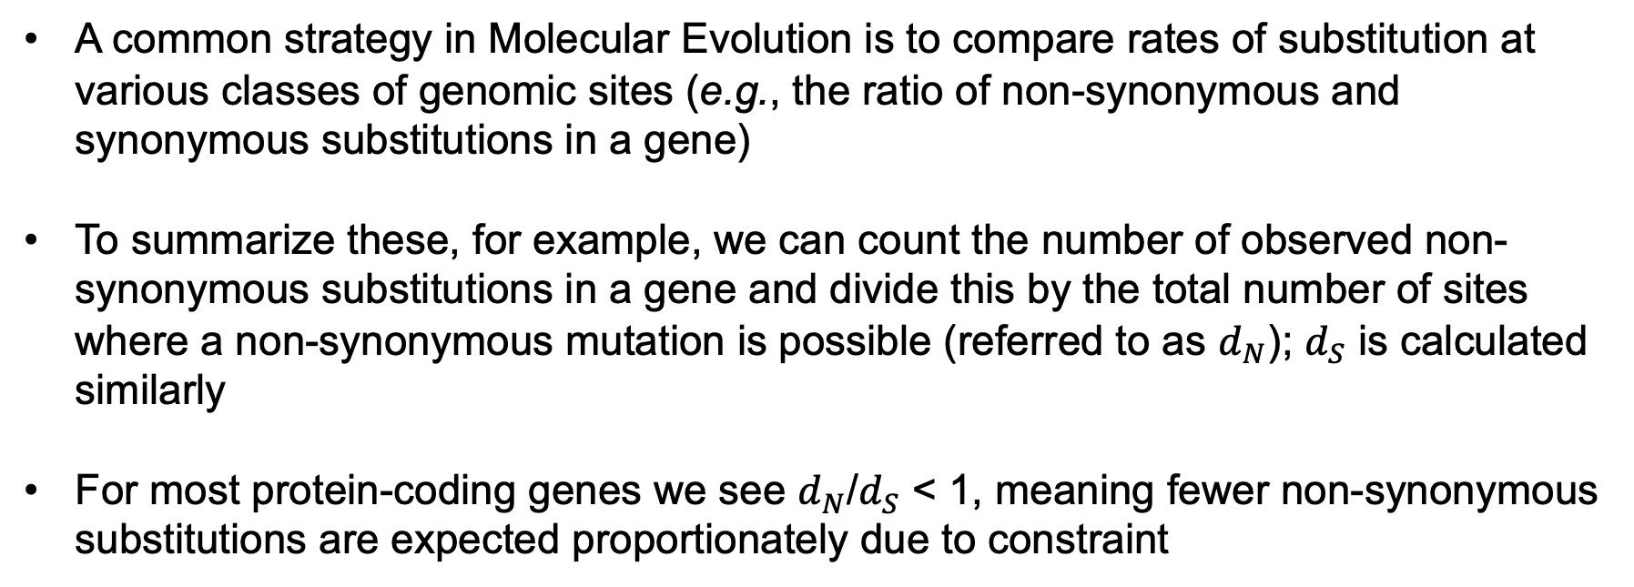
5.2.1 Rate of synonymous and non-synonymous substitutions
A common strategy in Molecular Evolution is to compare rates of substitution at various classes of genomic sites (e.g., the ratio of non-synonymous and synonymous substitutions in a gene)
To summarize these, for example, we can count the number of observed non-synonymous substitutions in a gene and divide this by the total number of sites where a non-synonymous mutation is possible (referred to as $d_{N}$); $d_{S}$ is calculated similarly
For most protein-coding genes we see $d_{N}$/$d_{S}$ < 1, meaning fewer non-synonymous substitutions are expected proportionately due to constraint

Slide 14


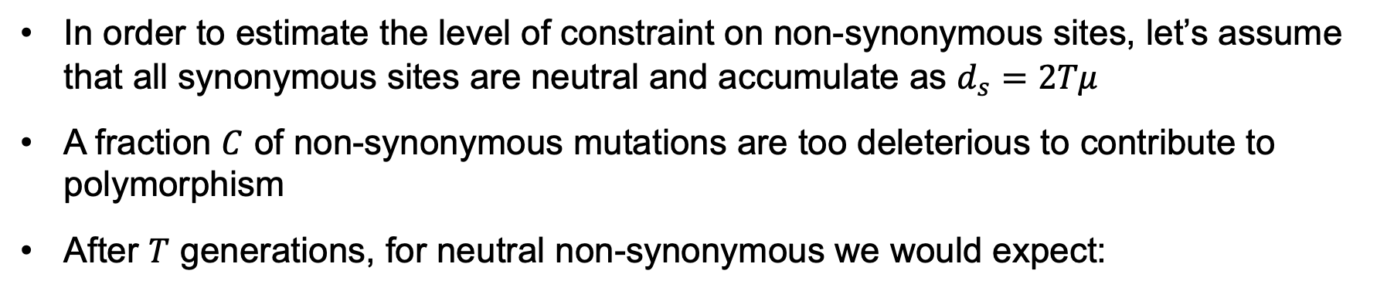
5.2.1 Rate of synonymous and non-synonymous substitutions
In order to estimate the level of constraint on non-synonymous sites, let’s assume that all synonymous sites are neutral and accumulate as $d_{s}$ $=2Tμ$
A fraction $C$ of non-synonymous mutations are too deleterious to contribute to polymorphism
After $T$ generations, for neutral non-synonymous we would expect:
Which, after dividing by $d_{S}$, gives us:
And $C=1 − d_{N}$/$d_{S}$

Slide 15
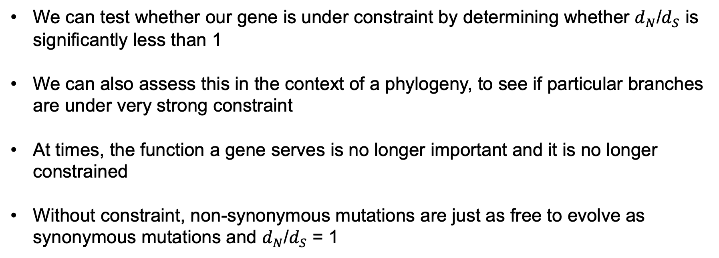
5.2.1 Rate of synonymous and non-synonymous substitutions
We can test whether our gene is under constraint by determining whether $d_{N}$/$d_{S}$ is significantly less than 1
We can also assess this in the context of a phylogeny, to see if particular branches are under very strong constraint
At times, the function a gene serves is no longer important and it is no longer constrained
Without constraint, non-synonymous mutations are just as free to evolve as synonymous mutations and $d_{N}$/$d_{S}$ = 1

Slide 16
5.2.1 Rate of synonymous and non-synonymous substitutions
The Enamlin protein is an excellent example where the underlying gene is no longer constrained in some lineages
This protein forms the enamel of teeth and certain mammals like sloths, whales, and aardvarks no longer need hard teeth because of dietary changes
They have lost their hard teeth enamel and the Enamlin gene is no longer under constraint
pseudogenizing substitutions have arisen
Insertions
Deletions
Premature Stop Codons

Slide 17
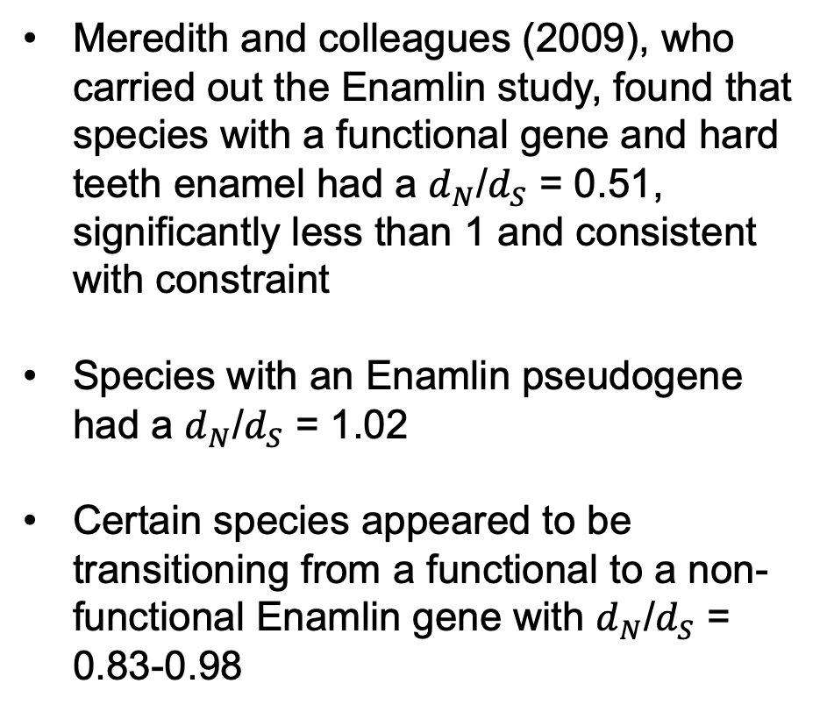
5.2.1 Rate of synonymous and non-synonymous substitutions
Meredith and colleagues (2009), who carried out the Enamlin study, found that species with a functional gene and hard teeth enamel had a $d_{N}$/$d_{S}$ = 0.51, significantly less than 1 and consistent with constraint
Species with an Enamlin pseudogene had a $d_{N}$/$d_{S}$ = 1.02
Certain species appeared to be transitioning from a functional to a non-functional Enamlin gene with $d_{N}$/$d_{S}$ = 0.83-0.98
Insertions
Deletions
Premature Stop Codons

Slide 18


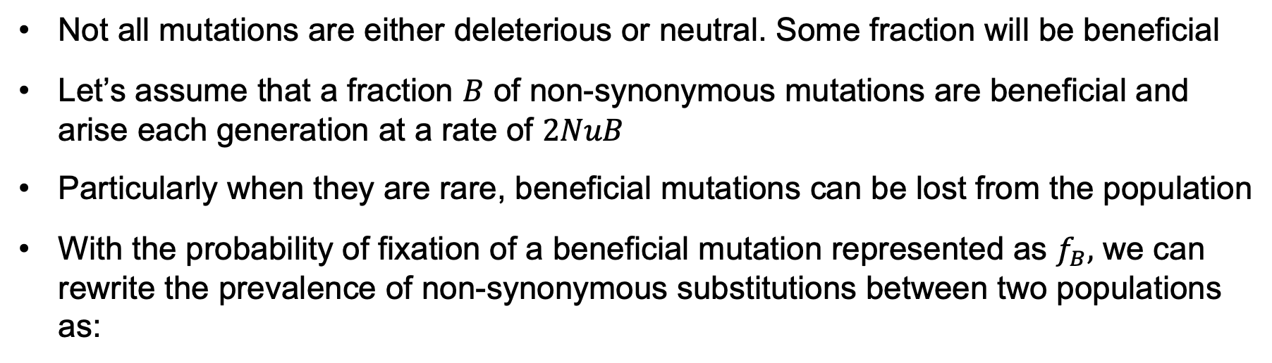
5.2.1 Rate of synonymous and non-synonymous substitutions
Not all mutations are either deleterious or neutral. Some fraction will be beneficial
Let’s assume that a fraction $B$ of non-synonymous mutations are beneficial and arise each generation at a rate of $2NuB$
Particularly when they are rare, beneficial mutations can be lost from the population
With the probability of fixation of a beneficial mutation represented as $f_{B},$ we can rewrite the prevalence of non-synonymous substitutions between two populations as:
and continuing to assume all synonymous mutations are neutral:

Slide 19
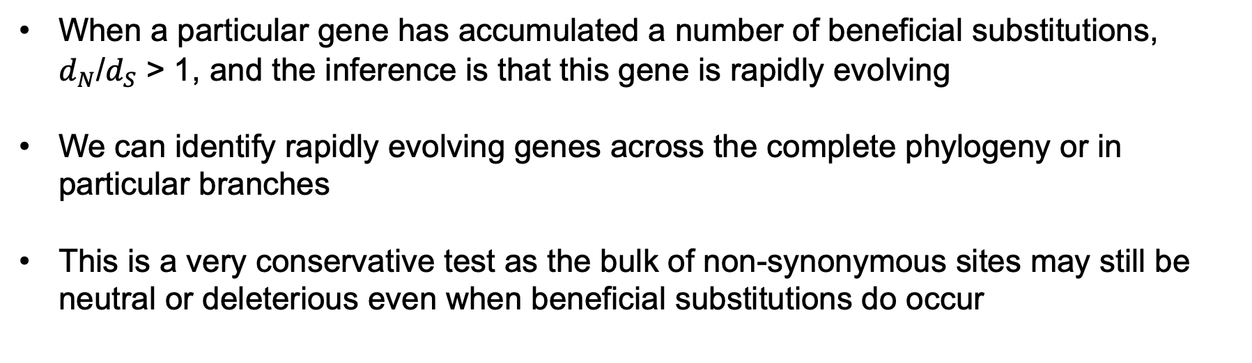
5.2.1 Rate of synonymous and non-synonymous substitutions
When a particular gene has accumulated a number of beneficial substitutions, $d_{N}$/$d_{S}$ > 1, and the inference is that this gene is rapidly evolving
We can identify rapidly evolving genes across the complete phylogeny or in particular branches
This is a very conservative test as the bulk of non-synonymous sites may still be neutral or deleterious even when beneficial substitutions do occur

Slide 20
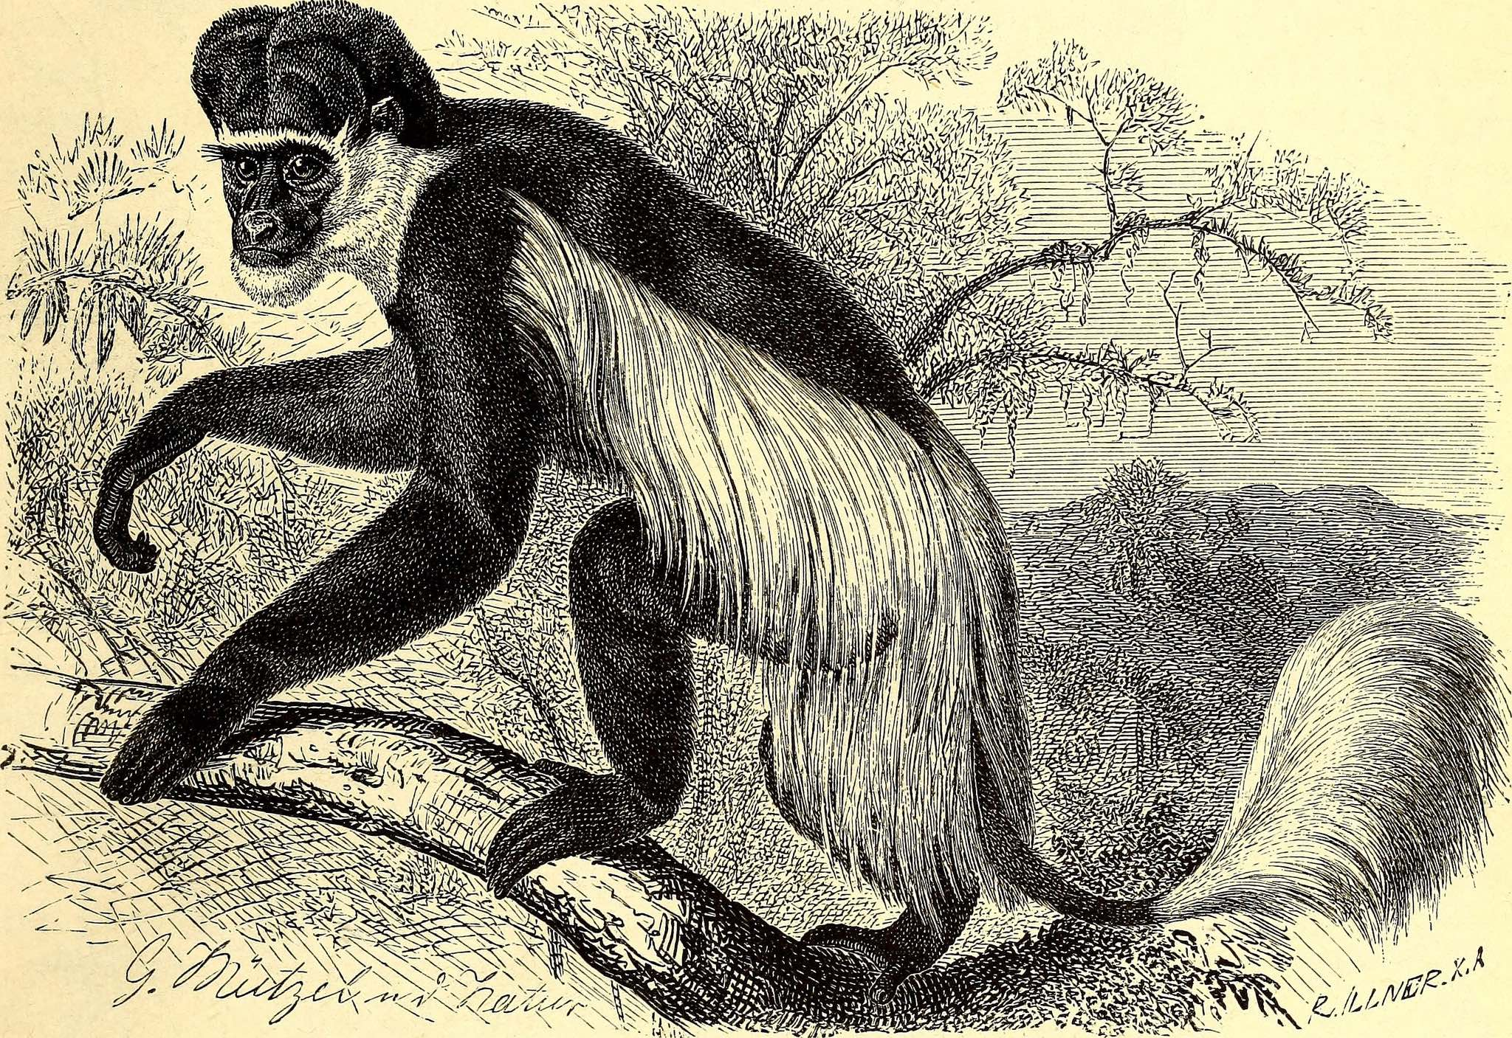
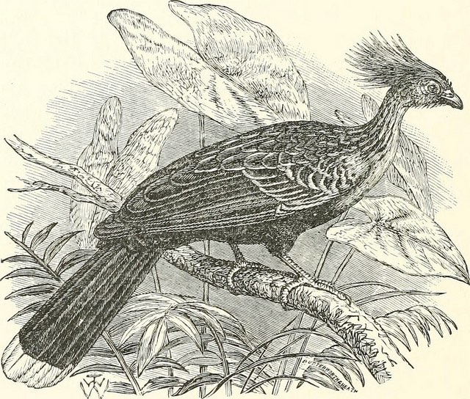
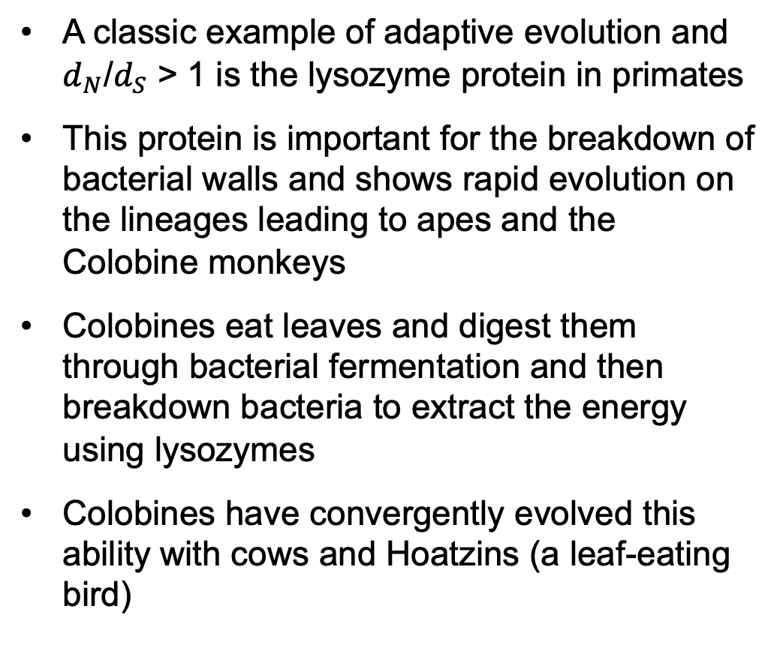
5.2.1 Rate of synonymous and non-synonymous substitutions
A classic example of adaptive evolution and $d_{N}$/$d_{S}$ > 1 is the lysozyme protein in primates
This protein is important for the breakdown of bacterial walls and shows rapid evolution on the lineages leading to apes and the Colobine monkeys
Colobines eat leaves and digest them through bacterial fermentation and then breakdown bacteria to extract the energy using lysozymes
Colobines have convergently evolved this ability with cows and Hoatzins (a leaf-eating bird)

Slide 21
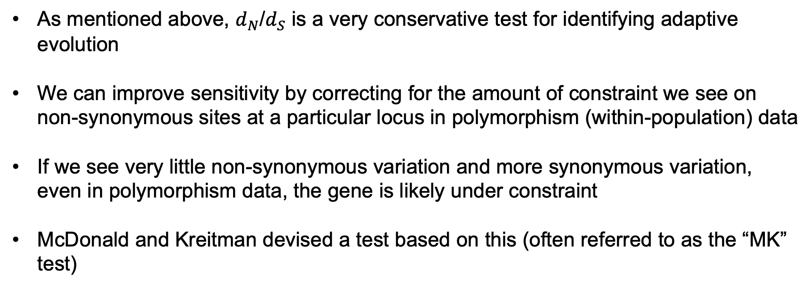
5.2.1 Rate of synonymous and non-synonymous substitutions
As mentioned above, $d_{N}$/$d_{S}$ is a very conservative test for identifying adaptive evolution
We can improve sensitivity by correcting for the amount of constraint we see on non-synonymous sites at a particular locus in polymorphism (within-population) data
If we see very little non-synonymous variation and more synonymous variation, even in polymorphism data, the gene is likely under constraint
McDonald and Kreitman devised a test based on this (often referred to as the “MK” test)

Slide 22
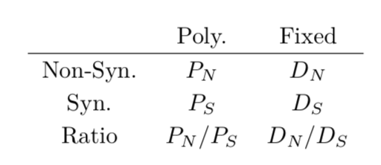
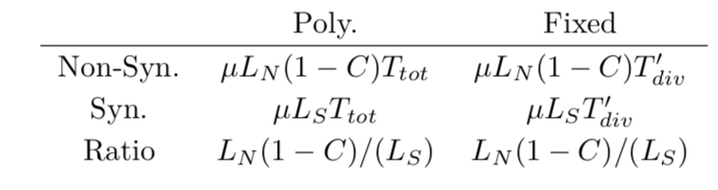
5.2.1 Rate of synonymous and non-synonymous substitutions
The MK test partitions polymorphism and substitution data into non-synonymous and synonymous sites:
Polymorphism
Substitution
Given the phylogeny to the right, our expectations for polymorphism and substitutions become:

Slide 23
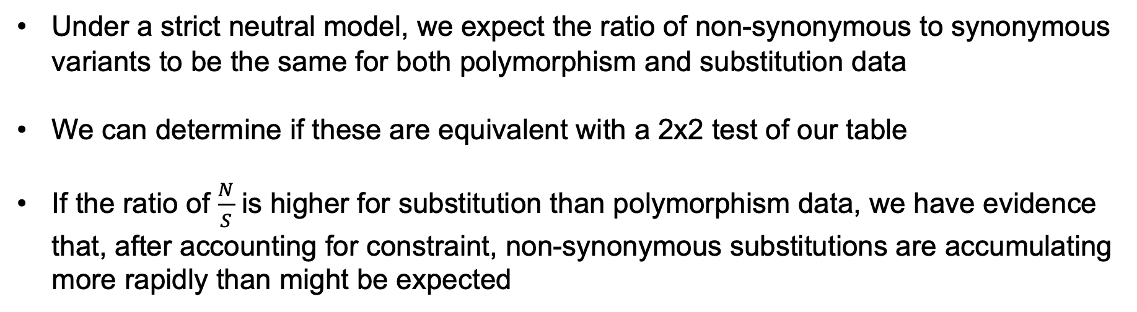
5.2.1 Rate of synonymous and non-synonymous substitutions
Under a strict neutral model, we expect the ratio of non-synonymous to synonymous variants to be the same for both polymorphism and substitution data
We can determine if these are equivalent with a 2x2 test of our table
If the ratio of $\frac{N}{S}$ is higher for substitution than polymorphism data, we have evidence that, after accounting for constraint, non-synonymous substitutions are accumulating more rapidly than might be expected

Slide 24
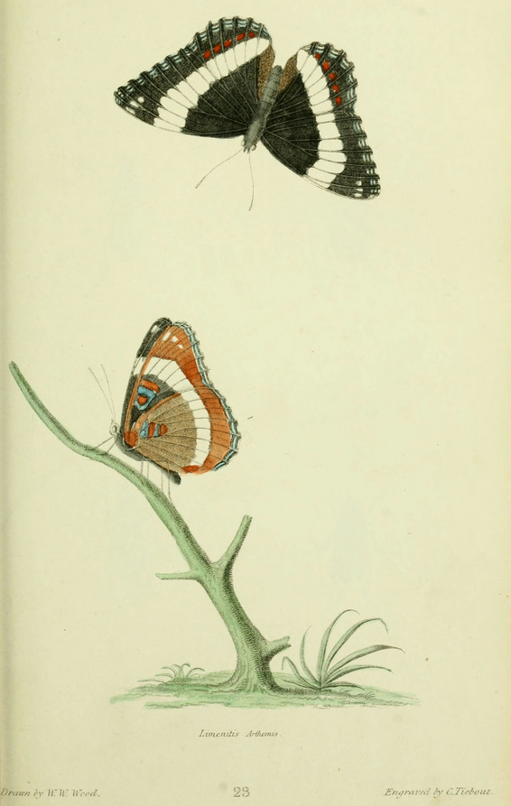
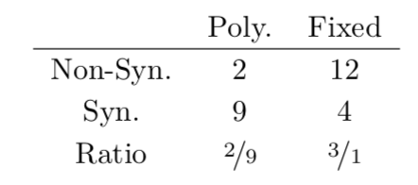
5.2.1 Rate of synonymous and non-synonymous substitutions
As an application of the MK test, Frentiu and colleagues (2007) looked at evolution of opsin genes, responsible for color vision, in two butterfly species
Adaptive substitutions relative to polymorphism constraint was assessed in an MK test:
There is a strong excess of non-synonymous substitutions

