Slide 1
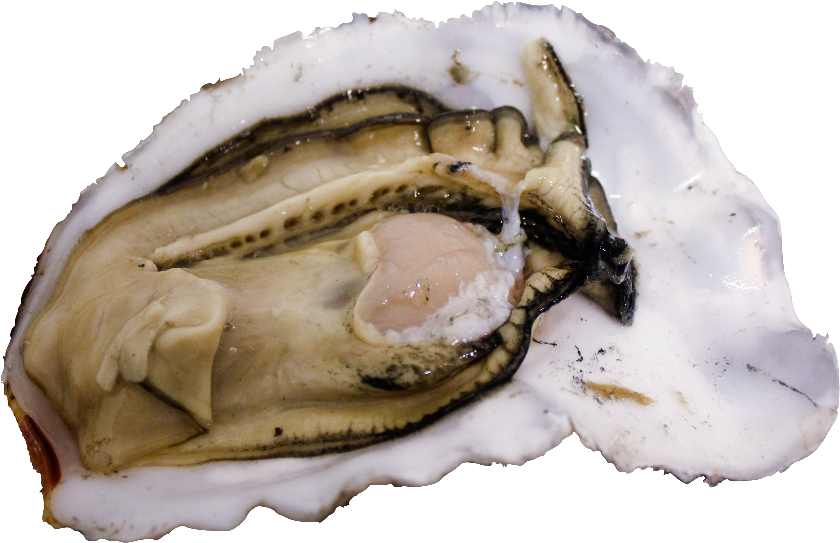

Oysters, Ocean Acidification,
and -Omics
Yaamini R. Venkataraman, Ph.D Candidate
Roberts Lab, University of Washington School of Aquatic and Fishery Sciences
yaaminiv@uw.edu
@YaaminiV
Notes:
LAND ACKNOWLEDGEMENT: Work at UW, Suquamish, Tulalip, Muckleshoot, and Duwamish nations.
The reason why I chose my title: accurately describes my work, fun alliteration
All 3 are interconnected, will show you this today.

Slide 2
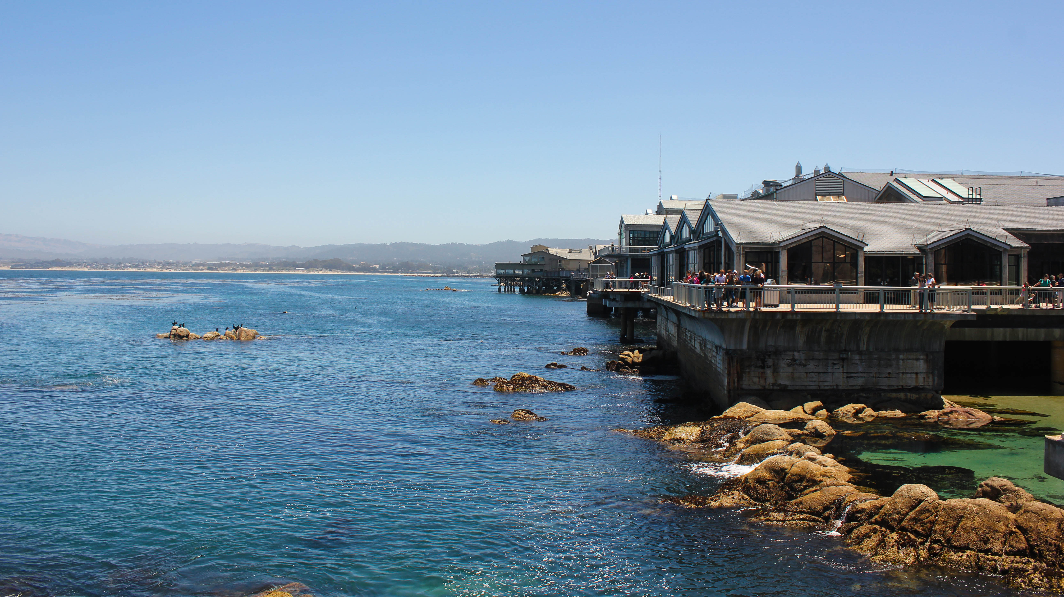

Slide 3



“why don’t you care about people?”
“you should become a doctor.”

Slide 4


Slide 5
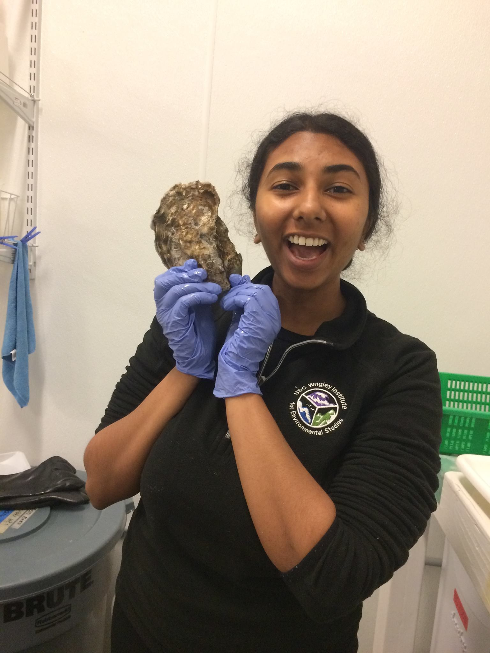
NAILED IT.

Slide 6
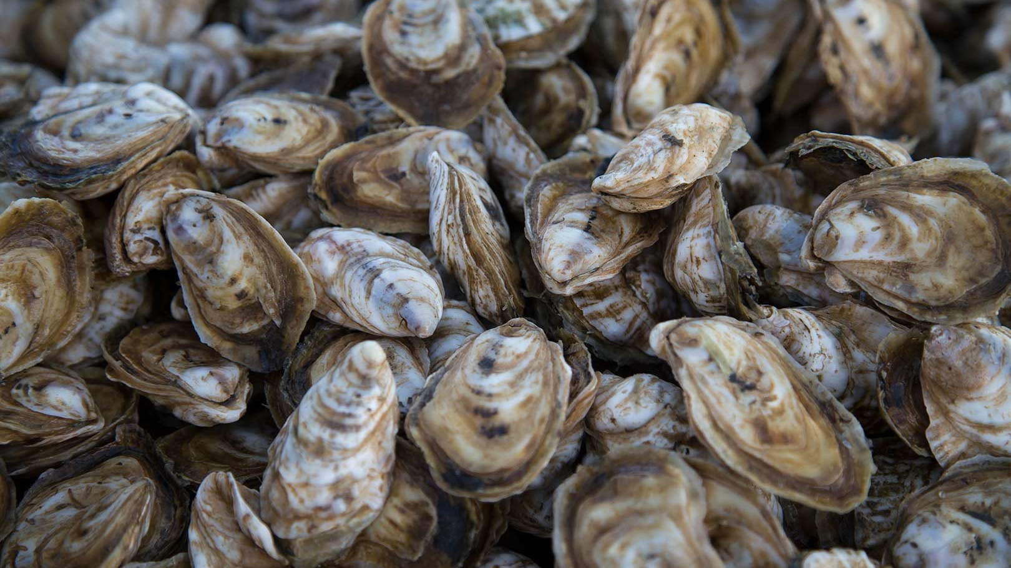
Notes:
Living in an era of rapid environmental change. In Washington and the Pacific Northwest, our canary in a coal mine was oysters in a hatchery. In 2012, shellfish scientists and hatchery operators learned that upwelled waters brought into the hatchery were naturally acidic and affecting oyster growth. Since then OA, has been a focus of hatchery adaptation strategies, policy councils, and researchers.

Slide 7
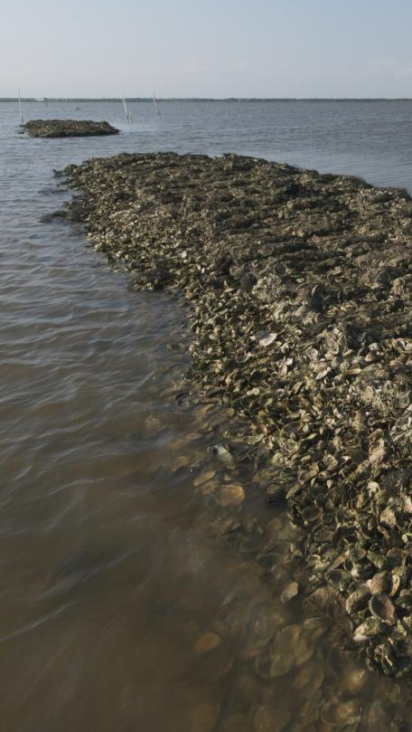
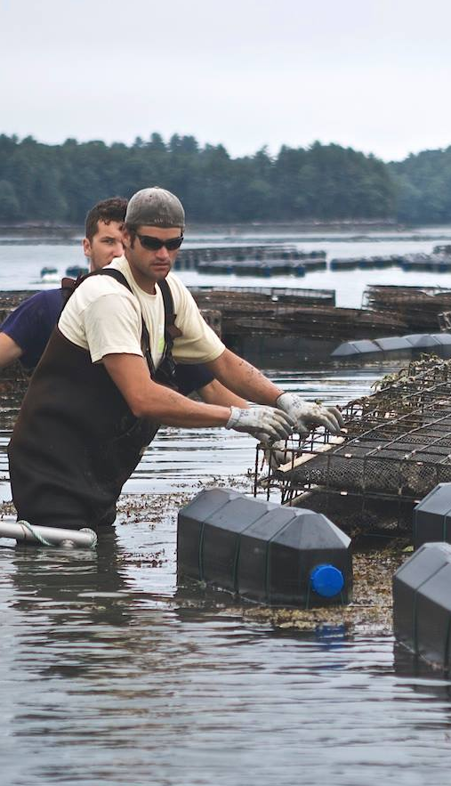
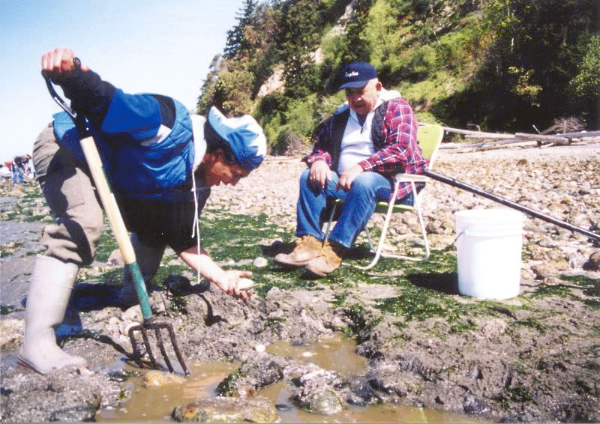
Ecological
Economic
Social
Notes:
Oysters are what we call ecosystem engineers. When they’re out in bays or along the seashore, they clump on top of eachother, forming oyster reefs. These reefs protect our shorelines from crumbling away in stormy weather. Oyster filter feeding also improves water clarity, which can increase the amount of light that penetrates the water and promote growth of eelgrass beds or other aquatic vegetation.
In 2013 Washington state shellfish farms owed over 1/3 of its profits — more than 25 million dollars — to oysters. In some coastal counties, shellfish hatcheries and farms are the number one employer.
Finally, when we think about shellfish broadly, there’s a social importance. Especially tribal communities, there are customs around harvesting and consuming these traditional food resources.

Slide 8
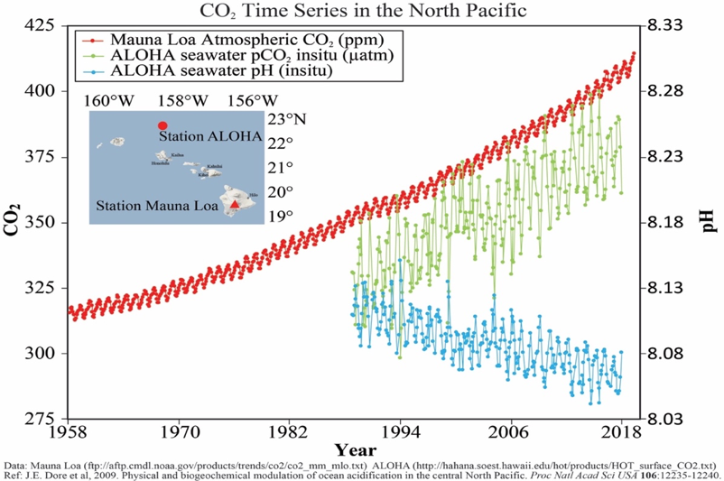
Atmospheric CO₂
Absorbed CO₂
Ocean pH
0.1 unit decrease
Dore et al. 2009
Notes:
Dore et al 2009
Scientists have monitored atmospheric and oceanic carbon dioxide concentrations at the Mauna Loa Observatory in Hawaii
25% more acidic since the Industrial Revolution, these changes are often exacerbated in coastal or estuarine regions like Puget Sound

Slide 9
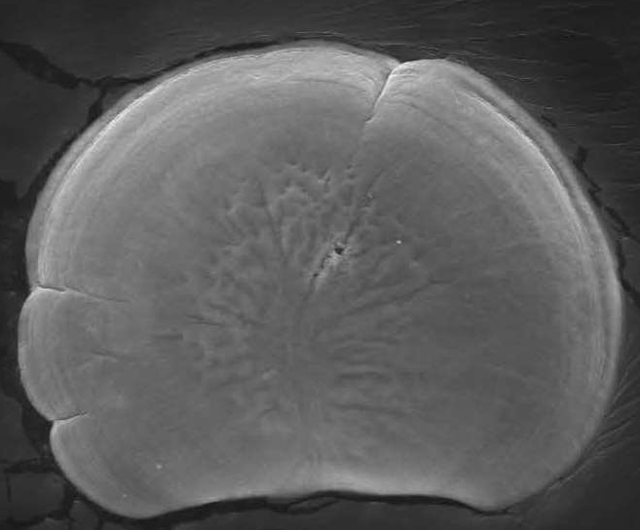
Changes to reproduction
Fertilized egg
Developmental delays
Parker et al. 2010; Boulais et al. 2018
Kurihara et al. 2007; Barton et al. 2012; Timmins-Schiffman et al. 2012
Larvae
Adult
Reduced calcification
Lower energy production
Gazeau et al. 2007; Timmins-Schiffman et al. 2014
Spat
Dineshram et al. 2016
Notes:
What do these changes mean for oysters? As oysters, like many marine invertebrates, have a complex life cycle with many different phases, I like to think about the impacts that oysters may face at each of these stages.
Developmental delays in larvae: Larvae: developmental delays, reduced shell growth
Oysters undergo metamorphosis where they transition from pelagic larvae to benthic spat, or oyster seed. During this process exposure to low pH or high pCO2 conditions can reduce energy production, making the metamorphosis process more difficult.
Shell-building difficulties and metabolic changes can progress into adulthood, and predator-prey interactions can also be affected.
Maybe you survive and grow just fine, but ocean acidification prevents you from getting it on. Again, oysters have a limited amount of energy that they have to budget out. If they’re spending too much of that budget coping with stressors, there’s not nearly enough energy left for them to develop enough sperm or eggs effectively. Changes to gamete development can lead to varied fertilization success.
There’s still so much we don’t know.

Slide 10
Leveraging –omics allows us to understand processes that we would not be able to otherwise.
Notes:
For my dissertation, I leverage –omics techniques to understand how oysters respond to ocean acidification. Using these molecular methods helps me untangle what is sometimes a complicated web of acidification effects on oysters, and understand processes we would not be able to otherwise. If there’s one thing you take away from today, it’s this! I’ll show you how I do this in my own work.

Slide 11
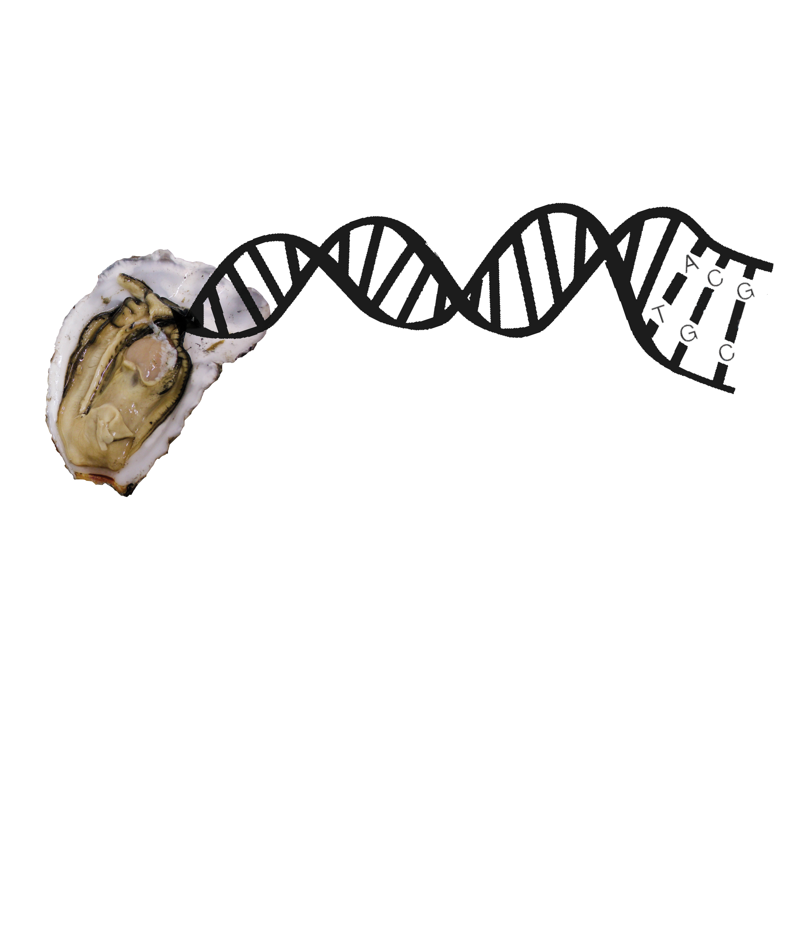
DNA
RNA
Proteins
Notes:
What is omics? We start with DNA. DNA is akin to the cookbook that holds the recipes for life. The recipes, or genes, are transcribed into a different molecule, RNA, then translated into proteins. Proteins are the “do-ers” of the cell, and are responsible for basically everything that happens within an organism. We’ll start today with proteomics, or the study of all proteins in an organism and their function.

Slide 12
Do natural pH gradients drive differential protein abundance?
Venkataraman et al. 2019. Mar Ecol Prog Ser

Slide 13
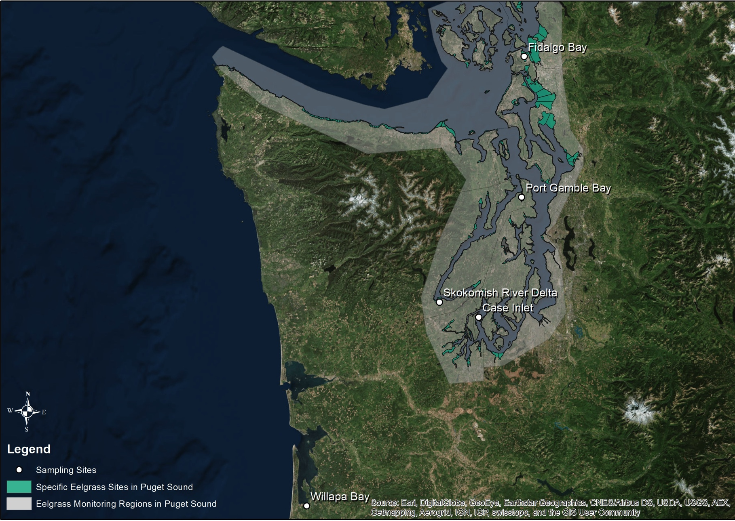
Hypothesis: Local environmental variability and eelgrass will drive different physiological responses
150 sibling Pacific oysters (Crassostrea gigas) outplanted June 2016
5 sites and 2 habitats
Continuous pH, DO, salinity, temperature monitoring
Collect ctenidia after one month
Notes:
Collab with DNR and UW Biology

Slide 14
Shotgun Proteomics: Discovery
Selected Reaction Monitoring: Targeted
Notes:
We can examine protein expression with two separate mass spectrometry methods: shotgun proteomics and selected reaction monitoring. Shotgun proteomics is a discovery phase. It allows us to answer the question: what proteins are there? It provides us with a panorama picture. We can then use our shotgun proteomics results to inform a second method, selected reaction monitoring, or targeted analysis. This method allows us to zoom in to what we're actually interested, like specific environmental response proteins and how their expression varies.

Slide 15
Peptide abundances different in Willapa Bay
Six proteins with increased abundance
Warmer, less variable temperatures influenced abundance
Notes:
PROTEIN DATA:
-hellinger transformation to give low weights to any peptides with low counts
-NMDS to compare peptide abundances
-1-way ANOSIM by site, region, and habitat
-2-way ANOSIM by site and habitat
-pairwise ANOSIM tests and post-hoc SIMPER analyses for each sig ANOSIM results
-protein abundance data sig between WB and SK (p < .10) and FB (p < 0.03)
-first 10 simper entries deemed influential for each significant comparison (WB and FB)
RDA:
-importance of env variables for explaining peptide abundances
-mean and variance env conditions for the duration of each outplant
-used as predictors to constrain peptide abundance (missing values not included)
-ANOVA used to calculate sig of RDA and env variables
-second RDA conducted using env conditions on the day of collection
-temperature mean and variance sig (< .10)
ENV DATA:
-mean and variance for each day
-gower’s distance matrix
-1-way ANOSIM for each env parameter (couldn’t do add comparisons due to low replicates)
-temperature mean by site significant
-all variables significant for variance by site

Slide 16
Proteomic response to natural pH gradients:
Significance
Antioxidant enzymes: peroxiredoxin-5, catalase, NAD(P) transhydrogenase, carbonic anhydrase, glucose-6-phosphate-1-dehyrdogenase
  Direct response to reactive oxygen species (ROS)
  Acid-base regulation of hemolymph pH
  Maintenance of metabolic activity
Molecular chaperones: protein disulfide-isomerase 1 and protein disulfide-isomerase 2
  Generalist response to conditions at WB
  Reflects a need to refold misshapen proteins, characterized in immunological studies
Notes:
PRX, CAT scavenge for ROS, NADPt maintains redox state
G6PD: catalyzes the oxidative portion of the pentose phosphate pathway, and products from this pathway are often precursors for nucleic and aromatic amino acids
WB oysters also had lower total fatty acid content when compared to oysters outplanted at PS locations, indicative of less access to food (less food availability or less time with valves open for filtration) or poorer quality food (Lowe et al. in prep)
Stress assays

Slide 17
Fertilized egg
Larvae
?
Adult
Spat
Notes:
Can exposure in one generation affect another?

Slide 18
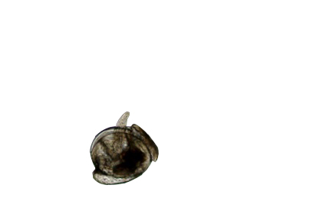
Higher survival
Bigger larvae
Fast-growing
Lower survival
Smaller larvae
Slow-growing
+
-
Parker et al. 2012, 2015, 2017
Griffith and Gobler 2017
Notes:
Parental exposure can be helpful or harmful
Helpful parental exposure to low pH or high pCO2 can lead to positive carryover effects. When adult Sydney rock oysters were exposed to high pCO2 conditions, resulting larvae were faster growing in the same pCO2 conditions than larvae from parents without that prior exposure (Parker et al. 2012, 2015, 2017).
Harmful parental exposure leads to negative carryover effects. Larvae from adult Atlantic hard clams (Mercenaria mercenaria) and bay scallops (Argopecten irradians) developed slower when parents were reproductively conditioned in low pH conditions (pH_{T} = 7.4) (Griffith and Gobler 2017).
Understanding how and why these carryover effects occur is crucial. Growers need to know how broodstock experience can affect next year’s larvae, and resource managers can apply this understanding to natural populations.
We’re already feeling the impact of OA in the PNW. Shellfish industries here have lost $110 million. These are people’s livelihoods and food systems.

Slide 19
How does ocean acidification affect multiple generations of Pacific oysters?
Venkataraman et al. 2019. J Shellfish Res
Notes:
Question I sought to answer

Slide 20
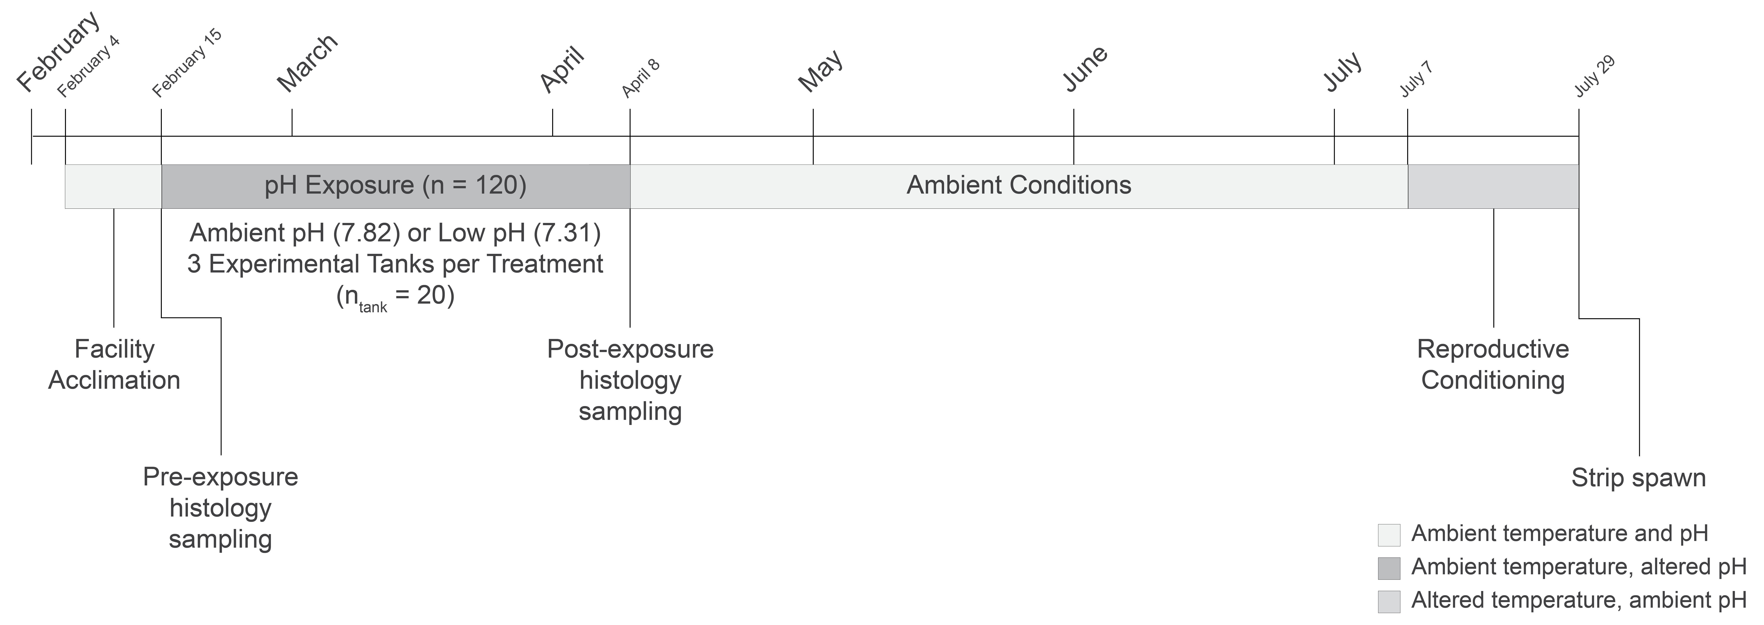
Hypothesis: Low pH conditions experienced four months before spawning will affect larval performance

Slide 21
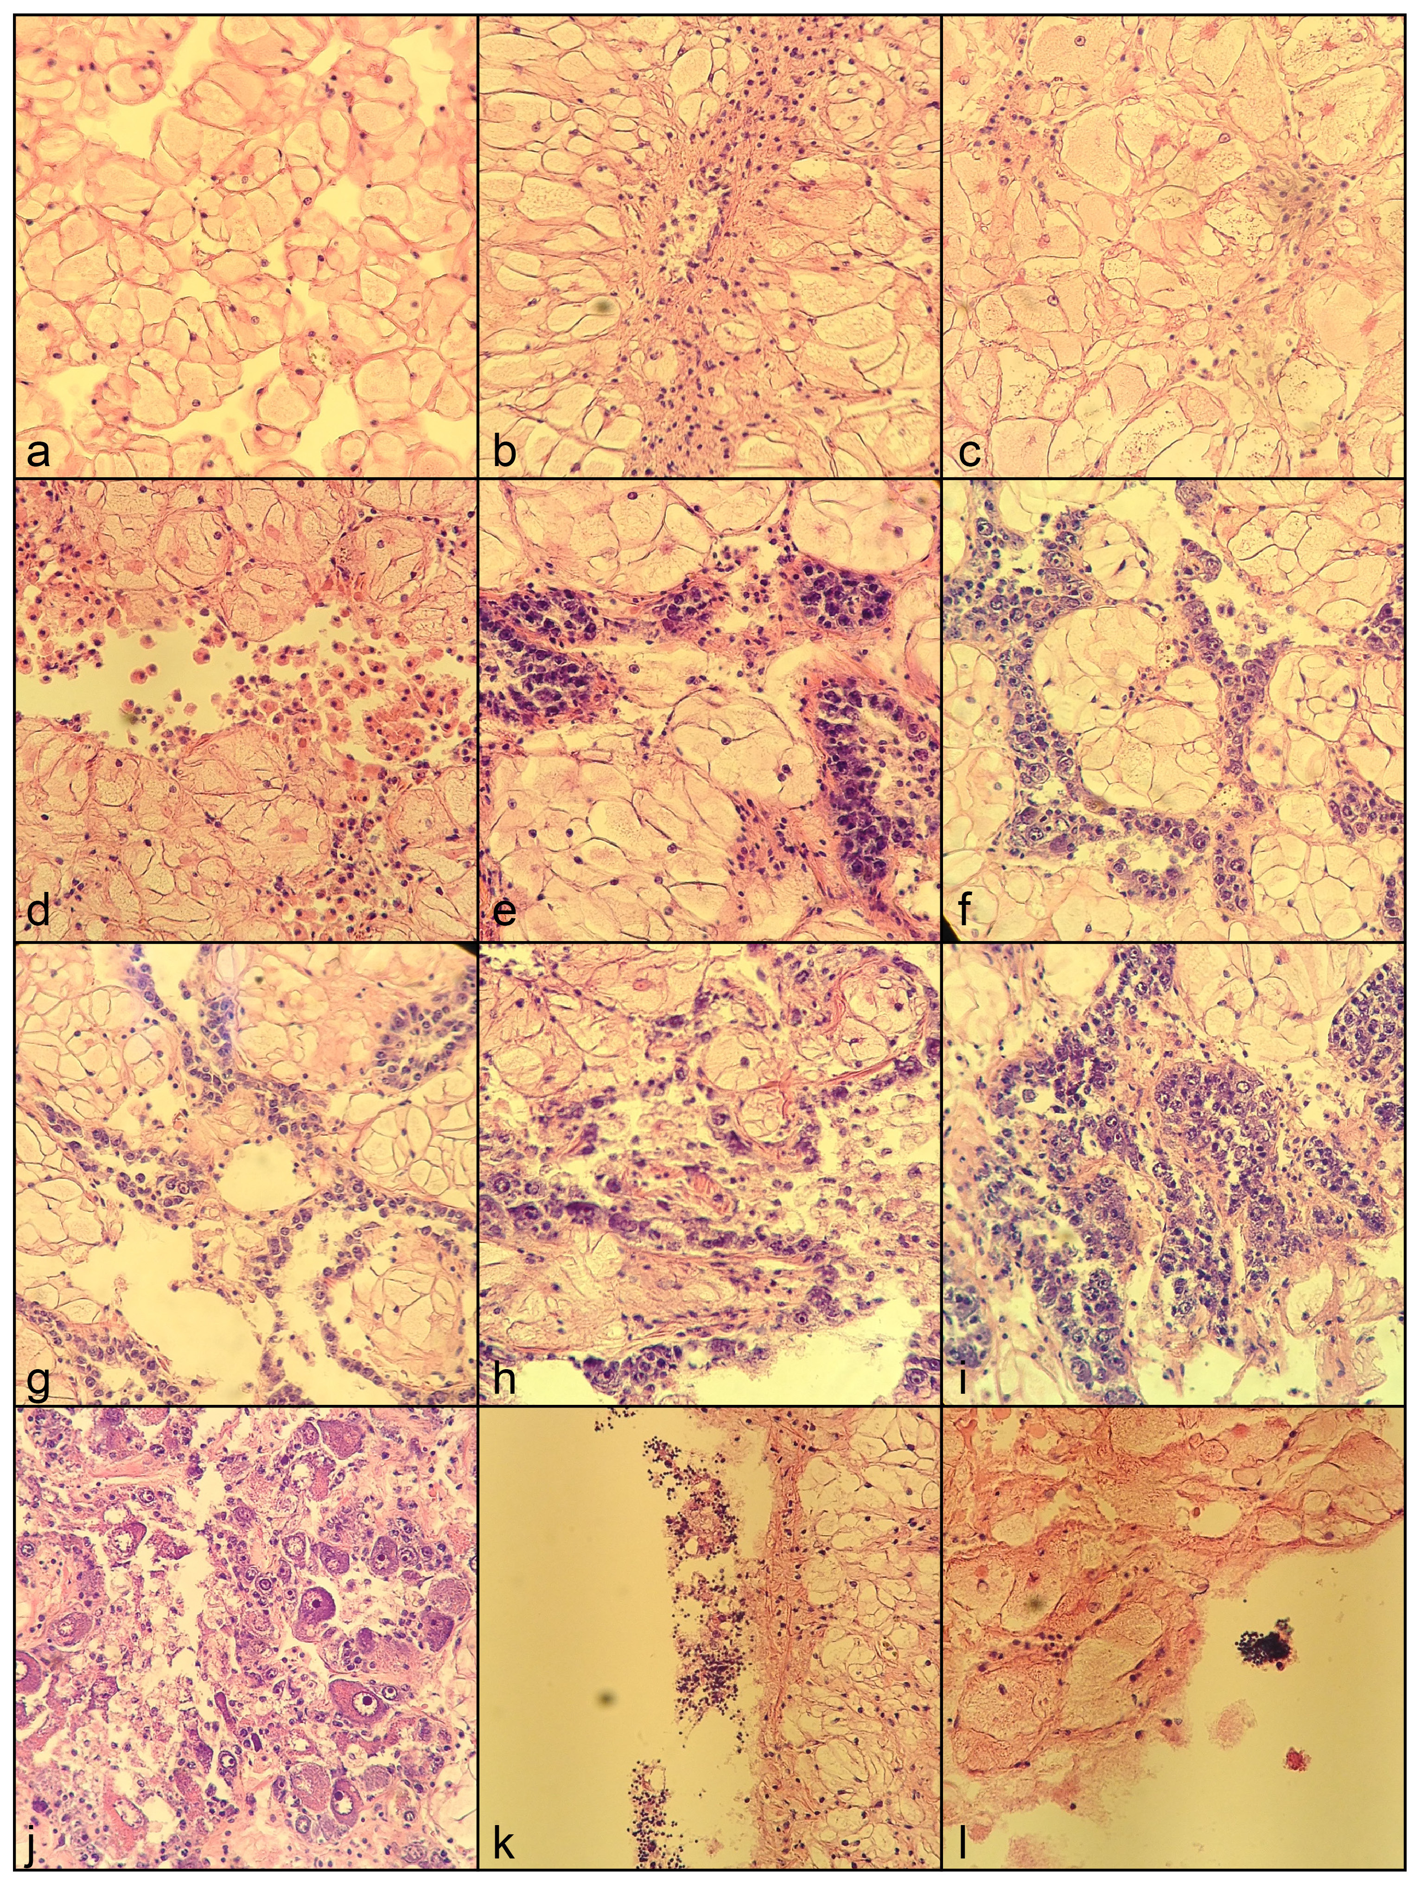
Pacific oyster carryover effects
Stage 0
Stage 1M
Stage 1F
Maturation status not significantly different before or after pH exposure (p = 0.3442) or between pH treatments (p = 0.1408)
Sex ratio was similar between pH treatments (p = 0.1942)
Stage 1F
Stage 2F
Stage 2F
Stage 4M
Notes:
Maturation status: binomial GLM
Sex ratio: chi-squared
a. Stage 0 individual from pre-treatment sampling. Individuals at this stage have a complete lack of sexuality.
b. Stage 0 individual from low pH post-treatment sampling. Individuals at this stage have a complete lack of sexuality.
C. Stage 0 individual from ambient pH pre-treatment sampling. Individuals at this stage have a complete lack of sexuality.
d. Stage 1 male from pre-treatment sampling. Gonads feature small follicles and early indications of spermatogonia.
e. Stage 1 female from pre-treatment sampling. Gonads feature small follicles and early indications of oogonia.
f. Stage 1 female from low pH post-treatment sampling. Gonads feature small follicles and early indications of oogonia.
g. Stage 1 female from ambient pH post-treatment sampling. Gonads feature small follicles and early indications of oogonia.
h. Stage 2 female from pre-treatment sampling. Primary gametes are apparent. No Stage 2 males were identified in either pre-treatment or post-treatment samples.
i. Stage 2 female from low pH post-treatment sampling. Primary gametes are apparent. No Stage 2 males were identified in either pre-treatment or post-treatment samples.
j. Stage 2 female from ambient pH post-treatment sampling. Primary gametes are apparent. No Stage 2 males were identified in either pre-treatment or post-treatment samples.
k. Stage 4 male from pre-treatment sampling. Indications of residual spermatozoa. No Stage 4 females were identified in either pre-treatment or post-treatment samples.
l. Stage 4 male from ambient pH post-treatment sampling. Indications of residual spermatozoa. No Stage 4 females were identified in either pre-treatment or post-treatment samples.

Slide 22
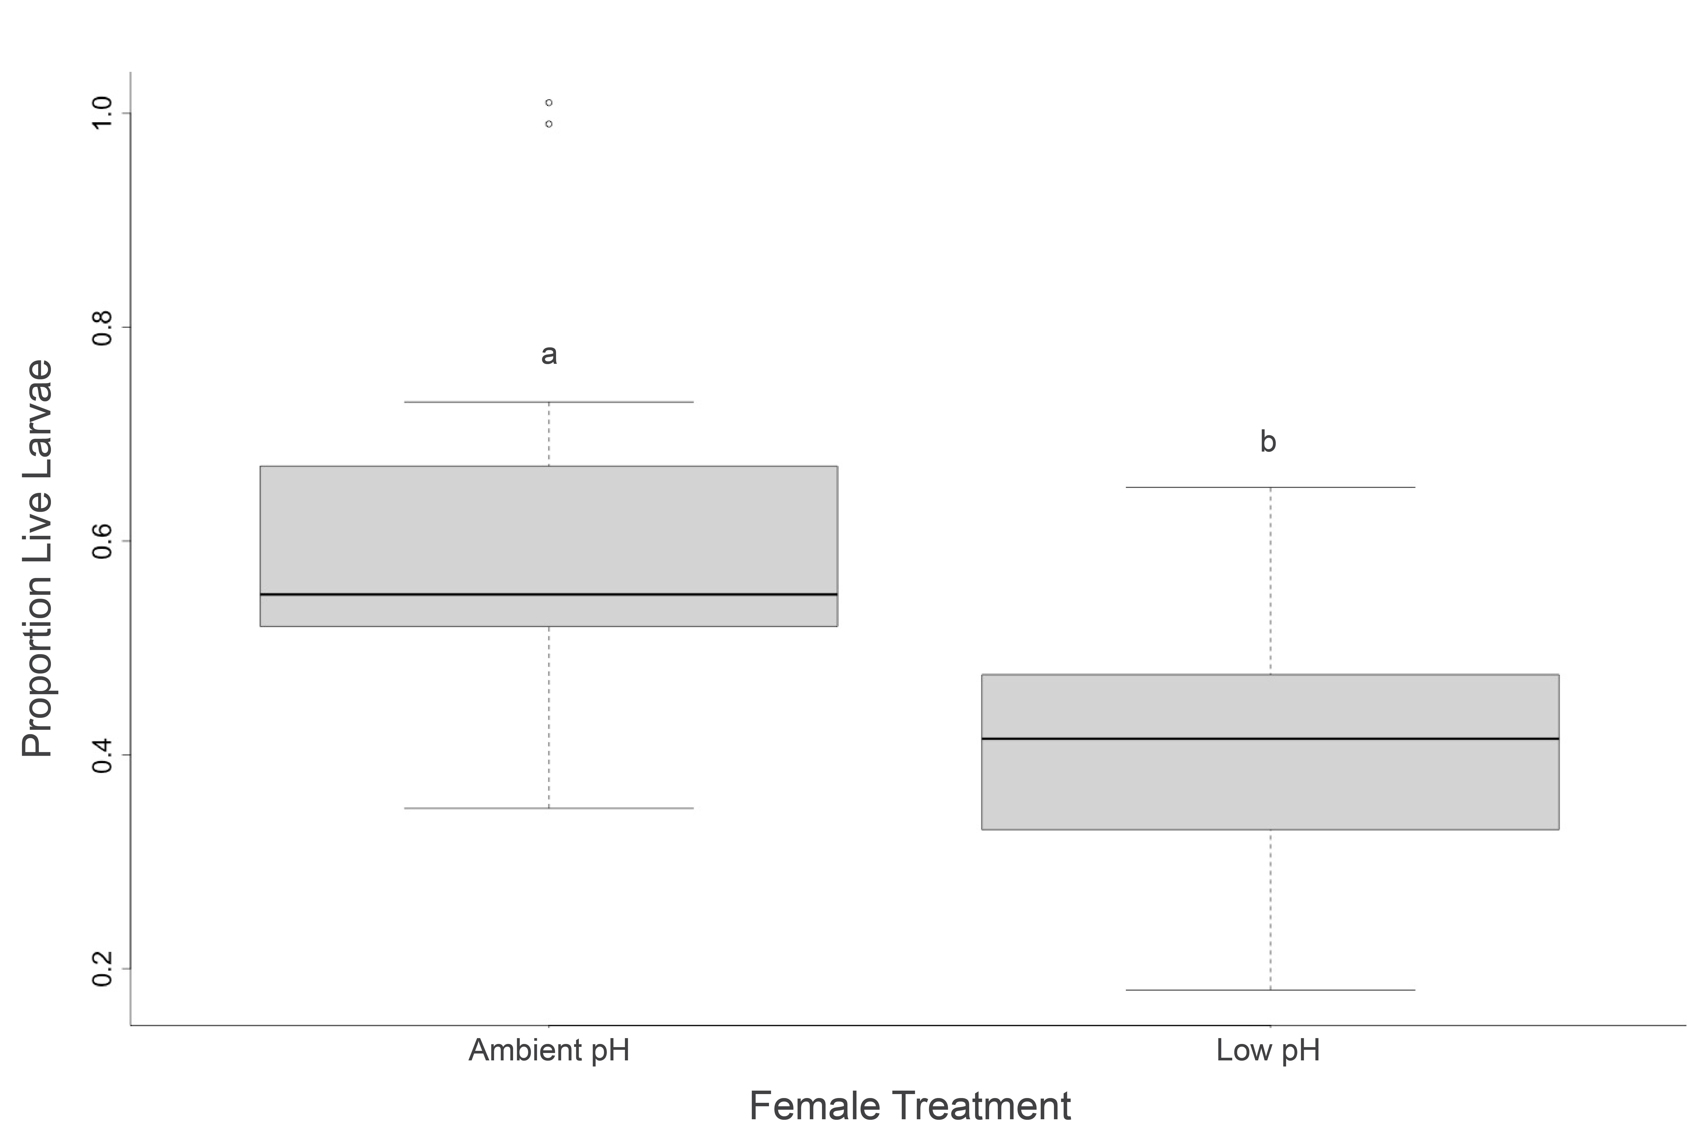
Maternal effect on larval survival
Notes:
Investigated paternal effects to and that was not significant

Slide 23
Pacific oyster carryover effects:
Significance
First to document intergenerational influence of ocean acidification on Pacific oysters
Significant carryover effects from adult low pH exposure four months prior to spawning broaden the current understanding of stressor timing and its effect on organismal physiology
Potential role for environmental memory in response to ocean acidification
Notes:
PRX, CAT scavenge for ROS, NADPt maintains redox state
G6PD: catalyzes the oxidative portion of the pentose phosphate pathway, and products from this pathway are often precursors for nucleic and aromatic amino acids
WB oysters also had lower total fatty acid content when compared to oysters outplanted at PS locations, indicative of less access to food (less food availability or less time with valves open for filtration) or poorer quality food (Lowe et al. in prep)

Slide 24
DNA
gene
Notes:
Cookbook = DNA; recipes = genes
We used to think that these cookbooks were passed down unaltered, parents to offspring. But now we know that's not the case.

Slide 25
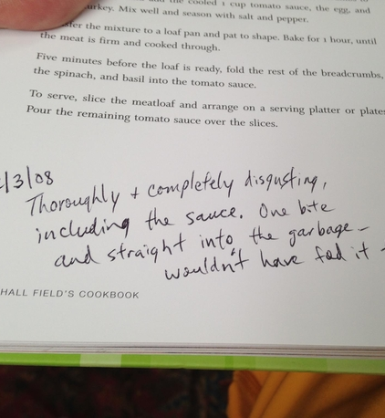

Epigenetics
Changes in gene expression that do not arise from changes in the DNA sequence
Notes:
Based on the environments the parents experience, there can be notes in the margins of these recipes (think the Half Blood Prince’s potions book). Large swaths of the cookbook can be highlighted, or covered in whiteout. They don’t change the recipes, or genes, themselves, but they change how the genes are interpreted

Slide 26
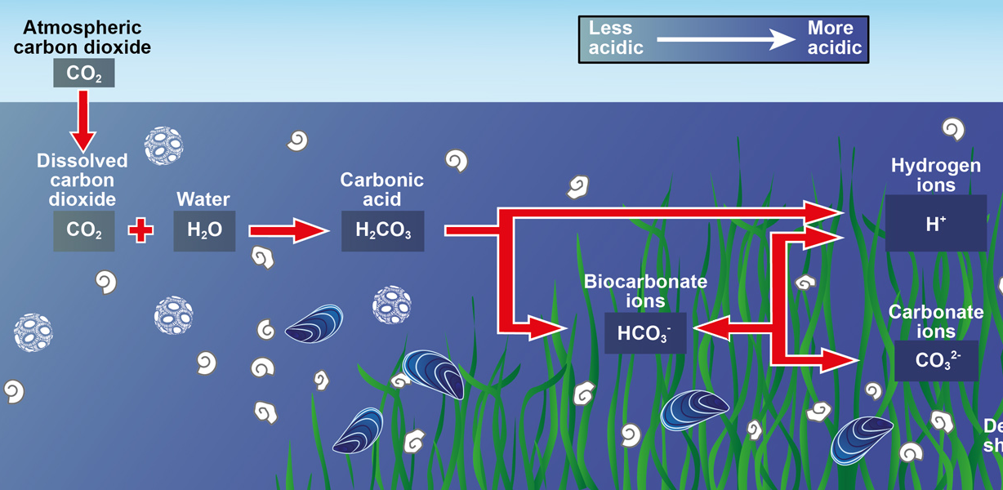
DNA
gene
-CH₃
DNA methylation
Notes:
How do the notes in the margins manifest in oysters?
Ocean acidification can add these accessories on DNA called DNA methylation, CpG
Presence or absence of methylation can change how genes are transcribed and translated into proteins → direct connection between the environment and the organism’s response, a potential tool organisms can use to rapidly respond to env change

Slide 27
Corals exhibit differential DNA methylation (Putnam et al. 2016)
Environment
Epigenome
Low pH, low salinity, pesticide exposure
Change gene regulation without altering DNA sequence
Multiple generations of daphnia inherited methylation patterns (Jeremias et al. 2018)
Diuron altered methylation and expression in adult and larval Pacific oysters (Rondon et al. 2017)
Notes:
Recent studies have demonstrated that changes in the environment can affect DNA methylation, which could then be related to changes in their physiology.
We also know that these DNA methylation patterns are heritable, which means epigenetics is the connection between parental experience and larval fitness. After one generation of daphnia was exposed to low salinity conditions, three subsequent generations exhibited the same DNA methylation patterns. Larvae from Pacific oysters exposed to the pesticide diuron also had differing methylation patterns and altered gene expression patterns
To recap: we want to know how parental exposure to OA can affect larval fitness. We know DNA methylation can influence carryover effects. Before looking at larvae, we need to know what happens in the adult

Slide 28
Does ocean acidification influence the reproductive tissue epigenome?
Venkataraman et al. 2020. Front Mar Sci, Venkataraman et al. OSM 2020
Notes:
Gonad → larvae

Slide 29
Hypothesis: Ocean acidification will change methylation patterns in oyster reproductive tissue
C. gigas:
7 week exposure
C. virginica:
4 week exposure
pH 7.31
pH 7.82
pH 7.29
pH 7.95
Process Gonad Tissue
MBD Enrichment and Bisulfite Sequencing
Characterize CpGs and Differentially Methylated Loci

Slide 30
C. virginica: 597
C. gigas: 628
Putative Promoters
Exons
Introns
Transposable Elements
Other
Percent DML
Genes
Genes
Notes:
Mostly within genes: makes sense with our framing that methylation will impact transcription and gene expression, therefore impacting oyster response to OA

Slide 31
C. virginica
C. gigas
Other Metabolic Processes
Protein Metabolism
RNA Metabolism
DNA Metabolism
Stress Response
Cell Organization and Biogenesis
Developmental Processes
Cell Cycle and Proliferation
Transport
Signal Transduction
Death
Cell Adhesion
Cell-Cell Signaling
Genes with DML/Genes
Notes:
Ratio: If there are proceses that are solely impacted, then we’d see higher and sig diff ratios
No processes affected. Makes sense since we know from other research that OA affects many biological processes.

Slide 32
Gonad methylation in oysters:
Significance
Ocean acidification changes methylation pattern in oyster gonad tissue
Role in gene activity
Some biomineralization genes with DML
Next steps: investigate larval methylation and compare

Slide 33
Proteomics
Epigenetics
Understand response to complex environmental conditions
Begin investigating carryover effect mechanisms
Notes:
Big question: how do oysters respond on the molecular level? As all other responses build off of minute molecular processes, its crucial that we keep these methods in mind when investigating how organsism respond to rapid environmental change.

Slide 34
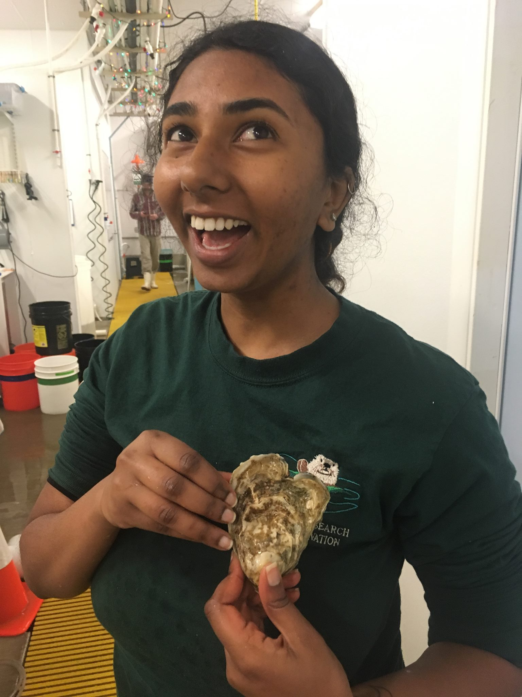


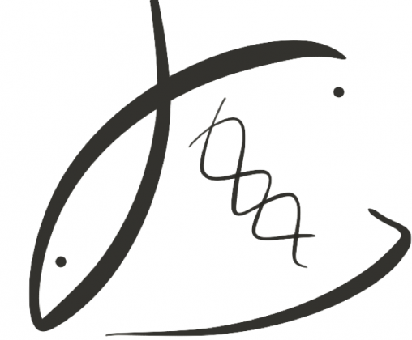


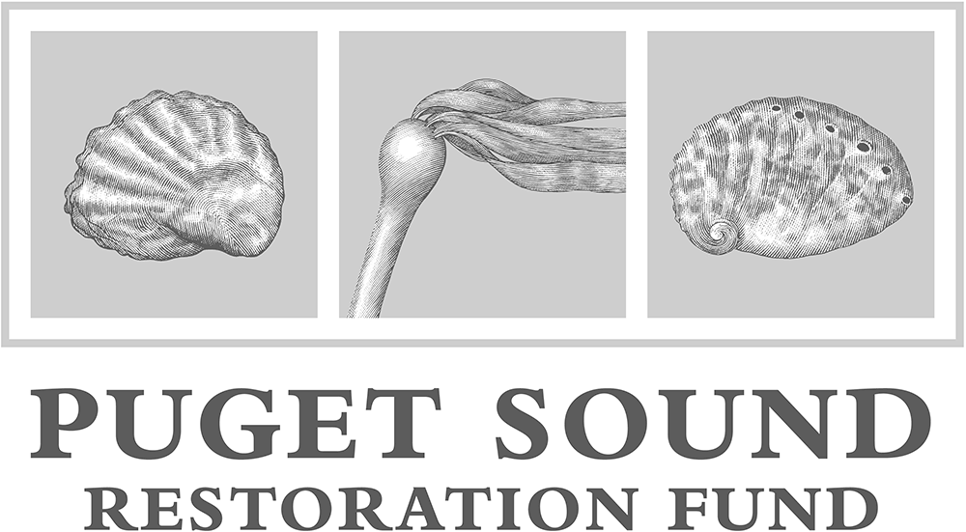
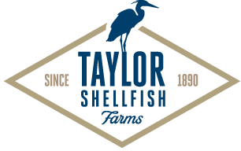

thank you!
yaaminiv.github.io
yaaminiv@uw.edu
@YaaminiV
Notes:
Do they have the tools and can the utilize them effectively?

Slide 35
Proteomic response to natural pH gradients:
Significance
No significant difference in protein abundance between habitats or between sites within Puget Sound
  Different suite of environmental response proteins could have captured variation
  Outplant duration could have been too short
  Environmental conditions that would elicit up- or down-regulation of monitored proteins were similar

Slide 36
Notes:
ANOSIM. No sig diff by habitat. Sig diff by site for DO and temperature (means), all variables for variances.

