Slide 1
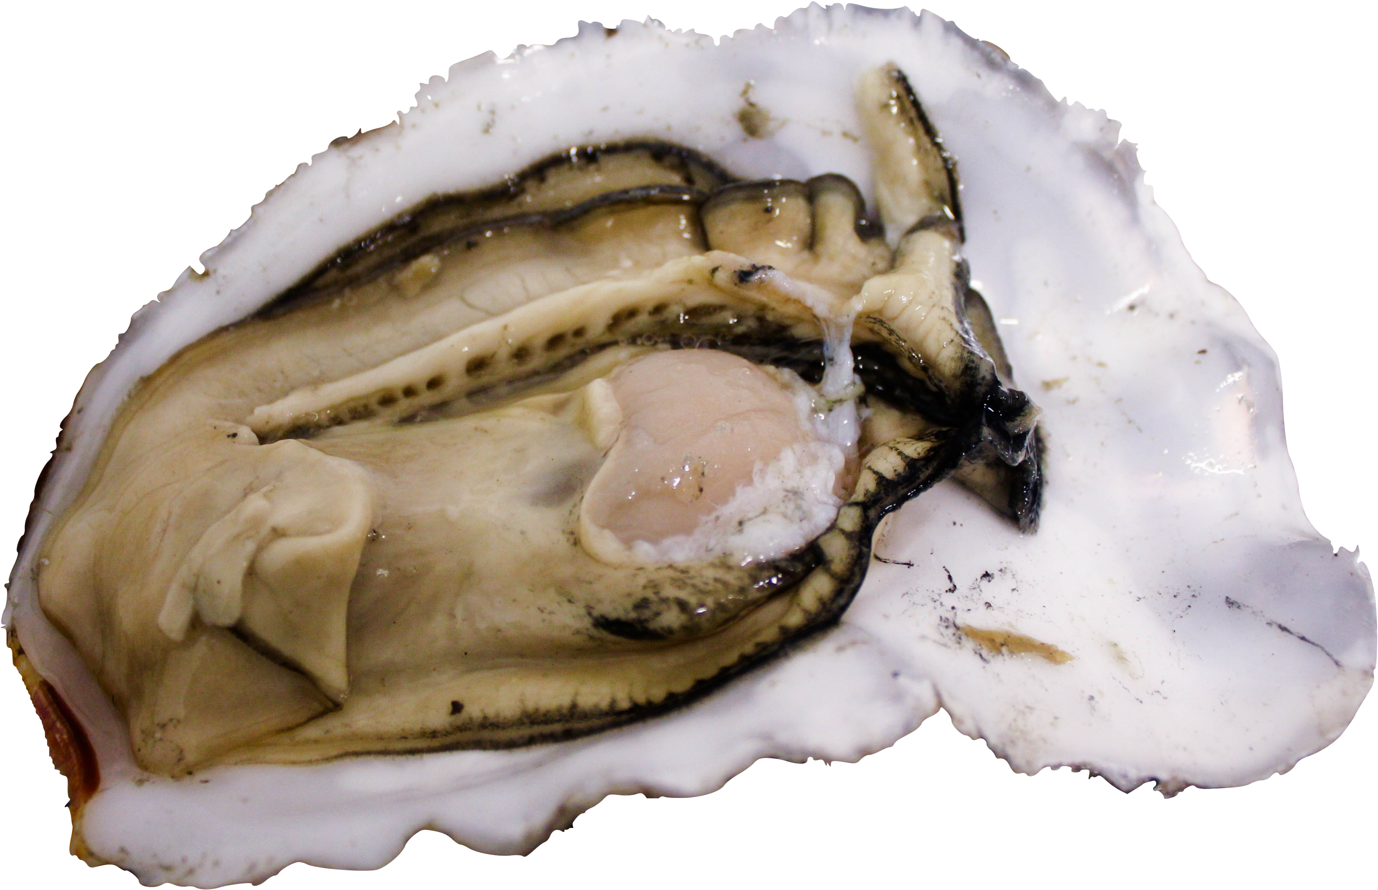
Oysters, Ocean Acidification,
and -Omics
Yaamini R. Venkataraman
Roberts Lab, University of Washington School of Aquatic and Fishery Sciences
yaaminiv@uw.edu
@YaaminiV
Notes:
We acknowledge with respect to the Coast Salish peoples on whose traditional territory Huxley College stands, and to the Lummi and Nooksack peoples whose historical relationships with the land continue to this day.
The reason why I chose my title: accurately describes my work, fun alliteration
All 3 are interconnected, will show you this today.

Slide 2
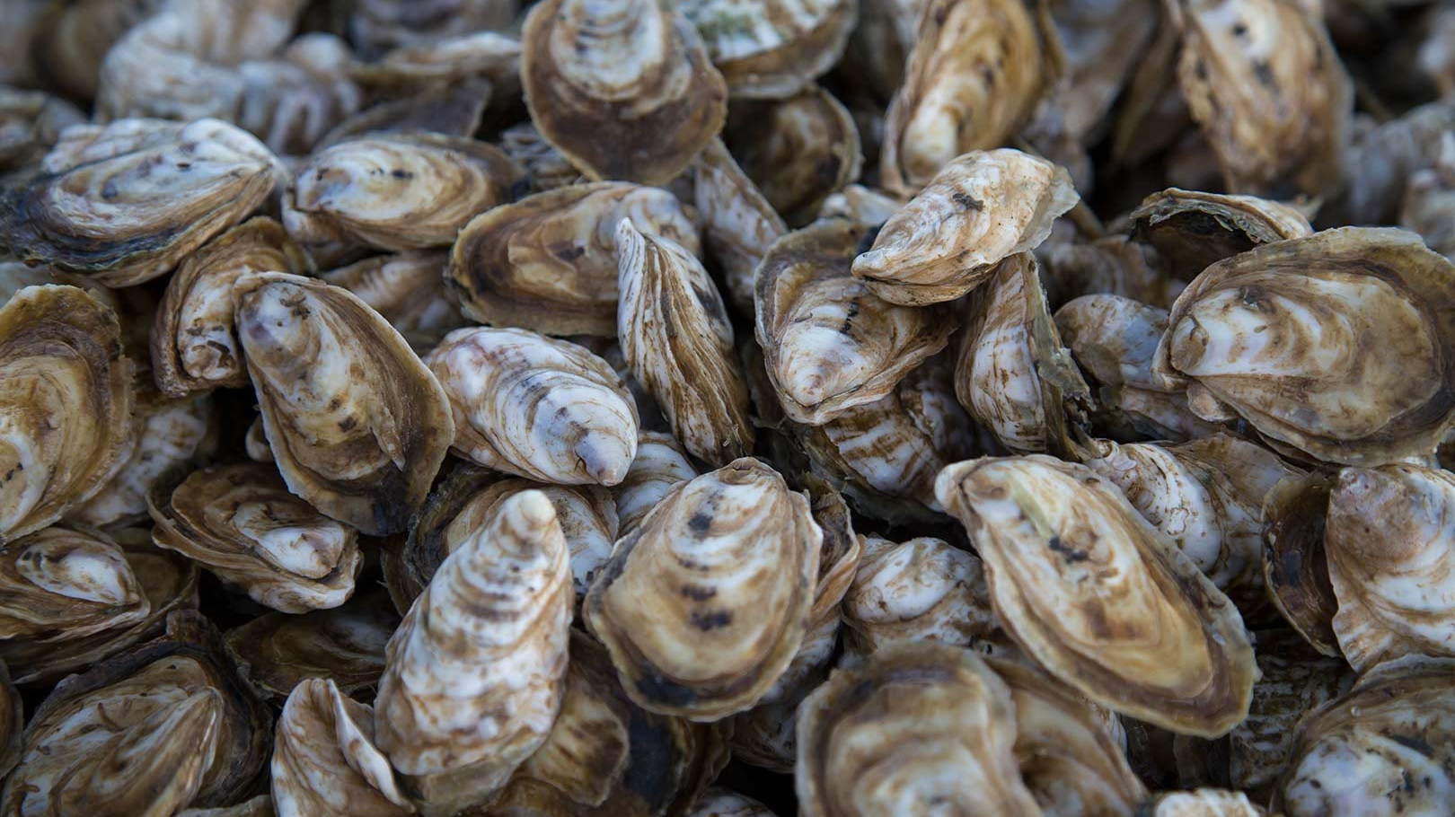
Notes:
Oysters are an iconic part of Washington. Oysters are shellfish that live in saltwater: think oceans or areas that have a mix of salt and freshwater like Puget Sound (what we call estuaries). Here in Washington, you’ll encounter up to 5 different oyster species.

Slide 3
Pacific
Olympia
Virginica
European flat
Kumamoto
Notes:
Olympia oyster: native oyster to the west coast, but was decimated at the end of the 1800s due to overharvest and lumber, pollution, etc.
Pacific oyster: Brought in from Japan to start growing. Although its an introduced oyster, it now makes up the fiber of the oyster industry here
Other species brought in for cultivation as well:
European flat oyster: closely related to Olympia oyster
Kumamoto from Japan and Virginica from east coast (Chesapeake bay): closely related to Pacific oyster
I study Pacific oyster which is grown all over the world and has been around in Washington for 100 years

Slide 4
Fertilized egg
Larvae
Adult
Spat
Notes:
Spawning
Fertilization
Larvae: different shapes, different abilities in water column
Settlement and spat
2-3 years depending on water conditions
Know what to do with their cookbook

Slide 5
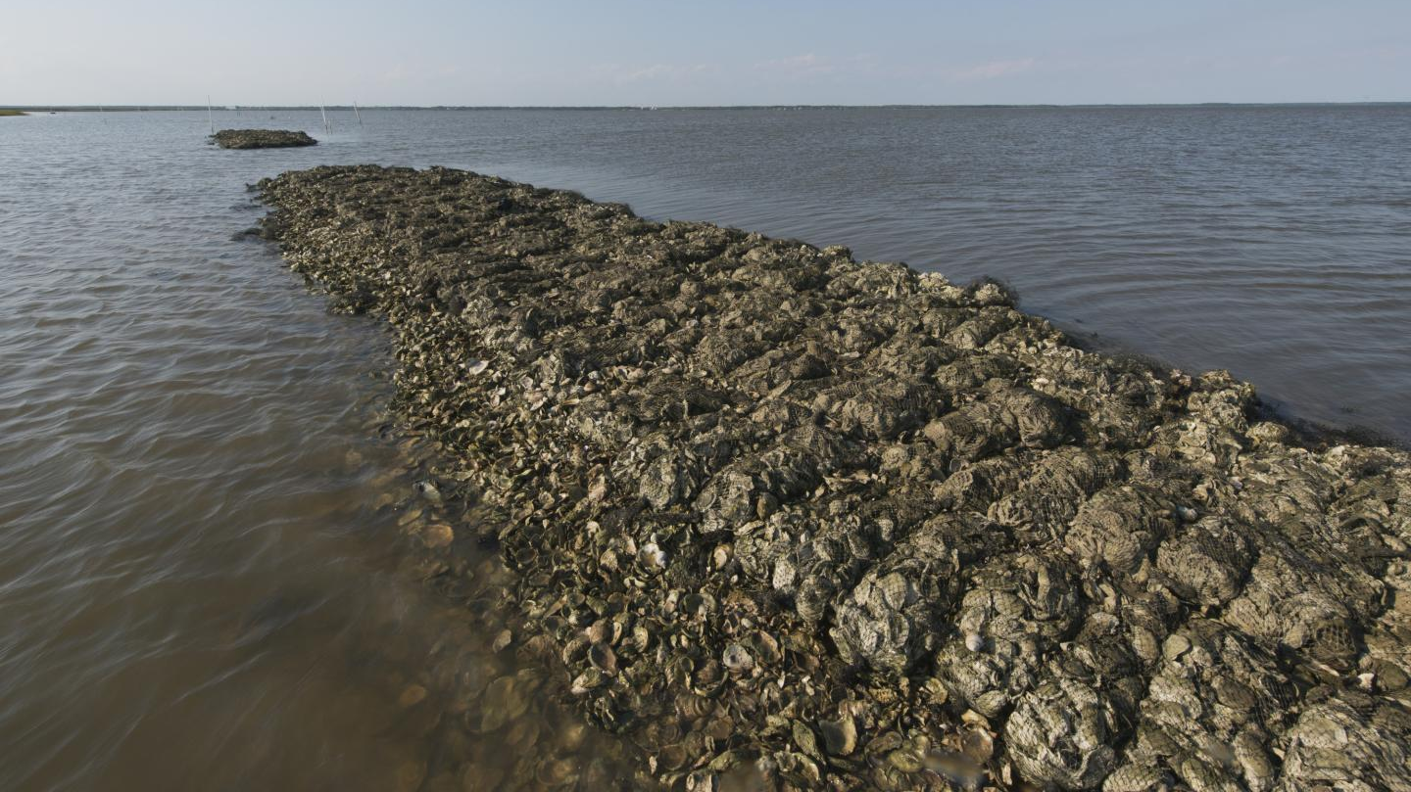
Ecological
Notes:
Oysters are what we call ecosystem engineers. When they’re out in bays or along the seashore, they clump on top of eachother, forming oyster reefs. These reefs protect our shorelines from crumbling away in stormy weather. Oysters also purify our water! They bring in water to feed on the tiny algae that live in it, and end up filtering out anything mucky from the water.

Slide 6
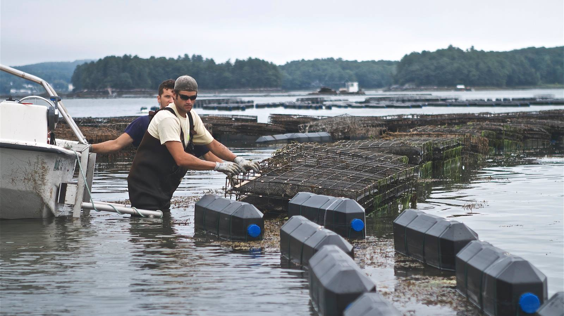
Economic
Notes:
Washington state shellfish farms owe over 1/3 of its profits — more than 25 million dollars — to oysters. In some counties, shellfish hatcheries and farms are the number one employer.

Slide 7
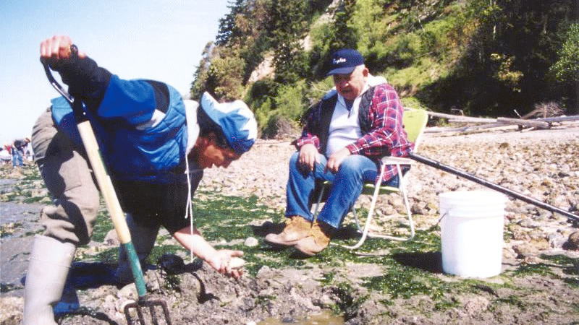
Social
Notes:
Finally, like most shellfish, oysters have a social importance. People, especially tribal communities, build customs around harvesting these traditional food resources.

Slide 8
Oysters are
threatened by ocean acidification.

Slide 9
CO₂
CO₂
CO₂
CO₂
CO₂
CO₂
CO₂
CO₂
CO₂
CO₂
CO₂
CO₂
CO₂
CO₂
CO₂
Notes:
We emit the gas carbon dioxide, or CO2. We actually need a little bit of carbon dioxide in our atmosphere. It’s what keeps our planet at the right temperature for life to flourish. But it’s that extra CO2 that comes from human activity that causes climate change and global warming. There’s also a second CO2 problem.

Slide 10
CO₂
CO₂
CO₂
CO₂
CO₂
CO₂
CO₂
CO₂
CO₂
CO₂
CO₂
CO₂
CO₂
CO₂
CO₂
Notes:
Our oceans absorb about 1/3 of that extra carbon dioxide. How do we know this? We can measure how acidic the ocean is.

Slide 11
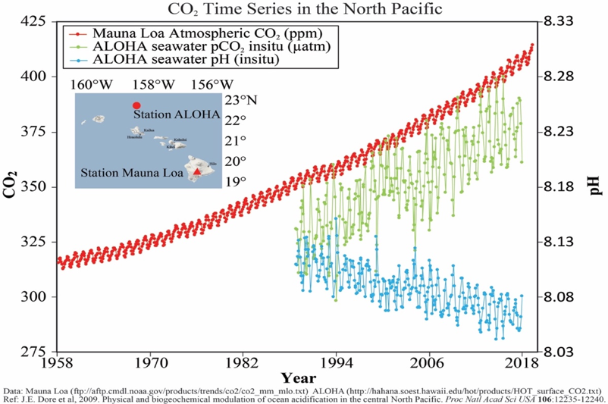
Atmospheric CO₂
Absorbed CO₂
Ocean pH
0.1 unit decrease
Dore et al. 2009
Notes:
Dore et al 2009
Scientists have monitored atmospheric and oceanic carbon dioxide concentrations at the Mauna Loa Observatory in Hawaii

Slide 12
0.1 pH units
change
impact
25% more acidic
Notes:
What seems like a small change actually has a big impact. Because of the way the pH scale is designed, a 0.1 pH unit change actually means the ocean has gotten 25% more acidic.

Slide 13
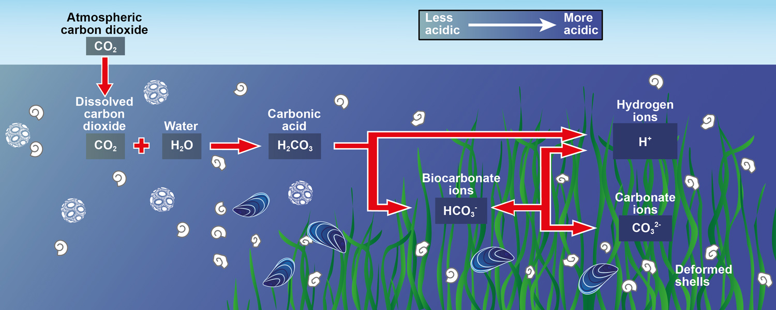
Difficult to maintain homeostasis
Fewer carbonate ions available for building shells
Plymouth Marine Laboratory
Notes:
What do these changes mean for oysters?

Slide 14
Varied fertilization success
Fertilized egg
Developmental delays
Parker et al. 2010; Boulais et al. 2018
Kurihara et al. 2007; Timmins-Schiffman et al. 2012
Larvae
Adult
Reduced calcification
Lower energy production
Gazeau et al. 2007; Timmins-Schiffman et al. 2014
Spat
Dineshram et al. 2016
Notes:
Developmental delays. Oysters build their shell using limestone-like materials, or calcium carbonate, that’s available in the water. Due to ocean acidification, that calcium carbonate ( those shell building blocks) are no longer available. These small oysters have to use more energy to build these shells, on top of feeding, and swimming, and doing eve3rything else. It’s harder for these stressed out larvae to build shells, so they build them slower.
Growing worse
Maybe you survive and grow just fine, but ocean acidification prevents you from getting it on. Again, oysters have a limited amount of energy that they have to budget out. If they’re spending too much of that budget coping with stressors, there’s not nearly enough energy left for them to develop enough sperm or eggs effectively.

Slide 15
Higher survival
Bigger larvae
Fast-growing
Lower survival
Smaller larvae
Slow-growing
+
-
Parker et al. 2012, 2015, 2017
Griffith and Gobler 2017
Notes:
Parental exposure can be helpful or harmful
Helpful parental exposure to low pH or high pCO2 can lead to positive carryover effects. When adult Sydney rock oysters were exposed to high pCO2 conditions, resulting larvae were faster growing in the same pCO2 conditions than larvae from parents without that prior exposure (Parker et al. 2012, 2015, 2017).
Harmful parental exposure leads to negative carryover effects. Larvae from adult Atlantic hard clams (Mercenaria mercenaria) and bay scallops (Argopecten irradians) developed slower when parents were reproductively conditioned in low pH conditions (pH_{T} = 7.4) (Griffith and Gobler 2017).
Understanding how and why these carryover effects occur is crucial. Growers need to know how broodstock experience can affect next year’s larvae, and resource managers can apply this understanding to natural populations.
We’re already feeling the impact of OA in the PNW. Shellfish industries here have lost $110 million. These are people’s livelihoods and food systems.

Slide 16
How does ocean acidification affect multiple generations of Pacific oysters?
Notes:
Question I sought to answer

Slide 17
7 Week Exposure
Characterize gonad tissue
Low pH
(7.3)
Ambient pH
(7.8)
12 Weeks Ambient pH conditions
Count larvae 18 hpf
Spawn
Notes:
150 sib adult Pacific oysters to pH; T
Conditions similar to what we see in Puget Sound
Characterize gonad tissue
In the wild or in the hatchery, broodstock and larvae can experience different conditions. We wanted to know if a long-removed stressor can still result in carryover effects.

Slide 18
No reproductive differences
All samples were immature (F_{3,36} = 2.2675; p = 0.1408)
No difference in energy investment between sexes (X²₂ = 3.2279; p = 0.1942)
Venkataraman et al. 2019
Notes:
No significant difference between gonad maturation stages between treatments → energy budgets
No significant difference in sex ratios between treatments → male vs. female (sperm is cheap)

Slide 19
Maternal effect on larval survival
(X²₁ = 8.1781; p = 0.0042)
Ambient pH Females
Low pH Females
1.0
n = 12
n = 12
0.8
*
Proportion live larvae 18hpf
0.6
0.4
0.2
Venkataraman et al. 2019
Notes:
First to document transgenerational influence of ocean acidification on Pacific oysters
Months after our initial pH exposure ended, we’re seeing a MATERNAL EFFECT ON LARVAL ABUNDANCE
Significant carryover effects from adult low pH exposure four months prior to spawning broaden the current understanding of stressor timing and its effect on organismal physiology
Return to ambient conditions + lag time before carryover effect was seen suggests epigenetic memory.

Slide 20
What can –omics tell us about Pacific oyster responses to ocean acidification?
Notes:
Why did this happen? That’s when we get into –omics

Slide 21
DNA
gene
Notes:
Cookbook = DNA; recipes = genes
We used to think that these cookbooks were passed down unaltered, parents to offspring. But now we know that's not the case.

Slide 22
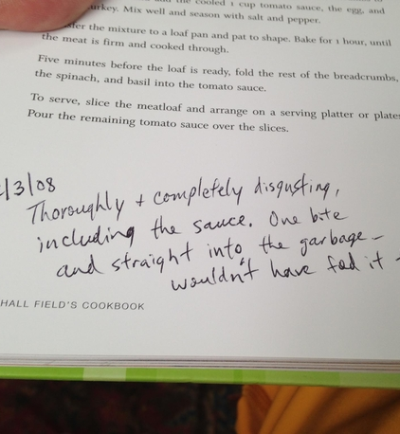
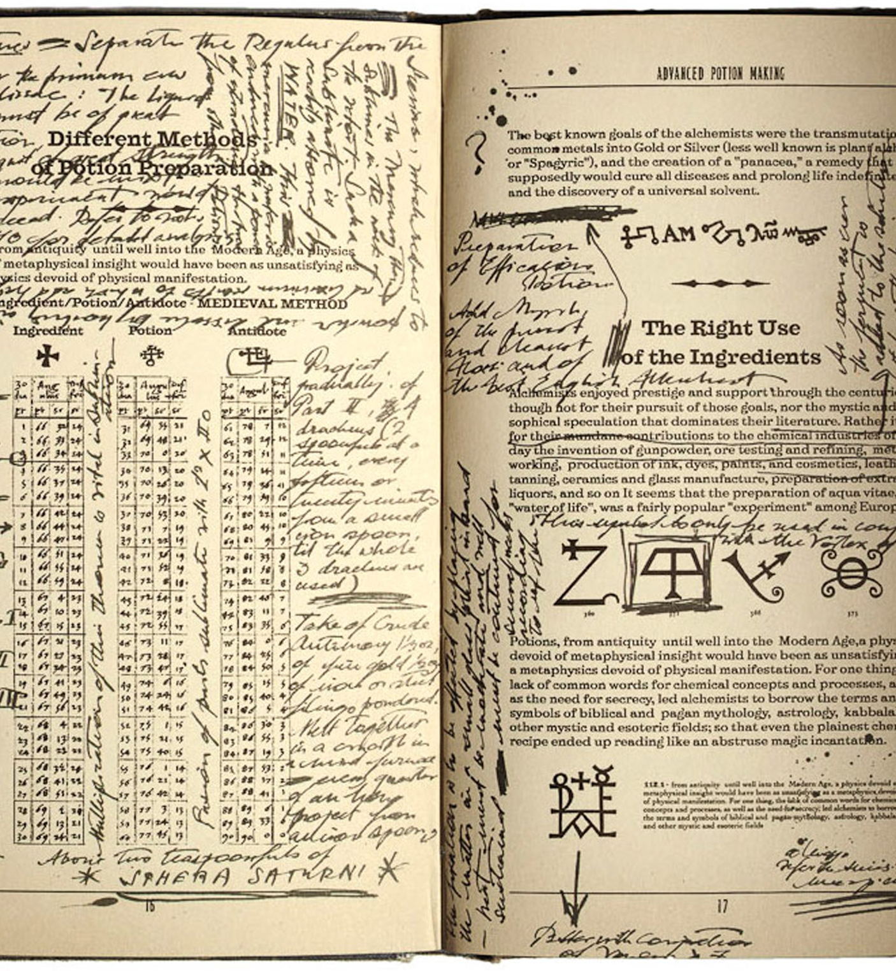
Epigenomics
Notes:
Based on the environments the parents experience, there can be notes in the margins of these recipes (think the Half Blood Prince’s potions book). Large swaths of the cookbook can be highlighted, or covered in whiteout. They don’t change the recipes, or genes, themselves, but they change how the genes are interpreted

Slide 23
DNA
gene
DNA methylation
Notes:
How do the notes in the margins manifest in oysters?
Ocean acidification can add these accessories on DNA called DNA methylation
Doesn’t change the DNA sequence itself, but changes how it can be interpreted by the oysters.
That can then be passed on → induce carryover effects

Slide 24
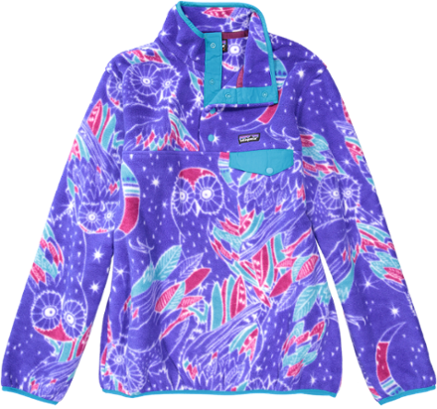
Adapt
Acclimatize
many generations
one generation
Notes:
Do they have jackets? Does it help?
Do they have tools, and are those tools helpful?

Slide 25
Oysters are important.
Ocean acidification affects oysters across generations.
-Omics can elucidate why oysters are affected.
Notes:
Oysters
Ocean acidification
Omics: do they have the tools, and can they use them effectively

Slide 26
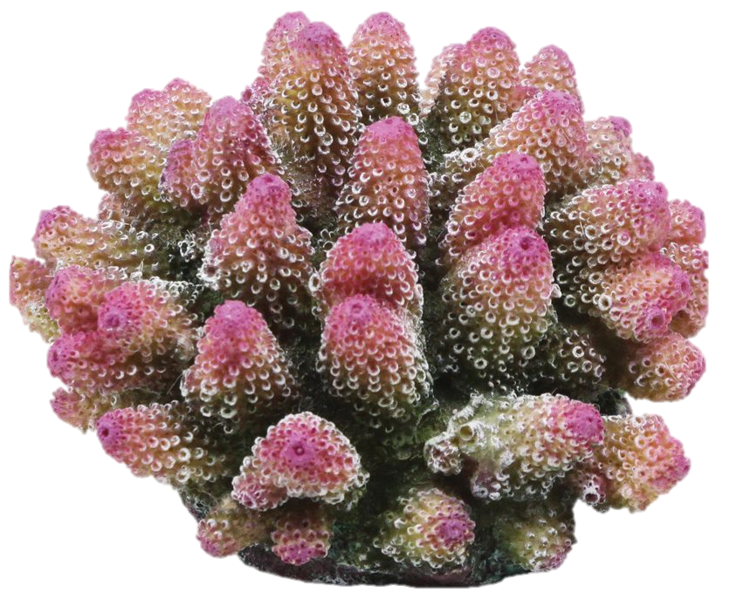
Can study methylation in other systems
Pacific
Geoduck
Olympia
Salmon
Virginica
Corals
Notes:
Can apply this thinking to many organisms, many stressors to understand how environmental changes will affect organisms in our future oceans

Slide 27
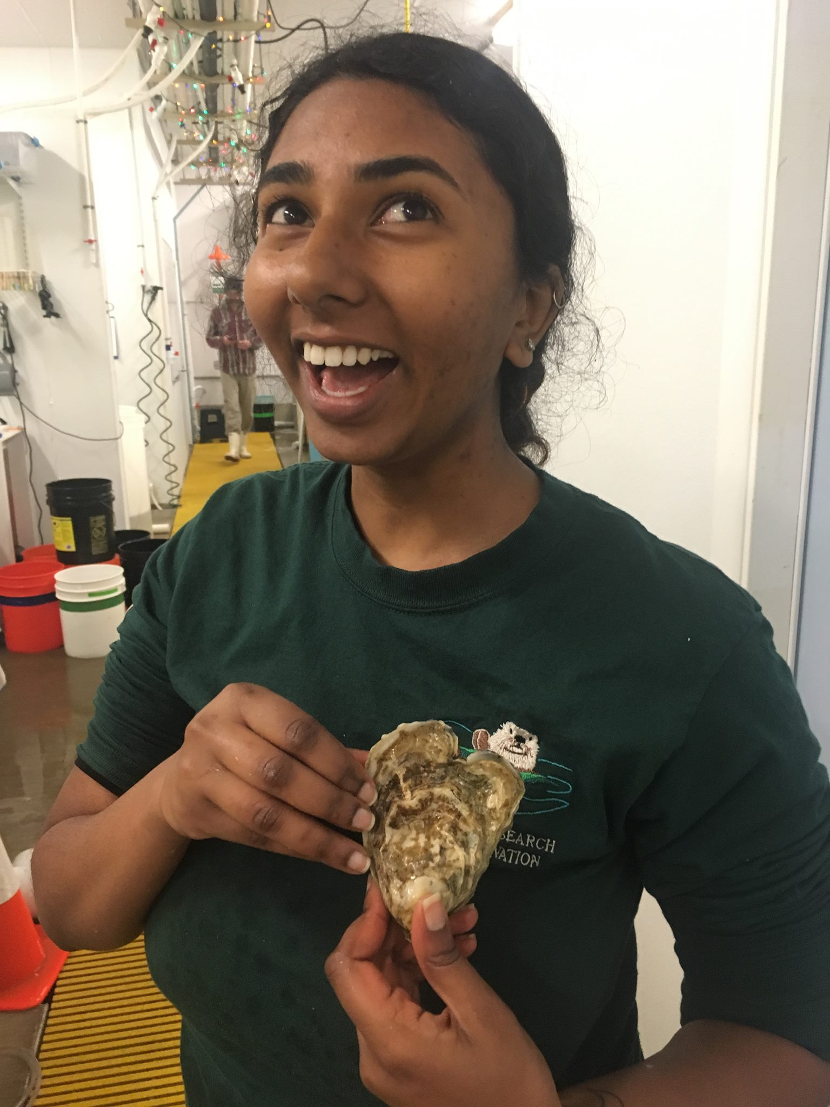
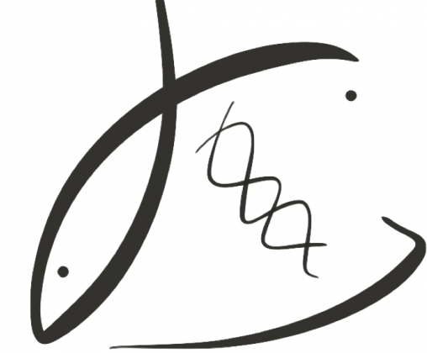
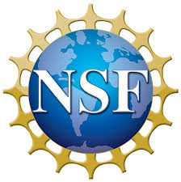
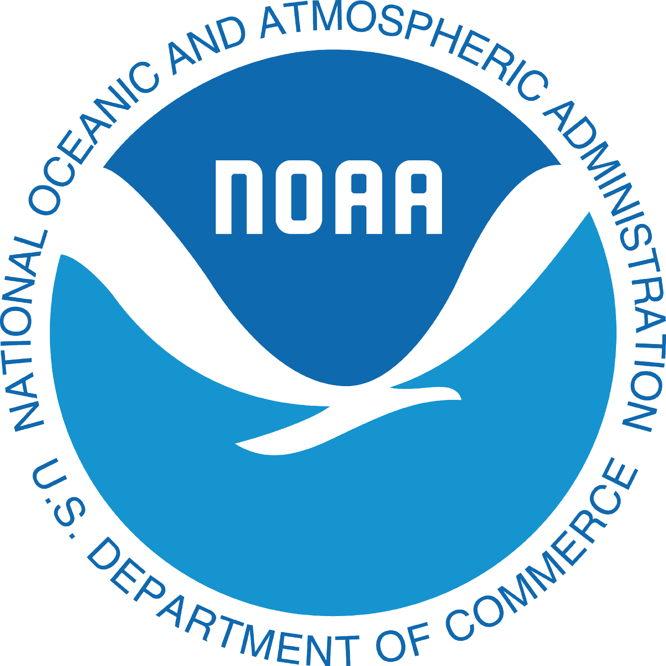
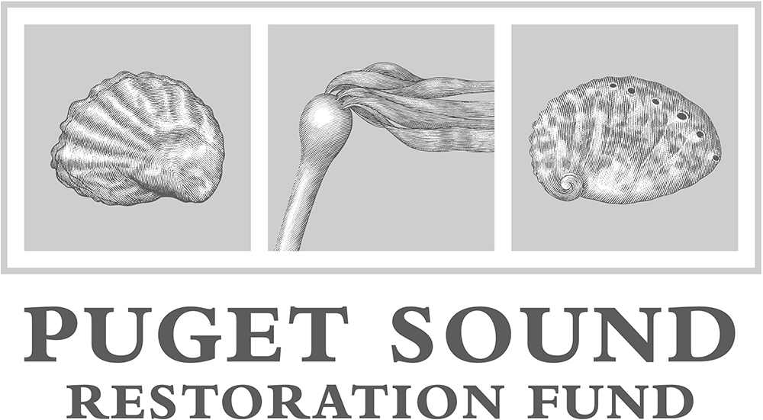
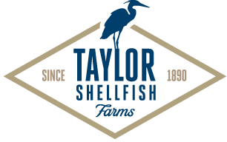
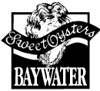
thank you!
Notes:
Do they have the tools and can the utilize them effectively?

