Slide 1
Getting your proposal funded: an ERC Success Story PAGES-ECN Webinar

Slide 2
Getting your proposal funded
an ERC Success Story
Alessio Rovere
Photo by rawpixel.com from Pexels
The background photo is not licensed under the CC-BY license, please obtain a copy from the links above

Slide 3
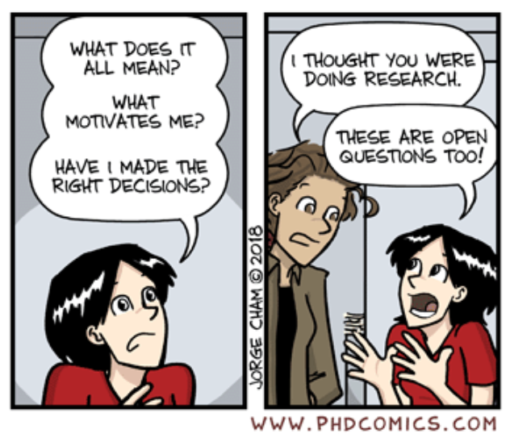
An ERC StG is about …
You
The brilliant young
researcher

Slide 4
An ERC StG is about …
You
The brilliant young
researcher
Your idea
The ground-breaking stuff you’ll do

Slide 5
An ERC StG is about …
You
The brilliant young
researcher
Your idea
The ground-breaking stuff you’ll do
Conception
Having the first idea

Slide 6
An ERC StG is about …
You
The brilliant young
researcher
Your idea
The ground-breaking stuff you’ll do
Inception
Streamlining the idea
Conception
Having the first idea

Slide 7
An ERC StG is about …
You
The brilliant young
researcher
Your idea
The ground-breaking stuff you’ll do
Inception
Streamlining the idea
Writing
Fixing the idea
on paper
Conception
Having the first idea

Slide 8
An ERC StG is about …
You
The brilliant young
researcher
Your idea
The ground-breaking stuff you’ll do
Inception
Streamlining the idea
Writing
Fixing the idea
on paper
Conception
Having the first idea
Interview
Presenting your
idea

Slide 9
An ERC StG is about …
You
The brilliant young
researcher
Your idea
The ground-breaking stuff you’ll do
Inception
Streamlining the idea
Writing
Fixing the idea
on paper
Conception
Having the first idea
Interview
Presenting your
idea

Slide 10
An ERC StG is about …
You
The brilliant young
researcher
Your idea
The ground-breaking stuff you’ll do
Inception
Streamlining the idea
Writing
Fixing the idea
on paper
Conception
Having the first idea
Interview
Presenting your
idea
Your aren’t giving up,
are you?

Slide 11
Disclaimer!
The following is what worked for me!
Take what you need
Leave what you don’t think will work for you

Slide 12
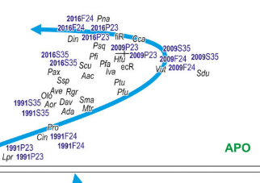
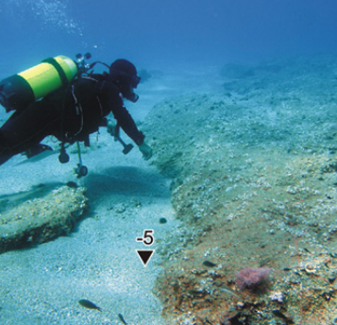
My path
I am attracted by things that I like but that I don’t know how to do
Bachelors and Masters
2000-2006
Learned to:
Get data
Analyse them
Publish (2006)

Slide 13
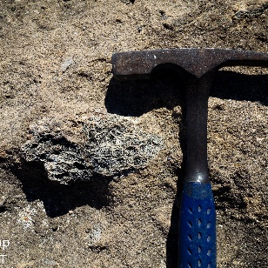
My path
I am attracted by things that I like but that I don’t know how to do
PhD
2008-2011
Bachelors and Masters
2000-2006
Learned to:
Work on a subject
Follow my interests
Publish more
Learned to:
Get data
Analyse them
Publish (2006)

Slide 14
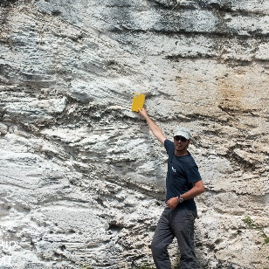
My path
Postdoctoral researcher
2012-2014
I am attracted by things that I like but that I don’t know how to do
PhD
2008-2011
Learned to:
Think big
Write better proposals
Write higher quality papers
Bachelors and Masters
2000-2006
Learned to:
Work on a subject
Follow my interests
Publish more
Learned to:
Get data
Analyse them
Publish (2006)

Slide 15
My path
Postdoctoral researcher
2012-2014
I am attracted by things that I like but that I don’t know how to do
PhD
2008-2011
Learned to:
Think big
Write better proposals
Write higher quality papers
Bachelors and Masters
2000-2006
Learned to:
Work on a subject
Follow my interests
Publish more
Spinoff CEO
2010-2015
Learned to:
Get data
Analyse them
Publish (2006)
Learned to:
Take budget responsability

Slide 16
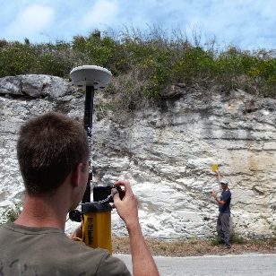
My path
Postdoctoral researcher
2012-2014
I am attracted by things that I like but that I don’t know how to do
PhD
2008-2011
Jr. Group leader
2014-2018
Learned to:
Think big
Write better proposals
Write higher quality papers
Bachelors and Masters
2000-2006
Learned to:
Work on a subject
Follow my interests
Publish more
Learned to:
Supervise
Keep improving writing
Think collaboratively
Spinoff CEO
2010-2015
Learned to:
Get data
Analyse them
Publish (2006)
Learned to:
Take budget responsability

Slide 17
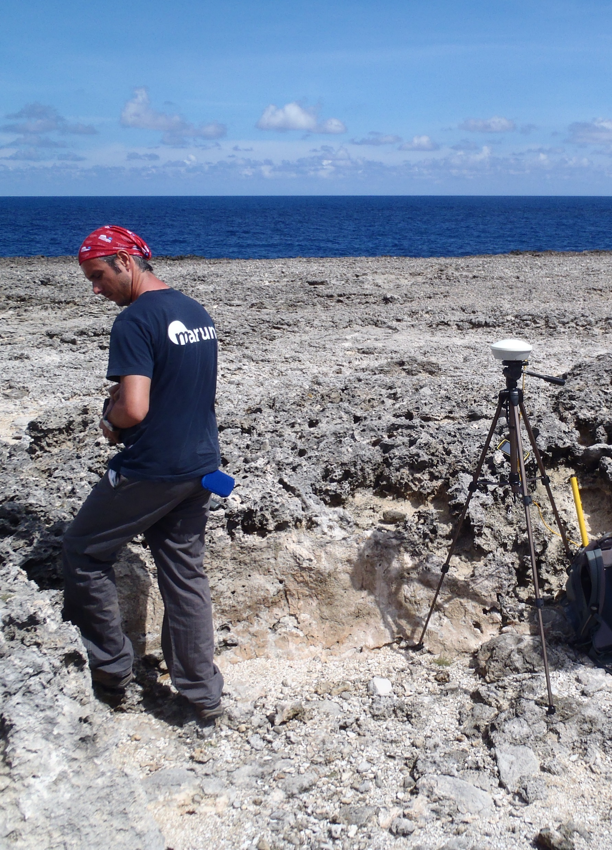
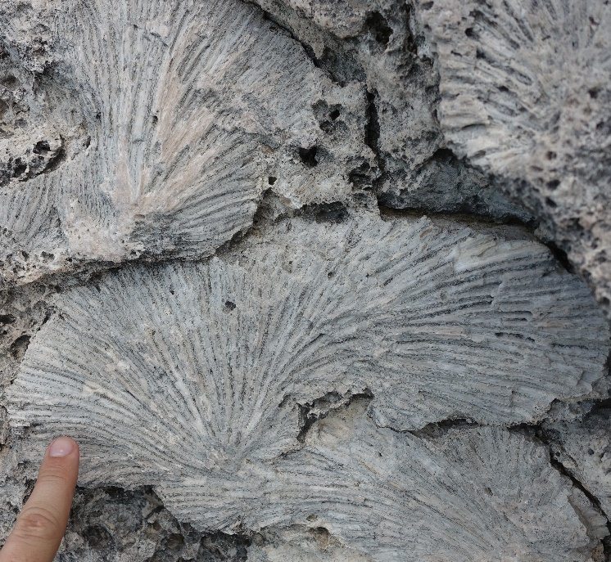
Bonaire, Netherland Antilles
Last Interglacial reef terrace
7.2 ± 0.1m
Fossil coral
reef
© Thomas felis – MARUM

Slide 18
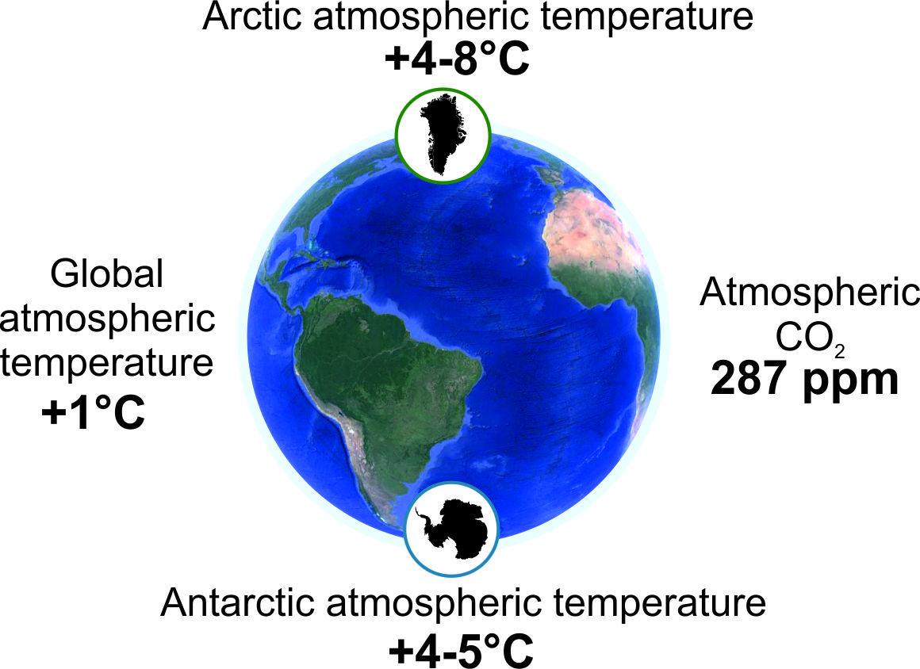
Bonaire, Netherland Antilles
Last Interglacial reef terrace
Last Interglacial
∼125.000 years ago
7.2 ± 0.1m
Fossil coral
reef
The last time the Earth was slightly warmer than today
An analog for future warmer worlds
© Thomas felis – MARUM

Slide 19
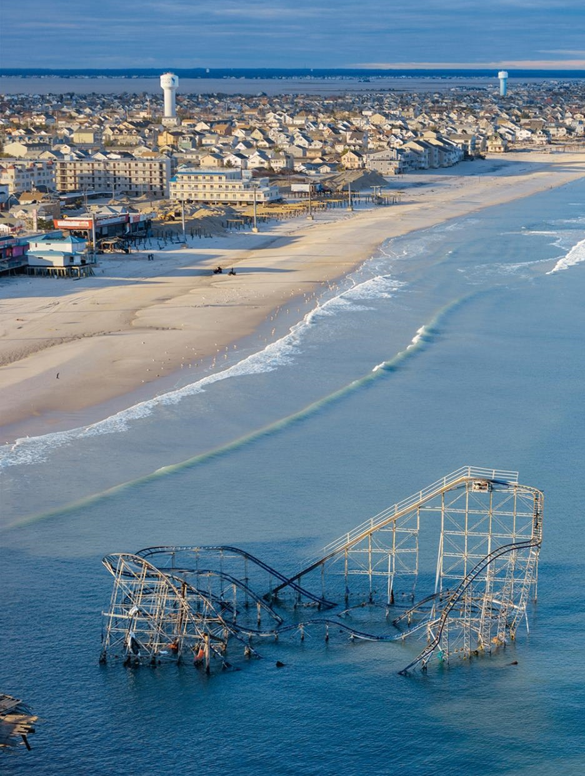
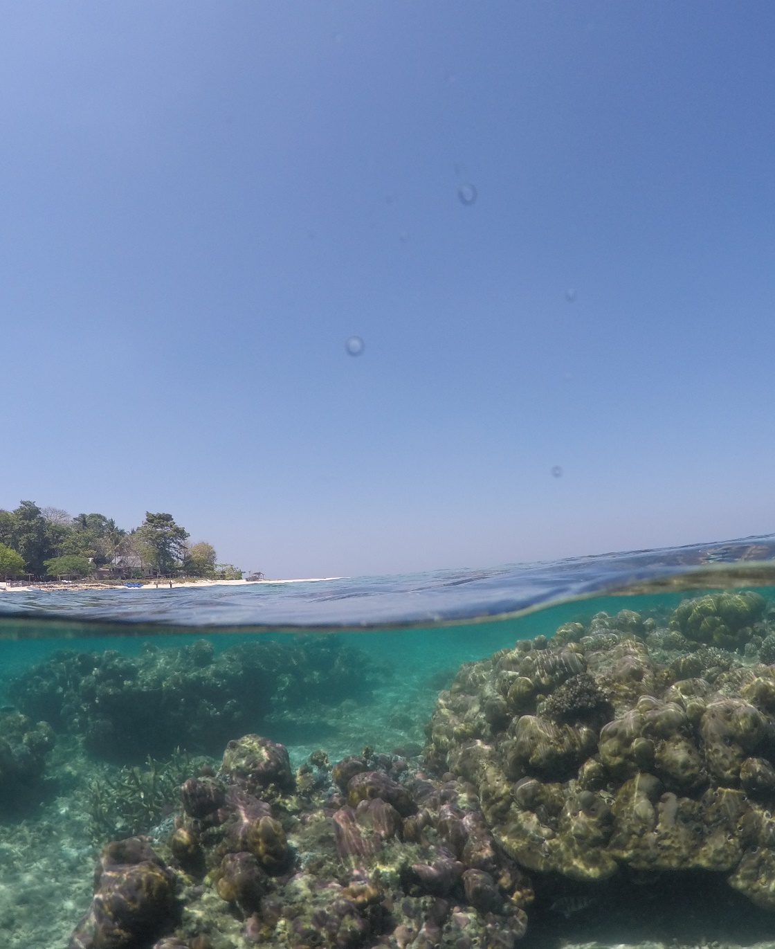
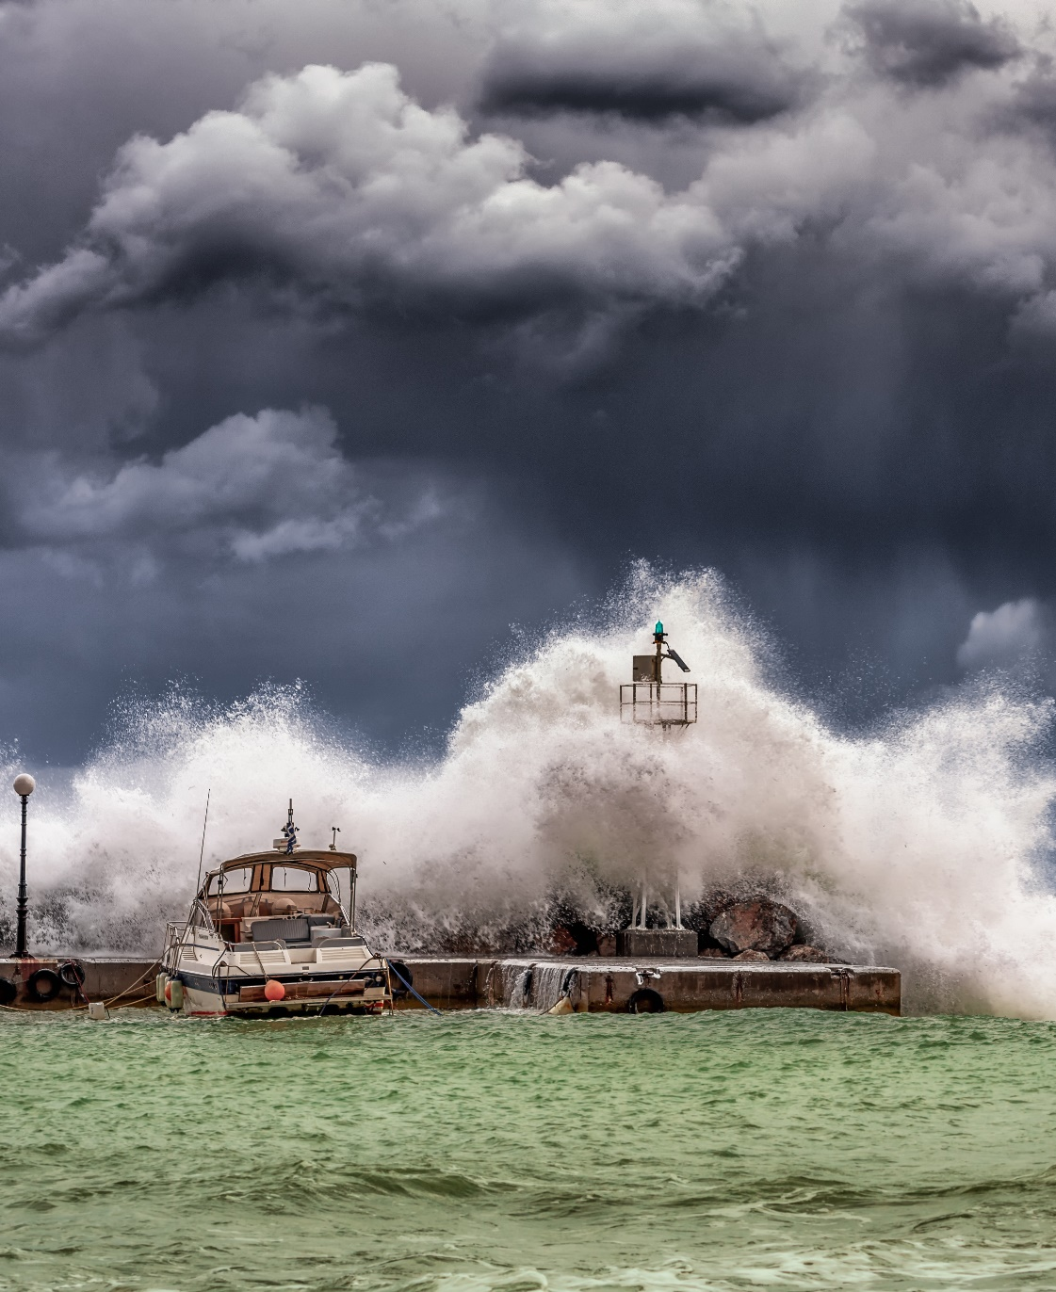
The big questions in sea level science:
How much?
How fast?
Stronger storms?
How much will sea level rise?
How fast will it rise?
Will there be stronger storms?
© Stephen Wilkes – National Geographic
© Maren Bender - MARUM
© George Desipiris - Pexels
Notes:
And there are three big questions we need to answer

Slide 20
My path
I am attracted by things that I like but that I don’t know how to do
More quantity than quality
Regional scale
Limited applications
Focussing on quality
Global scale
Bigger implications
Collaborative research
Senior authorship
Papers with students

Slide 21
My path
I am attracted by things that I like but that I don’t know how to do
More quantity than quality
Regional scale
Limited applications
Focussing on quality
Global scale
Bigger implications
Collaborative research
Senior authorship
Papers with students

Slide 22
My path
I am attracted by things that I like but that I don’t know how to do
More quantity than quality
Regional scale
Limited applications
Focussing on quality
Global scale
Bigger implications
Collaborative research
Senior authorship

Slide 23
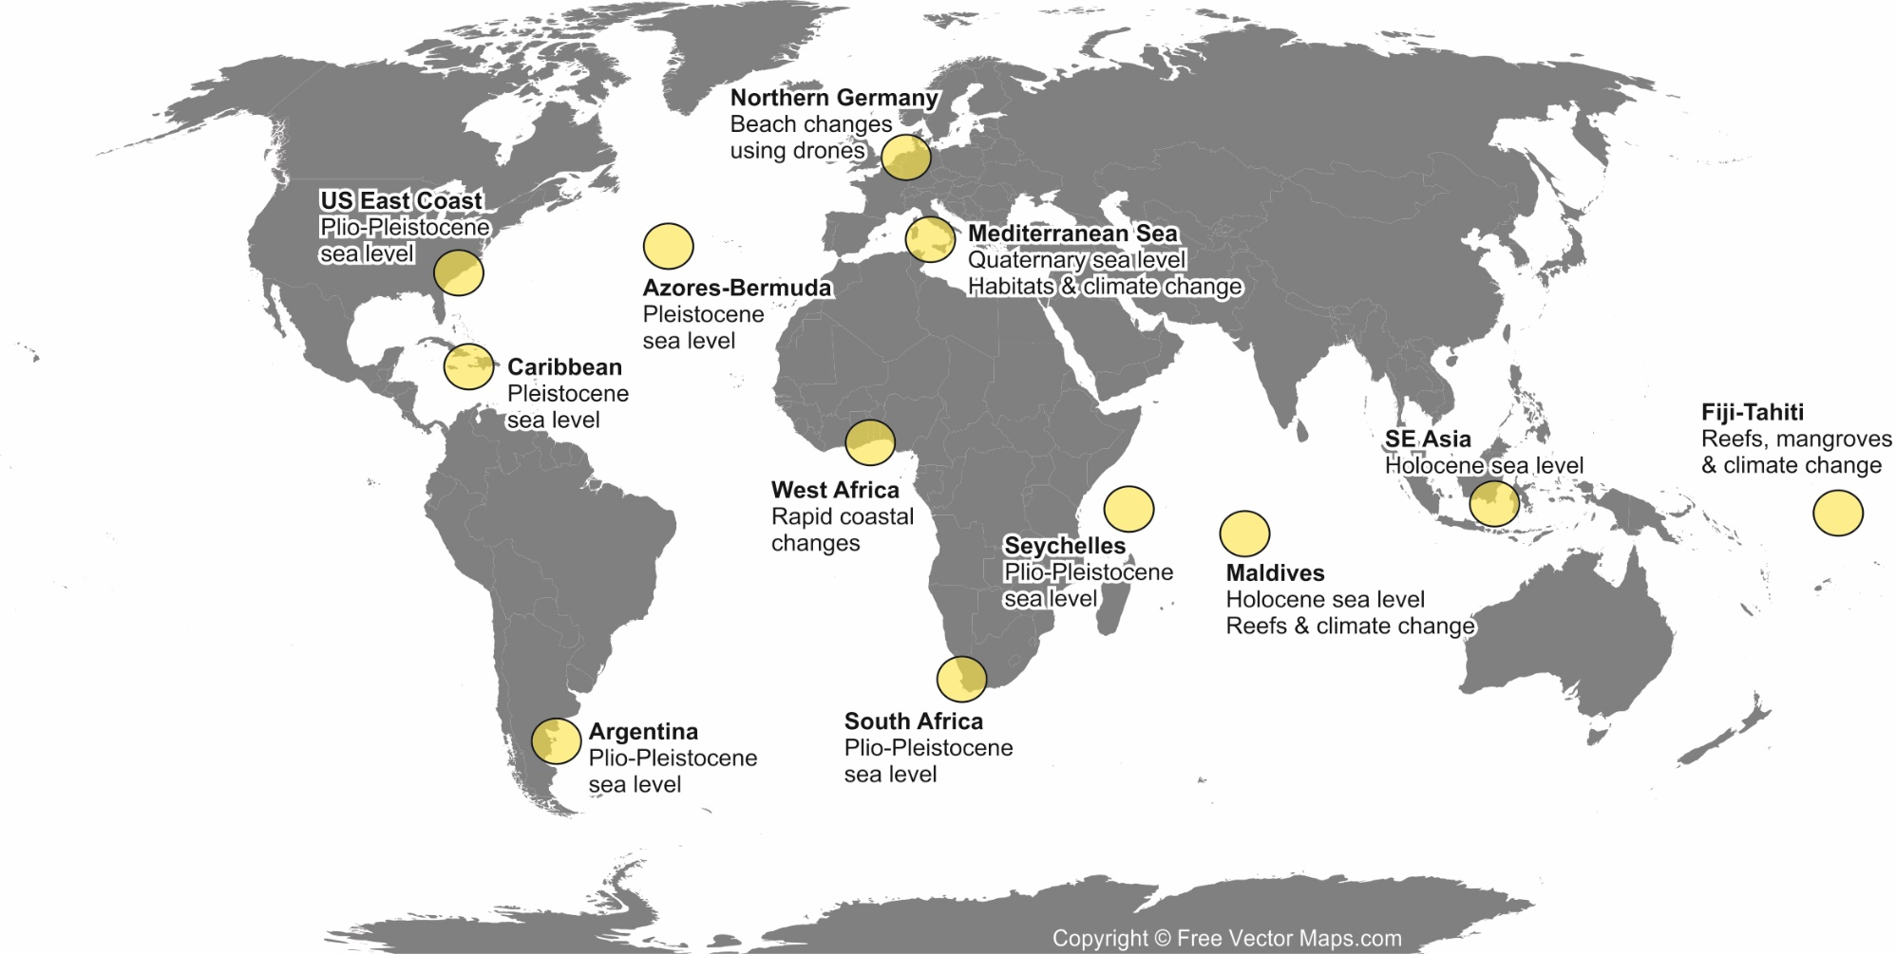
My path
I am attracted by things that I like but that I don’t know how to do

Slide 24
My path
I am attracted by things that I like but that I don’t know how to do
The publication statistics must be good, BUT…
More important are these four points
Demonstrated ability to propose and conduct ground-breaking research
Ability of creative independent thinking
Early achievements beyond the state of the art
Level of commitment to the project

Slide 25
Some comments on my profile from the ERC reviewers
An excellent publication record

Slide 26
Some comments on my profile from the ERC reviewers
An excellent publication record
Clear evidence of independence and leadership

Slide 27
Some comments on my profile from the ERC reviewers
An excellent publication record
Clear evidence of independence and leadership
…active in popular science, teaching, and service to the scientific community.

Slide 28
Some comments on my profile from the ERC reviewers
An excellent publication record
Clear evidence of independence and leadership
…active in popular science, teaching, and service to the scientific community.
The PI is clearly well connected and well regarded and has worked with/co-authored papers with many of the leading names in paleo sea level research.

Slide 29
Some comments on my profile from the ERC reviewers
An excellent publication record
Clear evidence of independence and leadership
…active in popular science, teaching, and service to the scientific community.
The PI is clearly well connected and well regarded and has worked with/co-authored papers with many of the leading names in paleo sea level research.
…enthusiastic, capable and accomplished…

Slide 30
Some comments on my profile from the ERC reviewers
An excellent publication record
Clear evidence of independence and leadership
…active in popular science, teaching, and service to the scientific community.
The PI is clearly well connected and well regarded and has worked with/co-authored papers with many of the leading names in paleo sea level research.
…enthusiastic, capable and accomplished…
The great majority of papers are without his PhD supervisor and many include his students.

Slide 31
Some comments on my profile from the ERC reviewers
An excellent publication record
Clear evidence of independence and leadership
…active in popular science, teaching, and service to the scientific community.
The PI is clearly well connected and well regarded and has worked with/co-authored papers with many of the leading names in paleo sea level research.
…enthusiastic, capable and accomplished…
The great majority of papers are without his PhD supervisor and many include his students.
There is strong evidence of independent thinking.

Slide 32
Your CV counts, but…
Your idea will “seal the deal”
Innovative, risky, not incremental
It may take years to develop – this includes rejections!

Slide 33
Conception
Daring ideas are like chessmen moved forward. They may be beaten, but they may start a winning game.
- Johann Wolfgang von Goethe

Slide 34
Conception
Daring ideas are like chessmen moved forward. They may be beaten, but they may start a winning game.
- Johann Wolfgang von Goethe
NERC, 2011

Slide 35
Conception
Daring ideas are like chessmen moved forward. They may be beaten, but they may start a winning game.
- Johann Wolfgang von Goethe
NERC, 2011

Slide 36
Conception
Daring ideas are like chessmen moved forward. They may be beaten, but they may start a winning game.
- Johann Wolfgang von Goethe
NERC, 2011
Problems:
Too local (Mediterranean)
Immature wording and organization
Data oriented, not innovative

Slide 37
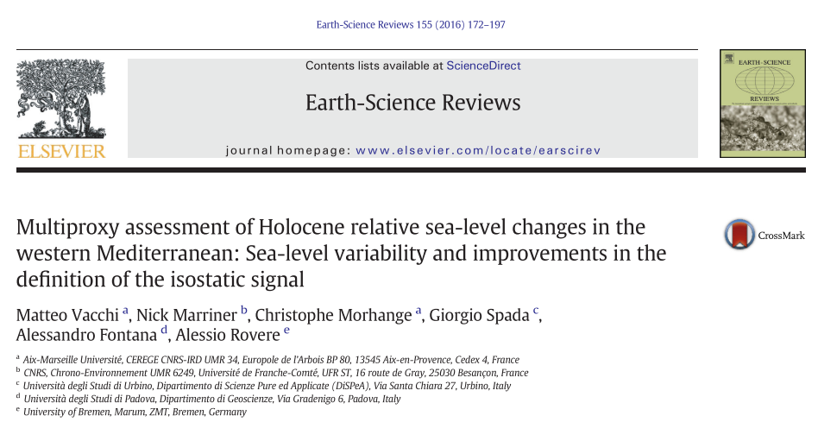
Conception
Daring ideas are like chessmen moved forward. They may be beaten, but they may start a winning game.
- Johann Wolfgang von Goethe
NERC, 2011
Few years later, we did it anyway!

Slide 38
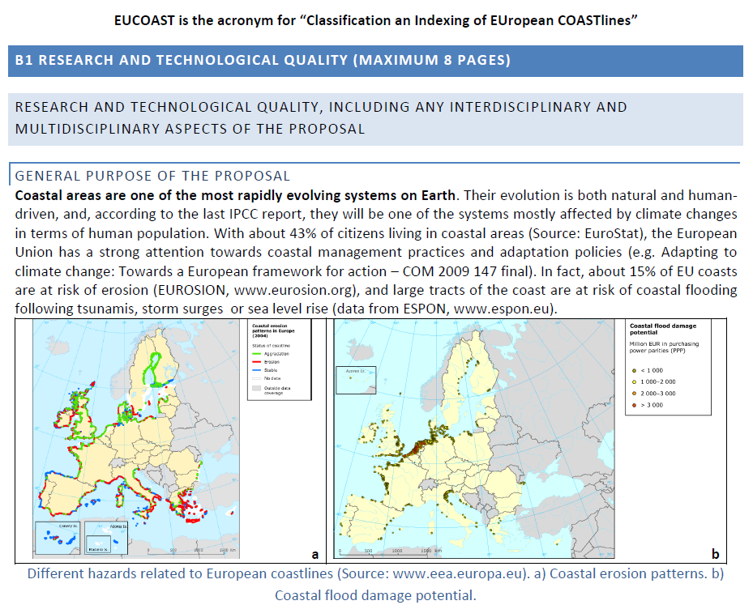
Conception
Daring ideas are like chessmen moved forward. They may be beaten, but they may start a winning game.
- Johann Wolfgang von Goethe
Marie Curie IEF, 2011

Slide 39
Conception
Daring ideas are like chessmen moved forward. They may be beaten, but they may start a winning game.
- Johann Wolfgang von Goethe
Marie Curie IEF, 2011

Slide 40
Conception
Daring ideas are like chessmen moved forward. They may be beaten, but they may start a winning game.
- Johann Wolfgang von Goethe
Marie Curie IEF, 2011
Few years later, we did it anyway!
Problems:
Technical work, not science
Workplan not very well organized
Still data oriented, no big questions tackled
Outcome: 77.9/100

Slide 41
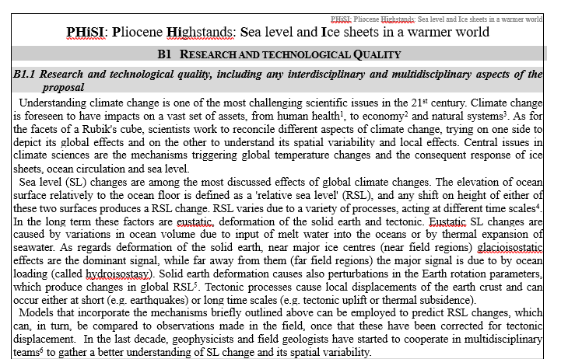
Conception
Daring ideas are like chessmen moved forward. They may be beaten, but they may start a winning game.
- Johann Wolfgang von Goethe
Marie Curie IOF, 2012

Slide 42
Conception
Daring ideas are like chessmen moved forward. They may be beaten, but they may start a winning game.
- Johann Wolfgang von Goethe
Marie Curie IOF, 2012

Slide 43
Conception
Daring ideas are like chessmen moved forward. They may be beaten, but they may start a winning game.
- Johann Wolfgang von Goethe
Marie Curie IOF, 2012
Problems:
Scientific work could be better defined
Big questions are there but already being tackled
Outcome: between 70 and 80/100

Slide 44
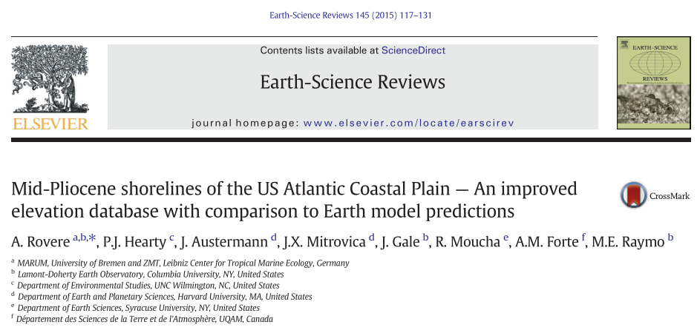
Conception
Daring ideas are like chessmen moved forward. They may be beaten, but they may start a winning game.
- Johann Wolfgang von Goethe
Marie Curie IOF, 2012
Some of it was used in a later review paper!

Slide 45
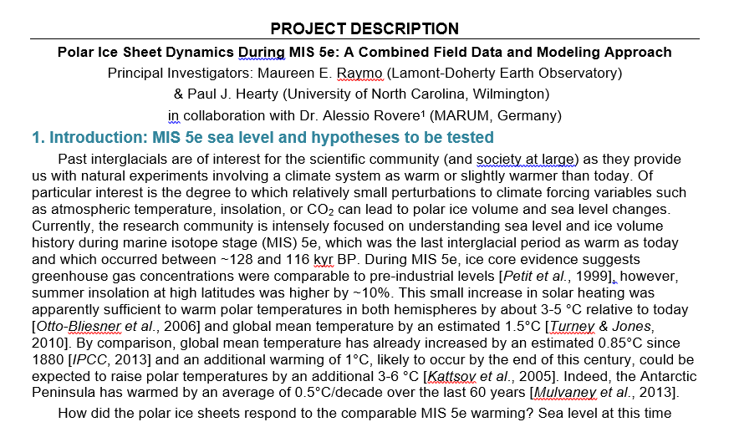
Conception
Daring ideas are like chessmen moved forward. They may be beaten, but they may start a winning game.
- Johann Wolfgang von Goethe
National Science Foundation, 2014

Slide 46
Conception
Daring ideas are like chessmen moved forward. They may be beaten, but they may start a winning game.
- Johann Wolfgang von Goethe
National Science Foundation, 2014

Slide 47
Conception
Daring ideas are like chessmen moved forward. They may be beaten, but they may start a winning game.
- Johann Wolfgang von Goethe
National Science Foundation, 2014
Problems:
The idea is mature, but it needs to be refined
Global scope is OK, but needs to be better framed
Not a single-person (postdoc) project, need of a team working through several years

Slide 48
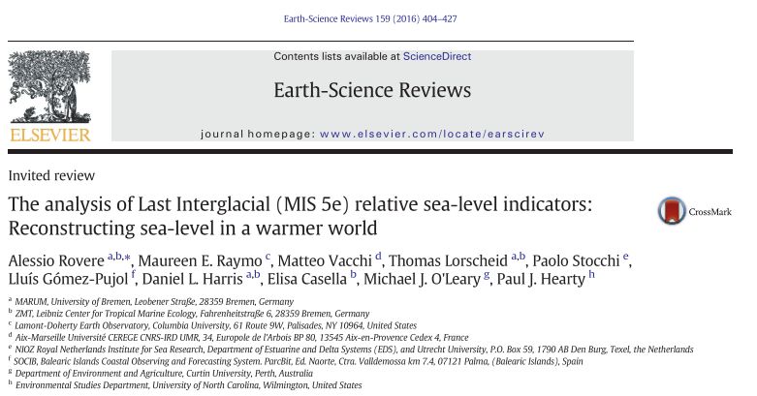
Conception
Daring ideas are like chessmen moved forward. They may be beaten, but they may start a winning game.
- Johann Wolfgang von Goethe
National Science Foundation, 2014
Some of it was used in a later review paper!

Slide 49
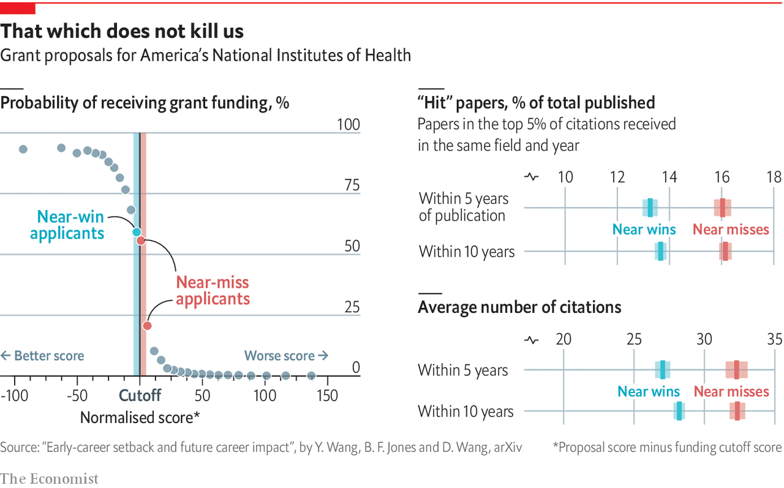
Conception
Daring ideas are like chessmen moved forward. They may be beaten, but they may start a winning game.
- Johann Wolfgang von Goethe
Scientists who fail early in their careers may benefit from the experience
https://www.economist.com/graphic-detail/2019/05/10/success-in-academia-is-as-much-about-grit-as-talent

Slide 50
Conception
Daring ideas are like chessmen moved forward. They may be beaten, but they may start a winning game.
- Johann Wolfgang von Goethe
MARUM Excellence Initiative 2014

Slide 51
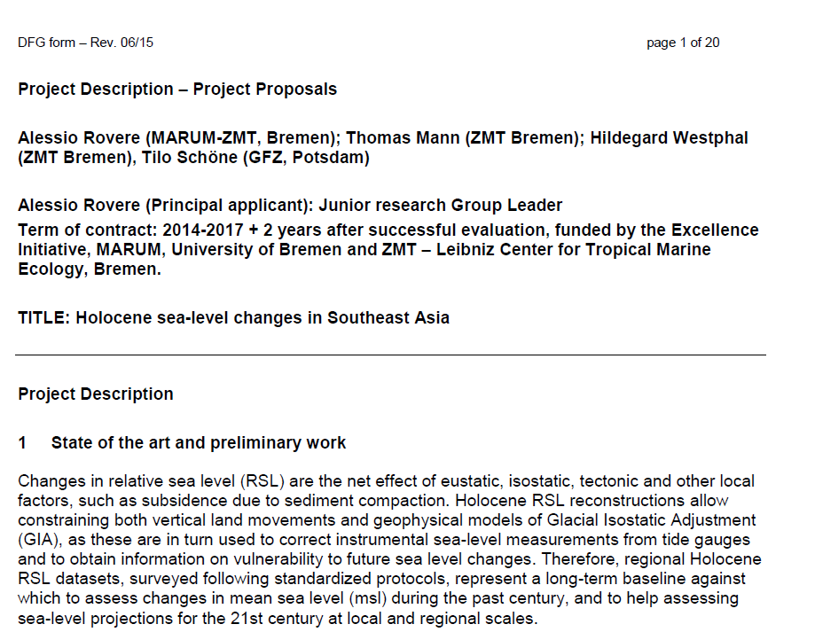
Conception
Daring ideas are like chessmen moved forward. They may be beaten, but they may start a winning game.
- Johann Wolfgang von Goethe
DFG Spp Sea Level 2016

Slide 52
Conception
Daring ideas are like chessmen moved forward. They may be beaten, but they may start a winning game.
- Johann Wolfgang von Goethe
DFG Spp Sea Level 2016
What changed
Mature ideas, naivety is gone
Big problems are tackled
More focused writing
Care on graphics

Slide 53
Lessons learned
2011-2019
It is a marathon, not a sprint
If an idea is good, persistence pays off
Use what you write for review papers
Keep reshaping the idea as new literature comes out

Slide 54
Inception
No army can withstand the strength of an idea whose time has come
- Victor Hugo

Slide 55
Inception
No army can withstand the strength of an idea whose time has come
- Victor Hugo
Streamline your idea into a project draft by defining your ROAR points
Research gaps

Slide 56
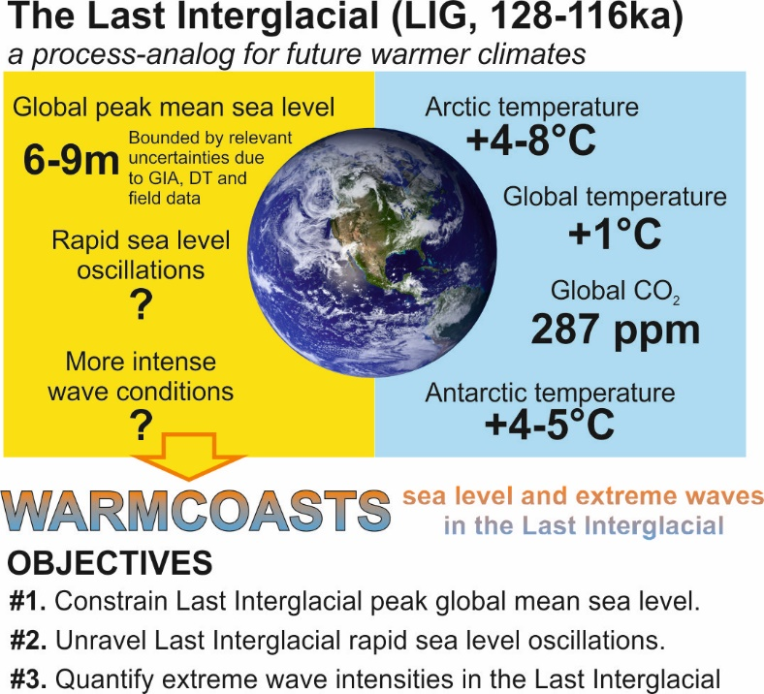
Inception
No army can withstand the strength of an idea whose time has come
- Victor Hugo
Streamline your idea into a project draft by defining your ROAR points
Research gaps
Overarching goals

Slide 57
Inception
No army can withstand the strength of an idea whose time has come
- Victor Hugo
Streamline your idea into a project draft by defining your ROAR points
Research gaps
Overarching goals
Actions

Slide 58
Inception
No army can withstand the strength of an idea whose time has come
- Victor Hugo
Streamline your idea into a project draft by defining your ROAR points
Research gaps
Overarching goals
Actions
Relevance

Slide 59
Inception
No army can withstand the strength of an idea whose time has come
- Victor Hugo
Ask yourself the hard questions
Is my idea ground-breaking?
Is it feasible, but with risky aspects?
Is it incremental? (It should not be)
Do I really need a team and lots of money?

Slide 60
Inception
No army can withstand the strength of an idea whose time has come
- Victor Hugo
Get out there and challenge your colleagues
European Geosciences Union

Slide 61
START WRITING!

Slide 62
Writing
If I had more time, I would have written a shorter letter
- Blaise Pascal

Slide 63
Writing
If I had more time, I would have written a shorter letter
- Blaise Pascal
1. Follow the instructions!
Read and conform to all instructions found on the ERC website.
Edited from
https://www.mcgill.ca/gps/students/research-tracking/proposals

Slide 64
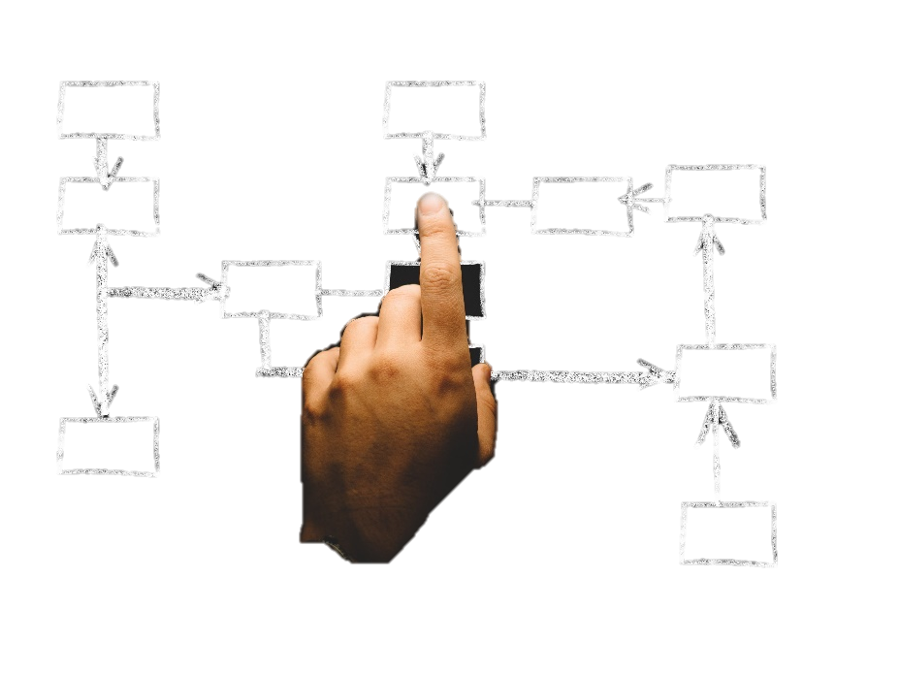
Writing
If I had more time, I would have written a shorter letter
- Blaise Pascal
Follow the instructions!
Break down your proposal into points
For each section, lay out in point form what you will discuss.
Pexels.com
Edited from
https://www.mcgill.ca/gps/students/research-tracking/proposals

Slide 65
Writing
If I had more time, I would have written a shorter letter
- Blaise Pascal
Follow the instructions!
Break down your proposal into points
Know your audience
Describe your research proposal in non-technical terms. Use clear, plain language and avoid jargon.
Edited from
https://www.mcgill.ca/gps/students/research-tracking/proposals

Slide 66
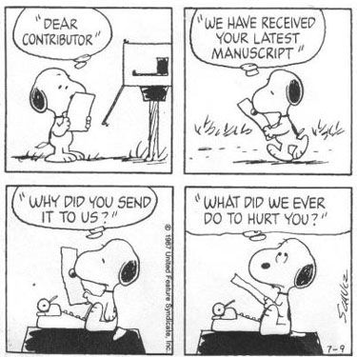
Writing
If I had more time, I would have written a shorter letter
- Blaise Pascal
Follow the instructions!
Break down your proposal into points
Know your audience
Make an impact in the first few sentences
Reviewers are very busy people. But they are also scientists, so they are keen to know new things. You must grab their attention and excite them about your project from the very beginning. Make it easy for them to understand (and thus fund) your proposal.
Edited from
https://www.mcgill.ca/gps/students/research-tracking/proposals

Slide 67
Writing
If I had more time, I would have written a shorter letter
- Blaise Pascal
Follow the instructions!
Break down your proposal into points
Know your audience
Make an impact in the first few sentences
5. Have a clear title.
It is important that the title of your project is understandable to the general public, reflects the goal of the study, and attracts interest.
Edited from
https://www.mcgill.ca/gps/students/research-tracking/proposals

Slide 68
Writing
If I had more time, I would have written a shorter letter
- Blaise Pascal
Follow the instructions!
Break down your proposal into points
Know your audience
Make an impact in the first few sentences
5. Have a clear title
6. Care about your graphics!
Make your own graphics, your proposal should look sharp, fresh, exciting. Avoid as much as possible copy-paste.
Edited from
https://www.mcgill.ca/gps/students/research-tracking/proposals

Slide 69
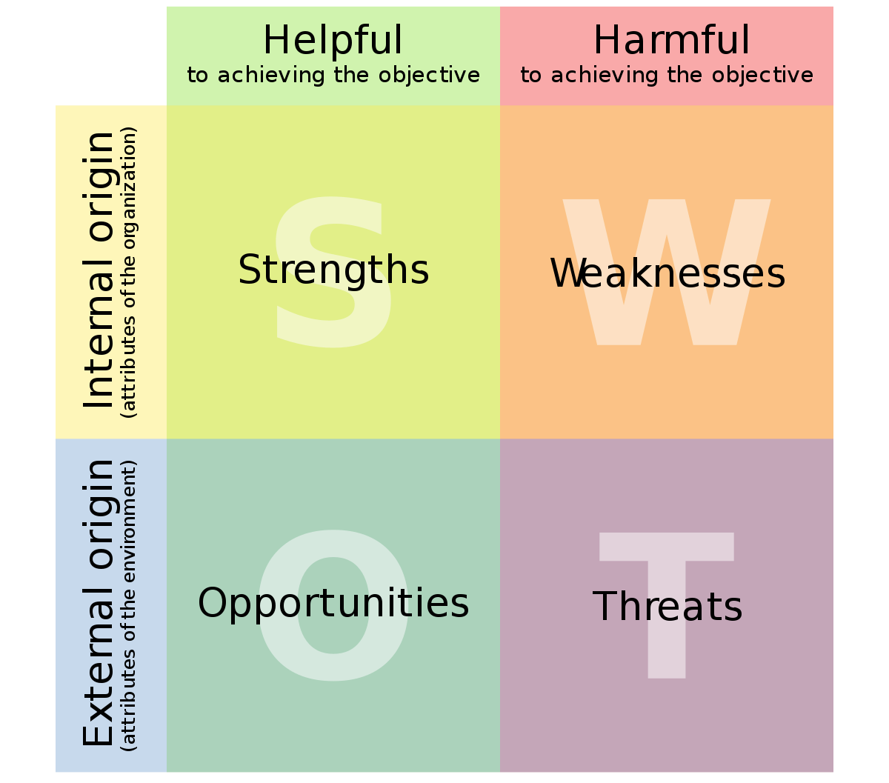
Writing
If I had more time, I would have written a shorter letter
- Blaise Pascal
Follow the instructions!
Break down your proposal into points
Know your audience
Make an impact in the first few sentences
5. Have a clear title
6. Care about your graphics!
7. Show that your research is feasible
Demonstrate that you are competent to conduct the research, and that you can tackle risks. Do not hide risks, state them and analyze them!
Source: Wikipedia
Edited from
https://www.mcgill.ca/gps/students/research-tracking/proposals

Slide 70
Writing
If I had more time, I would have written a shorter letter
- Blaise Pascal
Follow the instructions!
Break down your proposal into points
Know your audience
Make an impact in the first few sentences
5. Have a clear title
6. Care about your graphics!
7. Show that your research is feasible
8. Indicate how your research will make a “contribution to knowledge” Claim a vision, tell it to the reviewer
Edited from
https://www.mcgill.ca/gps/students/research-tracking/proposals

Slide 71
Writing
If I had more time, I would have written a shorter letter
- Blaise Pascal
Follow the instructions!
Break down your proposal into points
Know your audience
Make an impact in the first few sentences
5. Have a clear title
6. Care about your graphics!
7. Show that your research is feasible
8. Indicate how your research will make a “contribution to knowledge”
9. Get the proposal reviewed and commented on by others
Get feedback and edit. Then edit some more. And get more feedback. The more diverse opinion and criticism you receive on your proposal the better suited it will be for a multi-disciplinary audience.
Pexels.com
Edited from
https://www.mcgill.ca/gps/students/research-tracking/proposals

Slide 72
Writing
If I had more time, I would have written a shorter letter
- Blaise Pascal
Follow the instructions!
Break down your proposal into points
Know your audience
Make an impact in the first few sentences
5. Have a clear title
6. Care about your graphics!
7. Show that your research is feasible
8. Indicate how your research will make a “contribution to knowledge”
9. Get the proposal reviewed and commented on by others
Spend time on your budget!
The administration of your institute knows how to draft it, but you need to think about your needs
Pexels.com
Edited from
https://www.mcgill.ca/gps/students/research-tracking/proposals

Slide 73
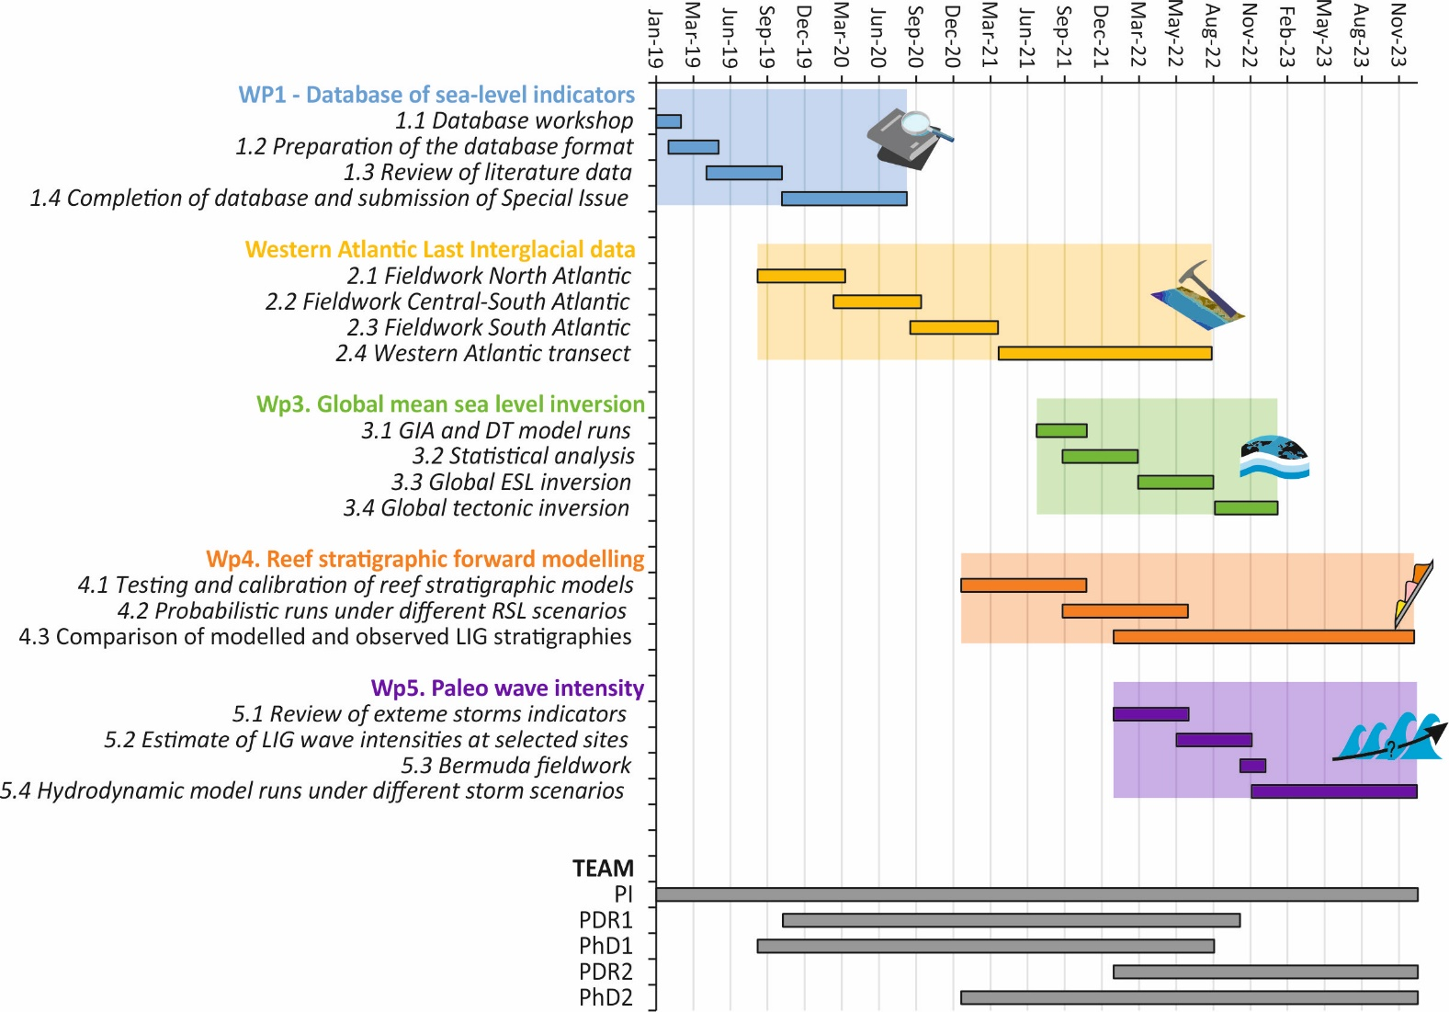
Budget (and workplan)
Describe each action
Assign researchers to each action
Describe the expertise needed
Budget for the team

Slide 74
If you have anything available at no cost… SAY IT!

Slide 75
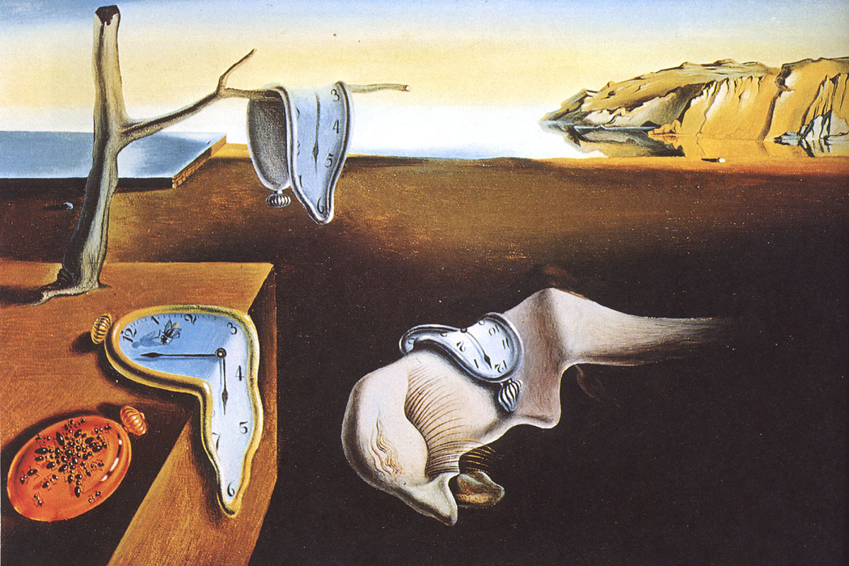
1 YEAR from inception to written proposal
Wikipedia

Slide 76
The review process
Part A
Info on:
Proposal and PI
Host institution
Budget
Part B1
Info on:
PI track record
Extended project synopsis
Part B2
Info on:
Full project description including ethics and budget

Slide 77
The review process
Part A
Info on:
Proposal and PI
Host institution
Budget
Part B1
Info on:
PI track record
Extended project synopsis
Part B2
Info on:
Full project description including ethics and budget
Step 1 – Remote assessment by panel members on Part B1
Panel meeting
Proposals retained for step 2
Eligibility checks

Slide 78
The review process
Part A
Info on:
Proposal and PI
Host institution
Budget
Part B1
Info on:
PI track record
Extended project synopsis
Part B2
Info on:
Full project description including ethics and budget
Step 1 – Remote assessment by panel members on Part B1
Panel meeting
Proposals retained for step 2
Eligibility checks
Step 2 –Assessment by panel members + external reviewers on Part B1 and Part B2
Panel meeting
+
interview
Ranked list of proposals
Interview invitation

Slide 79
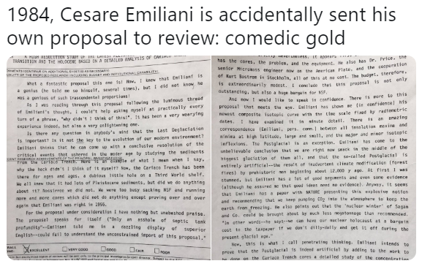
The review process
@moraymo, Twitter

Slide 80
The review process
@moraymo, Twitter

Slide 81
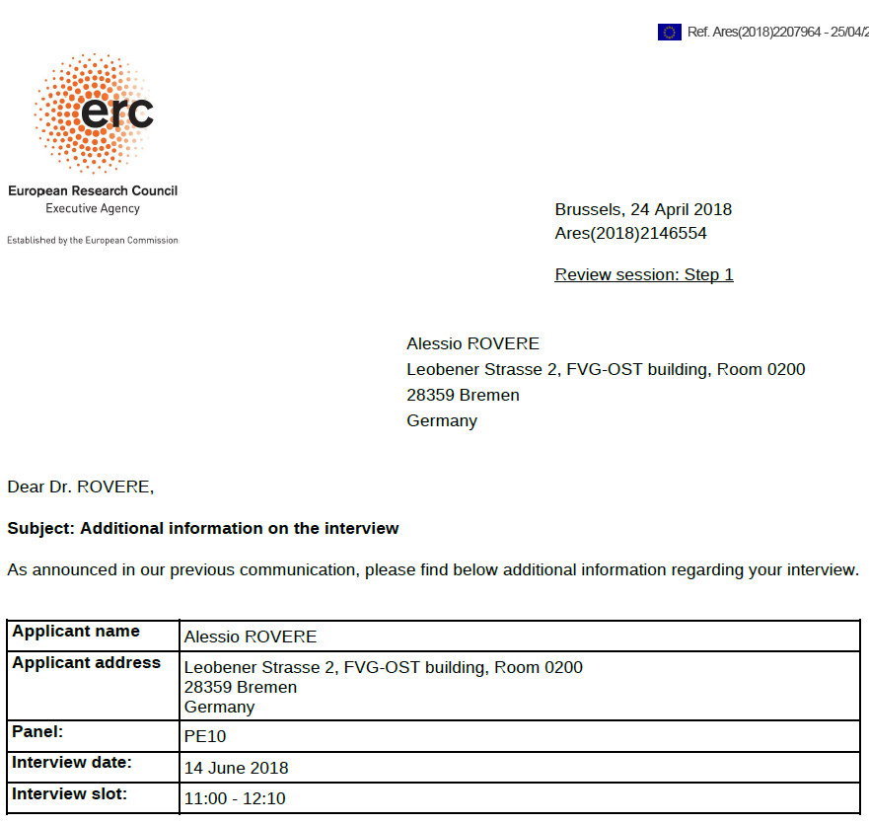

Slide 82
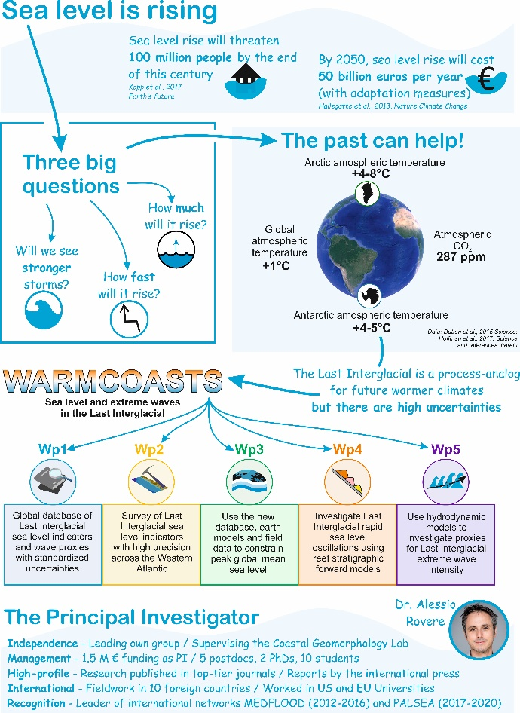
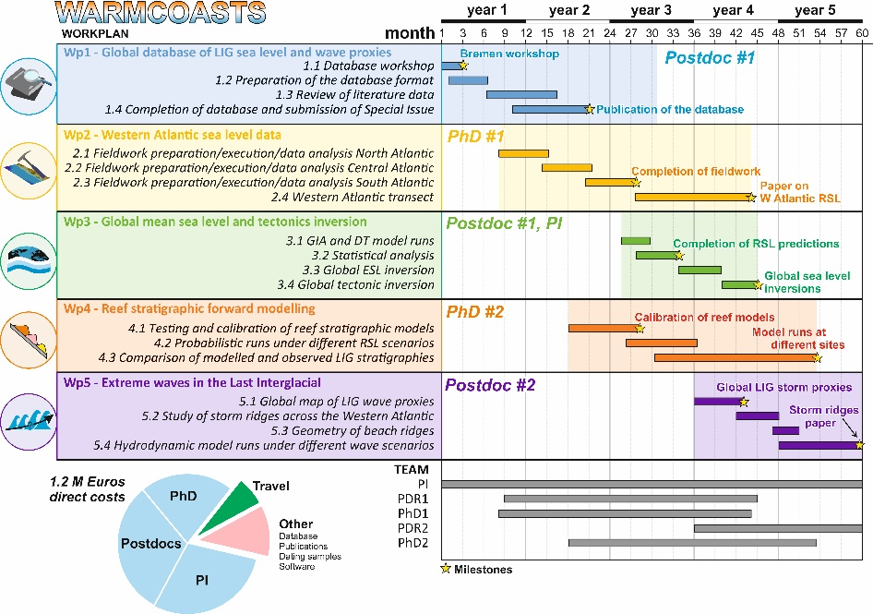
Interview
It usually takes me more than three weeks to prepare a good impromptu speech
- Mark Twain
Follow the instructions!
PE 10 (Earth sciences) has a 5 minutes presentation and 20 minutes discussion. STAY ON TIME
Slide printouts are possible – Ask if an infographic is accepted as well.

Slide 83
Interview
Suggested reading
It usually takes me more than three weeks to prepare a good impromptu speech
- Mark Twain
Follow the instructions!
Practice make you perfect
Watch presentations online (Ted Talk). Take a presentation course, learn how to stand on the podium and how to present. Record your talk, keep changing it until you are happy with it. Ask feedbacks from colleagues and organize trial panels.

Slide 84
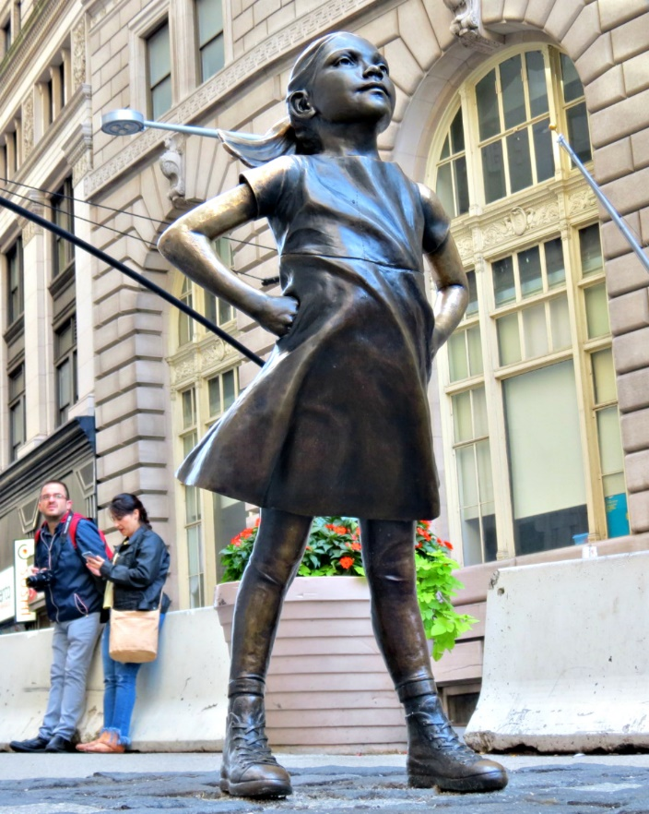
Interview
It usually takes me more than three weeks to prepare a good impromptu speech
- Mark Twain
Follow the instructions!
Practice make you perfect
Be confident
It is your project, your idea, and it is brilliant. If you are there, the panel thinks you are good. They just need to confirm the impression they had on paper
Wikipedia

Slide 85
Interview
It usually takes me more than three weeks to prepare a good impromptu speech
- Mark Twain
Follow the instructions!
Practice make you perfect
Be confident
Study your panel
ERC panels from previous years are available online. How they are composed in terms of expertise? Someone you know in your field?

Slide 86
Interview
It usually takes me more than three weeks to prepare a good impromptu speech
- Mark Twain
Follow the instructions!
Practice make you perfect
Be confident
Study your panel
5. Know your weaknesses
And turn this into a strength. Try to anticipate questions and pre-formulate the best possible answers. If it makes you feel better, use additional slides. But remember that when you answer they should focus on you, not on the slides…

Slide 87
Thank you for your attention and happy grant writing!

