Slide 1
ShEx & SHACL compared RDF Validation tutorial
Jose Emilio Labra Gayo
WESO Research group
University of Oviedo, Spain
Eric Prud'hommeaux
World Wide Web Consortium
MIT, Cambridge, MA, USA
Iovka Boneva
LINKS, INRIA & CNRS
University of Lille, France
Dimitris Kontokostas
GeoPhy
http://kontokostas.com/

Slide 2
Several common features…
Similar goal: describe and validate RDF graphs
Both employ the word "shape"
Node constraints similar in both languages
Constraints on incoming/outgoing arcs
Both allow to define cardinalities
Both have RDF syntax
Both have an extension mechanism

Slide 3
But some differences…
Underlying philosophy
Syntactic differences
Notion of a shape
Syntactic differences
Default cardinalities
Shapes and Classes
Recursion
Repeated properties
Property pair constraints
Uniqueness
Extension mechanism

Slide 4
Underlying philosophy
ShEx is more schema based
SHACL is more constraint based
Shapes ≈ grammars
More focus on validation results
Result shape maps
Info about conforming and non-conforming nodes
Shapes ≈ collections of constraints
More focus on validation errors
No info about conforming nodes
Difficult to distinguish between conforming nodes and nodes that have been ignored
Some implementations offer info about conforming nodes: SHACL-S, TopBraid

Slide 5
Semantic specification
ShEx semantics: mathematical concepts
SHACL semantics = textual description + SPARQL
Well-founded semantics*
Support for recursión and negation
Inspired by type systems and RelaxNG
SHACL terms described in natural language
SPARQL fragments used as helpers
Recursion is implementation dependent*
SHACL-SPARQL based on pre-binding
*Semantics and Validation of Shapes Schemas for RDF
Iovka Boneva Jose Emilio Labra Gayo Eric Prud'hommeaux
ISWC'17
Proposal to add recursion: *Semantics and Validation of Recursive SHACL
Julien Corman, Juan L. Reutter, Ognjen Savkovic, ISWC'18
It was made after the spec

Slide 6
Syntactic differences
ShEx design focused on human-readability
SHACL design focused on RDF vocabulary
Followed programming language design methodology
1. Abstract syntax
2. Different concrete syntaxes
Compact
JSON-LD
RDF
...
Design centered on RDF terms
Lots of rules to define valid shapes graphs
https://w3c.github.io/data-shapes/shacl/#syntax-rules
Compact syntax created after RDF syntax

Slide 7
Compact Syntax
SHACL has no compact syntax
ShEx compact syntax designed along the language
Test-suite with long list of tests
Round-trip with JSON-LD and RDF syntax
A WG Note proposed a compact syntax
It covers a subset of SHACL core
Compact
Syntax
JSON-LD/RDF
Syntax
Compact
Syntax
JSON-LD/RDF
Syntax
partial

Slide 8
Compact syntax
prefix schema: <http://schema.org/>
prefix xsd: <http://www.w3.org/2001/XMLSchema#>
prefix : <http://www.example.org/>
:UserShape CLOSED EXTRA rdf:type {
schema:name xsd:string ? ;
schema:gender [ schema:Male schema:Female ] ;
schema:birthDate xsd:date ? ;
schema:knows @:User *
}
prefix schema: <http://schema.org/>
prefix xsd: <http://www.w3.org/2001/XMLSchema#>
prefix : <http://www.example.org/>
shape :UserShape -> :User {
closed=true ignoredProperties=[rdf:type] .
schema:name xsd:string [0..1] .
schema:gender in = [ schema:Male schema:Female ] .
schema:birthDate xsd:date [0..1] .
schema:knows :User [0..*] .
}

Slide 9
RDF vocabulary
ShEx vocabulary ≈ abstract syntax
SHACL designed as an RDF vocabulary
ShEx RDF vocabulary obtained from abstract syntax
ShEx RDF serializations typically more verbose
They can be round-tripped to Compact syntax
Some rdf:type declarations can be omitted
SHACL RDF serialization typically more readable
:User a sx:Shape;
sx:expression [ a sx:EachOf ;
sx:expressions (
[ a sx:TripleConstraint ;
sx:predicate schema:name ;
sx:valueExpr [ a sx:NodeConstraint ;
sx:datatype xsd:string ]
]
[ a sx:TripleConstraint ;
sx:predicate schema:birthDate ;
sx:valueExpr [ a sx:NodeConstraint ;
sx:datatype xsd:date ] ;
sx:min 0
] )
].
:User a sh:NodeShape ;
sh:property [ sh:path schema:name ;
sh:minCount 1; sh:maxCount 1;
sh:datatype xsd:string
];
sh:property [ sh:path schema:birthDate ;
sh:maxCount 1;
sh:datatype xsd:date
] .

Slide 10
Notion of Shape
In ShEx, shapes only define structure of nodes
In SHACL, shapes define structure and can have target declarations
Shape maps select which nodes are validated with which shapes
Goal: separation of concerns
Shapes can be associated with nodes or sets of nodes through target declarations
Shapes may be less reusable in other contexts
Shape
Shape
:User IRI {
schema:name xsd:string
}
:User a sh:NodeShape, rdfs:Class ;
sh:targetClass :Person ;
sh:targetNode :alice ;
sh:nodeKind sh:IRI ;
sh:property [
sh:path schema:name ;
sh:datatype xsd:string
] .
target
declarations
Shape map
:alice@:User,
{FOCUS rdf:type :Person}@:User
structure

Slide 11
Default cardinalities
ShEx: default = (1,1)
SHACL: default = (0,unbounded)
:User {
schema:givenName xsd:string
schema:lastName xsd:string
}
:User a sh:NodeShape ;
sh:property [ sh:path schema:givenName ;
sh:datatype xsd:string ;
];
sh:property [ sh:path schema:lastName ;
sh:datatype xsd:string ;
] .
☺
:alice schema:givenName "Alice" ;
schema:lastName "Cooper" .
:bob schema:givenName "Bob", "Robert" ;
schema:lastName "Smith", "Dylan" .
:carol schema:lastName "King" .
:dave schema:givenName 23;
schema:lastName :Unknown .
☺
☹
☺
☹
☺
☹
☹
☺
= conforms to Shape
☹
= doesn't conform

Slide 12
Property paths
ShEx shapes describe neighborhood of focus nodes: direct/inverse properties
SHACL shapes can also describe whole property paths following SPARQL paths
Recursion paths can be emulated by nested shapes
Sometimes requiring auxiliary recursive shapes
:GrandSon a sh:NodeShape ;
sh:property [
sh:path (schema:parent schema:parent) ;
sh:minCount 1
];
sh:property [
sh:path [
sh:alternativePath (:father :mother) ]
];
sh:minCount 1
] ;
sh:property [
sh:path [sh:inversePath :knows ] ]
sh:node :Person ;
sh:minCount 1
]
.
:GrandSon {
:parent { :parent . + } + ;
(:father . | :mother .) + ;
^:knows :Person
}

Slide 13
Property paths
SHACL shapes can use property paths
ShEx shapes describe neighborhood of focus nodes: direct/inverse properties
Recursion paths can be emulated with auxiliary shapes
:GrandParent a sh:NodeShape ;
sh:property [
sh:path [ sh:zeroOrMorePath schema:knows] ;
sh:node :Person ;
] .
:Person a sh:NodeShape ;
sh:property [
sh:path schema:name ;
sh:datatype xsd:string ;
sh:minCount 1; sh:maxCount 1
] .
:GrandParent {
schema:knows @:PersonKnown*;
}
:PersonKnown @:Person {
schema:knows @:PersonKnown*
}
:Person {
schema:name xsd:string
}

Slide 14
Property paths
SHACL shapes can use property paths
ShEx shapes describe neighborhood of focus nodes: direct/inverse properties
Control about cardinalities
Some pathological cases
:Invoice {
:payment {
:amount xsd:decimal
}
}
:Invoice a sh:NodeShape ;
sh:property [
sh:path (:payment :amount ) ;
sh:datatype xsd:decimal ;
sh:minCount 1; sh:maxCount 1
] .
☺
:i1 :payment [ :amount 3.0 ] .
:i2 :payment [ :amount 3.0 ] ;
:payment [ :amount 2.0 ] .
:i3 :payment [ :amount 2.0 ] ;
:payment [ :amount 2.0 ] .
☺
☹
☹
☹
☺ ?
Try it: https://tinyurl.com/y97npq5s
Try it: https://tinyurl.com/yabl4v95

Slide 15
Inference
ShEx doesn't mess with inference
Some constructs have special meaning
Validation can be invoked before or after inference
rdf:type is considered an arc as any other
No special meaning
The same for rdfs:Class, rdfs:subClassOf, rdfs:domain, rdfs:range, ...
The following constructs have special meaning in SHACL
rdf:type
rdfs:Class
rdfs:subClassOf
owl:imports
Other constructs like rdfs:domain, rdfs:range,... have no special meaning
sh:entailment can be used to indicate that some inference is required

Slide 16
Inference and triggering mechanism
ShEx has no interaction with inference
In SHACL, RDF Schema inference can affect which nodes are validated
It can be used to validate a reasoner
Some implicit RDFS inference but not all
:User {
schema:name xsd:string
}
:User a sh:NodeShape, rdfs:Class ;
sh:property [ sh:path schema:name ;
sh:datatype xsd:string;
].
:Teacher rdfs:subClassOf :User .
:teaches rdfs:domain :Teacher .
:alice a :Teacher ;
schema:name 23 .
:bob :teaches :Algebra ;
schema:name 34 .
:carol :teaches :Logic;
schema:name "King" .
With or without
RDFS inference
No RDFS
inference
RDFS
inference
☹
☹
☹
☹
☹
Ignored
☺
☺
Ignored
☺
= conforms to Shape
☹
= doesn't conform

Slide 17
Repeated properties
ShEx (;) operator handles repeated properties
SHACL needs qualifiedValueShapes for repeated properties
Example. A person must have 2 parents, one male and another female
:Person {
:parent {:gender [:Male ] } ;
:parent {:gender [:Female ] }
}
Direct approximation (wrong):
:Person a sh:NodeShape;
sh:property [ sh:path :parent;
sh:node [ sh:property [ sh:path :gender ;
sh:hasValue :Male ; ]] ;
];
sh:property [ sh:path :parent;
sh:node [ sh:property [ sh:path :gender ;
sh:hasValue :Female ]];
]
.
This says that a person must have a parent which is at the same time male and female

Slide 18
Repeated properties
ShEx (;) operator handles repeated properties
SHACL needs qualifiedValueShapes for repeated properties
Example. A person must have 2 parents, one male and another female
Solution with qualifiedValueShapes:
:Person {
:parent {:gender [:Male ] } ;
:parent {:gender [:Female ] }
}
:Person a sh:NodeShape, rdfs:Class ;
sh:property [ sh:path :parent;
sh:qualifiedValueShape [ sh:property [ sh:path :gender ;
sh:hasValue :Male ] ] ;
sh:qualifiedMinCount 1; sh:qualifiedMaxCount 1
];
sh:property [ sh:path :parent;
sh:qualifiedValueShape [ sh:property [ sh:path :gender ;
sh:hasValue :Female ] ] ;
sh:qualifiedMinCount 1; sh:qualifiedMaxCount 1
] ;
sh:property [ sh:path :parent;
sh:minCount 2; sh:maxCount 2
]
.
It needs to count all possibilities

Slide 19
Recursion
ShEx handles recursion
Recursive shapes are undefined in SHACL*
Well founded semantics
Implementation dependent
Direct translation generates recursive shapes
:Person {
schema:name xsd:string ;
schema:knows @:Person*
}
:Person a sh:NodeShape ;
sh:property [ sh:path schema:name ;
sh:datatype xsd:string
];
sh:property [ sh:path schema:knows ;
sh:node :Person
]
.
Undefined because it is recursive
*Semantics and Validation of Recursive SHACL
Julien Corman, Juan L. Reutter and Ognjen Savkovic, ISWC'18

Slide 20
Recursion (with target declarations)
ShEx handles recursion
Recursive shapes are undefined in SHACL
Well founded semantics
Implementation dependent
Can be simulated with target declarations
Example with target declatations
It needs discriminating arcs
:Person a sh:NodeShape, rdfs:Class ;
sh:property [ sh:path schema:name ;
sh:datatype xsd:string
];
sh:property [ sh:path schema:knows ;
sh:class :Person
]
.
:Person {
schema:name xsd:string ;
schema:knows @:Person*
}
It requires all nodes to have rdf:type Person

Slide 21
Recursion (with property paths)
ShEx handles recursion
Recursive shapes are undefined in SHACL
Well founded semantics
Implementation dependent
Can be simulated property paths
:Person a sh:NodeShape ;
sh:property [
sh:path schema:name ; sh:datatype xsd:string ];
sh:property [
sh:path [sh:zeroOrMorePath schema:knows];
sh:node :PersonAux
].
:PersonAux a sh:NodeShape ;
sh:property [
sh:path schema:name ; sh:datatype xsd:string
].
:Person {
schema:name xsd:string ;
schema:knows @:Person*
}

Slide 22
Closed shapes
In ShEx, closed affects all properties
In SHACL, closed only affects properties declared at top-level
Properties declared inside other shapes are ignored
:Person CLOSED {
schema:name xsd:string
| foaf:name xsd:string
}
:Person a sh:NodeShape ;
sh:targetNode :alice ;
sh:closed true ;
sh:or (
[ sh:path schema:name ; sh:datatype xsd:string ]
[ sh:path foaf:name ; sh:datatype xsd:string ]
) .
☺
☹
:alice schema:name "Alice" .
☺
= conforms to Shape
☹
= doesn't conform

Slide 23
Closed shapes and paths
Closed in ShEx acts on all properties
In SHACL, closed ignores properties mentioned inside paths
:Person CLOSED {
schema:name xsd:string |
foaf:name xsd:string
}
:Person a sh:NodeShape ;
sh:closed true ;
sh:property [
sh:path [
sh:alternativePath
( schema:name foaf:name )
] ;
sh:minCount 1; sh:maxCount 1;
sh:datatype xsd:string ] ;
.
☺
☹
:alice schema:name "Alice".
☺
= conforms to Shape
☹
= doesn't conform

Slide 24
Property pair constraints
This feature was posponed in ShEx 2.0
SHACL supports equals, disjoint, lessThan, ...
ShEx 2.1 is expected to add support for value comparisons
:UserShape a sh:NodeShape ;
sh:property [
sh:path schema:givenName ;
sh:datatype xsd:string ;
sh:disjoint schema:lastName
] ;
sh:property [
sh:path foaf:firstName ;
sh:equals schema:givenName ;
] ;
sh:property [
sh:path schema:birthDate ;
sh:datatype xsd:date ;
sh:lessThan :loginDate
] .
Not supported in ShEx 2.0
:UserShape {
$<givenName> schema:givenName xsd:string ;
$<firstName> schema:firstName xsd:string ;
$<birthDate> schema:birthDate xsd:date ;
$<loginDate> :loginDate xsd:date ;
$<givenName> = $<firstName> ;
$<givenName> != $<lastName> ;
$<birthDate> < $<loginDate>
}

Slide 25
Uniqueness (defining unique Keys)
This feature was postponed in ShEx 2.1
No support for generic unique keys
sh:uniqueLang offers partial support for a very common use case
Uniqueness can be done with SHACL-SPARQL
Not supported yet
:UserShape {
schema:givenName xsd:string ;
schema:lastName xsd:string ;
UNIQUE(schema:givenName, schema:lastName)
}
Not supported yet
:Country a sh:NodeShape ;
sh:property [
sh:path schema:name ;
sh:uniqueLang true
] .
:Country {
schema:name . + ;
UNIQUE(LANGTAG(schema:name))
}

Slide 26
Modularity
ShEx has EXTERNAL and import keywords
SHACL supports owl:imports
import imports shapes from URI
externaldeclares that a shape definition can be retrieved elsewhere
SHACL processors follow owl:imports
:UserShape a sh:NodeShape ;
sh:property [ sh:path schema:name ;
sh:datatype xsd:string
] .
:UserShape {
schema:name xsd:string
}
http://example.org/UserShapes
http://example.org/UserShapes
<> owl:imports <http://example.org/UserShapes>
:TeacherShape a sh:NodeShape;
sh:node :UserShape ;
sh:property [ sh:path :teaches ;
sh:minCount 1;
] ;
import <http://example.org/UserShapes>
:TeacherShape :UserShape AND {
:teaches . ;
:teacherCode external
}

Slide 27
Reusability - Extending shapes (1)
ShEx shapes can be extended by conjunction
SHACL shapes can also be extended by conjunction
Extending by composition
:Product {
schema:productId xsd:string
schema:price xsd:decimal
}
:SoldProduct @:Product AND {
schema:purchaseDate xsd:date ;
schema:productId /^[A-Z]/
}
:Product a sh:NodeShape, rdfs:Class ;
sh:property [ sh:path schema:productId ;
sh:datatype xsd:string
];
sh:property [ sh:path schema:price ;
sh:datatype xsd:decimal
].
:SoldProduct a sh:NodeShape, rdfs:Class ;
sh:and (
:Product
[ sh:path schema:purchaseDate ;
sh:datatype xsd:date]
[ sh:path schema:productId ;
sh:pattern "^[A-Z]" ]
) .

Slide 28
Reusability - Extending shapes (2)
ShEx: no special treatment for rdfs:Class, rdfs:subClassOf, ...
SHACL shapes can also be extended by leveraging subclasses
Extending by leveraging subclasses
By design, ShEx has no concept of Class
Not possible to extend by declaring subClass relationships
No interaction with inference engines
:Product a sh:NodeShape, rdfs:Class ;
...as before...
:SoldProduct a sh:NodeShape, rdfs:Class ;
rdfs:subClassOf :Product ;
sh:property [ sh:path schema:productId ;
sh:pattern "^[A-Z]"
] ;
sh:property [ sh:path schema:purchaseDate ;
sh:datatype xsd:date
] .
SHACL subclasses may differ from RDFS/OWL subclases

Slide 29
Reusability - Extending shapes (3)
ShEx 2.2 Extends
SHACL: not possible to extend existing shapes
extends keyword added to the language
:Product {
:code /P[0-1]{4}/ ;
}
:Book extends :Product {
:code /^isbn:[0-1]{10}/
}
:phone :code "P4356" .
:mobyDick :code "P4789",
"isbn:9876543210"

Slide 30
Exclusive-or and alternatives
ShEx operator | declares choices
SHACL provides sh:xone for exactly one, but…
:Person {
foaf:firstName . ; foaf:lastName .
| schema:givenName . ; schema:familyName .
}
:PersonShape a sh:NodeShape;
sh:targetClass :Person ;
sh:xone (
[ sh:property [
sh:path foaf:firstName;
sh:minCount 1; sh:maxCount 1
] ;
sh:property [
sh:path foaf:lastName;
sh:minCount 1; sh:maxCount 1
]]
[ sh:property [
sh:path schema:givenName;
sh:minCount 1; sh:maxCount 1
] ;
sh:property [
sh:path schema:familyName;
sh:minCount 1; sh:maxCount 1
]]
) .
☺
:alice foaf:firstName "Alice" ;
foaf:lastName "Cooper" .
:bob schema:givenName "Robert" ;
schema:familyName "Smith" .
:carol foaf:firstName "Carol" ;
foaf:lastName "King" ;
schema:givenName "Carol" ;
schema:familyName "King" .
:dave foaf:firstName "Dave" ;
foaf:lastName "Clark" ;
schema:givenName "Dave" .
☺
☺
☺
☹
☹
☹
☺ ?
It doesn't check partial matches

Slide 31
Exclusive-or and alternatives
ShEx operator | declares choices
SHACL solution with normalization…
:Person a sh:NodeShape;
sh:or (
[ sh:property [
sh:path foaf:firstName;
sh:minCount 1;
sh:maxCount 1
];
sh:property [
sh:path foaf:lastName;
sh:minCount 1;
sh:maxCount 1
];
sh:property [
sh:path schema:givenName;
sh:maxCount 0
];
sh:property [
sh:path schema:familyName;
sh:maxCount 0
];
]
:Person {
foaf:firstName . ; foaf:lastName .
| schema:givenName . ; schema:familyName .
}
[ sh:property [
sh:path foaf:firstName;
sh:maxCount 0
];
sh:property [
sh:path foaf:lastName;
sh:maxCount 0
];
sh:property [
sh:path schema:givenName;
sh:minCount 1;
sh:maxCount 1
] ;
sh:property [
sh:path schema:familyName;
sh:minCount 1;
sh:maxCount 1
];
] )
.
☺
:alice foaf:firstName "Alice" ;
foaf:lastName "Cooper" .
:bob schema:givenName "Robert" ;
schema:familyName "Smith" .
:carol foaf:firstName "Carol" ;
foaf:lastName "King" ;
schema:givenName "Carol" ;
schema:familyName "King" .
:dave foaf:firstName "Dave" ;
foaf:lastName "Clark" ;
schema:givenName "Dave" .
☺
☺
☺
☹
☹
☹
☹

Slide 32
Annotations
ShEx allows annotations but doesn't have predefined annotations yet
SHACL allows any kind of annotations and has some non-validating built-in annotations
Annotations can be declared by //
Built-in properties: sh:name, sh:description, sh:defaultValue, sh:order, sh:group
:Person {
// rdfs:label "Name"
// rdfs:comment "Name of person"
schema:name xsd:string ;
}
:Person a sh:NodeShape ;
sh:property [
sh:path schema:name ;
sh:datatype xsd:string ;
sh:name "Name" ;
sh:description "Name of person"
rdfs:label "Name";
] .
Apart of the built-in annotations,
SHACL can also use any other annotation

Slide 33
Validation report
ShEx 2.0 defines a result shape map
SHACL defines a validation report
It contains both positive and negative node/shape associations
It doesn't specify the structure of errors
Describes only the structure of errors
Some properties can be used to control which information is shown
sh:message
sh:severity

Slide 34
Extension mechanism
ShEx uses semantic actions
SHACL has SHACL-SPARQL
Semantic actions allow any future processor
They can be used also to transform RDF
SHACL-SPARQL allows new constraint components defined in SPARQL
[See example in next slide]
It is possible to define constraint components in other languages, e.g. Javascript
:Event {
schema:startDate xsd:date %js:{ start = o %} ;
schema:endDate xsd:date %js:{ end = o %} ;
%js: { start < end %}
}

Slide 35
Stems
ShEx can describe stems
Stems are not built-in
Stems are built into the language
Example:
The value of :homePage starts by <http://company.com/>
Can be defined using SHACL-SPARQL
:StemConstraintComponent
a sh:ConstraintComponent ;
sh:parameter [ sh:path :stem ] ;
sh:validator [ a sh:SPARQLAskValidator ;
sh:message "Value does not have stem {$stem}";
sh:ask """
ASK {
FILTER (!isBlank($value) &&
strstarts(str($value),str($stem)))
}"""
] .
:Employee {
:homePage [ <http://company.com/> ~ ]
}
:Employee a sh:NodeShape ;
sh:targetClass :Employee ;
sh:property [
sh:path :homePage ;
:stem <http://company.com/>
] .

Slide 36
Foundations of ShEx and SHACL
A short introduction to the theoretical foundations
The section is based on several papers (see references)
For ShEx/SHACL we present:
- Abstract syntax of a core ShEx/SHACL language
- Semantics
- Simple validation algorithm

Slide 37
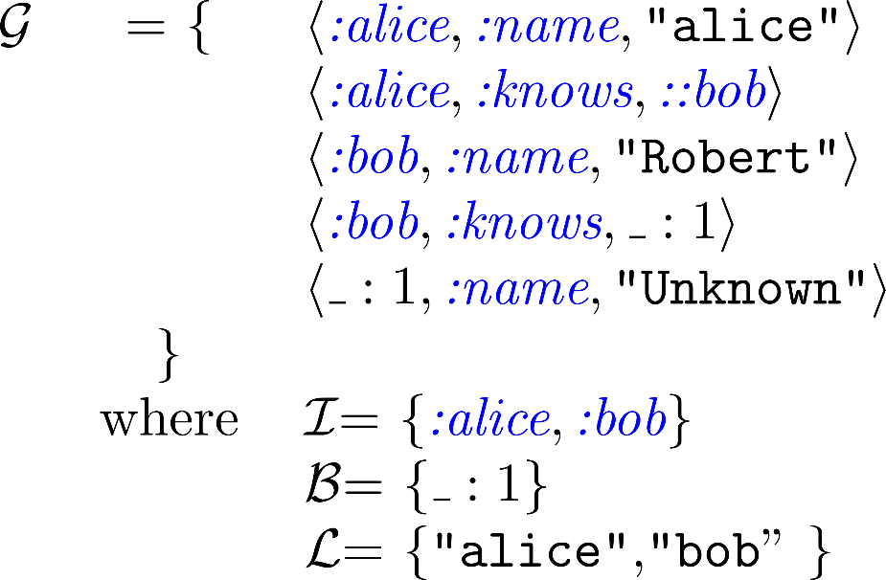
RDF data model
Typical definition of an RDF graph
Example

Slide 38
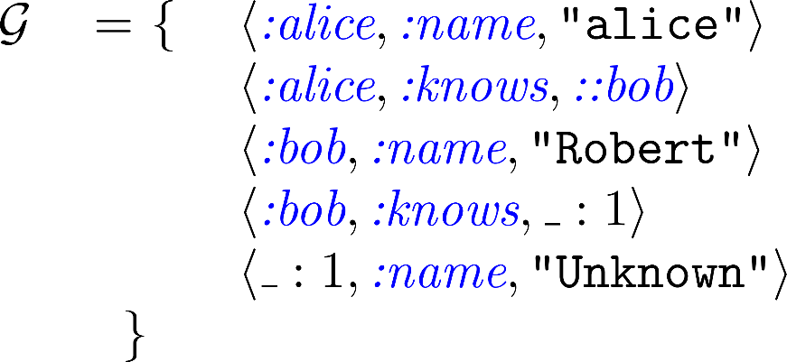
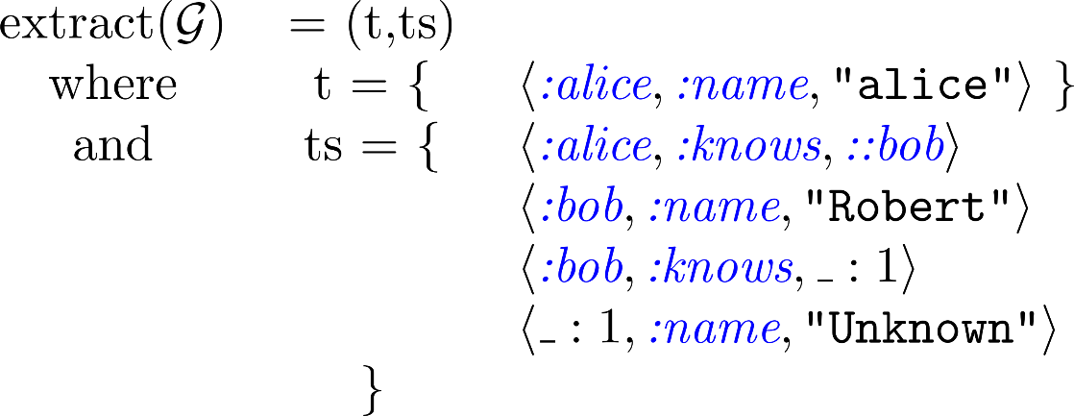
Operations on RDF graphs

Slide 39
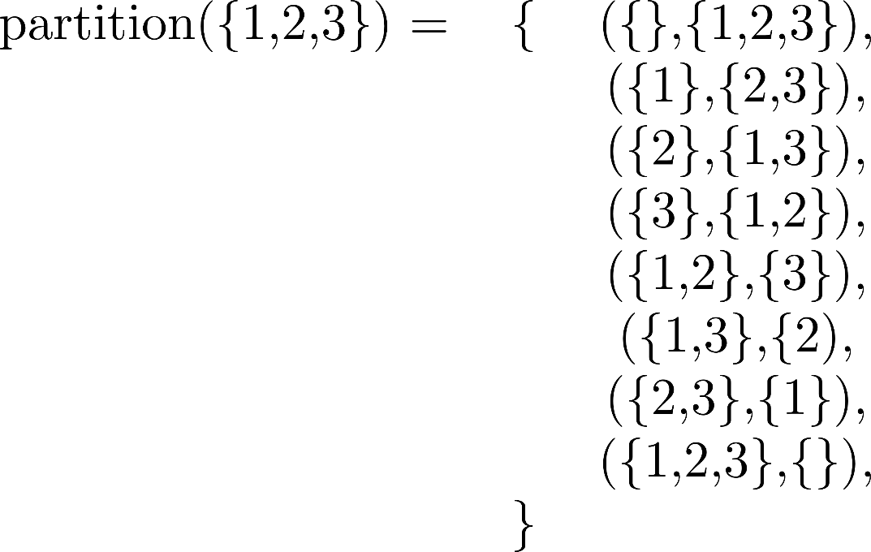
Operations on RDF graphs
Partition of a graph

Slide 40
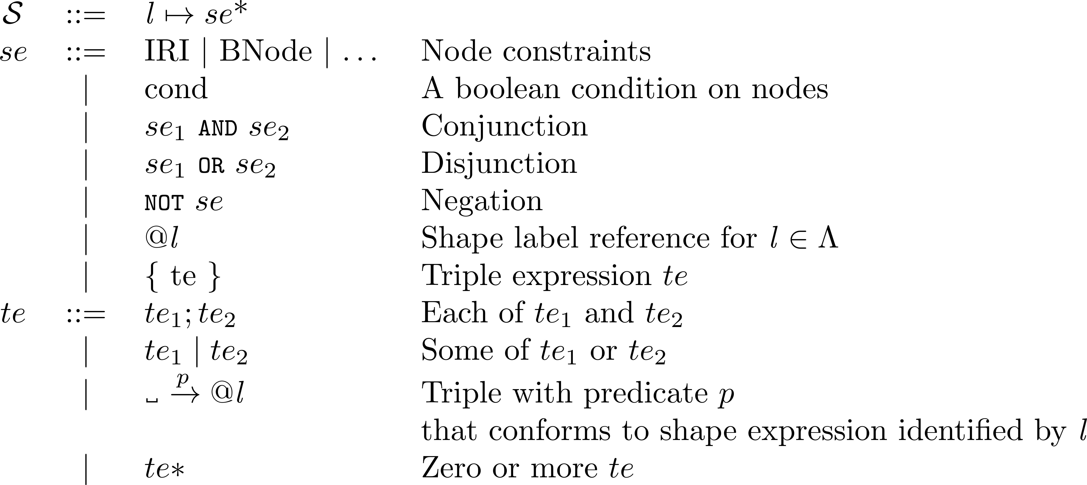
ShEx abstract syntax

Slide 41
Example of a shape expression

Slide 42
Fixed Shape Maps
Denoted by τ
Also known as Shape assignments, Shape typing, ...
Pairs or
Example:
Actions on shape map typings:

Slide 43
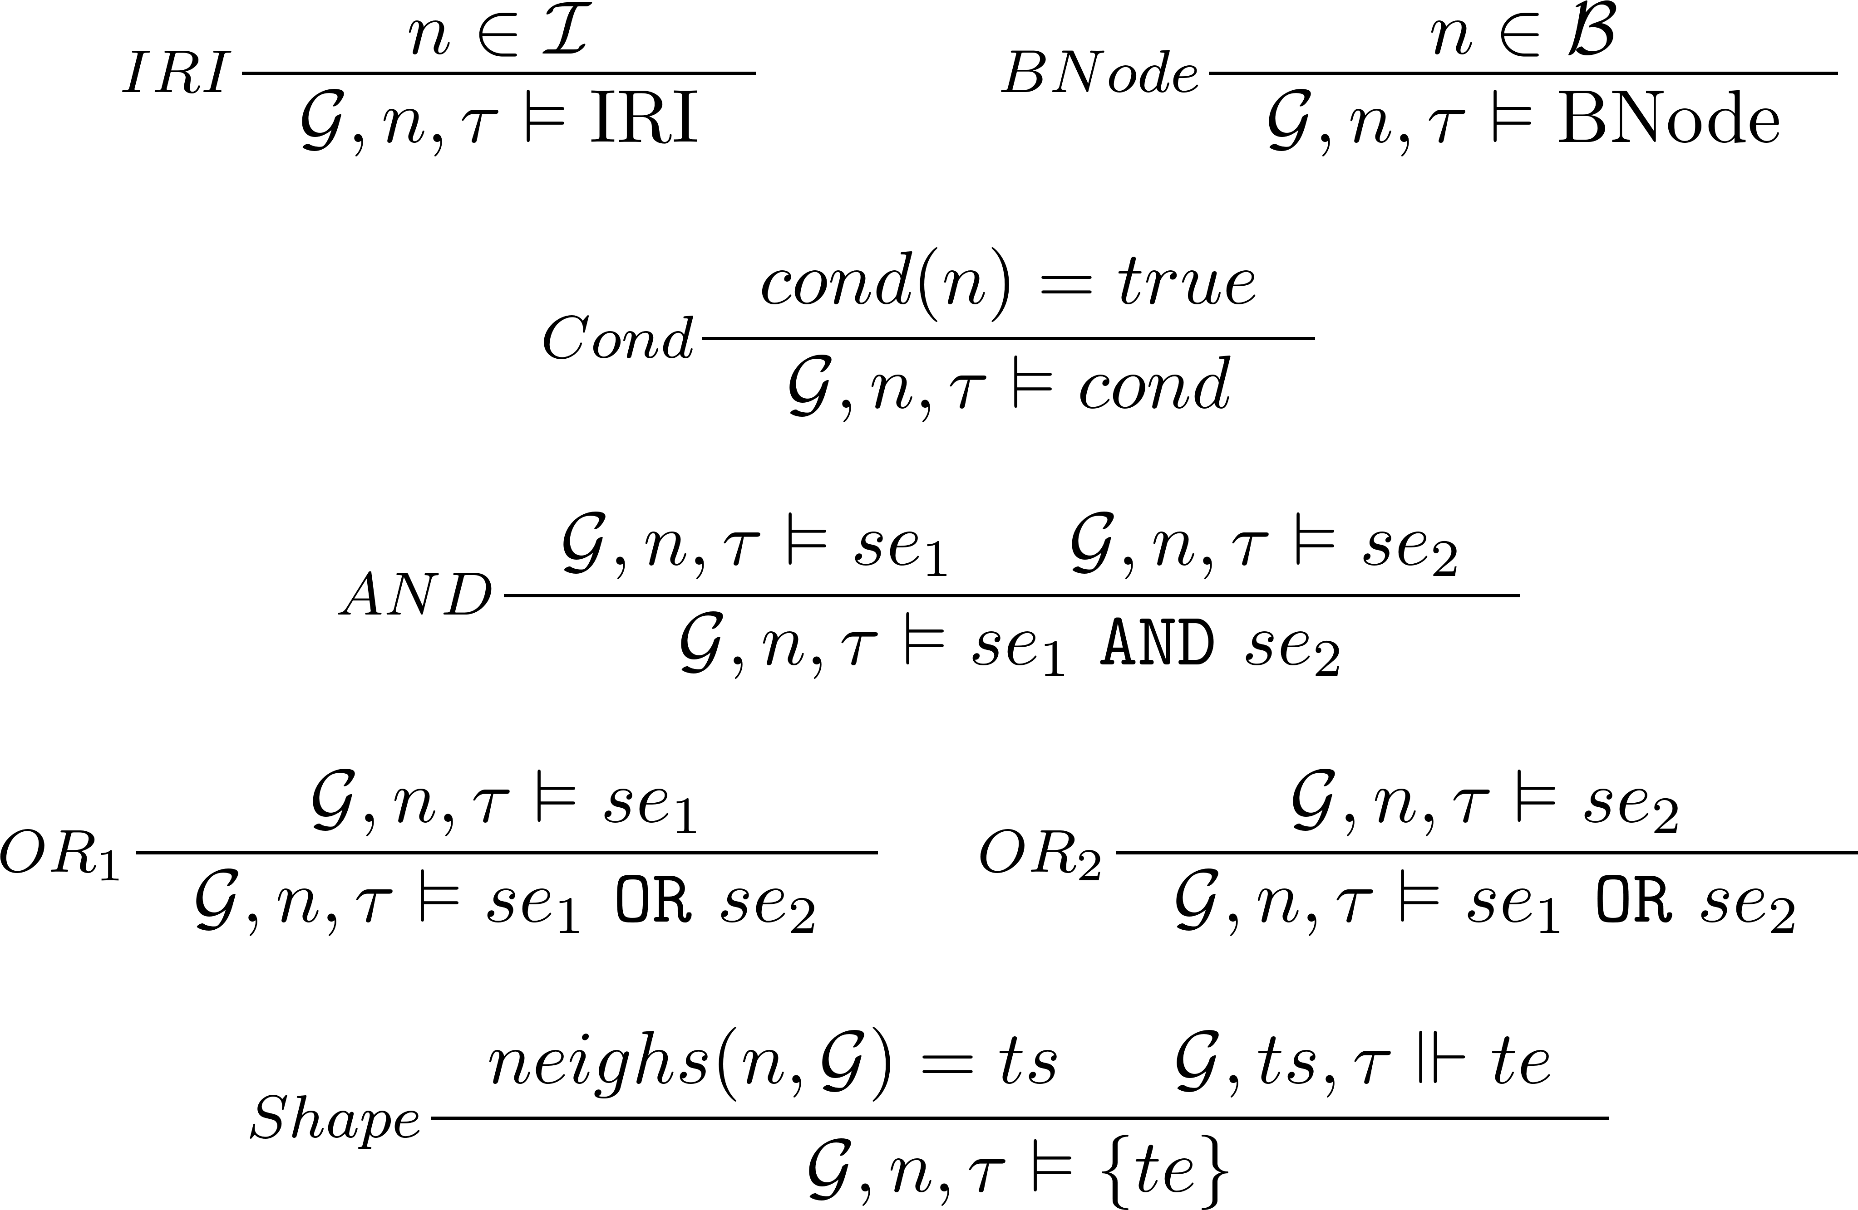
Semantics: Shape Expressions (se)

Slide 44
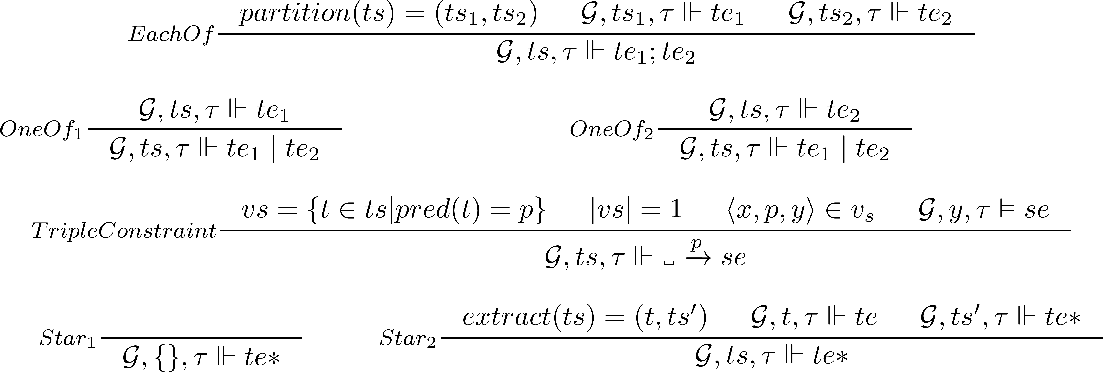
Semantics: Triple expressions (te)

Slide 45
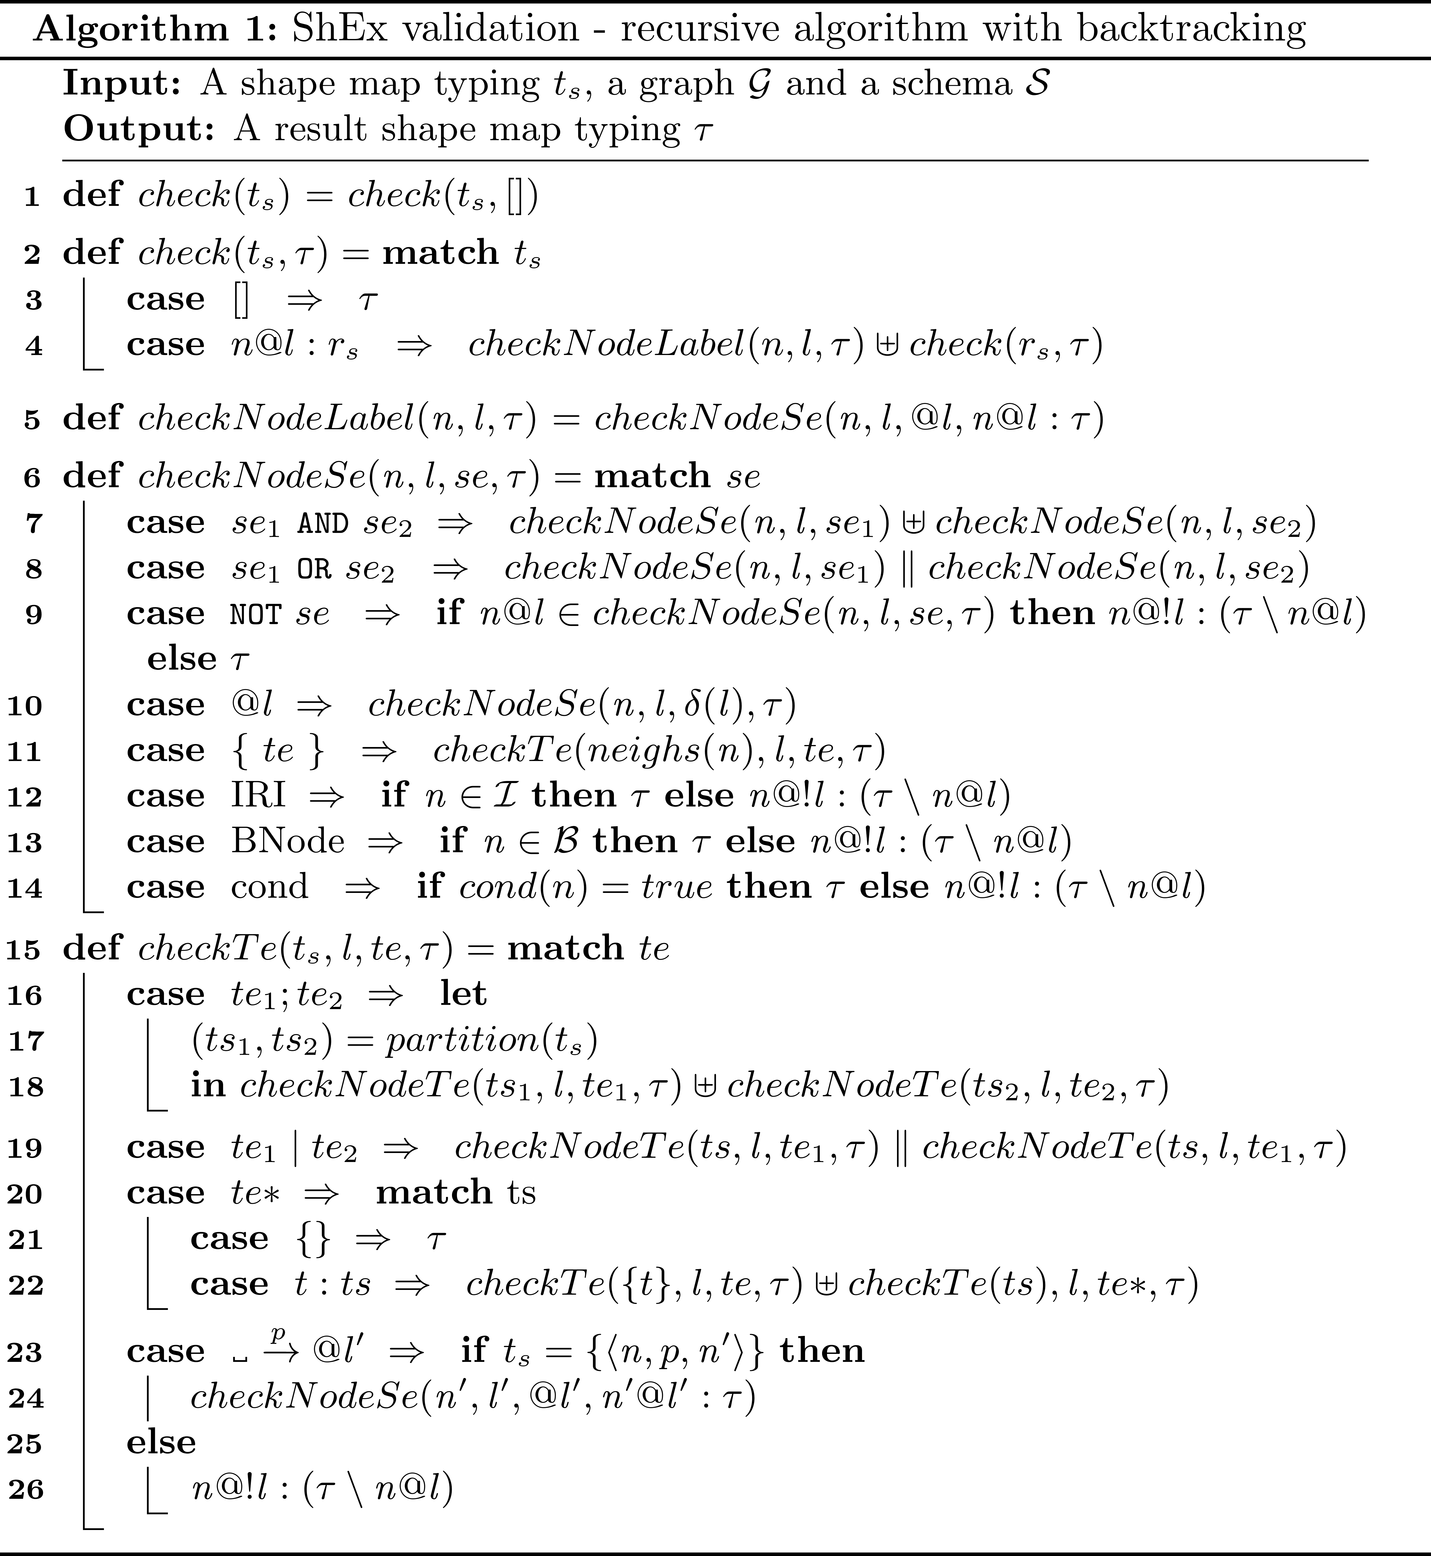
Validation algorithm

Slide 46
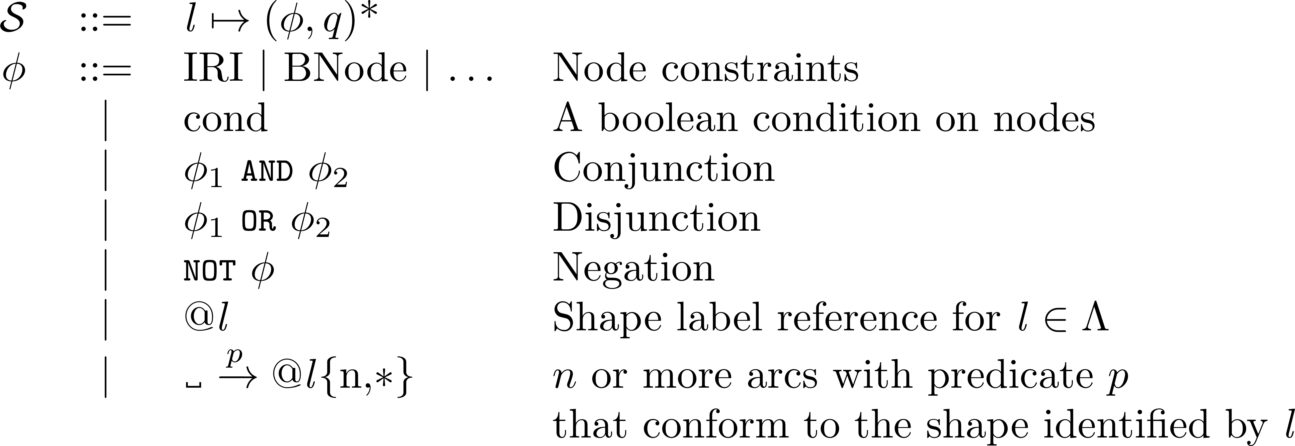
SHACL abstract syntax

Slide 47
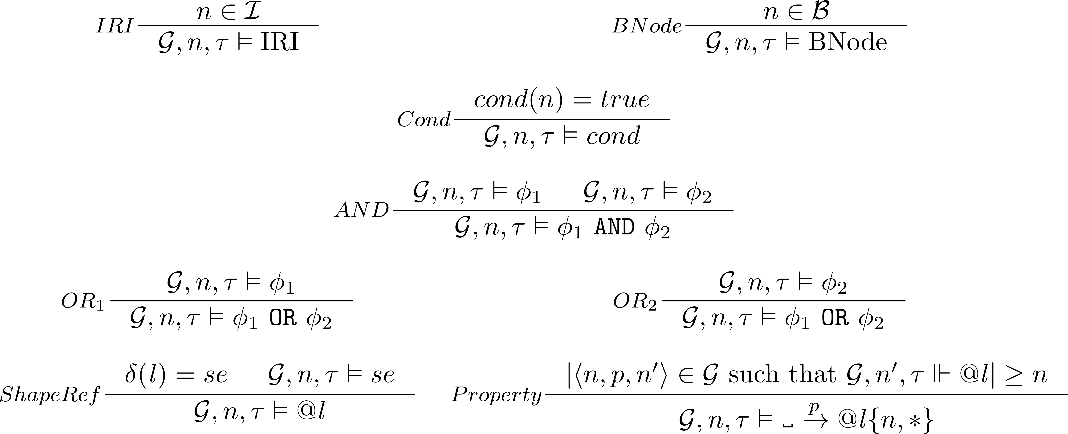
SHACL semantics

Slide 48
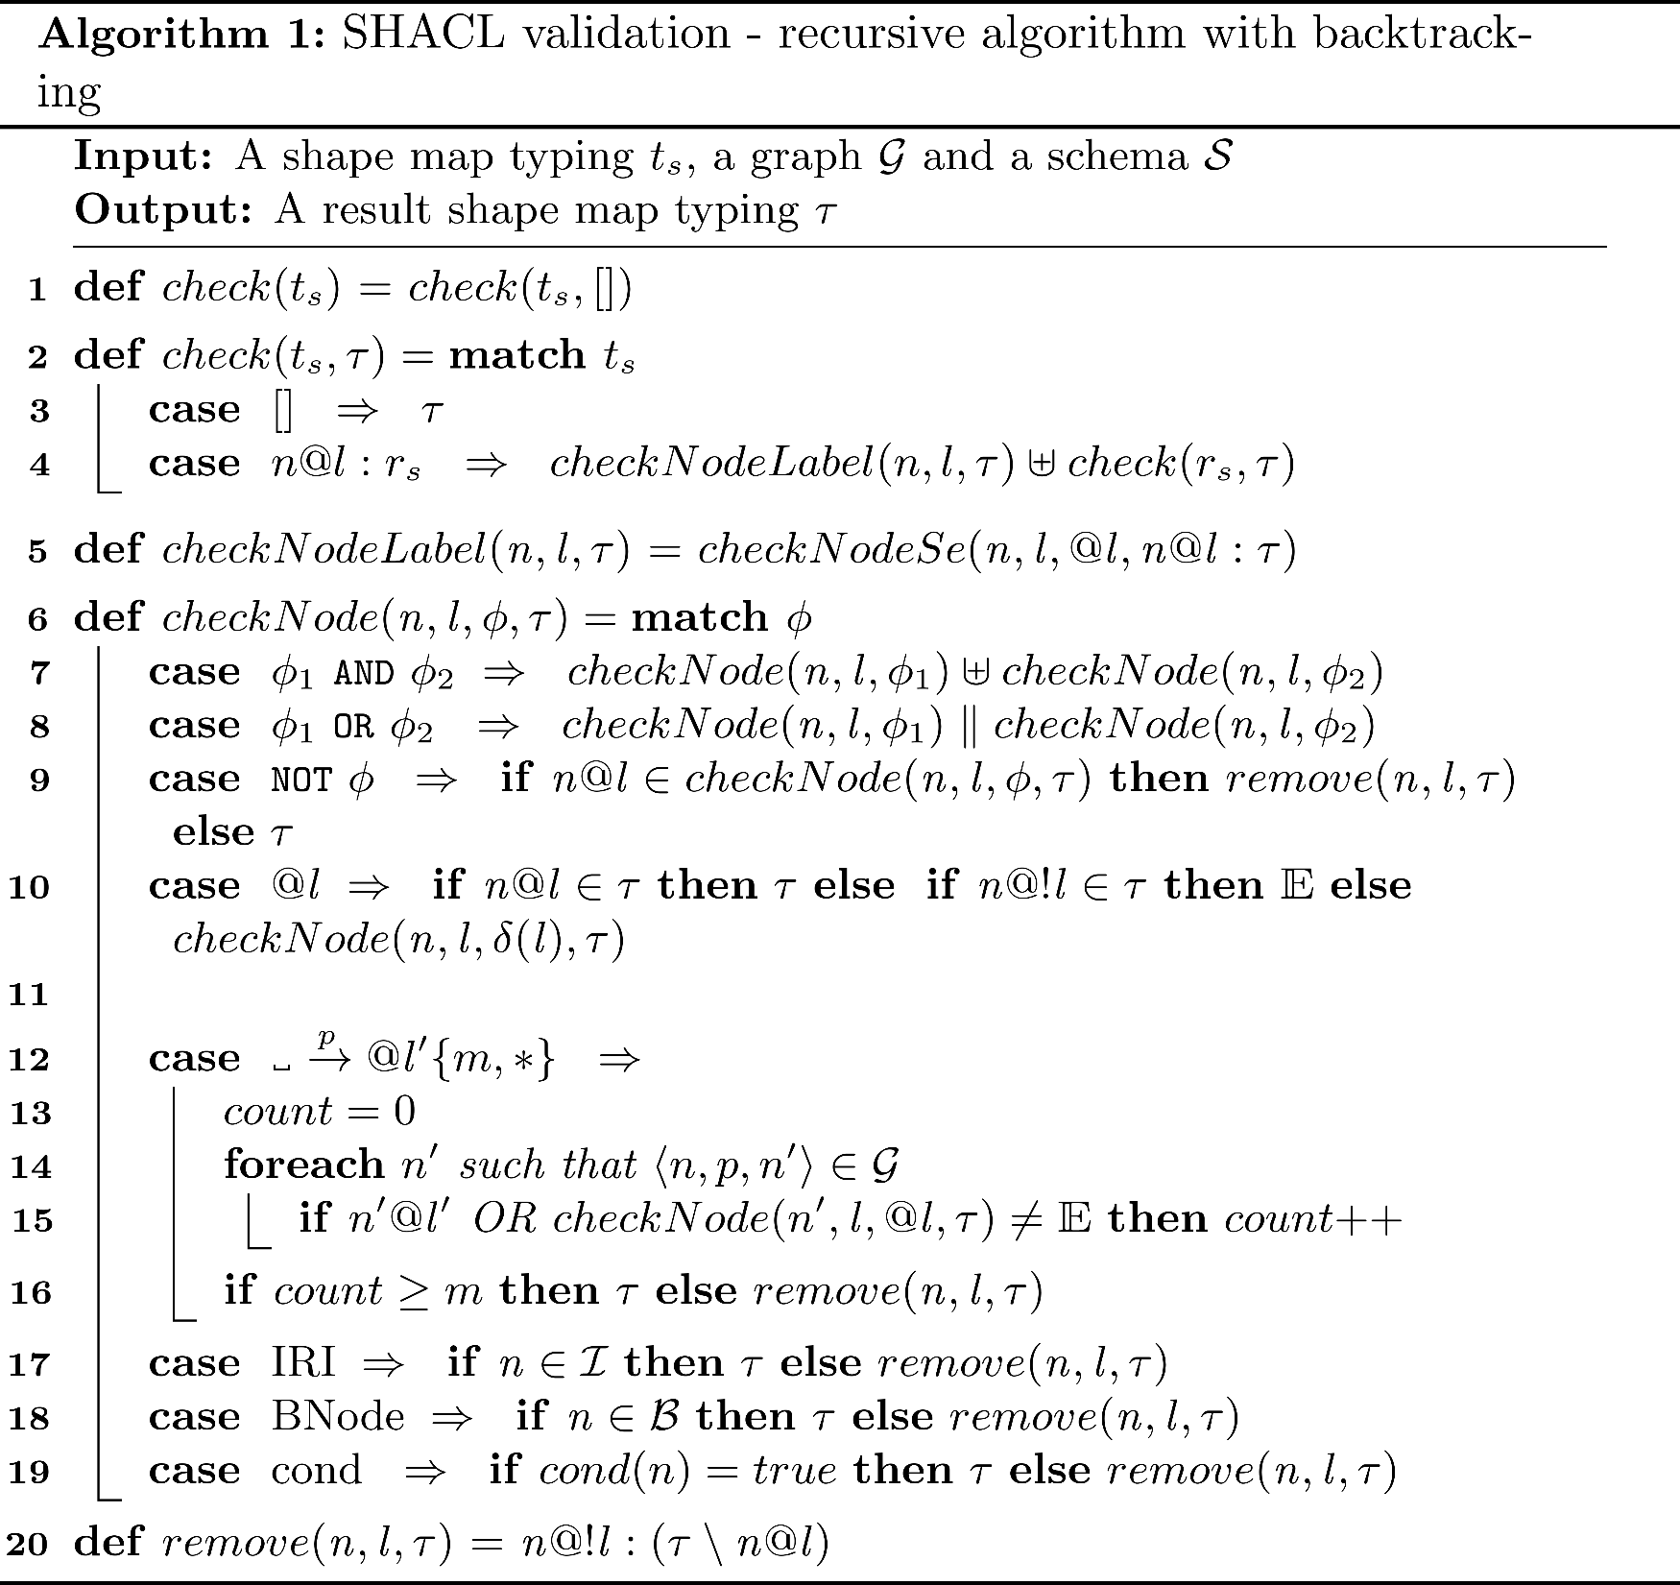
SHACL validation

Slide 49
Foundations ShEx/SHACL
ShEx language [Prud'hommeaux, 14]
ShEx Complexity [Staworko, 15]
Negation but no recursion [SHACL Rec.]
Stratification (ShEx) [Boneva 17]
Recursion + negation for SHACL [Corman 18]
Converting between ShEx and SHACL [SHaclEx]
Common language S [Labra 19]
ShEx-lite: Table based subset of both [Facundo 20]
Stable model semantics SHACL [Andresel 20]
ShEx
SHACL
ShEx-lite
S

Slide 50
References
[Prud'hommeaux 14] Eric Prud'hommeaux, José Emilio Labra Gayo, Harold R. Solbrig: Shape expressions: an RDF validation and transformation language. SEMANTICS 2014: 32-40
[Staworko 15] Slawek Staworko, Iovka Boneva, José Emilio Labra Gayo, Samuel Hym, Eric G. Prud'hommeaux, Harold R. Solbrig: Complexity and Expressiveness of ShEx for RDF. ICDT 2015: 195-211
[Boneva 17] Iovka Boneva, José Emilio Labra Gayo, Eric G. Prud'hommeaux: Semantics and Validation of Shapes Schemas for RDF. International Semantic Web Conference (1) 2017: 104-120
[Corman 18] Julien Corman, Juan L. Reutter, Ognjen Savkovic: Semantics and Validation of Recursive SHACL. International Semantic Web Conference (1) 2018: 318-336
[Labra 19] Labra G. J.E., García-González H., Fernández-Alvarez D., Prud’hommeaux E. (2019) Challenges in RDF Validation. Current Trends in Semantic Web Technologies: Theory and Practice. Studies in Computational Intelligence, vol 815. Springer, Cham. http://doi-org-443.webvpn.fjmu.edu.cn/10.1007/978-3-030-06149-4_6
[Andresel 20] Medina Andresel, Julien Corman, Magdalena Ortiz, Juan L. Reutter, Ognjen Savkovic, Mantas Simkus: Stable Model Semantics for Recursive SHACL. WWW 2020: 1570-1580
[Facundo 20] ShEx-Lite: Automatic generation of domain object models from a Shape Expressions subset language
Guillermo Facundo, Alejandro González, Emilio Rubiera and Jose E. Labra, ISWC 20 (Posters & Demo)

Slide 51
Further info
Further reading:
Validating RDF data, chapter 7. http://book.validatingrdf.com/bookHtml013.html
Other resources:
SHACL WG wiki: https://www.w3.org/2014/data-shapes/wiki/SHACL-ShEx-Comparison
Phd Thesis: Thomas Hartmann, Validation framework of RDF-based constraint languages. 2016, https://publikationen.bibliothek.kit.edu/1000056458

Slide 52
Acknowledgments
Irene Polikoff provided feedback on a previous version of these slides
Vladimit Alexiev helped with this list of ShEX/SHACL implementations:
https://github.com/validatingrdf/validatingrdf.github.io/wiki/Updated-list-of-implementations

Slide 53
End
This presentation was part:
http://www.validatingrdf.com/tutorial/iswc2020/

