Slide 1
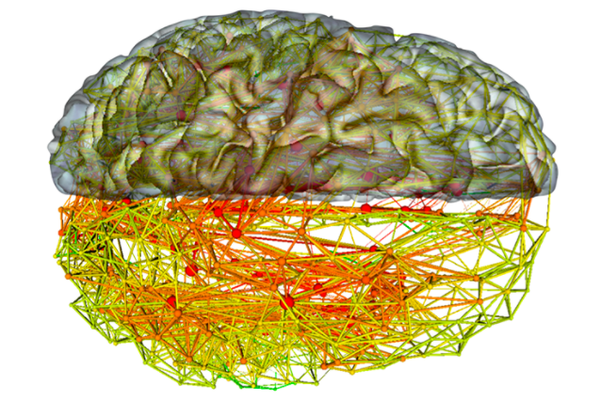
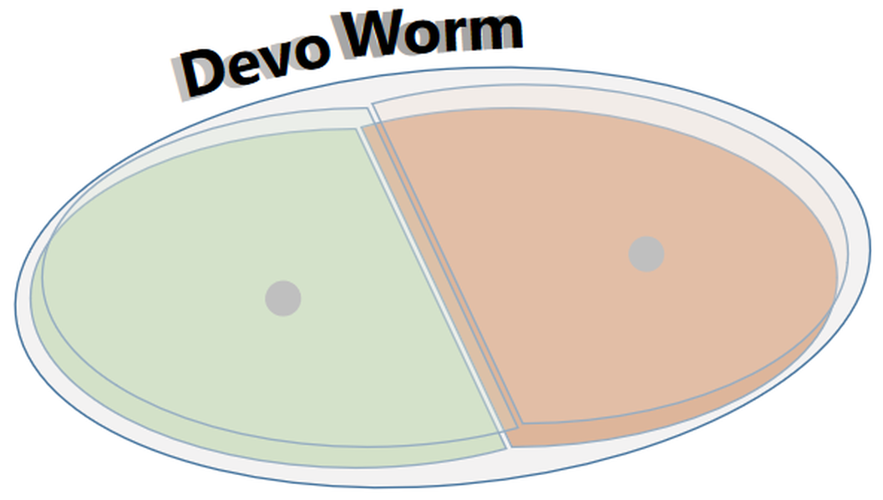
Contrast Between Biological and Artificial Neural Networks (BNNs vs ANNs)
Singer (2013). In Brain’s ‘Rich Club,’ Meetings of the Mind. Quanta Magazine, October 24.
https://www.quantamagazine.org/in-brains-rich-club-meetings-of-the-mind-20131024/
Krishna Katyal
Bradly Alicea

Slide 2
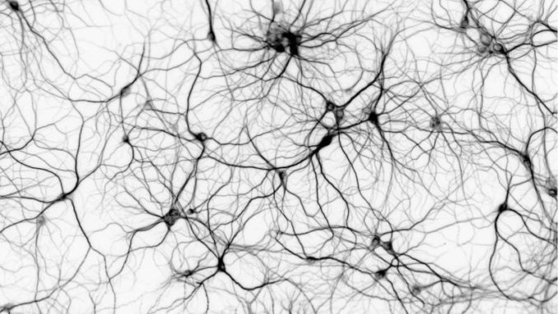
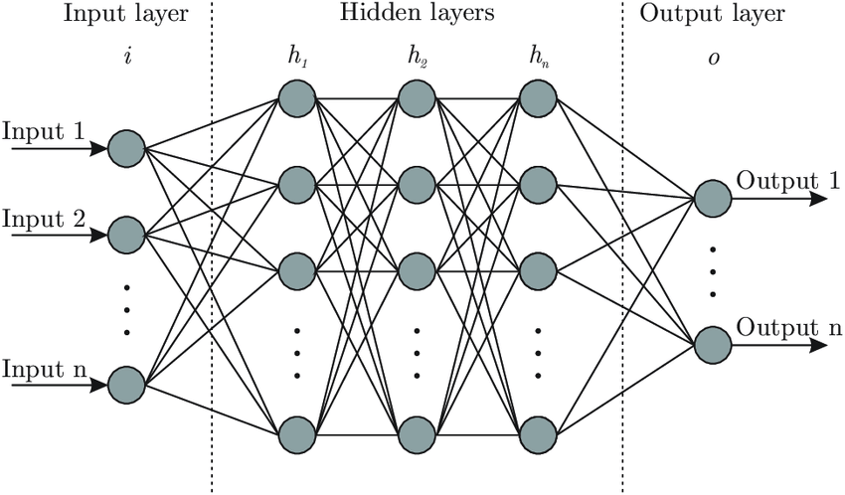
Biological Network
Artificial Network
ANNs are a sparse (selective) representation of BNNs. Recurrence but not reticulation.
ANN: essential cells and connections, BNNs: highly reticulating connections within an extracellular matrix.
BNN Image:https://www.nextplatform.com/2015/05/11/deep-learning-pioneer-pushing-gpu-neural-network-limits/
ANN Image: https://www.kdnuggets.com/2019/11/designing-neural-networks.html

Slide 3
Biological Network
Artificial Network
How much complexity do we need to capture the computational power of the nervous system?
ANNs are a sparse (selective) representation of BNNs. Recurrence but not reticulation.
ANN: cells and connections, BNNs: highly reticulating connections with extracellular matrix.
BNN Image:https://www.nextplatform.com/2015/05/11/deep-learning-pioneer-pushing-gpu-neural-network-limits/
ANN Image: https://www.kdnuggets.com/2019/11/designing-neural-networks.html

Slide 4
Biological neural networks (BNNs)
A neuron is a single cell that conducts both chemical and electrical signals. They receive and transmit information from/to other cells, muscles, and sensory organs.
Neurons can also exhibit electrical connections (gap junctions) in cells that come into contact with one another.
Neurons come in a variety of types and shapes, and produce action potentials and spike trains to communicate.
Biological neurons consist of: Dendrites (inputs), Soma (cell body), Axon (transmission wire), and Synapses (outputs).

Slide 5
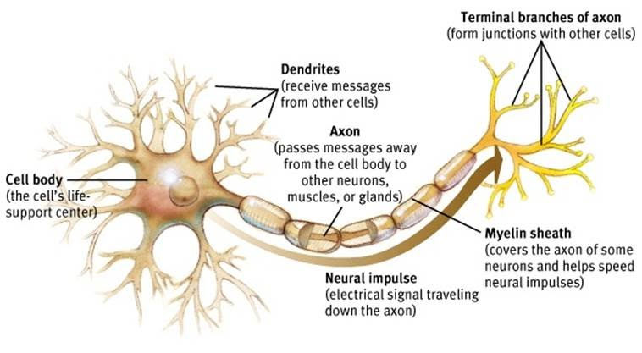
Biological neural networks (BNNs)
Biological Neuron Image:
https://sites.google.com/site/mrstevensonstechclassroom/hl-topics-only/4a-robotics-ai/neural-networks-computational-intelligence?tmpl=%2Fsystem%2Fapp%2Ftemplates%2Fprint%2F&showPrintDialog=1

Slide 6
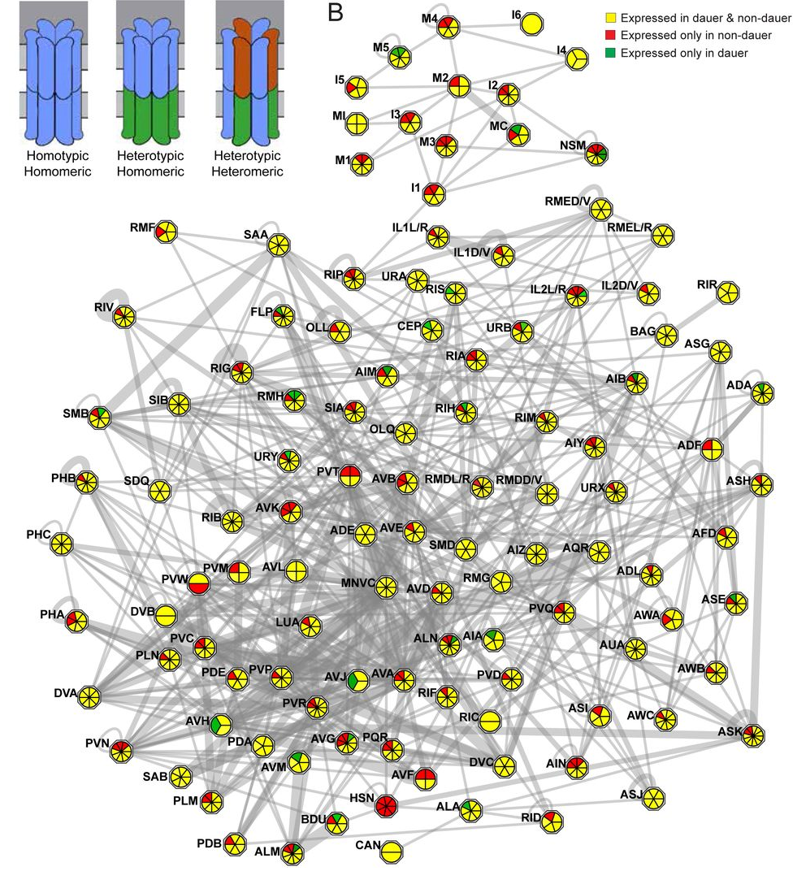
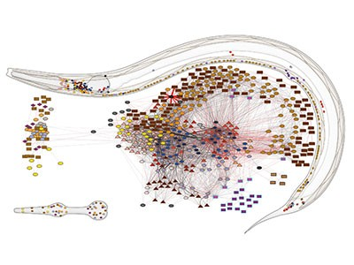
Connectome of C. elegans
Electrical (ion channels, left) and Chemical (synaptic, right)
Bhattacharya et.al (2019). Plasticity of the Electrical Connectome of C. elegans. Cell, 176(5), 1174-1189.
Cook et.al (2019). Whole-animal connectomes of both Caenorhabditis elegans sexes. Nature, 571, 63-71.

Slide 7
Artificial neural networks (ANNs)
An Artificial Neural Network (ANN) is a computing system whose fundamental composition is inspired by or analogous to biological neural networks.
Input represents the mean activity of dendrites, nodes represent a generic soma.
Interconnections represent axonal connectivity, weights represent the mean activity of synapses.
ANNs do not distinguish between different types or heterogeneous functions of neurons.

Slide 8
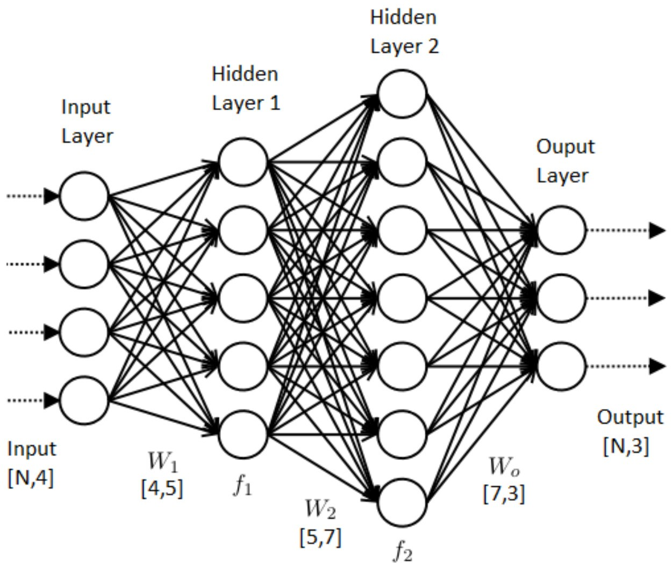
Four-layered ANN:
Does structure compare to a BNN? Yes and No.
Connectivity is initially random, then weights are defined over time.
this process is associated with learning-related plasticity in BNNs, but ANNs do not directly approximate biological learning.
Neuronal units are layered (as in neocortex) but serve generic functions (also inspired by neocortex).
yet a deep network is not at all like neocortex!
Image: https://medium.com/coinmonks/the-artificial-neural-networks-handbook-part-1-f9ceb0e376b4

Slide 9
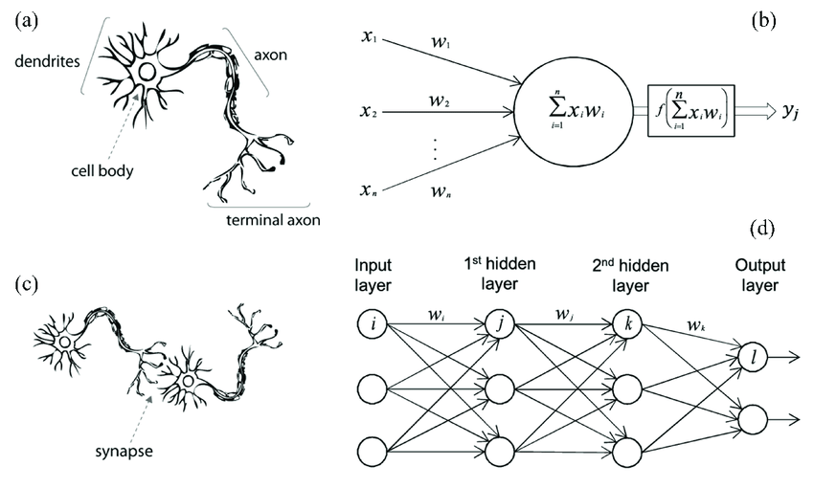
Difference between ANN and BNN
Figure 2. Meng et.al (2020). Using a Data Driven Approach to Predict Waves Generated by Gravity Driven Mass
Flows. Water, 12(2), doi:10.3390/w12020600.
https://www.researchgate.net/figure/A-biological-neuron-in-comparison-to-an-artificial-neural-network-a-human-neuron-b_fig2_339446790

Slide 10
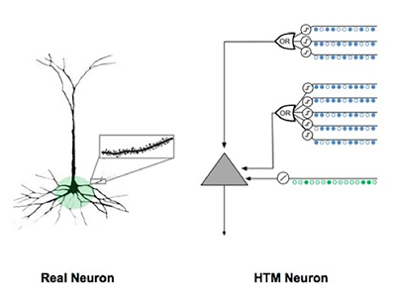
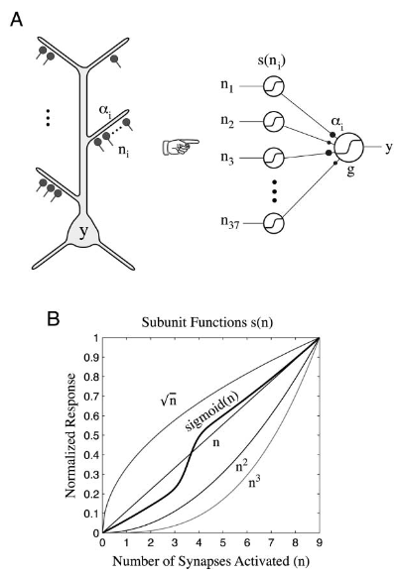
Biological computing techniques that incorporate these features such as Hierarchical Temporal Modeling (HTM, left) and Dendritic Computing (right).
Models provide a realistic but still limited account (representation) of BNN complexity.
Hawkins and Ahmad (2016). Why Neurons Have Thousands of Synapses, A Theory of Sequence Memory in Neocortex. Frontiers in Neural Circuits, 10, 1–13.
Poirazi et.al (2003). Pyramidal neuron as two-layer neural network. Neuron, 37(6), 989-999.
Gidon et.al (2020). Dendritic action potentials and computation in human layer 2/3 cortical neurons. Science, 367(6473), 83-87.

Slide 11
How to make ANNs more like BNNs: two examples from the Deep Learning revolution
Marblestone et.al (2016). Towards an Integration of Deep Learning and Neuroscience. Frontiers in Computational Neuroscience, 10, 94.
Structured Architectures matter! Make use of functional modules and other features observed in BNNs.
Heterogeneity matters! ANNs should consist of multiple functional subsystems with specialized roles.

Slide 12
How to make ANNs more like BNNs: two examples from the Deep Learning revolution
Marblestone et.al (2016). Towards an Integration of Deep Learning and Neuroscience. Frontiers in Computational Neuroscience, 10, 94.
Structured Architectures matter! Make use of functional modules and other features observed in BNNs.
Heterogeneity matters! ANNs should consist of multiple functional subsystems with specialized roles.
Richards et.al (2019). A deep learning framework for neuroscience. Nature Neuroscience, 22(11), 1761-1770.
ANNs should be faithful to anatomy and plasticity observed in BNNs.
Learning rules in ANNs should be biologically-inspired, but also not exhibit extensive bias or variance.
ANNs should reproduce representations observed in BNNs, including how they change over the course of learning.

Slide 13
Power Consumption/Topologies
Finally, we can look to the interactions between energy efficiency and network topology to understand the differences between BNNs and ANNs.
Due to topological centralization, BNNs are better than ANNs at fault and ambiguity tolerance. In addition, they exhibit plasticity ranging from physiological adaptation to regeneration.

Slide 14
Power Consumption/Topologies
Finally, we can look to the interactions between energy efficiency and network topology to understand the differences between BNNs and ANNs.
Due to topological centralization, BNNs are better than ANNs at fault and ambiguity tolerance. In addition, they exhibit plasticity ranging from physiological adaptation to regeneration.
Instead of a network with asynchronous computing nodes, ANNs compute one by one. Recurrent feedbacks are simulated in ANNs using two methods
long short-term memory (LSTM) networks
recurrent neural networks (RNNs)

Slide 15
Power Consumption/Topologies
Finally, we can look to the interactions between energy efficiency and network topology to understand the differences between BNNs and ANNs.
Due to topological centralization, BNNs are better than ANNs at fault and ambiguity tolerance. In addition, they exhibit plasticity ranging from physiological adaptation to regeneration.
Instead of a network with asynchronous computing nodes, ANNs compute one by one. Recurrent feedbacks are simulated in ANNs using two methods
long short-term memory (LSTM) networks
recurrent neural networks (RNNs)
Unlike BNNs, ANNs compute the state and weights of a layer of the neural network, then use the result to compute the next layer
in the case of backpropagation, weights are improvised and layers are not connected to non-neighboring layers.

Slide 16
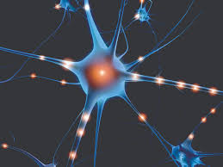
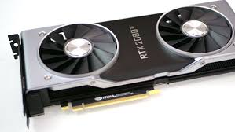
Power consumption/Topologies
Human Brain: around 20 watts of power consumption
GPU (graphics processing unit): consumes between 150 to 250 watts of power.

Slide 17
Power consumption/Topologies
Human Brain: around 20 watts of power consumption
GPU (graphics processing unit): consumes between 150 to 250 watts of power.
Why is the human brain more energetically efficient?

Slide 18
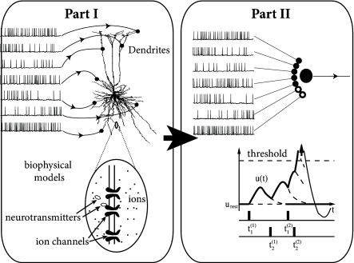
Power Consumption/Topologies
In BNNs neurons can fire asynchronously and in parallel, having dense neurons hubs and a large amount of lesser connected ones.
follows the power law for the large values of k
the fraction P(k) of nodes in the network having k connections to other nodes as P(k) ~ k^{-z}
where -z generally lies from 2 to 3, although may lie outside these bounds).
https://neuronaldynamics.epfl.ch/online/Pt2.html

Slide 19
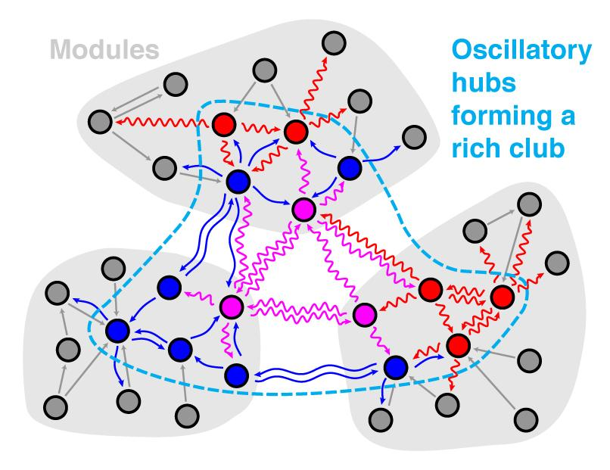
Rich Club Structure of a BNN
Pedersen and Omidvarnia (2016). Further Insight into the Brain's Rich-Club Architecture. Journal of Neuroscience, 36(21), 5675-5676.
Nigam et.al (2016). Rich-club organization in effective connectivity among cortical neurons. Journal of Neuroscience, 36, 670–684.
So-called “rich club” organization allows for efficient neuronal processing at the lowest energetic cost.
high energy consumption associated with metabolism offset by hierarchical organization (where a few nodes do most of the processing).
rich-club neurons are also responsible for a majority of the information flow in a BNN.
Rich Club Image: https://medicalxpress.com/news/2016-08-neuroscientists-nerve-cells-neural-networks.html

Slide 20
THANK YOU!
Krishna Katyal
krishnakatyal
krishnakatyal5121@gmail.com
https://in.linkedin.com/in/krishna-katyal-96129a115
Bradly Alicea
Contribute to DevoLearn for Hacktoberfest (or anytime)!
@balicea1
balicea
https://github.com/devolearn
balicea@openworm.org
https://bradly-alicea.weebly.com/

