Slide 1
Nicole Vasilevsky, OHSU
Chris Mungall, LBNL
ClinGen Biocurator Working Group Meeting, October 22, 2020
These slides: https://bit.ly/clingen-mondo

Slide 2
Overview
1
2
3
4
5
Overview of Mondo
View Mondo
Website
New term requests
Gene-based names
mondo.monarchinitiative.org
https://bit.ly/clingen-mondo
Notes:
Overview of Mondo
Structure
Where the information comes from
How the ontology was created
How the ontology is maintained
Where to view Mondo and search for Mondo IDs/terms
Review of the basic information on the website
Guidelines on how to request new terms/changes
Discussion on gene-based names

Slide 3
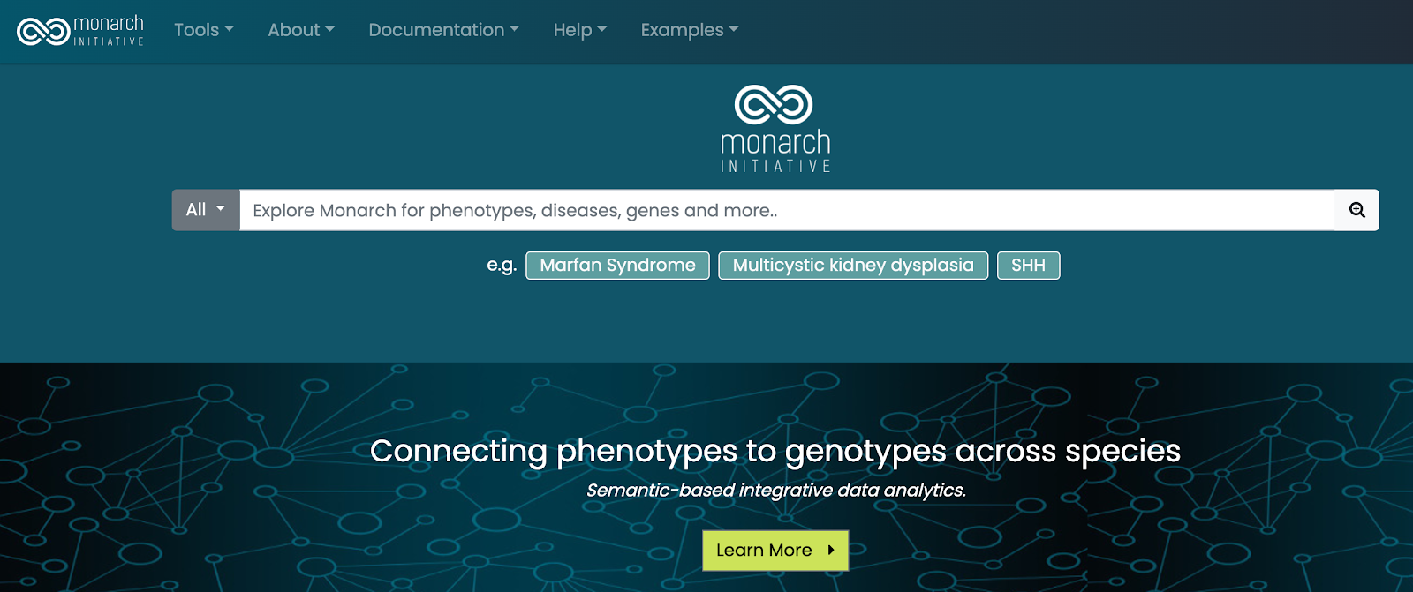
Monarch: connecting diseases, phenotypes, and genes
https://monarchinitiative.org/
https://bit.ly/clingen-mondo
Notes:
We are part of the Monarch Initiative, an NIH funded project to build a resource that connects info about human phenotypes, and genes and diseases in model organisms.
Can query for info about diseases, and genes that are involved and connections to model organisms.
The Monarch databases uses underlying ontologies to allow for intererencing and query across the data

Slide 4
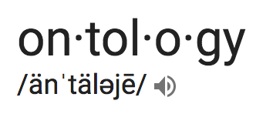
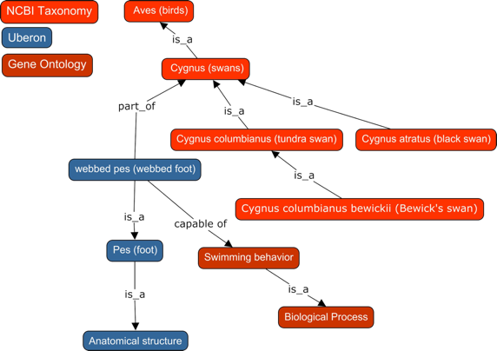
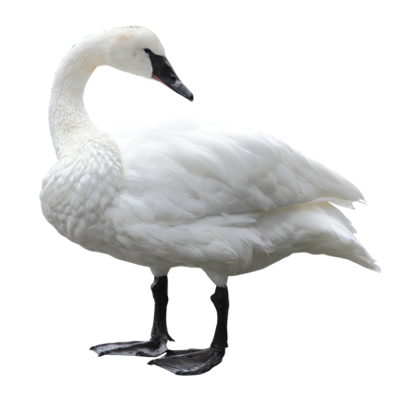
What is an ontology?
A knowledge classification of a domain, where the relationships between concepts are formally defined and logically related, which allows for computational reasoning
Key Features:
Terms are defined
Semantics - relationships between terms are defined, allowing logical inference and sophisticated data queries
Terms are arranged in a hierarchy
Expressed in a knowledge representation language such as RDFS, OBO, or OWL
http://www.obofoundry.org/resources
https://bit.ly/clingen-mondo

Slide 5
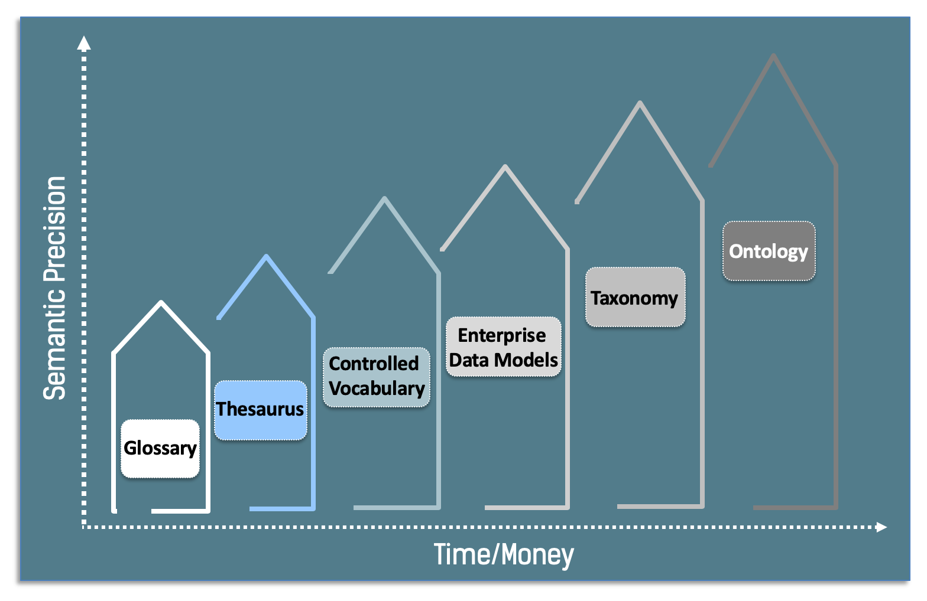
Complexity of Vocabulary Types
http://www.obofoundry.org/resources
https://bit.ly/clingen-mondo

Slide 6
What is the most clinically useful way to
define and group diseases?
CANCER
COMPLEX
We needed:
disease concepts spanning multiple categories
a systematic way of relating these concepts
Why not just use mappings?
Many terminologies / ontologies / lists include mappings
These can be used to cross-walk
Problems:
Often mutually inconsistent
N^2 sets of mappings!
Not 1:1 equivalents
INFECTIOUS
RARE
MENDELIAN
https://bit.ly/clingen-mondo
mondo.monarchinitiative.org
Notes:
As part of creating this monarch database, we found that we needed to unify information about diseases from different sources.

Slide 7
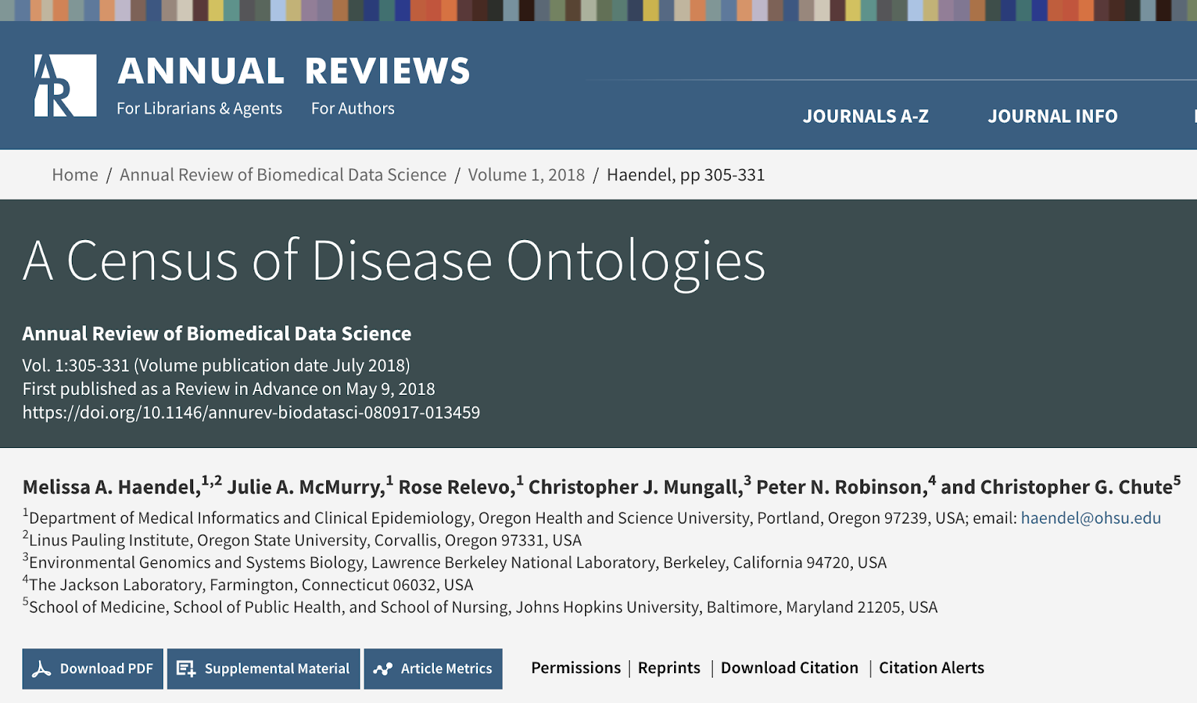
bit.ly/annual-reviews-ontologies
https://bit.ly/clingen-mondo

Slide 8
No one system fit the bill
There are a wealth of disease resources
specialized
(e.g OMIM: Mendelian)
generalized
(e.g. MESH, SNOMED)
No single resource sufficient
specialized
did not include concepts we needed
generalized
lacked sufficient depth/precision in key domains

Slide 9
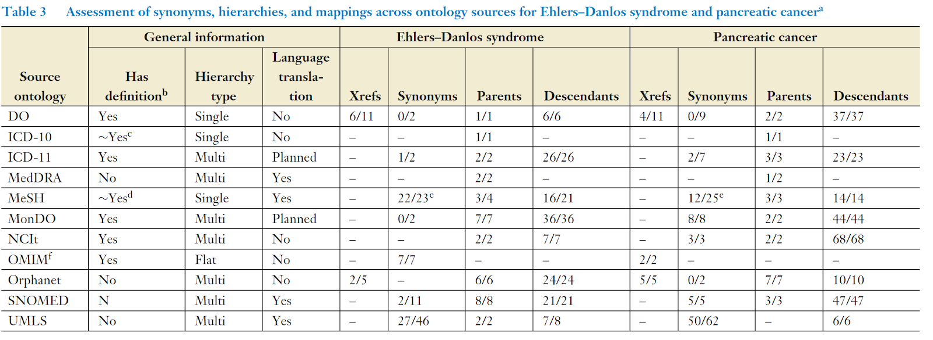
Assessment of synonyms, hierarchies, and mappings across ontology sources for example diseases EDS and Pancreatic cancer
Wide heterogeneity in:
placement of diseases hierarchically, and therefore meaning,
mapping to other diseases,
the number and typing of synonyms
http://bit.ly/annual-reviews-ontologies
Notes:
Abbreviations: DO, Human Disease Ontology; ICD-10/-11, International Classification of Diseases, Tenth Revision/Eleventh Revision; MedDRA, Medical Dictionary for Regulatory Activities; MeSH, Medical Subject Headings; MonDO, Monarch Disease Ontology; NCIt, National Cancer Institute Thesaurus; OMIM, Online Mendelian Inheritance in Man; SNOMED, Systematized Nomenclature of Medicine; UMLS, Unified Medical Language System; Xref, external reference (cross-reference). aThe Xref and synonym columns summarize the extent and precision of Xrefs and synonyms, respectively, provided by the respective records in the source ontologies. The denominators in these columns refer to the total number of Xrefs or synonyms listed by the source ontology; the numerators refer to the number of these that we manually assessed as equivalent to the concept (not narrower, broader, related, or obsolete). In some cases, something akin to a qualifier (narrower, broader, related, or obsolete) is already provided by the source; in such cases, if we found the qualifier to be accurate by manual review, it was counted toward the numerator. The notation “–’’ means that the denominator was zero (no such term was found). Source data and scripts for these assessments are available at https://github.com/monarch-initiative/ont-review. b“Has definition” refers to whether the record has a textual definition in addition to a label; some of the ontologies also have logical definitions (not shown). cClinical information is provided, but it is not as concise as a conventional definition. dThe scope note is an approximation of a definition. eThe MeSH field entry terms is the closest to synonyms; numbers are especially high due to casing and punctuation variants. fOMIM does not have a record for the group of diseases which comprise Ehlers–Danlos syndrome; these counts reflect those for a specific subtype (Ehlers–Danlos Syndrome, Kyphoscoliotic Type, 1; OMIM:225400).

Slide 10
Evidence-based merging of equivalent classes
Orphanet
Orphanet
Iterative curator-assisted generation
NCIT
k-BOOM
Bayesian
OWL
Ontology
Merging
Logical +
Probabilistic
Inference
NCIT
GARD
GARD
EFO
EFO
DO
Sources
DO
DC
ICD-10
MeSH
evaluate
MeSH
MEDIC
OMIM
...
Curate
Feedback
...
Curated equivalence relations

Slide 11
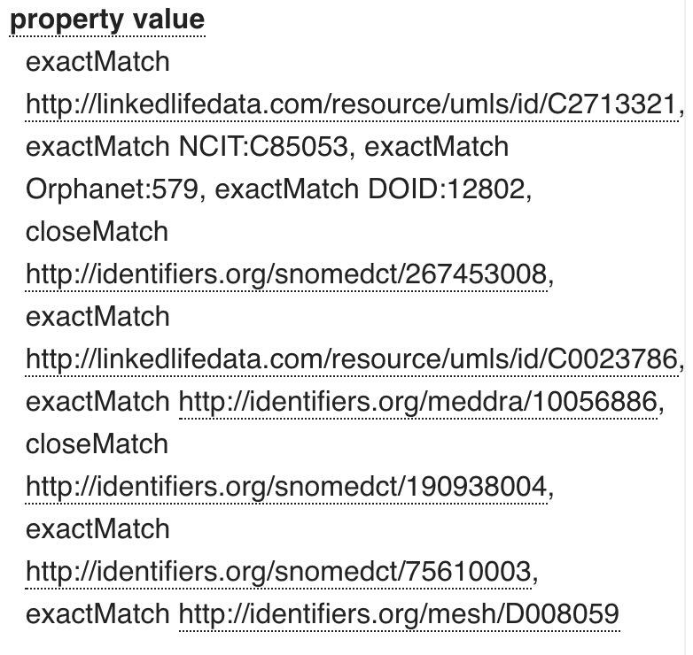
Relationships to other resources
In obo format version and in OLS these are database cross references (‘xrefs’)
In owl version we use explicit logical axioms, e.g:
equivalentTo
relatedTo
ebi.ac.uk/ols/ontologies/mondo
https://bit.ly/clingen-mondo

Slide 12
Current Status
MONDO IDs assigned and tracked for each concept
~20k disease classes
>2000 issues reported
>50 releases
Automated;
merge multiple resources together
Mondo as a distinct curated ontology
Use of standard ontology engineering practices
Periodically aligned and synced with existing resources
Released monthly
2016-2017
2018
Today
mondo.monarchinitiative.org
https://bit.ly/clingen-mondo

Slide 13
Mondo community
OBO Foundry
obofoundry.org/ontology/mondo
Community developed
Weekly Calls
Fridays, 9am PT/12pm ET
Zoom
Join our mailing list:
https://groups.google.com/forum/#!forum/mondo-users
Ontology Lookup Service
ebi.ac.uk/ols/ontologies/mondo
Where to view Mondo
GitHub
github.com/monarch-initiative/mondo
mondo.monarchinitiative.org
https://bit.ly/clingen-mondo
Notes:
Can view Mondo on Monarch’s site too, but it is not always in sync, so recommend OLS or downloading it from GitHub and viewing it in Protege

Slide 14
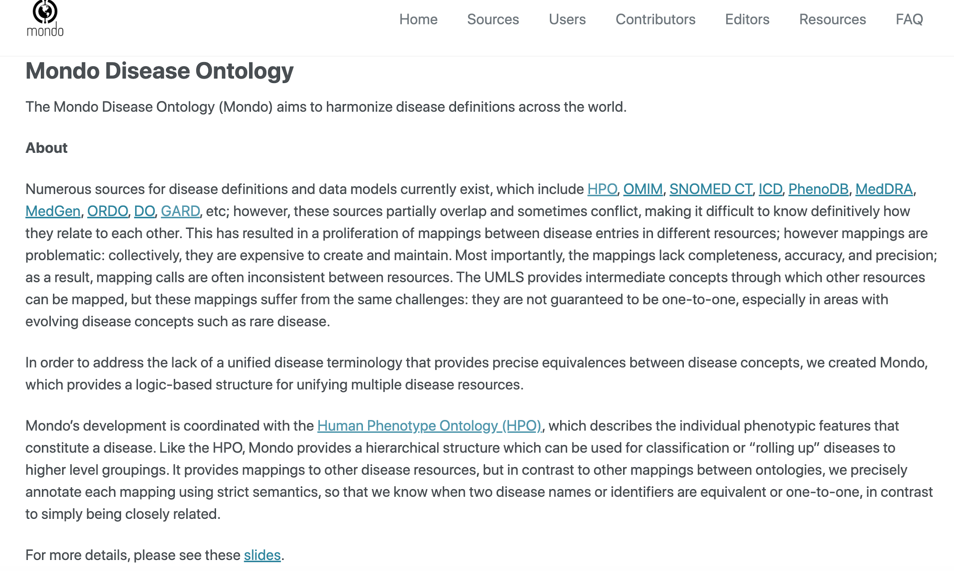
Mondo website
mondo.monarchinitiative.org
https://bit.ly/clingen-mondo

Slide 15
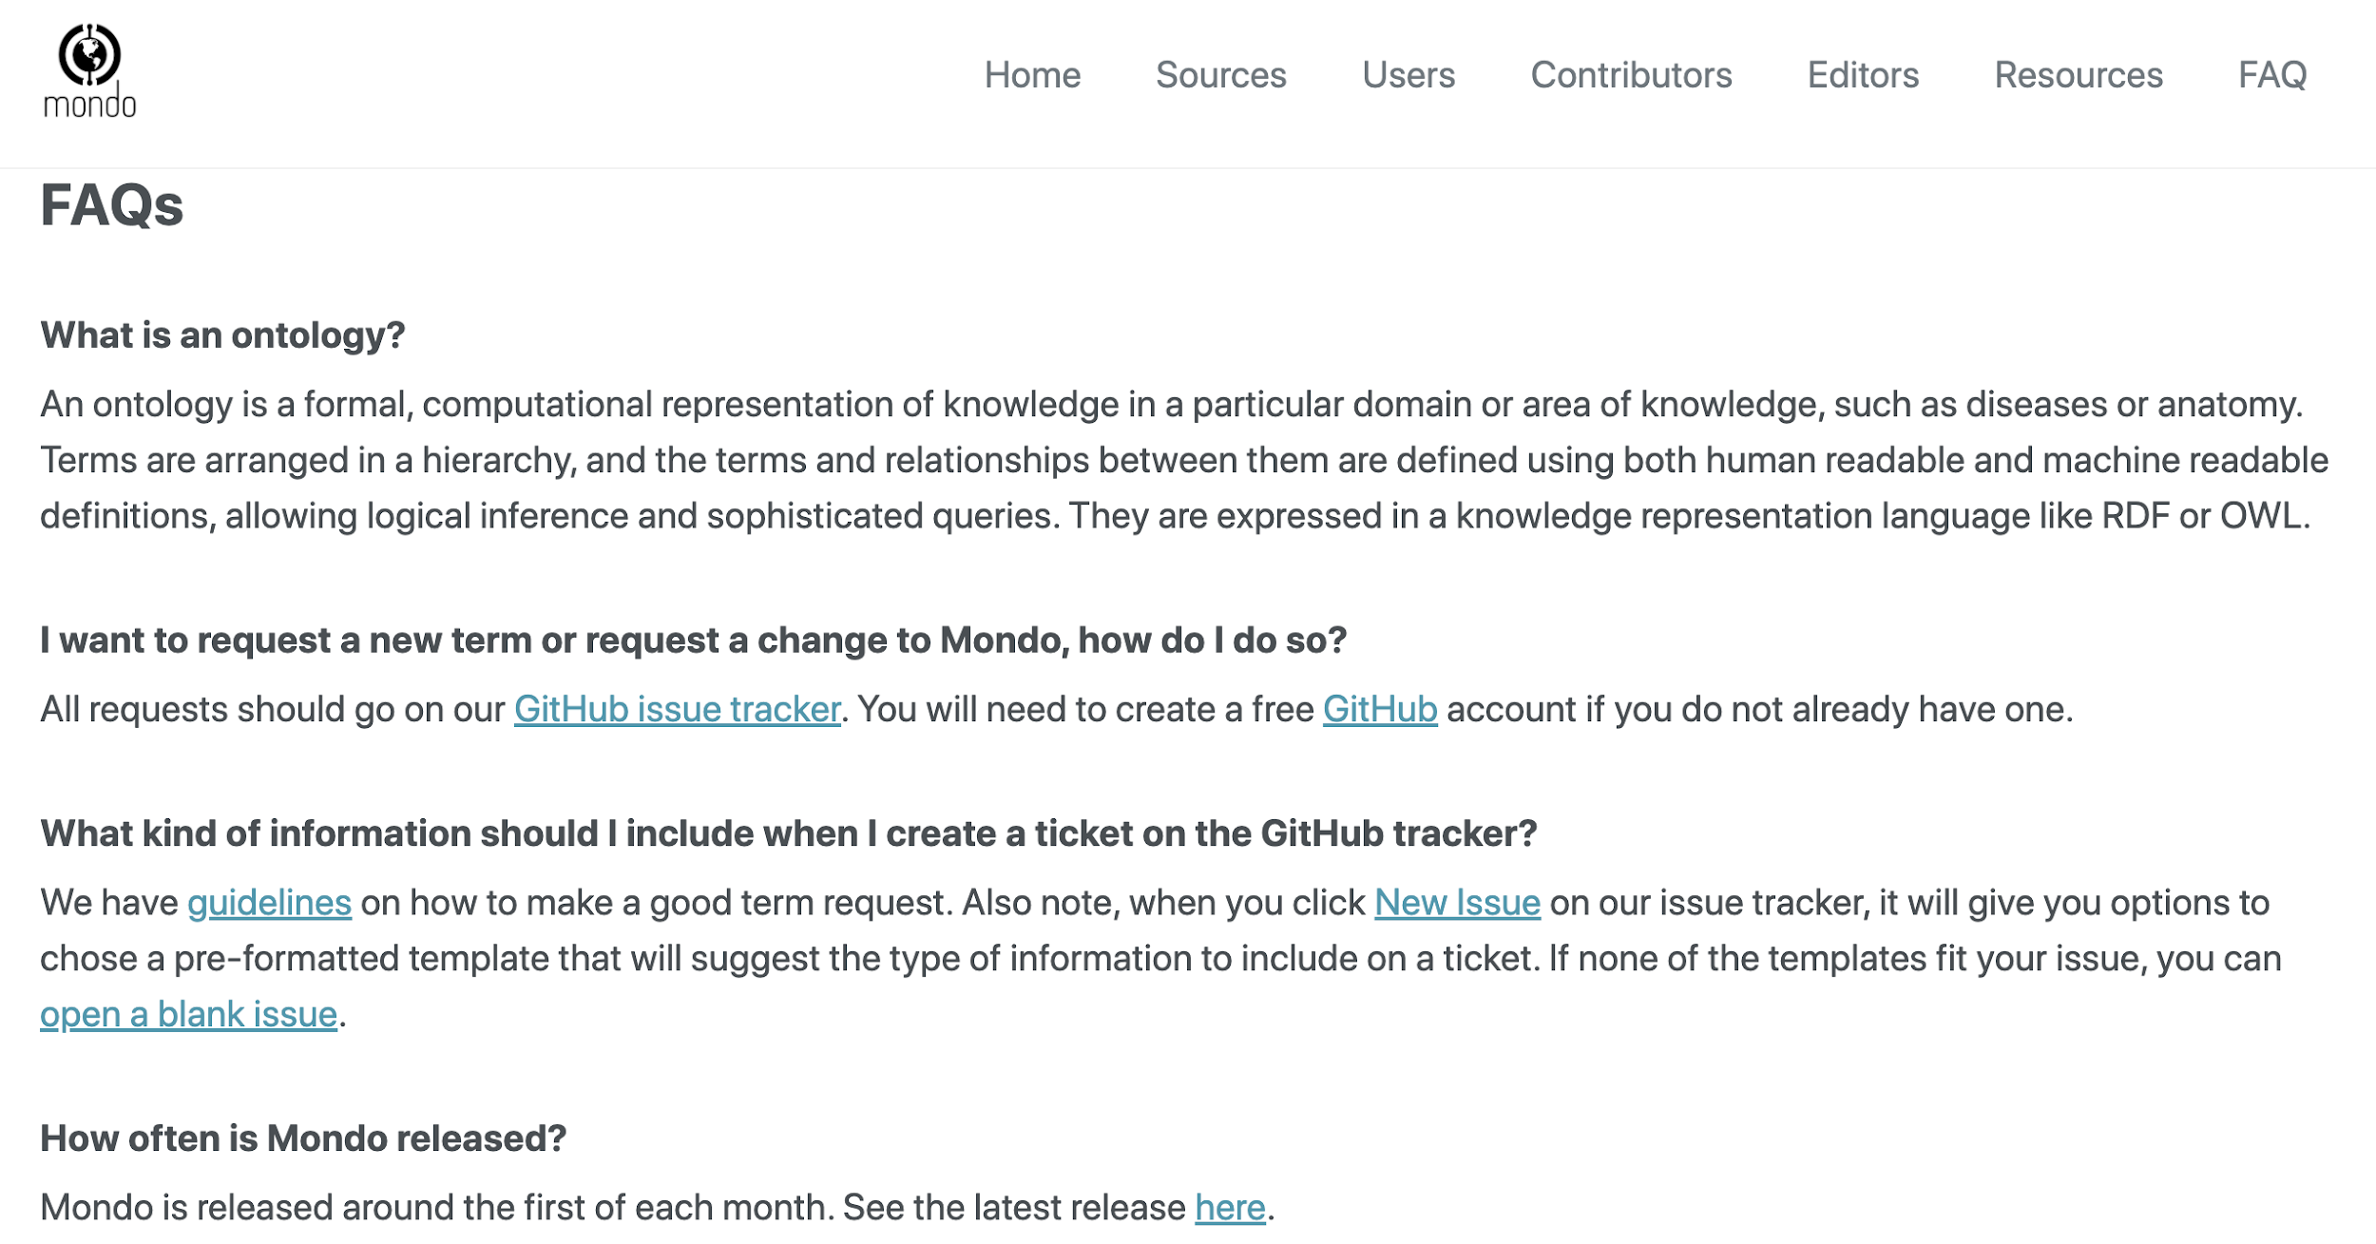
Mondo website
mondo.monarchinitiative.org
https://bit.ly/clingen-mondo

Slide 16
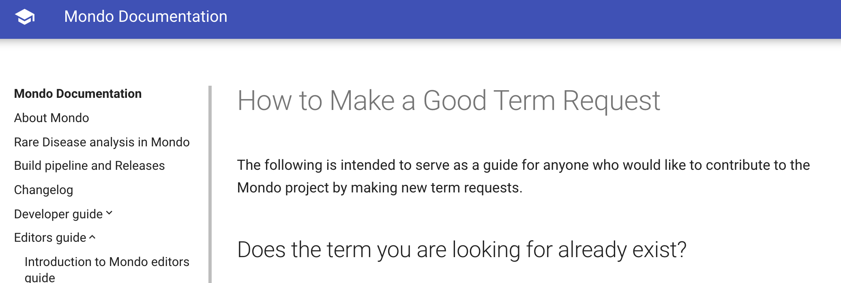
Mondo website
https://mondo.readthedocs.io/en/latest/editors-guide/c-make-good-term-request/
mondo.monarchinitiative.org
https://bit.ly/clingen-mondo

Slide 17
Overall design principles
Diseases series by gene
pattern_name: disease_series_by_gene
description: >-
This pattern is for diseases that are caused by a single mutation in a single gene, that have gene-based names, such as new disease terms that are requested by ClinGen, like like MED12-related intellectual disability syndrome.
Examples: [MED12-related intellectual disability syndrome](http://purl.obolibrary.org/obo/MONDO_0100000), [TTN-related myopathy](http://purl.obolibrary.org/obo/MONDO_0100175), [MYPN-related myopathy](http://purl.obolibrary.org/obo/MONDO_0015023)
classes:
disease: MONDO:0000001
gene: SO:0001217
relations:
disease has basis in dysfunction of: RO:0004020
vars:
disease: "'disease'"
gene: "'gene'"
name:
text: '%s caused by mutation in %s'
vars:
- disease
- gene
Dead Simple Ontology Design Patterns (DOSDP)
Pre-made patterns that specify:
label
text definition
synonyms
logical definition
https://github.com/monarch-initiative/mondo/tree/master/src/patterns/dosdp-patterns
Notes:
need to integrate MD of patterns w/ documentation

Slide 18
Disease series by gene
description: This pattern is for diseases that are caused by a single mutation in a single gene, that have gene-based names, such as new disease terms that are requested by ClinGen, like MED12-related intellectual disability syndrome.
Examples: MED12-related intellectual disability syndrome, TTN-related myopathy, MYPN-related myopathy
vars:
disease: "'disease'"
gene: "'gene'"
MED12-related intellectual disability syndrome
TTN-related myopathy
MYPN-related myopathhy
Disease: Intellectual disability syndrome
Disease: myopathy
Disease: myopathy
Gene: MED12
Gene: TTN
Gene: MYPN
https://github.com/monarch-initiative/mondo/tree/master/src/patterns/dosdp-patterns

Slide 19
Disease series by gene
name:
text: '%s caused by mutation in %s'
vars:
- disease
- gene
annotations:
- annotationProperty: exact_synonym
text: '%s %s'
vars:
- gene
- disease
Disease: myopathy
Name: myopathy caused by mutation in MYPN
Gene: MYPN
Exact synonym: MYPN myopathy
https://github.com/monarch-initiative/mondo/tree/master/src/patterns/dosdp-patterns

Slide 20
Disease series by gene
- annotationProperty: exact_synonym
text: '%s related %s'
vars:
- gene
- disease
def:
text: Any %s in which the cause of the disease is a mutation in the %s gene.
vars:
- disease
- gene
Disease: myopathy
Exact synonym: MYPN related myopathy
Gene: MYPN
Disease: myopathy
Definition: Any myopathy in which the cause of the disease is a mutation in the MYPN gene.
Gene: MYPN
https://github.com/monarch-initiative/mondo/tree/master/src/patterns/dosdp-patterns

Slide 21
How to request new terms (Mondo IDs) & changes
GitHub tracker: New issue
Pick appropriate template
Fill in the information that is requested on the template below each header
Please include:
A definition in the proper format
Sources/cross references for synonyms
Your ORCID or the URL for your ClinGen working group
Add any additional comments at the end
Nicole will automatically be tagged
Please email Nicole or comment on the ticket (Nicole will be emailed) if you have any additional questions or need the ticket is high priority
mondo.monarchinitiative.org
https://bit.ly/clingen-mondo

Slide 22
Recommendations for GitHub tickets/new term requests
Formatting:
Preferred term labels should be lowercase (unless it is a proper name or abbreviation)
Write the request below the prompts on the template so the Markdown formatting displays properly
Synonyms should be lowercase (with exceptions above)
Definition source - if from PubMed, please use the format PMID:XXXXXX (no space)
Include the Mondo ID and label for the parent term
List the children terms with Mondo ID and label in a bulleted list
We appreciate your contributions to extending and improving Mondo
General Recommendations:
New term requests should not match existing terms or synonyms
Write a concise definition in the definition field. More info about writing definitions is here
Synonyms - please provide a source/cross-reference
Check OMIM for children classes
mondo.monarchinitiative.org
https://bit.ly/clingen-mondo
Notes:
Jenny asked for common pitfalls when making new term requests
include link to paper: https://philpapers.org/archive/SEPGFW.pdf, include screenshot of paper

Slide 23
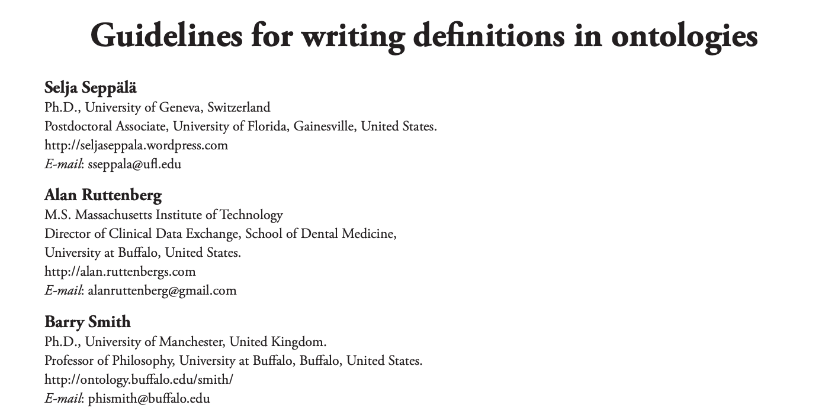
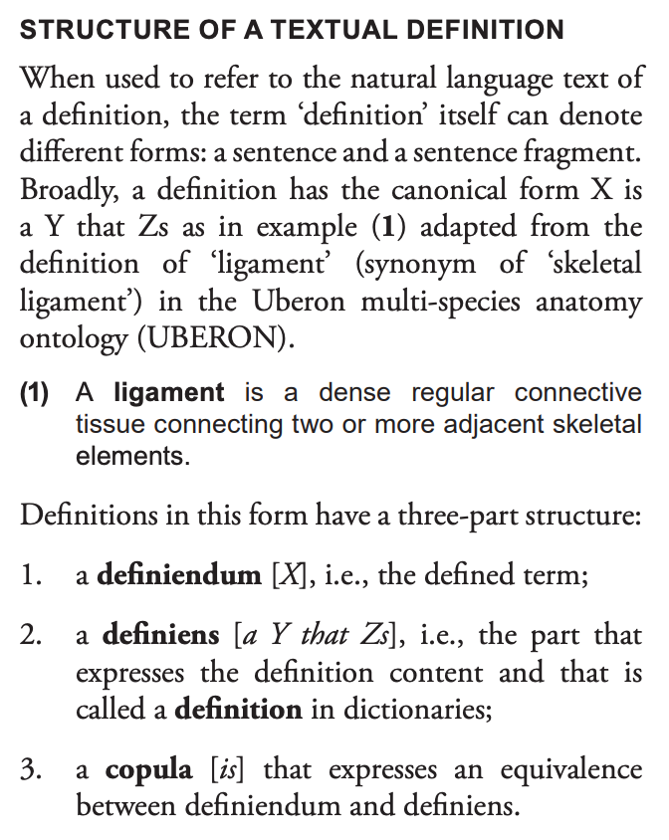
Writing Ontology Definitions
https://philpapers.org/archive/SEPGFW.pdf
https://bit.ly/clingen-mondo

Slide 24
Gene-based names
For example, 'GTP cyclohydrolase I deficiency'
**We are able to accomodate gene-based names**
ClinGen term
OMIM terms
mondo.monarchinitiative.org
https://bit.ly/clingen-mondo
Notes:
show examples from ClinGen vs OMIM

Slide 25
Synonym types
Exact
An exact match
E.g. hereditary Wilms' tumor
exact synonym: familial Wilms’ tumor
Narrow
A more specific term
E.g. asthma
narrow synonym: exercise-induced asthma
Scope
Broad
A more general term
E.g. autoimmune hepatitis
broad synonym, autoimmune liver disease
Related
A word of phrase has been used synonymously with the primary term name in the literature, but the usage is not strictly correct
E.g. AGAT deficiency
related synonym: disorder of glycine amidinotransferase activity
Excluded
Some synonyms are annotated with EXCLUDE, e.g. “NOS” (not otherwise specified) synonyms. It is useful to have these in the edit version, but these are filtered on release.
Type
Deprecated
We may also mark synonyms with DEPRECATED. E.g. all occurrences of “mental retardation” should be “intellectual disability”
https://mondo.readthedocs.io/en/latest/editors-guide/f-entities/#synonyms
Notes:
every syn has a scope and optionally has a type as well

Slide 26
Batching requests
Created a google spreadsheet with the metadata we need to capture:
https://bit.ly/clingen-batch
mondo.monarchinitiative.org
https://bit.ly/clingen-mondo
Notes:
NICOLE
https://docs.google.com/spreadsheets/d/1RqQeG01osF8ThC8cG-Nu1cuLIqsLMPLuNFV-0vY5qoM/edit#gid=0

Slide 27
How long does it take to see changes in to Mondo?
Term is available in next release (around 1st of each month)
Nicole adds term to Mondo, creates a Pull Request (PR)
Request new term (or changes) on GitHub
Expert advice
Chris reviews/approves term (or changes) for technical changes
OLS is updated approx 7 days after our release
✔
mondo.monarchinitiative.org
https://bit.ly/clingen-mondo
Notes:
Expert: https://thenounproject.com/search/?q=expert&i=3264273
Add term: https://thenounproject.com/term/cat-on-computer-desk/982216
Review: https://thenounproject.com/term/review/3306550/
Calendar: https://thenounproject.com/search/?q=calendar&i=1218700

Slide 28
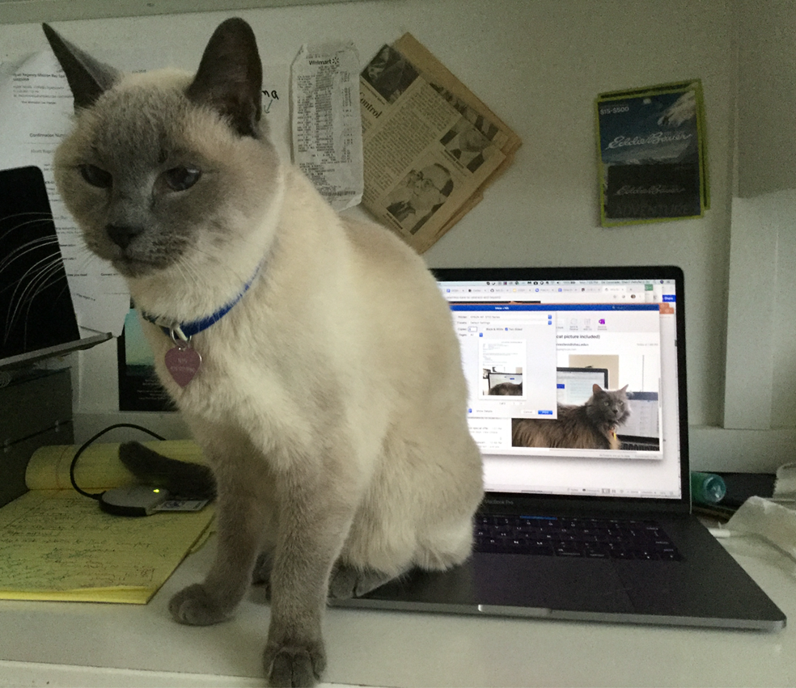
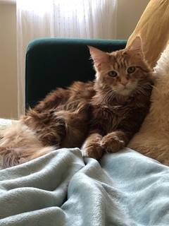
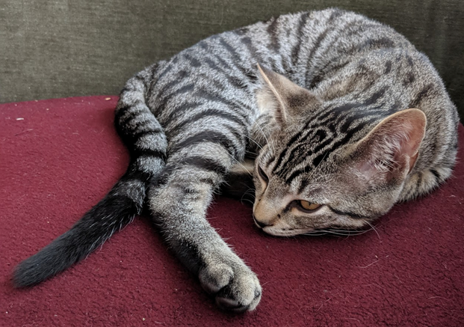
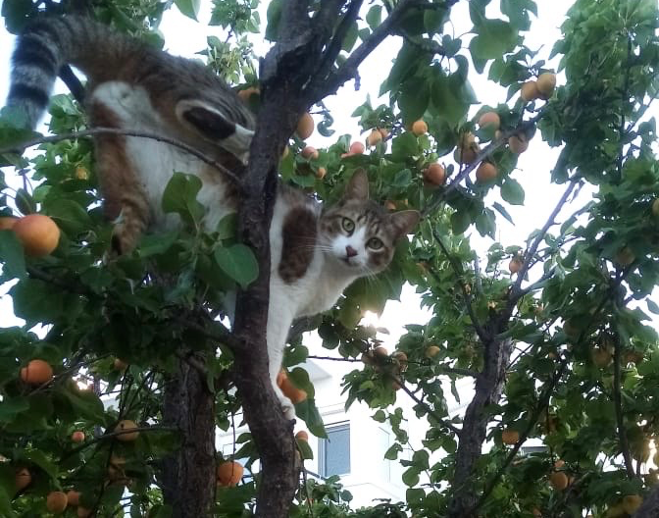
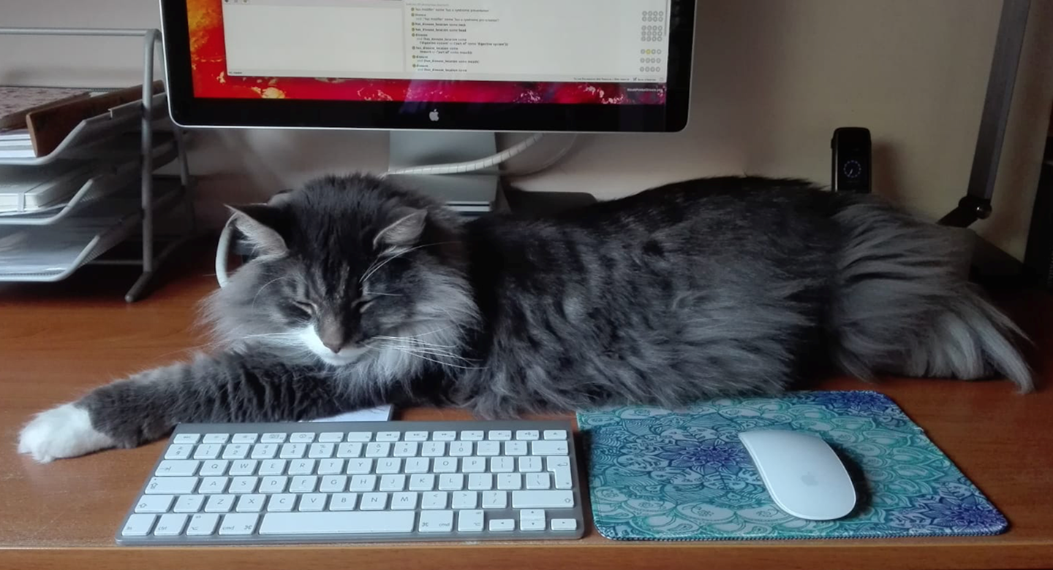
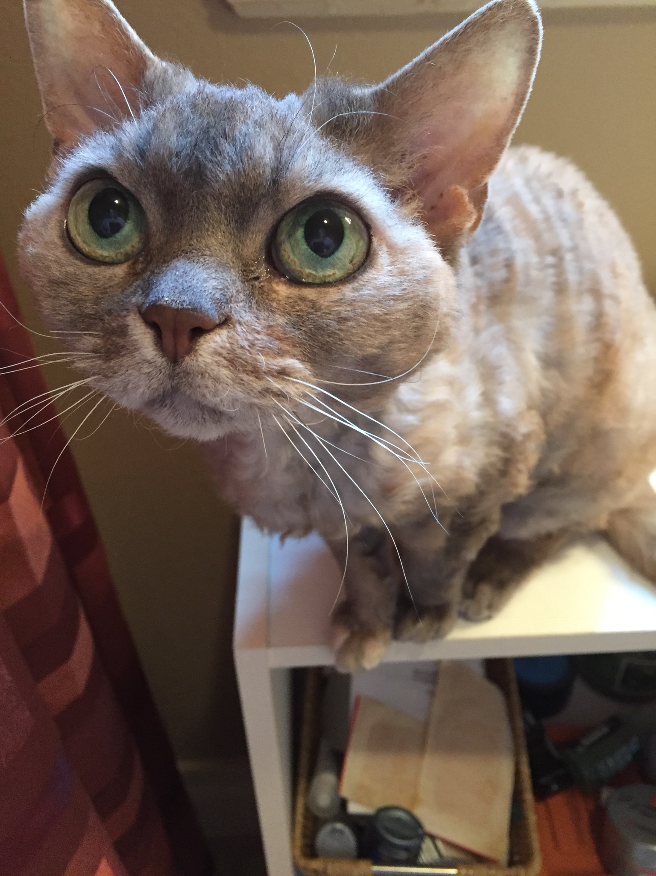
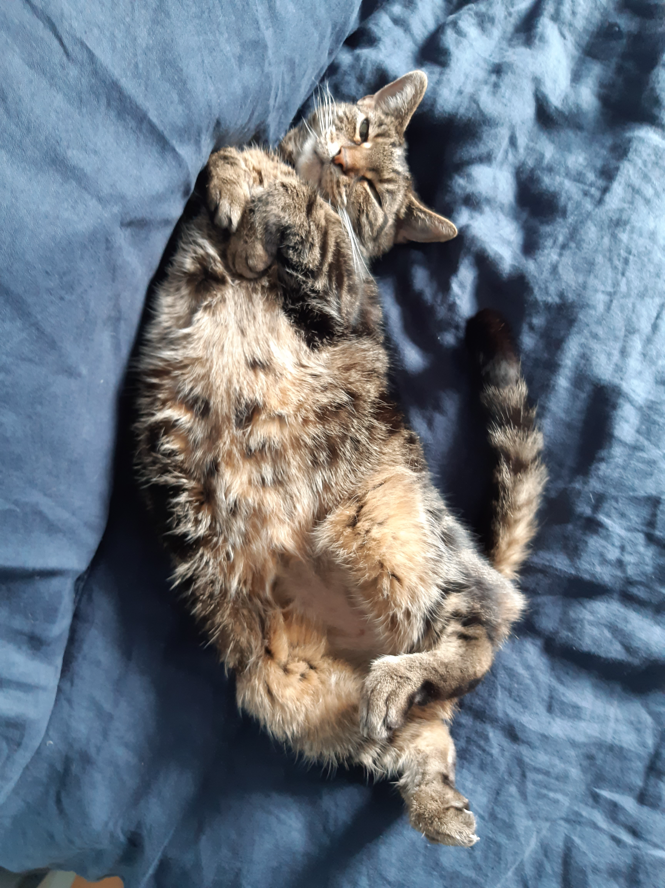
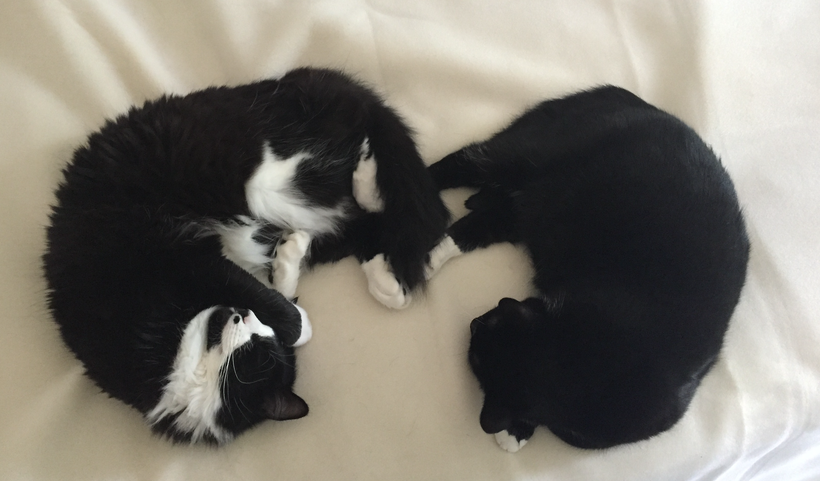
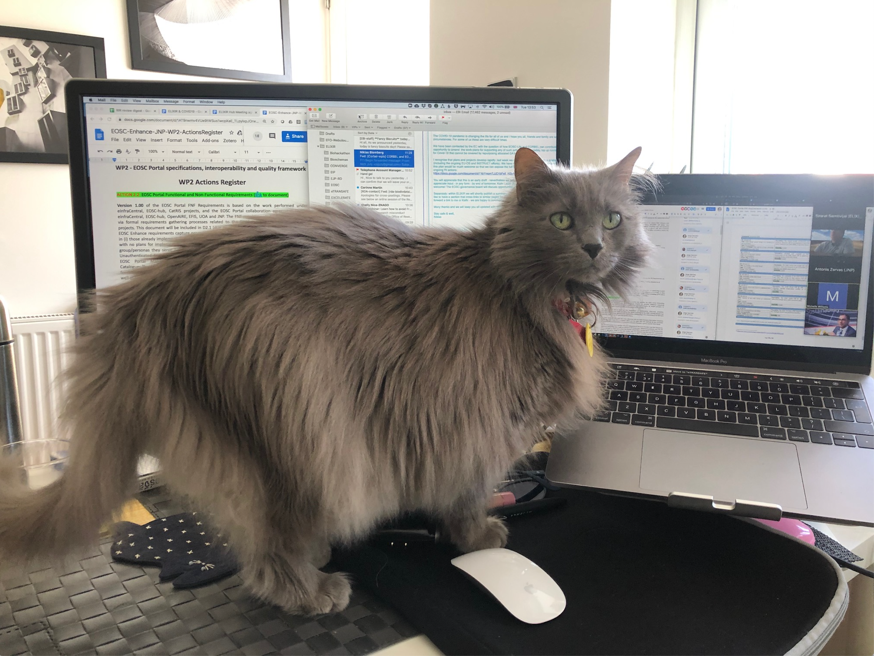
Cats of Mondo
Nin
Owner: Sherri De Coronado
Pepper
Owner: Melissa Haendel
Blue
Owner: Paola Roncaglia
Weasley
Owner: Zoe Pendlington
Zisimos
Owner: Nico Matentzoglu
Zed and Trillian
Owner: Leigh Carmody
Sapphire
Owner: Nicole Vasilevsky
Meow
Owner: Sira Sarntivijai
Owner: Ana Rath
Callie
Owner: Helen Parkinson
mondo.monarchinitiative.org
https://bit.ly/clingen-mondo

Slide 29
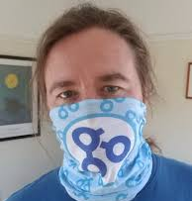
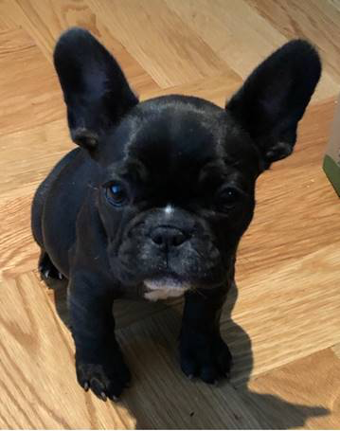
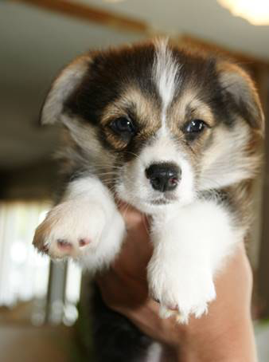
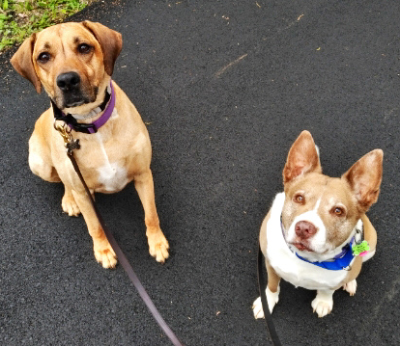
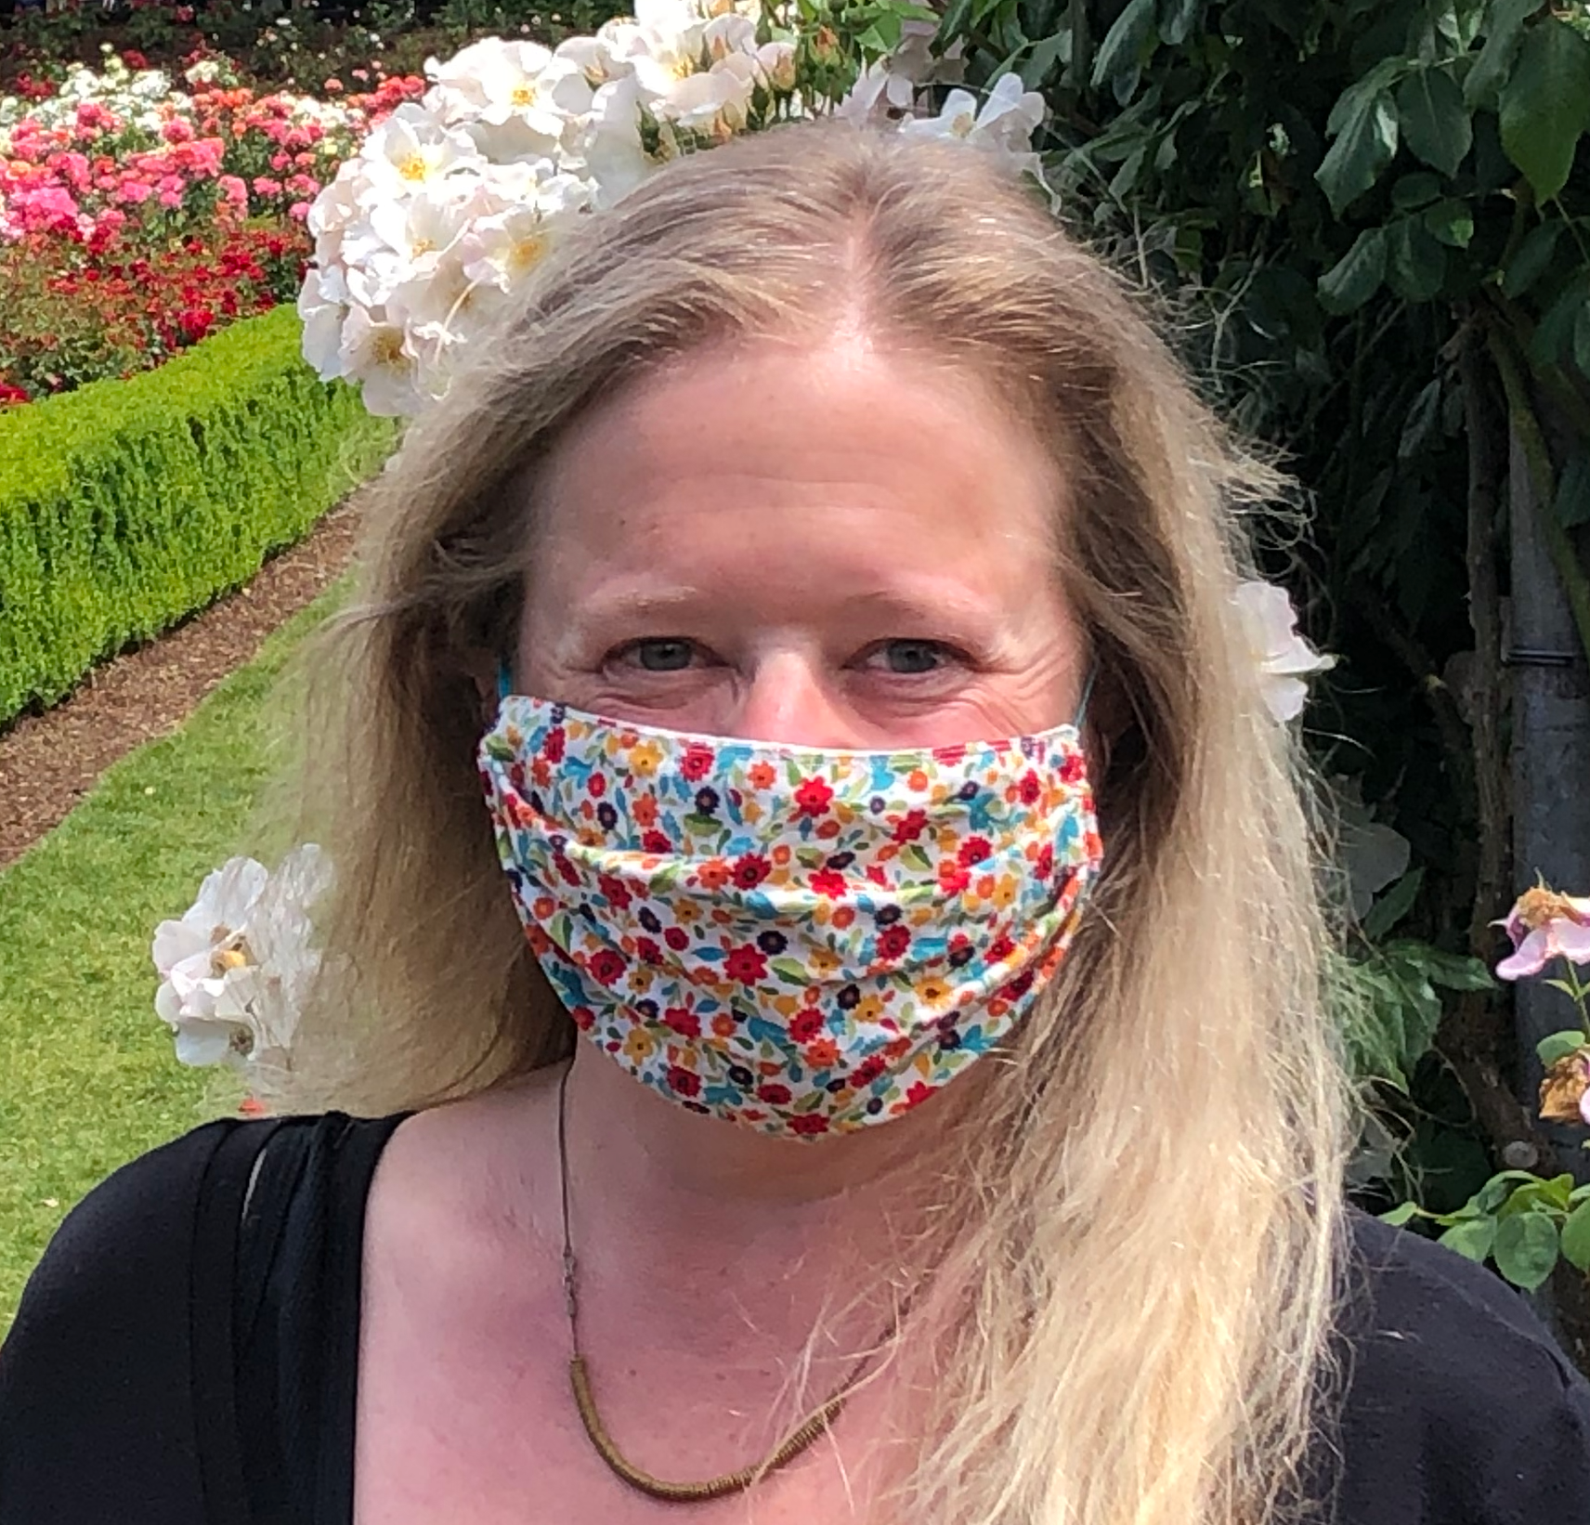
Thank you!
Dogs of Mondo
Chris Mungall, LBNL
Email: cjmungall@lbl.gov
Twitter: @chrismungall
GitHub: cmungall
Nicole Vasilevsky, OHSU
Email: vasilevs@ohsu.edu
Twitter: @n_vasilevsky
GitHub: nicolevasilevsky
Luna Neville
(grandma)-owner Anne Pariser
Copa and Molly
owner, Leigh Carmody
Funding:
Monarch is supported generously by a NIH Office of the Director Grant #5R24OD011883, as well as by NIH-UDP: HHSN268201350036C, HHSN268201400093P, NCI/Leidos #15X143.
mondo.monarchinitiative.org
https://bit.ly/clingen-mondo

Slide 30
Big thanks to our contributors!
Broad Institute
Samantha Baxter
Andrew Grant
Jessica Hekman
Madeline Hughes
Kate Megquier
Kathy Reinold
Rebecca Siegert
CHOP
Colin Ellis
Allison Heath
Ingo Helbig
Avi Kelman
CoRDS-Sanford
Austin Letcher
ClinGen
Larry Babb
Taylor Bingaman
Marina DiStefano
Jenny Goldstein
Brooke Palus
Heidi Rehm
Erin Riggs
Tam Sneddon
Courtney Thaxton
Matt Wright
EBI
Mélanie Courtot
Simon Jupp
David Osumi-Sutherland
Zoë Pendlington
Paola Roncaglia
GARD
Gioconda Alyea
PJ Brooks
Maria Della Rocca
Janine Lewis
Anne Pariser
Andrea Storm
Monarch Initiative
Melissa Haendel
Leigh Carmody
Shahim Essaid
Nomi Harris
Nico Matentzoglu
Julie McMurry
Moni Munoz-Torres
Peter Robinson
Kent Shefchek
Anne Thessen
Aaron Zhang
NCIt
Gilberto Fragoso
Bron Kisler
NIH NCATS
Alice Chen
Eric Sid
NCBI
Donna Maglott
Johns Hopkins
Christopher Chute
NIH NHGRI
Robert Fullem
Morgan Similuk
NORD
Vanessa Boulanger
OMIM
Joanna Amberger
Ada Hamosh
Orphanet
Marc Hanauer
Annie Olry
Ana Rath
University of Colorado
Tiffany Callahan
mondo.monarchinitiative.org
https://bit.ly/clingen-mondo

