Slide 1
Social Network Analysis of Waste Bank in Indonesia
Laili Fitria
Environmental Engineering Study Program, Universitas Tanjungpura
The 4th International Conference of Combinatorics, Graph Theory, and Network Topology (ICCGANT)
Jember, 22nd – 23rd August 2020

Slide 2
Introduction

Slide 3
The development of cities today still uses a conventional waste management paradigm, namely the "end-of-pipe" approach.
Where the community immediately throws their waste into a temporary garbage dump, then continues it to the final processing site without sorting or reducing waste.
This will cause an accumulation of waste volume in the Landfill

Slide 4
Batu Layang Landfill in Pontianak City, West Kalimantan, Indonesa

Slide 5
Bantar Gebang Landfill in Bekasi, West Java, Indonesia
Source : https://mediaindonesia.com/read/detail/106946-tpa-bantar-gebang-overload-bank-sampah-dioptimalkan

Slide 6
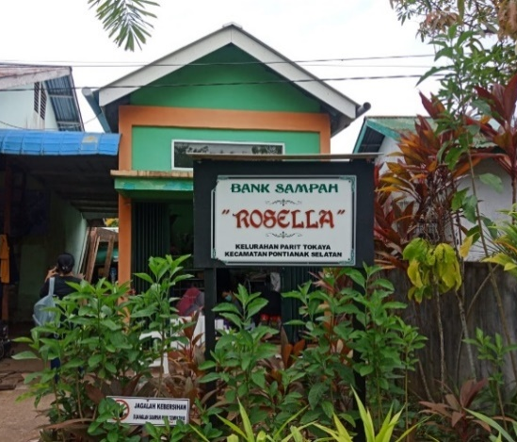
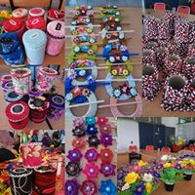
Waste Bank
A waste bank is a place for sorting and collecting waste that can be recycled and / or reused which has economic value.
(PERATURAN MENTERI NEGARA LINGKUNGAN HIDUP REPUBLIK INDONESIA NOMOR 13 TAHUN 2012)
Notes:
ministerial regulations

Slide 7
The management system at the Waste Bank prioritizes waste reduction and handling activities to overcome waste problems.

Slide 8
Social Benefits of Waste Bank
First, through socialization from the Waste Bank, the community is taught to sort waste between organic and non-organic waste.
Second, the community is directed to a creative mindset in managing waste by turning it into items that can be reused through waste craft training conducted by the Waste Bank.
Third, the Waste Bank as a community empowerment organization, moves the community to be more sensitive to environmental problems, especially waste.

Slide 9
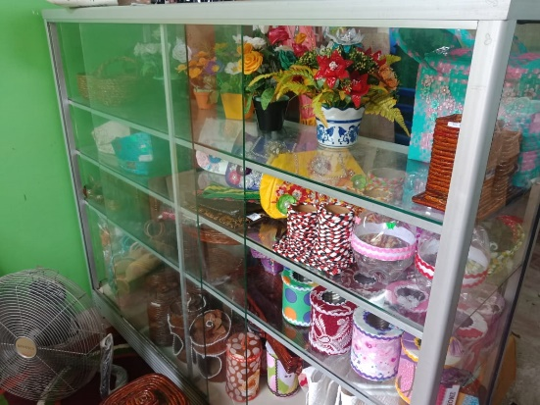
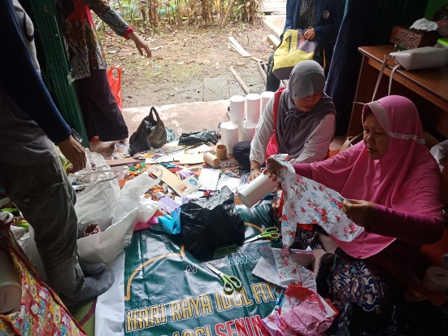
Empowering the community in the waste bank

Slide 10
Source of Waste
The amount, composition and characteristics of waste are related to people's consumption patterns.
Waste handling depends on the level of individual awareness.

Slide 11
Research Purposes
Understanding Social Behavior Society about waste bank through social media

Slide 12
SNA: Social Network Analysis
SNA is a mapping against relations between people, organizations, topic, location, and entity other information.
Inside node or point network describe person, organization, location, or information entity.
Connection lines between points describe the relationship between point.

Slide 13
Method
Using Drone Emprit Academic
Twitter data used from October to mid-November 2019.
The search for data on twitter will be captured by keywords: Sampah
Filter : Bank Sampah, SDGs.

Slide 14
Drone Emprit Academic
Drone Emprit Academic is a big data system that captures and analyzes conversations on social media, especially Twitter, developed by PT Media Kernels Indonesia, and installed in the data center of the Indonesian Islamic University Information System Agency (BSI).
Drone Emprit uses Twitter's API (Applications Programming Interface) to capture conversations in semi-realtime via a streaming method.

Slide 15
(Fahmi, 2017)

Slide 16
(Fahmi, 2017)

Slide 17
Why Twitter & Online News? Cross-platform Resonance
(Fahmi, 2017)

Slide 18
Twitter: Issue Detection Channel
• Only Twitter still provides a full 'search' facility
• Facebook and Instagram only provide access to Public Page only.
• WhatsApp conversations cannot be captured on it.
• However, looking at patterns of virality and resonance between media platforms social, we can use Twitter as a 'proxy' for knowing what's going on, on social media.

Slide 19
Result and Discussion

Slide 21
Conversation Trends about Waste Bank

Slide 22
conversation trends by day

Slide 23
hourly conversation trends

Slide 24
SENTIMENT ANALYSIS

Slide 25
SENTIMENT’S TRENDS

Slide 26
Engagement

Slide 27
SOCIAL NETWORK ANALYSIS ‘WASTE BANK’

Slide 28
MOST RETWEETED

Slide 29
TOP HASTAGS

Slide 30
WORD CLOUD

Slide 31
TOP INFLUENCERS

Slide 32
MOST ACTIVE ACCOUNT

Slide 33
Conclusion
Currently only Twitter data can be retrieved to obtain general description of netizen behavior on social media.
Trends in virality and resonance allow us to use Twitter as a proxy for reading netizen behavior patterns on social media.
Drones Emprit Academic can be used to see the current development trends of social media.
The results of the data on Drone Emprit Academic are media grouping, netizens, behavior in giving comments, and several other clusters. This can be used as a reference for policy makers to create activity programs to reduce waste generation.

Slide 34
Thank you

