Slide 1
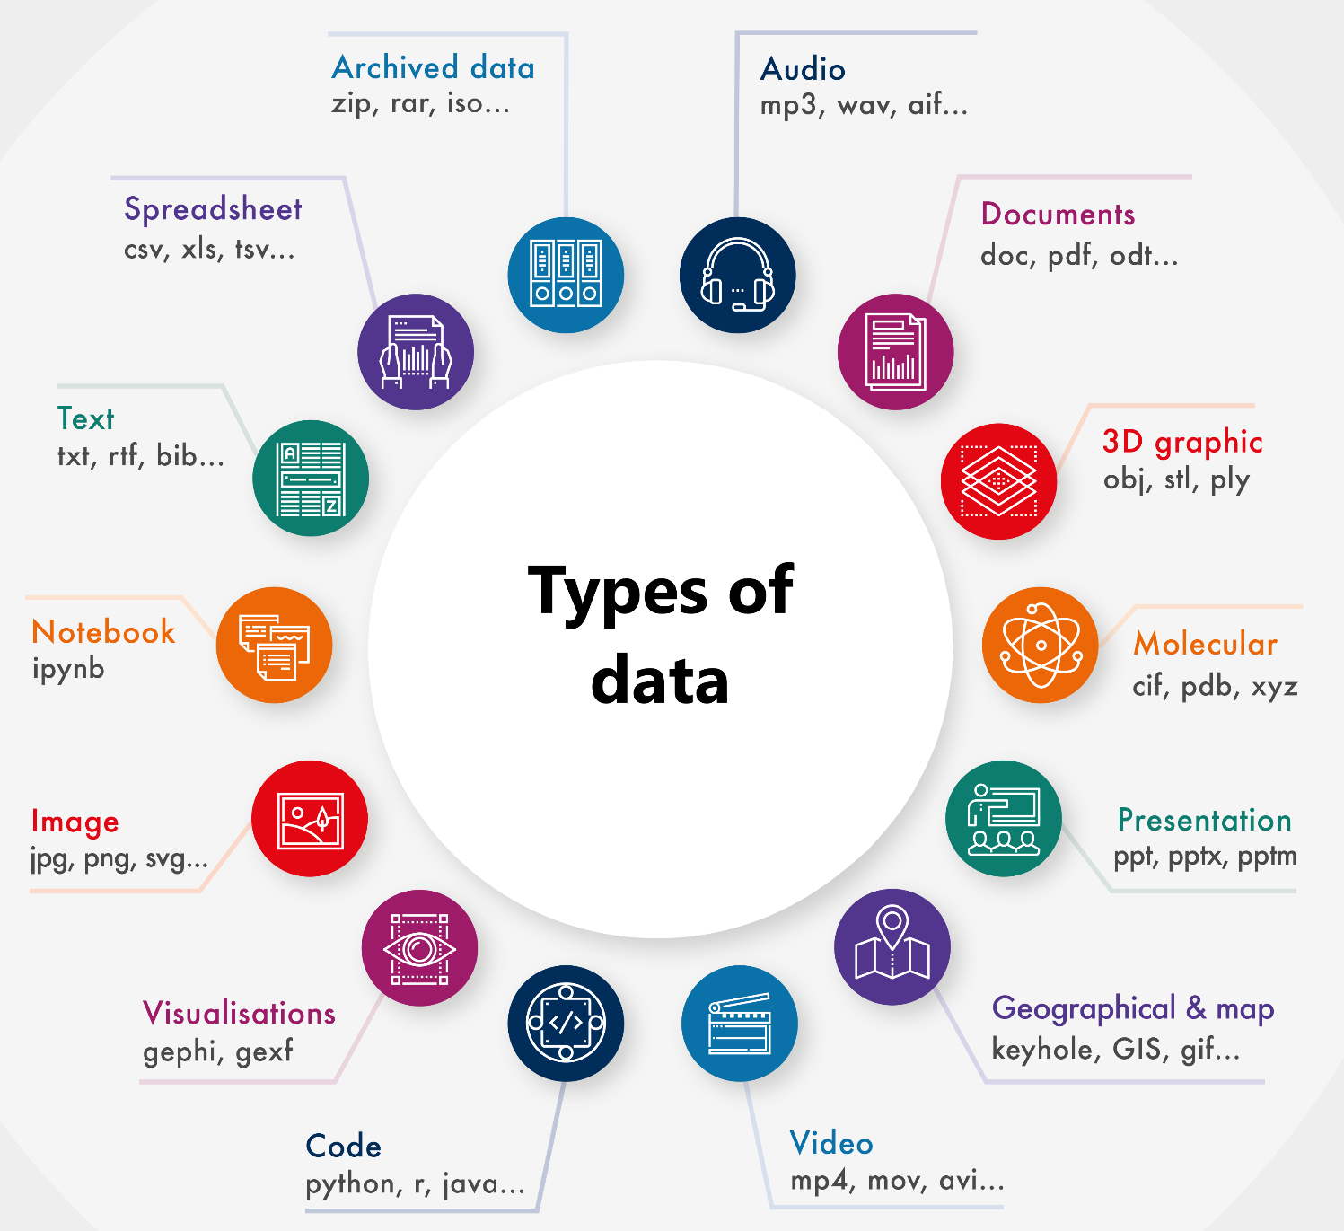
Data Management: Make sense of the complexity around data storage, description, re-use and archiving
Justin Farquhar, Subject Librarian
Antje Lübcke, Research Services Librarian
Notes:
1. Introduce presenters and point to the graphic – i.e. wide range of research data. Can they see theirs? Anything missing?
2. ‘Bag of thingees’ exercise:
In groups, students organise a random selection of ‘things’ into groups/sets (use e.g. coloured paper clips, pens, tea bags, post it notes, keys, business cards, …. Basically things that could be grouped in various ways, according to different categories).
Once finished, if time, get the groups to look at each other's final grouping of ‘thingees’ and see if they can guess what the ordering principle is behind other groups ‘thingees’.
Report back to whole group.
Key takeaway – this is an ice breaker but also gets students thinking about organisation and the choices they made in grouping their set of ‘thingees’. How well would someone in another group have been able to figure out why the items were grouped in the way they were? Documenting decisions made in grouping things is important.

Slide 2
What we will cover today
Context for this session: why manage your research data?
Data management level 1: organising and backing up your data
Data management level 2: using a data management plan
Data management level 3: preserving data – file formats, storage, metadata
Data management level 4: sharing data – repositories, publishing, open research
This workshop will prepare you to meet funder and publisher requirements.
Notes:
Go through what will be covered – briefly.
(don’t want to overwhelm them before we get to the ‘meaty’/content bit of the workshop).
Perhaps note that it is not expected they make it ‘pro level’ or apply everything we tell them today.
Basically, this workshop aims to cover general best-practice principles of management, storage and sharing of research data.
We will give you some practical tips for improving your data management practices that you can implement immediately regardless of your research domain.

Slide 3
Why manage your data?
Good data management:
Makes your data easier to find, understand, & analyse – efficiency
Allows you and others to use your data in the future – sharing
Demonstrates research integrity and validates findings – transparency & integrity
Reduces the risk of data loss – security
Ensures compliance with funders’, publishers’, institutions’ policies – compliance
And, as a bonus, your data sets can be cited! – CREDIT
Notes:
Go through list, expand on any of the points as you like/can (e.g. well documented, findable, accessible, re-usable data means the potential for new discoveries and can lead to collaborations with other researchers in your field).
Mention eTheses deposit in future & good link to next slide: Otago policy document: https://www.otago.ac.nz/administration/policies/otago003211.html (see next slide).

Slide 4
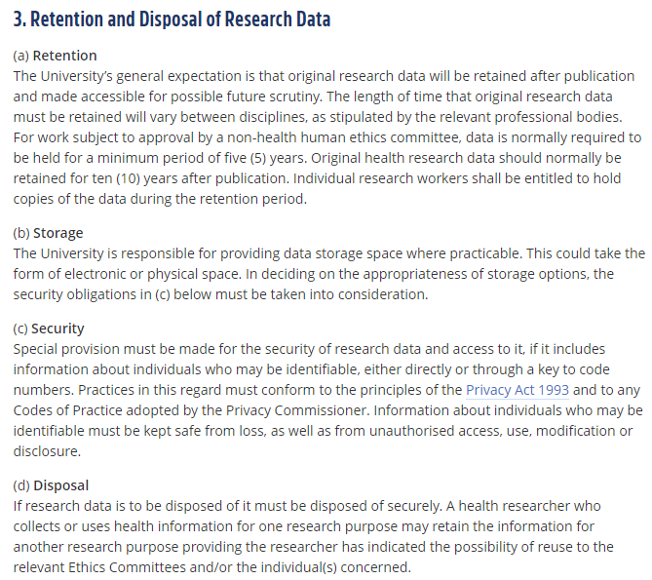
Why manage your data? continued…
University of Otago, Responsible Practice in Research – Code of Conduct (https://www.otago.ac.nz/administration/policies/otago003211.html)
Notes:
The University of Otago has a code of conduct for responsible practice in research that includes specific mention of research data – its retention, storage, security and disposal (3(a) – 3(d) in document. NB Only part of this is shown in this slide).
NB Universities around the world have these policies. Some are even more sophisticated than Otago University’s – which is something to consider if they plan to continue in their PG studies or take up post docs or other research positions overseas.

Slide 5
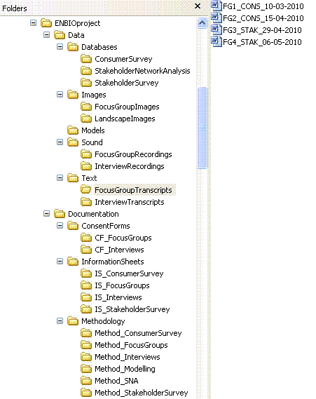
Gain: Clarity and Efficiency.
Data Management: Level 1
Be organised
Clear file structures
Clear file naming system
Version control
Automated options?
Regularly back up your data and documents
External hard drive OR cloud storage
How do you back up your data?
Notes:
File structure:
Use what makes the most sense for your research project/data. Think carefully how best to structure files in folders so that you can easily locate your data.
Think of the best hierarchy for your files (how many ‘layers’/i.e. how deep or shallow do you think your hierarchy should be?)
See example from UK Data Service: https://www.ukdataservice.ac.uk/manage-data/format/organising (graphic in slide):
In the example in the slide, data and documentation files are held in separate folders. Data files are further organised by data type and then according to research activity. Documentation files are also organised according to type of documentation file and research activity.
Try to restrict the level of folders to three or four deep (though, again, this is dependent on your project needs/the data you have).
File naming:
Be consistent when naming files – short but descriptive is best.
Avoid special characters in file names (& or ? or !) – use capitals, underscores instead of periods, spaces, etc.
Use date format ISO 8601: YYYYMMDD (NB this is different to the example in the slide – oops. The UK Data Service recommends using hyphens in date).
Include a version number (i.e. version control)
(for later slide/level: 5. write down your naming convention in your data management plan)
Backing up:
Ensure you regularly back up your data in at least three locations
Consider if your data can be saved in cloud storage (i.e. ethics considerations)
Be selective when choosing cloud storage provider – read the documentation and make sure they are trusted/recommended by other researchers in your field.
Know that hard drives and USB sticks can go missing or be corrupted
Discuss – “How do you back up your data/work?”

Slide 6
Gain: Risk Management.
Data Management: Level 2
Data Management Plan (DMP)
A formal document that outlines and describes the data you expect to collect or generate during your research, how you will manage, describe, analyse, store those data, and how you will preserve and share that data at the end of your project.
Many funding agencies require a DMP
Some publishers will ask for a data management plan
DMPs help you meet your obligations to the University as laid out in the research code of conduct discussed earlier
Use University supported systems for back up and moving of data where applicable. Consider:
Size
Data sensitivity
Data sovereignty
Notes:
Otago University Library DMP tool: https://www.otago.ac.nz/library/dmp/index.html --- show the tool
Some extra points to maybe mention:
Designed for all disciplines.
No compulsory fields (deliberate).
It is a living document - you don’t have to fill it all in at one time and can revise it as your project matures/progresses
Output to .txt file format allows you to take the metadata anywhere (relates to level 3): you can reuse the info from the Otago DMPt without having to re-enter in multiple forms (e.g. if a funder has a DMP form they require you to fill in).
Helps you think holistically about your data in the context of your research project and beyond (ethics/consent considerations might become clear in the process of filling it in as well as the need to potentially license it)
Pull out ‘key’ fields and explain to students then show them the info hover text.
2. Students explore the DMPt independently (c. 3-5 mins)
3. Otago Uni supported systems for back up and moving data:
HCS
Syncplicity (though moving to One Drive, I think soon-ish)
NB also DMP Online - https://dmponline.dcc.ac.uk/
i.e. They do not have to use the Otago DMPt (keeping in mind that the Otago DMPt is only available for Otago Staff and PG students to use. This is something to consider if they intend to work in a collaborative field of research).
--------------------------------------------------------------------------------------------
Extra info for DMP:
Related policies (to DMPt):
https://www.otago.ac.nz/administration/policies/otago003211.html – Responsible Practice in Research – Code of Conduct
https://www.otago.ac.nz/administration/policies/otago003228.html - Intellectual Property Rights of Graduate Research Students Policy

Slide 7
Gain: Data that lives beyond the life of one specific research project.
Basic Metadata
These are some ISO (International Organization for Standardization) suggested minimal metadata elements to use when you are documenting your data:
Title
Creator (Principal Investigators)
Date Created (also versions)
Format (and software required)
Subject
Unique Identifier
Description of the specific data resource
Coverage of the data (spatial or temporal)
Publishing Organization
Type of Resource
Rights
Funding or Grant
Data Management: Level 3
Save your data in formats that allow the future you, or another future researcher, to open them
If you are working with data as part of a bigger research team, clarify your long term access to and use of that data
Document everything
Metadata is the key
Plan for long-term storage
Notes:
Data beyond your immediate research project – future proofing for future access and use of data
1. File formats
Explain proprietary vs. open format. For example, .docx VS .txt or .xlsx VS .csv/.tsv (if time, demo saving a Word doc to .txt format)
2. Plan for the future not only in terms of format of the data but also potential access. If your research formed part of a larger project you might not ‘own’ the data you created during your research. If you moved on from the Uni/research team, would you still be able to access and use the data? – something to keep in mind and which could be clarified in the process of completing a DMP; keeping in mind that you might need to have discussions with your supervisors/Principle Investigators.
3. Document everything
A metadata standard or schema is a set group of elements that have been standardized for a particular field. [Not certain what to show them here – it would be worth seeing a schema but, out of context, they can seem very daunting.]
Some scientific disciplines already have established metadata standards for data sets.
Some data repositories also have their own standards.
If there is not a standard already in place for your data, there are several general purpose schemas that you can adapt to your needs.
At the bare minimum, use the ISO Basic Metadata elements in the slide above.
4. Long term storage
Consider where you can store your data after your research is completed. (NB data repositories an option, if appropriate for the data type. More on this at Level 4. But you might not want to store raw data in a repo. Consider cloud storage, but be aware of sensitive data etc.)
Again, documentation is key – ensure documentation is clearly associated with the data (file-naming, location/file structures).
---------------------------------------------------------------------------------------------------
DDI example (metadata schema):
http://www.ddialliance.org/training/getting-started/data-catalog
NB controlled vocab = exact meanings for each field

Slide 8
Notes:
*** Break and educational video – how NOT to ‘manage’ your data ☺
https://youtu.be/66oNv_DJuPc
After watching the video perhaps ask for feedback/thoughts:
Has anyone had or heard of a similar experience?
Does some of this resonate with your current RDM practices? ☺ (Don’t call them out on this, however – leave this question rhetorical.)

Slide 9
Gain: Visibility and Impact.
Data Management: Level 4
Data Repositories
Domain/discipline Specific vs General vs Institutional
Persistent Identifier for your data
Citation Impact
Data Journals
Creative commons licence?
Open Science/Research movement and the reproducibility crisis
Where do you think your discipline stands on reproducibility?
Notes:
Long term storage (cont.), but also sharing data, gaining visibility and achieving impact with your research data
Data repositories
Pros to repos over e.g. personal or project webpage:
webpages may be costly,
webpages are unlikely to offer a data repository’s functionality or long term solution.
Webpages are less likely to make your data collection visible to new users and contacts, or to sustain long term access to your data collection.
! NB Your data can get a DOI or similar peristent identifier when placed in a data repository - another big plus as you can now get credit for your data in the form of citations.
Examples of domain agnostic repositories for data:
https://figshare.com/
https://dataverse.org/
https://data.mendeley.com/
NB Speak to your supervisor and other researchers in your lab/field of research as there might be a repository that is recommended for the types of data you are working with (e.g. GenBank for DNA sequences). And always make sure to read the ‘small print’/’About’ section of these websites/repos to ensure that the platform is appropriate and safe for your research data.
2. Data journals:
These are exactly what they sound like: journals in which you publish and describe your data set/s.
https://www.journals.elsevier.com/data-in-brief
3. Enabling re-use of data – CC licences:
Putting your data in a repository is step one – and might be the end of it if you have sensitive etc. data (NB some/most(?) repositories allow you to display the metadata only if you choose),
... consider how easy it would be for someone who has found your openly available data set to use it in their own research.
CC licences very clearly signal what can and can’t be done with your data set.
License Types (https://creativecommons.org/share-your-work/licensing-types-examples/)
Creative Commons offers six copyright licenses, based on combinations of the four conditions:
Attribution (CC BY)
Attribution ShareAlike (CC BY-SA)
Attribution-NoDerivs (CC BY-ND)
Attribution-NonCommercial (CC BY-NC)
Attribution-NonCommercial-ShareAlike (CC BY-NC-SA)
Attribution-NonCommercial-NoDerivs (CC BY-NC-ND)
Exercise: does anyone know what this licence [click on slide] means? What can someone do with your work if this licence is slapped on it? What can’t they do?

Slide 10
Today we covered
How to organise and back up your data in your day-to-day workflows
Using a data management plan to document your data collection and creation practices, analysis, storage, and sharing of data as part of your larger research project
Preserving data by ensuring file formats are non-proprietary, storage options are appropriate to data type and size, and metadata is rich and consistent
How to share your data by using repositories, publishing it in data journals, and ensuring a licence is applied that indicates how your data can be used
Notes:
Recap main points of session and underline that the reason they want to properly and thoroughly manage their research data is to ensure:
They work more efficiently
They are able to back up their research findings
Their data is not lost or corrupted
They comply with university, funder, publisher policies
They and others can easily access and use the data in future research
They can get credit for their work/data ☺

Slide 11
Key takeaways from this session
Plan early…
Keep updating your data management plan throughout your research project
Metadata counts: be as sophisticated as you have to be and as simple as you can be
Be mindful of metadata standards in your discipline and be consistent in applying them to your datasets
Know what funders, publishers, institutions, etc. require in terms of DMPs, metadata, data sharing etc.
Persistent identifiers are your friends
BACK IT UP!!
BACK IT UP!!!
Department based workshops possible – talk to your Subject Librarian

