Slide 1
Communicate your Research: Telling your Story
Josh Borycz & Alex Carroll
Sarah Shannon Stevenson Science & Engineering Library
Vanderbilt University Libraries

Slide 2
Outline
What makes a good talk?
Narrative approach to presentation
How technical should I be?
Elevator pitch
Poster presentations

Slide 3
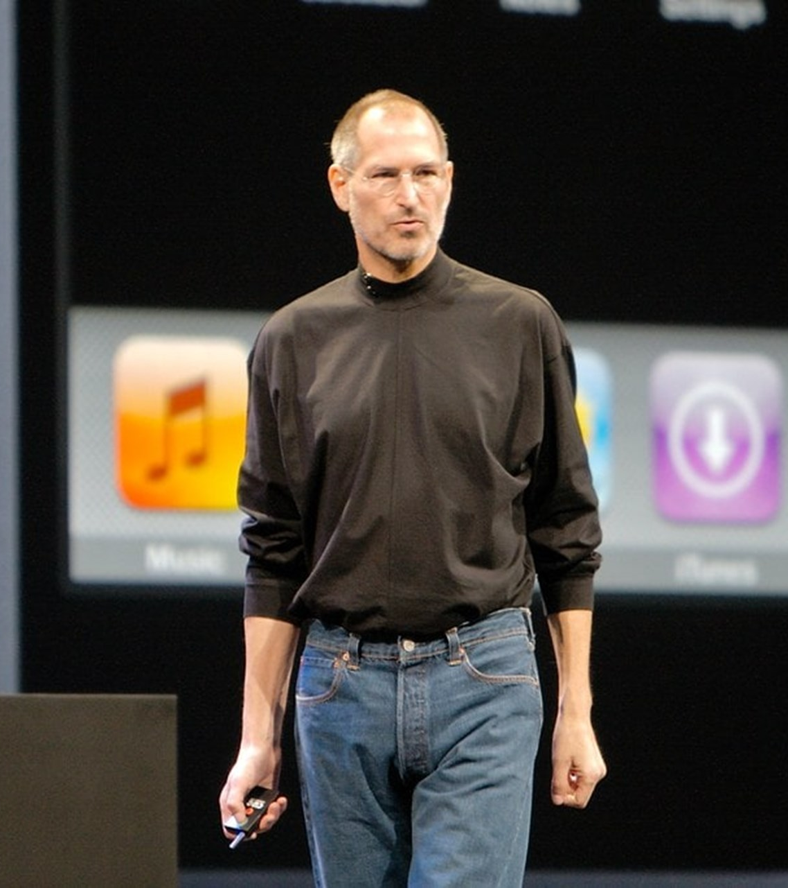
Think about the BEST presentation you’ve ever attended.
Think about the WORST presentation you’ve ever attended.
What made that presentation great?
What made that presentation bad?

Slide 4
Great presentations are unique, but have similar foundations
???
Inter-active
Good
stories
Tuned to audience
Stage
presence
Interesting content
Organized
effectively

Slide 5
Bad presentations are usually bad for the same reason
Designed for speaker’s convenience, rather than audience’s interest and memory
Who is my audience?
Bad presentations start by asking “what do I want to talk about?”
WHAT DO I WANT THEM TO LEARN?
Great presentations start by asking different questions:
Notes:
Presentations go wrong in many ways, but often for the same reasons
Lack of practice, too much material, lack of enthusiasm, etc.

Slide 6
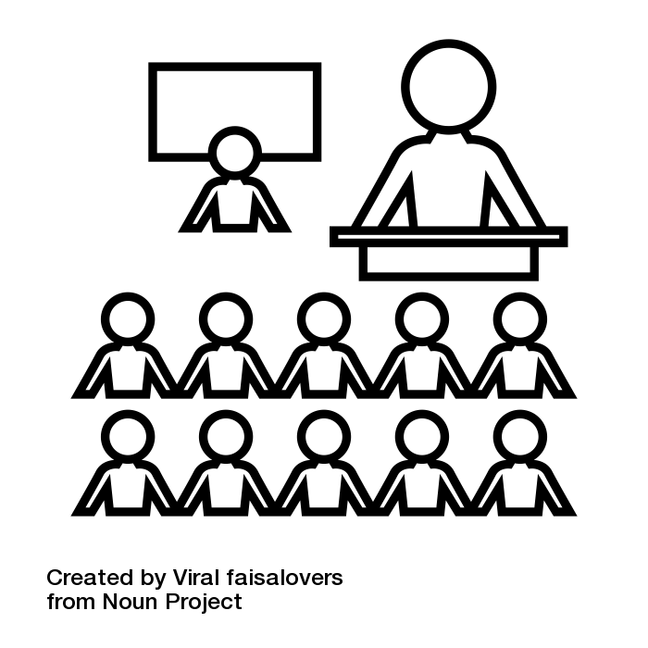
How do people learn?
We can rely on research from educational psychology to understand how people learn
Despite our apparent differences, people mostly learn in mostly the same ways
Storytelling is an effective way of communicating complex ideas
Willingham, D., & Daniel, D. (2012). Teaching to What Students Have in Common. Educational Leadership, 69(5), 16.
Willingham, D. T. (2013). Learning Styles. In H. Pashler (Ed.), Encyclopedia of the Mind (pp. 467–468). New York: SAGE Publications, Inc.

Slide 7
Why is storytelling so effective?
“The human mind seems exquisitely tuned to understand and remember stories - so much so that psychologists refer to stories as 'psychologically privileged,’ meaning that they are treated differently in memory than other types of [non-narrative] material."
-Daniel Willingham, PhD, Why Don’t Students Like School?
What was your last class about?
What happens in Star Wars?
Willingham, D. T. (2009). Why don’t students like school?: a cognitive scientist answers questions about how the mind works and what it means for the classroom. San Francisco, CA: Jossey-Bass.

Slide 8
Stories have consistent and familiar structures
Stories, or narratives, have consistent structures and elements
Involve major and minor characters
Have a plot with a beginning, middle, and end
Feature a conflict and a resolution
Narratives allow listeners to place a new story within the context of other stories they already know
Overlapping characters
Similar settings or environments
Common sources of conflict
Bruner, J. (1991). The Narrative Construction of Reality. Critical Inquiry, 18(1), 1–21.
Fisher, W. R. (1987). Human communication as narration: Toward a philosophy of reason, value, and action. University of South Carolina Press. https://tenderhuman.com/shapes-of-stories-infographic

Slide 9
Storytelling Promotes retention and transfer
Promotes retention
Narratives organize information into a familiar format
Because the organization is familiar, framing your research as a narrative helps audiences remember (retain) what you say
Promotes transfer
When encountering new information, you process this information in a portion of your brain called working memory
You have retained information when it moves from working memory into long-term memory
This process is called transfer
Willingham, D. T. (2009). Why don’t students like school?: a cognitive scientist answers questions about how the mind works and what it means for the classroom. San Francisco, CA: Jossey-Bass.
Klipfel, K. M., & Cook, D. B. (2017). Learner-Centered Pedagogy: Principles and Practice. Chicago: American Library Association.

Slide 10
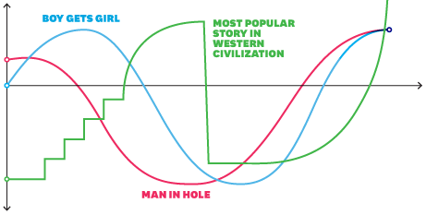
Storytelling Facilitates Moving New information into long-term Memory
Lists and symbols are hard to remember
Information needs to be meaningful for retention
Narrative is familiar to everyone
Familiarity leads to retention and transfer
Information
Transfer
Working Memory
Long-term Memory
Klipfel, K. M., & Cook, D. B. (2017). Learner-Centered Pedagogy: Principles and Practice. Chicago: American Library Association.

Slide 11
Storytelling with Bacteria
“[REDACTED] were first discovered by accident in 1987. In the determination of the gene sequence coding an alkaline phosphatase isozyme responsible for conversion aminopeptidase in E. coli, a peculiar repeat sequence was detected downstream of the gene.”
CRISPR-Cas
Han, W., & She, Q. (2017). CRISPR History: Discovery, Characterization, and Prosperity. In Progress in Molecular Biology and Translational Science (Vol. 152, pp. 1–21). Elsevier. https://doi.org/10.1016/bs.pmbts.2017.10.001

Slide 12
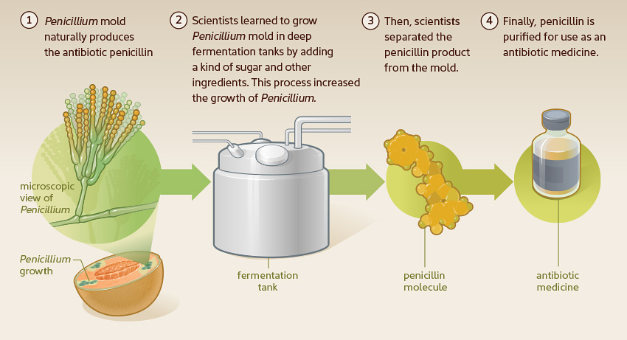
Storytelling with Bacteria
“Returning from holiday on September 3, 1928, Fleming began to sort through petri dishes containing colonies of Staphylococcus, bacteria that cause boils, sore throats and abscesses. He noticed something unusual on one dish. It was dotted with colonies, save for one area where a blob of mold was growing. The zone immediately around the mold—later identified as a rare strain of [REDACTED] was clear, as if the mold had secreted something that inhibited bacterial growth.”
Penicillin
American Chemical Society. (n.d.). Discovery and Development of Penicillin. American Chemical Society International Historic Chemical Landmarks. Retrieved January 31, 2020, from https://www.acs.org/content/acs/en/education/whatischemistry/landmarks/flemingpenicillin.html
https://www.nlm.nih.gov/exhibition/fromdnatobeer/exhibition-interactive/illustrations/penicillin-alternative.html

Slide 13
Don’t take our word for it…
Storytelling is a thoroughly tested strategy of improving engagement and retention of information
Jeff Bezos’ insists on narrative use
Presents meeting information in narrative memos
Structuring in a narrative forces you to think about most important aspects of your work
Brains are hardwired for narrative structure
Willingham, D. T. (2009). Why don’t students like school?: a cognitive scientist answers questions about how the mind works and what it means for the classroom. San Francisco, CA: Jossey-Bass.

Slide 14
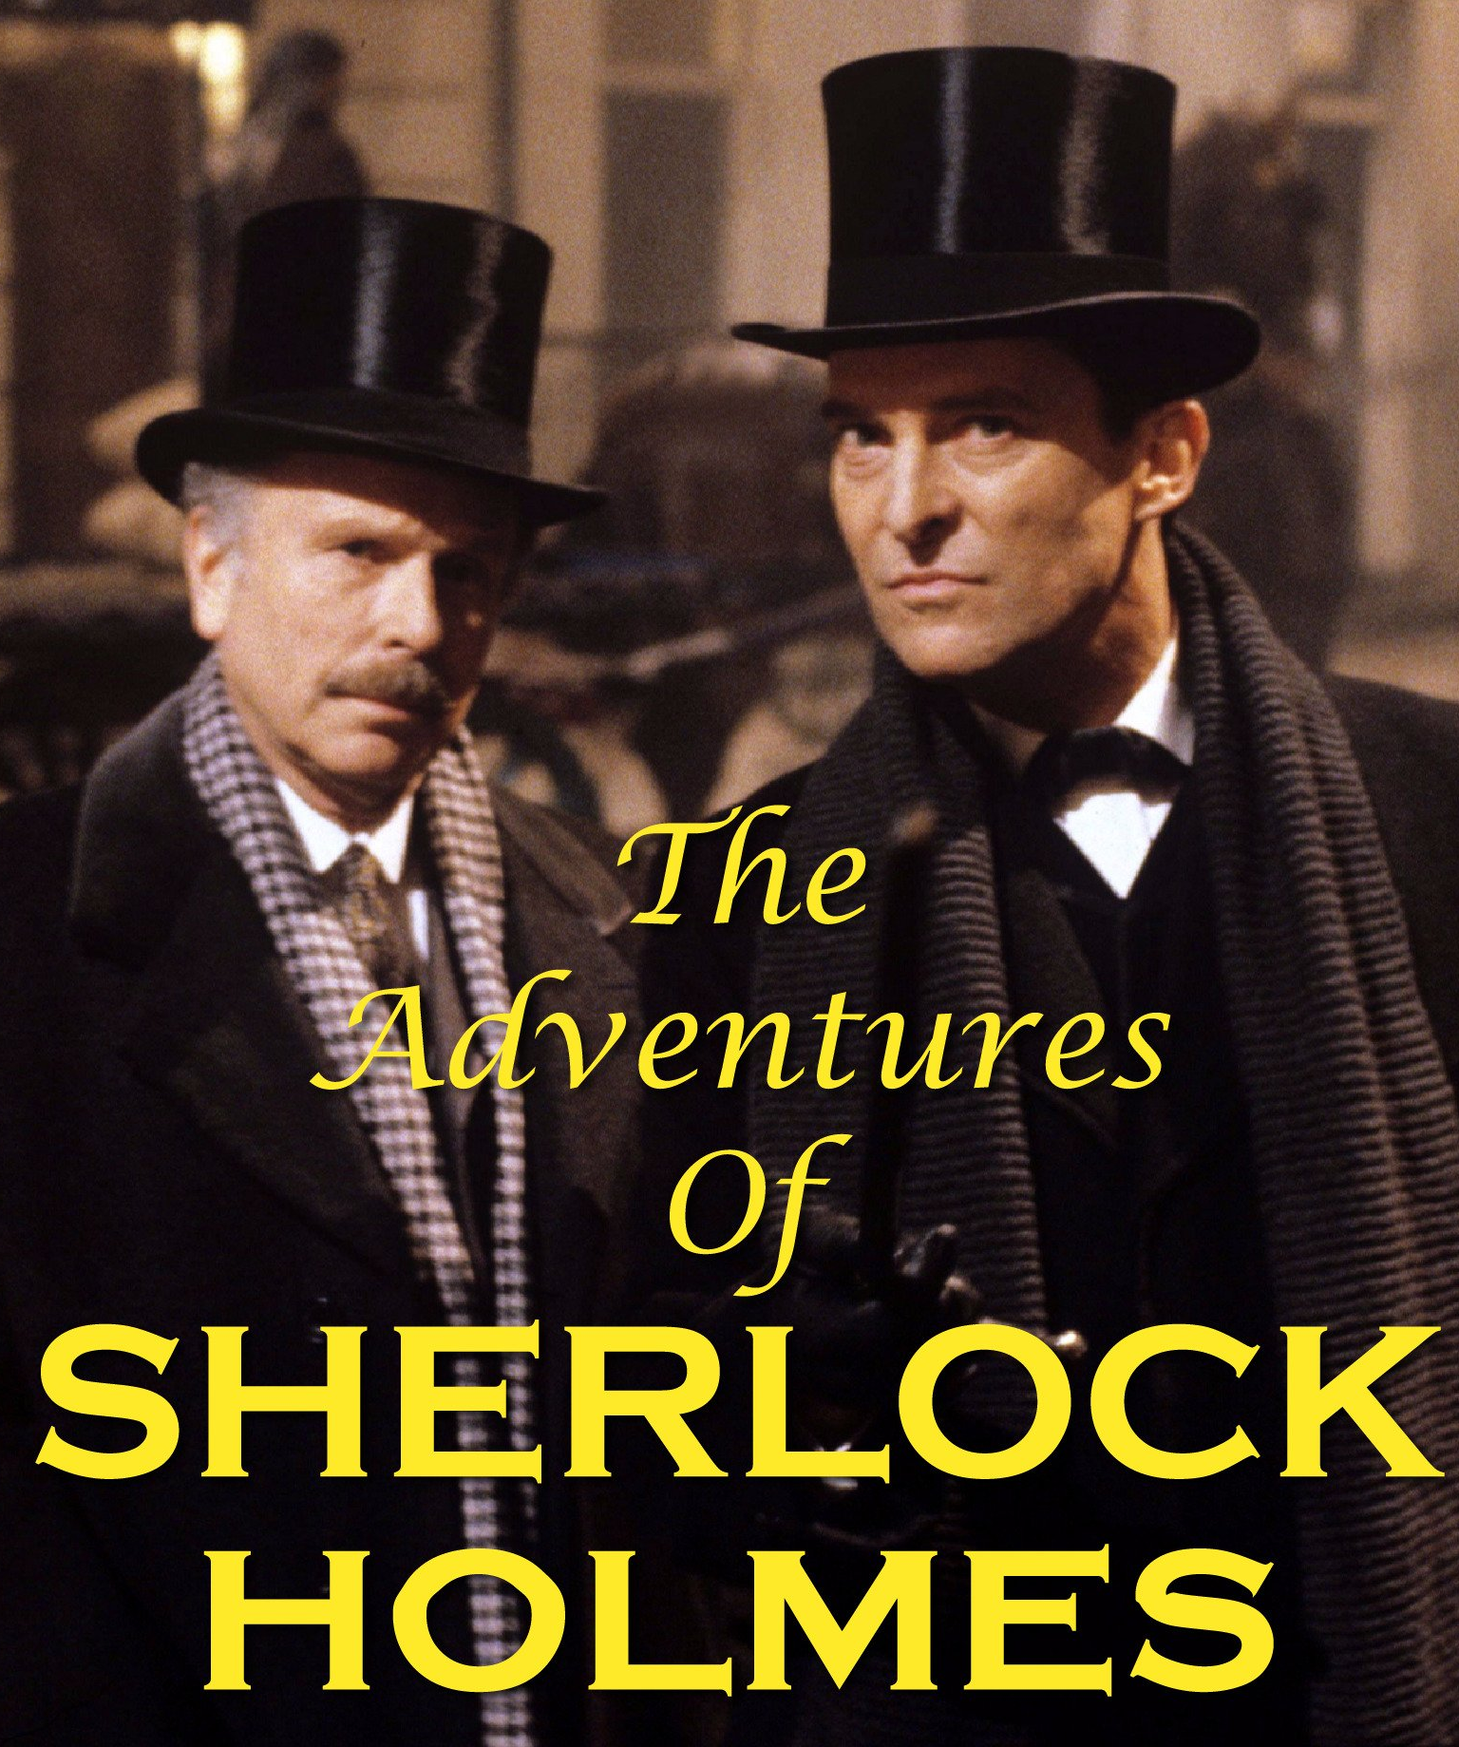
Storytelling and research
What kind of story lends itself to describing research?
“Many of the best talks have a narrative structure that loosely follows a detective story. The speaker starts out by presenting a problem and then describes the search for a solution. There’s an ‘aha’ moment, and the audience’s perspective shifts in a meaningful way. “
—Chris Anderson
Anderson, C. (2013, June). How to Give a Killer Presentation. Harvard Business Review. https://hbr.org/2013/06/how-to-give-a-killer-presentation.
https://www.amazon.com/The-Adventures-of-Sherlock-Holmes/dp/B074PBHNTV

Slide 15
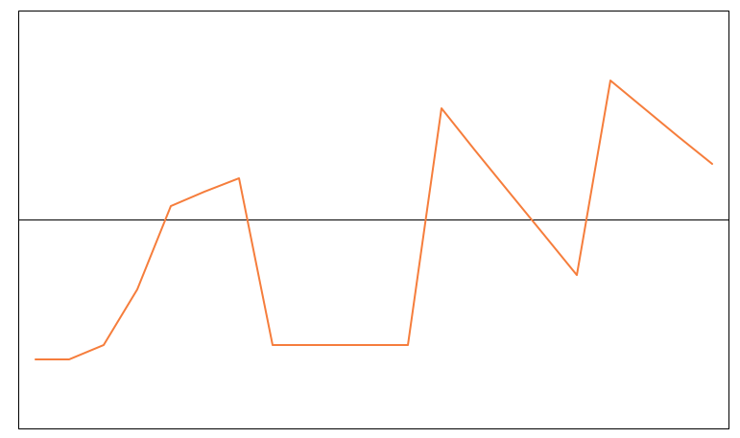
Genre: Detective Story
Good
Fortune
Nabbed!
Big reveal
Wrong
guy!
Find
evidence
Attempted escape
Normalcy
Time
He might get away!
False leads
MURDER!
Oddball
newcomer
Confusion
AH HA!
Bumbling
detectives
Bad
Fortune
Detective story. (1988). In The Editors of Encyclopaedia Britannica (Ed.), Encyclopaedia Britannica. https://www.britannica.com/art/detective-story-narrative-genre

Slide 16
Genre: Research Story
Good
Fortune
Tell your group
Accepted!
Wrong
conclusion
Group challenges ideas
Find
evidence
Normalcy
Time
Submit to journal
Research
question
New
idea
False leads
Confusion
AH HA!
Literature
search
Bad
Fortune
Detective story. (1988). In The Editors of Encyclopaedia Britannica (Ed.), Encyclopaedia Britannica. https://www.britannica.com/art/detective-story-narrative-genre

Slide 17
Detective Story Activity
1. The seemingly perfect crime
2. The wrongly accused suspect
3. The bungling of dim-witted police
4. The superior mind of the detective
5. The big reveal where the real culprit is identified
Notes:
To present your research more like the “discovery of penicillin” and less like the “discovery of CRISPR,” try using the structure of a detective story.
To reframe your research as a story following this template, think of your topic as a “crime” and yourself as the brilliant detective who “cracks the case.”

Slide 18
Detective Story Activity
Spend the next five minutes using a worksheet to frame a current (or previous) research project as a “whodunit”
Digital version of worksheet:
https://bit.ly/33Nyq18

Slide 19
Report-Story Continuum
Reading a Paper
Keynote Address
Financial Presentations
VC Pitches
Report - data-rich, exhaustive, and informative, but not very engaging
Stories - help speaker connect with an audience, but listeners often want facts and information, too
Good science presentations need both, but what is the balance?
Anderson, C. (2013, June). How to Give a Killer Presentation. Harvard Business Review. https://hbr.org/2013/06/how-to-give-a-killer-presentation.

Slide 20
When, where & How to use this?
Group meeting
Back
ground
Conc-lusions
Methods
Results
Professional conference
Background
Methods
Results
Conclusions
General science talk
Background
Methods
Results
Conclusions
Anderson, C. (2013, June). How to Give a Killer Presentation. Harvard Business Review. https://hbr.org/2013/06/how-to-give-a-killer-presentation.

Slide 21
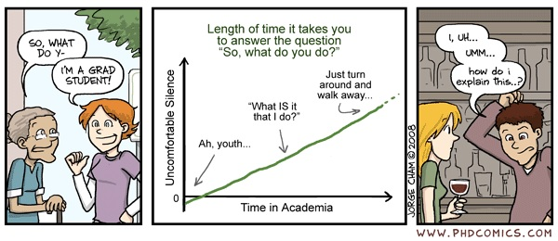
Elevator pitch

Slide 22
Elevator pitch
A 1 minute summary of your work for someone outside your field
Narrative works here as well, but try thinking of this as a monster flick
Focus on how horrible the problem (monster) is and how you solved (killed) it
The methods (weapon) should only be described briefly
How would you describe your favorite novel or movie in 1 minute?
PRACTICE IS KEY!

Slide 23
Poster presentation
Designing the poster
Dirty little secret – almost no one will read your poster
Posters are visual media – use charts and graphs, not words
Include background, methods, results, conclusions
Most important/interesting graphics should be BIG and in the middle of the poster
Be creative with your graphics but organize items consistently

Slide 24
Poster presentation
Designing the poster
NO!
Too much text!
Dirty little secret – almost no one will read your poster
Posters are visual media – use charts and graphs, not words
Include background, methods, results, conclusions
Most important/interesting graphics should be BIG and in the middle of the poster
Be creative with your graphics but organize items consistently

Slide 25
Poster presentation
Designing the poster
Dirty little secret – almost no one will read your poster
Posters are visual media – use charts and graphs, not words
Include background, methods, results, conclusions
Most important/interesting graphics should be BIG and in the middle of the poster
Be creative with your graphics but organize items consistently

Slide 26
Poster presentation
Presenting the poster
Read the person
Professor? Student? Casual? Intense? Do they know the lingo?
Make eye contact and smile
Stand beside, not in front of, your poster
Typical 1st question – “Could you just give me a summary of what you do?”
Give them your elevator pitch!
Most people walk away after this
If person hangs around, but does not ask follow-up questions, ask about their work

Slide 27
Conclusions
Whodunit/ monster storyline has parallels to many types of research (e.g. ah ha! moment, big reveal
Consider introducing narrative elements into your research presentations
Narrative is in our DNA: using it increases attention, retention, and transfer
Adapt narrative style to the audience by focusing on certain aspects of research
Back-ground
Methods
Results
Conc-lusions

Slide 28
Acknowledgements & References
SPECIAL THANKS to Andrew Horbal, Director of Access Services at Cornel University Libraries, for inspiring the detective exercise.
American Chemical Society. (n.d.). Discovery and Development of Penicillin. American Chemical Society International Historic Chemical Landmarks. Retrieved January 31, 2020, from https://www.acs.org/content/acs/en/education/whatischemistry/landmarks/flemingpenicillin.html
Anderson, C. (2013, June). How to Give a Killer Presentation. Harvard Business Review. https://hbr.org/2013/06/how-to-give-a-killer-presentation
Bruner, J. (1991). The Narrative Construction of Reality. Critical Inquiry, 18(1), 1–21. JSTOR.
Detective story. (1988). In The Editors of Encyclopaedia Britannica (Ed.), Encyclopaedia Britannica. https://www.britannica.com/art/detective-story-narrative-genre
Fisher, W. R. (1987). Human communication as narration: Toward a philosophy of reason, value, and action. University of South Carolina Press.
Han, W., & She, Q. (2017). CRISPR History: Discovery, Characterization, and Prosperity. In Progress in Molecular Biology and Translational Science (Vol. 152, pp. 1–21). Elsevier. https://doi.org/10.1016/bs.pmbts.2017.10.001
Klipfel, K. M., & Cook, D. B. (2017). Learner-Centered Pedagogy: Principles and Practice. American Library Association.
Willingham, D., & Daniel, D. (2012). Teaching to What Students Have in Common. Educational Leadership, 69(5), 16.
Willingham, D. T. (2009). Why don’t students like school?: A cognitive scientist answers questions about how the mind works and what it means for the classroom. Jossey-Bass.
Willingham, D. T. (2013). Learning Styles. In H. Pashler (Ed.), Encyclopedia of the Mind (pp. 467–468). SAGE Publications, Inc.

Slide 29
WE’RE HERE TO HELP!
Josh
Borycz
joshua.d.borycz @vanderbilt.edu
http://vanderbi.lt/borycz
Alex
Carroll
alex.carroll @vanderbilt.edu
http://vanderbi.lt/carroll
Honora
Eskridge
honora.eskridge @vanderbilt.edu
http://vanderbi.lt/eskridge
Notes:
OUTLINE: US!
Names and faces
Roles / how we can help / specific examples:
Finding literature to support your coursework and research
Designing literature searches
Writing literature reviews
Managing and visualizing your data
What we don’t do: grade or evaluate you as students

