Slide 1
Filamentation: starting point (T.0) from colonies in LB agar to 96 microplate well
Objective 63X
FM143
DAPI
DIC
C02
C01

Slide 2
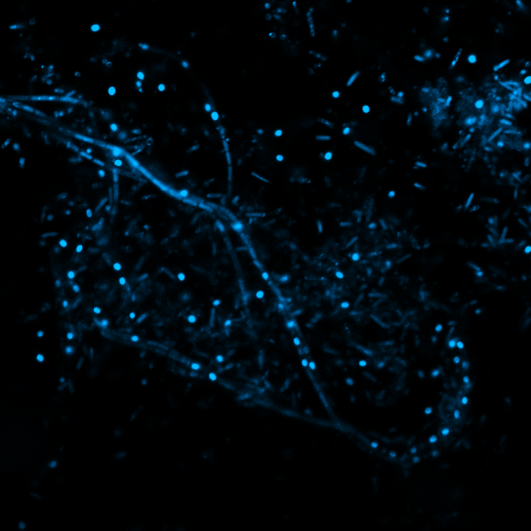
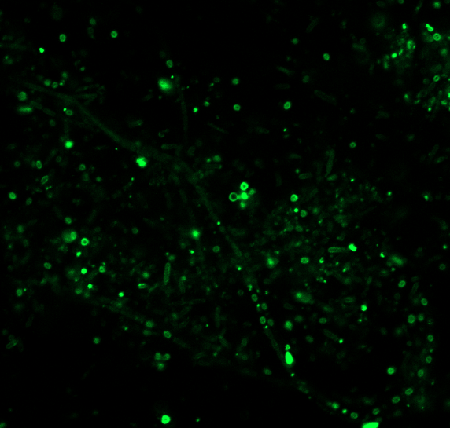
Filamentation observation with DAPI and FM 1-43 from colonies in LB agar to 96 microplate well
Objective 63X
FM143
DAPI
Exp 29-10-19
LSM 980 ZEISS
Merge fluor +DIC
A05z2

Slide 3
Objective 63X
FM143
DAPI
DIC
merge
A03z7
AIRYSCAN
Bacterial transformation
A03Airy

Slide 4
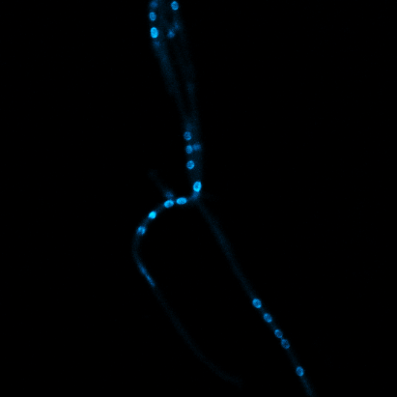
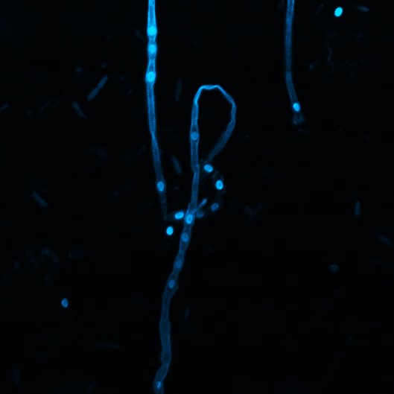
DAPI
DIC
merge
Objective 63X
B00
FM143
DAPI
DIC
merge
B04z2

Slide 5
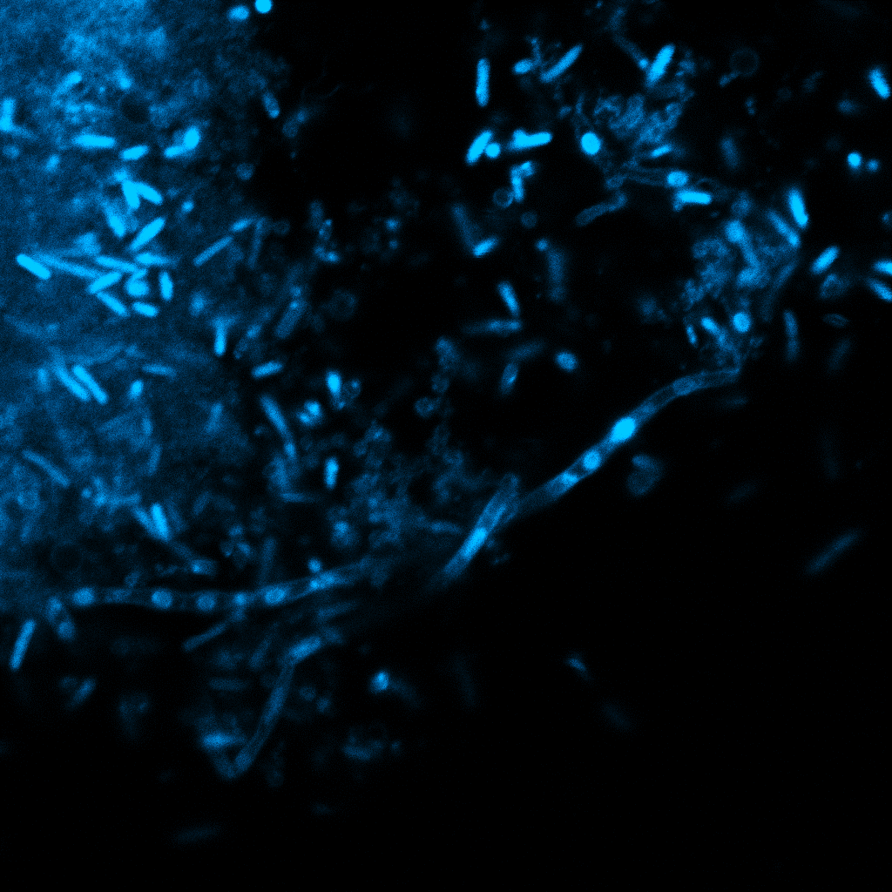
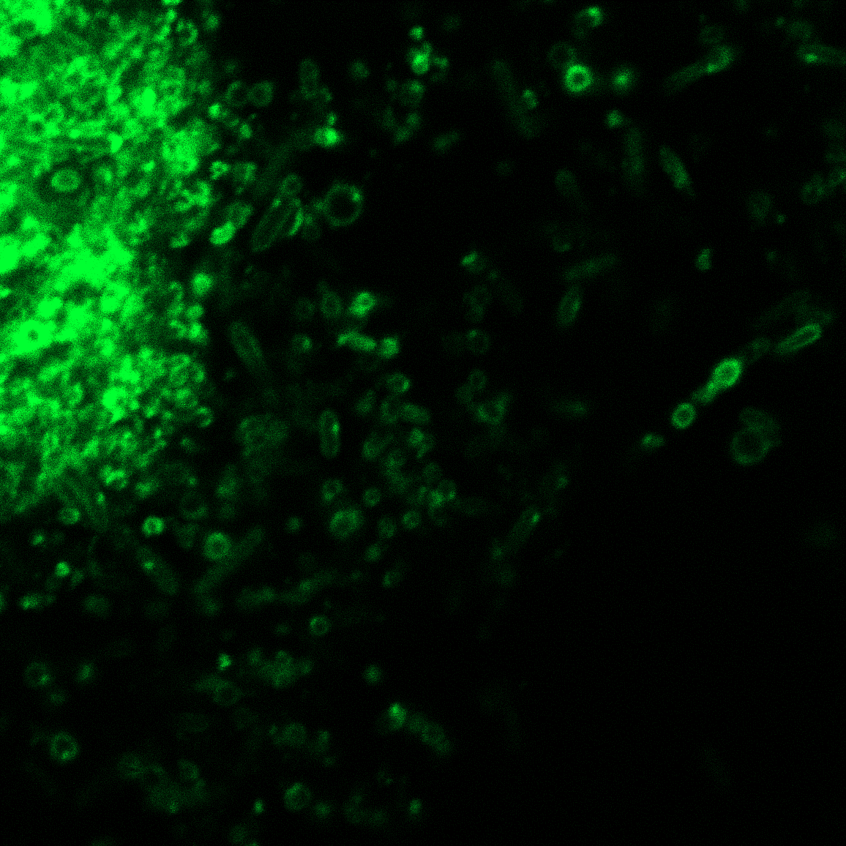
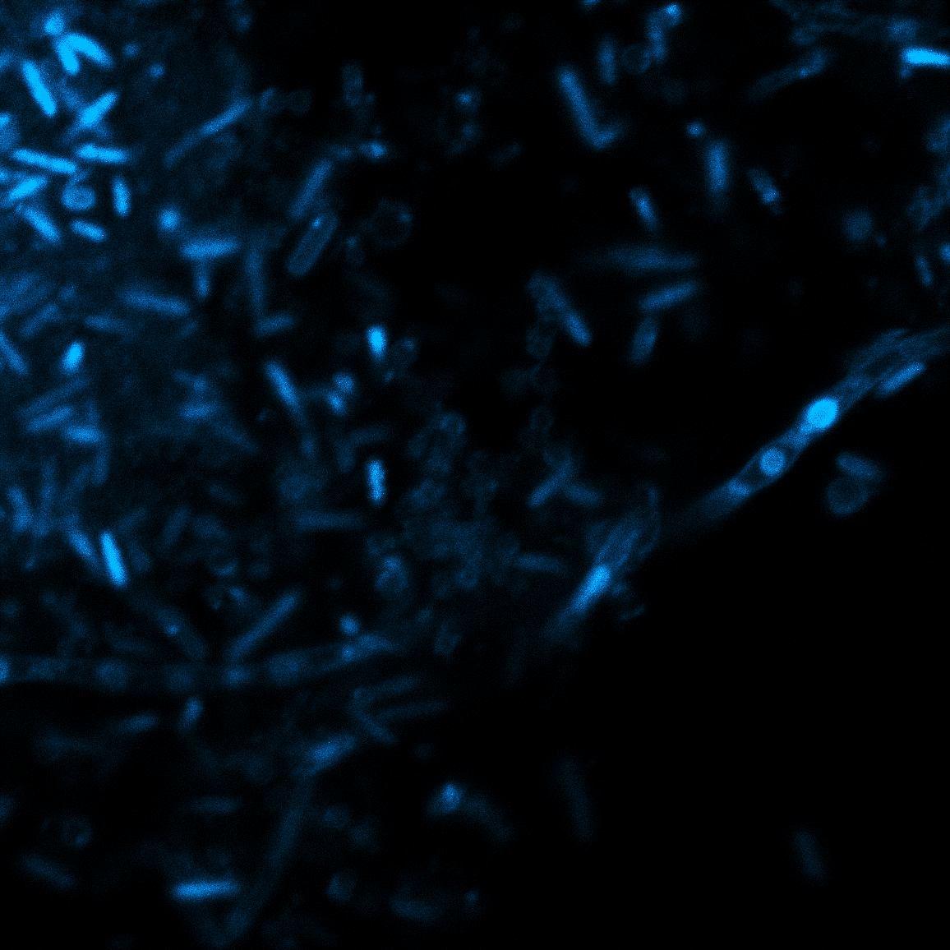
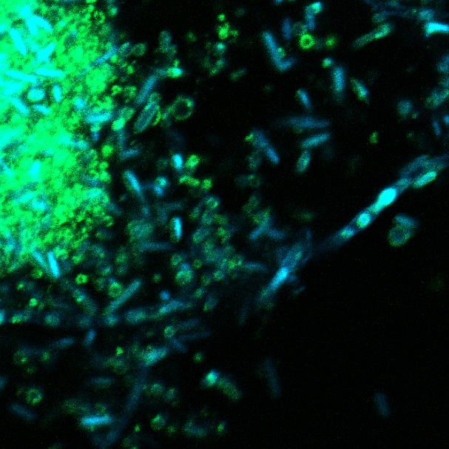
Filaments from water column
Objective 63X
FM143
DAPI
DIC
merge
Anche qui le spore hanno una membrana più spessa rispetto ai batteri, sono FM143++ e DAPI++
A01z3
PARTICOLARE AIRYSCAN
A02Airy z1

Slide 6
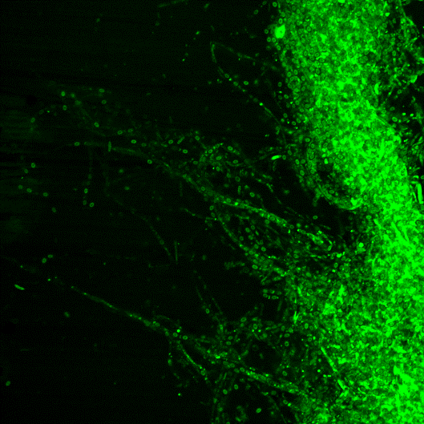
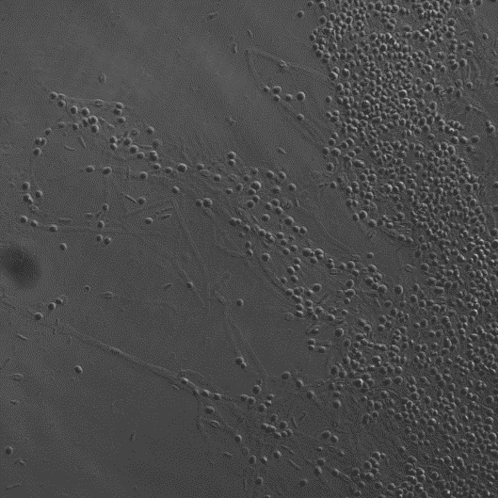
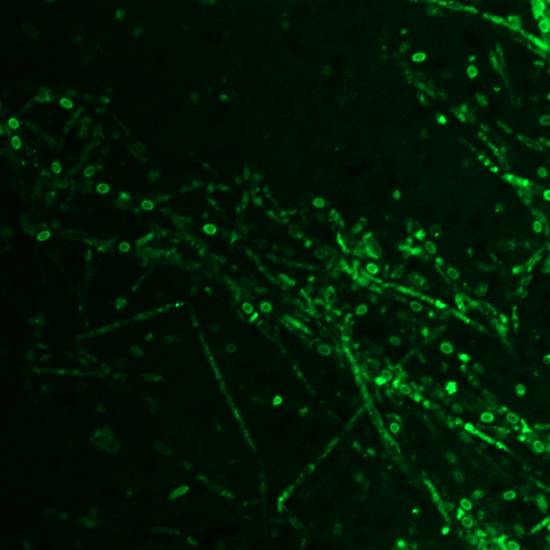
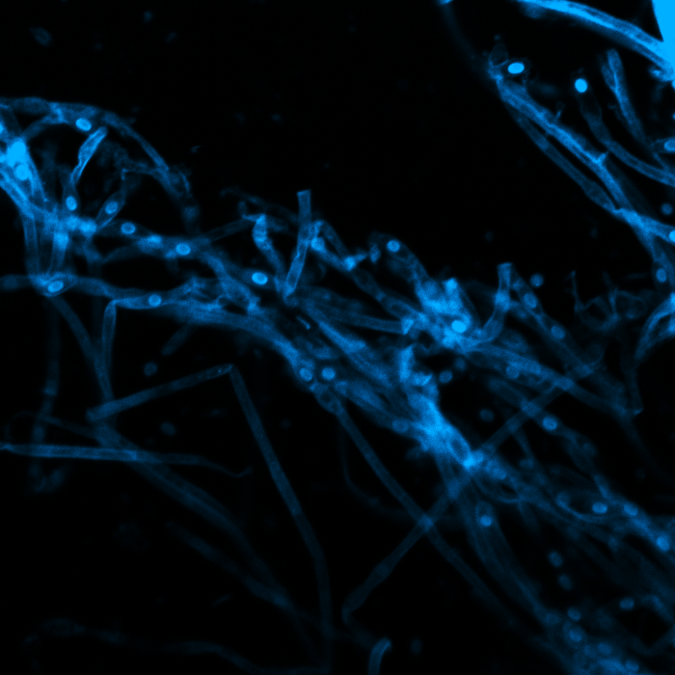
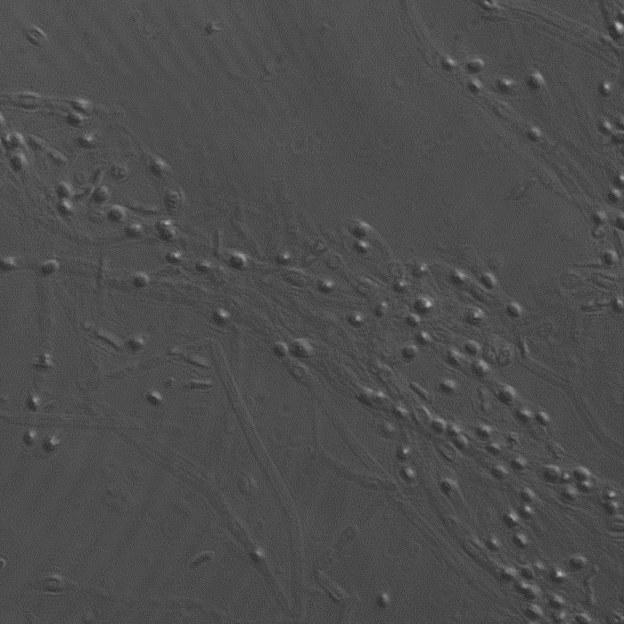
Objective 63X
#BATTERI1
FM143
DAPI
DIC
merge
B06z5

