Slide 1
Filamentation process
Bacterial filaments were collected from the water column of the L-MFC (liquid microbial fuel cell) prototype. The filaments were pelleted at 300 rcf and gently resuspended in M9. Filaments were smeared on plates with LB agar and incubated at 30 °C for 24 h in aerophilic conditions.
To study the bacterial filamentation, single colonies were taken from plates and grown in LB in 15 mL tubes (Falcon) and/or in 96-well microplates incubating in microventilation conditions at 30 °C for 7-10 days at 0 rpm. The filamentation was photographed at the beginning of the process in the presence of oxygen (figures page 1) and during the filamentation process under microventilation conditions (hypoxia).

Slide 2
Staining Antonella 29-10-19, fix PFA
Exp 20-10-19
LSM 980 ZEISS
MBP
O4
MBP + O4
Objective 63X
The figures show that the bacteria replicate maintaining a typical rod-like morphology during the first hours of microventilation incubation when the oxygenation conditions are not yet critical (hypoxia). At this stage Mielyn Basic Protein and O4 like proteins do not appear to be expressed.
DIC
Merge
DAPI
1

Slide 3
On the following pages it is shown that after 48 h in the microplate the appearance of bacterial filaments in which rod-shaped and rounded shapes are aligned (page 2). The rounded shapes seem to express proteins that cross-react with the MBP and O4 typical of the myelin sheets that surround the oligodendrocytes of vertebrates. On page 3 the colocalizations of proteins within the filaments rich in similar myelin structures are shown. Similar results are absent in the filaments that contain rod-shaped forms that represent the internal control of this interesting process (pages 4-7).
2

Slide 4
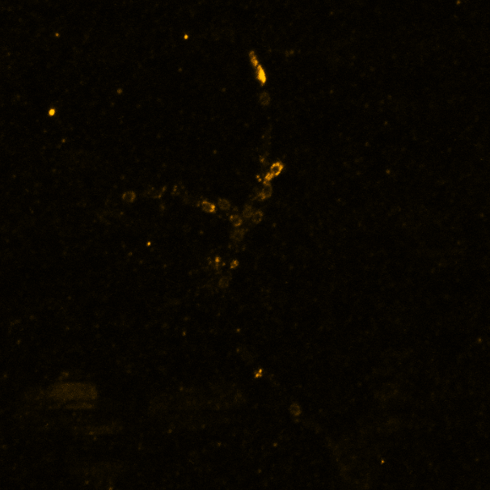
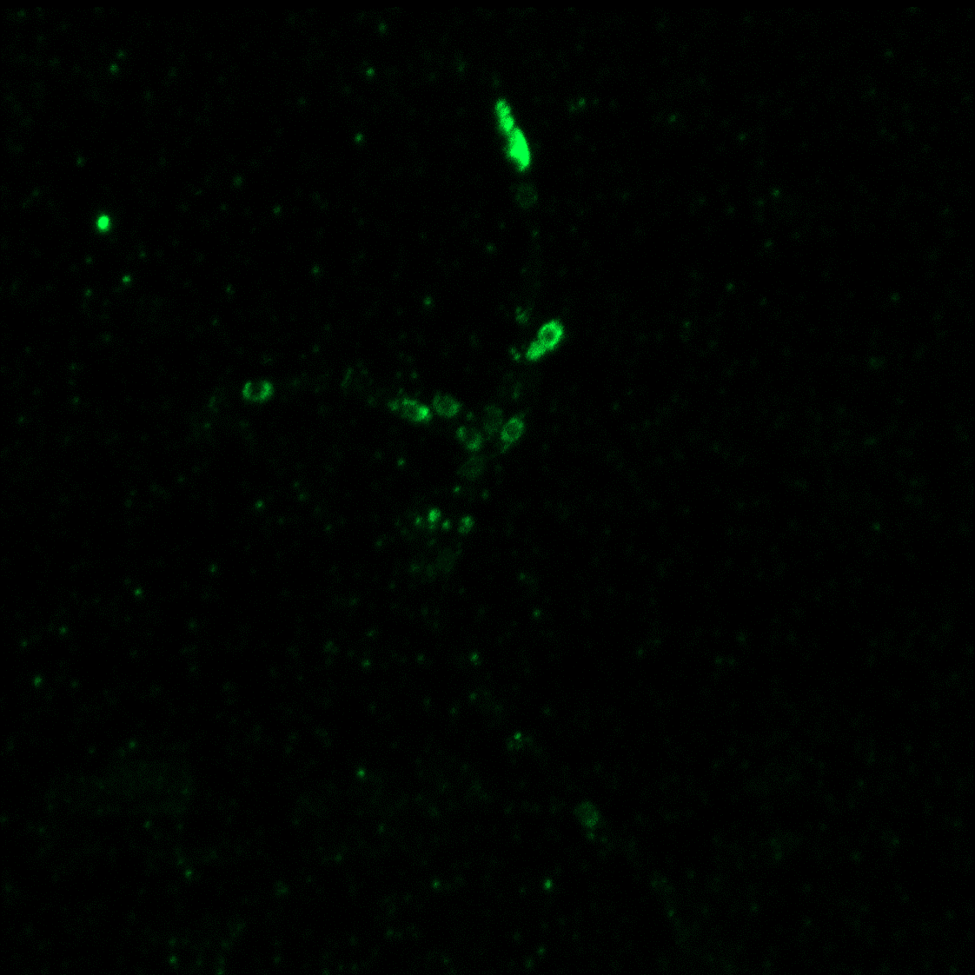
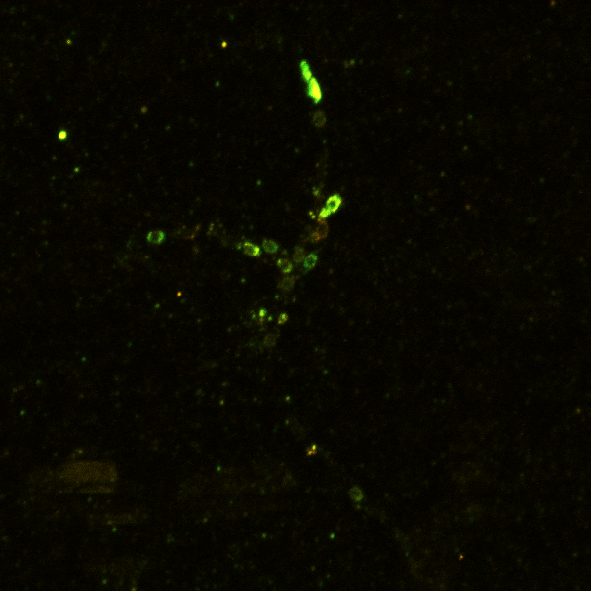
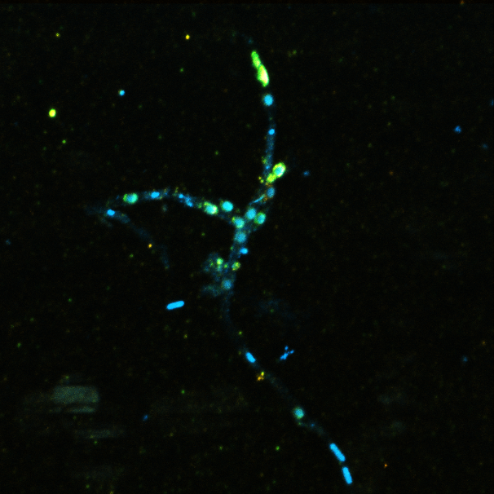
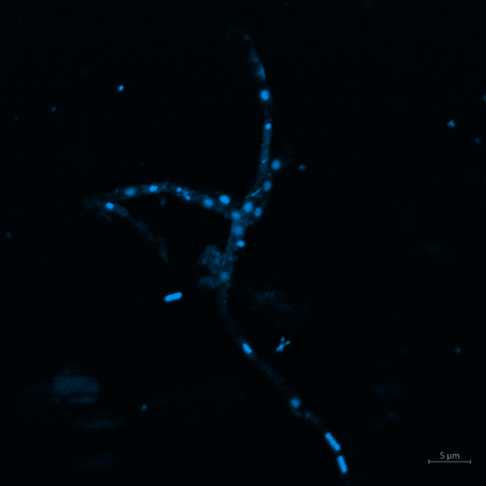
Staining Antonella 29-10-19, fix PFA
filaments
Exp 20-10-19
LSM 980 ZEISS
Objective 63X
MBP
O4
MBP + O4
DIC
Merge
DAPI
2

Slide 5
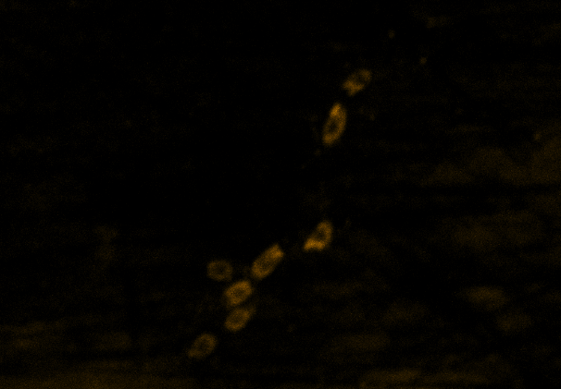
Staining Antonella 29-10-19, fix PFA
Exp 20-10-19
LSM 980 ZEISS
Objective 63X
MBP
O4
DIC
MBP + O4
3

Slide 6
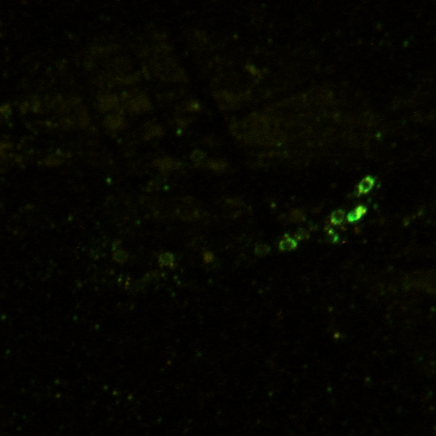
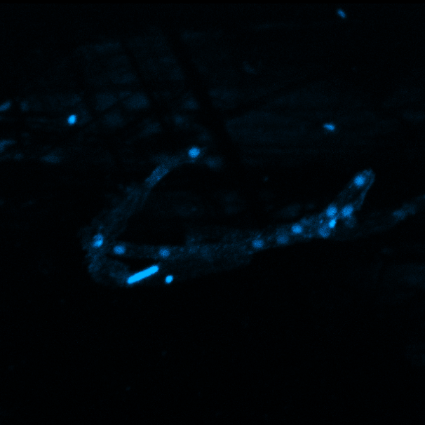
Staining Antonella 29-10-19, fix PFA
Exp 20-10-19
LSM 980 ZEISS
MBP
O4
MBP + O4
Objective 63X
DIC
DIC+ fluor
DAPI
Negative
4

Slide 7
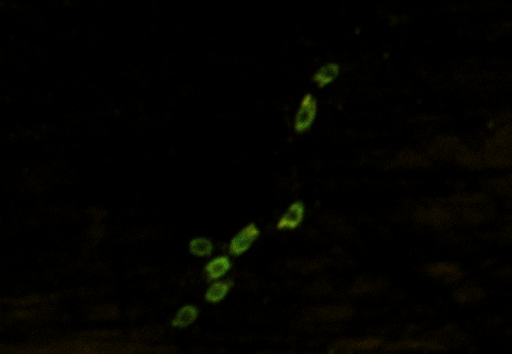
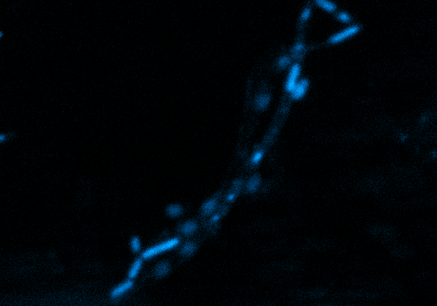
Staining Antonella 29-10-19, fix PFA
Exp 20-10-19
LSM 980 ZEISS
MBP
O4
MBP + O4
Objective 63X
DIC
Merge
DAPI
5

Slide 8
Staining Antonella 29-10-19, fix PFA
Exp 20-10-19
LSM 980 ZEISS
Objective 63X
MBP
O4
MBP + O4
DIC
Merge
Airyscan
6

Slide 9
Staining Antonella 29-10-19, fix PFA
Exp 20-10-19
LSM 980 ZEISS
Objective 63X
MBP
O4
MBP + O4+ DAPI
7

Slide 10
To verify the phospholipid nature of the myelin-like layer, CLSM analysis of filaments was performed with FM1-43, a lipophilic compound usually used for staining of the myelin sheaths of Schwann cells. Live-labelled samples showed an intense annular signal around the spores in the filaments, probably consistent with the multi-lamellar layers.

Slide 11
Filaments stained by DAPI and FM-143 (enriched filaments from water column in ipoxic condictions showed a prevalence of anular morphology)

