Slide 1
Observation of filamentous bacteria along the water column in a Liquid Microbial Fuel Cells (L-MFC). Acquisitions on wells of a 96-well plate (plastic bottom) using ProgResC10 optical microscope (Nikon).

Slide 2
Bacterial filaments were collected from the water column of the Liquid Microbial Fuel Cell. The filaments were pelleted at 300 rcf and gently resuspended. Filaments were smeared on plates with LB agar and incubated at 30 °C for 24 h in aerophilic conditions.

Slide 3
To study the bacterial filamentation, single colonies were taken from plates and grown in LB in 15 mL tubes (Falcon) and in wells of 96-well plates (plastic bottom) incubating in microventilation conditions at 30 °C for 7-10 days at 0 rpm.
As can be observed in the following images, after a few days of incubation, the wells of the microplates shown the consistent presence of filaments compared to T.0.

Slide 4
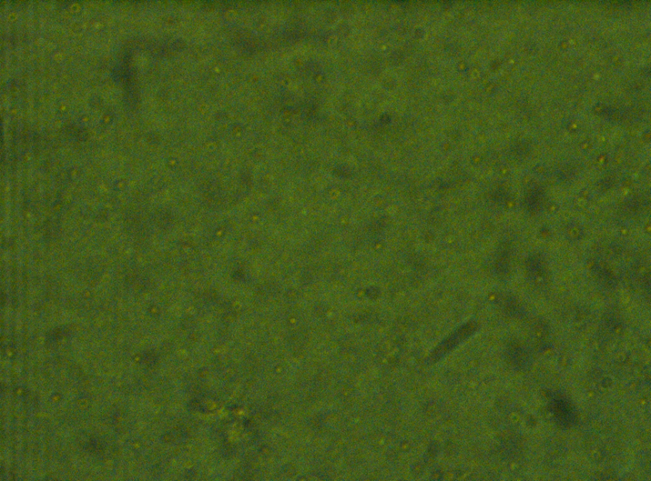

Slide 12
T. 0

Slide 26
Filaments from water column of a Liquid Microbial fuel Cell

