Slide 1
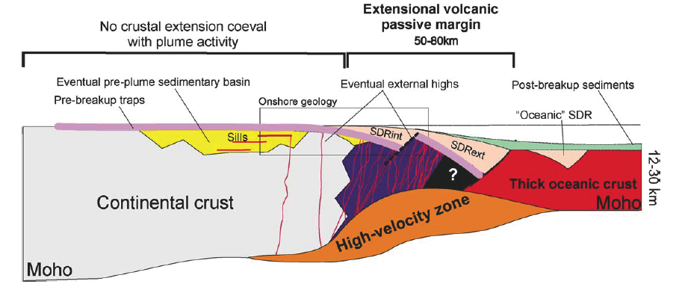
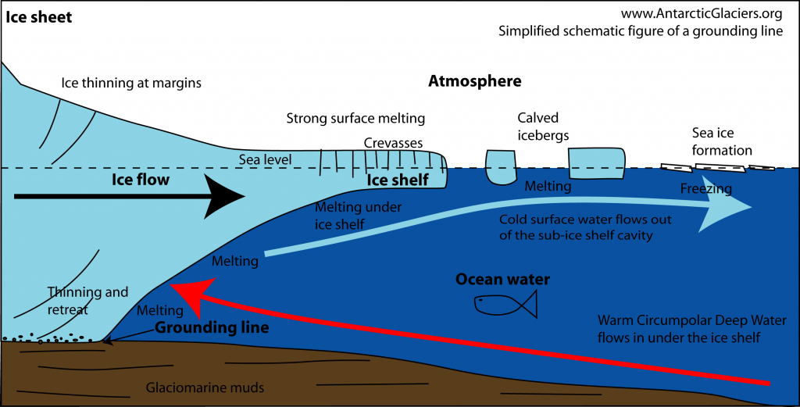
1) Seaward Dipping
Reflectors (SDRs)
Defining feature of volcanic rifted margins
2) Ice Shelf
Basal Crevassing
Affects loss of ice sheets and sea level rise
Two Examples of Fluids Affecting Extensional Tectonics: Volcanic Margin Construction
and Ice Shelf Destruction
W. Roger Buck, Xiaochuan Tian and Ching-Yao Lai
Lamont-Doherty Earth Observatory of Columbia University
Geoffroy, 2005
Antarctc
Glaciers.org

Slide 2
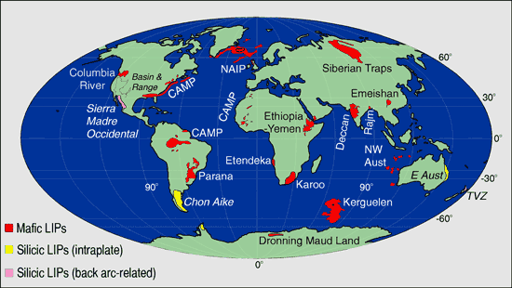
Dating of Large Igneous Provinces (LIPs) shows that they form just before most major rifting events
After White and McKenzie (1989); Courtillot et al., 1999

Slide 3
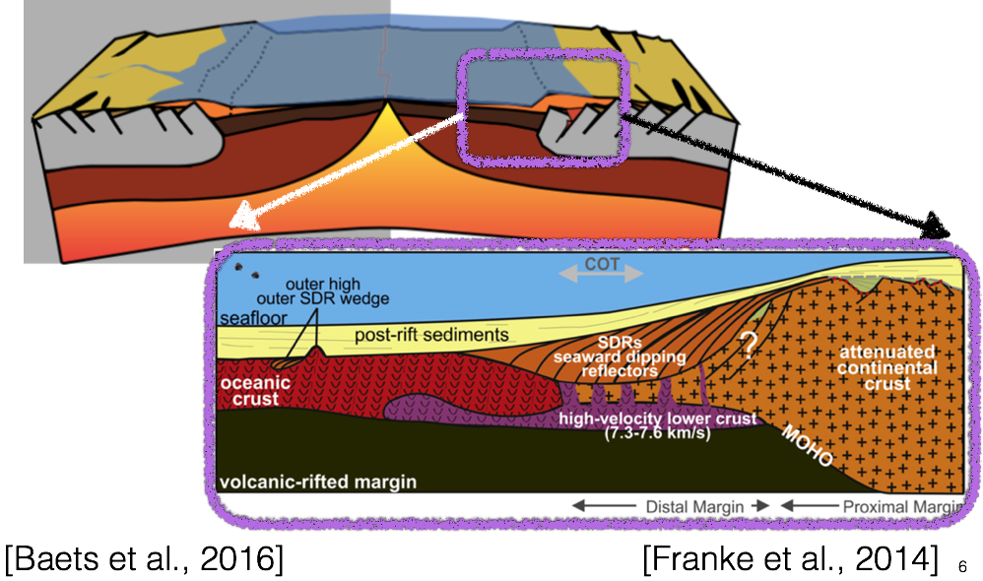
Dating of Large Igneous Provinces (LIPs) shows that they form just before most major rifting events
Baets et al. (2016)
Franke et al. (2014)

Slide 4
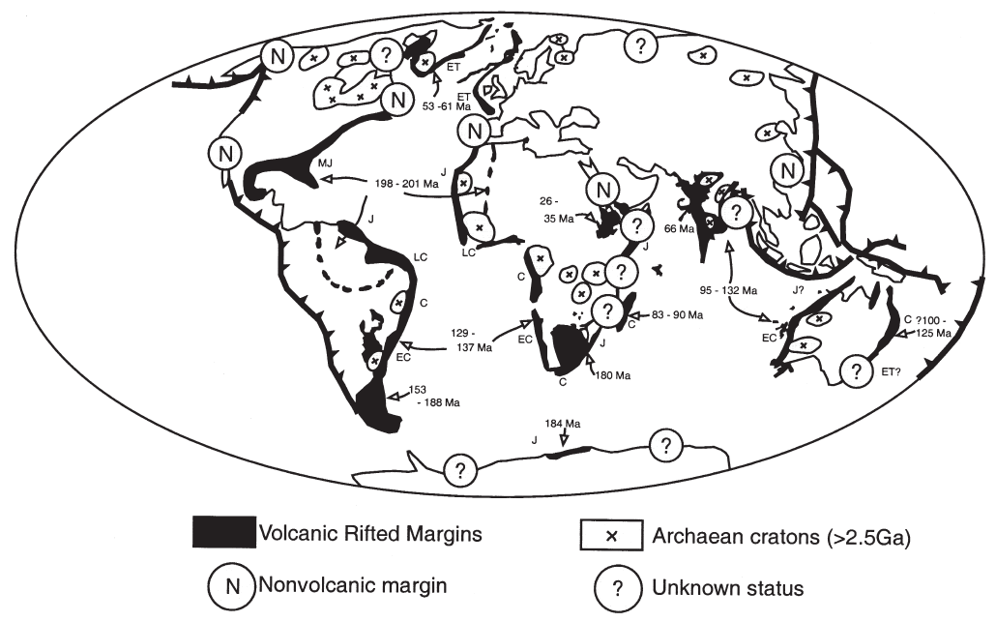
Most Rifted Margins May Be Volcanic
Geoffroy, 2005
Menzies et al., 2002

Slide 5
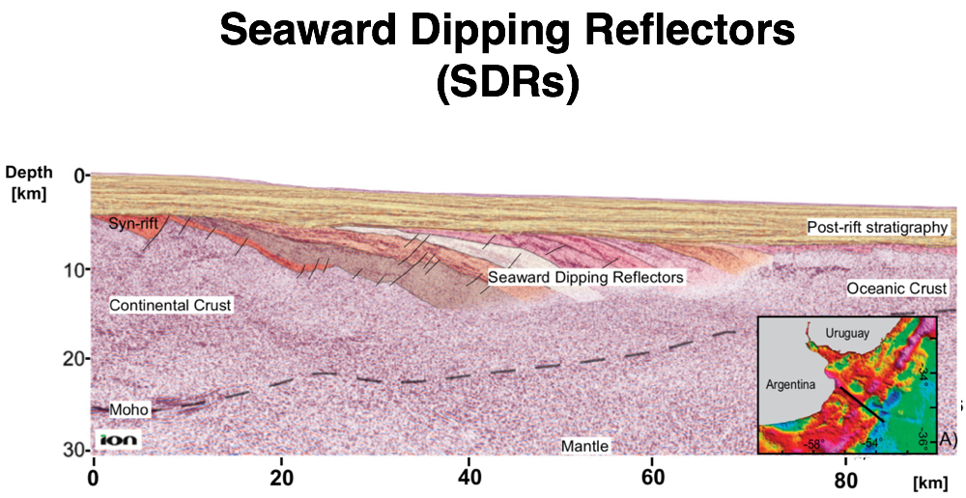
The Formation of Volcanic Rifted Margins and SDRs
Patton et al. (2017)

Slide 6
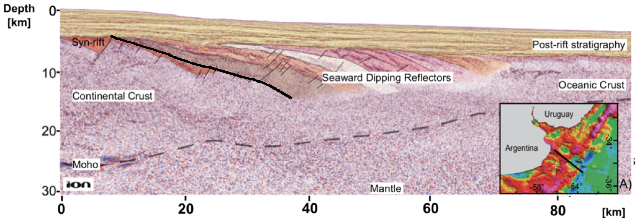
Seaward Dipping Reflectors
(SDRs)

Slide 7
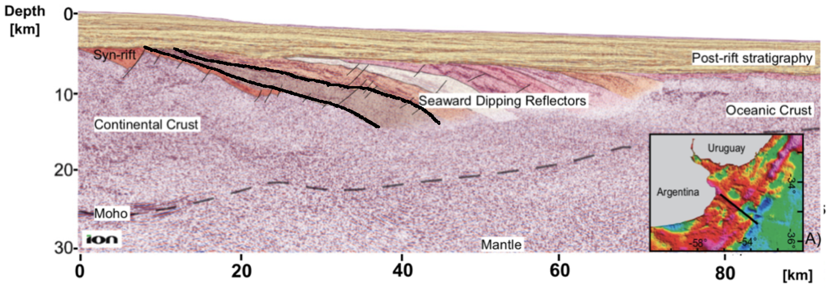
Seaward Dipping Reflectors
(SDRs)

Slide 8
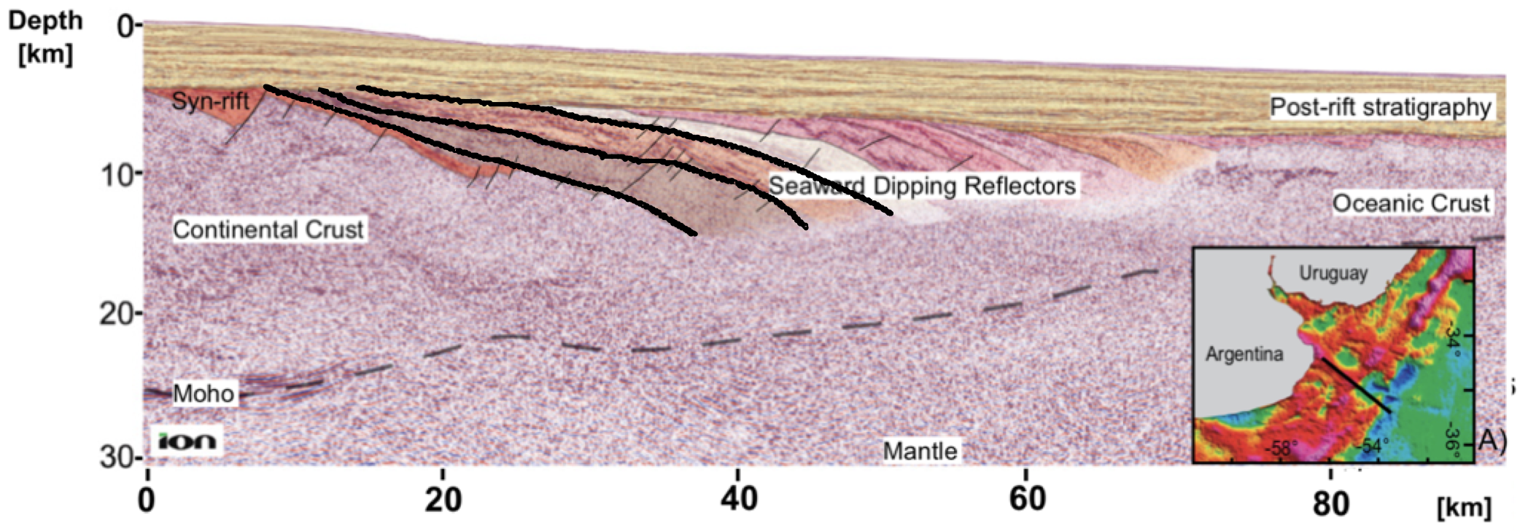
Seaward Dipping Reflectors
(SDRs)

Slide 9
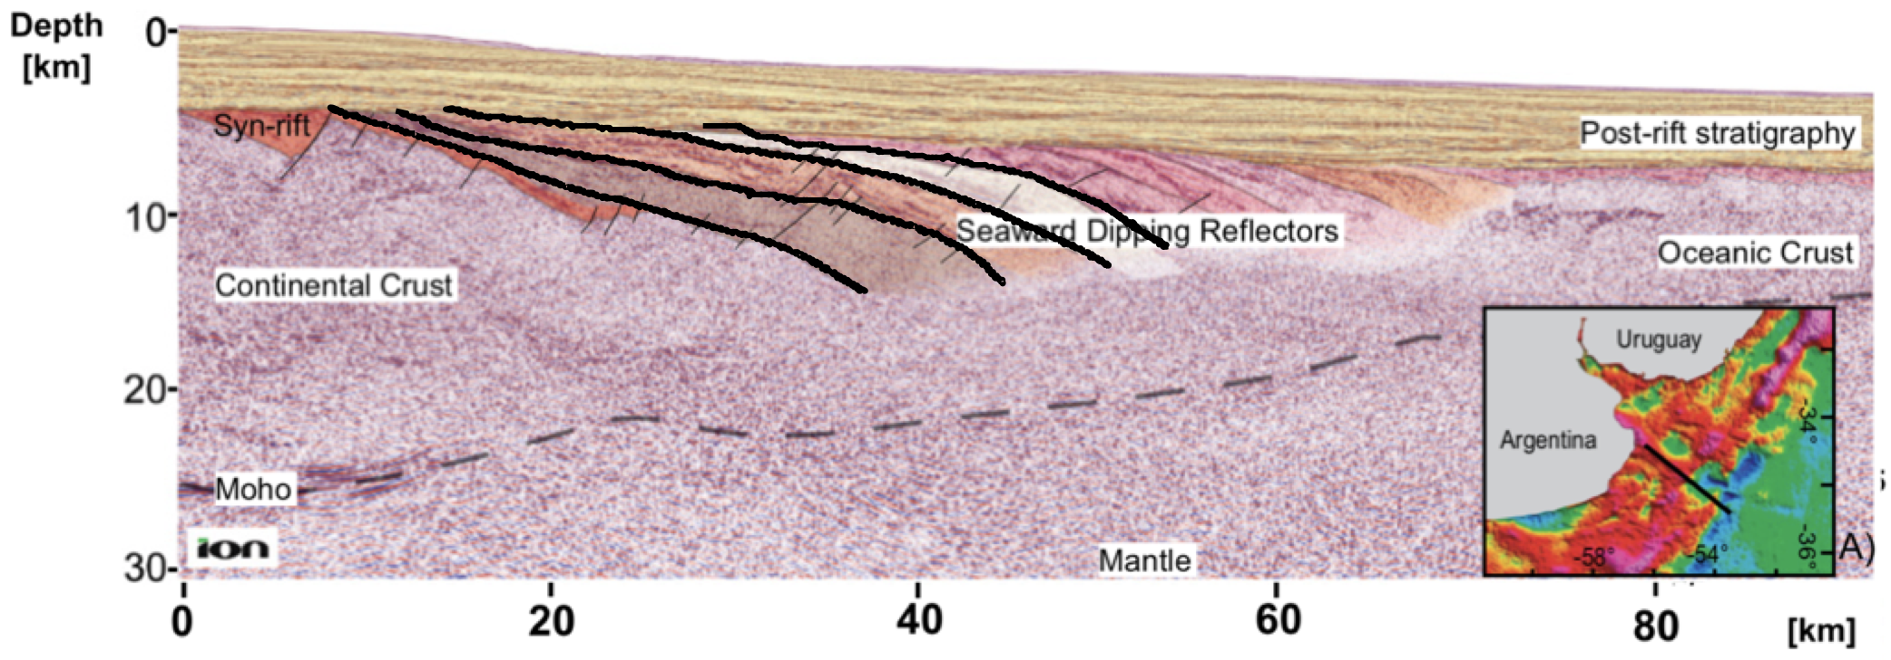
Seaward Dipping Reflectors
(SDRs)

Slide 10
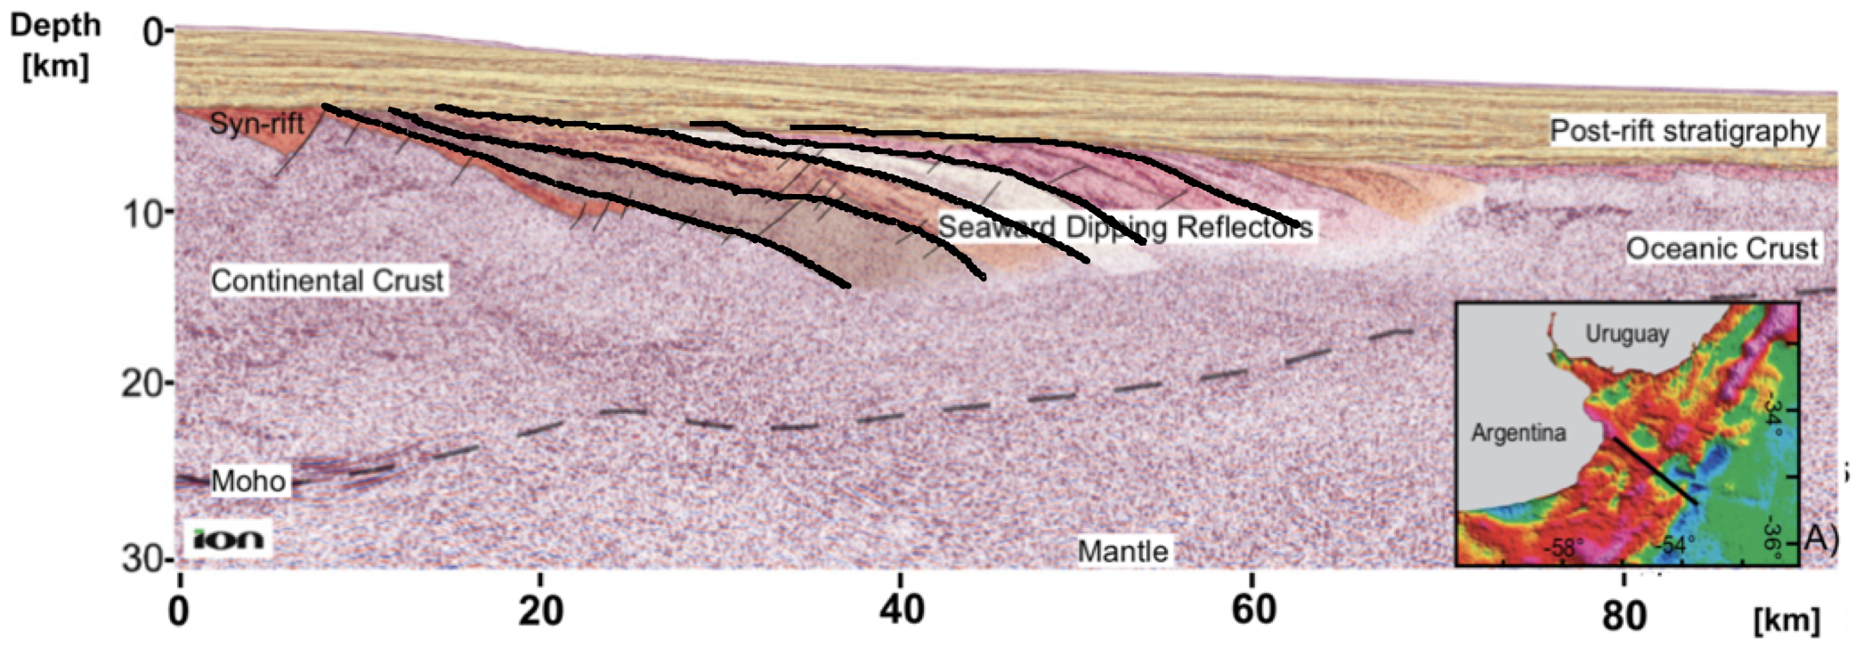
Seaward Dipping Reflectors
(SDRs)

Slide 11
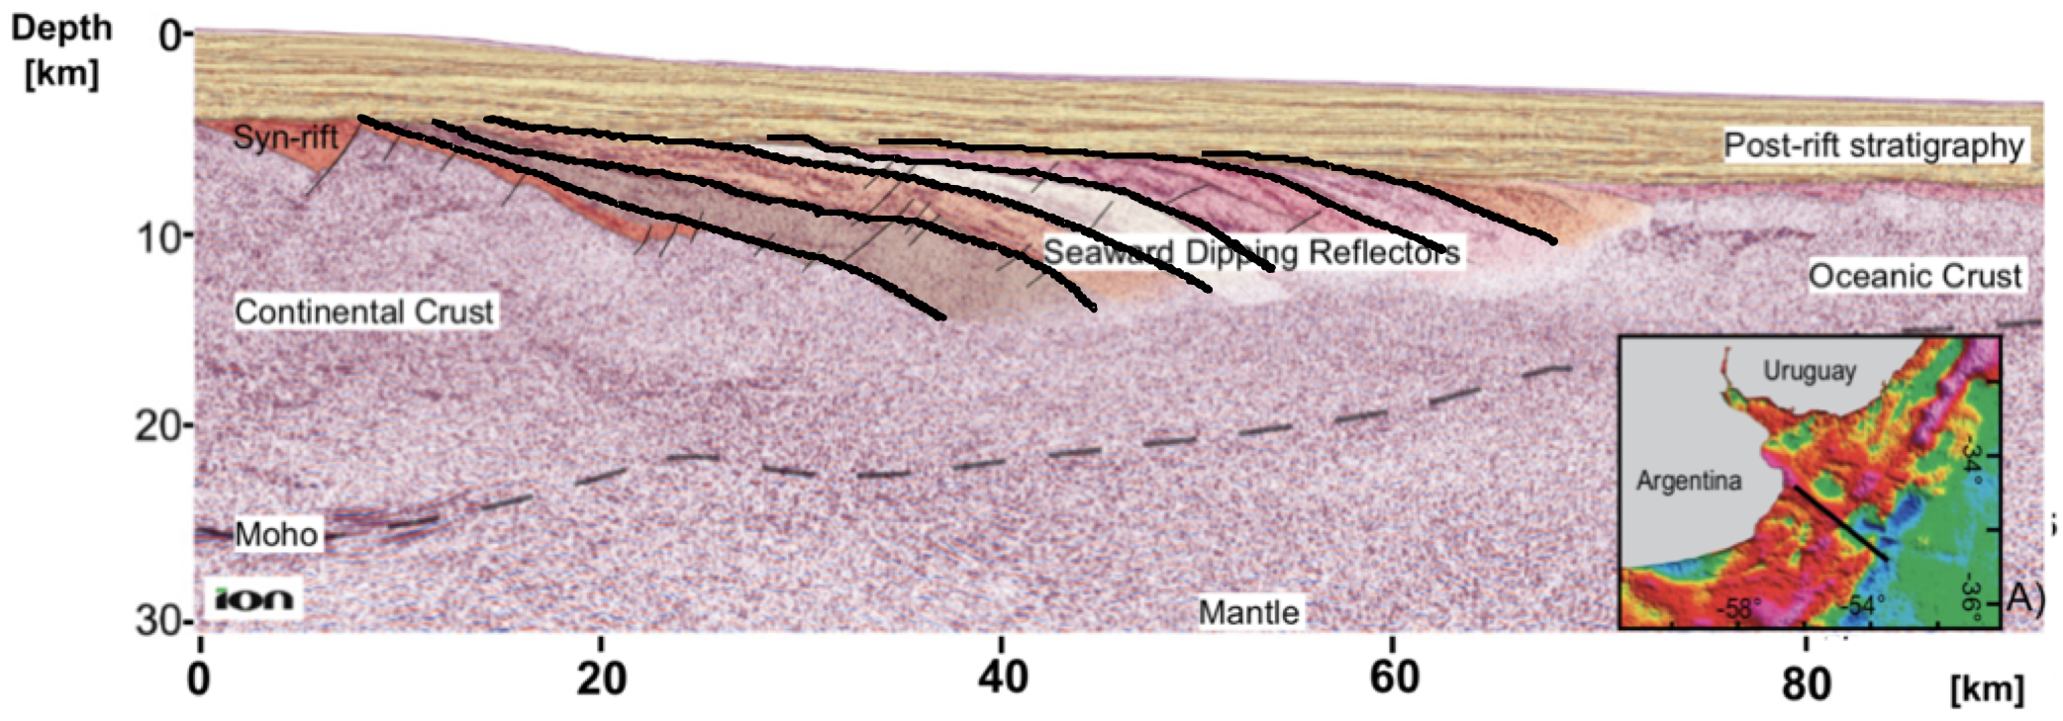
Seaward Dipping Reflectors
(SDRs)

Slide 12
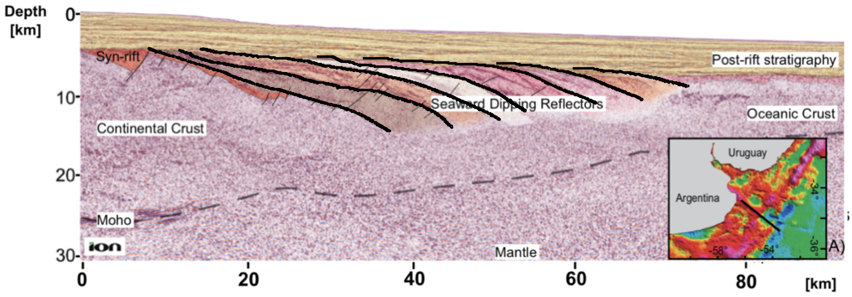
Seaward Dipping Reflectors
(SDRs)
Notes:
Here is a depth converted multi-channel seismic profile off-shore Argentina. At the continent-ocean transition zone, we see these reflectors that dip toward the ocean, sitting beneath 4 km of post-rift sediments.
The SDRs wedges generally has a spatial domain of 10s of km wide and several km thick.
They usually have a concave upward shape and each wedge is thicker at depth.
Drilling offshore Norway indicates SDRs consist of thin layers of sediments (of couple meters) interbedded within thick piles of lava (of 10s of meters) (Eldholm et al., 1995).
Each bright reflector results from constructive interference btw several layers of adjacent lava flows.

Slide 13
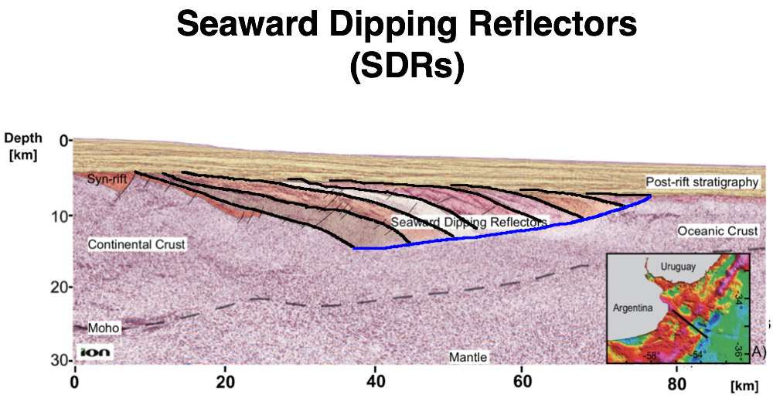
The Formation of Volcanic Rifted Margins and SDRs
after Patton et al. (2017)

Slide 14
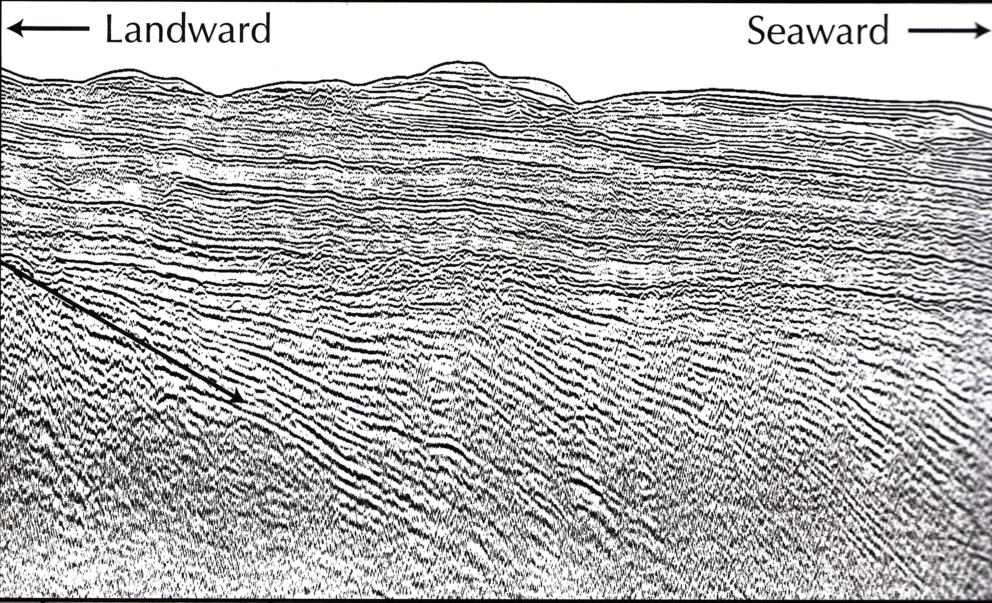
Seaward Dipping Reflectors (SDRs)
First found by Hinz (1981), Drilling showed they are volcanic
This seismic reflection profile is off the coast of Greenland
From Hopper et al., (2007)

Slide 15
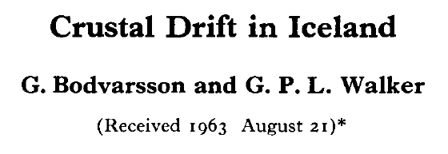
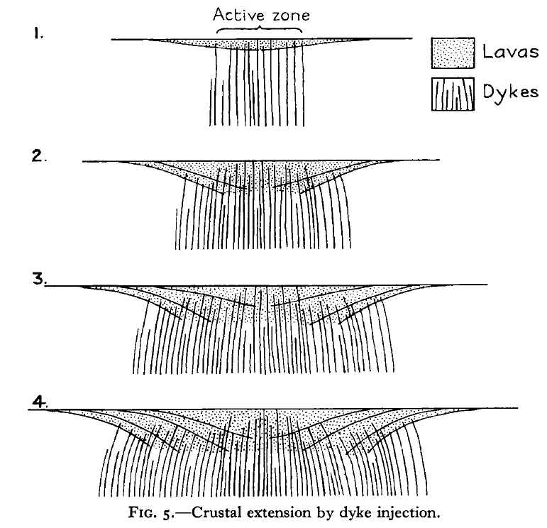
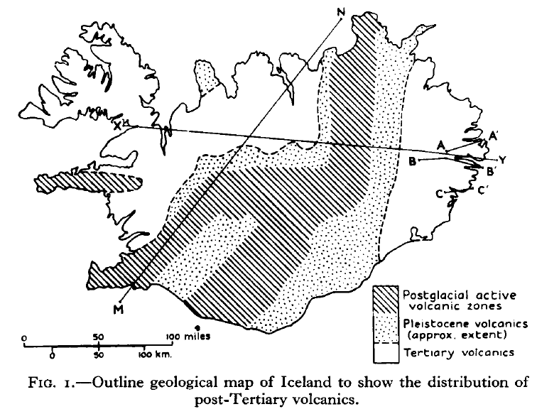
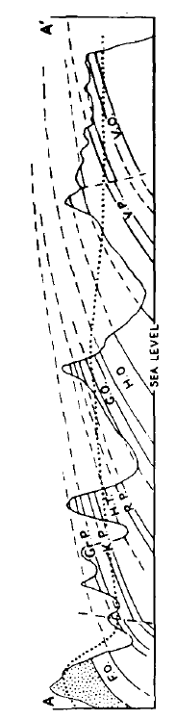
The original volcanic loading model for SDRs was based on structures in Iceland

Slide 16
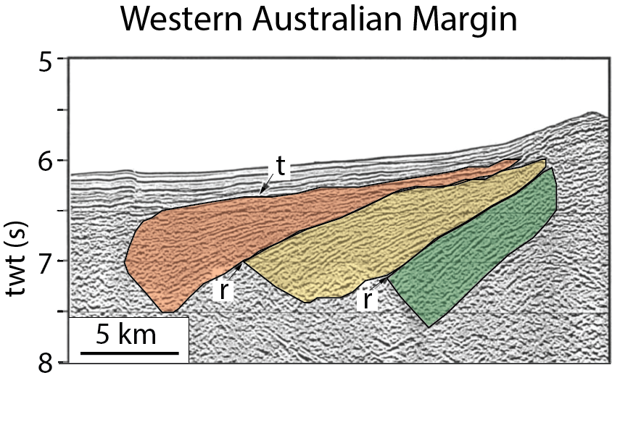
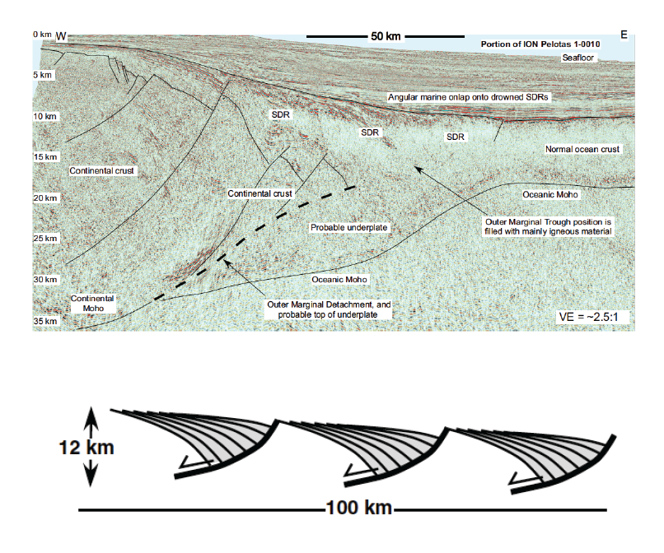
Better seismic data seems to indicate that
SDRs form in “Packages”
Pindell et al., 2014
Planke et al.,1999
Simple explanation is that volcanic flows fill in fault-bounded basins
So, is volcanism secondary to tectonic extension?

Slide 17
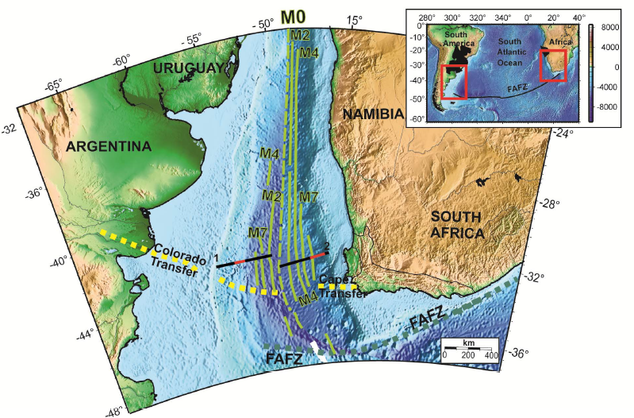
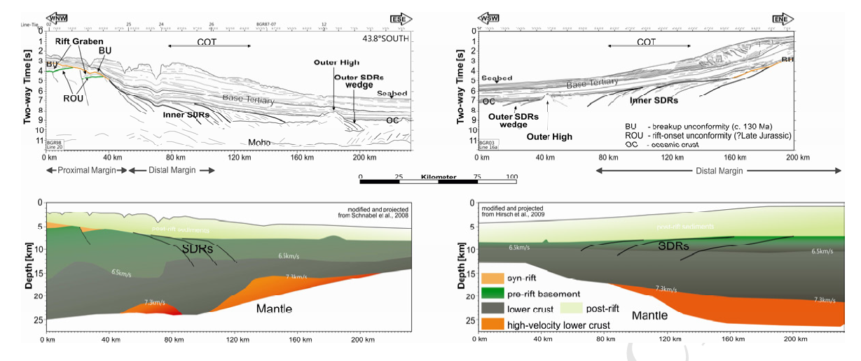
Asymmetry of SDRs is clear for the South Atlantic
Franke (2013)

Slide 18
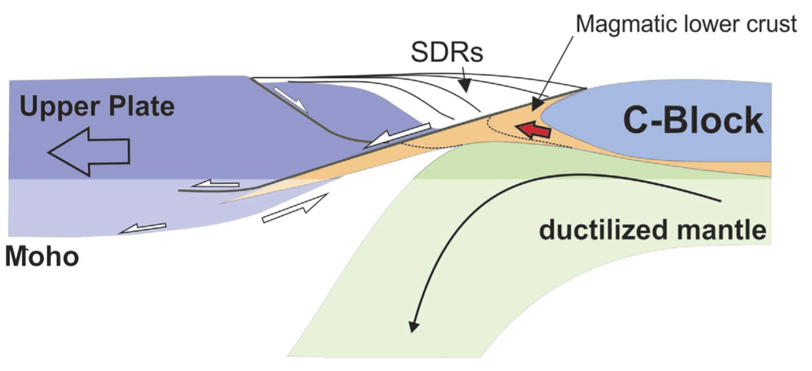
Faulting suggested to explain asymmetry
[Geoffroy et al., 2015]
Notes:
Some people think SDR formation requires large offset faulting.
however, the mechanics of simultaneous faulting and massive volcanism is unlikely to exist.

Slide 19
Problems with faults and SDR formation:
1. Abundant magma should make stresses too small for faulting
2. Putative faults dip the wrong way
Geoffroy, 2005

Slide 20
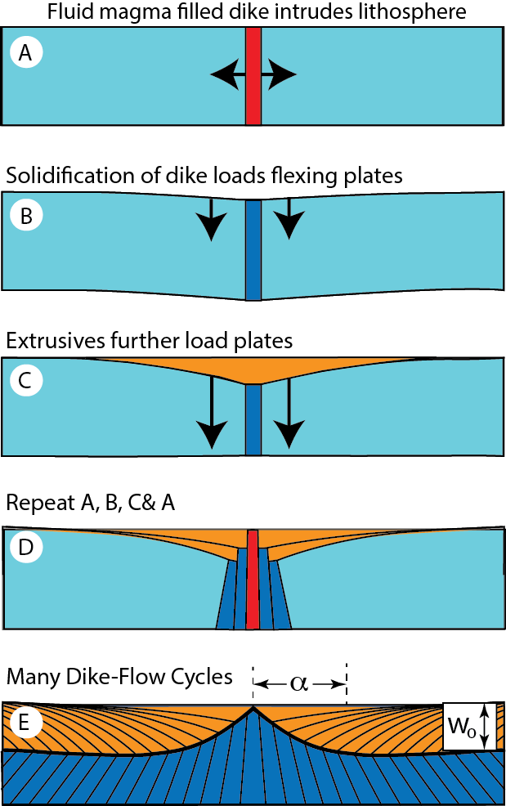
To treat SDR asymmetries and “packages” we need a quantitative model
Bodvarsson and Walker (1964)
Analytic thin-plate flexure model
Buck (2017)

Slide 21
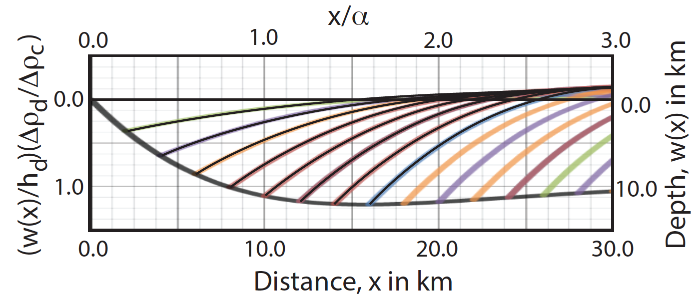



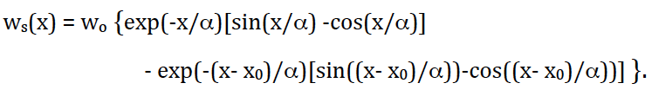
Equations for Volcanic flexure
Position of the flow-dike interface
Position of the surface of flows now Xo away from axis

Slide 22
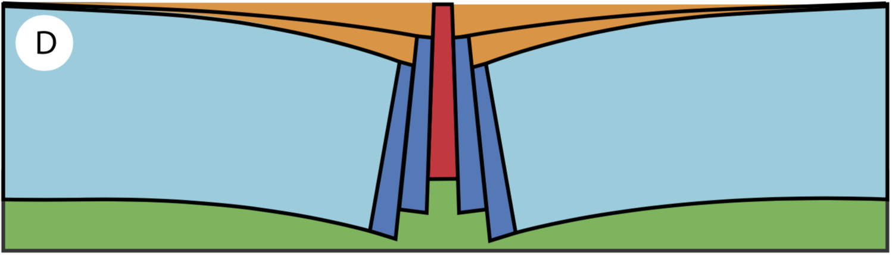

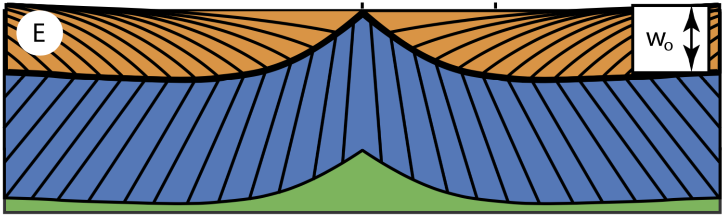

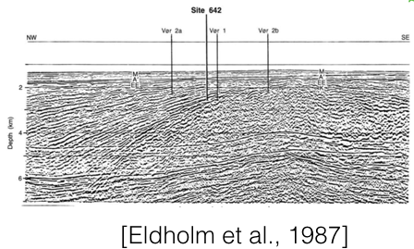

lava flows
dikes
Notes:
Repetitively, the old dikes move off axis, with the plate and layers of lava flows keep bending, the analytic model can reproduce most features of the observed SDRs.
concave upward shape
dip angle increases with depth

Slide 23
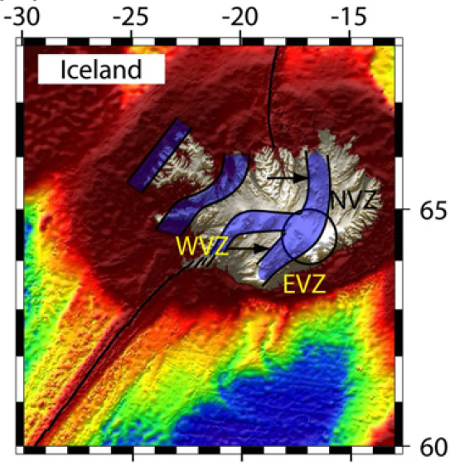
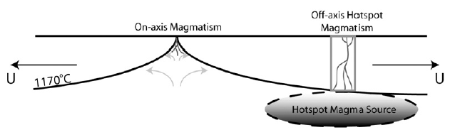
Ridge/Rift Jumps
Occur on Iceland and on Mid-ocean ridges-
Causes:
-Jump to have ridge over plume
-Jump due to plate reorganization (poles shift)
Mittlestadt et al. (2008)

Slide 24
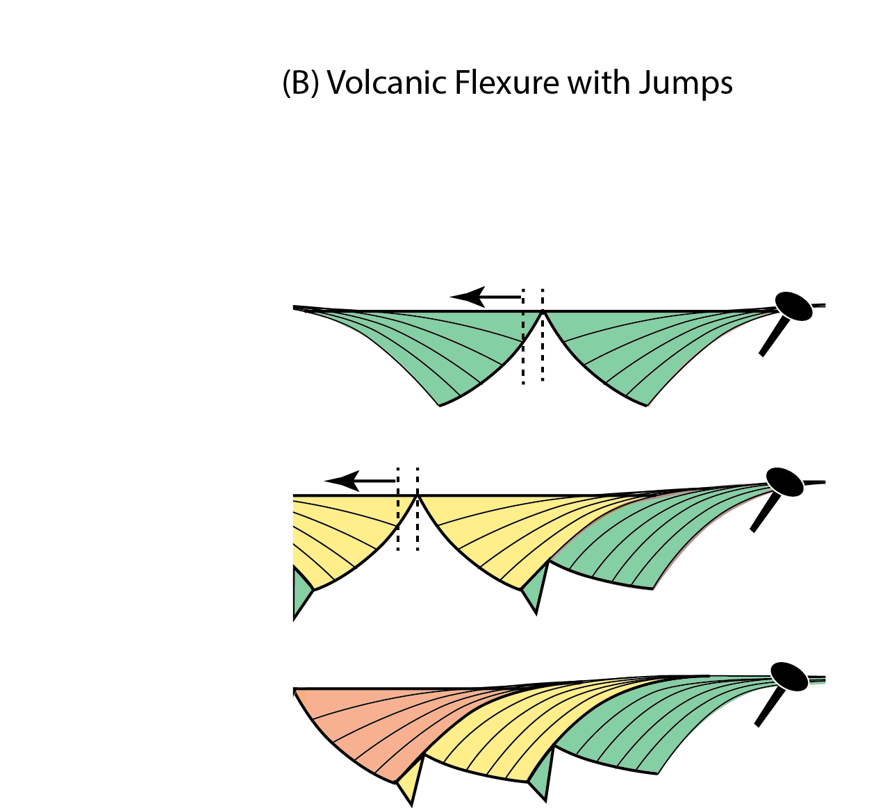
Volcanic Flexure with Jumps

Slide 25
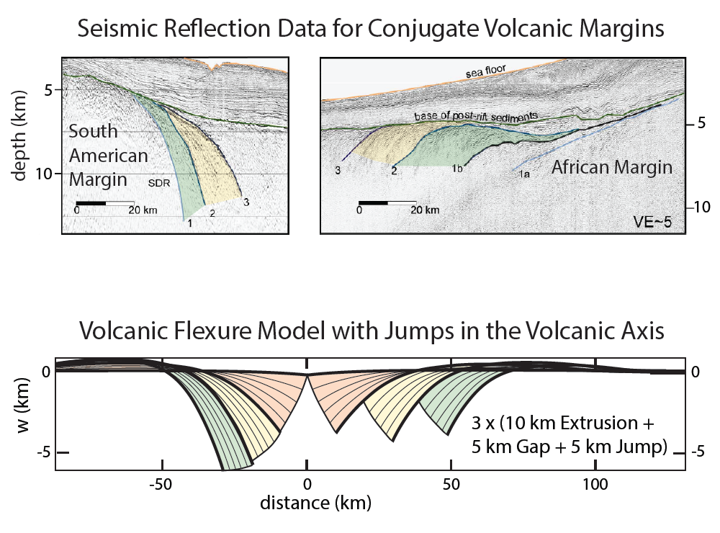
Becker et a. (2016)
Buck (2017)

Slide 26
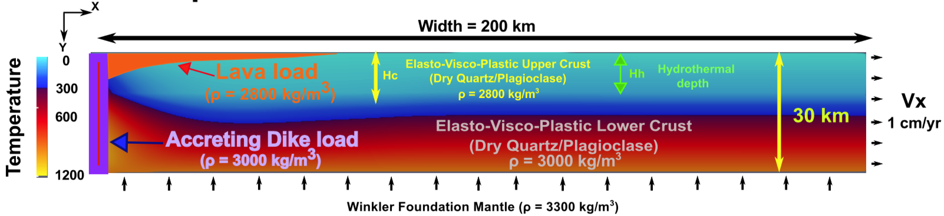
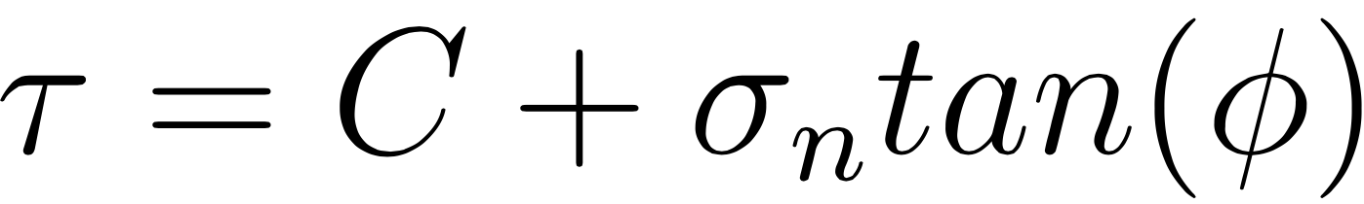
Elasto-Visco-Plastic (EVP) Rheology
Dry Quartz
Tian and Buck (2019)

Slide 27
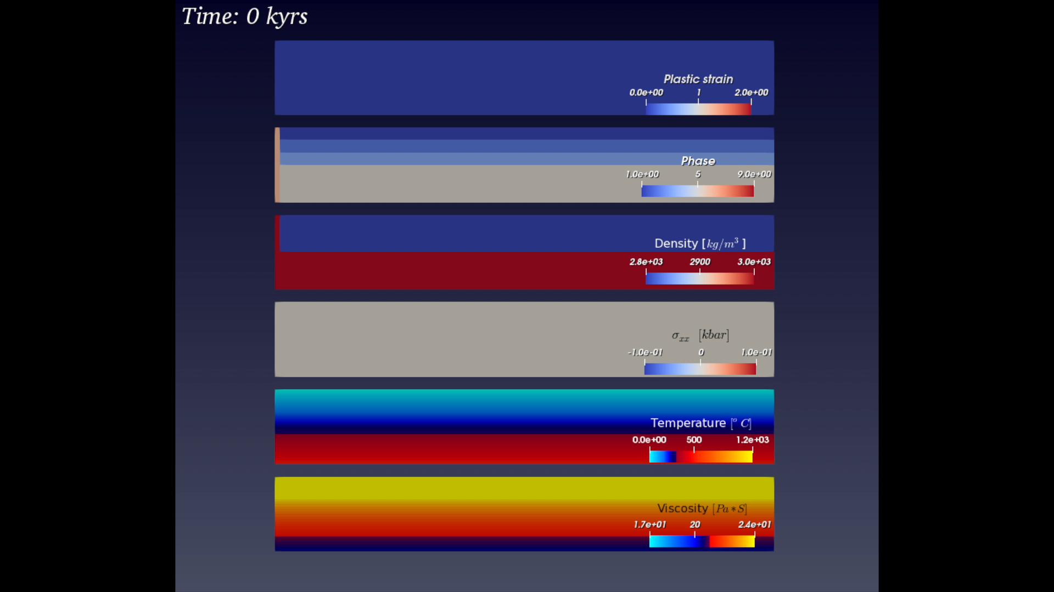
Dry Quartz
Plastic Strain
Phase
Density
Stress
Temperature
Viscosity

Slide 28

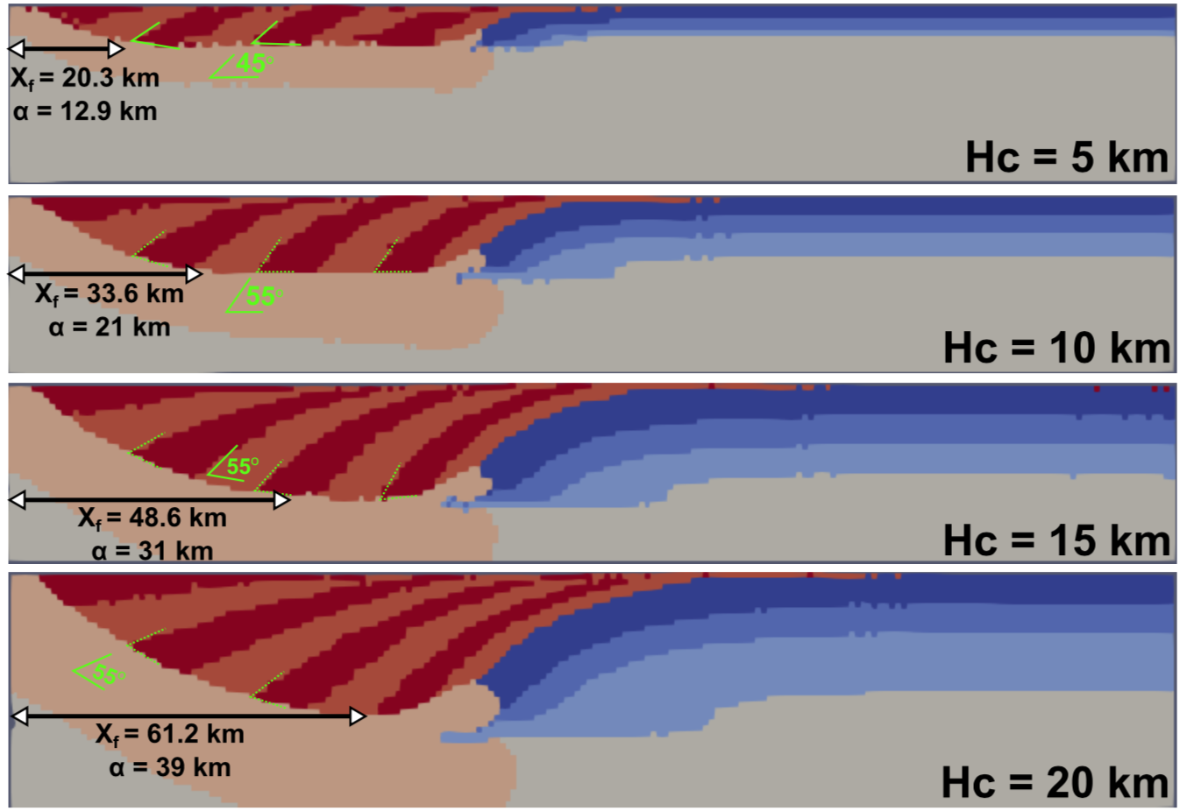
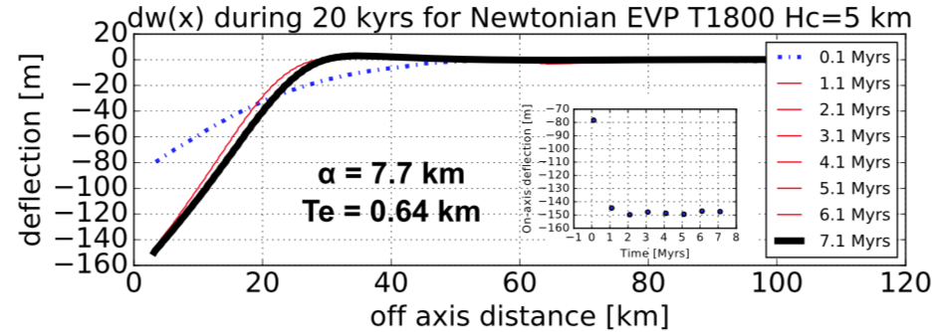
s
Tian and Buck (2019)

Slide 29
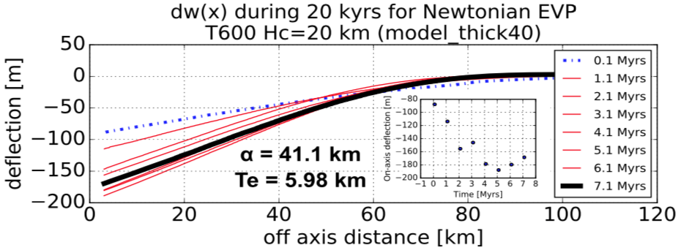
Tian and Buck (2019)

Slide 30
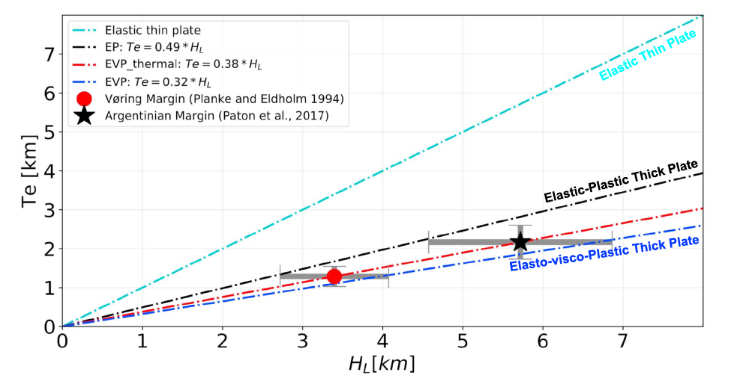
Sufficiently High Quality Data for Only 2 Rifted Margins,
But results fit advanced models
Tian and Buck (2019)

Slide 31
Can Analog Models:
Illustrate how Rift jumps can produce SDR packages across conjugate volcanic margins?
Give Insight into intrusion versus extrusion of magma at volcanic margins?

Slide 32
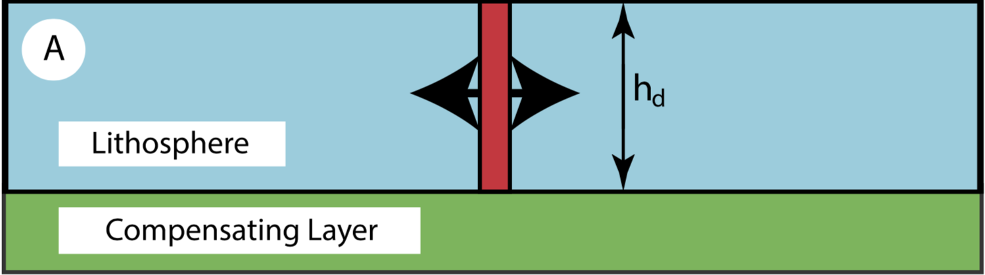
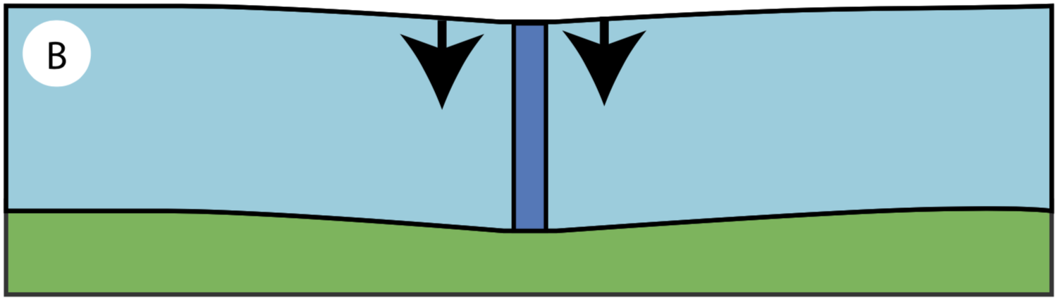
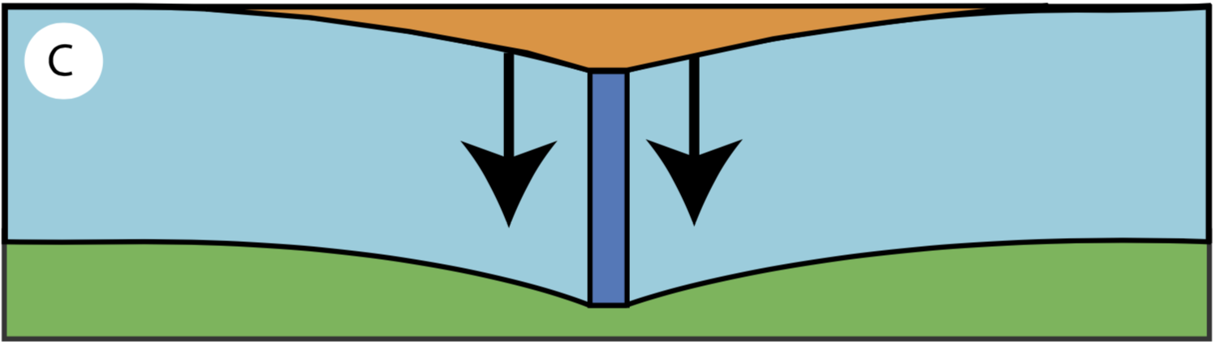
2800
kg/m^3
3000
kg/m^3
lava
2800
kg/m^3
[Buck, 2017]
Notes:
My thesis advisor develop the idea of magmatic loading makes the accommodation space for these large wedge of lava flows
and
first quantitatively described the physical relationship between magmatic loads, plate strength and SDRs geometries.
When a fluid dike opens at the rifting center. it has a density around 2800 kg per meter cube similar to that of the typical continental crust.
As it solidified and accreted to the country rock, it becomes denser and provides a vertical downward load that pulls down the lithosphere.
Meanwhile, erupted lava fills in the deflected surface and further loads the plate.

Slide 33
Fluid in gelatin models are used extensively for simulating magma intrusion. Here is one that relies on strength contrasts to have an ascending dike turn in into a sill.
Could models be built to have an evolution of density that could affect the transition of sill formation to extrusion?

Slide 34
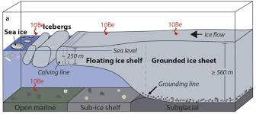
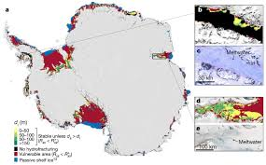
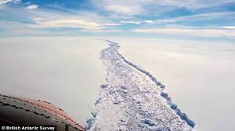
Ice Shelf Extension is an Analog for Lithospheric Extensional Processes
Ice Shelves Can Rift

Slide 35
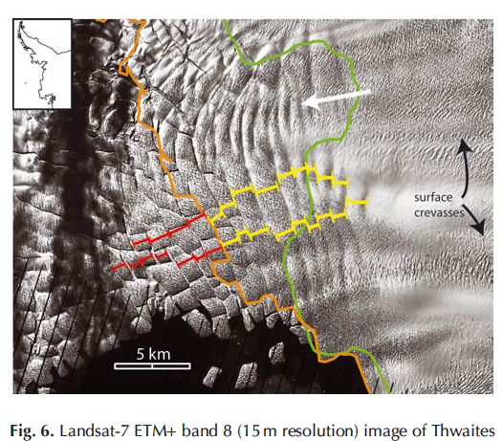
Basal crevasses can control shelf breakup
Ice Shelf form multiple basins
Underlain by basal crevasses.
Pattern as for wide rifts
Logan et al (2013)

Slide 36
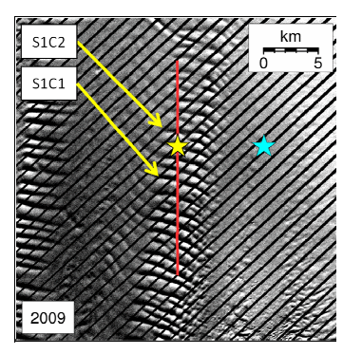
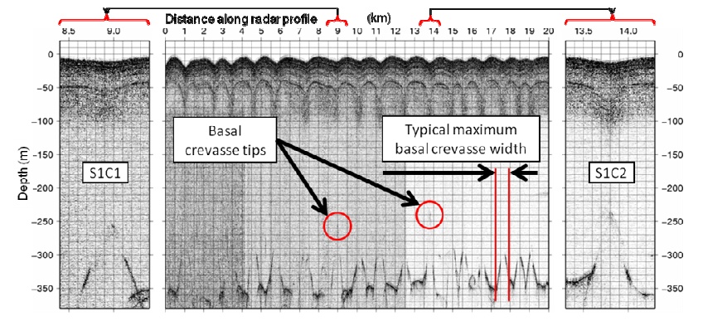
Ice Penetrating Radar

Slide 37


Ice Penetrating Radar

Slide 39






Slide 40





Slide 41
Previous treatments of basal crevasses do not fully account for free surface

Slide 42





Thin Plate Flexure Analysis of Basal Crevasse Opening

Slide 43

Numerical Basal Crevasse Models

Slide 44
Numerical Basal Crevasse Models
Stress Change ~ Flexural Wavelength
Stress Change ~ Crevasse Height

Slide 45
Comparison of Numerical Models with Flexure and Previous Analyses
Nye (1955) Ignore the stress change on crevasse opening
Weertman (1973) accounted for such stress change, but for elastic half-space

Slide 46
Comparison of Analytic and Numerical Estimates of Maximum Basal Crevasse Opening
MAX

Slide 47

Why is basal crevasse width important?
Freezing time
depends on the square of crevasse width.
So, a 10 times wider crevasse
takes 100 times longer to freeze

Slide 48
Can analog models give insight into breakup of ice shelves?
Logan et al (2013)

