Slide 1
Toolkit for a Successful Researcher
Modular course for academic research masters
by: Loek Brinkman l.brinkman@uu.nl Twitter: @LoekBrinkman
Image: Wikipedia

Slide 2
What is a Successful Researcher?
  Contributes knowledge
  to society
  Makes a career

Slide 3



Toolkit for a Successful Researcher
Your career
within and outside academia
Rethinking statistics
Data science in R
Power analysis
Open Science
Ethics?
Evaluating literature:
strength of evidence
Data management?
Writing papers & proposals?
Notes:
How?
Insight in ‘how science works’ & develop skills
To identify relevant skills, we need to take a step back: what is science (is psychology a science)? How do we do science (the academic system)

Slide 4
Integration in the SHP master program
1. 2. 3. Rethinking statistics 4. | 5. 6. 7. Reproducible Data Science in R 8. Your career / Open Science
9. Academic writing? 10. 11. Eval. Literature / Power analys. | 12. Academic writing? 13.

Slide 5

Your career
within or outside academia
by: Loek Brinkman
l.brinkman@uu.nl
Twitter: @LoekBrinkman
Image: Pixabay
Notes:
First session: 30 minutes intro, 90 minutes working
Second session: 60 minutes student presentations, 60 minutes OS

Slide 6



What do you want to do, MSc?
PhD?
In reality
Teacher?
Industry?
Pharma?
Research support?
Entrepreneur?
Ministry?
Policy?
Data Scientist?
Politics?
Notes:
Start: ask students what they want to do after graduation. Do they know how to get there? Do they know alternatives?
Don’t stress out: you can always change your path

Slide 7

The academic career path
PhD (4 years)
Post-doc (1 - 4 years)
Assistant professor (Universitair Docent)
Associate professor (Universitair Hoofddocent)
Full Professor (Hoogleraar)

Slide 8

The academic career path
PhD (4 years)
Post-doc (1 - 4 years)
Assistant professor
Associate professor
Full professor
Temporary positions
Fixed positions*
https://www.rathenau.nl/nl/wetenschap-cijfers/wetenschappers/personeel-aan-de-universiteiten/academische-carriere-van
http://www.vsnu.nl/files/documenten/CAO/Salarisschalen%20per%201%20feb%202019.pdf
*assistant professor positions can also be temporary

Slide 9
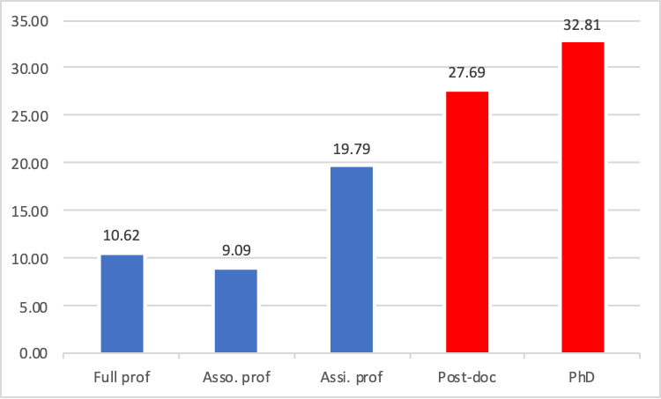
Not everyone is going to be a professor
Fixed positions*
Temporary positions
*assistant professor positions can also be temporary

Slide 10
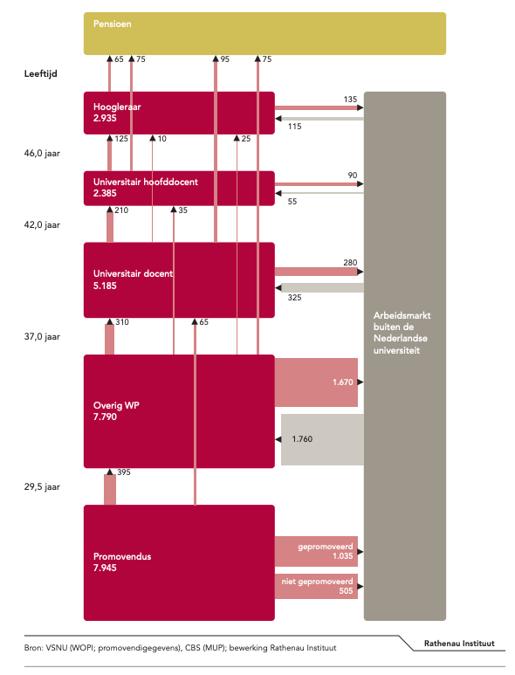
https://www.scienceguide.nl/wp-content/uploads/2018/07/Feiten_en_Cijfers_Academische_Carrieres_2013.pdf
<10% gets a permanent position
60% leaves academia after PhD

Slide 11
Take-home message
A PhD is a prerequisite for a career in academia
A PhD is more likely a first step in another career path
  Which is fine!
  Work on your transferable skills
  Actively search for opportunities (e.g. collaborations) outside academia

Slide 12
Academic career: how are you evaluated?
Publications (publish or perish!)
  Citations
  “Impact factors”, but see DORA
Grants
  Early career: Veni, Rubicon, Madam Curie
  Mid career: Vidi, Horizon Europe
  Late career: Vici, Gravitation,
Teaching
Validation
  Impact
  Outreach

Slide 13
Other jobs at the university
Support staff (e.g. library, RSO)

Slide 14
Jobs outside academica
Commercial research (food and pharma)
Science journalism
Government (ministry OCW)
Data Scientist
…
…

Slide 15
What’s your PhD worth outside academia
Skills
  Project management
  Analytical thinking
  Interpreting scientific literature
  Statistics
  Data Science
  Independent worker
  Network
But you do need to sell it!
Consider boosting relevant skills during your PhD

Slide 16
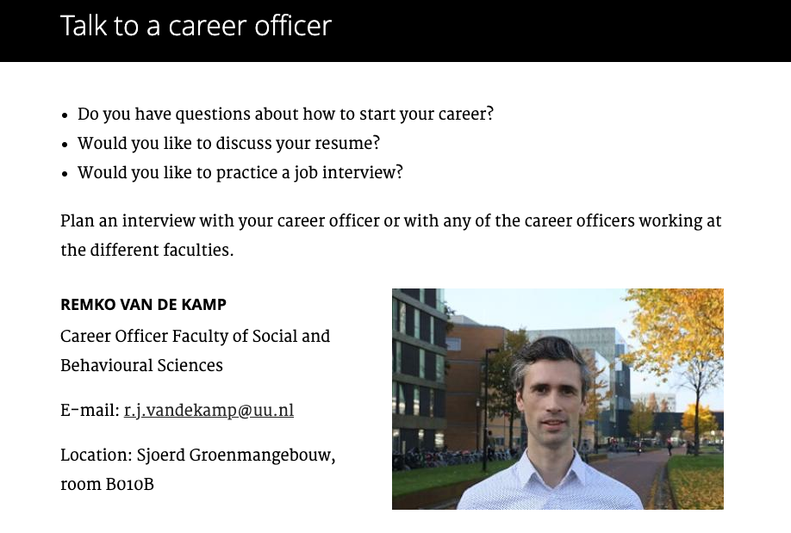
Career training
Finding positions / grants
Pimp your resume
Effectively work with LinkedIn
Practice job interviews

Slide 17
Loek’s career

Slide 18
Hans’ career

Slide 19
Workshop
http://tinyurl.com/SHP-career
How to get a PhD position
  Find vacancies (academic transfer, university website)
  Grant opportunities for PhD positions
  Talk to a PhD student! (What do they do, how did they get there, what do they (dis)like?)
How to make a career in academia
  DORA, scienceguide VSNU, NPOS, UU-OSP & interview professor(s)
Career paths outside academia

Slide 20
Workshop
http://tinyurl.com/SHP-career
Prepare your slides
Give a 1 minute pitch at the end of this class
For Friday: prepare a 10 minute presentation

Slide 21

Open Science
“Times they are a changin’” - Bob Dylan
by: Loek Brinkman
l.brinkman@uu.nl
Twitter: @LoekBrinkman
Image: Pixabay
Notes:
In my experience, the slides with the various topics (4th slide) can take up a lot of time if students know very little about Open Science. It is important to spend as much time here as needed, to get everyone on the same page. If pressed for time, you can choose to either discuss Open Acces or Open Data in-depth (and skip the other).

Slide 22
Open Science
What comes to mind?

Slide 23
Open Science
My definition:
  The stance that the core values of science are:
Set of practices
  Such as open acces, open data, open code
A movement
  Changing the way we do research
Accessibility
Transparency
Reliability
Cooperation and inclusivity
Notes:
Why I’m in Science
fundament of society
should be effective and efficient
discover and communicate relevant and reliable knowledge
…and so so in an effective and efficient manner

Slide 24
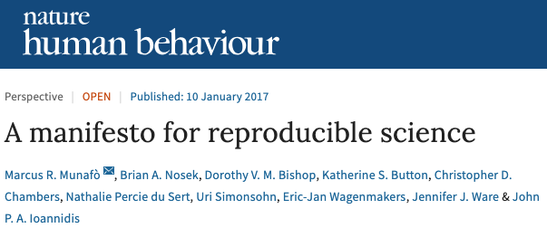
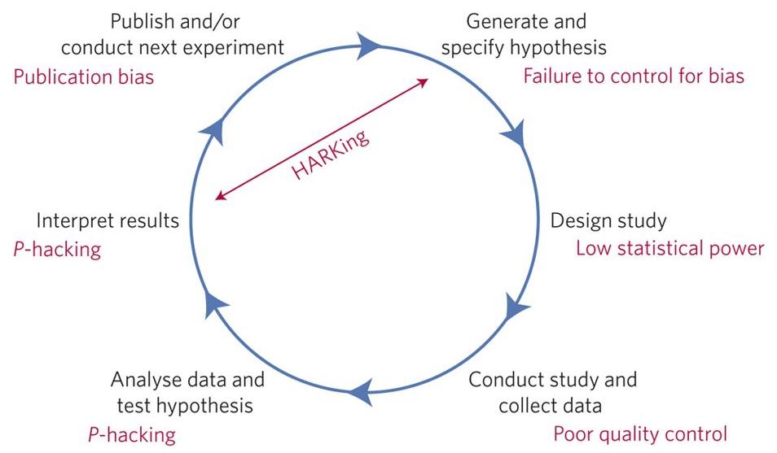

Slide 25

Open Software
Open Science Badges
Open Education
Open Peer-Review
Open Access
Citizen Science
Meta Science
Preprints
Replication studies
Open assessment
Team Science
Incentives & rewards
Preregistration
Open Code
FAIR data
Registered Reports
Open Materials
Open Data
Image: Centre for Open Science
Notes:
The Open Research Cycle

Slide 26
Open Software
Open Science Badges
Open Education
Open Peer-Review
Open Access
Citizen Science
Meta Science
Preprints
Replication studies
Open assessment
Team Science
Incentives & rewards
Preregistration
Open Code
FAIR data
Registered Reports
Open Materials
Open Data
Image: Centre for Open Science
Notes:
My priorities

Slide 27
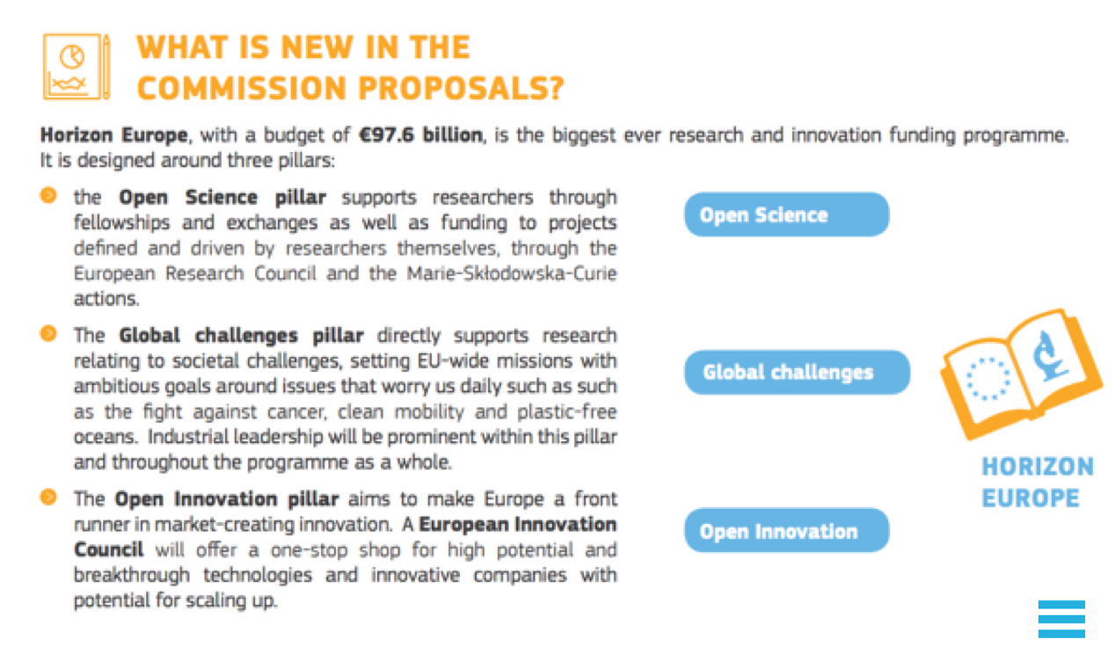





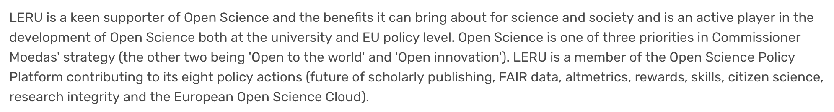
Open Science is booming!

Slide 28


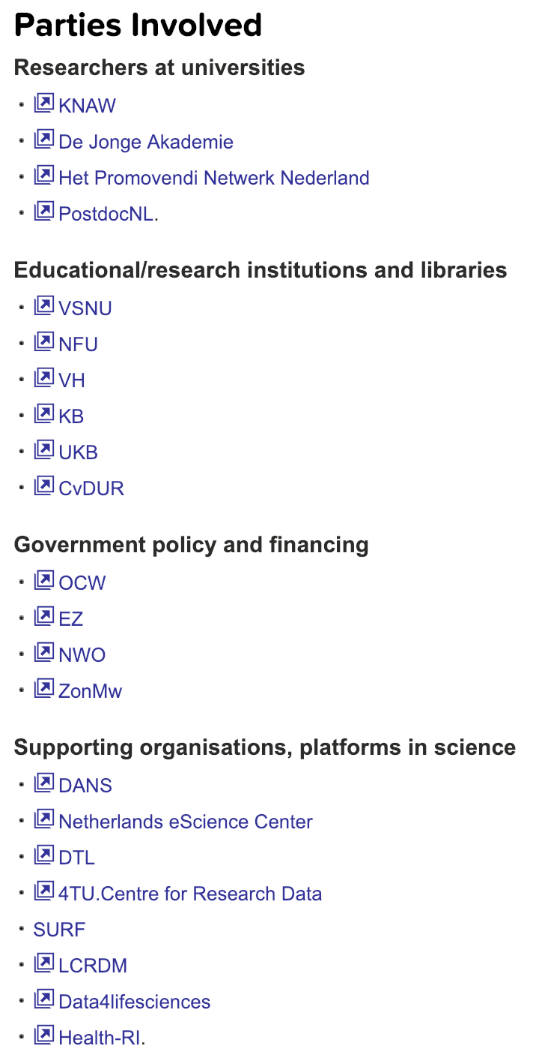




Slide 29
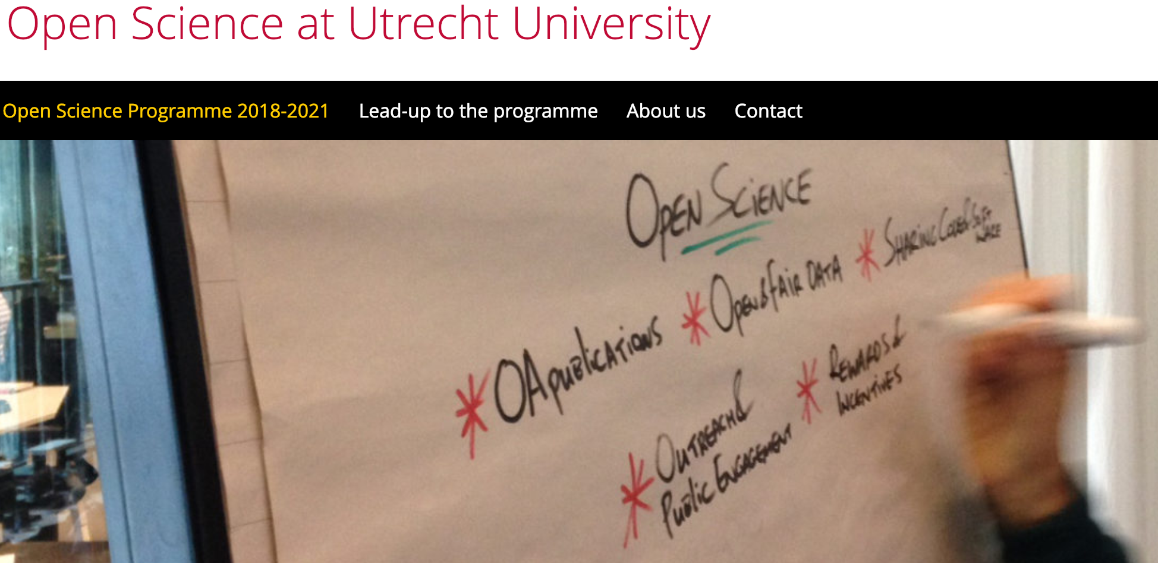

“as open as possible,
as closed as necessary”
 | Goals 2021
Open Access | 100% Open Access
FAIR & Open Data | As FAIR as possible, open where viable
Open Code and Software | Share code and software Use free en open software where possible
Outreach and public engagement | Increase societal participation Career diversity (societal impact, entrepreneurship)
Rewards and incentives | Include openness characteristics and consider all types of output for tenure and promotion

Slide 30
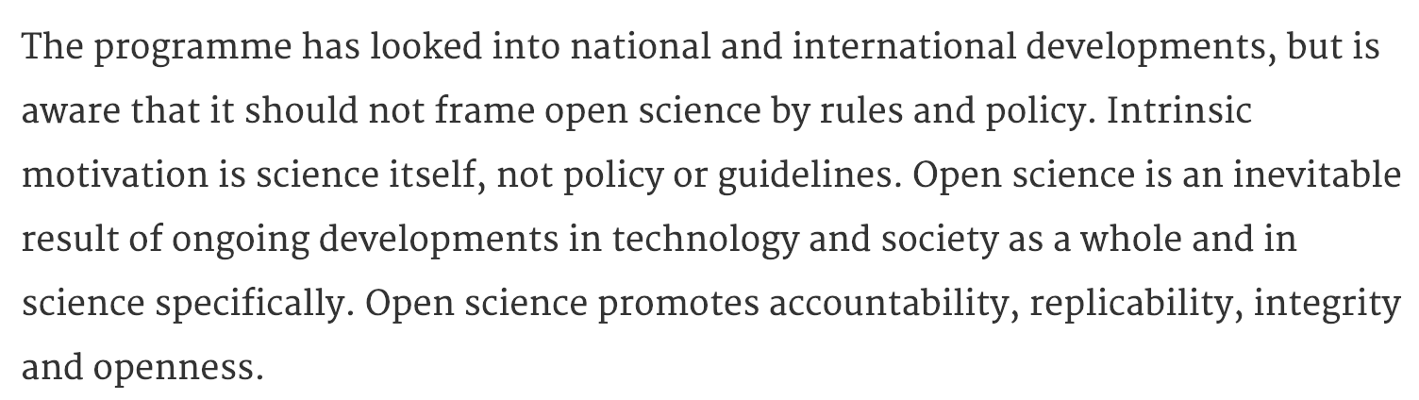


Slide 31
How open do you want to be?
Under what conditions?

Slide 32
Today:
PlanS (Open Access)
Open and Fair data
Team Science
Reproducible coding
Privacy
Open Science Community Utrecht

Slide 33

Open Access
and PlanS
Materials reused from Jeroen Bosman, Bianca Kramer
& Barbara Vreede (Utrecht University Library)
Image: Wikipedia

Slide 34
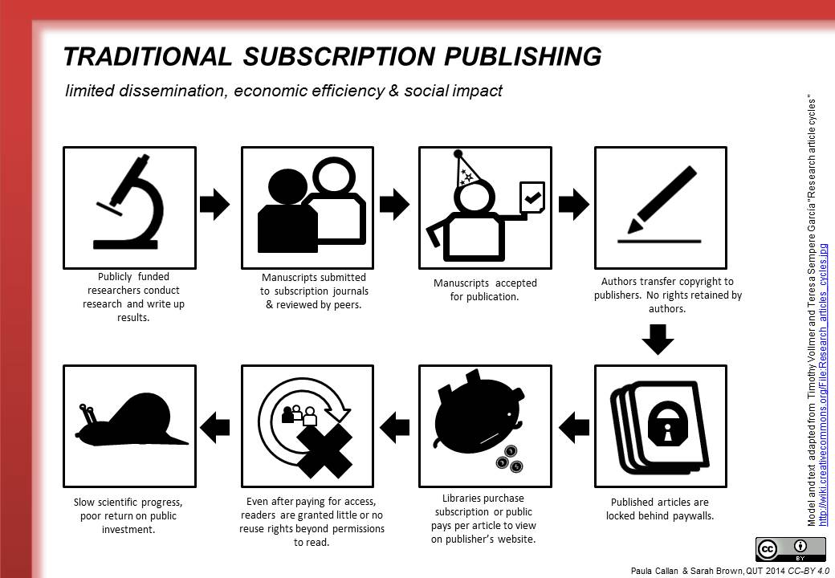

Slide 35
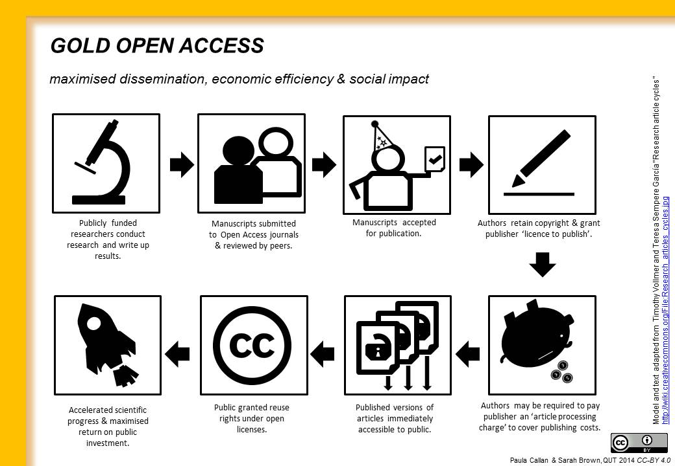

Slide 36
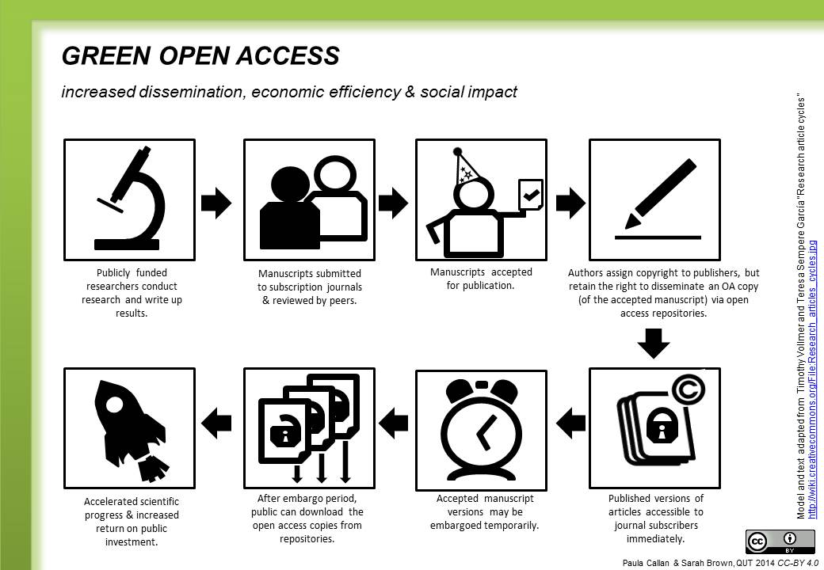

Slide 37
Different routes of Open Access
 | gold | hybrid-gold | green | preprint
Who provides access? | publisher | publisher | author | author
Where? | ~10K journals | almost all subscription journals | institutional repository | preprint archives
When? | Upon publication | Upon publication | After embargo | Around submission
How much does it cost? | ~0-4000 $ (diamond/platinum if free) | ~1000-6000 $ | free | free
Who pays? | you / UU OA fund 50% | you / VSNU big deals | n/a | n/a
Does it fulfill funder requirements? | always | currently yes, but unsure in future | depends on embargo period | usually not
Who has copyright? | author, with limited CC license options | author, with exclusive rights for publisher | publisher | author, with CC licence of choice
Slide adopted from Jeroen Bosman, Bianca Kramer. Modified by Barbara Vreede

Slide 38

How to get access?

Slide 39




Slide 40
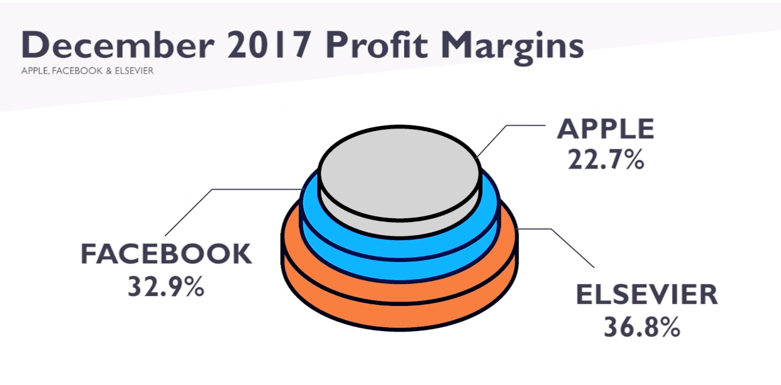

Kill the ‘subscription fee’ model

Slide 41
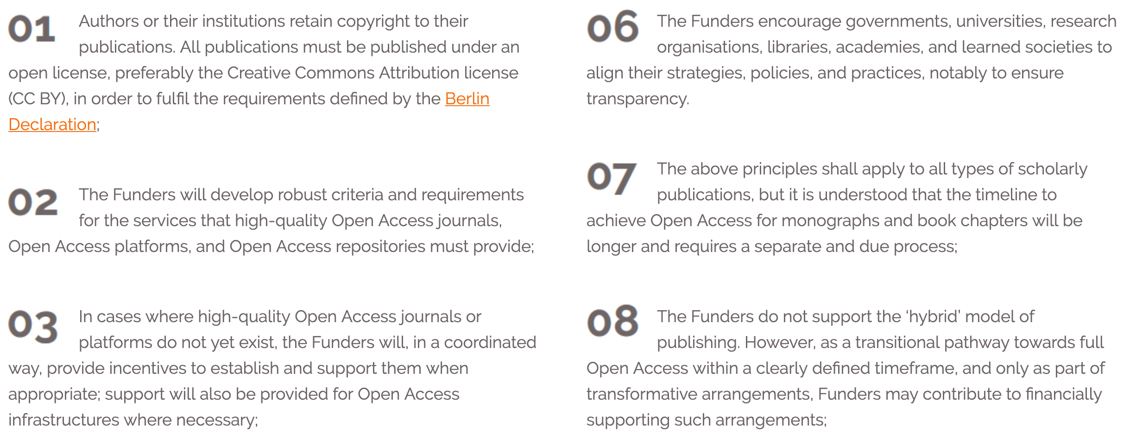


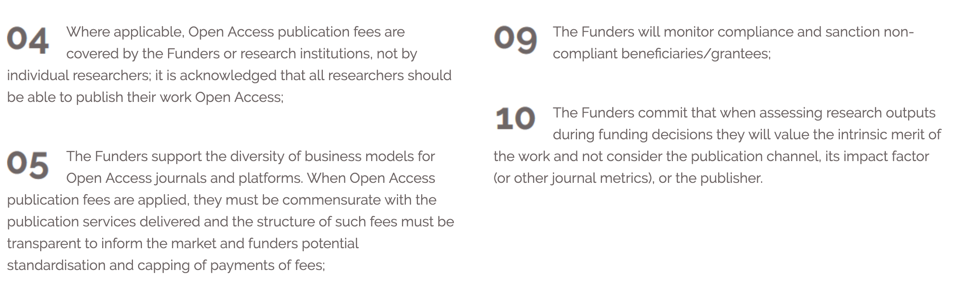



Slide 42

Open and FAIR data
Source: The Hyve

Slide 43
Source: LIBER Europe

Slide 44



Slide 45

Optional assignment
Split the group in four, each group has one topic:
  Findable, Accessible, Interoperable, Reusable
Read the sections of the FAIRytale regarding your topic (30-45 minutes)
Present to fellow students (4x 5 minutes)

Slide 46
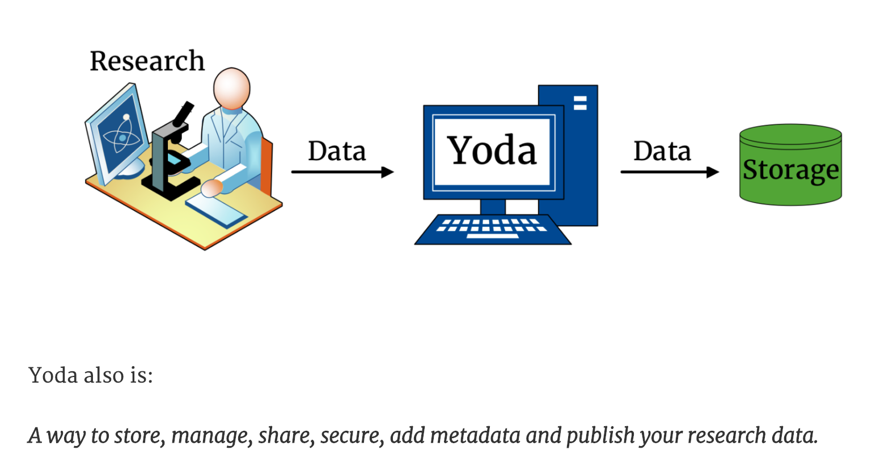


Where to share data
YODA
DataverseNL
Open Science Framework
European Open Science Cloud
https://osf.io/tgvhy/

Slide 47
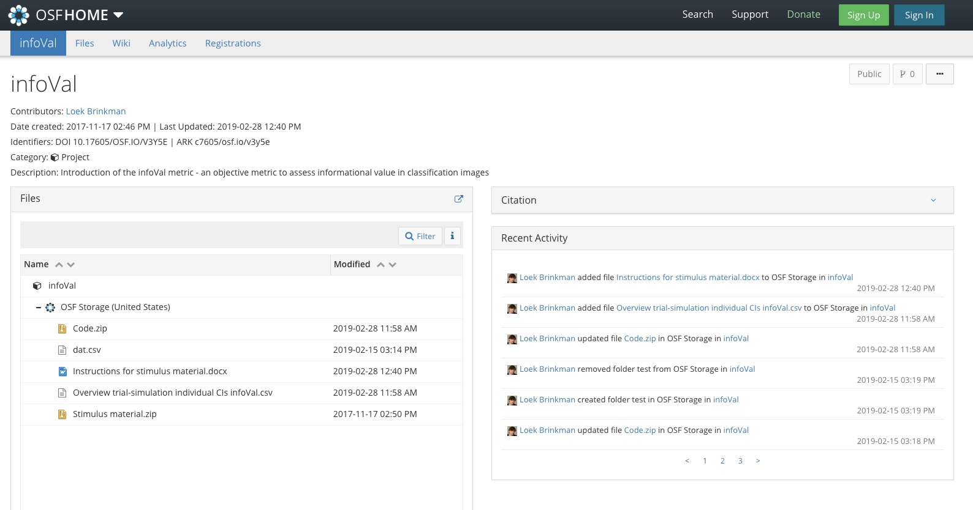
The Open Science Framework

Slide 48


The Open Science Framework
Our custom workshop:
Webinars
https://osf.io/tgvhy/

Slide 49

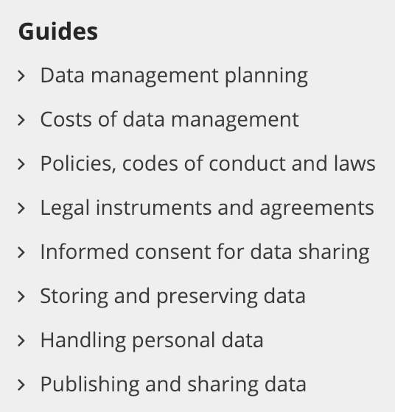
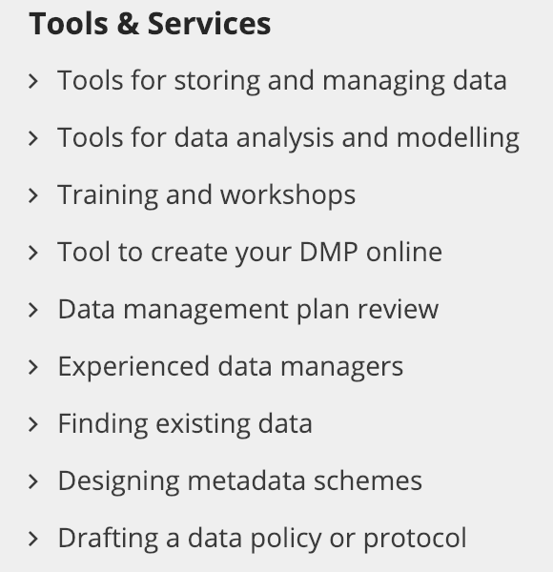
How to share data

Slide 50
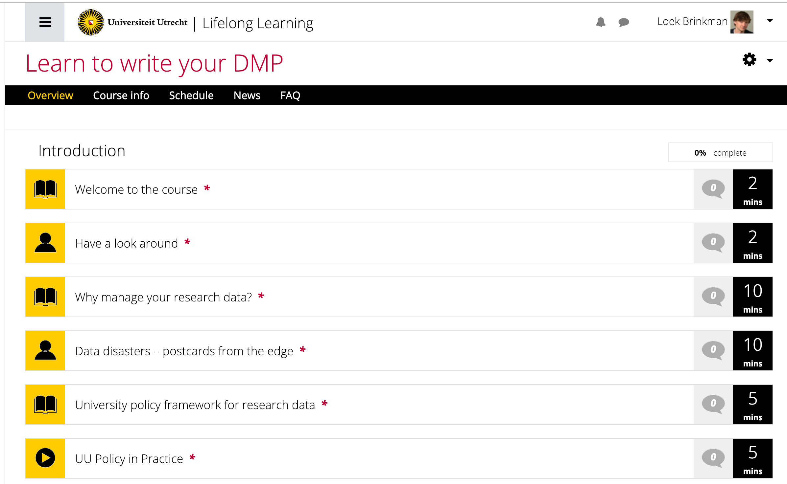
Data Management Plan

Slide 51
Reproducible coding
RMarkdown
Github
  Version control
  Sharing and collaborating
  CV!
https://elifesciences.org/labs/ad58f08d/introducing-elife-s-first-computationally-reproducible-article

Slide 52

Team Science
PsychScience Accelerator
Collaborative Replications and Education Project
https://osf.io/wfc6u/

Slide 53

Open Science & privacy
New privacy law:
  General Data Protection Regulation (GDPR)
  Algemene verordening gegevensbescherming (AVG)
UU: “As open as possible, as closed as necessary”
Informed consent: ask permission to share data
Always check whether/what you are allowed to share!

Slide 54
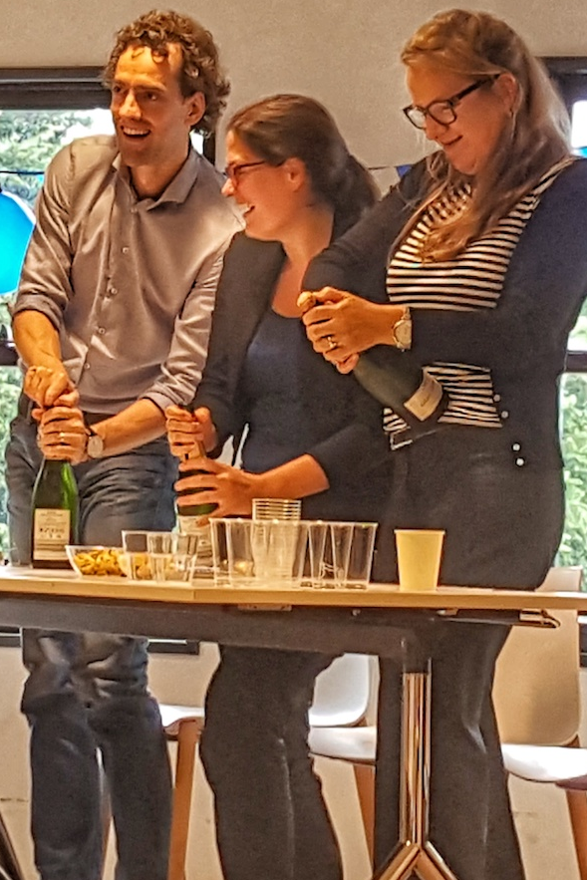
Photo by Annemiek van der Kuil

Slide 55
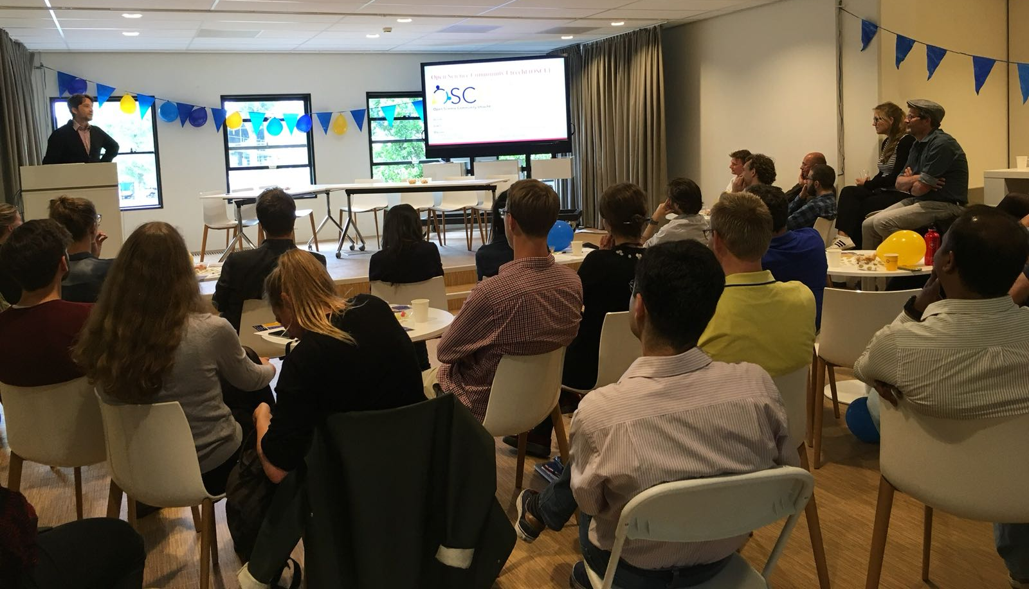
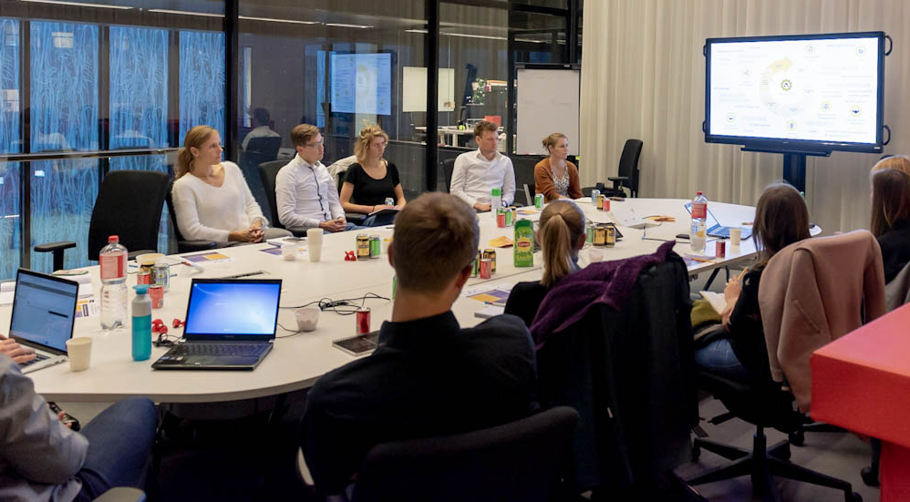
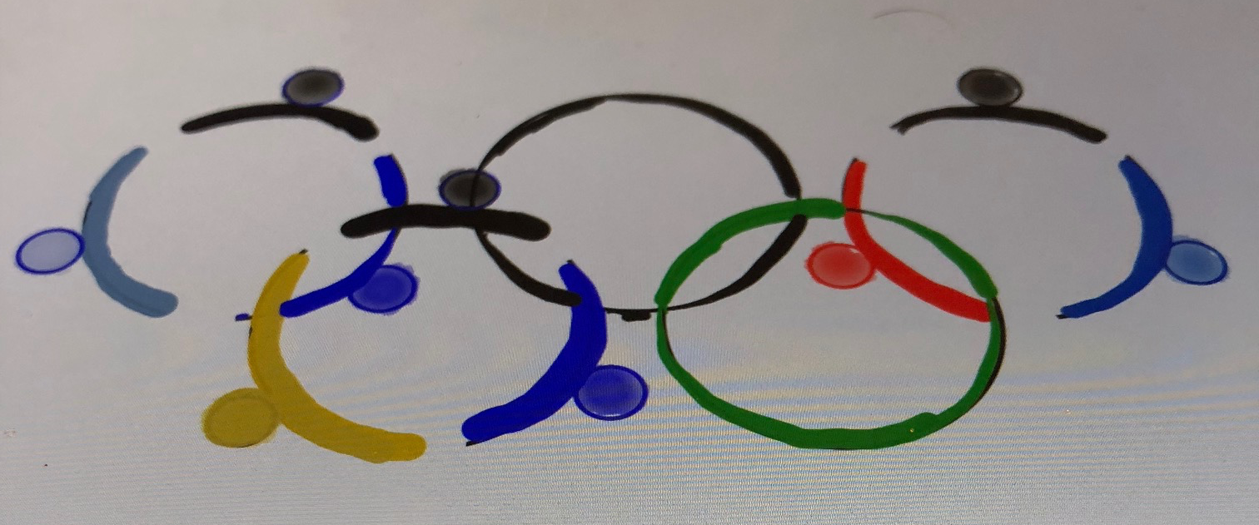
Open Science Community Utrecht
140+ members (six faculties)
Workshops and cafés
Many universities are following suit
Join us to:
  Learn OS skills
  Meet colleagues and support staff
  Shape the way we do research
CC-BY Verbeeldingskr8
Photo’s by Manuel Oliveira and Laura Dijkhuizen

Slide 56

Notes:
These are our previous workshops (to get a feel for the topics). In 2019-2020 will will organise 7 Open Science symposia (on for each faculty). More info at www.openscience-utrecht.com

Slide 57
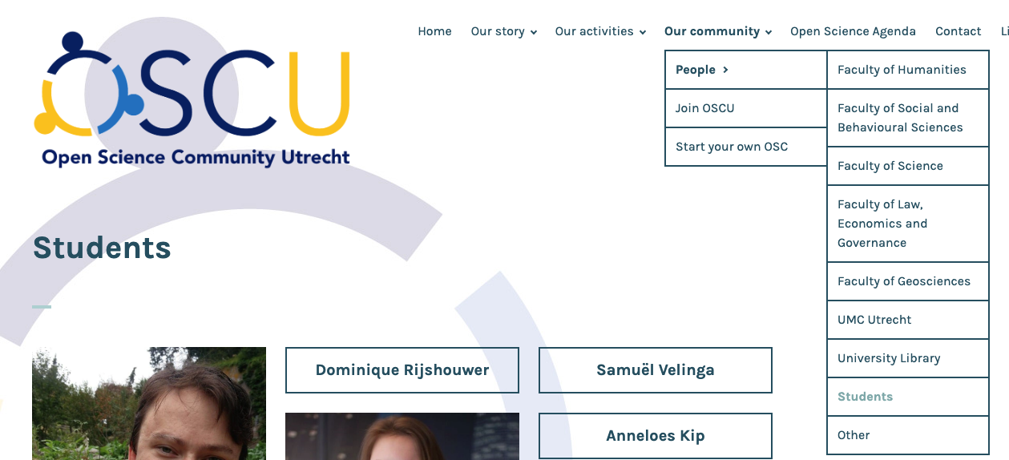
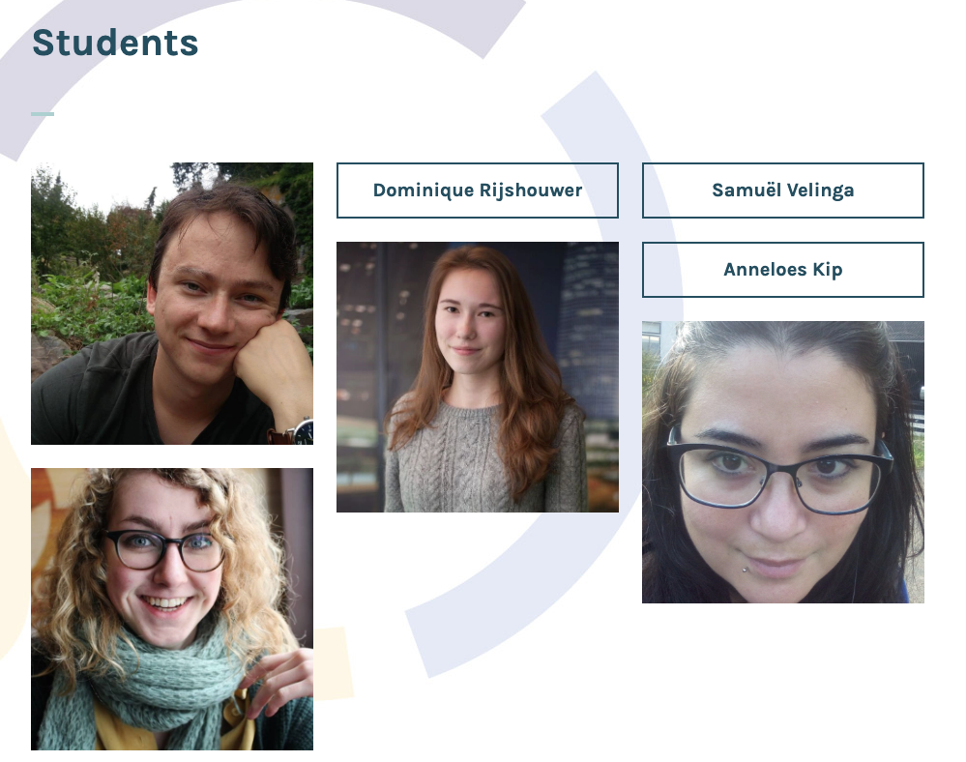
www.openscience-utrecht.com
Twitter: @OpenSciUtrecht

Slide 58
Dutch OS communities

Slide 59

Evaluating strength of evidence in literature
a meta-science perspective
by: Loek Brinkman
l.brinkman@uu.nl
Twitter: @LoekBrinkman
image: pixabay
Notes:
Science is standing on the shoulders of giants. We build on knowledge acquired by others. Can we trust this knowledge to be robust?
Science is theory building, based on observations in samples, which we generalise to populations.
How can we estimate whether an generalisation holds?
CONTENT:
lecture on PVV (30-45 minutes)
Assignment I (PVV) (20 minutes + 5 minutes discussion)
Assignment II (predict replication) 20 minutes

Slide 60
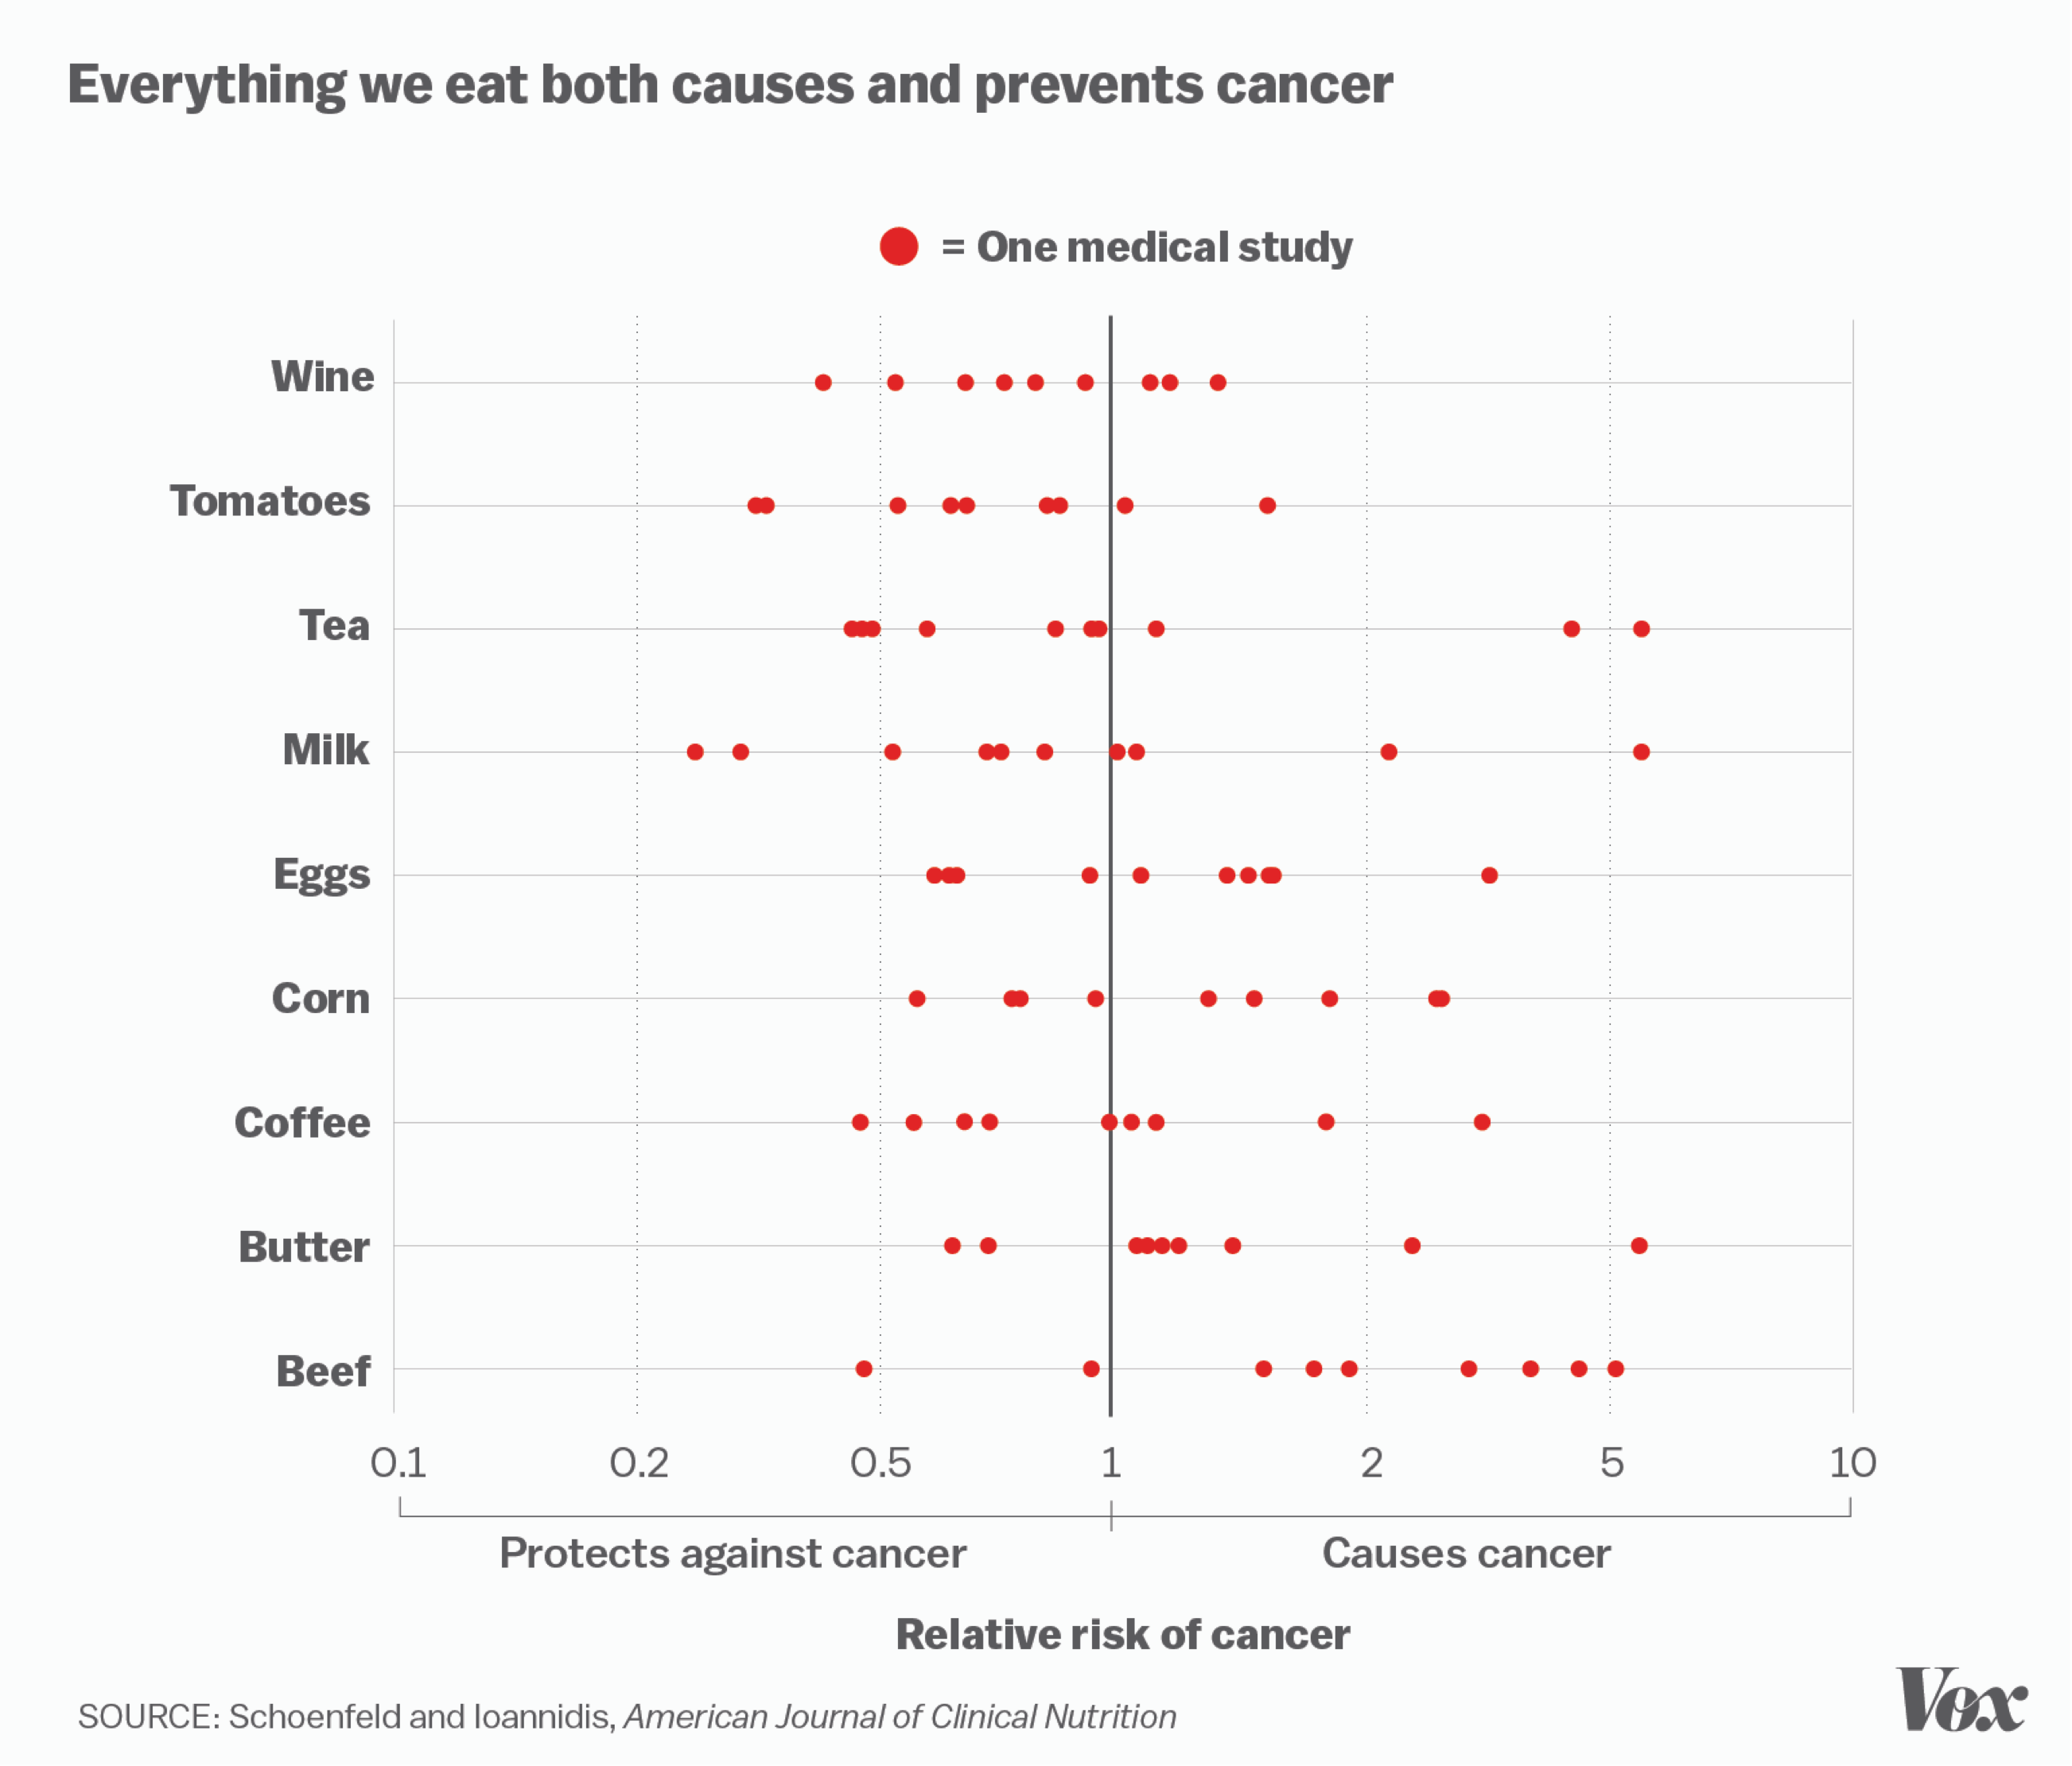
Problem: contradicting evidence
Notes:
If two studies that show contradicting effects differ in methodological set-up, it may inform us under what conditions our predictions are valid. This leads to better theories. If the set-up is identical, (at least) one of them must be false.

Slide 61
Evaluating papers:
Type of evidence
Body of evidence

Slide 62
Evaluating papers:
Strength of evidence
Statistical inference
  What can we infer from p < 0.05?
So, 95% chance observation in sample generalises to population
  Replications —> same results (depending on power)
  Positive Predictive Value (PPV)
    Given a significant finding, what is the chance the finding is true?
    PPV = ??? (A = 95%, B = 50%, C = 5%)
    What determines PPV?
Notes:
We observe samples, and generalise to populations. We rely on statistical inferences to warrant the generalisation. Typically, we rely on p < 0.05. What does this mean?
I ask student what they think the PPV (in %) actually is in practice. 95%, 50% or 5%. The most accurate estimate of the PPV is ~50% now.

Slide 63
Determinants of PPV
A prior chance of hypothesis
Power (80%)
Alpha-level (0.05)

Slide 64
We start with 1000 studies…
*each square represents 10 studies
Notes:
Each square represents 10 studies

Slide 65
1. Let’s say, 60% of our hypotheses are correct (600 studies)
Hypothesis
correct
Hypothesis
incorrect
Notes:
How many of the hypotheses (H1) that we come up with are true in the population? We do not know this number (that’s why we do science). It is not 0%, but also not 100%. It differs per study. Let’s say it is on average 60% (later, we’ll see how this number effects the PPV)

Slide 66


2. With 80% power, we detect 80% of 600 = 480 studies
480
Notes:
With 80% power, we detect 480 TRUE POSITIVES

Slide 67
3. With alpha = 0.05, we expect 5% false positives (400 x 0.05 = 20 studies)
480
20
Notes:
In edition to the 480 TRUE POSITIVES, we also find 20 FALSE POSITIVES (because alpha = 0.05). Assuming only results that are statistically significant end up in literature, we have 500 published studies. The results of the remaining 500 studies go in the file drawer/the waste bin.

Slide 68
Positive Predictive Value
480
=
96%
+
480
20
Notes:
The PPV is the ratio of TRUE POSITIVES over TOTAL AMOUNT OF PUBLISHED PAPERS.

Slide 69

A more grim example…
Image:pixabay
Notes:
It’s almost Halloween, so we need a pumpkin in the presentation.

Slide 70
We start with 1000 studies…
Notes:
Each square represents 10 studies

Slide 71
1. Let’s say, 30% of our hypotheses are correct (300 studies)
Hypothesis
correct
Hypothesis
incorrect
Notes:
Let’s say, we test more unlikely hypotheses, because they will give us more interesting findings (more publicity)

Slide 72
2. Say, we actually have 40% power,
we detect 40% of 300 = 120 effects
120
Notes:
Say, we didn’t properly think about power and determined sample-size on heuristics. Especially, when we are investigating small effects, power might actually be low (more on this: next workgroup).

Slide 73
3. With 5% false positives, we expect 700 * 0.05 = 35 false positives
120
35

Slide 74
Positive Predictive Value
120
=
77%
+
120
35
Notes:
Idem

Slide 75

4. P-hacking can turn non-significant findings
into significant findings.
Let’s say this happens in 20% of the cases.
36
120
35
133
This turns 133 of the 665 true negatives into false positives
And, ironically, also turns 36 of the 180 false negatives into true positives
Notes:
P-hacking and other ‘questionable research practices’ can turn a nonsignificant results into a significant result. This means that papers the normally would end up in the wastebin, now end up in literature. This produced additional FALSE POSITIVES (and ironically also some additional TRUE POSITIVES).

Slide 76
Positive Predictive Value
False negatives
P-hacked to true positives
True positives
120
+
36
=
48%
120
+
36
+
35
+
133
True positives
False positives
False negatives
P-hacked to true positives
True negatives
P-hacked to false positives

Slide 77
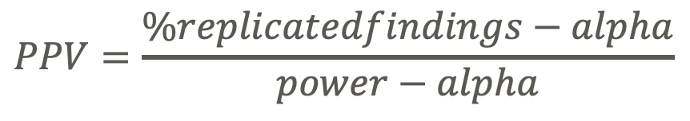
Back to reality:
estimating the true PPV
Replicate 1000 studies with 90% power
  If PPV = 0.8
    800 x 90% = 720 true positives
    200 x 5% = 10 false positives
    expected: 730/1000 = 73% replicated findings
So, we can compute the estimate of the PPV from the observed % of replicated findings
  Lets check this for the example above: (73% - 5%) / (90% - 5%) = 0.8
$$\%replicatedfindings=PPV∗power+(1−PPV)∗alpha$$
$$PPV=\frac{\%replicatedfindings−alpha}{power−alpha}$$

Slide 78
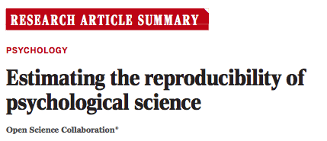
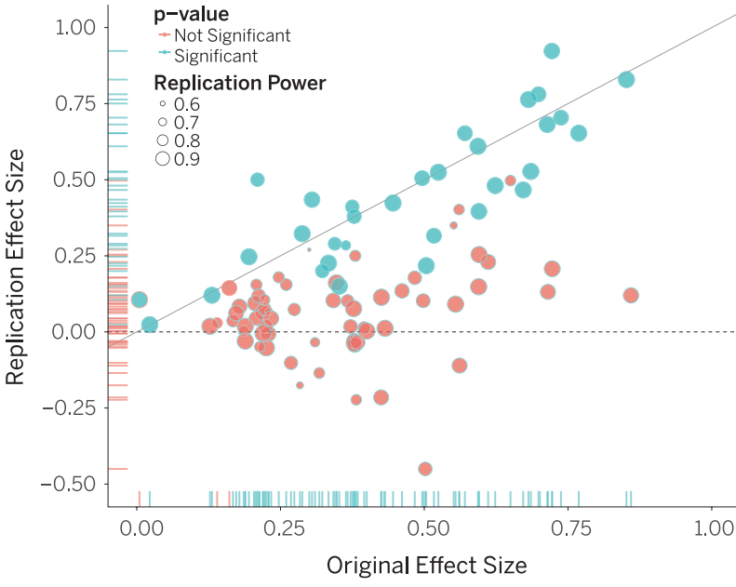
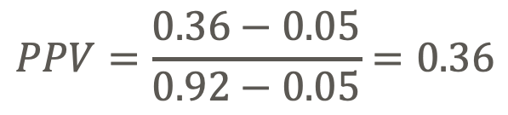
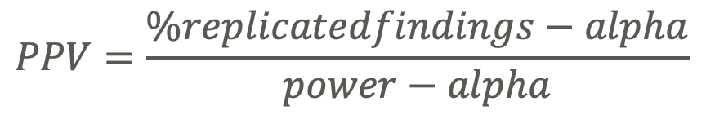
Average power = 92%
36% of replications significant
Science, 2015
$$PPV=\frac{\%replicatedfindings−alpha}{power−alpha}$$
$$PPV=\frac{0.36−0.05}{0.92−0.05}=0.36$$
N = 97

Slide 79
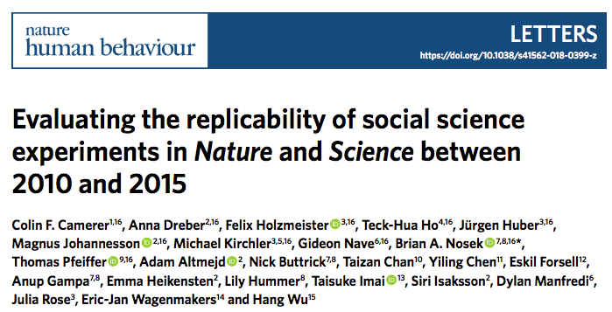
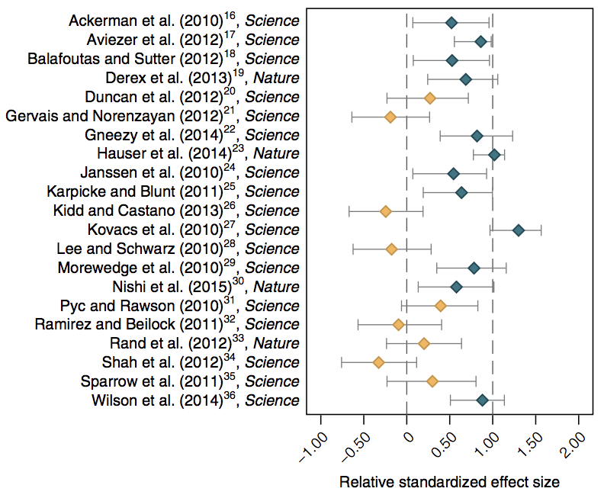
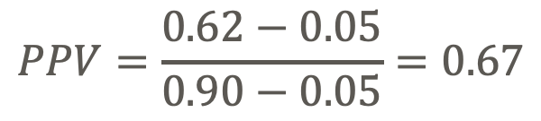
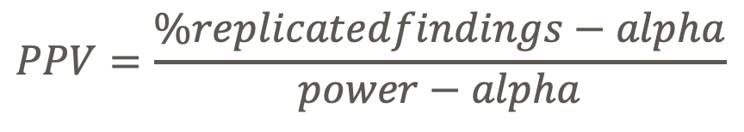
Average power = 90%
62% of replications significant
$$PPV=\frac{\%replicatedfindings−alpha}{power−alpha}$$
$$PPV=\frac{0.62−0.05}{0.90−0.05}=0.67$$
N = 21

Slide 80
Assignment I: realistic parameter values
http://shinyapps.org/apps/PPV/ (F. Schönbrodt)
Find a realistic combination of parameters that leads to a PPV of ~60%
A prior chance of hypothesis
Power
Alpha-level (0.05)
p-hacking
Notes:
Assignment: try and find a combination of parameters that you deems realistic that gives you a PPV of ~50%.
One thing that you need to add is the % of p-hacked studies. That is: the % of studies that initially did not yield a significant effect, but by flexibly using researchers degrees of freedom (changes in analyses) were turned into significant results. In other words, studies that entered the literature, that would otherwise end up in the waste-bin. NOTE: p-hacking does not equal fraud. It is often done with the best intentions or because of ignorance.

Slide 81
How to do robust science
Determinants of PPV | Best practice
Likelihood of hypothesis | Theory-driven hypotheses
Power | High-powered designs
Alpha | Unlikely hypothesis? Consider a lower alpha
P-hacking | Protect yourself from bias (e.g. preregistration)

Slide 82
Checklist: estimating strength of evidence
How likely was the hypothesis?
What was the a-priori power?
Possible p-hacking?
  Logical steps in analysis? preregistered?
Has the observation been replicated?
Large effect-size? Low p-value?

Slide 83

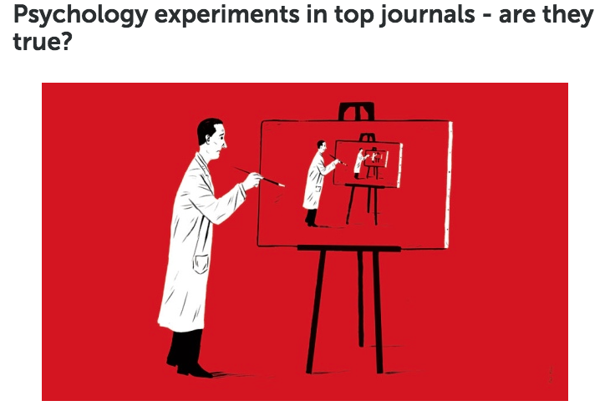

Assignment II:
https://80000hours.org/psychology-replication-quiz/
Notes:
https://80000hours.org/psychology-replication-quiz/

Slide 84
Take-home thoughts
How do you evaluate literature?
What causes low rates of replicability?
How can this be improved?

Slide 85
Additional reading & acknowledgements
Ioannidis, J. P. A. (2005). Why most published research findings are false. PLoS Medicine, 2(8), e124. http://doi.org/10.1371/journal.pmed.0020124
Blogpost by Felix Schönbrodt
  http://www.nicebread.de/whats-the-probability-that-a-significant-p-value-indicates-a-true-effect/
Open Science Collaboration (2015) Estimating the reproducibility of psychological science. Science, 349 (6251). aac4716-aac4716. ISSN 0036-8075 link
Camerer, C.F. (2018). Evaluating the replicability of social science experiments in Nature and Science between 2010 and 2014. Nature Human Behaviour, 2, 637-644
Manuscript icon by Kristina Handrikova from the Noun Project
Waste icon by SBTS from the Noun Project

Slide 86

Power Analysis
Determining sample-sizes for sensitive experiments
by: Loek Brinkman
l.brinkman@uu.nl
Twitter: @LoekBrinkman
Image: Pixabay
Notes:
Lecture (2 x 45minutes)

Slide 87
But first…
What do you remember of last week’s class?
What is the PPV and what determines it?
How do you evaluate literature?

Slide 88

Power analysis - why you should care
Study design: sample-size
  Sensitivity vs. Efficiency
  Error control
    Type 1: alpha = 0.05
    Type 2: beta = 0.2
      Power = 1 - beta = 80%
 | H0 true | H1 true
Accept H0 | True negative | False negative (type 2)
Accept H1 | False positive (type I) | True positive
What do you know about error control?

Slide 89
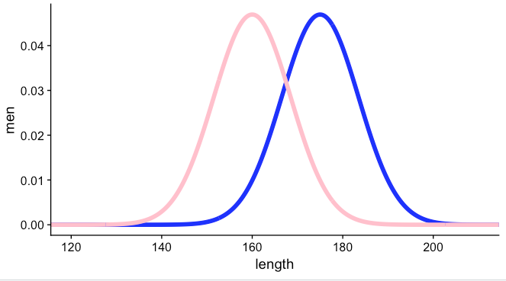
H1: men and women differ in length
Do you think H1 is true?
Experiment:
  Alpha = 0.05
  Power = 0.80
  Cohens d = 1.67
  N = 14 (7 per group)
Men
Women
Notes:
N = 14 (7 participants per group)
Based on d = 1.67

Slide 90
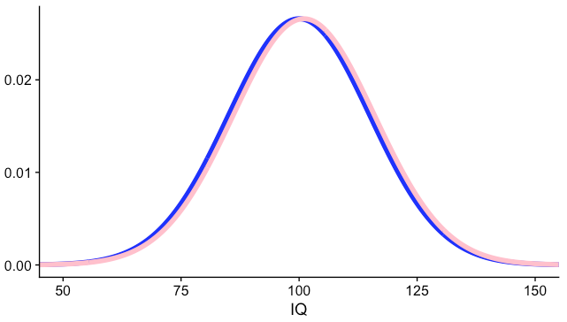
H1: men and women differ in IQ
Do you think H1 is true?
Experiment:
  Alpha = 0.05
  Power = 0.80
  Cohens d = 0.0067
  N = 700.000
Men
Women
Notes:
Total N = ~700.000 (based on 0.1 point difference per group, d = 0.0067)

Slide 91
Effect size matters!
What do you know about effect-sizes?
Sample size depends on:
  alpha, power & effect-size!
Men
Men
Women
Women

Slide 92
Effect-sizes come in many forms…
d family
Cohen’s d, Hedges G, Glass delta, …
r family
r for correlations, r^2 for regression, eta^2 for ANOVA, …
Common language effect-size
Lakens 2013 Frontiers + spreadsheet

Slide 93
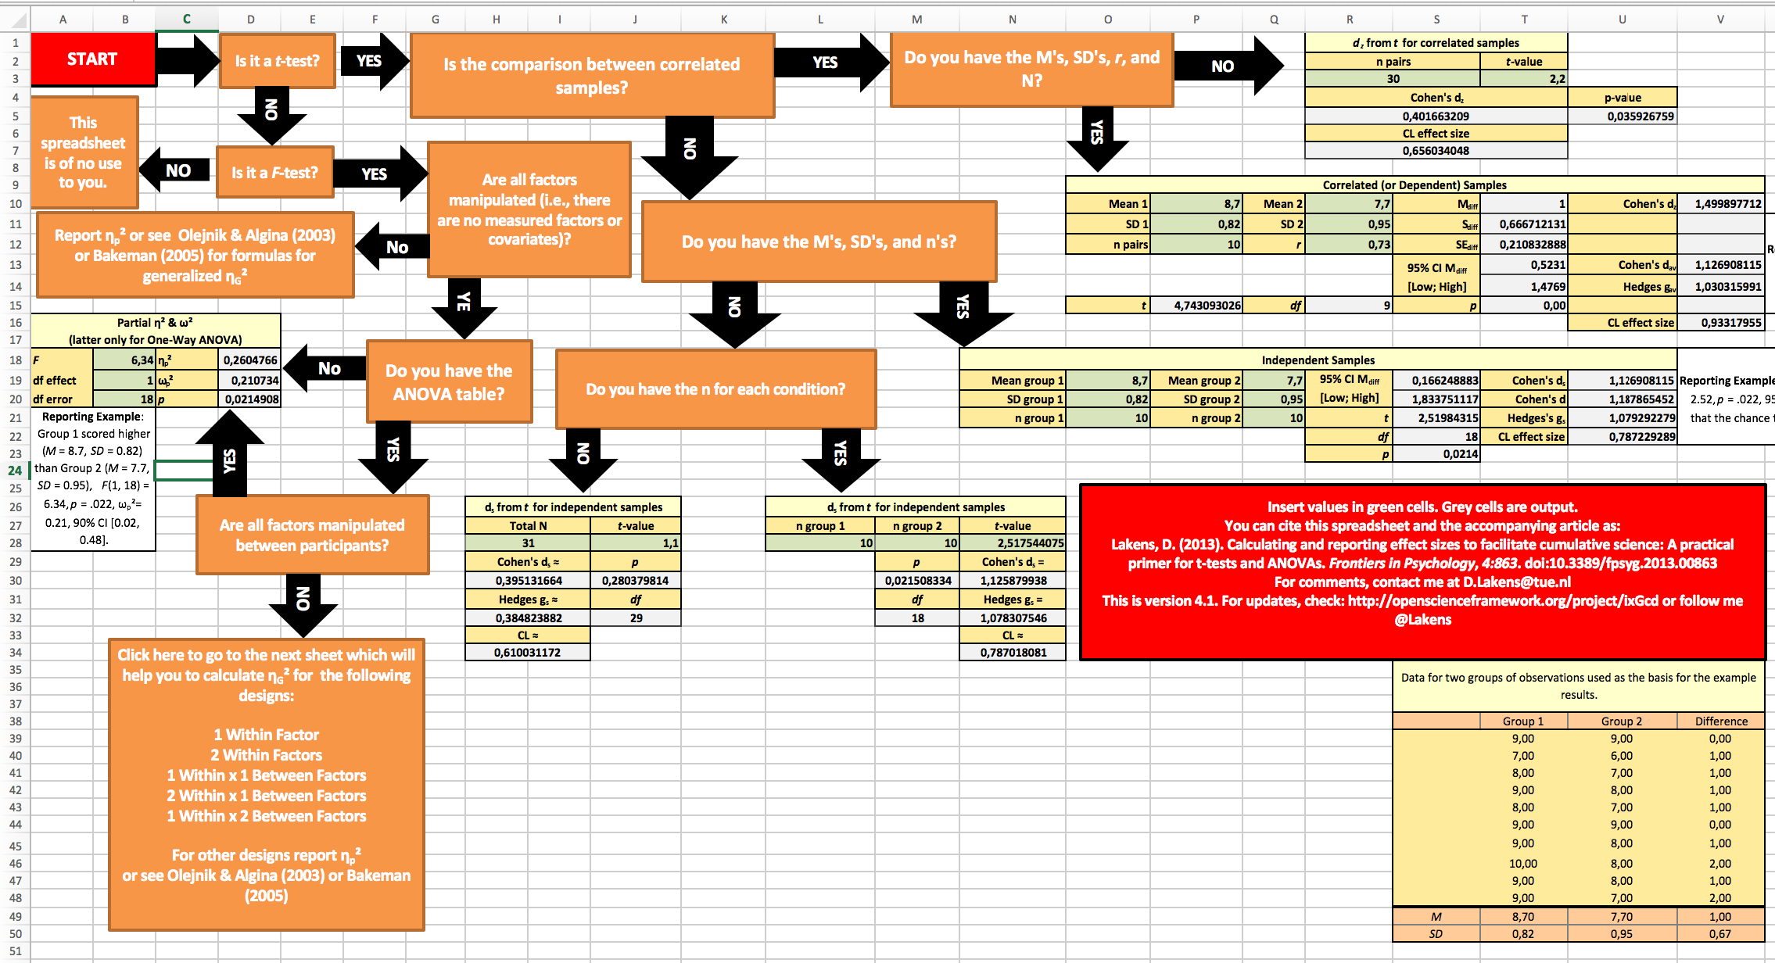

Slide 94
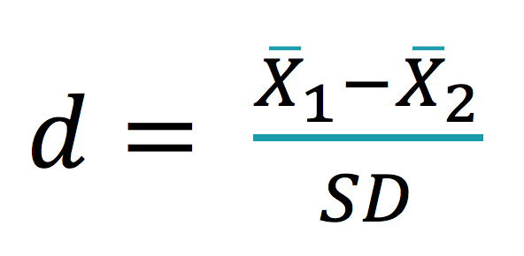
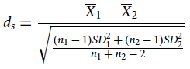
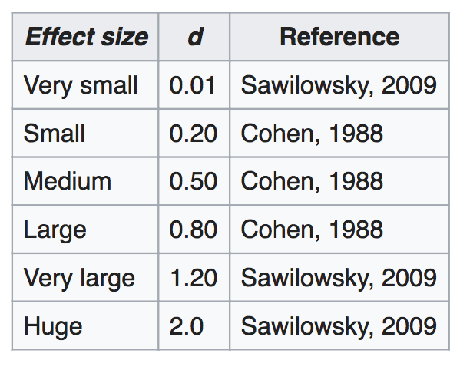
Cohen’s d
Simple form:
Slight more complex form:
BIG / small = BIG
d = 1.67
small / BIG = small
d = 0.0067
Wikipedia

Slide 95
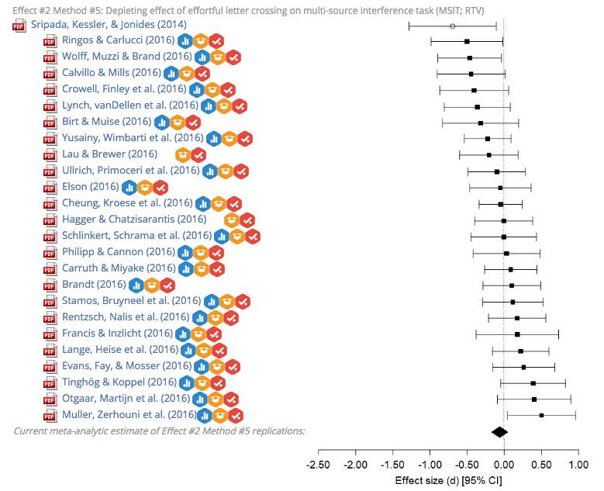
Let’s care about effect-sizes
(not significance)
www.curatescience.org

Slide 96
Pledge: from this day onward,
I will always report effect-sizes*
*and confidence intervals around effect sizes

Slide 97
How to do power analyses
Alpha
Power
Effect size
Sample size
Four ingredients:
Plug in three values to obtain the fourth
  A priori power analysis (compute sample size)
  Sensitivity analysis (compute effects-size)
  criterion/compromise analysis (compute alpha and/or beta)
  Post-hoc power - debated!

Slide 98
How to do power analyses
G*Power
‘pwr’ package (R)
Simulations (R)
…many other tools

Slide 99
Assignment 1
Do average test-scores of SHP master students differ from those of another university?
  SHP: mean = 7.3, SD = 0.5
  OtherUni: mean = 7.1, SD = 0.5
Determine the sample size for a study with 80% power and an alpha of 0.05.
  Using: 1. G*Power; 2. pwr package (R); 3. simulations (R)
Notes:
d = 0.4
200 (100 + 100)

Slide 100
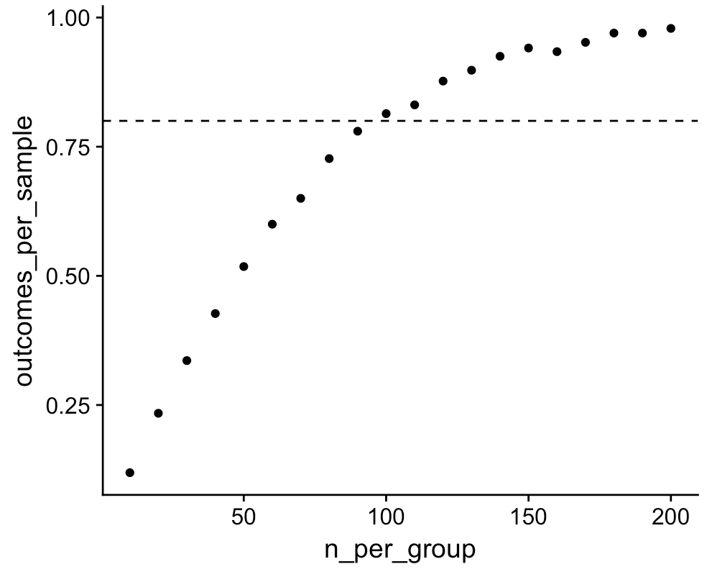
Simulation approach

Slide 101
Simulation approach
Estimate the distributions of your DVs in the population
Choose a sample size (e.g. n = 5)
draw a random sample of size n from the estimated populations
Perform your test (works for any test!). Significant? YES/NO
Repeat step 2 & 3 many times (10.000).
Compute ratio YES/NO (this is power!)
Increase the sample size (e.g. n = 10)
Repeat steps 3, 4, 5, 6 for each sample size
Output:
Sample size | 5 | 10 | 15 | 20 | 25 | …
Ratio | .1 | .2 | .3 | .4 | .5 | …

Slide 102
Download the example-code
https://github.com/LoekBrinkman/code-for-toolkit-T4SS

Slide 103
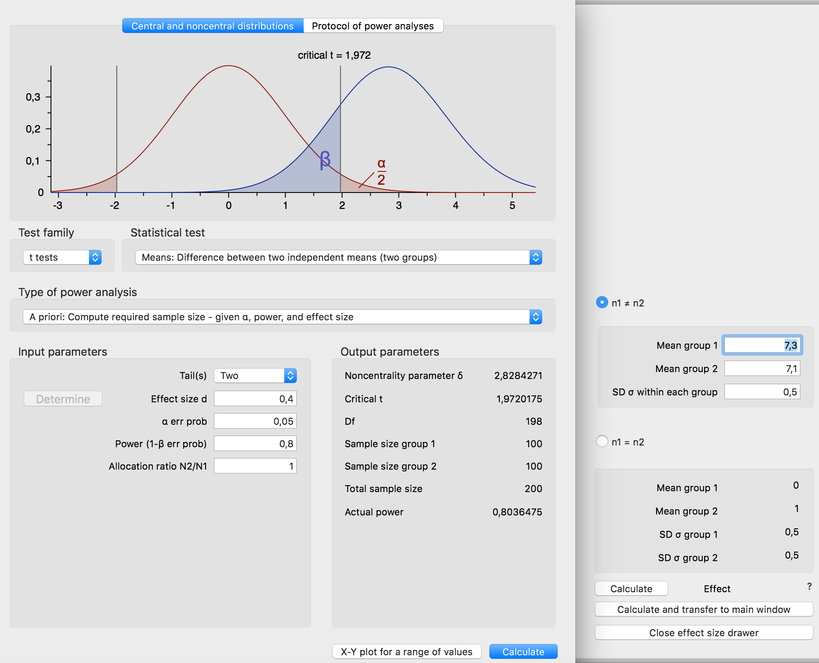
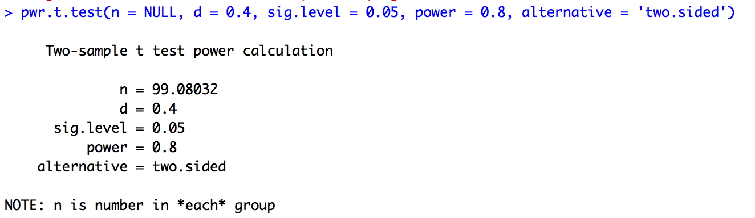
G*Power
Simulation
pwr package

Slide 104
Assignment 2
Do average grades change after taking this toolkit?
  pre: mean = 7.1
  post: mean = 7.3
  SD of difference = 0.5
Determine the sample size for a study with 80% power and an alpha of 0.05.
  Using: 1. G*Power; 2. pwr package (R); 3. simulations (R)
Notes:
Here you can stress the added value of within subject designs versus between subject designs: the power of within subject designs is typically much higher with the same amount of participants.

Slide 105
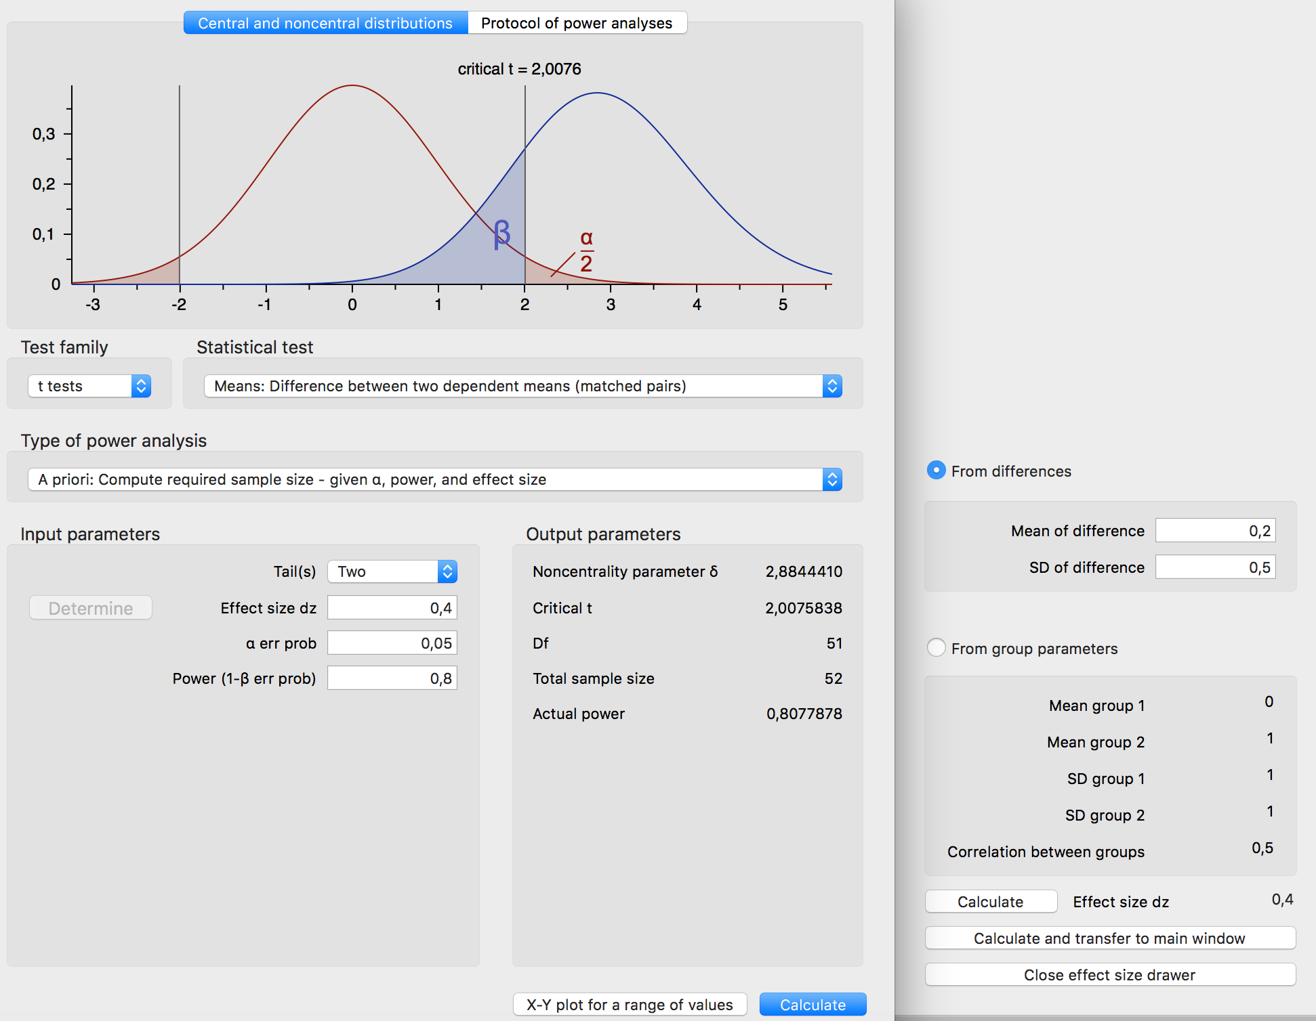
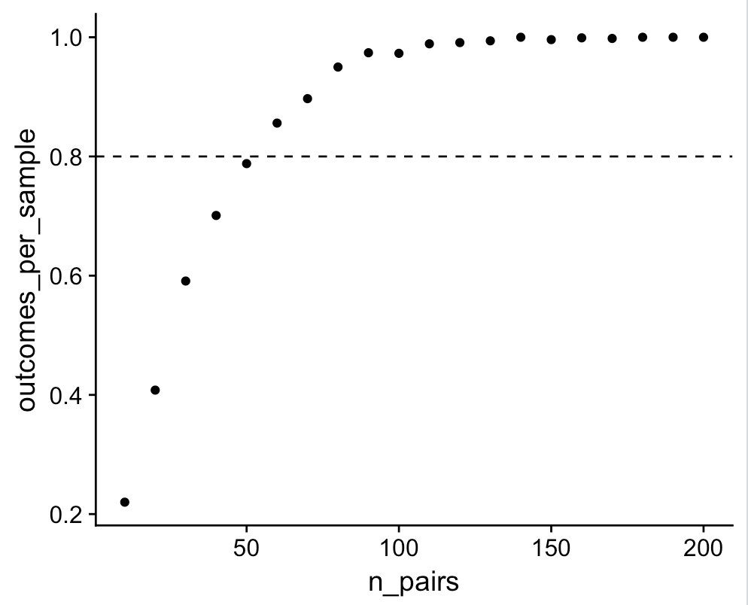

G*Power
Simulation
pwr package

Slide 106
Assignment 3
Grades of students from [UU, UVA, RU] who [love, like, dislike, hate] statistics
3 x 4 ANOVA
  a. Main effect of liking
    partial eta-squared = 0.2, df = 3
  b. Interaction of university x liking
    partial eta-squared = 0.2, df = 6

Slide 107

3a: main effect of ‘liking’

Slide 108

3b: interaction of ‘liking’ and university’
Notes:
You can stress were that you need to perform separate power analyses from main effects and interactions effects. Make sure that you have enough participants to have enough power for ‘the weakest link’ in your design (e.g. the interaction effect). You need more participants for the interaction effect as the interaction has more degrees of freedom: in a 3 x 4 design, the interaction has (3-1) * (4-1) = 6 degrees of freedom (compared to the (3-1)=2 and (4-1)=3 degrees of freedom of the two main effects, respectively.

Slide 109
Effect-size measures:
Common Language effect size
1000 blind dates (man + woman)
  Man taller: 89%
  Man lower IQ: 50.05%

Slide 110
Wrap-up
Always perform power analyses
  Any way you like…
Let’s care about effect-sizes (not significance)
  Always report effect-sizes (including CI)

Slide 111
Acknowledgements
Lakens, D. (2013) Calcucating and reporting effect sizes to facilitate cumulative science: a practical primer for t-tests and ANOVAs Front. Psychol. https://doi.org/10.3389/fpsyg.2013.00863

