Slide 1
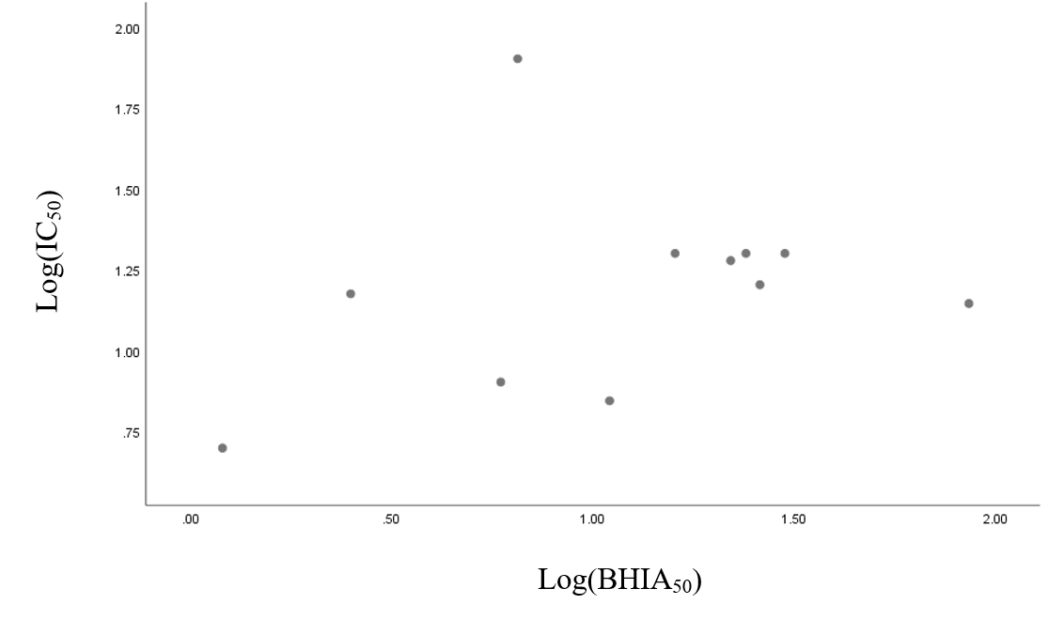
Figure S25. Correlation between β-haematin inhibition activity (log(BIHA₅₀)) and anti-malarial activity (log(IC₅₀­)) for biquinolines against sensitive strain D6

