Slide 1

Introduction to alternative metrics and Altmetric data
Terry Bucknell
Sales Director – EMEA
t.bucknell@digital-science.com

Slide 2
Today…
What are alternative metrics?
Who are we at Altmetric.com?
Understanding Altmetric data

Slide 3
Alternative metrics = online indicators of engagement
Shares and comments on social media
Coverage in news media and blogs
Citations on Wikipedia
Citations in Policy Documents
Research output (article, dataset, clinical trial etc)
Discussions on peer review platforms
Inclusion on reading lists
Behaviors identified here are specifically captured by Altmetric.com and do not represent the entirety of behaviors alternative metrics can measure.

Slide 4
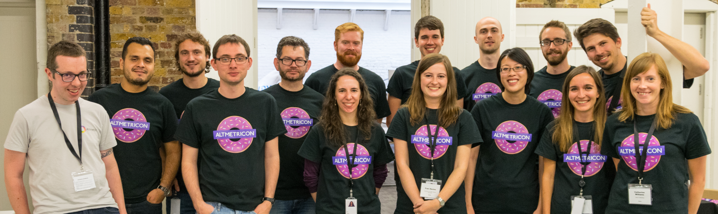
Altmetric LLP is a UK-based data science company dedicated to tracking and analyzing the online activity around scholarly research outputs.

Slide 5
























Global multi-industry customer base

Slide 6
Differences between alt and traditional metrics – they’re complementary
Traditional journal
Alternative metrics
Slow; take months/years
Only for journal articles
Reflect one stakeholder group: Other researchers who read/cite journals articles
Immediate; take hours/days/weeks
Apply to scholarly outputs broadly (clinicaltrials.gov, articles, data set, books, websites)
Reflect diverse stakeholder engagement from policy makers to educators to patients/practitioners

Slide 7
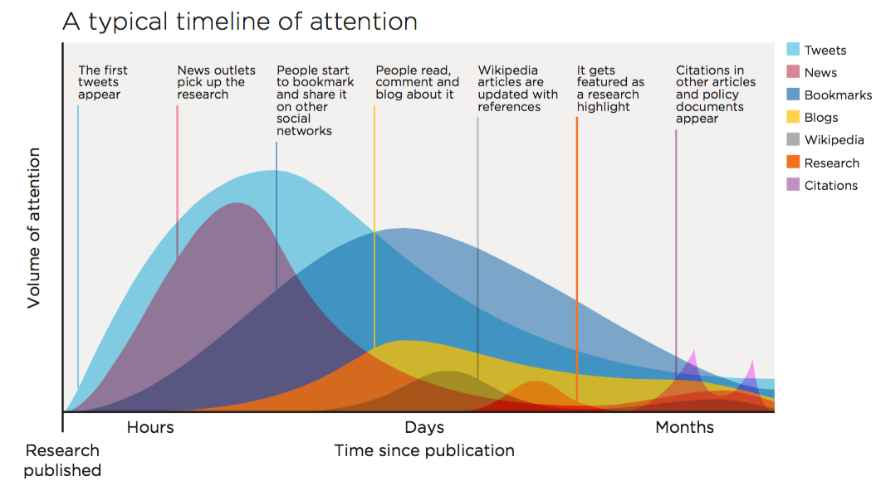

Slide 8
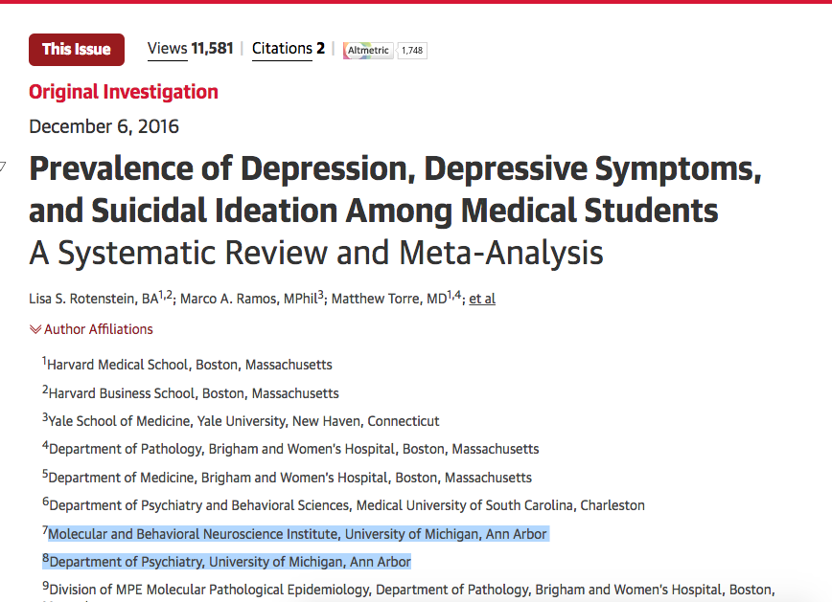
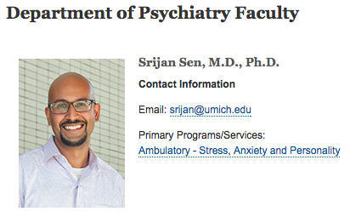
Known for our Altmetric Attention Score in thousands of academic journals, repositories, and websites
Data as of 26 Jan 2017, 6pm eastern
Notes:
Here discuss how altmetrics accrue immediate while traditional metrics can take months/years to advance

Slide 9
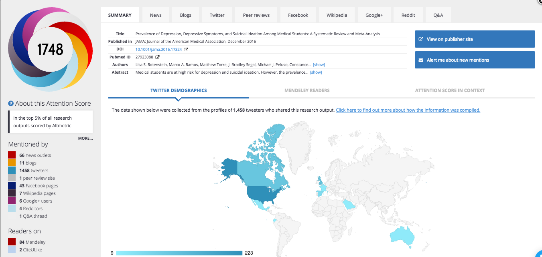
Known for our colorful donut and real time attention gathering (see tabs)
Data as of 26 Jan 2017, 6pm eastern

Slide 10
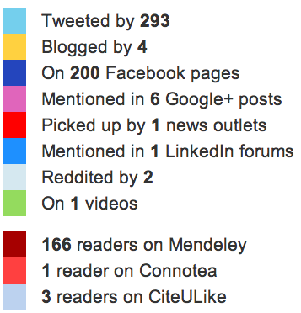


What is the donut? What does it indicate?
Mention type | Points
News | 8
Blogs | 5
Twitter | 1
Facebook | 0.25
Sina Weibo | 1
Wikipedia | 3
Policy Documents (per source) | 3
Q&A | 0.25
F1000/Publons/Pubpeer | 1
YouTube | 0.25
Reddit/Pinterest | 0.25
LinkedIn | 0.5
More info at: www.altmetric.com - About altmetrics – The donut and score; Algorithm and score are publicly available.

Slide 11
The Altmetric Attention Score is generated by a weighted algorithm
Volume | Sources | Authors
The score for an article rises as more people mention it. | Each source category contributes a different base amount to the final score. | Assess the author of each mention in terms of their reach, promiscuity and bias.
More info at: www.altmetric.com - About altmetrics – The donut and score; Algorithm and score are publicly available.

Slide 12
ATTENTION not quality indicator
Majority of articles receive no attention
Some fields/subjects are noisier than others
Most articles with attention score >15
Attention can be negative (sentiment analysis)
  Fraud, misconduct, unclear data, issues with methodology, etc
Notes:
Cancer research is more engaged with than analytical chemistry research
Research affecting the general public more than niche
Applied more than fundamental
Biomedical more than humanities

Slide 13
What about gaming?
Tough to do because
  Traps for crawlers/spam
  Data transparency means you can tell us when you see incorrect mentions captured
  Scholarly sites don’t allow spam (F1000, peer-review sites)
  (and if you can get the Washington Post to write about your work, is that gaming? Or doing your job?)

Slide 14
Altmetric data capture and transparency
Or: We already have your attention data

Slide 15
3 things required to capture attention
Research output
Persistent ID
Engagement in a platform we track (16)
Data set, article, clinical trial, etc
DOI, PMID, SSRN, NCCT etc
News, policy, social media, peer review sites etc

Slide 16
Research output - any part of the research lifecycle
Data sets
Clinical trial records
Peer reviewed journal articles
Books
Book chapters
Policy documents, guidelines, white papers
Presentations, blogs, anything web-native

Slide 17
Persistent IDs
DOIs
PubMed IDs
ISBNs
Handles
arXiv IDs
ADS IDs
SSRN IDs
RePEC IDs
ClinicalTrials.gov records
URLs
IDs facilitate disambiguation and the collection of accurate data
Altmetric is fully integrated with ORCID but ORCIDs remain the one of the least accurate IDs as they require manual curation by their owners.

Slide 18
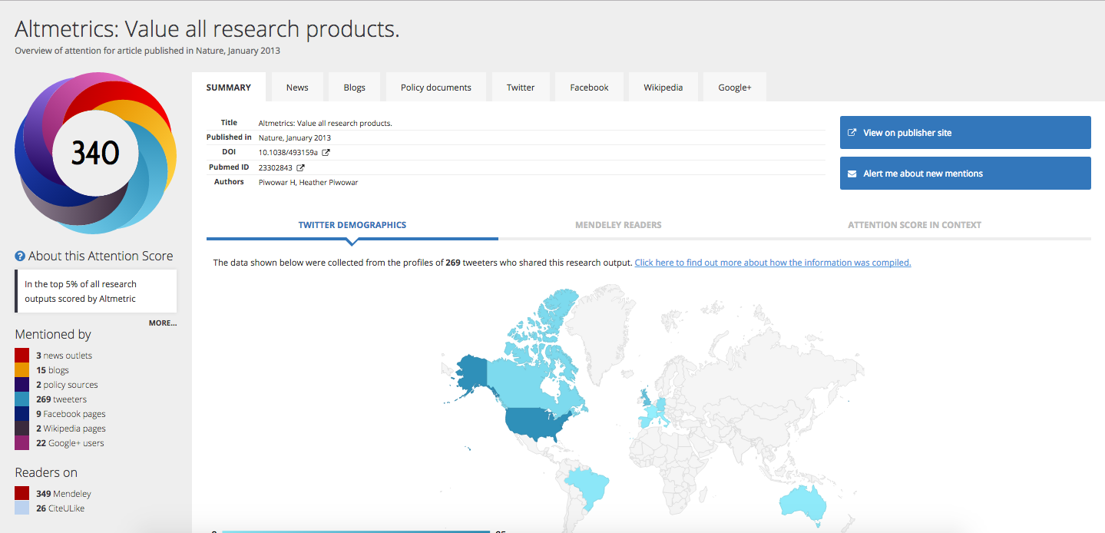
Reporting platforms
News media
Commentary platforms
Reddit
Social media
Facebook
Practitioner platforms
Policy docs
Twitter
Google+
Weibo
F1000
Publons
Pubpeer
Wikipedia
Q&A sites
YouTube
Syllabi - NEW
Academic/field blogs
LinkedIn
Pinterest
Platforms we track
These are the 16 source types (channels) Altmetric currently tracks.

Slide 19
How data capture works
Across thousands of domains
Looking for links
Finding ID
Generating details pages

Slide 20
How data capture works: Exceptions
News
  Looking for keywords (journal and author name), cross referencing with PubMed or CrossRef
Policy documents
  Scraping bibliographies
Syllabi
  Feed from Harvard Open Syllabus Project

Slide 21
So we are already capturing your data!
We just don’t know it’s yours
You need to feed us your data
So we can identify what’s yours
And group your research into authors/departments/funding areas/etc
Via:
  RIM/CRIS system - preferred
  Custom homegrown database - preferred
  .csv file updated quarterly
  Ask me for our Data Implementation Guide

