Slide 1
“Making decisions based on evidence requires the appropriate display of that evidence. Good displays of data help to reveal knowledge relevant to understanding mechanism, process and dynamics, cause and effect. That is, displays of statistical data should directly serve the analytical task at hand”
- Edward Tufte

Slide 2
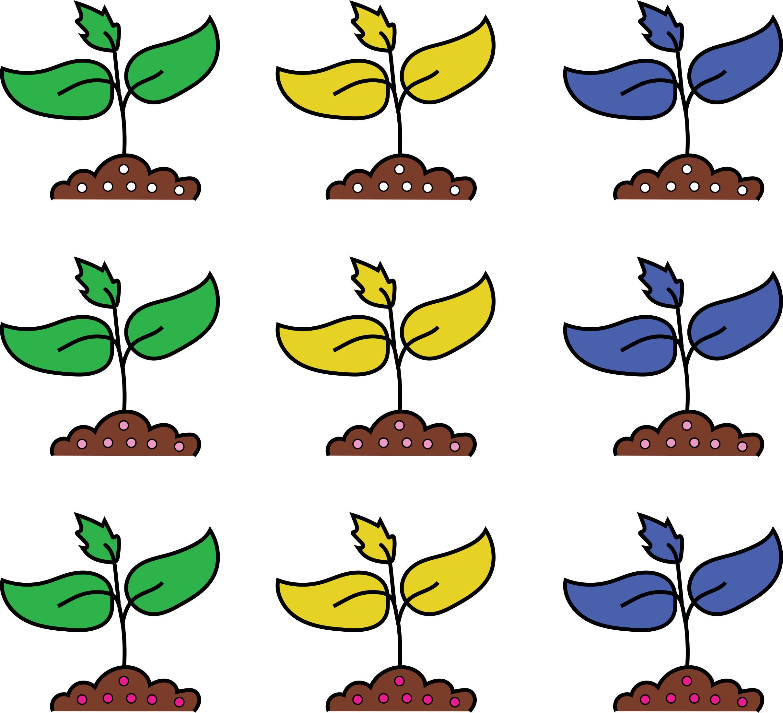
A “typical” experiment
?
Phenotype
Plant Size
@mmjulkowska

Slide 3
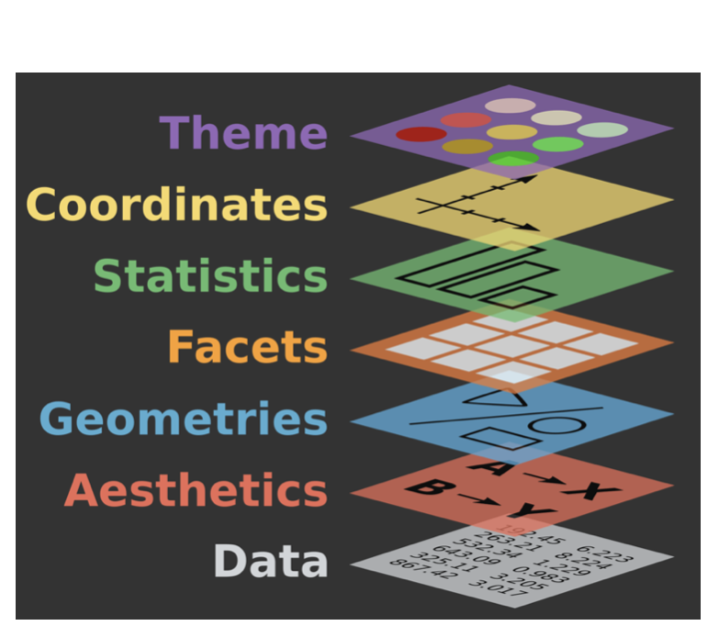
Grammar of graphics
“framework which follows a layered approach to describe and construct visualizations or graphics in a structured manner.”
Leland Wilkinson (1980) “The Grammar of Graphics”
https://www.springer.com/in/book/9780387245447
@mmjulkowska

Slide 4
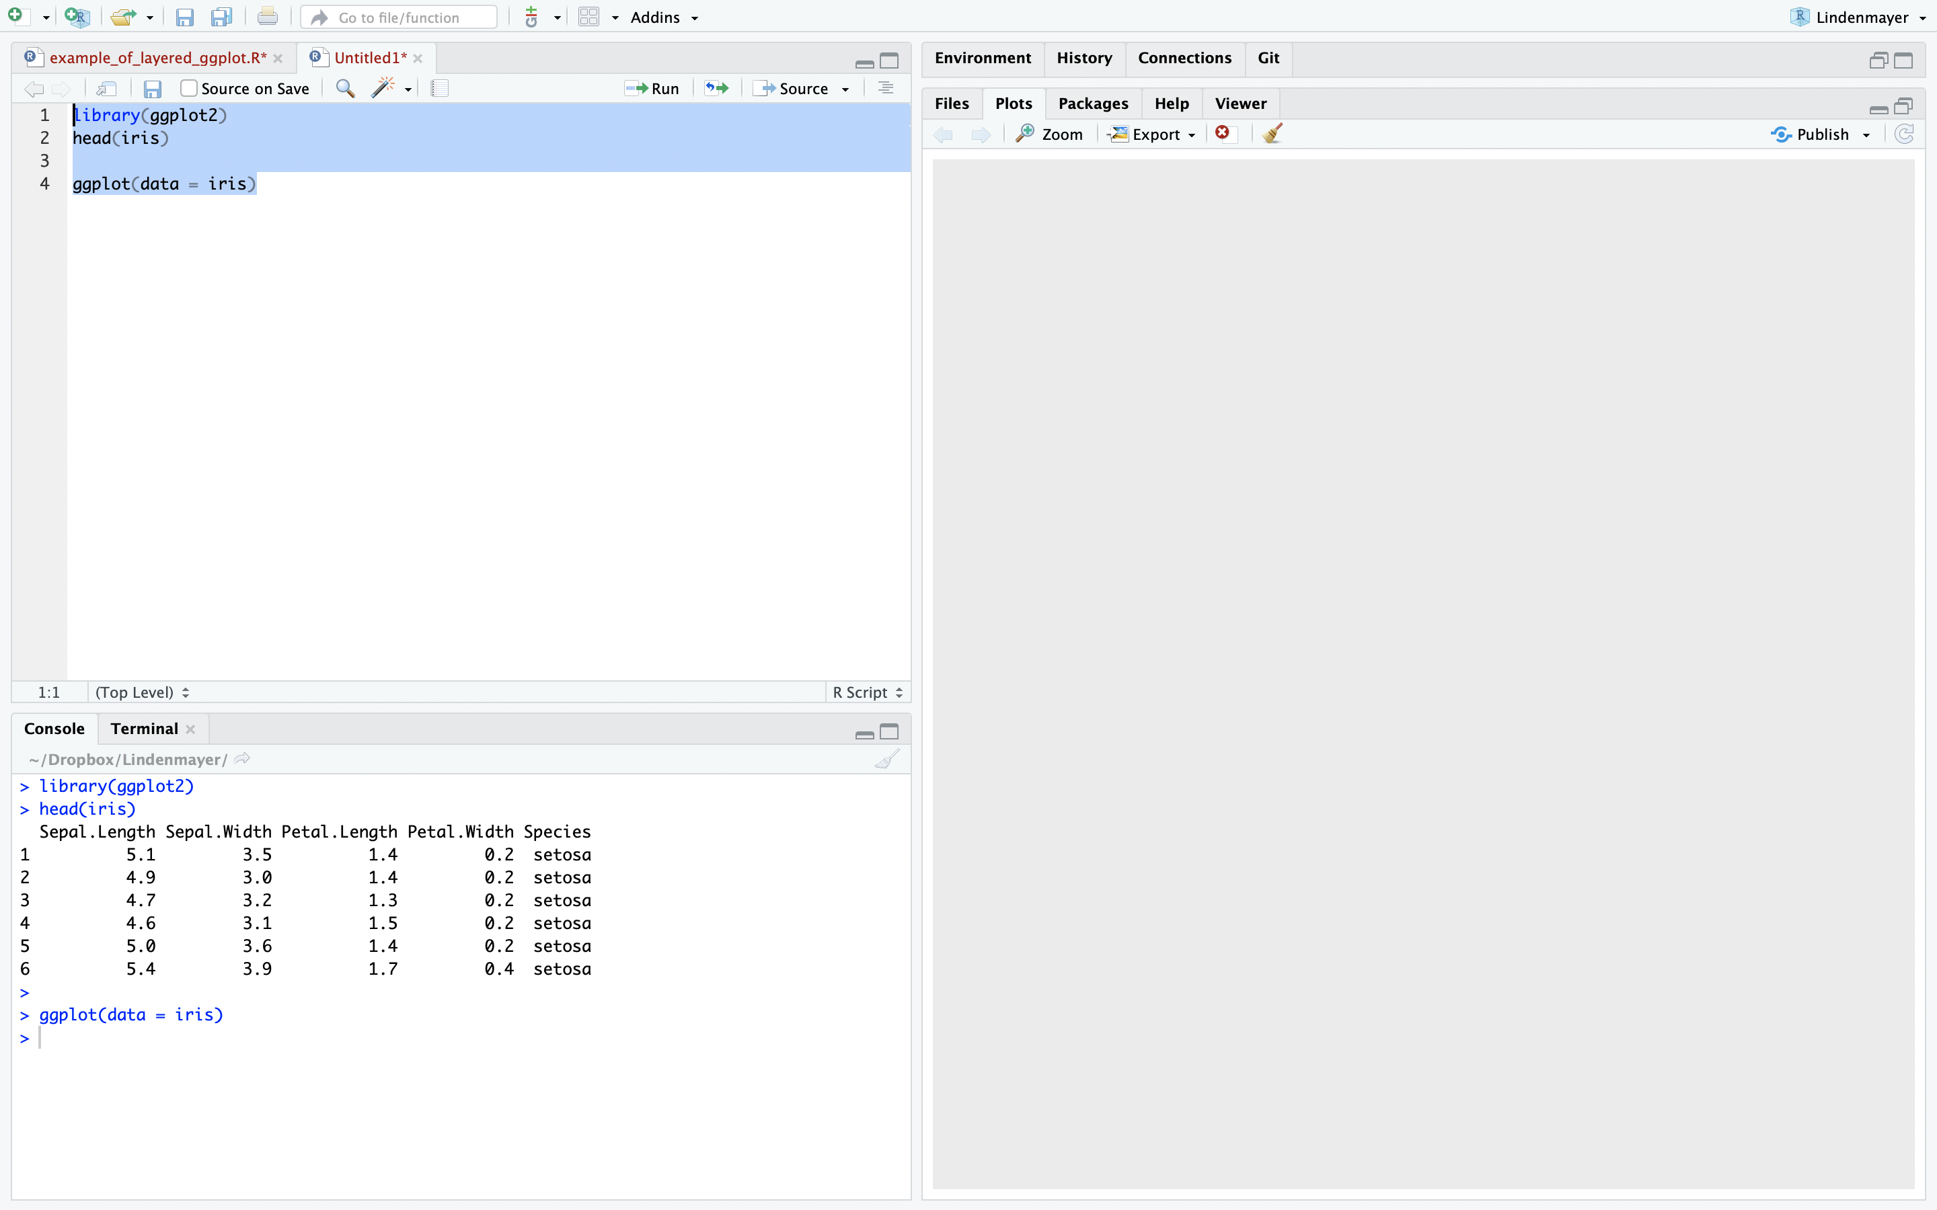
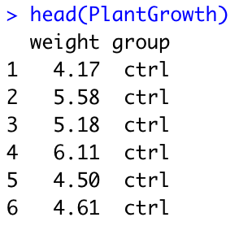
Grammar of Graphics using ggplot
# R-code:
library(ggplot2)
head(PlantGrowth)
my_plot <- ggplot(data = PlantGrowth)
my_plot
Inspired by Rladies ggplot2 flipbook https://evamaerey.github.io/ggplot_flipbook/ggplot_flipbook_xaringan.html#232
@mmjulkowska

Slide 5
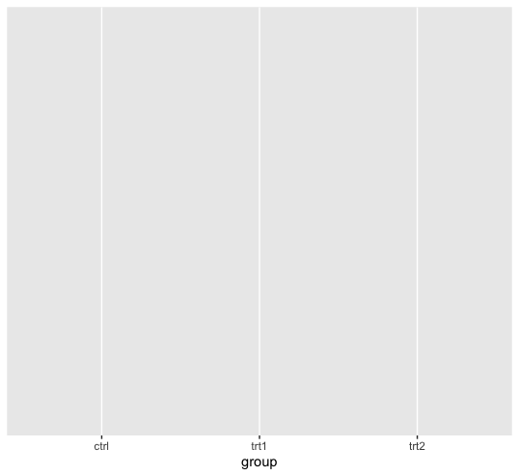
Grammar of Graphics using ggplot
# R-code:
library(ggplot2)
head(PlantGrowth)
my_plot <- ggplot(data = PlantGrowth, aes(x=group))
my_plot
Inspired by Rladies ggplot2 flipbook https://evamaerey.github.io/ggplot_flipbook/ggplot_flipbook_xaringan.html#232
@mmjulkowska

Slide 6
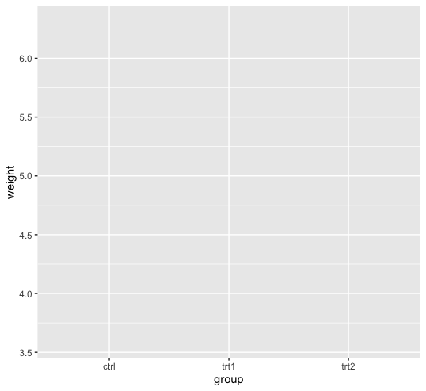
Grammar of Graphics using ggplot
# R-code:
library(ggplot2)
head(PlantGrowth)
my_plot <- ggplot(data = PlantGrowth, aes(x=group, y=weight))
my_plot
Inspired by Rladies ggplot2 flipbook https://evamaerey.github.io/ggplot_flipbook/ggplot_flipbook_xaringan.html#232
@mmjulkowska

Slide 7
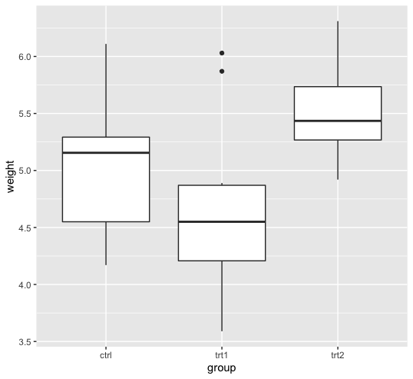
Grammar of Graphics using ggplot
# R-code:
library(ggplot2)
head(PlantGrowth)
my_plot <- ggplot(data = PlantGrowth, aes(x=group, y=weight))
my_plot <- my_plot + geom_boxplot()
my_plot
Inspired by Rladies ggplot2 flipbook https://evamaerey.github.io/ggplot_flipbook/ggplot_flipbook_xaringan.html#232
@mmjulkowska

Slide 8
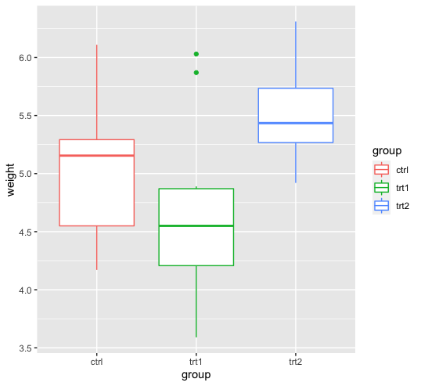
Grammar of Graphics using ggplot
# R-code:
library(ggplot2)
head(PlantGrowth)
my_plot <- ggplot(data = PlantGrowth, aes(x=group, y=weight))
my_plot <- my_plot + geom_boxplot()
my_plot <- my_plot + aes(col=group)
my_plot
Inspired by Rladies ggplot2 flipbook https://evamaerey.github.io/ggplot_flipbook/ggplot_flipbook_xaringan.html#232
@mmjulkowska

Slide 9
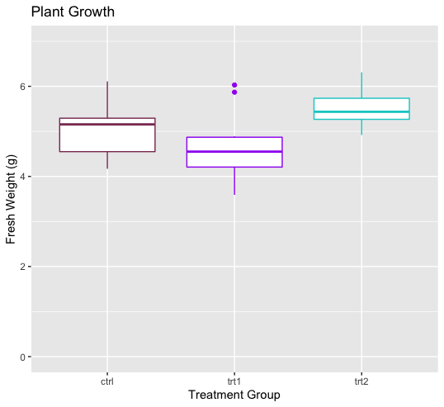
Grammar of Graphics using ggplot
# R-code:
library(ggplot2)
head(PlantGrowth)
my_plot <- ggplot(data = PlantGrowth, aes(x=group, y=weight))
my_plot <- my_plot + geom_boxplot()
my_plot <- my_plot + aes(col=group)
my_plot <- my_plot + scale_color_manual(values = c("hotpink4", "purple", "cyan3"))
my_plot <- my_plot + ylim(0,7) + labs(col="")
my_plot <- my_plot + labs(title="Plant Growth", x ="Treatment Group", y= "Fresh Weight (g)")
my_plot <- my_plot + theme(legend.position = "none")
my_plot
Inspired by Rladies ggplot2 flipbook https://evamaerey.github.io/ggplot_flipbook/ggplot_flipbook_xaringan.html#232
@mmjulkowska

Slide 10
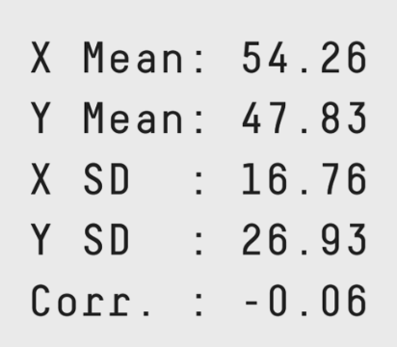
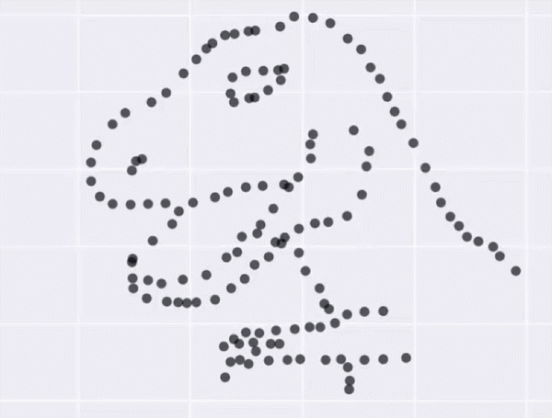
You can do better than a bar graph!
Same Stats, Different Graphs: Generating Datasets with Varied Appearance and Identical Statistics through Simulated Annealing
@mmjulkowska

Slide 11
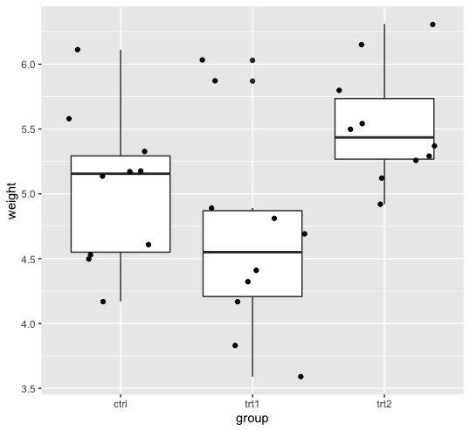
Grammar of Graphics using ggplot
# R-code:
library(ggplot2)
library(ggbeeswarm)
library(RColorBrewer)
library(ggridges)
library(gapminder)
my_plot <- ggplot(data = PlantGrowth, aes(x=group, y=weight))
my_plot <- my_plot + geom_boxplot()
my_plot <- my_plot + geom_jitter()
my_plot
Inspired by Rladies ggplot2 flipbook https://evamaerey.github.io/ggplot_flipbook/ggplot_flipbook_xaringan.html#232
@mmjulkowska

Slide 12
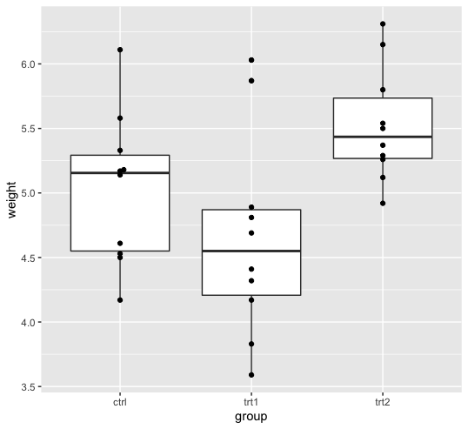
Grammar of Graphics using ggplot
# R-code:
library(ggplot2)
library(ggbeeswarm)
library(RColorBrewer)
library(ggridges)
library(gapminder)
my_plot <- ggplot(data = PlantGrowth, aes(x=group, y=weight))
my_plot <- my_plot + geom_boxplot()
my_plot <- my_plot + geom_beeswarm()
my_plot
Inspired by Rladies ggplot2 flipbook https://evamaerey.github.io/ggplot_flipbook/ggplot_flipbook_xaringan.html#232
@mmjulkowska

Slide 13
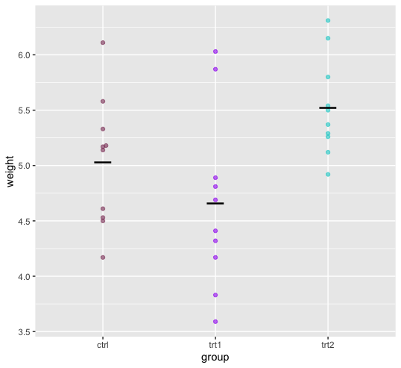
Grammar of Graphics using ggplot
# R-code:
library(ggplot2)
library(ggbeeswarm)
library(RColorBrewer)
library(ggridges)
library(gapminder)
my_plot <- ggplot(data = PlantGrowth, aes(x=group, y=weight, col=group))
my_plot <- my_plot + geom_beeswarm(alpha=0.6)
my_plot <- my_plot + scale_color_manual(values = c("hotpink4", "purple", "cyan3"))
my_plot <- my_plot + stat_summary(fun.y=mean, geom="point", shape=95, size=10,
color="black", fill="black")
my_plot <- my_plot + theme(legend.position = "none")
my_plot
Inspired by Rladies ggplot2 flipbook https://evamaerey.github.io/ggplot_flipbook/ggplot_flipbook_xaringan.html#232
@mmjulkowska

Slide 14
@mmjulkowska

Slide 15
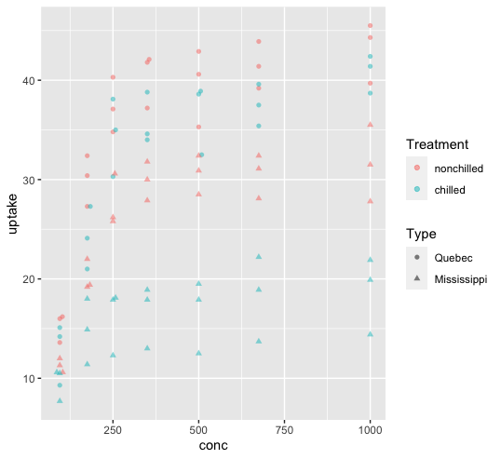
Do NOT rely on shape of the datapoints
# R-code:
library(ggplot2)
library(ggbeeswarm)
library(RColorBrewer)
library(ggridges)
library(gapminder)
my_plot <- ggplot(data = CO2, aes(x=conc, y=uptake, col=Treatment, shape=Type))
my_plot <- my_plot + geom_beeswarm(alpha=0.5)
my_plot
Inspired by Rladies ggplot2 flipbook https://evamaerey.github.io/ggplot_flipbook/ggplot_flipbook_xaringan.html#232
@mmjulkowska

Slide 16
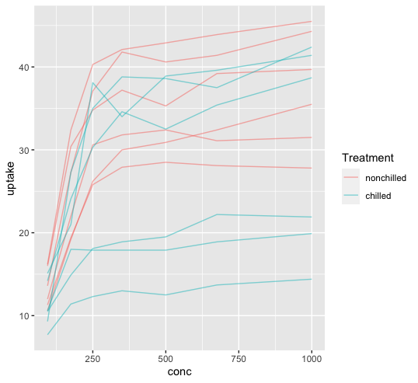
Right type of graph will reveal trends in your data
# R-code:
library(ggplot2)
library(ggbeeswarm)
library(RColorBrewer)
library(ggridges)
library(gapminder)
my_plot <- ggplot(data = CO2, aes(x=conc, y=uptake, col=Treatment, id=Plant))
my_plot <- my_plot + geom_line(alpha=0.5)
my_plot
Inspired by Rladies ggplot2 flipbook https://evamaerey.github.io/ggplot_flipbook/ggplot_flipbook_xaringan.html#232
@mmjulkowska

Slide 17
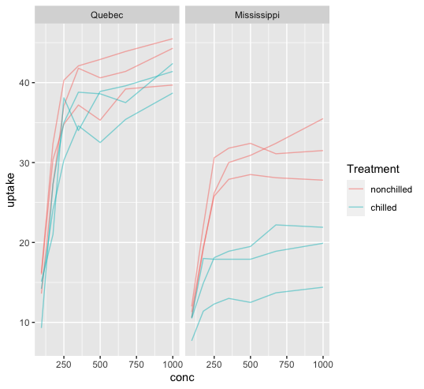
Facet your graphs to make meaningful comparisons
# R-code:
library(ggplot2)
library(ggbeeswarm)
library(RColorBrewer)
library(ggridges)
library(gapminder)
my_plot <- ggplot(data = CO2, aes(x=conc, y=uptake, col=Treatment, id=Plant))
my_plot <- my_plot + geom_line(alpha=0.5)
my_plot <- my_plot + facet_grid( ~ Type)
my_plot
Inspired by Rladies ggplot2 flipbook https://evamaerey.github.io/ggplot_flipbook/ggplot_flipbook_xaringan.html#232
@mmjulkowska

Slide 18
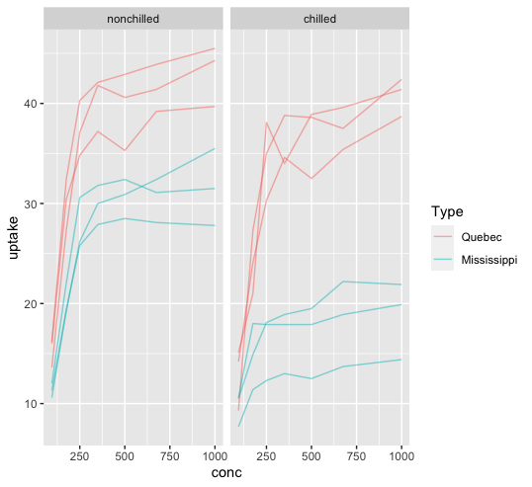
Facet your graphs to make meaningful comparisons
# R-code:
library(ggplot2)
library(ggbeeswarm)
library(RColorBrewer)
library(ggridges)
library(gapminder)
my_plot <- ggplot(data = CO2, aes(x=conc, y=uptake, col=Type, id=Plant))
my_plot <- my_plot + geom_line(alpha=0.5)
my_plot <- my_plot + facet_grid( ~ Treatment)
my_plot
Inspired by Rladies ggplot2 flipbook https://evamaerey.github.io/ggplot_flipbook/ggplot_flipbook_xaringan.html#232
@mmjulkowska

Slide 19
Useful resources
Short papers:
  Rolandi et al 2011. A Brief Guide to Designing Effective Figures for the Scientific Paper. Advanced Materials 23
  Rougier et al 2014. Ten Simple Rules for Better Figures. Plos Computational Biology 10:9
  Weissgerber et al., 2019. Reveal don’t conceal: Transforming Data Visualization to Improve Transparency. Circulation 140:18
Design for scientists/ data:
  Carter. 2013. Designing science presentations – not just for figures, very clear
  Munzner. 2014. Visualization, analysis and design from a computer-graphics perspective
  Tufte. 2001. The visual display of quantitative information – from a theory-of-design perspective
  Meirelles. 2013. Design for information – advanced information visualizations (maps, time-space, flows)
Graphic design more generally:
  Krause. 2004. Design basics index – very concise and to the point
  Samara. 2014. Design elements: a graphic design manual – reference book
  Nature Points of View: http://blogs.nature.com/methagora/2013/07/data-visualization-points-of-view.html
Plantae seminar on Data Visualization:
https://community.plantae.org/article/5255167006813979855/data-visualization-optimizing-data-exploration-and-illustrative-storytelling-magdalena-julkowska
@mmjulkowska

