Slide 1
A Short Introduction to Data Management Plans
Sebastian Karcher, QDR
July 14, 2020

Slide 2
Definitions
Research data management is caring for, facilitating access to, preserving and adding value to research data throughout its lifecycle.
Source: University of Edinburgh Information Services
A data management plan (DMP) helps researchers consider during the research design and planning stage, how the data will be managed during the research process itself and potentially shared afterwards with the wider research community.
Notes:
Researchers must develop, enhance and professionalize their research data management skills to meet these challenges.

Slide 3
Why Manage Research Data Well?
Your data creation is likely to be expensive
Your data underpin your published findings
Protect your data from loss, destruction
Compliance with ethical codes, data protection laws, journal requirements, funder policies
To benefit your future self
Notes:
A variety of mutually reinforcing benefits for the individual conducting the research, any participants involved, the quality of the final product and the general contribution to knowledge

Slide 4
Data Management Plans: A Very Short History
Originated in 1960s and 1970s for complex engineering projects, especially aerospace
In early 2000s, renewed interest to accommodate growth of digital data
Mandated for all funding bodies in UK since mid-2000s
In US, mandated by NSF since 2011; focus on data sharing
Mandated for EU funding as part of Horizon 2020

Slide 5
What’s in a DMP?
What data will be collected and how
How data will be organized
What documentation will be created
How data will be stored and protected during the research
How data will be stored and protected after project completion
What data will be shared, when, and how
Detailed checklist: https://qdr.syr.edu/guidance/managing/dmp-checklist

Slide 6
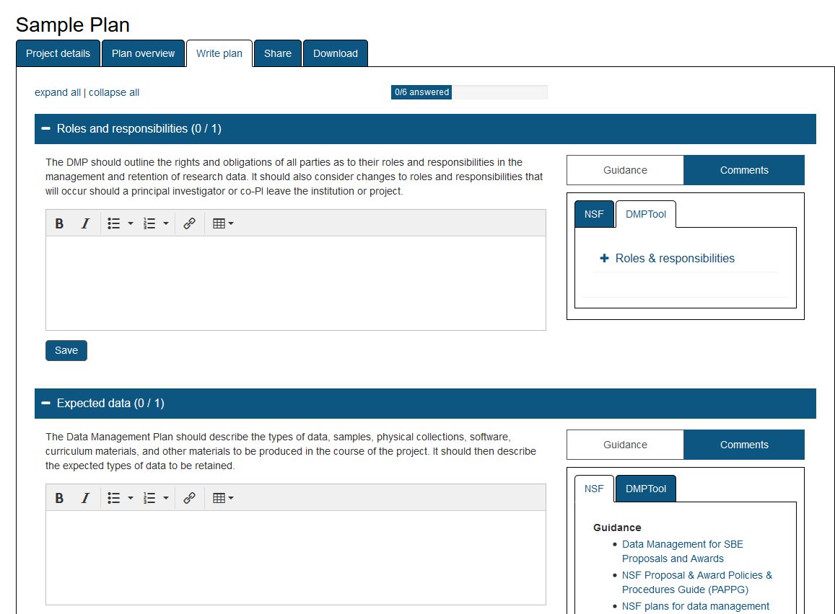
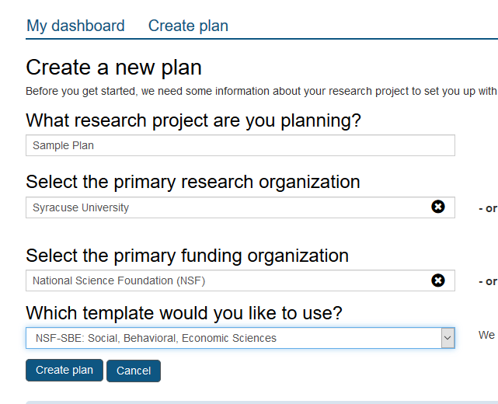
There’s an App for That
DMP Tool: https://dmptool.org (US) DMP Online: https://dmponline.dcc.ac.uk/ (UK)

Slide 7
DMP vs. IRB/Ethics Review Board
IRB/ERB: Required based on federal regulations
DMP: Required by many funders
Both require you to document data collection and sharing procedures
Critical to ensure DMP and IRB/ERB application align
Notes:
Researchers must develop, enhance and professionalize their research data management skills to meet these challenges.

Slide 8
Consult with…
Ethics Board / IRB (ethics, data security)
Local IT Department (secure storage, university rules)
Partner Organization (local rules, expectations for data handling & sharing)
Data Repository (DMP advice, data sharing, costing)

Slide 9
DMP: Consider Your Audiences
Your funder
Main interest: funding impact, data sharing
Grant reviewers
Main interest: your proposal, does the DMP support your proposal
Your team
Co-authors, student workers, translators, transcribers, committee members
Main interest: data collection, does DMP help convey principles to team members
Your future self
Main interest: does DMP help remind you of/prepare you for key decisions

Slide 10
Stay in Touch
qdr@syr.edu
Twitter: @qdrepository
Blog: https://qdr.syr.edu/qdr-blog
Available for curation consultation for DMPs involving qualitative data

