Slide 1
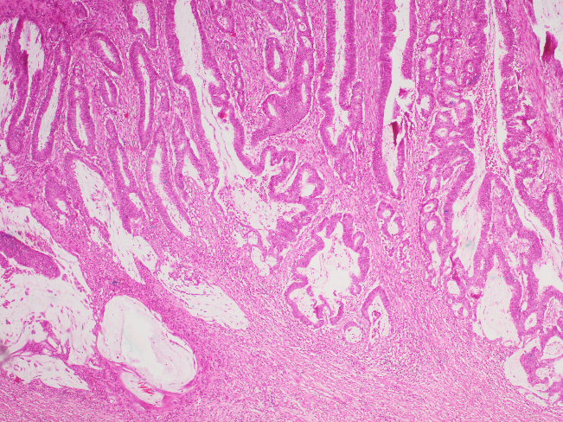
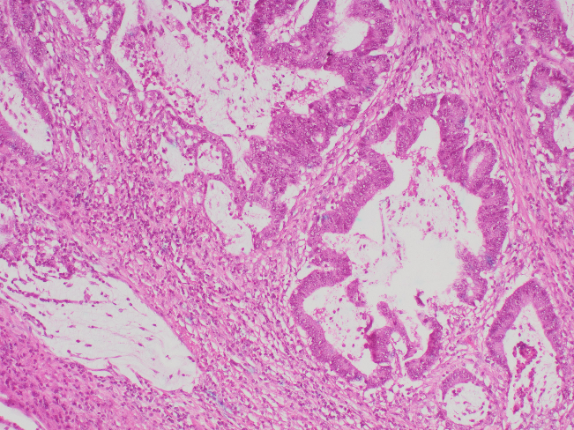
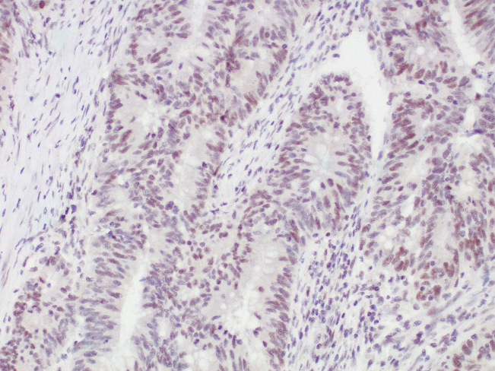
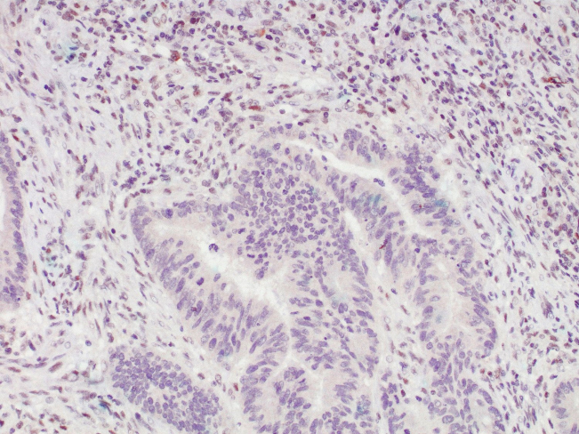
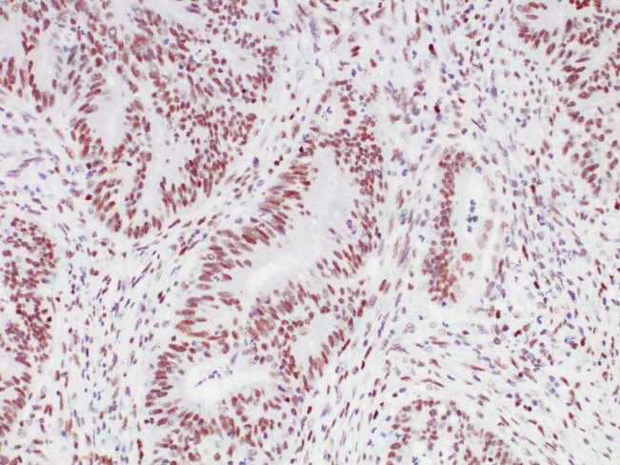
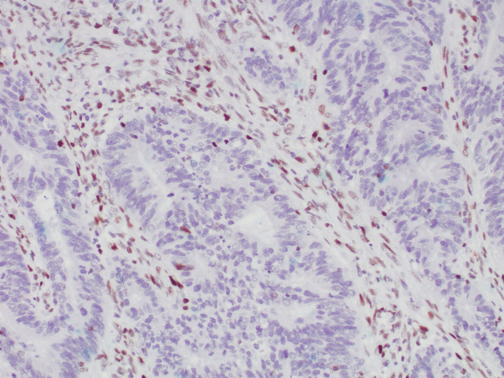
a
b
c
d
e
f
Primary tumour in patient 2. a-b Hematoxylin-eosin. c MLH1 positive staining. d PMS2 negative staining. e MSH2 positive staining. f MSH6 negative staining.

