Slide 1
The MultiCellular Data Standard – Digital Cell Lines
FNLCR – DCC Portal Integration

Slide 2
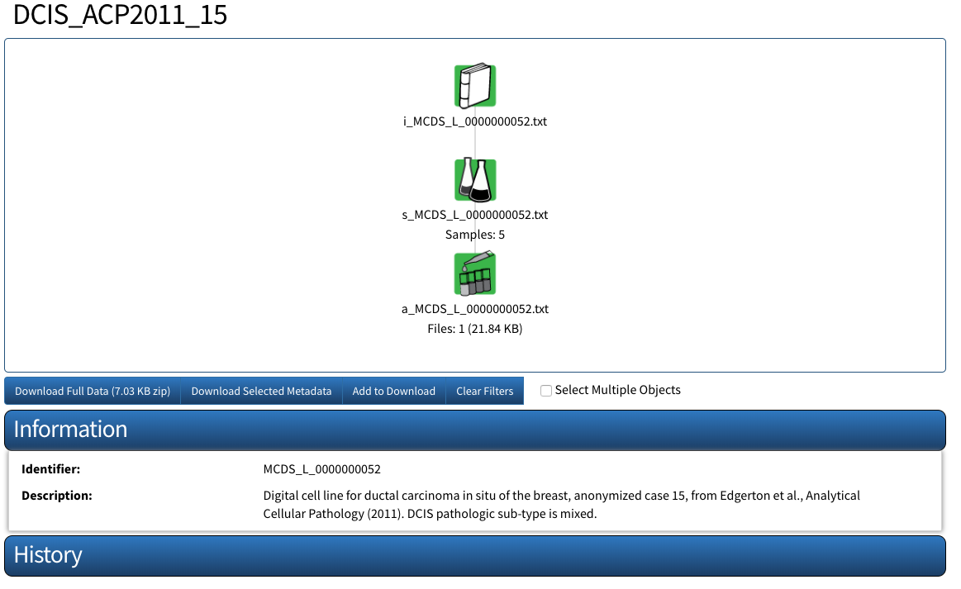
Sample Demonstration - MCDS_L_0000000052.xml
https://fr-s-bsg-cssi-d.ncifcrf.gov/cssiportal/view/5ae779fa34b81e35805ece27/

Slide 3
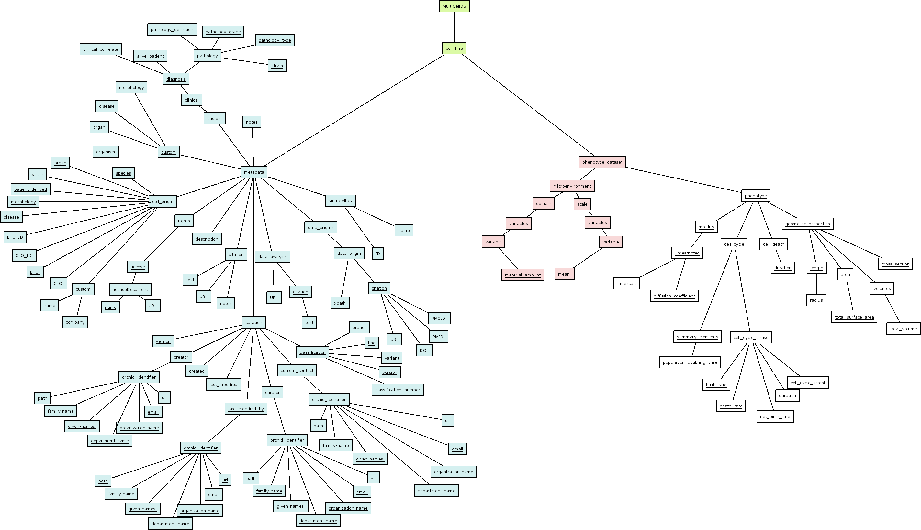

Slide 4
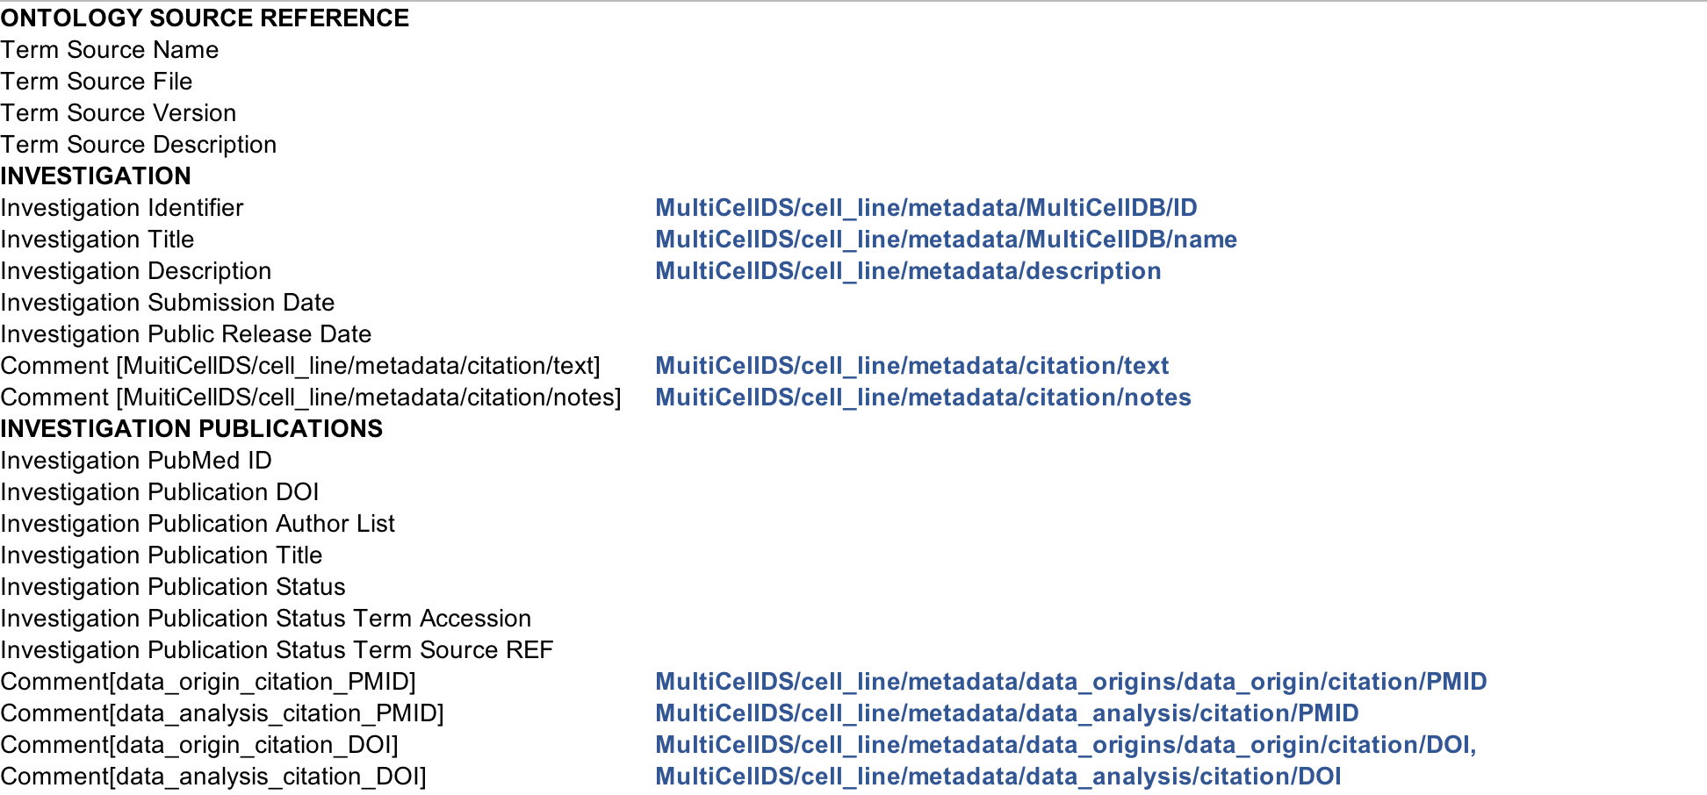
i_file, ISA-TAB – MultiCellDS XML map

Slide 5
i_file, ISA-TAB – MultiCellDS XML map continued

Slide 6
i_file, ISA-TAB – MultiCellDS XML map continued

Slide 7
i_file, ISA-TAB – MultiCellDS XML map continued

Slide 8
i_file, ISA-TAB – MultiCellDS XML map continued

Slide 9
s_file, ISA-TAB – MultiCellDS XML map

Slide 10
a_file, ISA-TAB – MultiCellDS XML map

