Slide 1
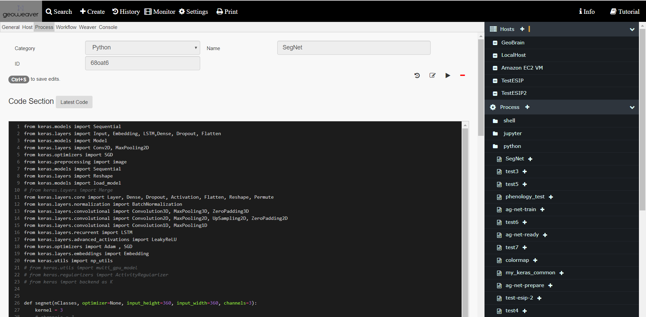
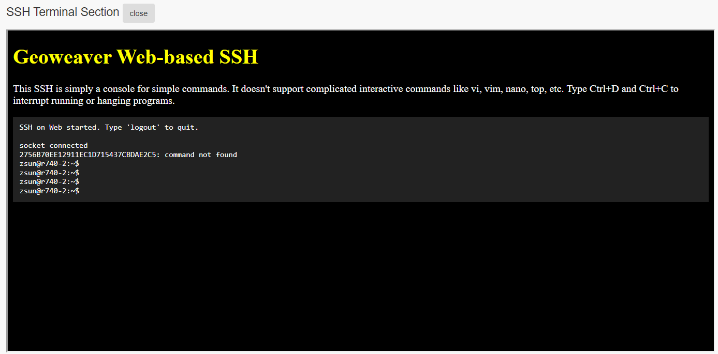
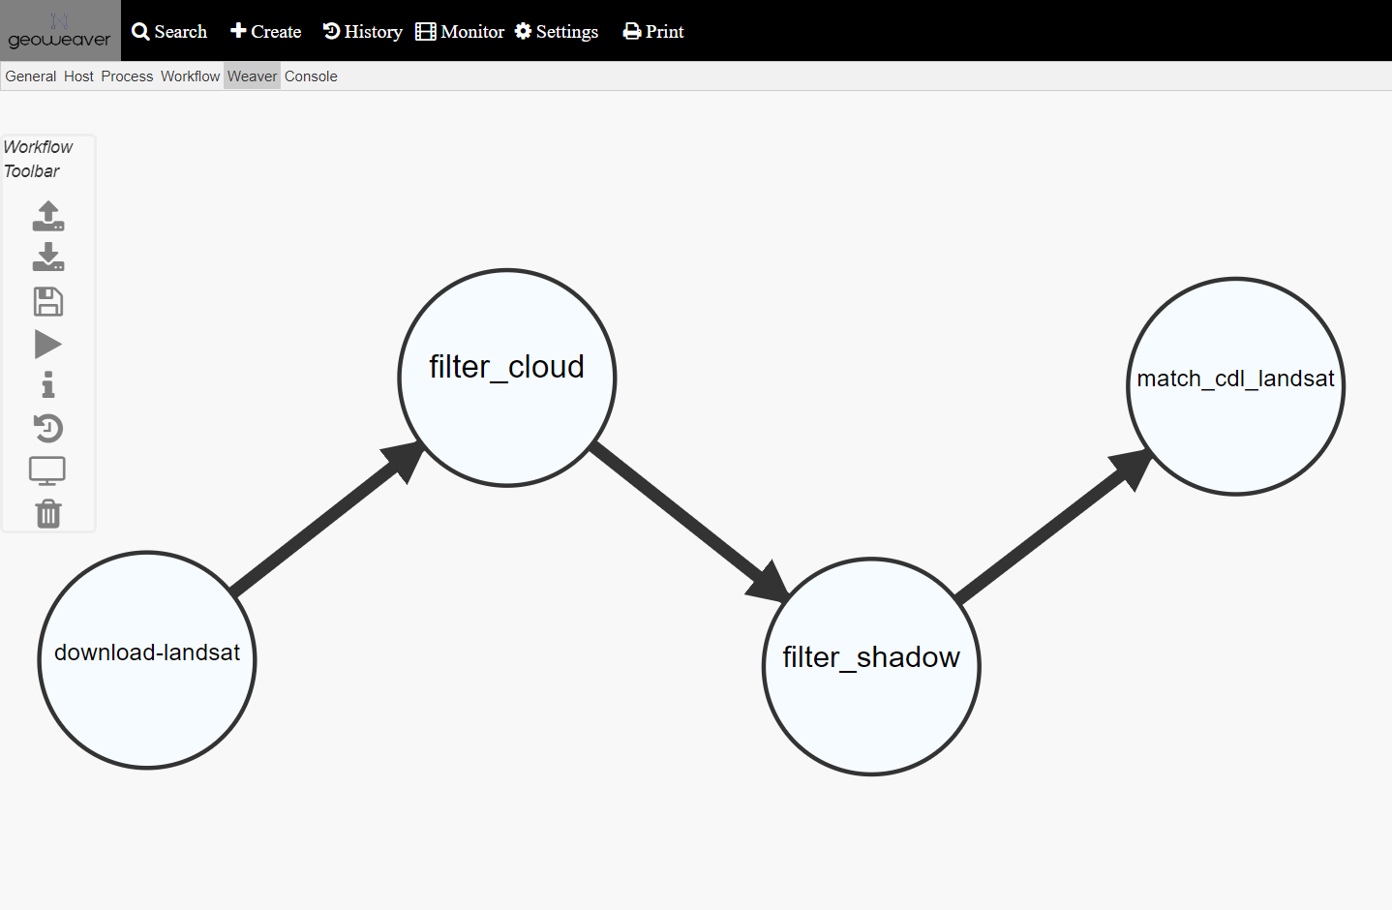
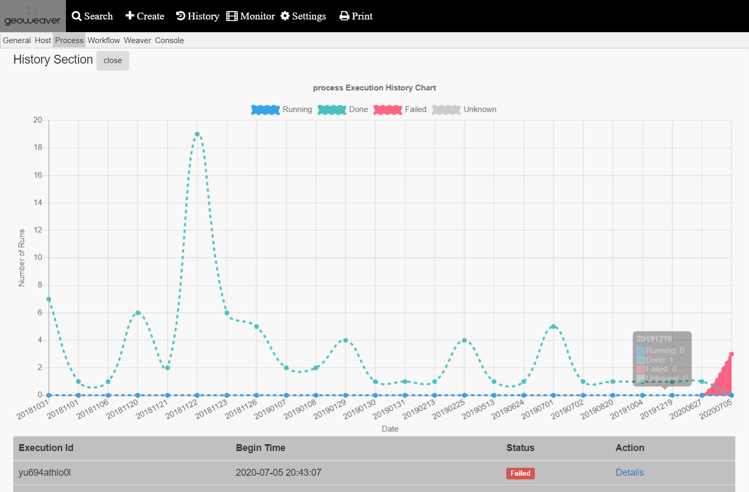
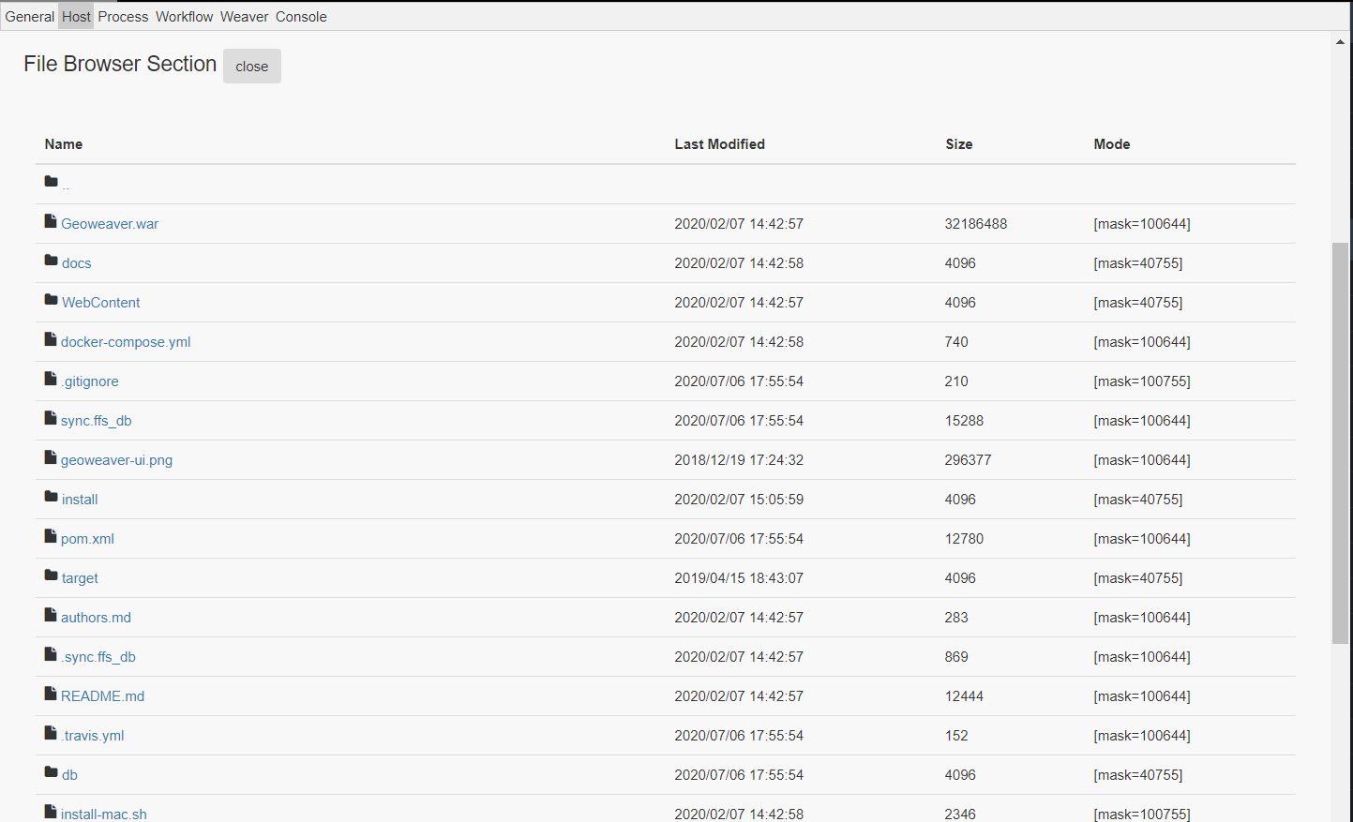
Geoweaver: Cloud-Oriented Hybrid Workflow Management
Ziheng Sun¹, Liping Di¹, Annie Burgess²
1 Center for Spatial Information Science and Systems, George Mason University; 2 ESIP
Introduction
Geoweaver is a web system allowing users to easily compose and execute full-stack hybrid workflows distributed on multiple platforms, including cloud virtual machines, university machines, and personal machines.
Initiative
Too much headache in managing our hybrid workflow
Too much time spent on preprocessing postprocessing
Too much confusion in version control of neural network result
Too many libraries, software, and incompatible issues
Goal
turning large-scale distributed experiments into manageable modernized workflows;
boosting higher utilization ratio of the existing online facilities by separating scientists from tedious technical details;
enhancing the frequency and accuracy of classified land cover land use maps for agricultural purposes;
enabling the tracking of provenance by recording the logs in structured tables to evaluate the quality of the result maps;
explore the feasibility of operationally using large-scale distributed deep learning neural network in classifying remote sensing image time series into value-added products.
Software Release
Geoweaver is an open source project on Github.
http://github.com/ESIPFed/Geoweaver
Tutorials are available for downloading and installing Geoweaver on your own machines. Users can install via Docker, Tomcat or VM template.
This work is funded by ESIPLab.
Contact: Dr. Ziheng Sun (zsun@gmu.edu)
Dr. Liping Di (ldi@gmu.edu)
3 Aug 2016

