Slide 1
Combined Optical Raytrace and Monte-Carlo Simulation of Complex Biological Imaging
Guillem Carles and Andrew R. Harvey
School of Physics and Astronomy
University of Glasgow

Slide 2
Outline
Motivation: modelling of biological imaging
Modelling of Scanning Laser Ophthalmoscope
Simulation of image formation
Confocality
Oximetry
Modelling of Light-Sheet Microscopy
Diffraction and weak scattering
Fluorescence
Conclusions

Slide 3
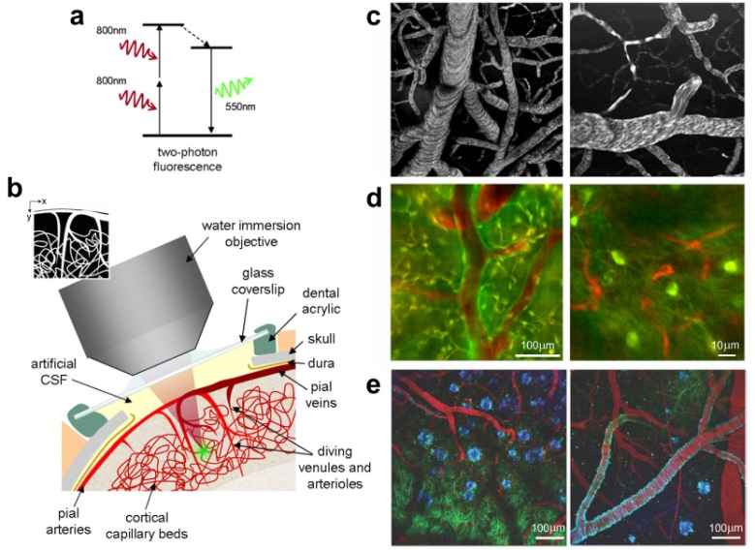
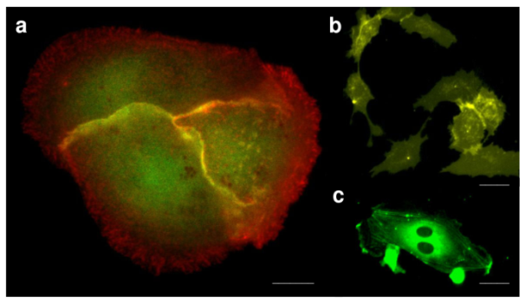
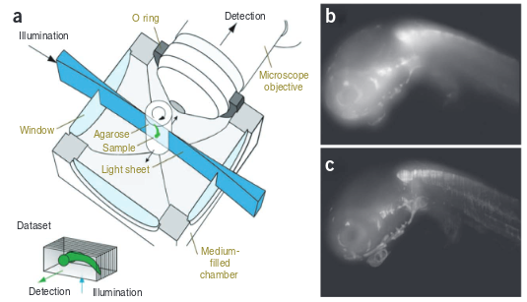
Motivation
Biological and Biomedical imaging are extremely active scientific fields that rely on light propagation in turbid media, in particular biological tissue.
Fluorescence [Kerlopian 2008]
SPIM Microscopy [Ntziachristos 2010]
Multi-photon microscopy [Kerlopian 2008]

Slide 4
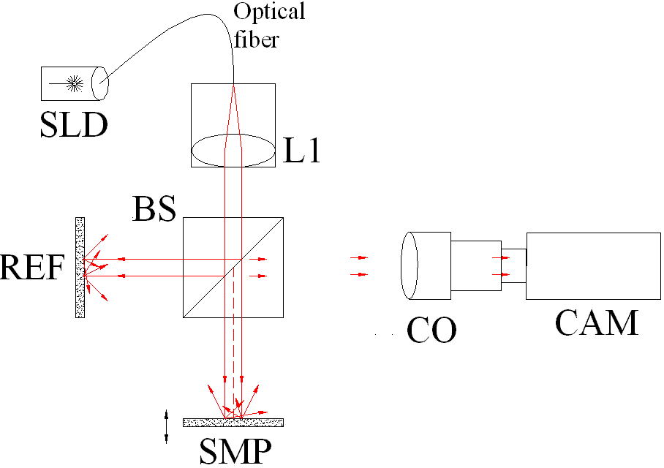
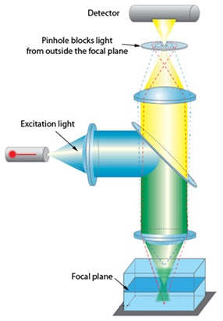
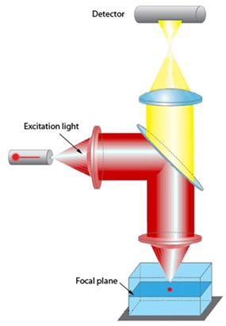
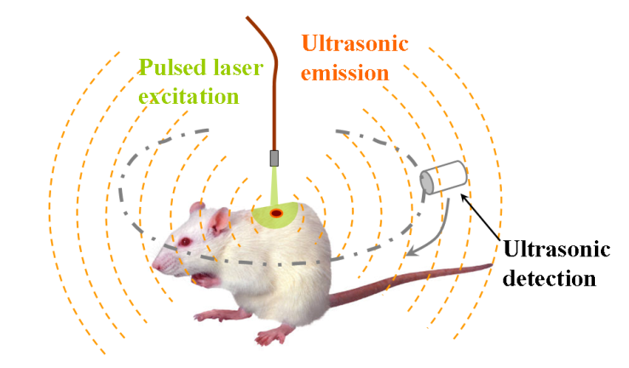
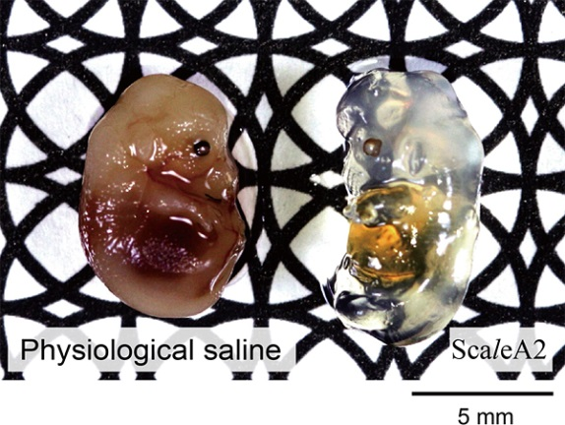
Motivation
Scattering of light prevents high-contrast deep-tissue imaging. Range of techniques to circumvent this
[Wikipedia]
[Duke.edu]
[Duke.edu]
[Wikipedia]
Development requires accurate simulation of the system
1: Light diffusion (sample)
2: Optical performance (instrument)
[Nat Neuroscience 2001]

Slide 5
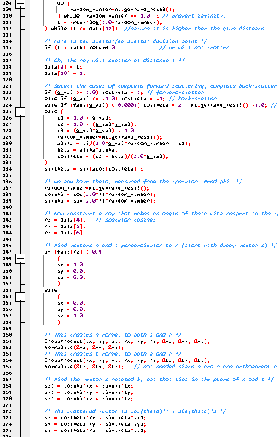
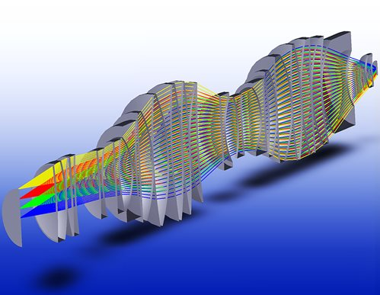
Motivation
1: Light diffusion within turbid media
Monte-Carlo is the gold standard technique
Underpins simulation in biological imaging
Arbitrary system complexity (in principle)
But, not friendly to the non-expert
2: Optical performance of instrument
Optical ray-trace software
Powerful and user friendly
Zemax-OpticStudio
OSLO
Code V
…

Slide 6
Motivation
Two components treated in isolation
Light diffusion in the sample
Performance of the instrument
Light is not propagated from source to detector
Rigorous modelling of all components
Polarisation, fluorescence, coherence, etc.
Connection?
Interaction!

Slide 7
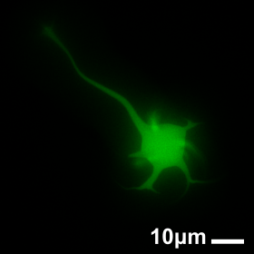
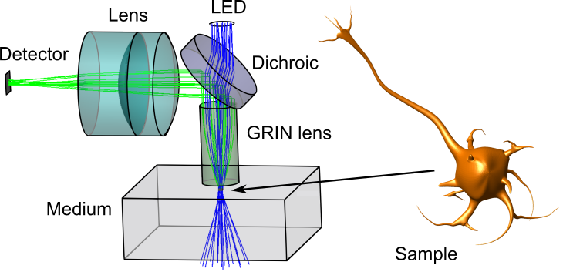
Motivation
The physical principles of optical ray-trace and Monte-Carlo simulation are the same
Holistic modelling: their integration to simulate the complete imaging process (instrument and sample)
For example:
Notes:
(rigorous optical prescriptions, complexity, scattering fluorescence, polarisation)
Aberrations, scattering, chromaticity, etc

Slide 8
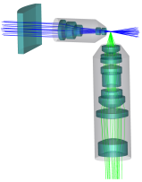
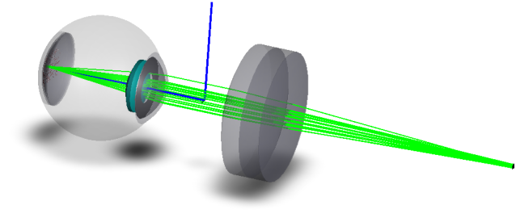
Motivation
Report two examples:
Scanning Laser Ophthalmoscope
Light-Sheet Microscope

Slide 9
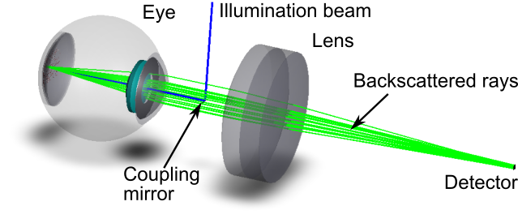
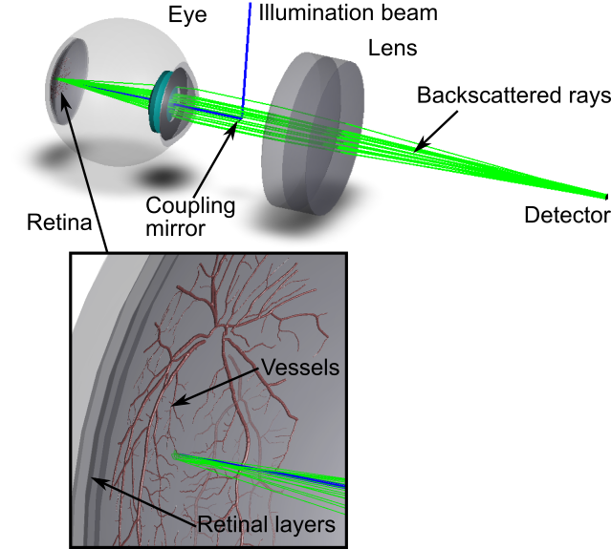
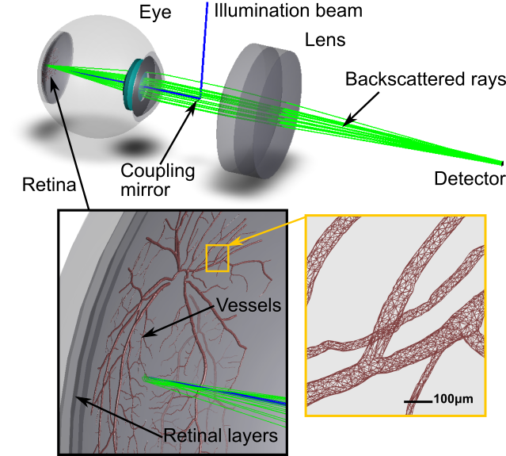
Modelling of SLO

Slide 10
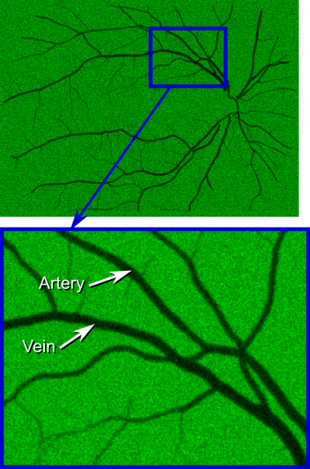
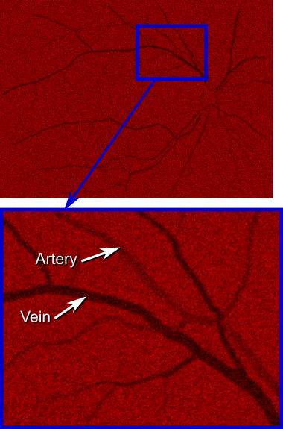
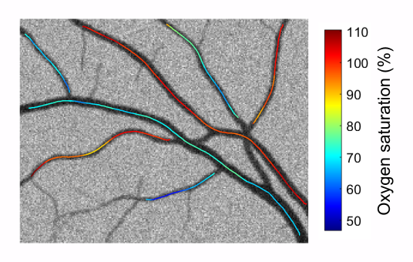
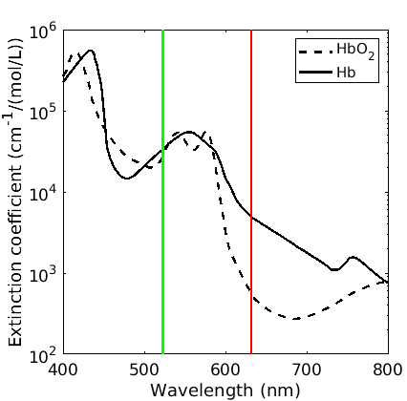
Modelling of SLO: oximetry
λ=532nm
λ=633nm

Slide 11
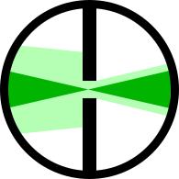
Modelling of SLO: confocality
Pinhole
retina
Double pass
Less confocal
Single pass
Confocality increases contrast but reduces SNR
More confocal

Slide 12
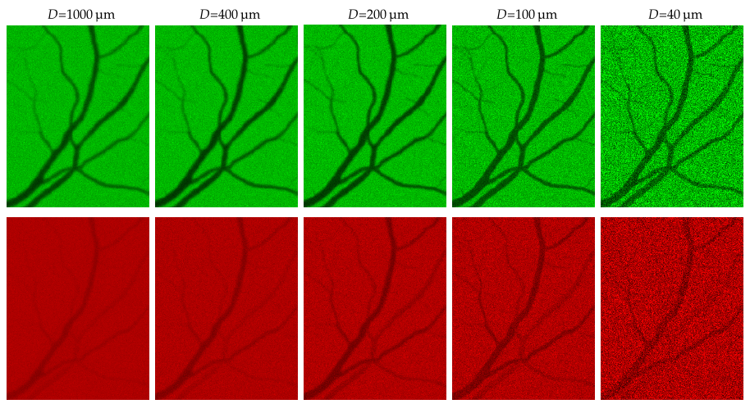
Modelling of SLO: confocality
Confocality increases contrast but reduces SNR

Slide 13
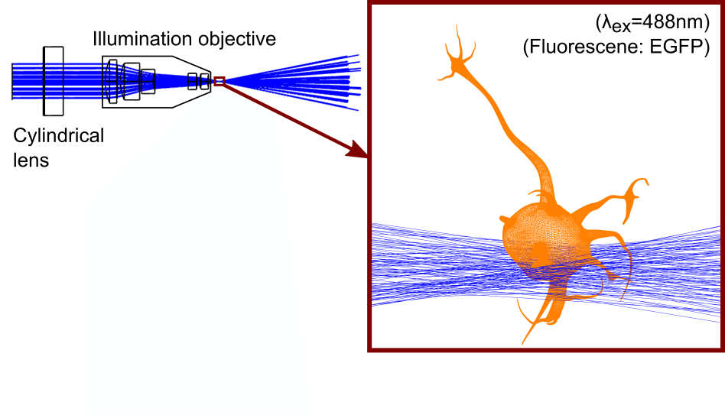
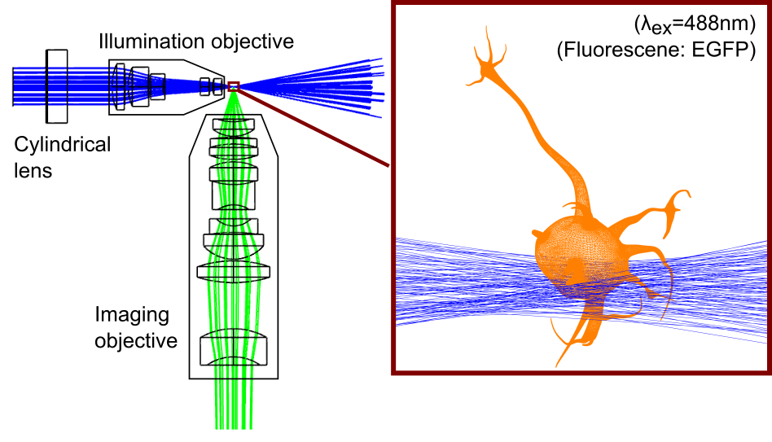
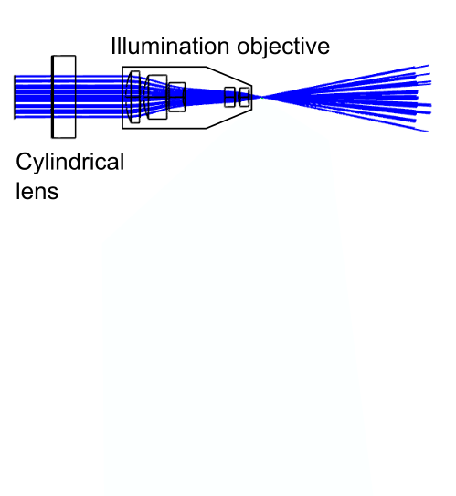
Modelling LSFM
Aims, to model:
Realistic optics
Diffraction
Scattering
Fluorescence
DLL: calculate Angular Spectrum

Slide 14
Conclusions
Reported usage of commercial optical raytracing to perform Monte-Carlo simulation of photon transport
Enables optically-complete simulations of systems
Complex geometries (through GUI)
Couple sample/medium and instrument
Benefits
Construction of rigorous forward-imaging models for inversion
Investigation of complex setups (rapid virtual prototyping)
Optimisation of complex systems
Development/assessment of new computational techniques
Generation of ground-truth data for training of data-starved algorithms

Slide 15
Conclusions
Reported examples that illustrate the potential of this approach
Software plugins for rapid and user-friendly virtual prototyping:
Polarisation-sensitive Mie scattering DLL, with fluorescence
Angular Spectrum calculator DLL, enables beam diffraction
Source from database DLL, enables generation of fluorescence
Software available:
https://github.com/gcarles
Guillem.CarlesSantacana@glasgow.ac.uk

Slide 16
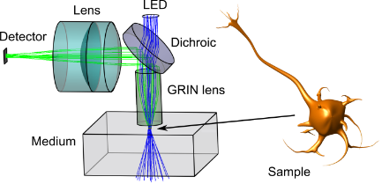
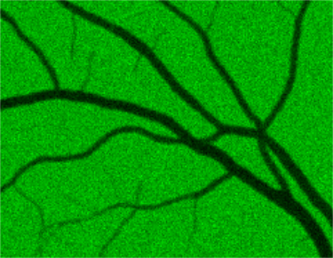
Thanks for your attention Guillem.CarlesSantacana@glasgow.ac.uk
Postdoc and PhD positions available in Glasgow in computational microscopy and computational imaging:
contact andy.harvey@glasgow.ac.uk

Slide 17
Monte Carlo modelling of scattering
Macroscopically; beam extinction due to
Absorption
Scattering
Scattered light
Turbid media
Incoming beam
Output Beam
I₀
I₀
exp(-μ_{a}z)
exp(-μ_{s}z)
Fluorescence

Slide 18
Monte Carlo modelling of scattering
One scattering event
ray
Decide new direction of propagation
(probability defined by the Phase Function)
…and decide new propagation distance again.
Decide distance that ray will travel before it scatters
(probability exp(-μ_{s}z) to reproduce scattering extinction)
This will reproduce macroscopic results after we trace enough rays

Slide 19
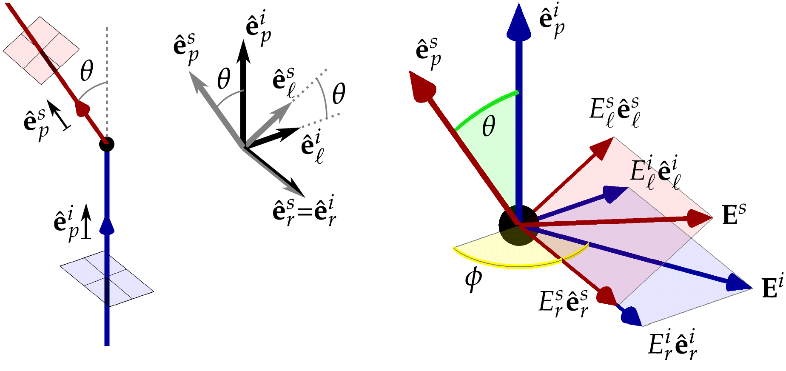
Monte Carlo modelling of scattering
One scattering event: directions and polarisation
General:
Phase function:
Mie scattering:
[van de Hulst, Light scattering by small particles]

Slide 20
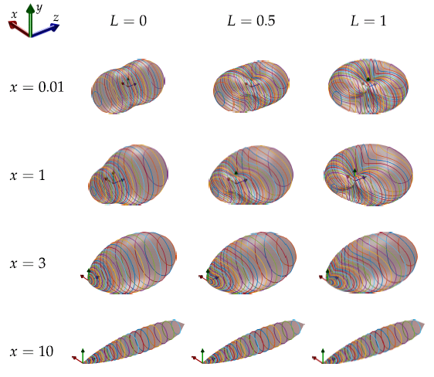
Monte Carlo modelling of scattering
The phase function for Mie scattering

Slide 21
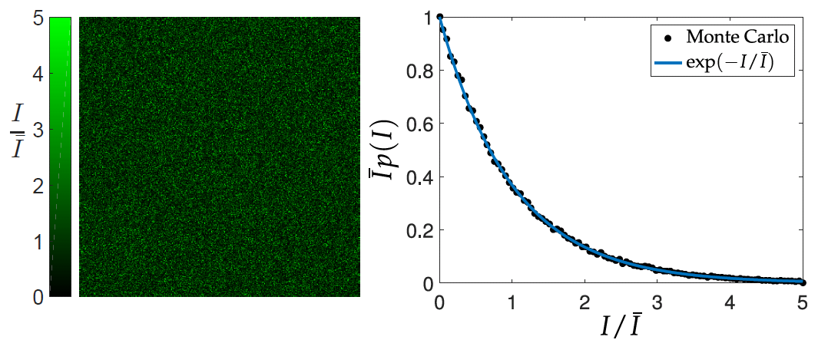
Monte Carlo modelling of scattering
Tracking electric field enables simulation of coherence phenomena
E.g. backscattered speckle pattern
Incident beam
Scattering
medium
Detector
Backscattered ray

Slide 22
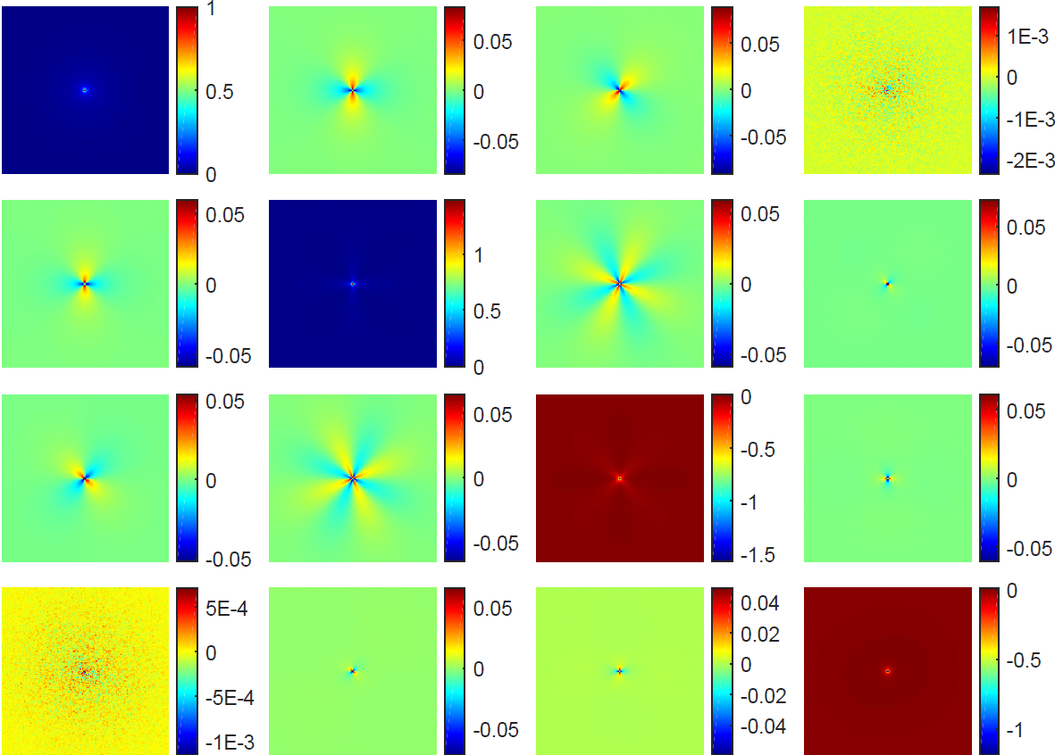
Monte Carlo modelling of scattering
Mueller matrices from backscattering (validation)
Incident
Backscattered
Polarisation:
S_{b} = M S_{i}
Mueller matrix (4x4)
Stokes vector (1x4)

Slide 23
Monte Carlo modelling of scattering
We coded a DLL that computes all of this within Zemax-OpticStudio

Slide 24
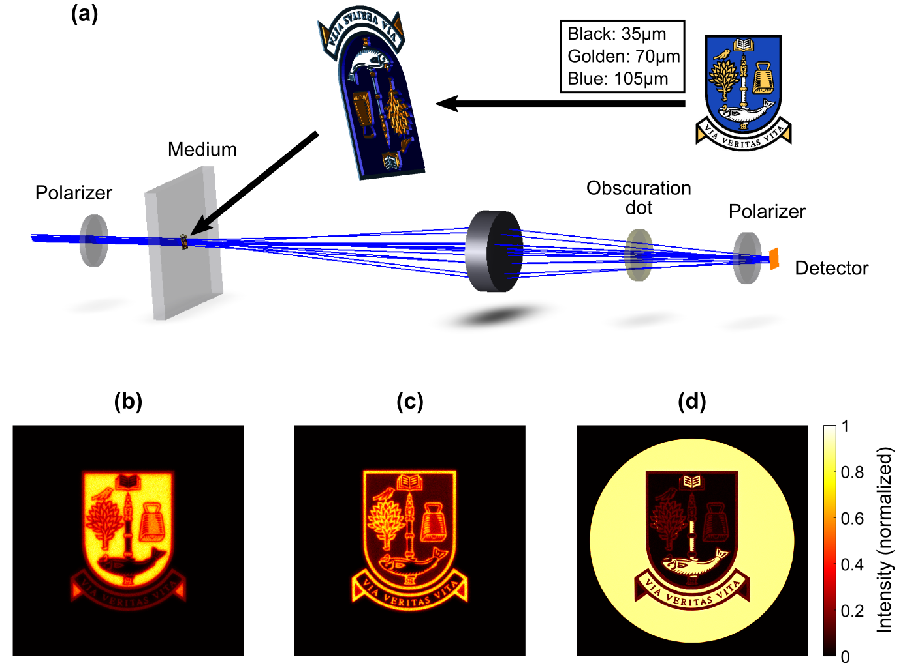
Monte-Carlo modelling with Zemax
Toy example demonstrating polarisation

Slide 25
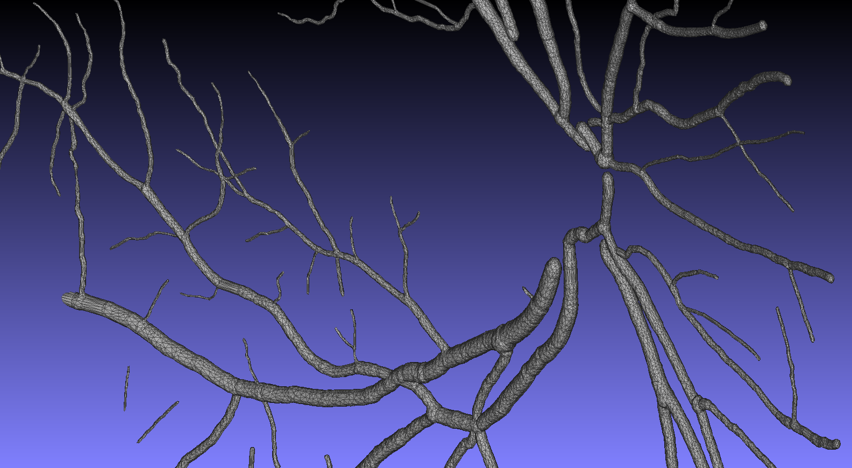
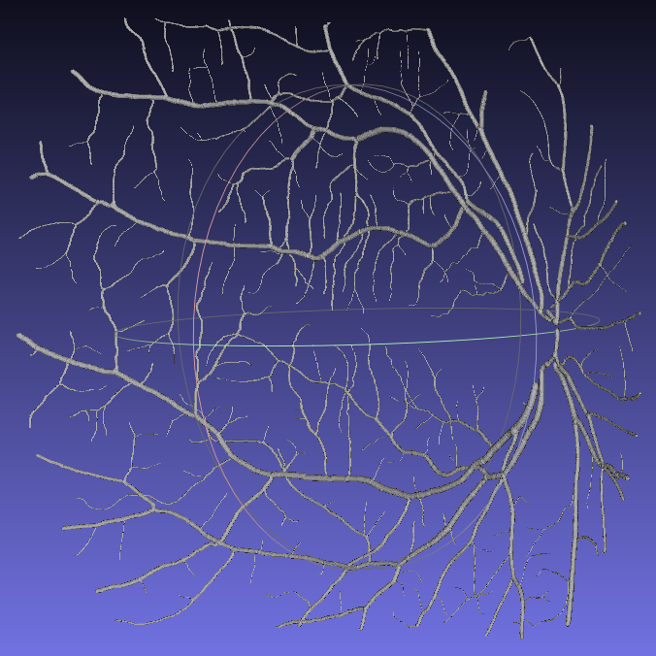
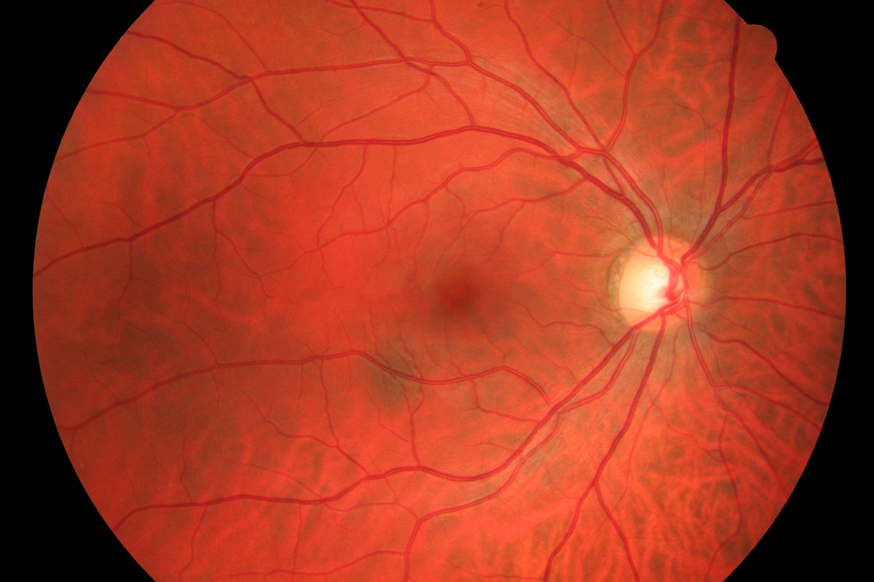
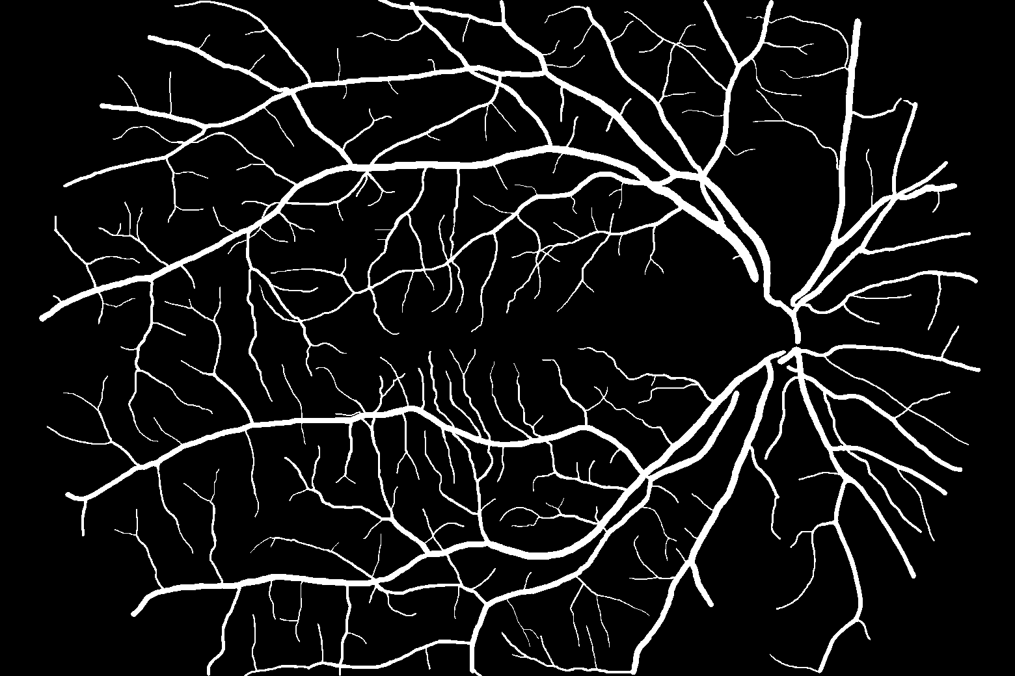
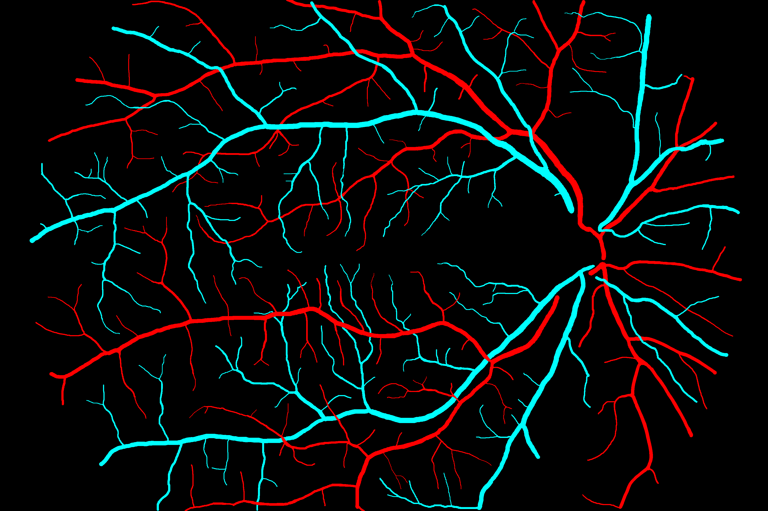
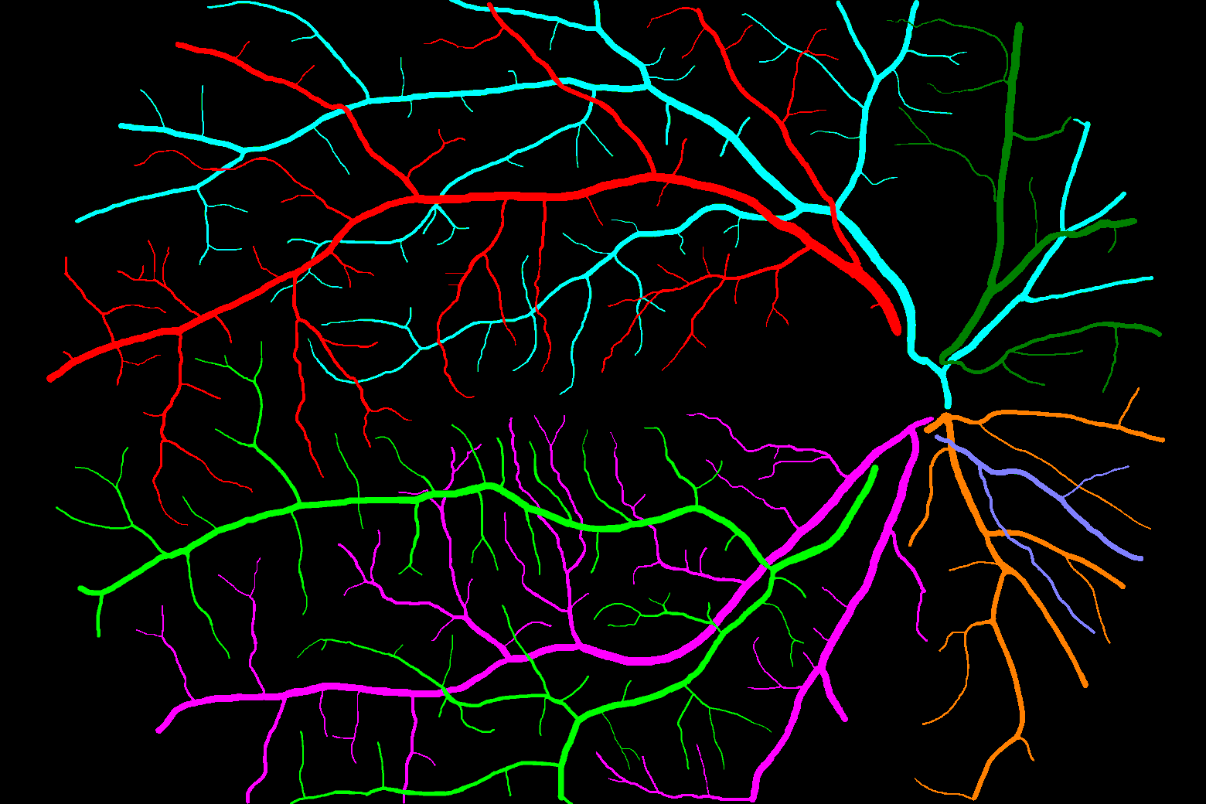
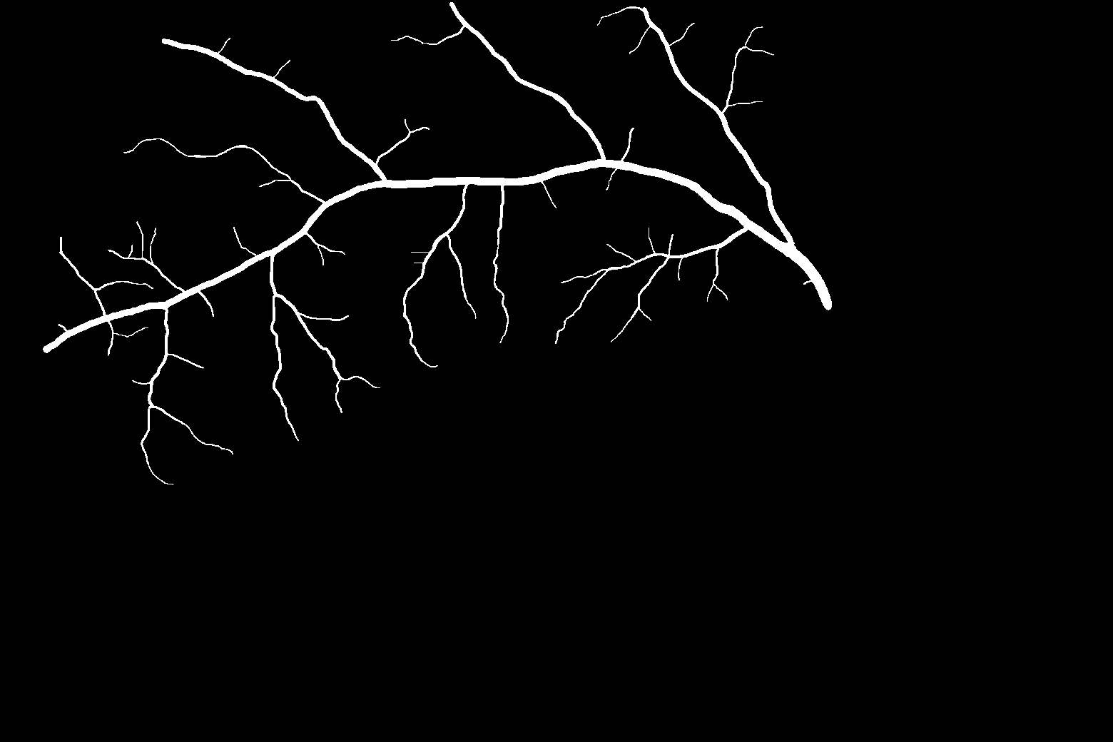
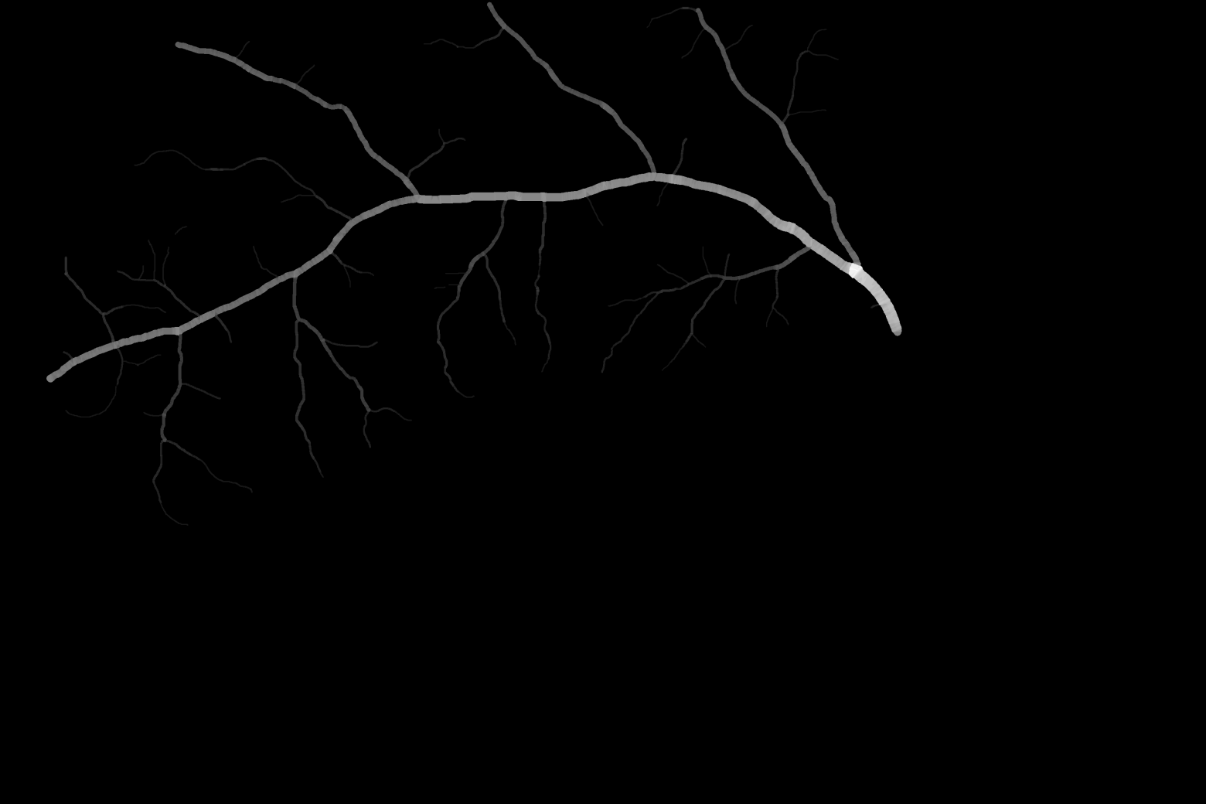
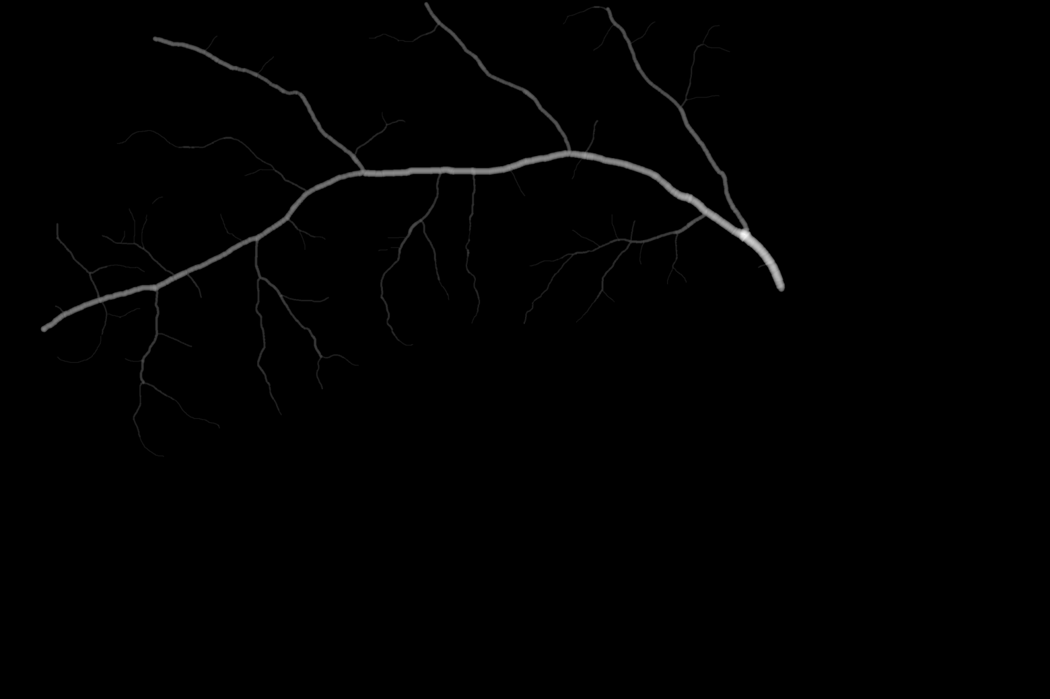
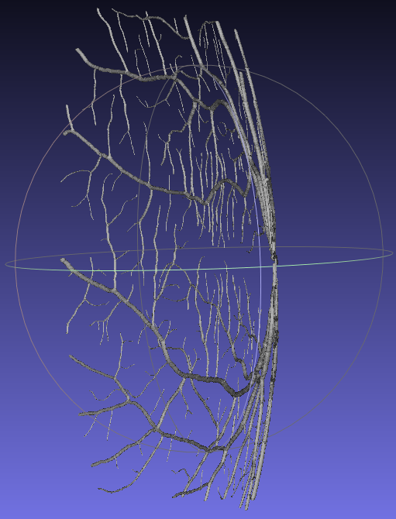
CAD retinal vasculature network
Scanning Laser Ophthalmoscope
[Fundus Image Database (Erlangen-Nuremberg / Brno)]

