Slide 1
Combined multi-aperture 3D panoramic thermal imaging and single-photon ranging
Laura V. Cowan¹, Ashley Lyons¹, Guillem Carles¹, James Babington^{2,3}, Andy Wood², Andrew R. Harvey¹
¹School of Physics and Astronomy, University of Glasgow, Glasgow, UK G12 8QQ
²Qioptiq Ltd, St Asaph, Denbighshire LL17 0LL, UK
³ now at Thales UK, 1 Linthouse Rd, Glasgow G51 4BZ
Author e-mail address: Andy.Harvey@Glasgow.ac.uk
Notes:
Hi, My name is Laura Cowan and I will be talking to you today about my research in combined multi-aperture 3D panoramic thermal imaging and single photon ranging.

Slide 2
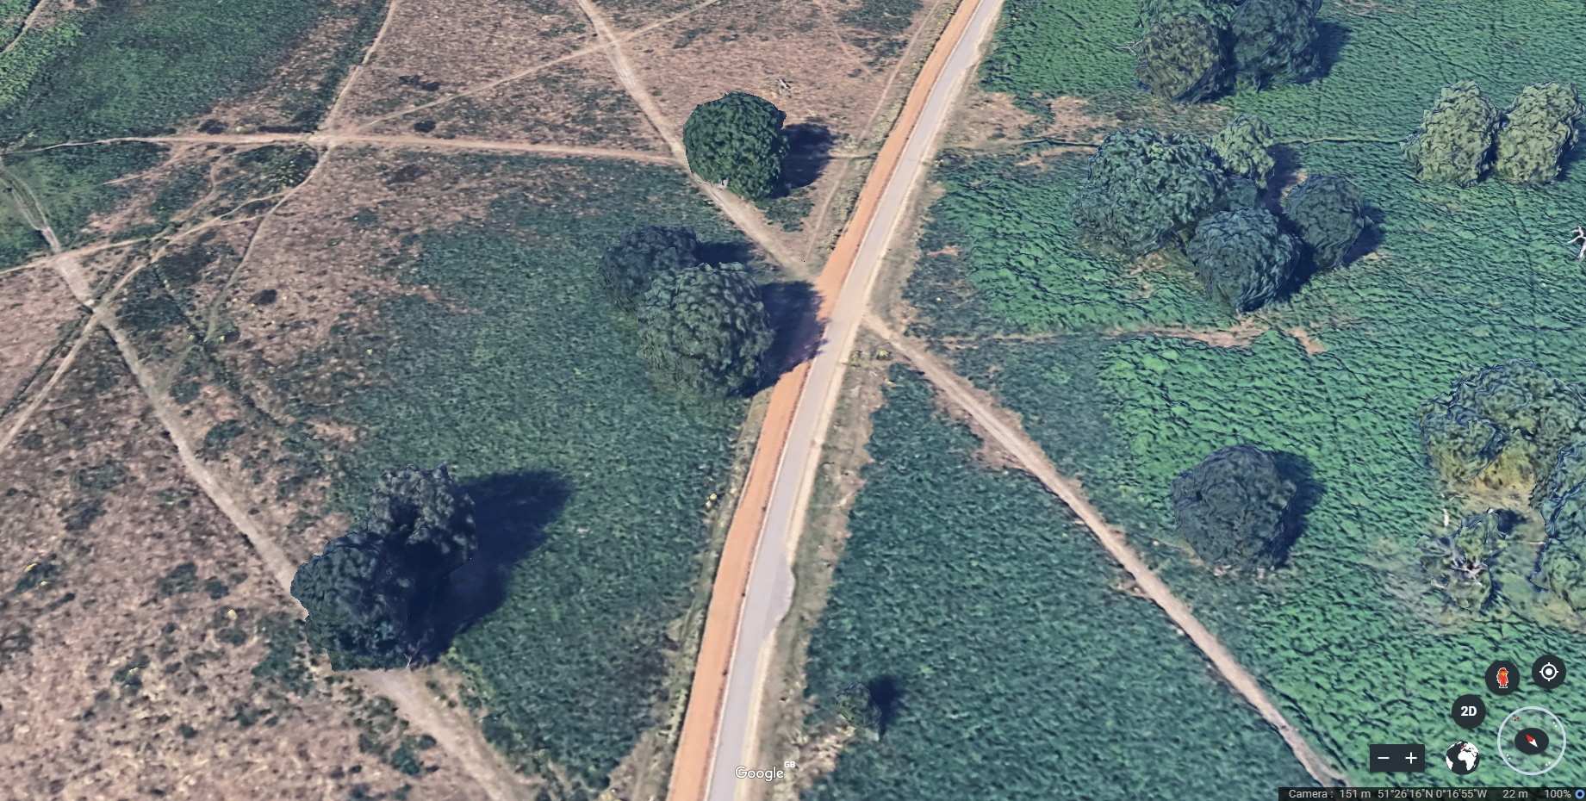
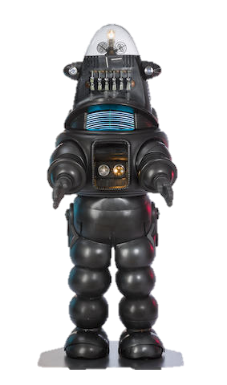
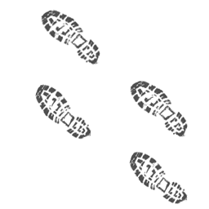
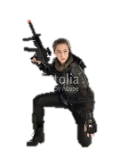
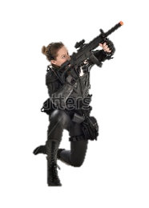
Q: How can we provide 3D situational awareness and identification of threats?
A
~10m
B
Notes:
So I'd like to start by presenting a scenario. A solider is walking through unknown territory surrounded by possible threats*. And the question I'd like to ask is* how can we provide 3D situational awareness and identification of threats? So as to know where the threats are? and Are these threats people or not?

Slide 3
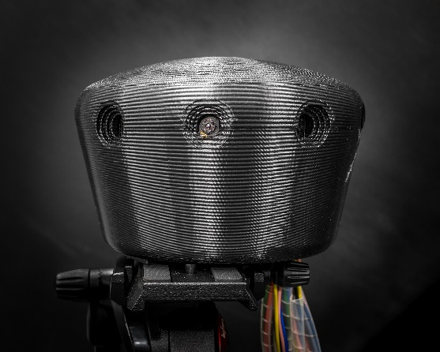
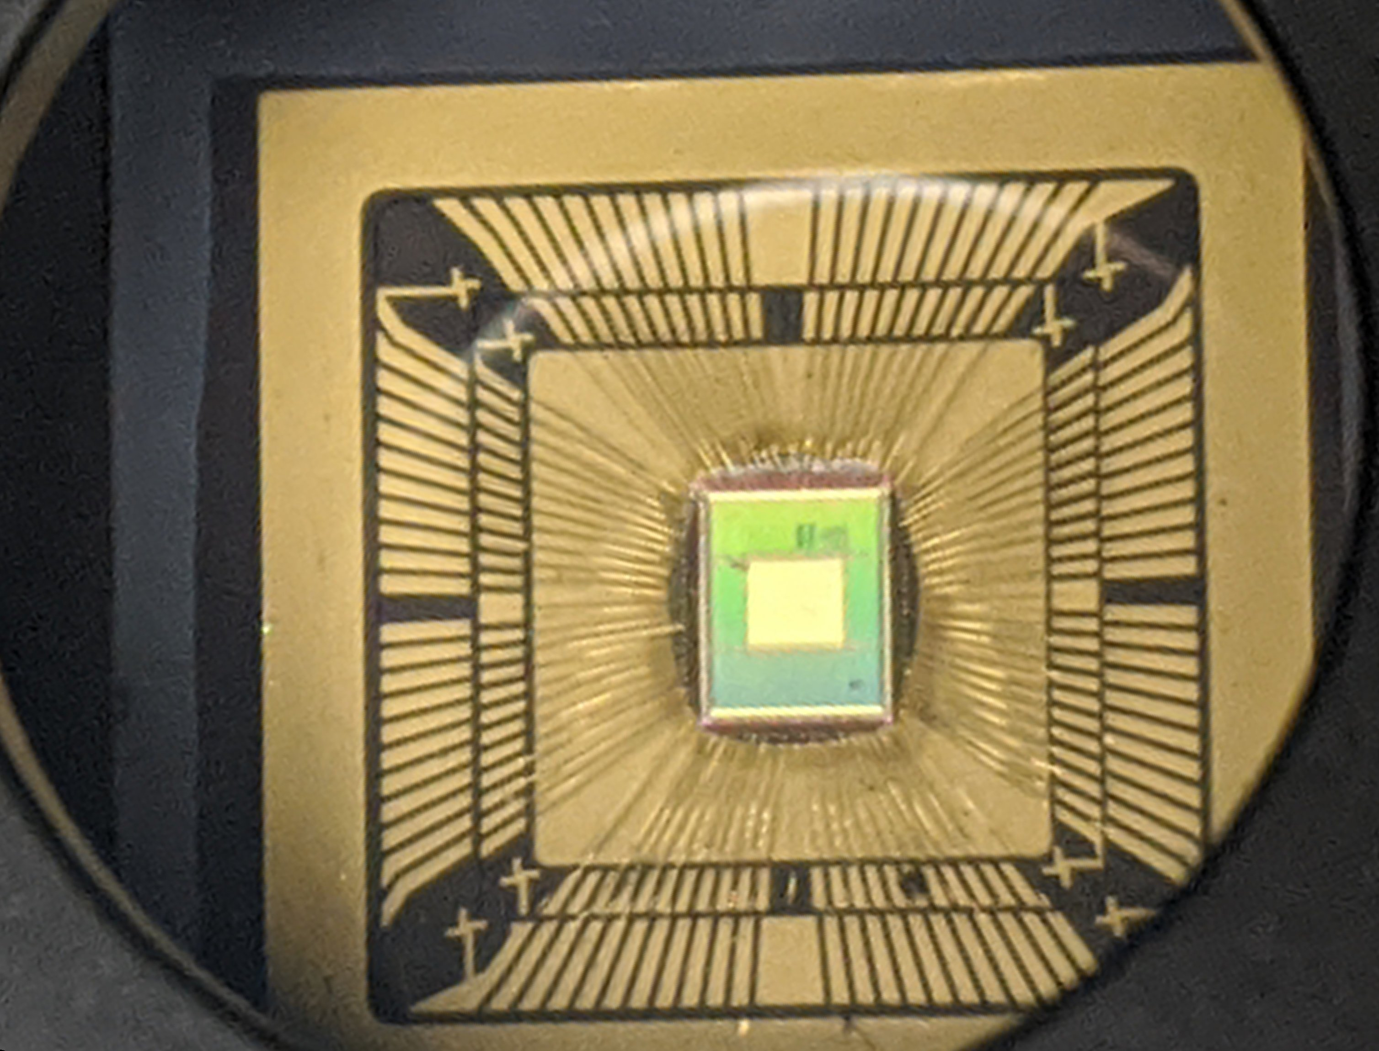
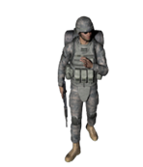
What we have done:
A
~10m
B
Answer:
360 3D Panoramic Imaging
Ranging and imaging occluded objects
Detection of biological micro-movements
Notes:
So to answer this question we have created a 360 degree multi-aperture thermal infrared imaging system*. This system has been designed to be integrated into battlefield equipment such as helmets*, but could be used on vehicles or drones also. A threat* such as this solder behind foliage can be identified with thermal imaging and then by introducing a translation*, from point A to B*, stereo vision can be used for passive ranging, and integral imaging can be used to remove* objects occluding the person of interest. Fusing this infrared imaging with single-photon technology* allows for threat detection through precision ranging to detect biological micro-movements such as breathing and material discrimination through impulse response measurement.
Is this threat alive and human or not?

Slide 4
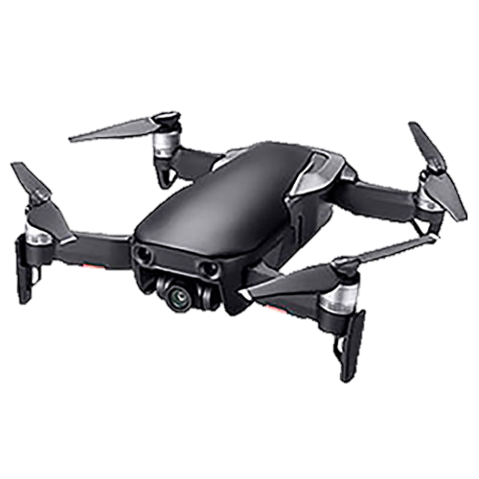
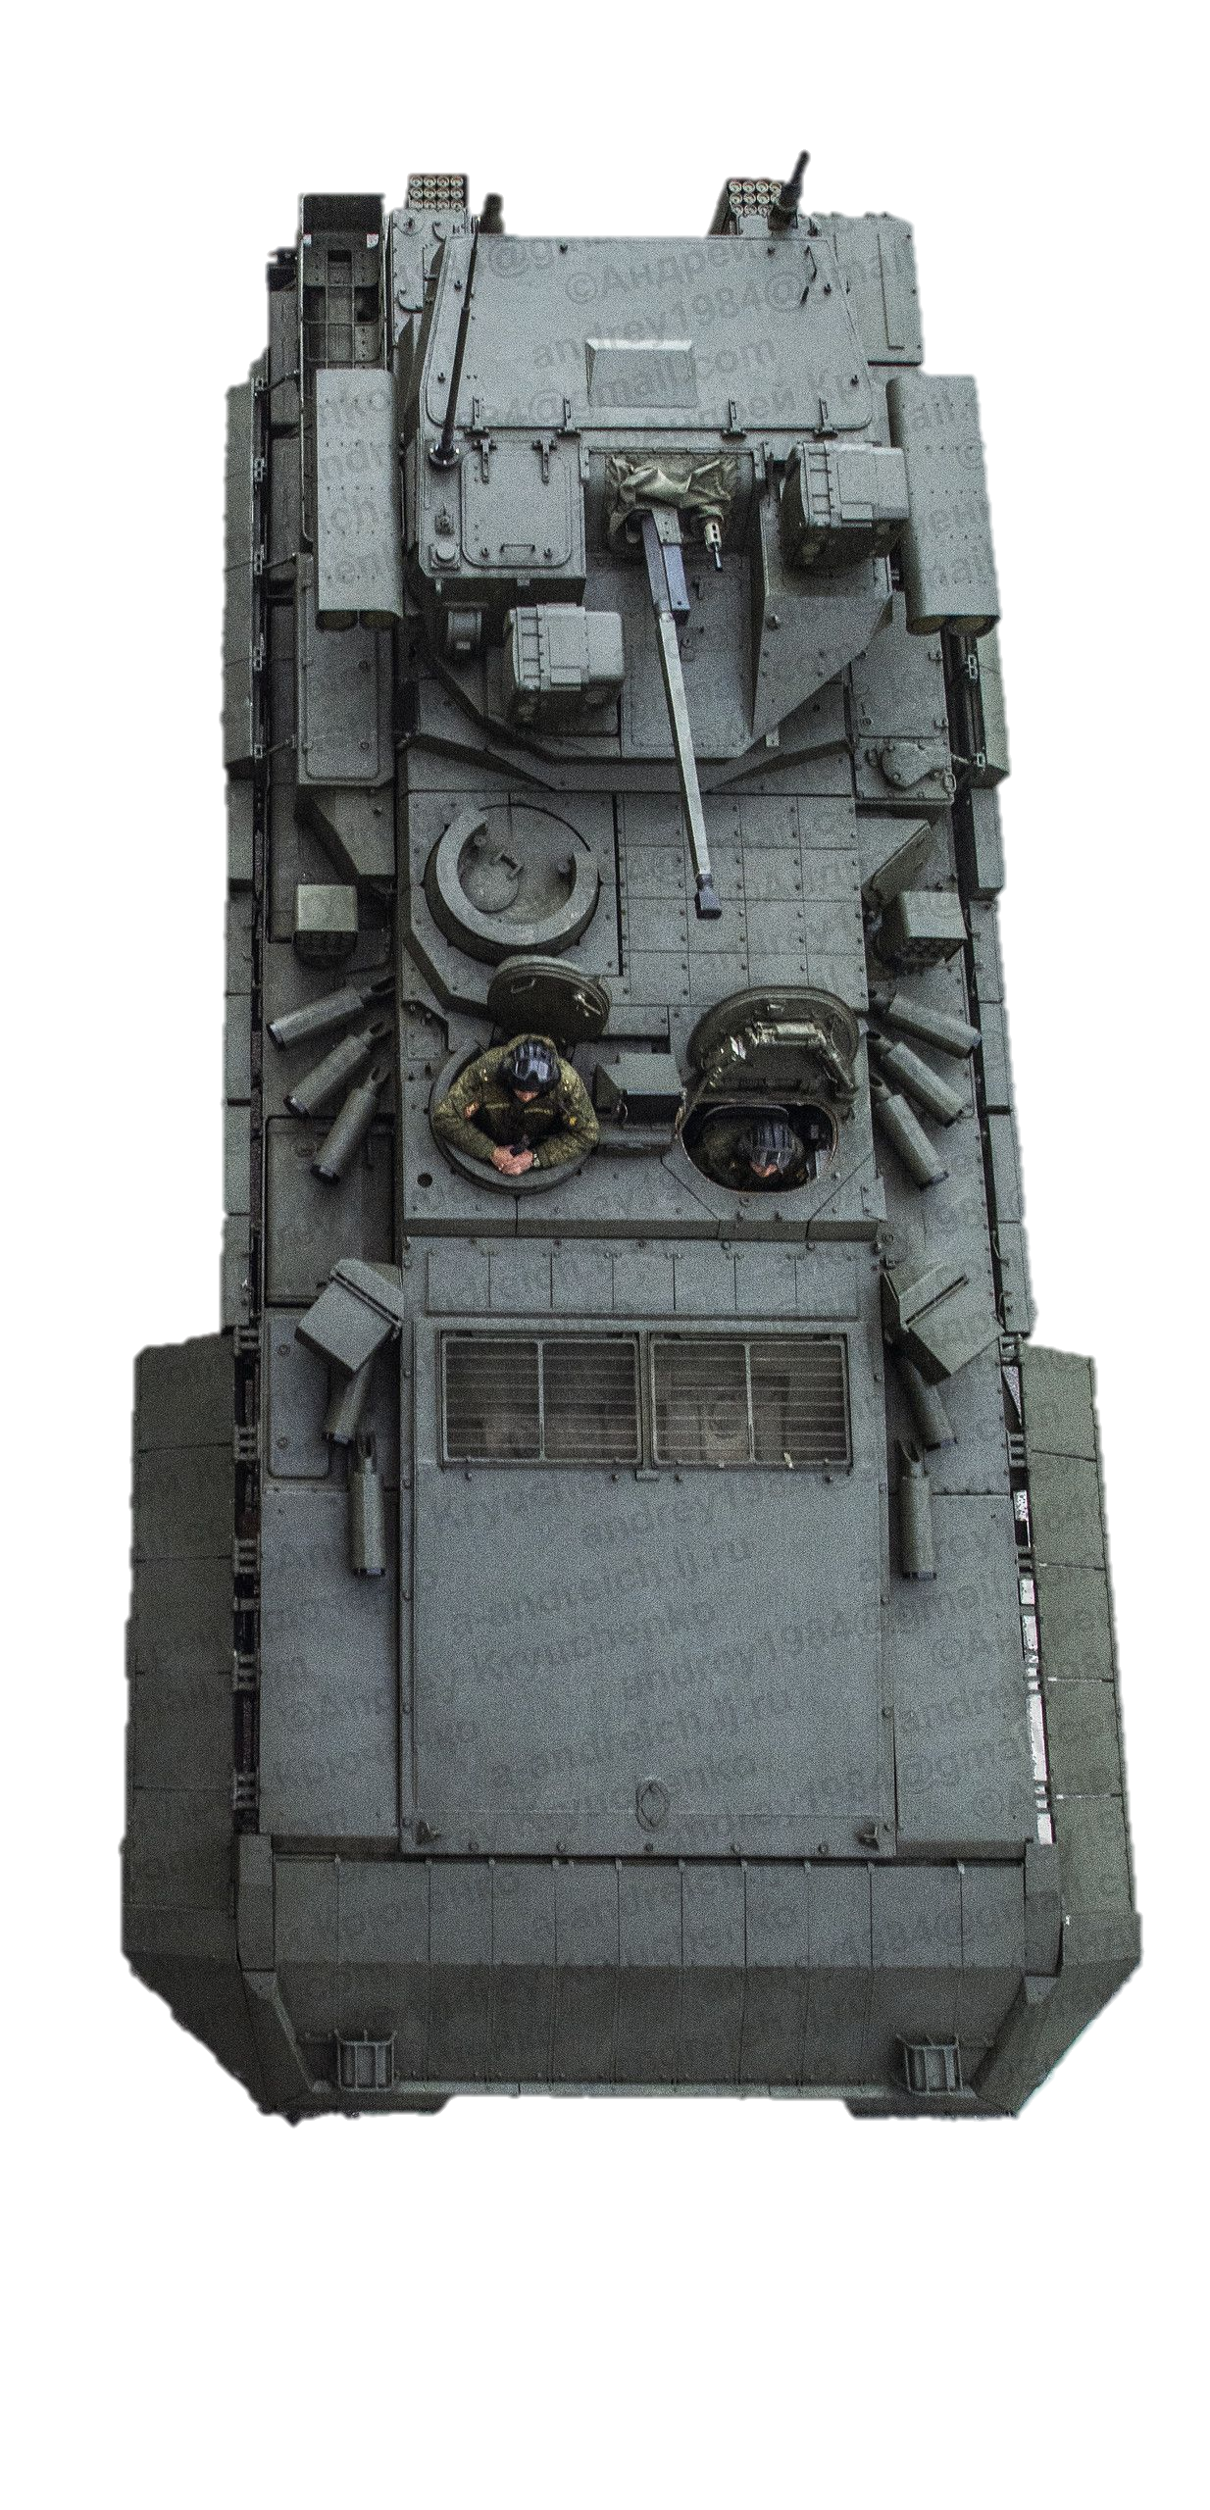
Notes:
Extended applications
Attached to drone
Moving vehicle – reduce risk to life

Slide 5
The fusion of multi-aperture panoramic thermal imaging and single-photon LIDAR to provide 360° 3D situational awareness and threat detection.

Slide 6
Presentation Outline
Multi-aperture panoramic imaging
360º 3D situational awareness
Passive Ranging
Imaging occluded objects
Fusion with Single Photon LIDAR
Detection of Breathing
Material Discrimination
Notes:
So what I will present today is the benefits of multi-aperture panoramic imaging. The prototype 360 degree panoramic imaging system and how that allows for 3-dimentional situational awareness providing passive ranging and imaging of occluded objects. I will then discuss the fusion of this technology with single Photon LIDAR for the detection of breathing and material discrimination.

Slide 7
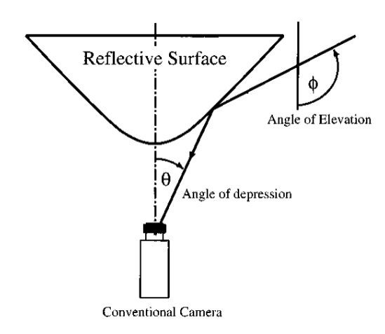
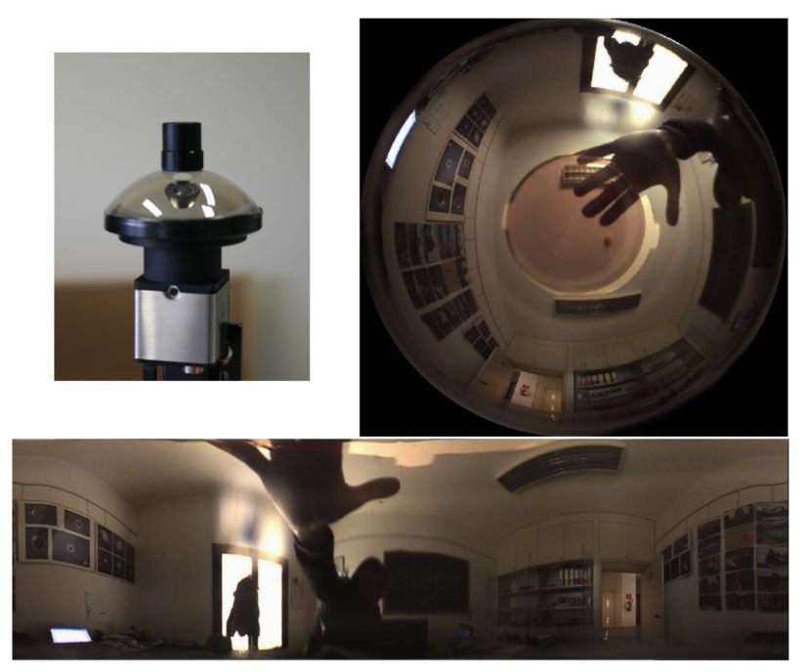
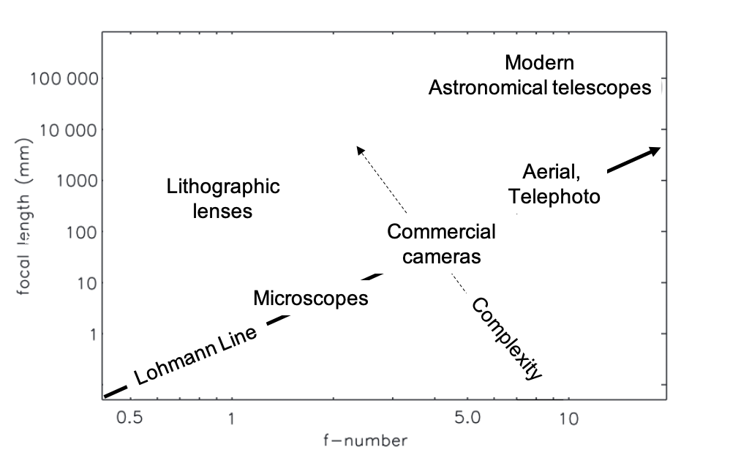
Compact Panoramic Imaging is not possible using conventional techniques
[1]
[2]
[3]
Trade field-of-view for angular resolution
Total Pixel count limited by detector
Optical aberrations limit resolution
Optical aberrations increase lens complexity, size, weight, cost
[1] Chahl and Srinivasan, Appl Optics (1997).
[2] Pernechele, Opt. Express (2016).
[3] Brady, David J., et al. "Multiscale gigapixel photography." Nature 486.7403 (2012): 386-389.
Notes:
Compact panoramic imaging is not possible with conventional imaging techniques.* Traditional approaches consist of using a reflection optic or a hyper hemispherical lens. These approaches limit the total pixel count to that of one detector and the resulting images are highly distorted. *Addressing this through optical design results in an optical system with an increased size, weight, cost, and complexity which is undesirable.

Slide 8
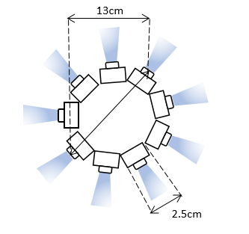
Curved Detector Array
MA-TIR Design
[1]
Curved focal surface reduces optical aberrations and enables simpler optics
Concave Focal surface with single aperture
Convex array of Multiple Cameras
Panoramic field-of-view of 600 pixels can be achieved
Scalable to 4 π
[1] Chahl and Srinivasan, Appl Optics (1997)
Notes:
One method of increasing field-of-view while maintaining reduced complexity is with a curved focal surface.* A curved focal surface reduces optical aberrations and enables simpler optics. The reflection optic is replaced with a curved detector array* for example a monocentric single aperture system with a concave focal surface.Or system complexity can be reduced further replacing the central optic with a convex array of low-cost cameras*. This then allows for a scalable architecture. *The design shown here is the schematic of the prototype multi-aperture panoramic thermal infrared system that i will present today.

Slide 9
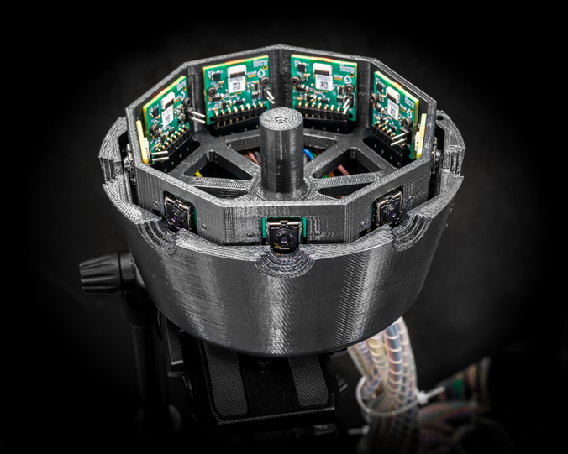
Multi-aperture Panoramic Imaging
9 low-cost LWIR FLIR Lepton cameras in convex array
Each camera 80x60 pixels with short focal length silicon lens
Powered by a low cost single board computer (Raspberry Pi)
Video imaging
PHOTO: KEVIN. J. MITCHEL
PHOTO: KEVIN. J. MITCHEL
Notes:
The prototype system comprises 9 low-cost long wave infrared cameras. Each camera has 80 by 60 pixels and a short focal length silicon lens and is powered by a Raspberry Pi. The prototype system can be assembled from off-the shelf components for around 2000 dollars. Which is significantly cheaper than state-of-the-art wide field of view thermal imaging systems. Snapshot and video rate panoramic imaging is possible with this setup.

Slide 10
Panoramic Images and Videos
Visible Image
Snapshot Panoramic Image
0º
180º
360º
link to interactive panoramic video… https://youtu.be/BiIq44osxIo
Notes:
An example of a snapshot panoramic iamge is shown here. Individual images have been stitched together to create a panoramic image covering 360 degrees. The image is much less distorted than that of the reflection optics as shown previously.**This can be shown as a video which has been mapped onto a torus as shown here, to aid image understanding. This can be shown as a virtual reality video.
Displaying panoramic images is well known as being awkward – mapped on to a torus.

Slide 11
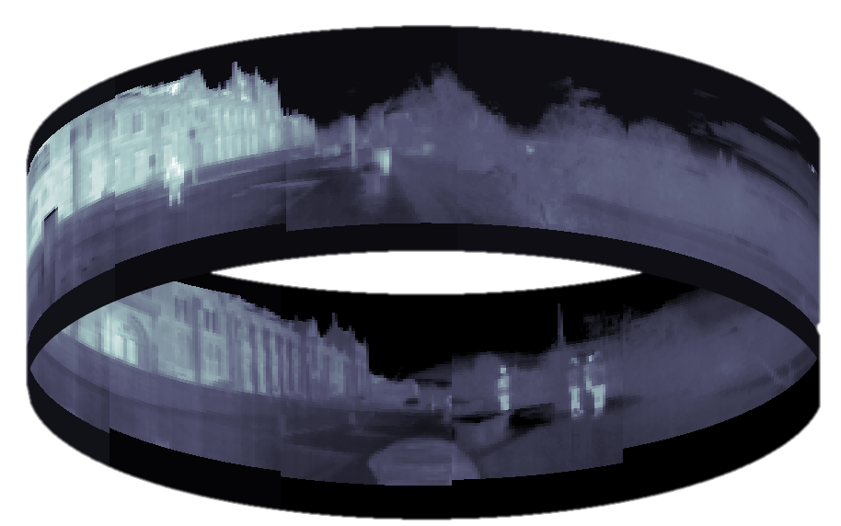
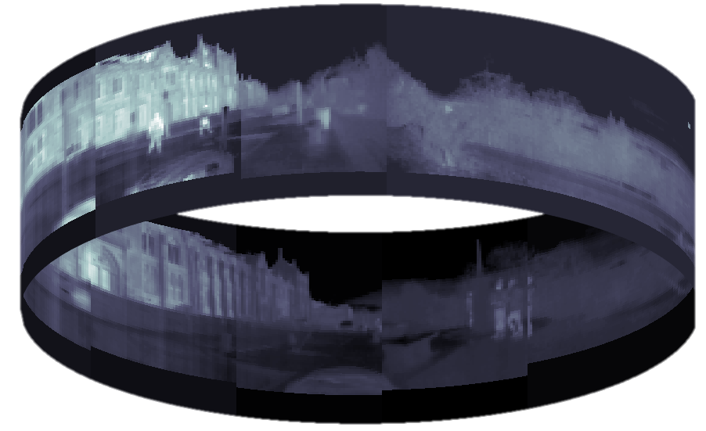
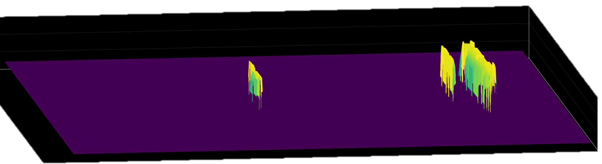
Passive Ranging
Left Image
Visible Image
Right Image
Left Image
Right Image
Depth map of People from
Stereo Panoramas
Left position
-5
Right position
[1]
-10
Range (m)
-15
-20
-25
11
Notes:
Passive ranging can be achieved* by translating the system through a scene. *After Recording a panorama at point A and point B.* Areas of interest * can then be segmented in the image, such as people who may pose potential threats* and stereo vision can be used to create a depth map of the scene. In this case the baseline was half a metre where single pixel disparity translates to 40m. This can be extended further for example a footstep equivalent to 1 meter would give a maximum range of

Slide 12
Passive Ranging
Left Image
Visible Image
Right Image
Left Image
Right Image
-5
Left position
Right position
[1]
-10
Range (m)
-15
-20
-25
Notes:
Use of multiple aperture increases versatility
Passive ranging and imaging through obscurants
Two approaches to this – one disparity
Synthetic aperture in time sequence – x10 improvement
Second approach via super resolution image registration
Battlefield Connectivity
Next steps in work plan to take

Slide 13
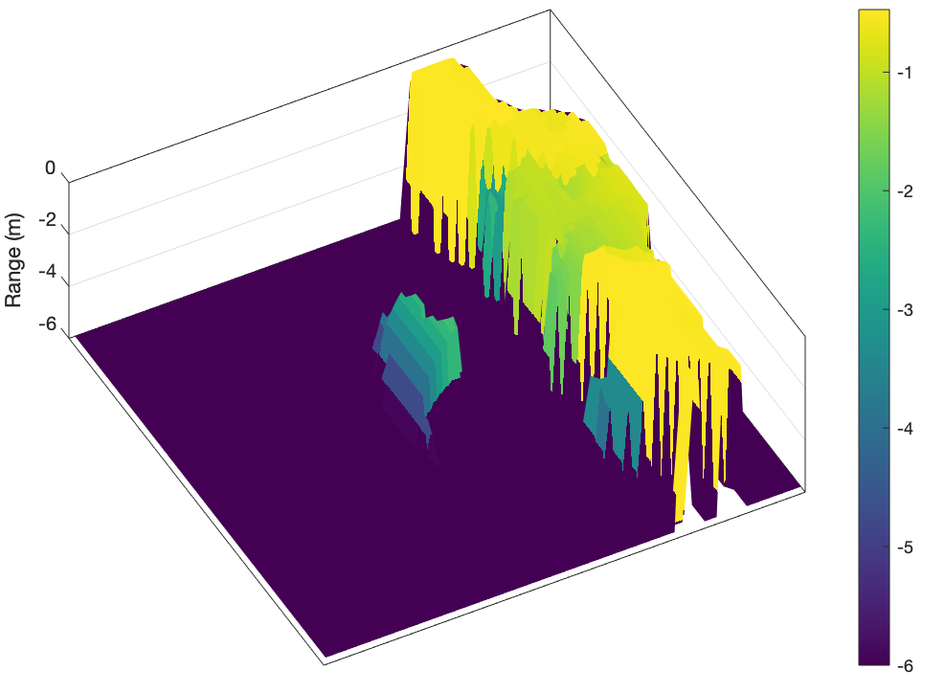
Enhanced Situational Awareness - PR

Slide 14
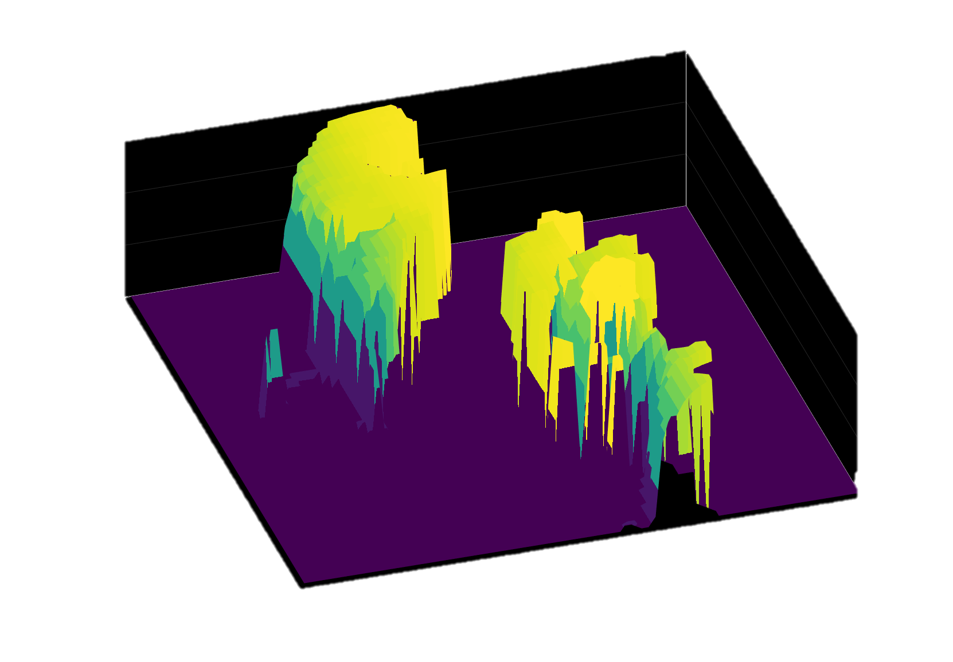
Imaging through obscurations
Imaging occluded objects with Synthetic Aperture Integral Imaging
Elemental Images
Left position
Right position
Refocused on Person
Refocused on Foliage
Depth Map of Person
Depth Map of Foliage
0
-2
-6
Range (m)
-10
-14
Notes:
Further to this integral imaging can be used to image occluded objects. In the scene here there is a person hidden amongst the trees*. When translating the multi-aperture imaging system** the person can be seen through the trees, with a different perspective in each image.* These perspectives can then be registered and summed to refocus on the depth plane of interest.* The objects can then be passively ranged with the stereo vision technique shown previously.

Slide 15
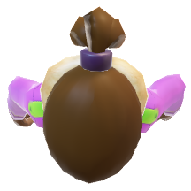
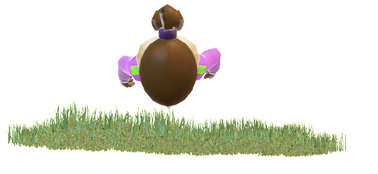
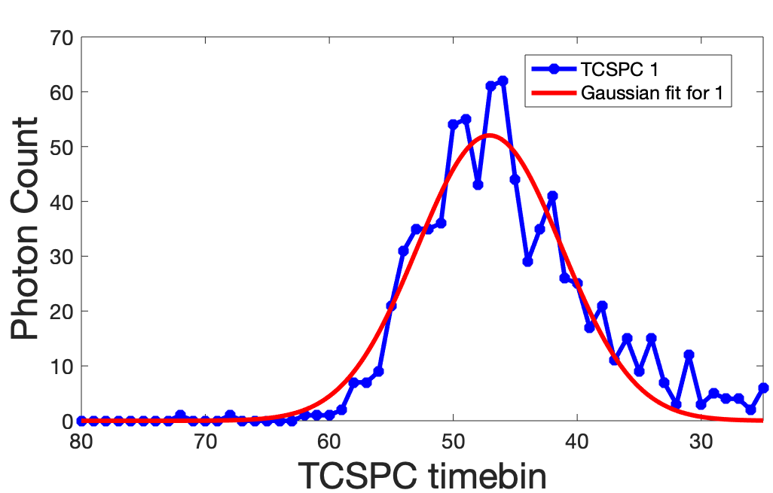
Single Photon LIDAR
?
32x 32 SPAD array
TCSPC Histogram
Time correlated single photon counting mode (TCSPC)
Temporal resolution: 300,000 8-bit images per second
Precision Ranging ~1cm
SPAD
⏄
TRIGGER
PULSED
LASER
DIODE
Notes:
The complementarity of single photon LIDAR is then investigated. *Single photon ranging is acheived in time correlated single photon counting (TCSPC) mode, with an array of single photon avalnche diodes (32 by 32). This system can capture 300,000 8-bit images a second, providing precison ranging on the order of 1cm. This compliments the macro passive ranging achieved with stereo vison, with an accuracy of 0.5m.* This schematic shows our setup for TCSPC mode. *A pulsed laser diode emits light* which hits a beam splitter* directing light to a trigger which starts the clock. Pulsed light then travels towards the scene illuminating the objects of interest.*This is reflected and focussed onto the SPAD array and the clock stops, and a histogram of photon arrival times is produced.
This method is used to interrogate the objects in the scene, what material are they made of and are they breathing or not?

Slide 16
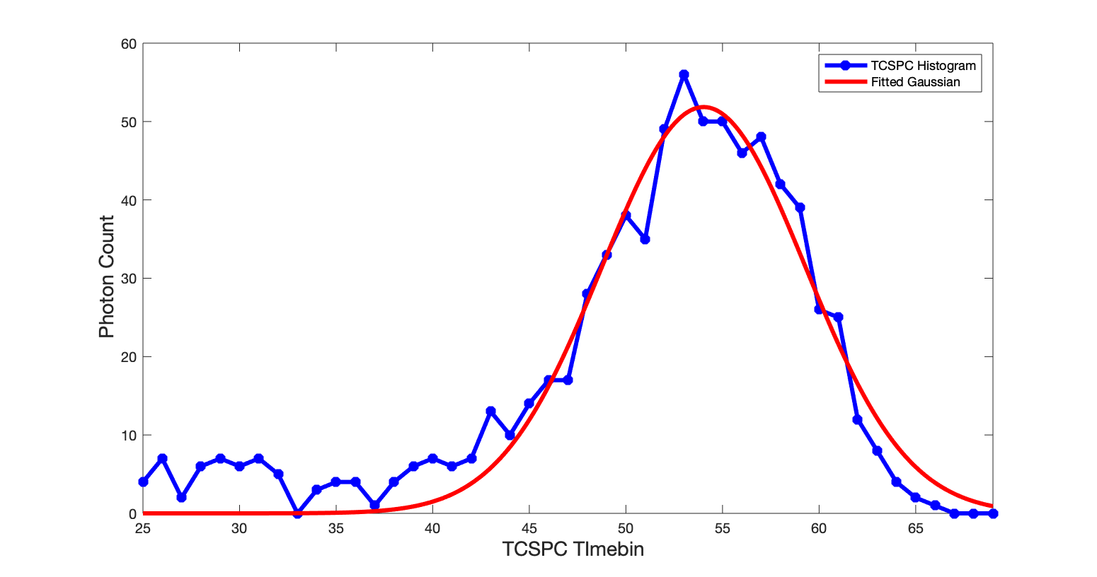
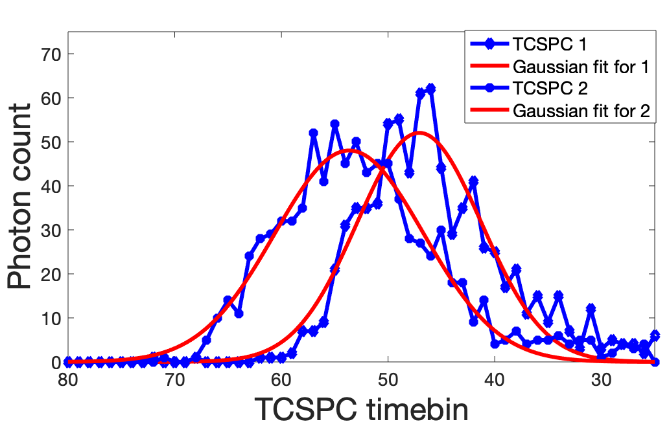
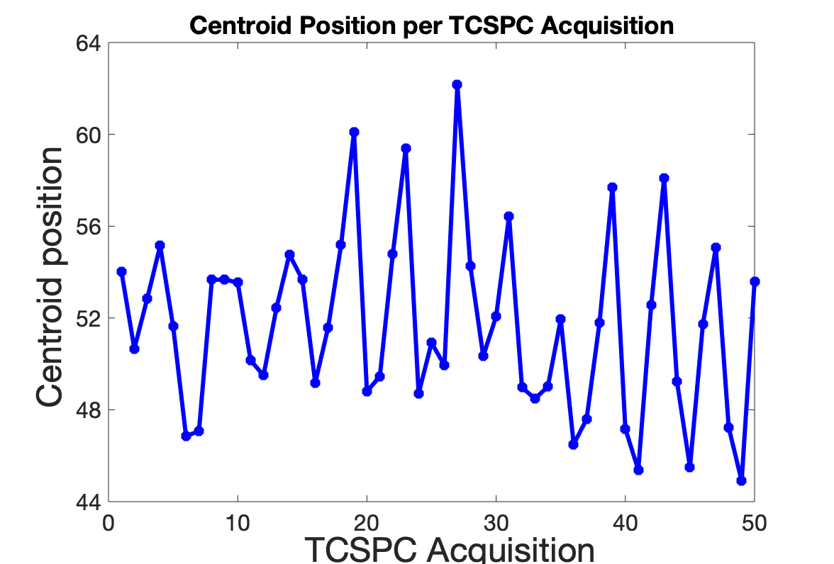
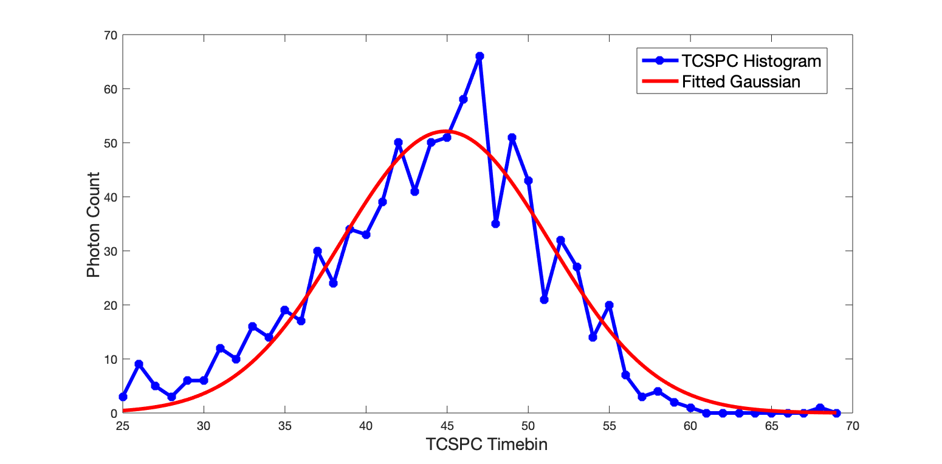
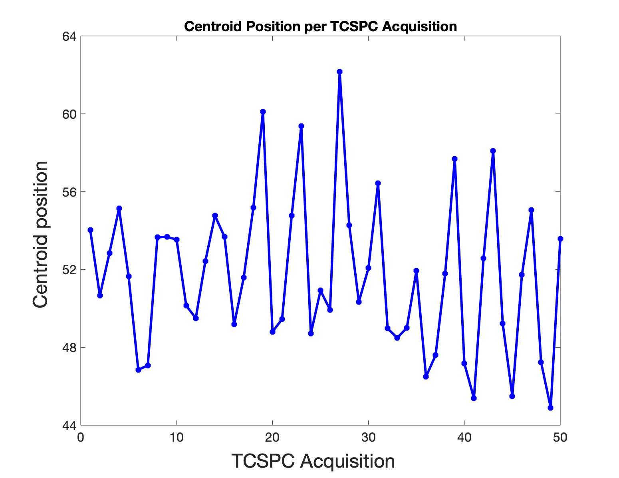
Detection of biological micromovements
?
TCSPC Histogram
time
Breath
in
Breath
out
Are they breathing?
SPAD
⏄
SPAD
Peak position over time
Breath out
TRIGGER
⏄
TRIGGER
PULSED
LASER
DIODE
PULSED
LASER
DIODE
Thermal Image
TCSPC Data Overlaid
Does this oscillate between 0.2 Hz and 0.3 Hz, average adult breathing frequency?
= yes
= no
Notes:
Using the setup from before*, multiple TCSPC histograms are recorded with the aim to determine whether an object is breathing or not. *For example This is a histogram recorded at time A and then this is the histogram recorded half a second later*, they are offset* as they represent a breath in and a breath out. 50 TCSPC histograms are recorded in 3 seconds A gaussian is fitted and the centroid position is extracted and plotted for each histogram** The frequency of the oscillation of the peak centroid position is then categorised as breathing or not breathing.

Slide 17
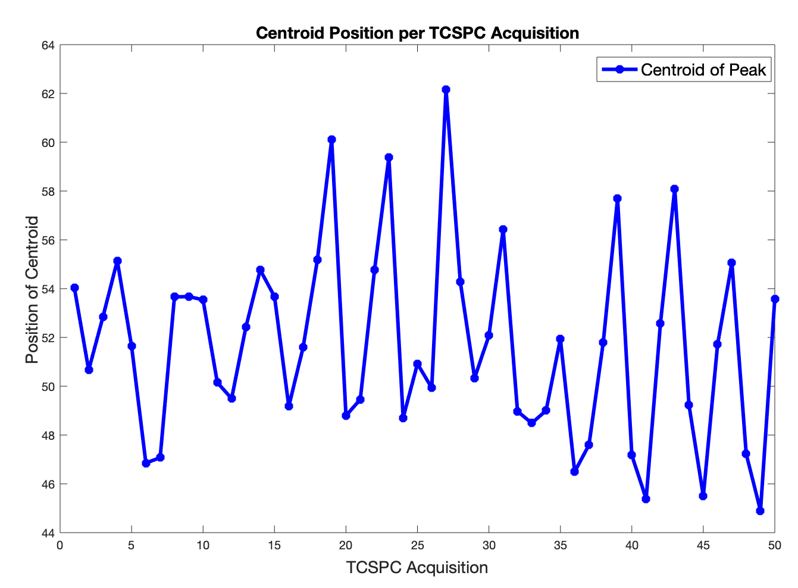
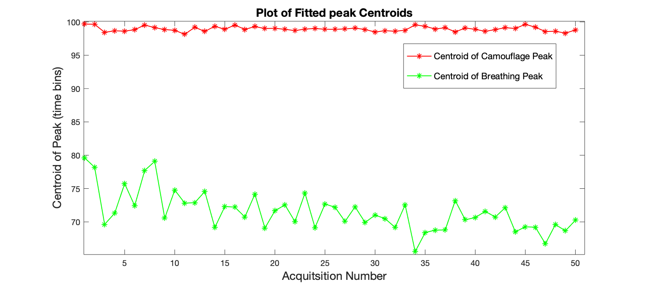
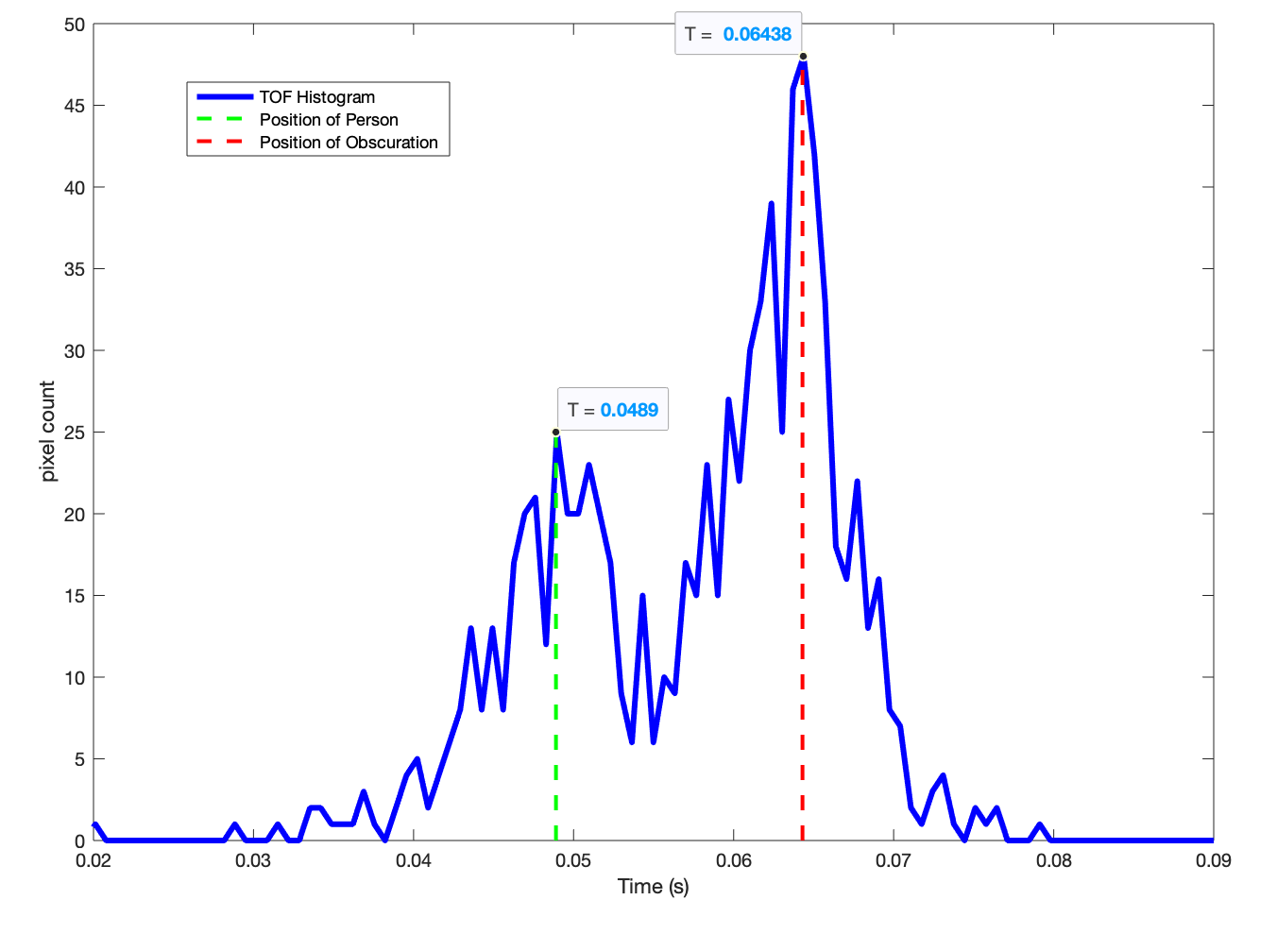
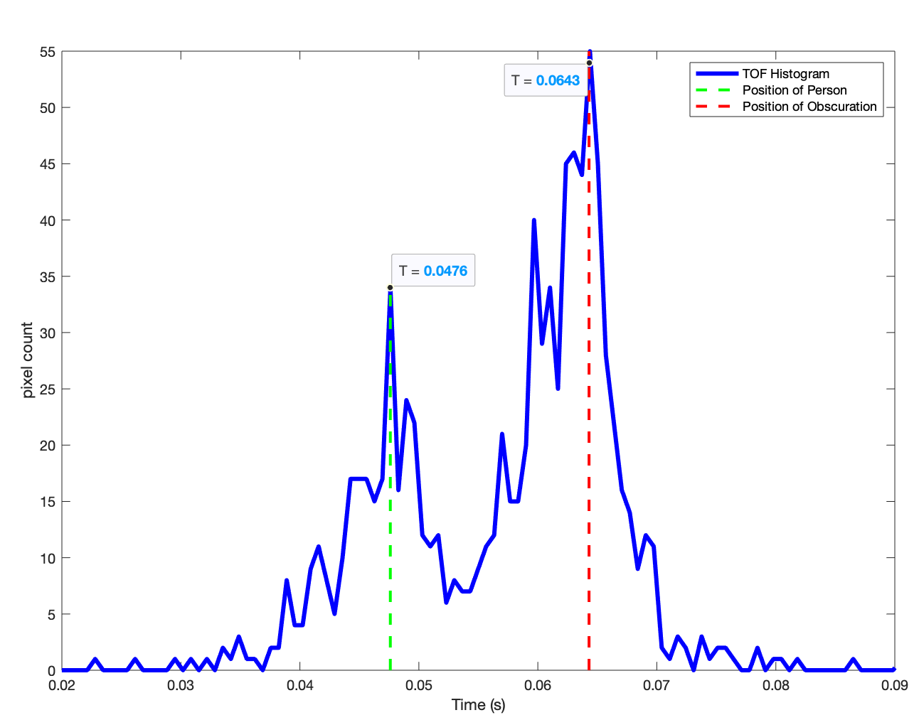
Detection of biological micromovements
Where is the person?
TCSPC HISTOGRAM
Position 1
Position 2
Peak position over time
TCSPC Data
Overlaid
Thermal Image
Are they breathing?
Average adult breathing frequency
between 0.2 Hz and 0.3 Hz
= yes
= no
Visible Image

Slide 18
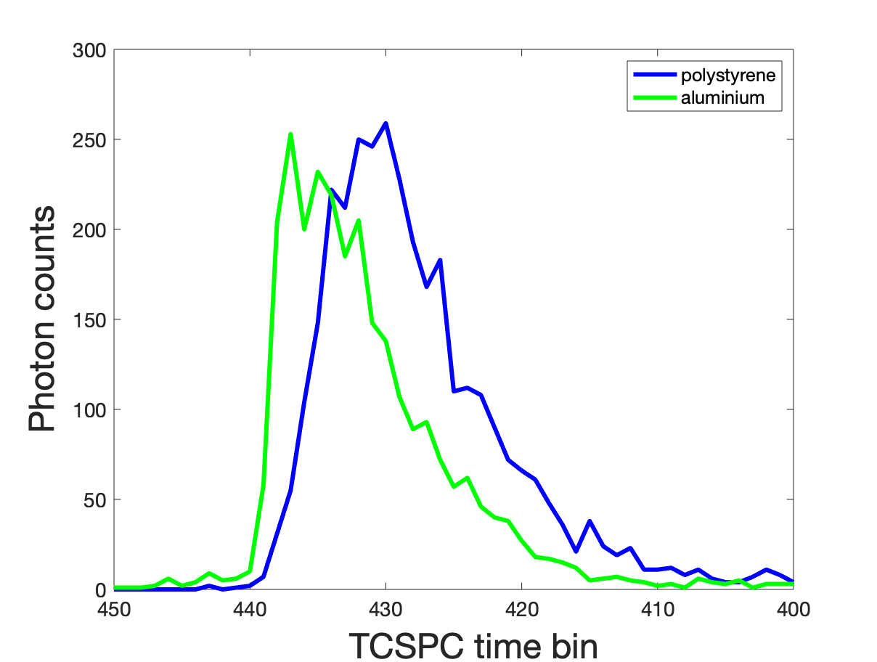
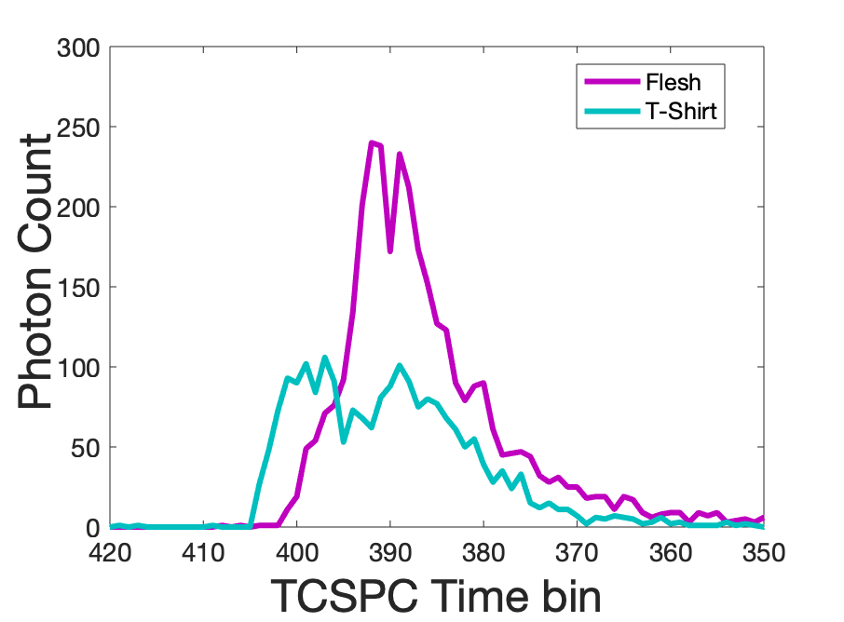
Material discrimination from Impulse Response
Plot α vs σ
TCSPC Histograms
?
Aluminium vs Polystyrene
Hardness of surface?
Flesh
clothes
Polystyrene
Aluminium
σ
Flesh vs T-shirt
Polystyrene
AL
Human?
α
Not Flesh
Flesh
σ = Width
α = Skewness
α
Notes:
Further to this material can be catagorized by measuring the impulse response through TCSPC. * So again is the threat a human or a robot? Polystyrene and Aluminium have been examined to investigate the 'hardness' of a surface. Along with flesh and clothes over flesh to compare the impulse response in each case.* As before the same setup is used to measure TCSPC histograms, and then this distribution is modelled as an exgaussian distribution* where sigma is related to the width of the distribution and alpha is the skewness.* We then plot alpha against sigma and expect the relationship to be warped differently depending on which material is present. * The results are shown here where the relationship is distinct for each material.

Slide 19
Review and Conclusion
PHOTO: KEVIN. J. MITCHEL
0º
180º
360º
Refocused on Person
Scalable Multi-aperture panoramic imaging
3D panoramic imaging for Passive Ranging
Imaging through obscurations
Fusion with single-photon LIDAR
Early Threat detection
Identification of signs-of-life
Material Discrimination
Breathing?
Notes:
So to conclude a scalable multi aperture panoramic imaging system has been developed which provides enhanced situational awareness through 3D panoramic imaging capabilities, passive ranging and imaging occluded objects. The fusion with single photon LIDAR has then been explored with the complimentary precision ranging enabling early thread detection through identification of signs of life, such as breathing and material discrimination.

Slide 20
Thank you for your attention
Interactive 360º Panorama
Please email: Laura.Cowan@glasgow.ac.uk
Notes:
Thank you for your attention.

