Slide 1
esipfed.org | #ESIPfed
ESIP & COVID-19
Erin Robinson,
ESIP Executive Director
Supported by:
Image Credit: NASA
Image Credit: National Geographic

Slide 2
ESIP VISION
To be a leader in promoting the collection, stewardship and (re)use
of Earth science data, information, and knowledge
that is responsive to societal needs.

Slide 3
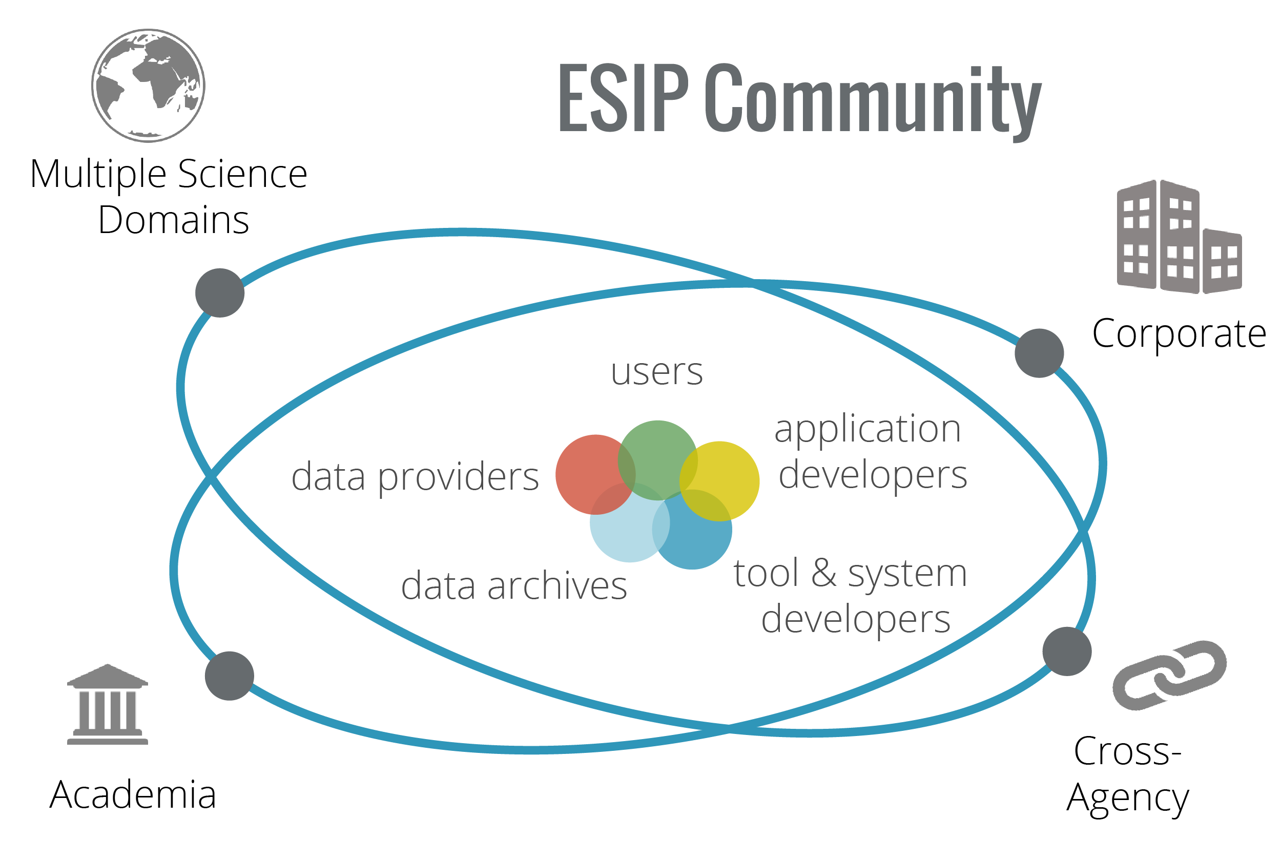
Supported by:
Brain trust of Earth
science data professionals

Slide 4
TYPES OF ESIP PARTNERS
TYPE I
TYPE II
TYPE III
TYPE IV
TYPE V
DATA AND INFORMATION DISTRIBUTORS, REPOSITORIES, & ARCHIVE CENTERS
EARTH SCIENCE APPLIED SERVICE PROVIDERS
PRODUCT & SERVICE PROVIDERS
COLLABORATIVE DATA NETWORKS
ESIP SPONSORS
Plus 140 more… ESIPFED.ORG/JOIN
Notes:
Type 1 -- Data and Information Distributors, Repositories, and Archive Centers: Type 1 ESIP Partners shall be primarily stewards and distributors of Earth science and related data and/or their supporting catalogs, metadata, software, and/or documentation.
Type 2 -- Product and Service Providers: Type 2 ESIP Partners shall be engaged principally in the development, provision, and support of Earth Science research data and information products, including technology, infrastructure, or services, aimed primarily at the Earth science and research communities.
Type 3 -- Earth Science Applied Service Providers: Type 3 ESIP Partners shall be engaged principally in the development, provision, and support of applications or services that use or disseminate Earth science data/information for such activities as decision support, outreach, advocacy, or education.
Type 4 -- ESIP Sponsors: Type 4 ESIP Partners shall be major financial or in-kind supporters of ESIP activities.
Type 5 -- Collaborative Data Networks: Type 5 Partners shall be other associations or networked organizations with missions that complement ESIP

Slide 5
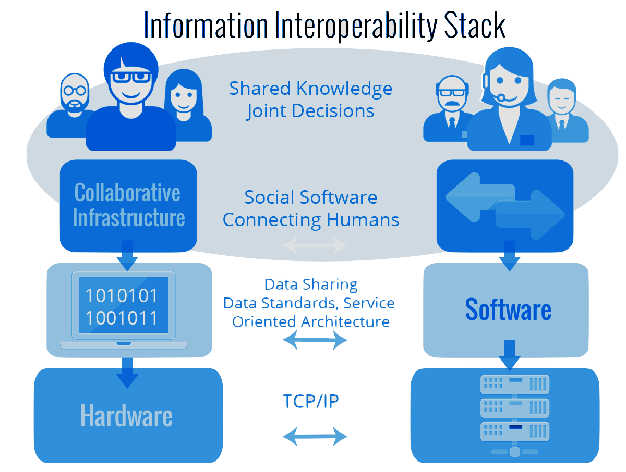
INFORMATION INTEROPERABILITY STACK
Generate recommendations and work products.
Have a lasting impact in the recommendation of standards.
ESIP does not:
Provide data
Sustain cyberinfrastructure
Compete with our members
Develop standards

Slide 6
VIRTUAL COLLABORATION
Facilitate professional development, outreach, and collaboration opportunities.
THREE APPROACHES
IN PERSON MEETINGS
Seed innovation and community-generated best practices.
Provide funding for prototyping, experimentation, and skill development.
ESIP LAB
Notes:
Community-generated best practices
Incubate seed ideas & evaluate tech projects
Professional development & outreach
Provide virtual and in-person venues for collaboration and connections
Provide mini-grants to make stuff happen

Slide 7
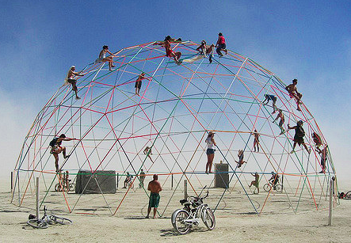
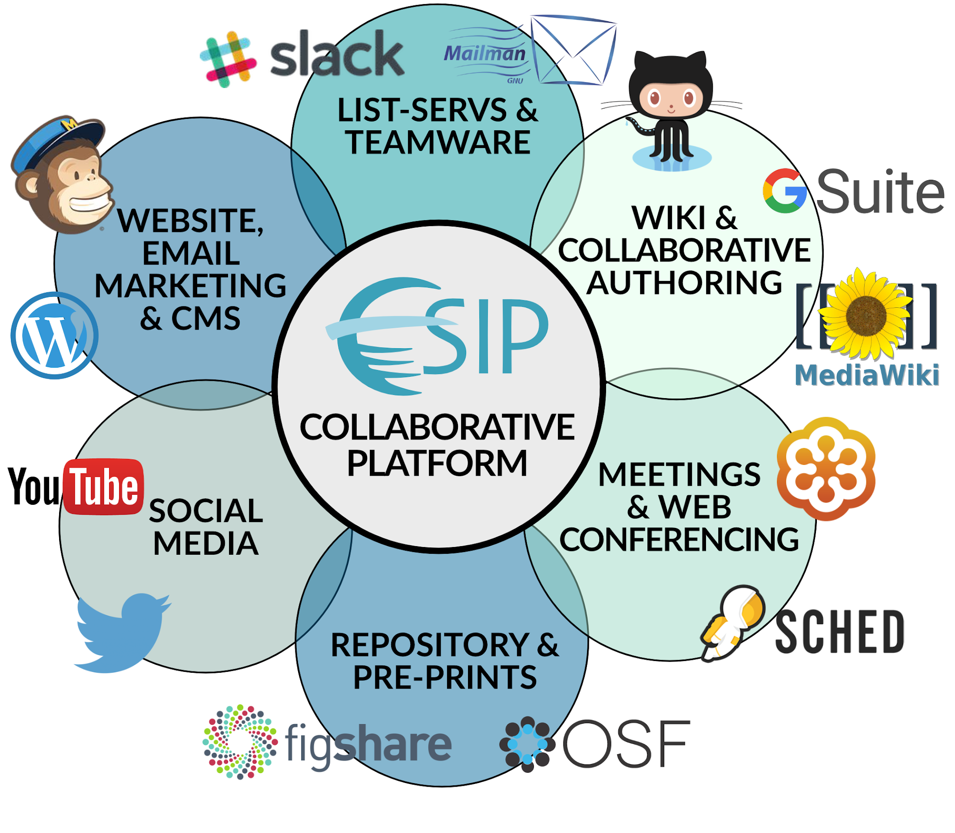
ESIP BACKBONE

Slide 8
ESIP BACKBONE
Erin Robinson Megan Carter
Dan Keyes Annie Burgess

Slide 9
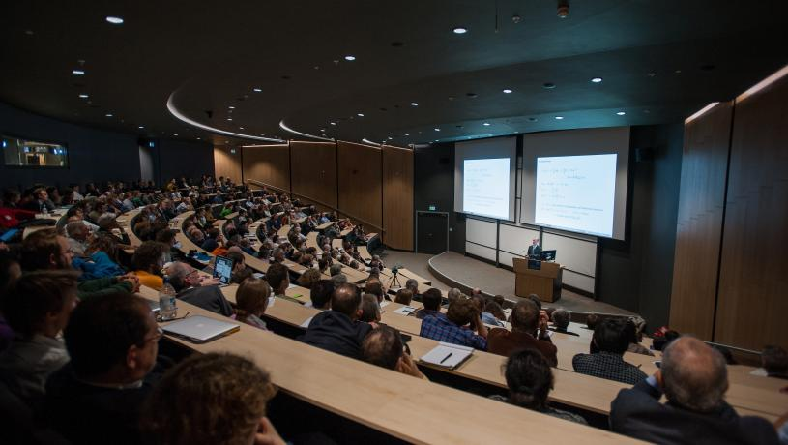
TRADITIONAL MEETINGS

Slide 10
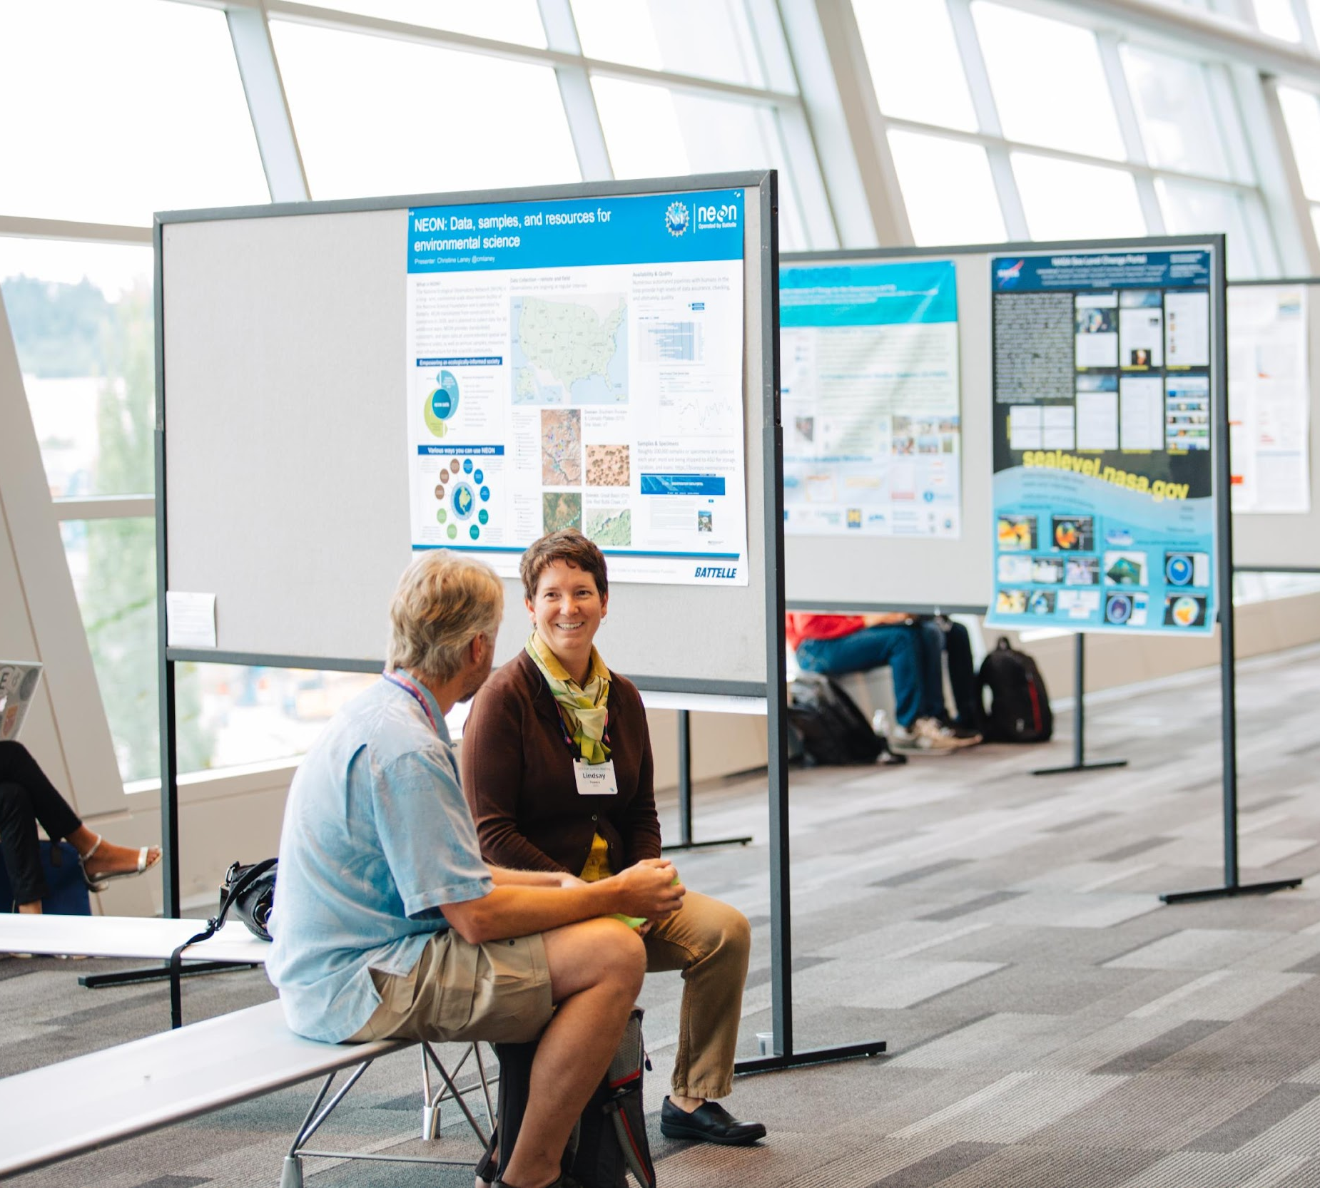
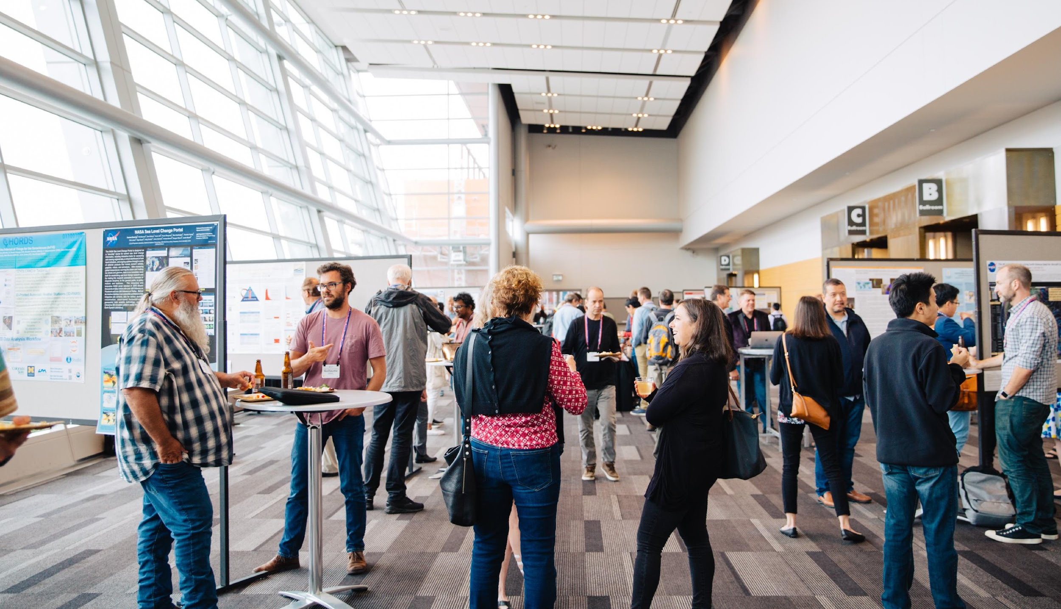
WHAT MAKES ESIP MEETINGS DIFFERENT
Plenaries
Breakouts
Networking Time
Unconference Time
Co-located Events

Slide 11
WHAT THE ESIP COMMUNITY SAYS ABOUT OUR MEETINGS
A serious meeting that actually performs a function– the data are slightly more interoperable at end of the meetings.
Hardest questions I ever got were at ESIP.
ESIP is a gathering place for other groups to convene and co-locate their meetings. Co-located meetings are coveted slots!
I found my [Earth science data] people.
Clear professional ‘home’ for earth science data people.
Highly skilled people who are a good sounding board for ideas.

Slide 12
March -
March 13 – Cancelled ESIP-supported meeting planned for April 14-16
April
May
June
Reworked our FY20 Budget
created registration structure for ESIP Summer 2020
Researched Virtual Platforms
Researched Fee structures
Begin contingency planning
ESIP Board met and moved next 2 ESIP conferences to virtual
Trained session leaders in both tech and new facilitation skills
Board approved FY20 Budget revision
Cancelled second ESIP-Supported Meeting
Supported EarthCube Annual Meeting
Moved EarthCube Annual meeting to virtual
Timeline of our Pivot to Virtual Conferences

Slide 13
Key Learnings - Cancellation
All our meetings should have had contingency plans in place
We investigated event insurance and ultimately, decided against
Force Majeure clause is critical.
We utilized our lawyer to cancel the April Meeting w/ no penalty.
We renegotiated the contract FM for our 2020 Summer Meeting for the same week in 2021

Slide 14
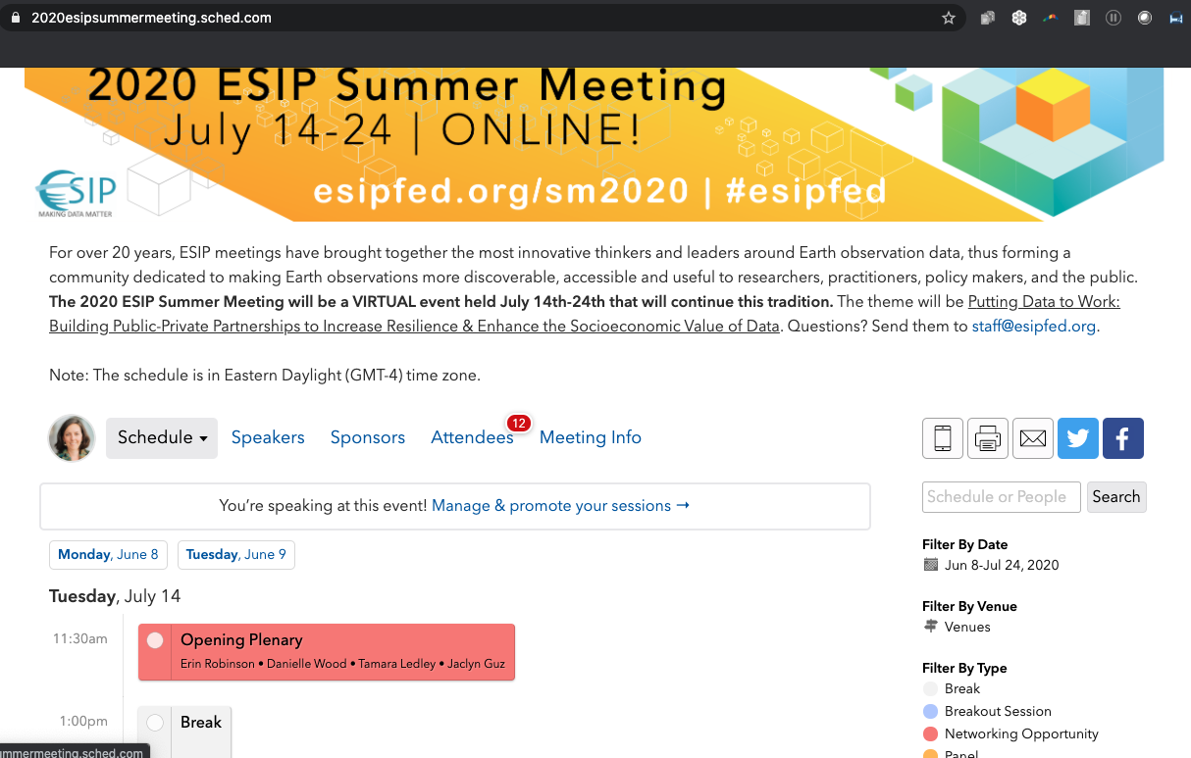

Slide 16
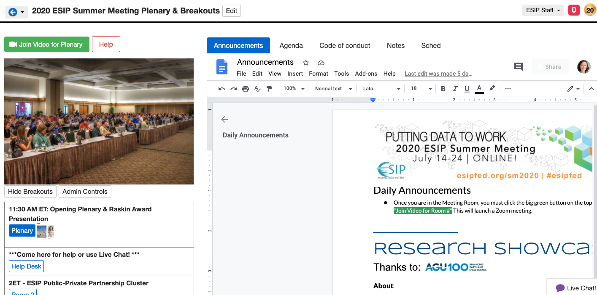

Slide 18
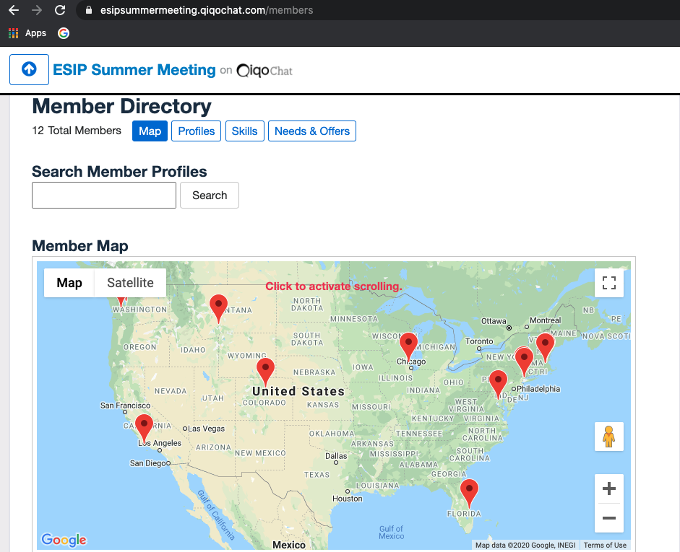
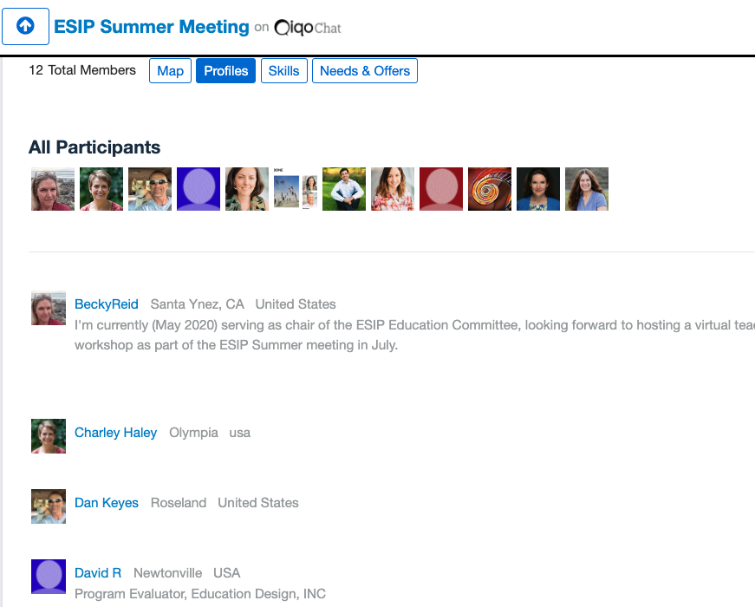
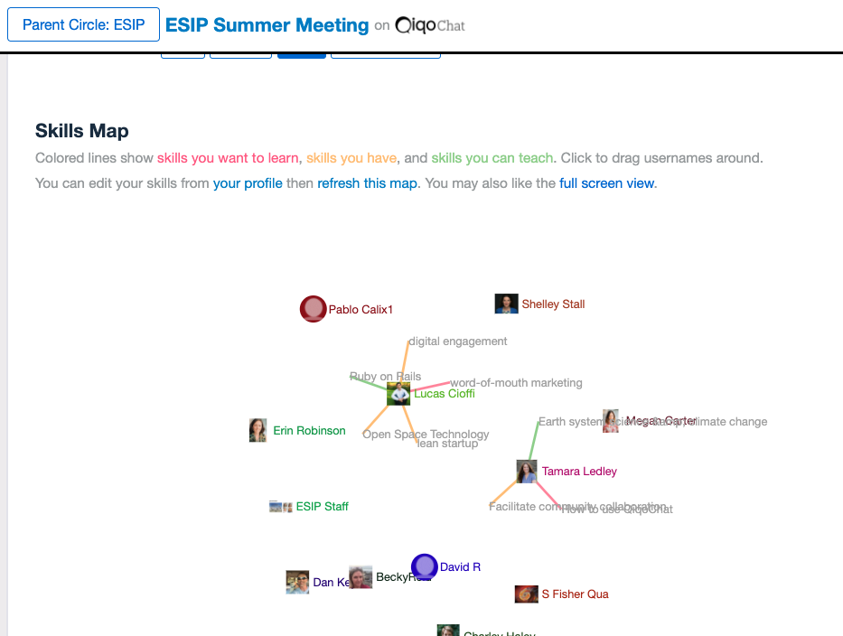
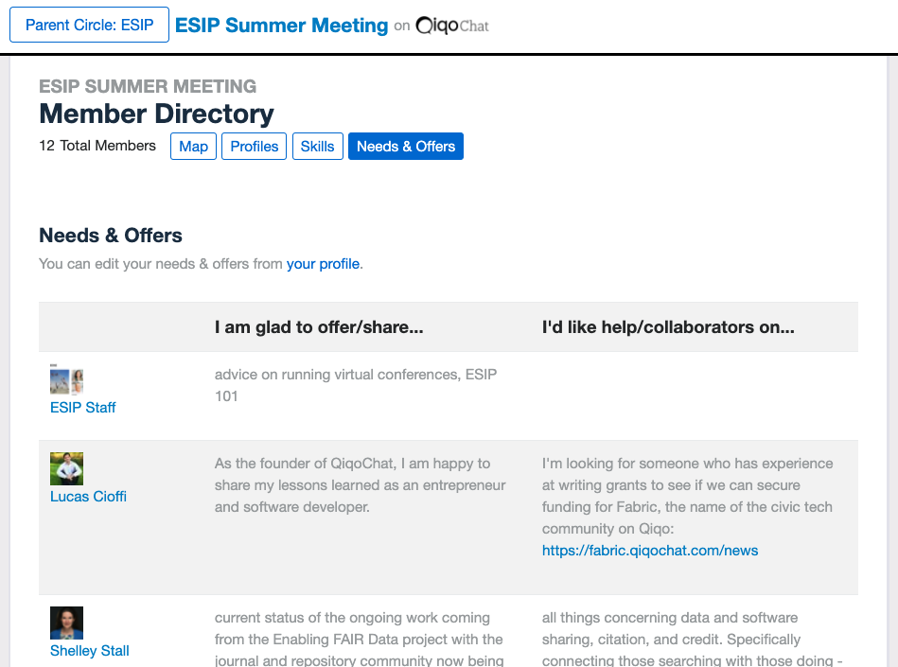

Slide 19
Key Learnings – Pivot
Making the decision sooner than later allowed us to provide the community certainty
It was important for us to be able to use some of the tools/systems we had in place for in-person meetings (Cvent, Sched)
We repurposed our FY20 travel to support facilitation and tech support
Rethink special events and ways that people will network
TONS of training
Feedback & evaluation are more important

Slide 20
Key Learnings – Registration Fees
Consider pricing structures for elearning/courses*
We based our price on $25/hour of plenary content and the cost of full use of our platform for the 10 days of our meeting
We provided comp’d registration for Session Leaders to give to 1-2 new to ESIP speakers
*Source: https://helloendless.com/virtual-event-pricing/

Slide 21
Resources – ESIP
ESIP Summer Meeting: https://2020esipsummermeeting.sched.com/
ESIP Session Breakout Leader Guidance: https://docs.google.com/document/d/1dIIJQyR0-Ky7RbisYjjsxe_pXM4JCaL5J8Ca2osStRo/edit
ESIP Summer Contingency Plan: https://docs.google.com/document/d/1AJiOHR0JxOktusN6iJXg58ZrDptV3bfS4LgAjHP_IUY/edit
Virtual Conference Pricing Justification Background: https://docs.google.com/document/d/1-XIvnsrmhn95TVg1ueXEiNq0x-oEX0sbANnHN8NqLvQ/edit

Slide 22
Resources – Gathered from around the Internet
Virtual Conference Resources
A guide to hosting on Zoom: https://docs.google.com/document/d/1KLRrnm6g5YvD8QRSPwwNWq6NPk9FYvMpZPy_XEyOmMM/edit#
ACM Presidential Task Force on What Conferences Can Do to Replace Face-to-Face Meetings
Mozilla Blog: Rapid Virtual Meeting Prototyping in the Age of a Pandemic
Liberating Structures (particular recent work on how to turn in-person methods into virtual methods)

Slide 23
esipfed.org | #ESIPfed
ESIP Meetings
ESIPFED.ORG/MEETINGS
THANK YOU
ESIP Collaboration Areas
ERIN ROBINSON
ERINROBINSON@ESIPFED.ORG
ESIPFED.ORG/COLLABORATE
ESIP Lab
ESIPFED.ORG/LAB
Supported by:

