Slide 1
Altmetric for Benchmarking @vito
Luc Int Panis Altmetric Virtual Event 17 June 2020

Slide 2
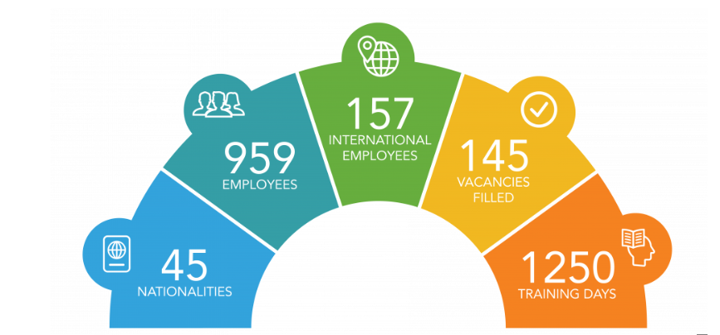
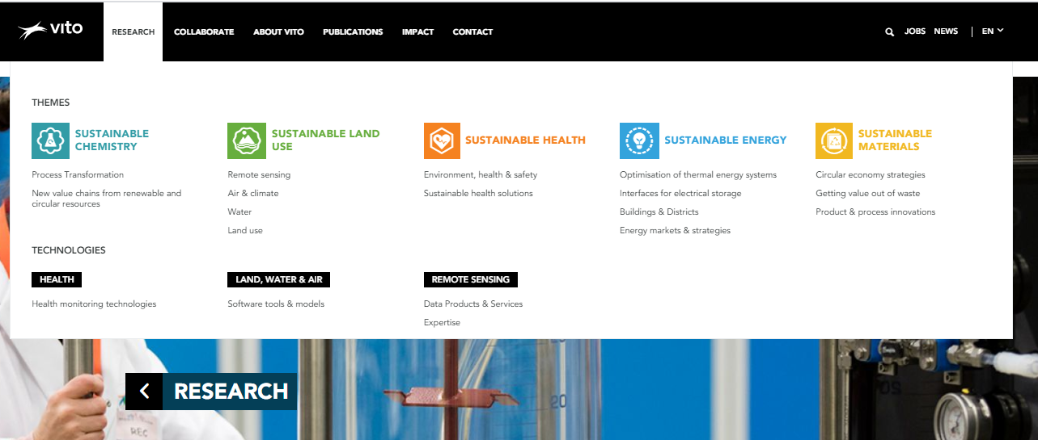
VITO
VITO www.vito.be/en
A Flemish research institute focusing on cleantech & sustainability
Applied research on:
Sustainable Energy
Sustainable Materials
Sustainable Chemistry,
Sustainable Land-Use
Sustainable Health

Slide 3
MOTIVATIONS for using Altmetric @vito
motivations & agenda
External communication
No results so far (Flemish press does not use DOI’s)
Knowing & Understanding
How research is perceived / impacts the world outside of Academia
Mentions in press are perceived more important than citations
Applied research: so citations in patents are preferred over citations in papers
Monitoring reactions pos/neg on social media
Monitoring effect of our Open Access policy
Internal Benchmarking
Over time
Between departments
With other research institutes in Flanders (using GRID ID function)

Slide 4
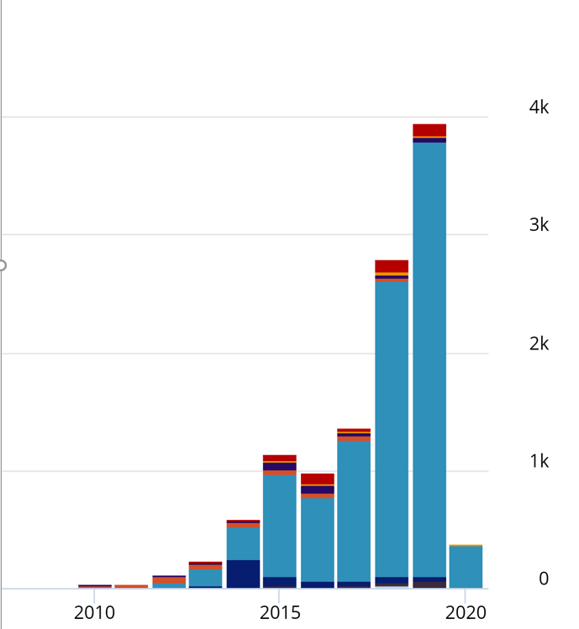
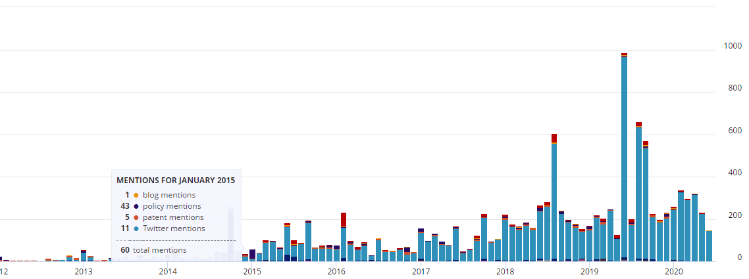
Strong increase / mostly Twitter Become Less dependent on a few block busters
Altmetric
Benchmarking over time
SSN

Slide 5
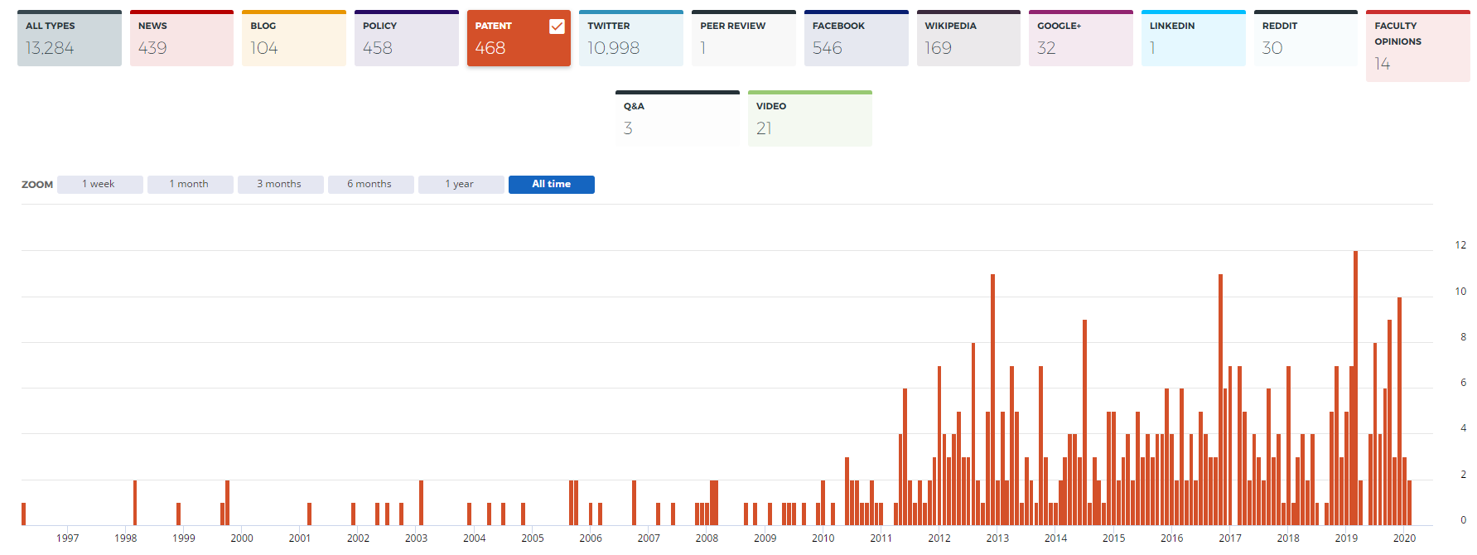
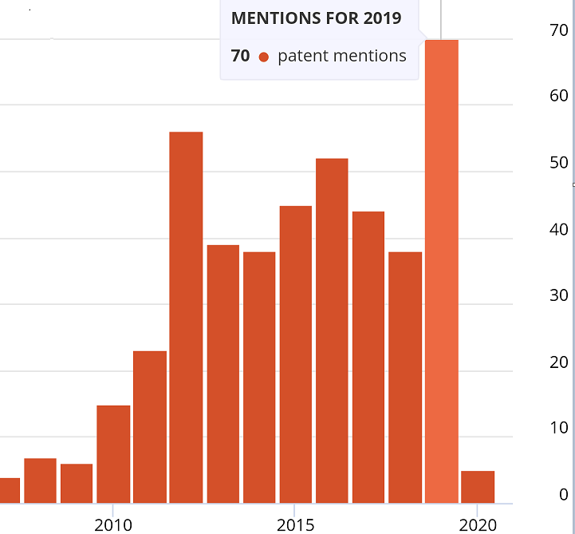
Monitoring over time
Patents

Slide 6
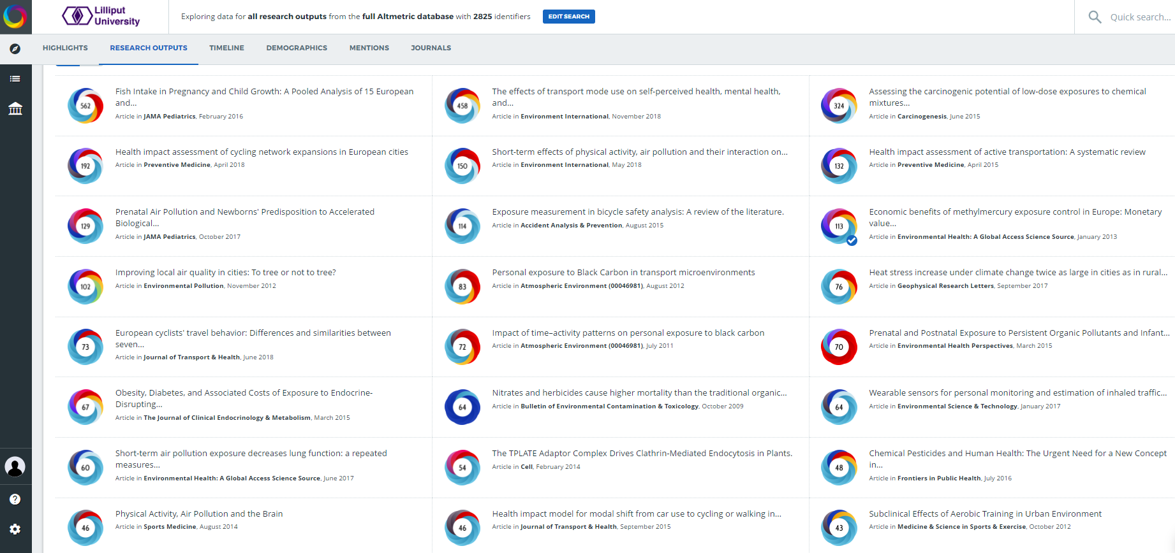
MRG
MRG
MRG
MRG
MRG
MRG
MRG
MRG
MRG
RMA
MRG
RMA
MRG
MRG
MRG
MRG
MRG
MRG
MRG
MRG
MRG
MRG
MRG

Slide 7
HBM
MRG
HBM
MRG
MRG
MRG
HBM
MRG
HBM
RMA
MRG
RMA
MRG
MRG
HBM
HBM
HBM
MRG
MRG
HBM
MRG
MRG
MRG

Slide 8
External benchmarking

Slide 9
External benchmarking

