Slide 1
Data Available Upon Request
Leslie McIntosh
figshare Fest 2020
@ripeta1

Slide 2
TL;ZO
Notes:
Too long, zoned out
Open Science is great, but it’s hard.
One push within open science has been to have Data Availability Statements within research articles.
This is suppose to help with data sharing, but it falls short.
There are different ways that authors say they share data - 7 categories
One category is that “Data available upon request”
“Data upon request” is really data that aren’t available. Either not when you need it, or never.
So what can we do...when no one is responsible, but science is accountable?
For that...tune in to the end :)

Slide 3
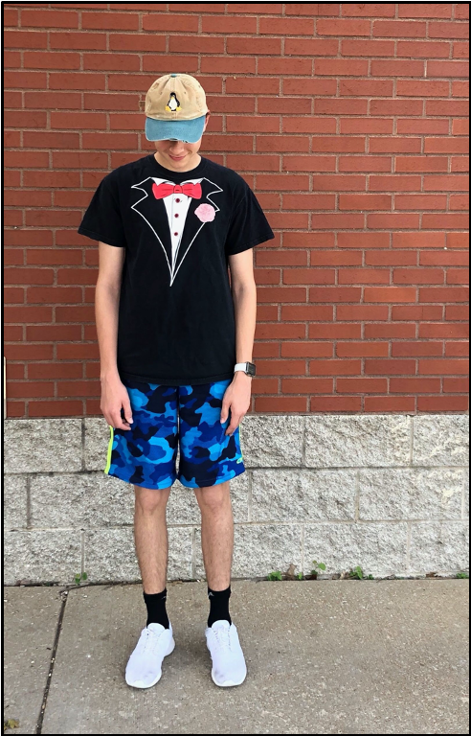
Open Science
It’s a challenge
Notes:
Open science is a challenge, much like a teen trying to put together an outfit.
You see, scientific research is like this teen,
Who promised me his clothes were clean,
But he had other things on his mind,
And the outfit did not combine.
We know open science is leading to more reproducibility of scientific research, so how do we move that forward.

Slide 4
Transparency as a Solution
Notes:
Transparency is where reproducibility begins. It can be thought of as the sufficiently clear and complete documentation of the research This is distinct from accessibility, which requires information to be available as opposed to the processes being transparently described. While not all research materials need to be accessible due to confidentiality and/or anonymity, achieving adequate transparency is essential to reproducibility. This also is vital to improving the quality of science.

Slide 5
Quality Indicators
Author Identifiers
Study Objective
Data Availability
Code Sharing
Ethical Approval
Funding Source
Notes:
But what does quality look like? And why is it important? looking through the lens of a scientific publication,
There are quality indicators for which trust is built. These are not explicit statements/guarantees, but a footprint of trust, if you will. For example, to quickly judge if a researcher supports reproducibility and responsible research I look for the a few key items in an article or grant: use of unique author identifiers (e.g. ORCIDs), a well-stated hypothesis, data availability, citing data, sharing code, ethical approval, funding citations, limited self-citations. So, if there is a data availability statement but all it states is to contact the author, I am going to have less trust in their work than if they have given specific instructions for obtaining the data or a link to the data.

Slide 6
Data
Code
Software
Reproducibility
Notes:
Core components of reproducibility include having data, code, and software shared or transparently reported.
One place the scientific community has made great strides is in requiring data availability statements.

Slide 7
Find the Data
Notes:
Data Availability Statements have been growing within publications and publisher and funder policies for a number of years. This is to help make data available.
So, let’s look at some of the ways

Slide 8
Data Sharing: Upon Request without Justification
“The raw data supporting the conclusions of this article will be made available by the authors, without undue reservation, to any qualified researcher.”
Article Title: Pulmonary Group 2 Innate Lymphoid Cell Phenotype Is Context Specific: Determining the Effect of Strain, Location, and Stimuli
Article DOI: 10.3389/fimmu.2019.03114
Notes:
Data Availability Statement: The data underlying the results presented in the study are owned by Abstract Nationally representative data on the micronutrient status of Ghanaian women and children are very scarce.

Slide 9
Data Sharing: Upon Request with Justification
The datasets for this article are not publicly available because they have not been released yet to the public by the Indonesian Ministry of Health. Until that takes place requests to access the datasets should be directed to Dr F., Head of the Microbiology Department at Sanglah Hospital, Denpasar, Bali. The request shall be sent via email to the following email address: info@shospital.com.
Article Title: Identification and Distribution of Pathogens in a Major Tertiary Hospital of Indonesia
Article DOI: 10.3389/fpubh.2019.00395
Notes:
Most relevant data have been provided in the paper and its Supporting Information files. Several variables from the data set ("chc_date," "visitdate," and "visitreturn") are potentially identifying and are therefore available only on request.
OR
Data availability statement The data that support the findings of this study are available from the corresponding author upon reasonable request.
OR
The datasets for this article are not publicly available because they have not been released yet to the public by the Indonesian Ministry of Health. Until that takes place requests to access the datasets should be directed to Dr Fatmawati, Head of the Microbiology Department at Sanglah Hospital, Denpasar, Bali. The request shall be sent via email to the following email address:
OR
The author is unable to share the qualitative data due to ethical restrictions. The qualitative data is available upon request. Data access requests will be handled by the ethical committee through the following institutional contact:
OR

Slide 10
Data not Available
Notes:
IF we can get the data,
What kind of data are we talking about? Raw data, summary data, questionnaires? All important and it’s very important to know what you are searching for.
And what about this email thing?
Email’s get outdated (sometimes aren’t even real to begin with),
and let’s be honest about two things:
Point 1: Having to request data creates gatekeepers. And gatekeeping will have biases.
Point 2: Which researcher do you know that likes to answer emails?
Image by <a href="https://pixabay.com/users/qimono-1962238/?utm_source=link-attribution&amp;utm_medium=referral&amp;utm_campaign=image&amp;utm_content=1804499">Arek Socha</a> from <a href="https://pixabay.com/?utm_source=link-attribution&amp;utm_medium=referral&amp;utm_campaign=image&amp;utm_content=1804499">Pixabay</a>

Slide 11
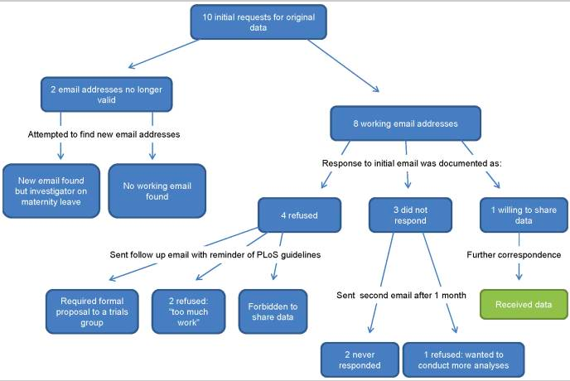
Savage CJ, Vickers AJ. Empirical study of data sharing by authors publishing in PLoS journals. PLoS One. Published 2009 doi:10.1371/journal.pone.0007078
Notes:
1/10 PLoS authors shared data when asked to, despite the PLoS agreement to make data available to other parties.
Caroline Savage and Andrew Vickers
Savage CJ, Vickers AJ. Empirical study of data sharing by authors publishing in PLoS journals. PLoS One. 2009;4(9):e7078. Published 2009 Sep 18. doi:10.1371/journal.pone.0007078

Slide 12
Odds of a data set existing fell by 17% per year
Odds of being able to contact the author fell by 7% each year as well
Notes:
Cell paper talking about this issue
Highlights:
-They examined the availability of data from 516 studies between 2 and 22 years old
-The odds of a data set existing fell by 17% per year
-Broken e-mails and obsolete storage devices were the main obstacles to data sharing
-Odds of being able to contact the author fell by 7% each year as well
-Only 23% of data was confirmed as existing (which meant either supplied or still in use so it thus could not be shared)
https://www.cell.com/current-biology/fulltext/S0960-9822(13)01400-0?_returnURL=https%3A%2F%2Flinkinghub.elsevier.com%2Fretrieve%2Fpii%2FS0960982213014000%3Fshowall%3Dtrue

Slide 13
1 | External repository
2 | In article & supplementary files
3 | Online
4 | Within paper
5 | Not publically available*
6 | Upon request*
7 | Not Applicable*
Availability of Data
*With or without justification
Notes:
So that is the sad news, but let’s look at ways people are sharing data…
Here they are from most readily available to least, although there is still a bit of discussion around these

Slide 14
Data Sharing: In Supp. Files
“...supplemental material available online with this article… Detailed methods are described in the Supplemental Methods.”
Article Title: COP1-DET1-ETS axis regulates ERK transcriptome and sensitivity to MAPK inhibitors
Article DOI: 10.1172/jci94840
Notes:
This could still not be the data you need, as many people put the summary data in, not the raw data for compuational needs. Moreover, there is typically limited metadata describing the data.

Slide 15
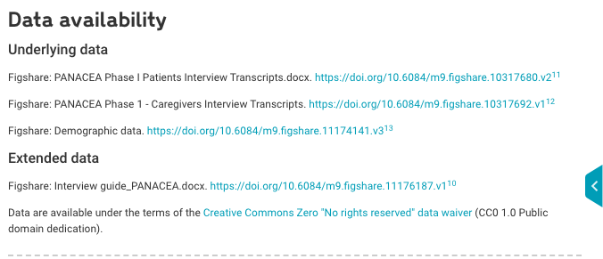
Data Sharing: External Repository
Article Title: Patient and caregiver reported facilitators of self-care among patients with chronic heart failure: report from a formative qualitative study
Article DOI: 10.12688/wellcomeopenres.15485.1

Slide 16
DAS
≠
Data Available
Notes:
How does a policy help?
Let’s look at a little more data….
So let’s look at how publishers are performing who put into place policies over the past few years.

Slide 17
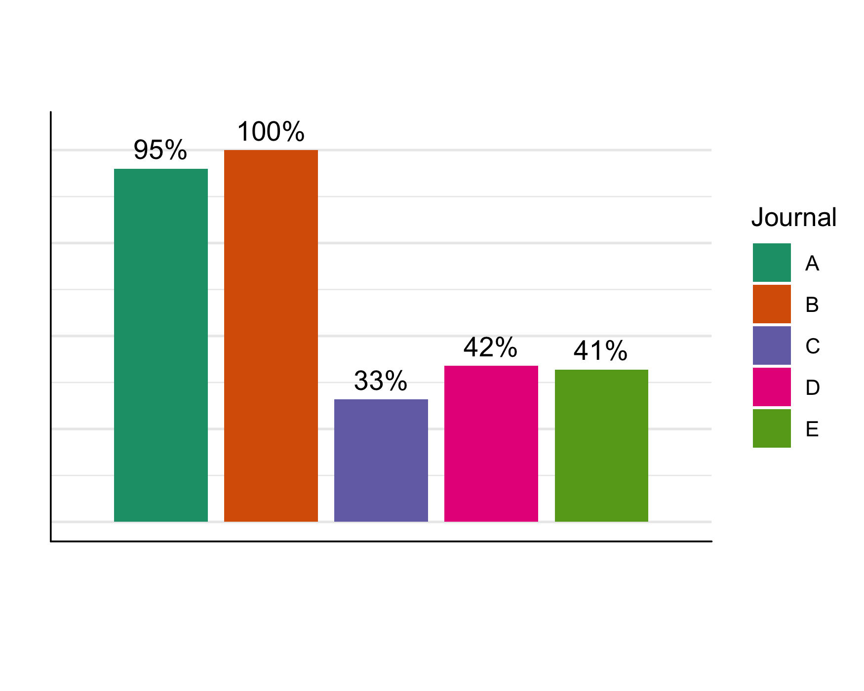
Data Availability Statements
Percentage
Journals
Notes:
Looking across five journals that have data sharing policies, we looked at the percentage of articles within each journal that had data availability statements

Slide 18
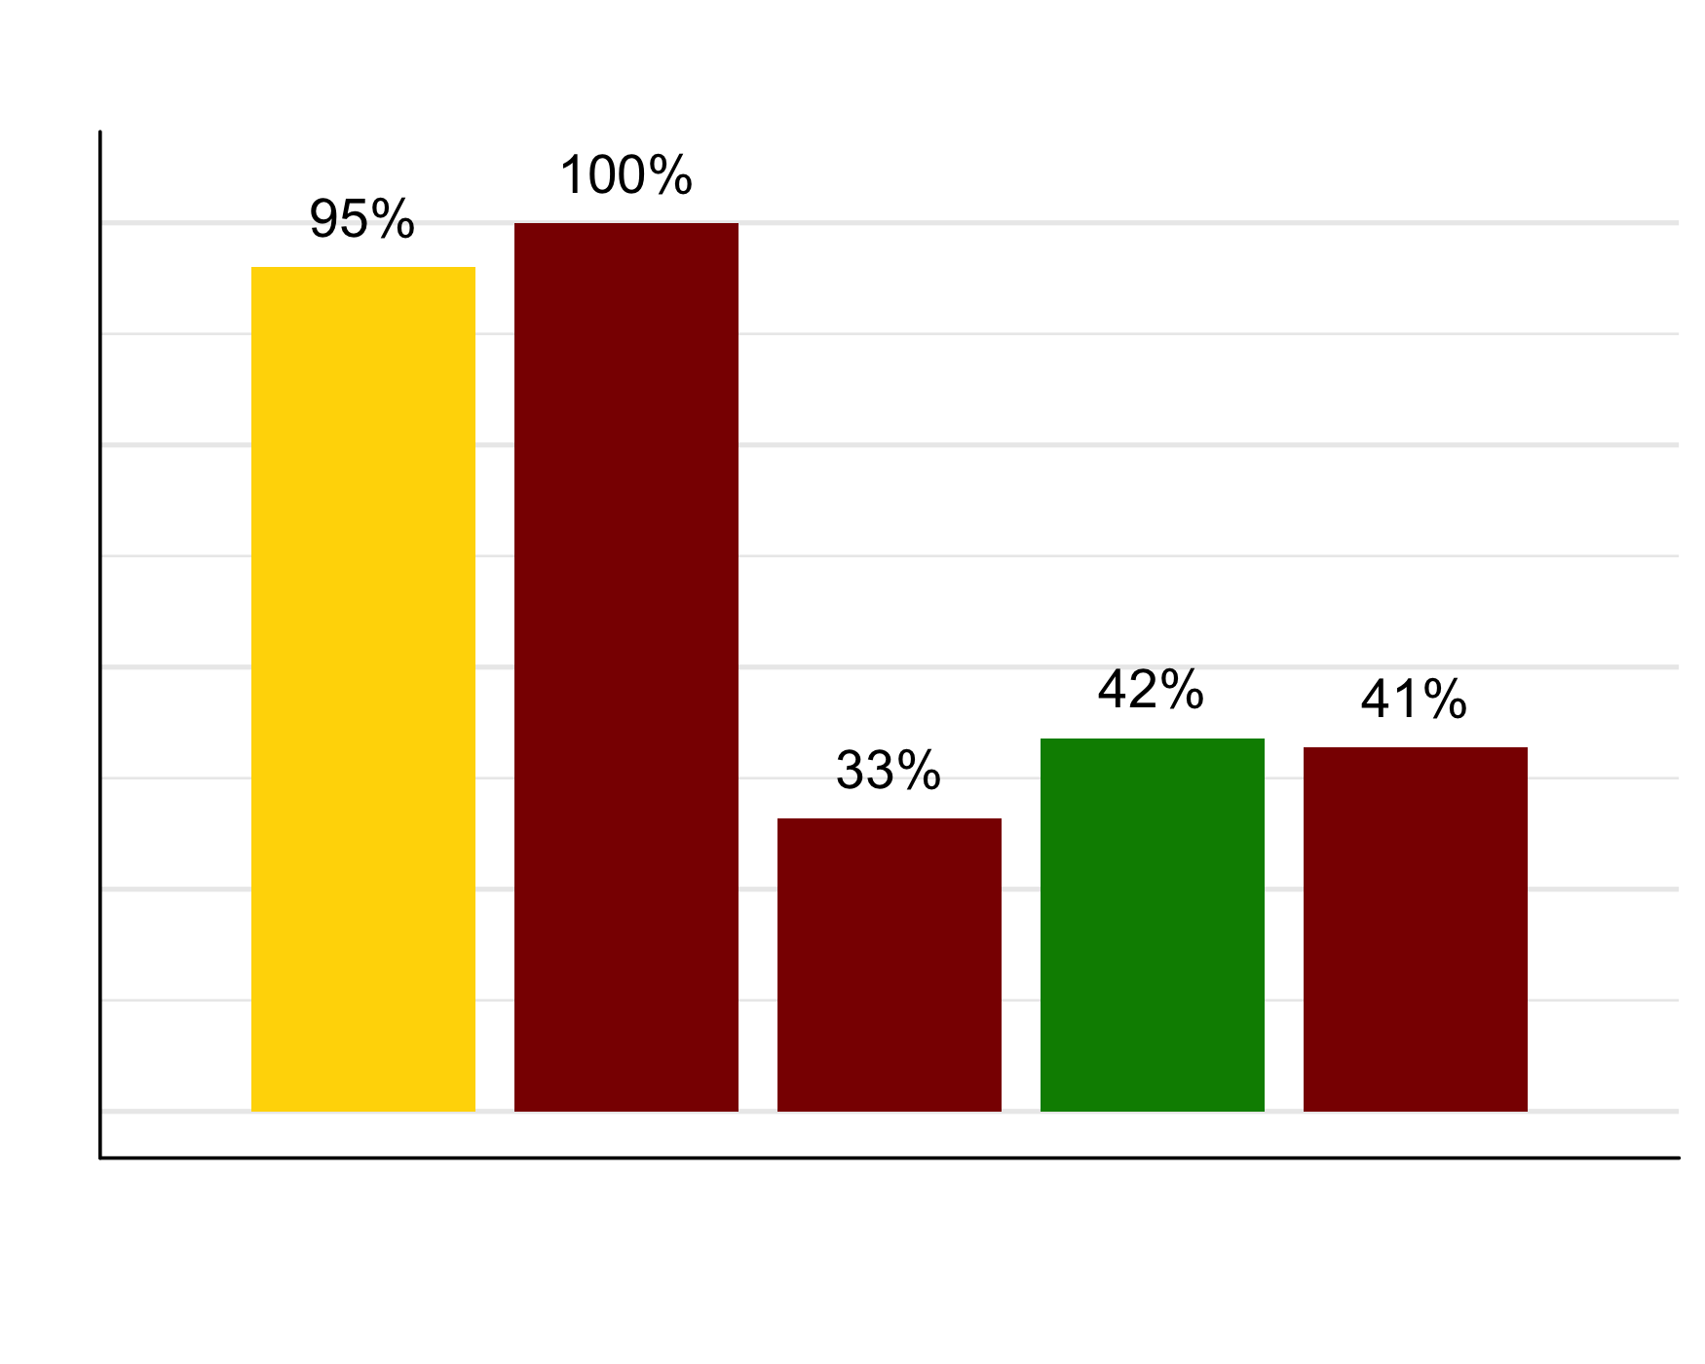
Data Availability Statements
Percentage
Journals by Impact Factor
Notes:
There was not greater compliance in have a DAS present by journal impact factor
Data Availability colored by impact factor - not faming or shaming

Slide 19
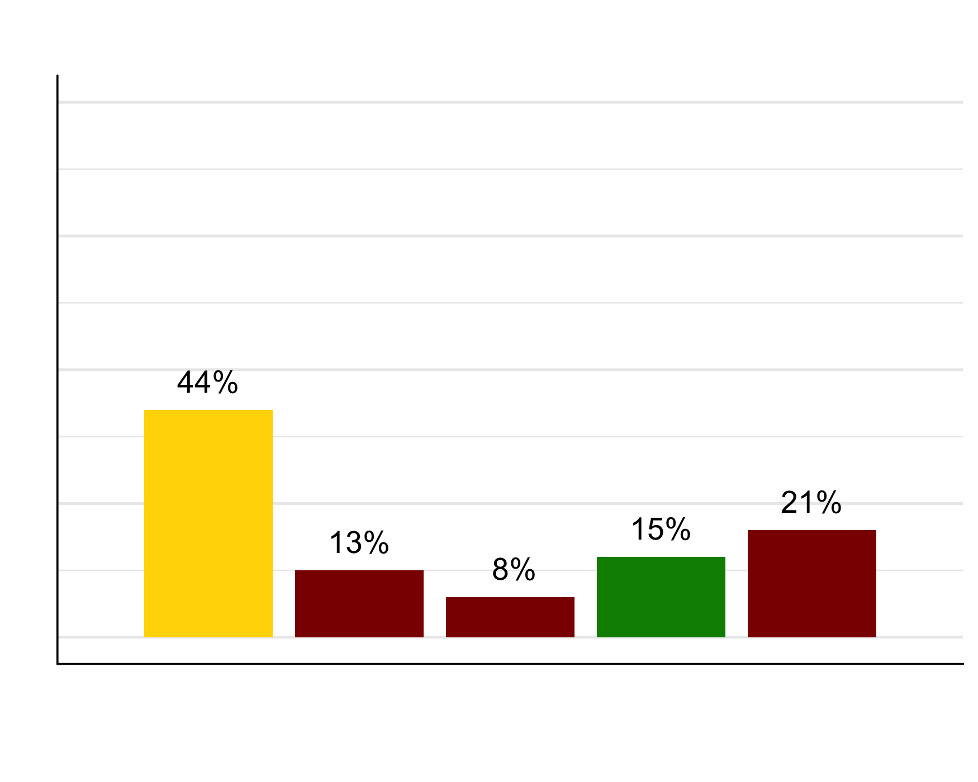
Availability of Data
Percentage
Journals by Impact Factor
Notes:
Slide 15
Percent that have data as Public or listed as in a specific Repository colored by impact factor

Slide 20
Who takes responsibility?
Notes:
So, how do we fix this and who takes responsibility?
-----
‘Who’s in charge here?’ slide I was thinking of the “who is your lord” sequence from monty python (the anarcho syndicalists part), but it might feel like a stretch?
Possible answers: “No one is in charge, it is everyone’s job”, “Journals”, “Publishers”, “Funders” Seizing the means of publication, it’s everyone’s job:
Price of publishing and the structure in place is inherently discriminatory, but it can be massively decentralized to cool effect and you know exactly what everyone contributed.
On a thread here, 27 different people posted 800 substantive mathematical comments containing 170,000 words. That’s a lot of mathematics done very quickly. After 37 days he used his blog to announce that the problem had most probably been solved. In fact, a generalization of the original problem which they were attacking.
So they end up publishing a couple of papers based on this method of doing math proofs! There is one behind a paywall which is absolutely hilarious, but there are arXiv versions of each so it’s kinda irrelevant (and one paper on princeton.edu which is open https://arxiv.org/abs/0910.3926 , https://annals.math.princeton.edu/2012/175-3/p06). And all the information is still available in its more raw form from an archived blog comment trail https://gowers.wordpress.com/category/polymath5/ .
https://gowers.wordpress.com/2009/01/27/is-massively-collaborative-mathematics-possible/
Journals/Publishers/Funders
Not as cool of a point, the rest are basically asking someone else to make a rule for people to follow. Works… okay, not well.
People ignoring guidelines:
https://content.apa.org/record/2006-12925-016
Researchers were only able to gain access to 25.7% of the total number of 249 data sets used for 141 studies despite authors all having agreed to share data. https://www.ncbi.nlm.nih.gov/pmc/articles/PMC2739314/
1/10 PLoS authors shared data when asked to, despite the PLoS agreement to make data available to other parties.
Image: Image by <a href="https://pixabay.com/users/geralt-9301/?utm_source=link-attribution&amp;utm_medium=referral&amp;utm_campaign=image&amp;utm_content=5273066">Gerd Altmann</a> from <a href="https://pixabay.com/?utm_source=link-attribution&amp;utm_medium=referral&amp;utm_campaign=image&amp;utm_content=5273066">Pixabay</a>

Slide 21
Notes:
Retracted covid papers
https://www.thelancet.com/journals/lancet/article/PIIS0140-6736(20)31180-6/fulltext
https://www.nejm.org/doi/full/10.1056/NEJMoa2007621
Two studies by the same authors.
Three of the four authors became concerned about the quality of the underlying data and requested the retraction
Data came from Surgisphere, a small data company. The fourth author is the CEO of Surgisphere, Sapan Desai. He would not share the data with a third-party seeking to review the paper. (Classic example of what goes wrong when the author is the gatekeeper of the data, i.e. "Upon Request from Author")
First paper, published in The Lancet, found that hydroxychloroquine increased the risk of death for coronavirus patients.
Second paper, published in The New England Journal of Medicine, examined the use of ACE inhibitors (blood pressure drugs) in coronavirus patients.

Slide 22
Improving quality,
Improves efficiency
Notes:
We believe that improving the quality will improve efficiency. And automating what we can will improve the speed of science.
We believe that the scientific community needs faster means to check and improve science.
As we build new algorithms to speed up the process of scientific review, how do we build in and assess trust in the the automation.
Let me quickly take you through our process...
Alignment of Policies checking for quality and Automation for practice
Quality Improvement systematic review (2017) https://www.ncbi.nlm.nih.gov/pmc/articles/PMC5337696/

Slide 23
100+ unique variables
12 critical variables
ripetaFramework
Ripeta, LLC. All rights reserved. This is not to be shared without official permission from Ripeta, LLC.
Notes:
We developed a framework based on existing guidelines as well as personal expertise.
-----
What is the problem?
There are a plethora of existing best practices, recommendations, policies, and literature throughout the computational, health, and library sciences defining what and how research ought to be documented and shared to ensure reproducibility.
However, many of these policies are ambiguous and contradictory (non-interoperable) to one another.
We synthesized and adjudicated best practices (covering the ambit of data management, analysis, and publishing) within the field of biomedical health research and compiled them into a framework defining what ought to be documented and shared within a research publication to ensure verifiability and reproducibility of the entire scientific method.
Conducted interviews with researchers to examine where their own methods failed to be documented and their needs when attempting to verify or reproduce a result.
(Focused on the reproducibility of research using the electronic medical record as a secondary data source)

Slide 24
ripetaReport
Ripeta, LLC. All rights reserved. This is not to be shared without official permission from Ripeta, LLC.

Slide 25
Study Purpose Stated = Yes
Anisogamy evolved with a reduced sex-determining region in volvocine green algae
COMMUNICATIONS BIOLOGY DOI: 10.1038/s42003-018-0019-5
In this study, we focus on a more suitable combination for a comparative study of the transition from isogamy to anisogamy: two closely related intermediate volvocine species that bracket the transition from isogamy to anisogamy—isogamous Yamagishiella unicocca and anisogamous Eudorina sp., both of which share essentially the same vegetative (asexual) morphology
ripetaExample
Ripeta, LLC. All rights reserved. This is not to be shared without official permission from Ripeta, LLC.
Notes:
Notes in ‘s42003-018-0019-5’ Notes in Workspace: Excerpt: In this study, we focus on a more suitable combination for a comparative study of the transition from isogamy to anisogamy: two closely related intermediate volvocine species that bracket the transition from isogamy to anisogamy—isogamous Yamagishiella unicocca and anisogamous Eudorina sp., both of which share essentially the same vegetative (asexual) morphology(s42003-018-0019-5, p.2) Excerpt: Molecular evolutionary analysis. Divergence scores of synonymous and non- synonymous substitutions between gametologs were computed using yn00 of the PAML4 package45; nonsynonymous and synonymous site divergence of aligned coding sequences of gametologs was calculated based on Yang and Nielsen46 with equal weighting between pathways, and the same codon frequency for all pairs11(s42003-018-0019-5, p.6) Excerpt: Data availability. Raw reads, genome assemblies, and annotations were deposited at DDBJ/EMBL/GenBank under the accessions as follows; DRA: DRA004920, DRA002727, and DRA004919; whole genome assembly: BDSI01000001- BDSI01003180, BDSJ01000001-BDSJ01002471, BDSK01000001-BDSK01001897, BDSL01000001-BDSL01001461; annotations: LC314412- LC314416. All the other data generated or analyzed during this study are included in this published article and its Supplementary information.(s42003-018-0019-5, p.6)

Slide 26
Data Availability = Yes
Anisogamy evolved with a reduced sex-determining region in volvocine green algae
COMMUNICATIONS BIOLOGY DOI: 10.1038/s42003-018-0019-5
ripetaExample
Data availability. Raw reads, genome assemblies, and annotations were deposited at DDBJ/EMBL/GenBank under the accessions as follows; DRA: DRA004920, DRA002727, and DRA004919; whole genome assembly: BDSI01000001- BDSI01003180, BDSJ01000001-BDSJ01002471, BDSK01000001-BDSK01001897, BDSL01000001-BDSL01001461; annotations: LC314412- LC314416. All the other data generated or analyzed during this study are included in this published article and its Supplementary information.
Ripeta, LLC. All rights reserved. This is not to be shared without official permission from Ripeta, LLC.
Notes:
Notes in ‘s42003-018-0019-5’ Notes in Workspace: Excerpt: In this study, we focus on a more suitable combination for a comparative study of the transition from isogamy to anisogamy: two closely related intermediate volvocine species that bracket the transition from isogamy to anisogamy—isogamous Yamagishiella unicocca and anisogamous Eudorina sp., both of which share essentially the same vegetative (asexual) morphology(s42003-018-0019-5, p.2) Excerpt: Molecular evolutionary analysis. Divergence scores of synonymous and non- synonymous substitutions between gametologs were computed using yn00 of the PAML4 package45; nonsynonymous and synonymous site divergence of aligned coding sequences of gametologs was calculated based on Yang and Nielsen46 with equal weighting between pathways, and the same codon frequency for all pairs11(s42003-018-0019-5, p.6) Excerpt: Data availability. Raw reads, genome assemblies, and annotations were deposited at DDBJ/EMBL/GenBank under the accessions as follows; DRA: DRA004920, DRA002727, and DRA004919; whole genome assembly: BDSI01000001- BDSI01003180, BDSJ01000001-BDSJ01002471, BDSK01000001-BDSK01001897, BDSL01000001-BDSL01001461; annotations: LC314412- LC314416. All the other data generated or analyzed during this study are included in this published article and its Supplementary information.(s42003-018-0019-5, p.6)

Slide 27
Software Stated = Yes
Software Version = Yes
Software Cited = Yes
Anisogamy evolved with a reduced sex-determining region in volvocine green algae
COMMUNICATIONS BIOLOGY DOI: 10.1038/s42003-018-0019-5
Molecular evolutionary analysis. Divergence scores of synonymous and non- synonymous substitutions between gametologs were computed using yn00 of the PAML4 package⁴⁵; nonsynonymous and synonymous site divergence of aligned coding sequences of gametologs was calculated based on Yang and Nielsen⁴⁶ with equal weighting between pathways, and the same codon frequency for all pairs¹¹
ripetaExample
Ripeta, LLC. All rights reserved. This is not to be shared without official permission from Ripeta, LLC.
Notes:
Notes in ‘s42003-018-0019-5’ Notes in Workspace: Excerpt: In this study, we focus on a more suitable combination for a comparative study of the transition from isogamy to anisogamy: two closely related intermediate volvocine species that bracket the transition from isogamy to anisogamy—isogamous Yamagishiella unicocca and anisogamous Eudorina sp., both of which share essentially the same vegetative (asexual) morphology(s42003-018-0019-5, p.2) Excerpt: Molecular evolutionary analysis. Divergence scores of synonymous and non- synonymous substitutions between gametologs were computed using yn00 of the PAML4 package⁴⁵; nonsynonymous and synonymous site divergence of aligned coding sequences of gametologs was calculated based on Yang and Nielsen⁴⁶ with equal weighting between pathways, and the same codon frequency for all pairs¹¹(s42003-018-0019-5, p.6) Excerpt: Data availability. Raw reads, genome assemblies, and annotations were deposited at DDBJ/EMBL/GenBank under the accessions as follows; DRA: DRA004920, DRA002727, and DRA004919; whole genome assembly: BDSI01000001- BDSI01003180, BDSJ01000001-BDSJ01002471, BDSK01000001-BDSK01001897, BDSL01000001-BDSL01001461; annotations: LC314412- LC314416. All the other data generated or analyzed during this study are included in this published article and its Supplementary information.(s42003-018-0019-5, p.6)

Slide 28
Code Availability = No
Anisogamy evolved with a reduced sex-determining region in volvocine green algae
COMMUNICATIONS BIOLOGY DOI: 10.1038/s42003-018-0019-5
Code availability not found.
ripetaExample
Ripeta, LLC. All rights reserved. This is not to be shared without official permission from Ripeta, LLC.
Notes:
Notes in ‘s42003-018-0019-5’ Notes in Workspace: Excerpt: In this study, we focus on a more suitable combination for a comparative study of the transition from isogamy to anisogamy: two closely related intermediate volvocine species that bracket the transition from isogamy to anisogamy—isogamous Yamagishiella unicocca and anisogamous Eudorina sp., both of which share essentially the same vegetative (asexual) morphology(s42003-018-0019-5, p.2) Excerpt: Molecular evolutionary analysis. Divergence scores of synonymous and non- synonymous substitutions between gametologs were computed using yn00 of the PAML4 package45; nonsynonymous and synonymous site divergence of aligned coding sequences of gametologs was calculated based on Yang and Nielsen46 with equal weighting between pathways, and the same codon frequency for all pairs11(s42003-018-0019-5, p.6) Excerpt: Data availability. Raw reads, genome assemblies, and annotations were deposited at DDBJ/EMBL/GenBank under the accessions as follows; DRA: DRA004920, DRA002727, and DRA004919; whole genome assembly: BDSI01000001- BDSI01003180, BDSJ01000001-BDSJ01002471, BDSK01000001-BDSK01001897, BDSL01000001-BDSL01001461; annotations: LC314412- LC314416. All the other data generated or analyzed during this study are included in this published article and its Supplementary information.(s42003-018-0019-5, p.6)

Slide 29
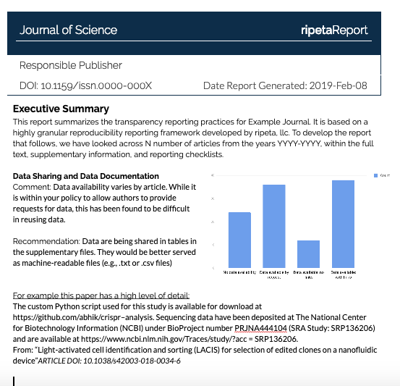
Summary Report
ripetaReport
Ripeta, LLC. All rights reserved. This is not to be shared without official permission from Ripeta, LLC.
Notes:
Ripeta generates a single report based on one manuscript. Working before something goes to publication.
However, we don’t assess just the manuscript, but a collection of manuscripts across something like an institution or funder.

Slide 30
A tale of COVID-19 articles
535 pre-prints
Notes:
Preprints from medRxiv and bioRxiv

Slide 31
Analysis
Article DOI | Study Purpose | Author- ship | Funding Statement | Data location | DAS | Code availability
10.1101/2020.01.30.927871 | Yes | 2 | No | None | No | No
10.1101/2020.03.16.20037135 | Yes | 1 | Yes | On request | Yes | No
10.1101/2020.03.11.20031096 | Yes | 4 | Yes | In paper | Yes | No
10.1101/2020.02.03.933226 | Yes | 4 | Yes | External repo | Yes | Yes
Notes:
10.1101/2020.01.30.927871 Uncanny similarity of unique inserts in the 2019-nCoV spike protein to HIV-1 gp120 and Gag - RETRACTED
10.1101/2020.03.16.20037135 Hydroxychloroquine and azithromycin as a treatment of COVID-19: results of an open-label non-randomized clinical trial - QUESTIONED
10.1101/2020.03.11.20031096 Relationship between the ABO Blood Group and the COVID-19 Susceptibility - IMPACT OVERSTATED
10.1101/2020.02.03.933226 Preliminary identification of potential vaccine targets for the COVID-19 coronavirus (SARS-CoV-2) based on SARS-CoV immunological studies - MEETS ALL RIPETA VARIABLES

Slide 32
Uncanny similarity of unique inserts in the 2019-nCoV spike protein to HIV-1 gp120 and Gag
WITHDRAWN
Article DOI | Study Purpose | Author- ship | Funding Statement | Data location | DAS | Code availability
10.1101/2020.01.30.927871 | Yes | 2 | No | None | No | No
Methodology
Retrieval and alignment of nucleic acid and protein sequences
We retrieved all the available coronavirus sequences (n=55) from NCBI viral genome database (https://www.ncbi.nlm.nih.gov/) and we used the GISAID (Elbe & Buckland-Merrett, 2017)[https://www.gisaid.org/] to retrieve all available full-length sequences (n=28) of 2019-nCoV as on 27 Jan 2020. Multiple sequence alignment of all coronavirus genomes was performed by using MUSCLE software (Edgar, 2004) based on neighbour joining method. Out of 55 coronavirus genome 32 representative genomes of all category were used for phylogenetic tree development using MEGAX software (Kumar et al., 2018). The closest relative was found to be SARS CoV.
Notes:
https://www.biorxiv.org/content/10.1101/2020.01.30.927871v1.full
Failed ripeta analysis as a first pass serves as a flag for a closer look at the scientific methods and research
Retracted for poor methods: “The sequence differences are not unique to COVID-19. Closely related [bat] coronaviruses have these chunks as well. They are small motifs used by nature over and over again.

Slide 33
Hydroxychloroquine and azithromycin as a treatment of COVID-19: results of an open-label non-randomized clinical trial
QUESTIONED
Article DOI | Study Purpose | Author- ship | Funding Statement | Data location | DAS | Code availability
10.1016/j.ijantimicag.2020.105949 | Yes | 1 | Yes | None | No | No
Elisabeth Bik took a close look at the IJAA article and detailed a long list of serious problems with the study, including questions about its ethical underpinnings, messy confounding variables, missing patients, rushed and conflicted peer review, and confusing data.
Notes:
https://doi.org/10.1101/2020.03.16.20037135
Ripeta analysis as a first pass serves as a flag for a closer look at the scientific methods and research
Questioning methods: does not meet the [International Society of Antimicrobial Chemotherapy’s] expected standard, especially relating to the lack of better explanations of the inclusion criteria and the triage of patients to ensure patient safety.
Elisabeth Bik took a close look at the IJAA article and detailed a long list of serious problems with the study, including questions about its ethical underpinnings, messy confounding variables, missing patients, rushed and conflicted peer review, and confusing data.
Cited 268 times as of June 15, 2018
Fantastic review: https://intensiveblog.com/gautret-et-al-2020-hydroxychloroquine-and-azithromycin-as-a-treatment-of-covid-19-results-of-an-open-label-non-randomized-clinical-trial-intensive-review/

Slide 34
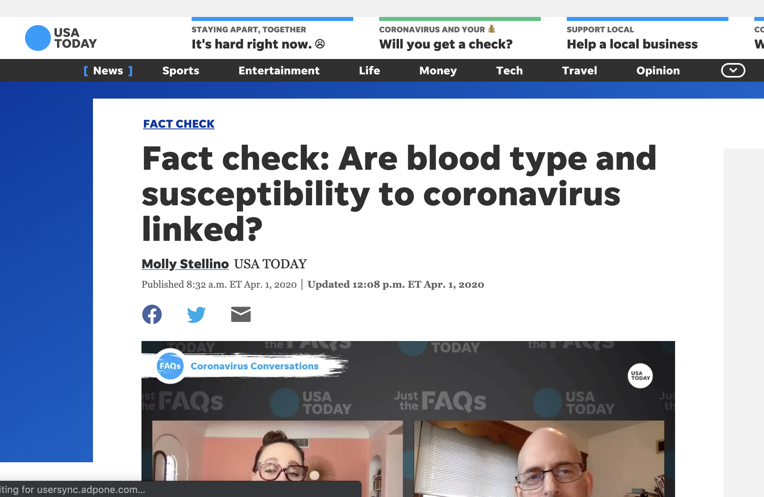
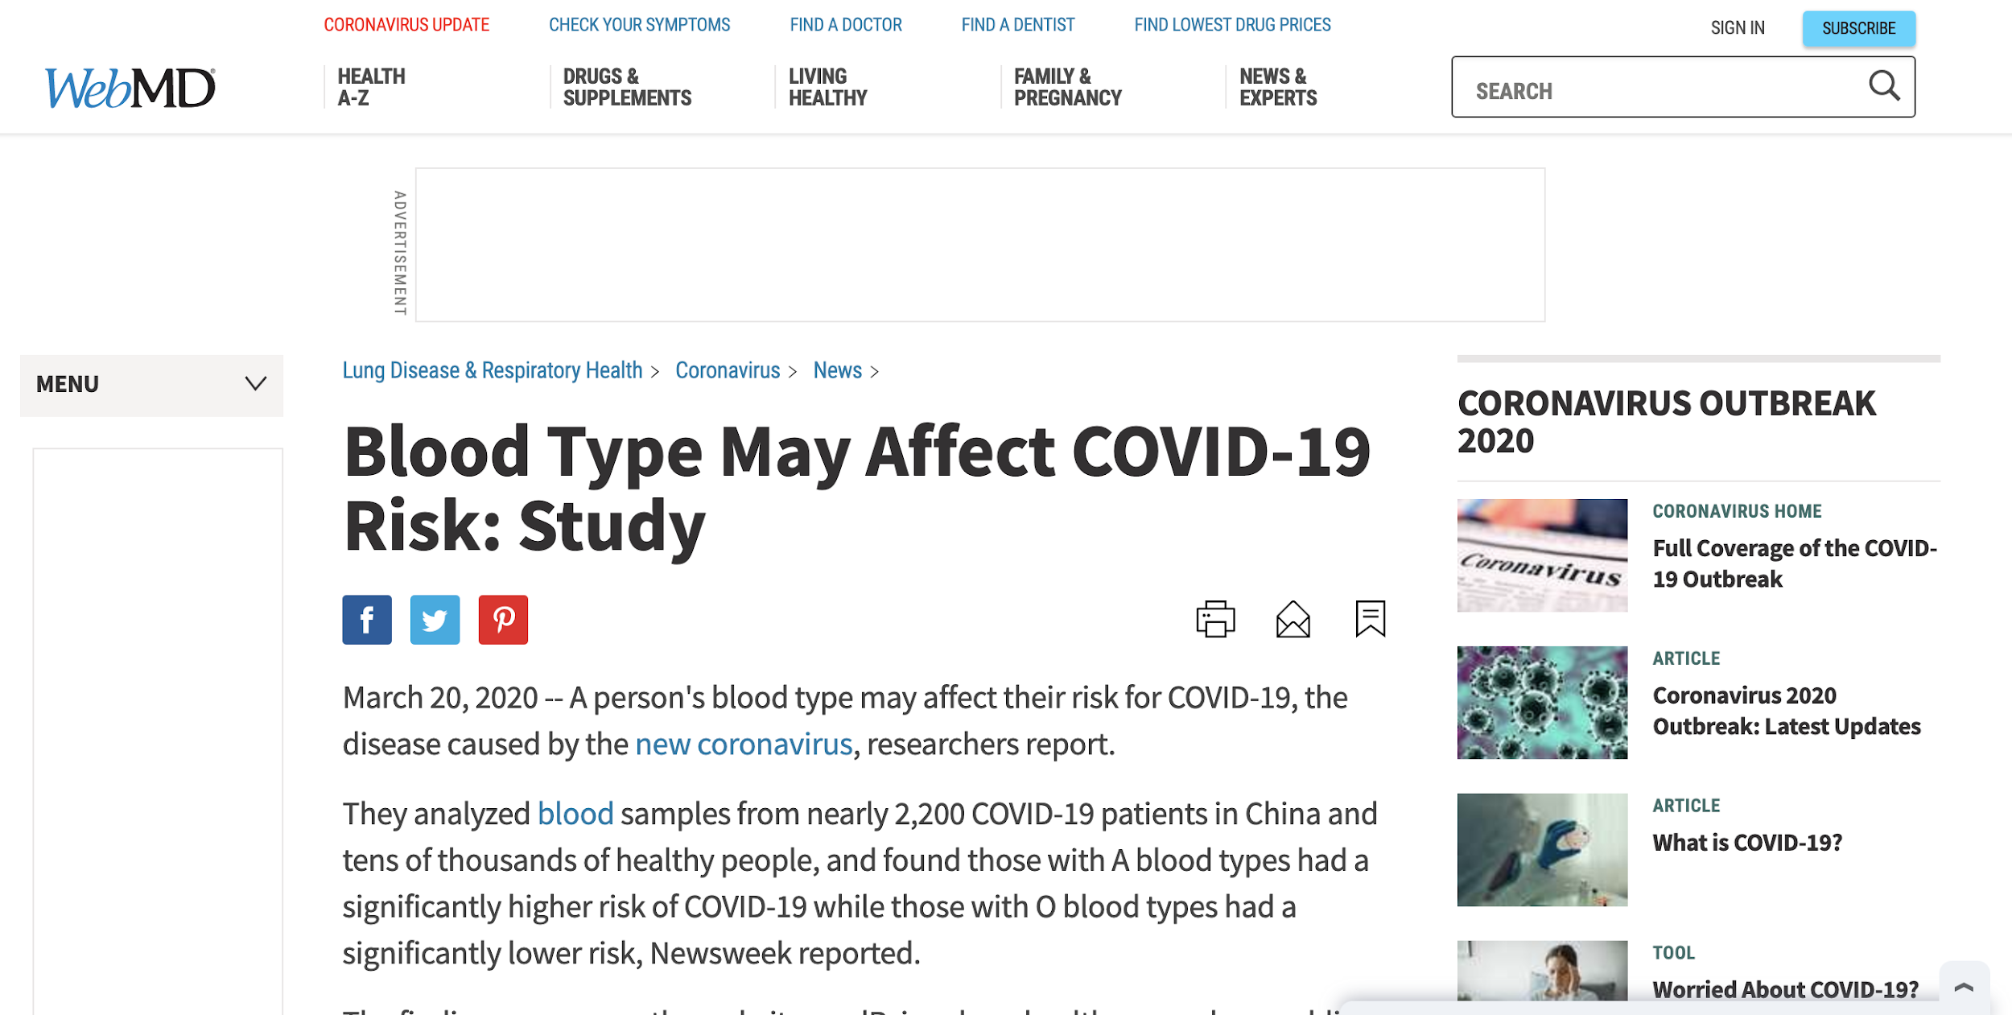
Relationship between the ABO Blood Group and the COVID-19 Susceptibility
OVERSTATED IMPACT
Article DOI | Study Purpose | Author- ship | Funding Statement | Data location | DAS | Code availability
10.1101/2020.03.11.20031096 | Yes | 4 | Yes | In paper | Yes | No
Notes:
https://doi.org/10.1101/2020.03.11.20031096
NOTE: USATODAY STORY ACTUALLY STATES THE CLAIMS ARE OVERSTATED: https://www.usatoday.com/story/news/factcheck/2020/04/01/fact-check-coronavirus-blood-type-a-more-susceptible/2922465001/
WebMD: https://www.webmd.com/lung/news/20200320/blood-type-may-affect-covid19-risk-study - Story does include a quote that the sample size was small - but the headline is clickbait and

Slide 35
Preliminary identification of potential vaccine targets for the COVID-19 coronavirus (SARS-CoV-2) based on SARS-CoV immunological studies
PUBLISHED
Article DOI | Study Purpose | Author- ship | Funding Statement | Data location | DAS | Code availability
10.1101/2020.02.03.933226 | Yes | 4 | Yes | External repo | Yes | Yes

Slide 36
Analysis
Article DOI | Study Purpose | Author- ship | Funding Statement | Data location | DAS | Code availability
10.1101/2020.01.30.927871 | Yes | 2 | No | None | No | No
10.1101/2020.03.16.20037135 | Yes | 1 | Yes | On request | Yes | No
10.1101/2020.03.11.20031096 | Yes | 4 | Yes | In paper | Yes | No
10.1101/2020.02.03.933226 | Yes | 4 | Yes | External repo | Yes | Yes
Notes:
Slide 19
Covid: 22% of DAS were Upon Request (total 21% had a DAS)
10.1101/2020.01.30.927871 Uncanny similarity of unique inserts in the 2019-nCoV spike protein to HIV-1 gp120 and Gag - RETRACTED
10.1101/2020.03.16.20037135 Hydroxychloroquine and azithromycin as a treatment of COVID-19: results of an open-label non-randomized clinical trial - QUESTIONED
10.1101/2020.03.11.20031096 Relationship between the ABO Blood Group and the COVID-19 Susceptibility - IMPACT OVERSTATED
10.1101/2020.02.03.933226 Preliminary identification of potential vaccine targets for the COVID-19 coronavirus (SARS-CoV-2) based on SARS-CoV immunological studies - MEETS ALL RIPETA VARIABLES

Slide 37
535 pre-prints
5 minutes or 43 hours
Notes:
As Mark mentioned in the opening, how do we make science Fast - open - and checked
Saving time while checking the quality
This is what we are doing to improve research. It’s one piece in the bigger challenge of improving the speed of science by checking for the quality of scientific reporting.

Slide 38
What can you do?
Notes:
What can you do?
The scientific 'community’ is an ecosystem with many stakeholders: researchers, librarians, funders, institutions, publishers, public. Each stakeholder must take some responsibility to improve science, yet no one has full control. Publishers are not responsible for the science but hold the crucial role of reporting the research. Funders are responsible for paying for but not conducting the science. Researchers conduct the science and are experts who may still lack expertise in all areas of fully reporting science. And data librarians have the skills to improve the transparency of science but don’t conduct the research and are many times excluded from the process.
Improvement in research quality will come when multiple, diverse actors in this network make changes.

Slide 39
To make better science, Make better science easier
Notes:
So I will end on this...what is the one thing you can do to improve science particularly with making data that should be available, be available? Not solve the entire problem of making science transparent and open, just one thing to make science better and better science easier.

Slide 40
Data Available Upon Request
Leslie McIntosh
figshare Fest 2020
@ripeta1
Notes:
Thanks for taking the time to be here today. I’m happy to take questions.

Slide 41
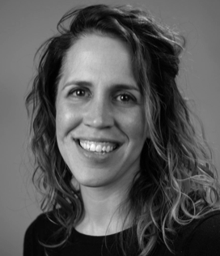
Leslie McIntosh
CEO
Cynthia Hudson Vitale
COO, co-founder
Ruth Whittam
Data Scientist, Lead
Chris Westling
Data Engineer
ripetaTeam
Leah Haynes
Data Scientist, Intern
Sarah Nathan
Editor
Paola Ortega Saborío
Data Engineer
Josh Sumner
Data Scientist
Notes:
Cynthia Hudson Vitale
COO, co-founder

