Slide 1
ORCID US Community Showcase #5
June 4, 2020
Presented by the ORCID US Community, supported by LYRASIS, in partnership with ORCID, Pennsylvania State University, Stanford University, and University of Rochester
Notes:
Sheila

Slide 2
Agenda
ORCID US Community Overview
Global ORCID Overview
Highlights from US research institutions:
Penn State University
University of Rochester
Stanford University
Questions & Discussion
Notes:
Sheila

Slide 3
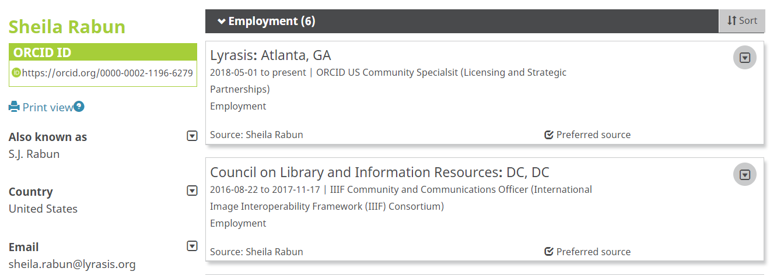
ORCID: Open Researcher & Contributor ID
https://orcid.org/0000-0002-1196-6279
Notes:
Sheila

Slide 4
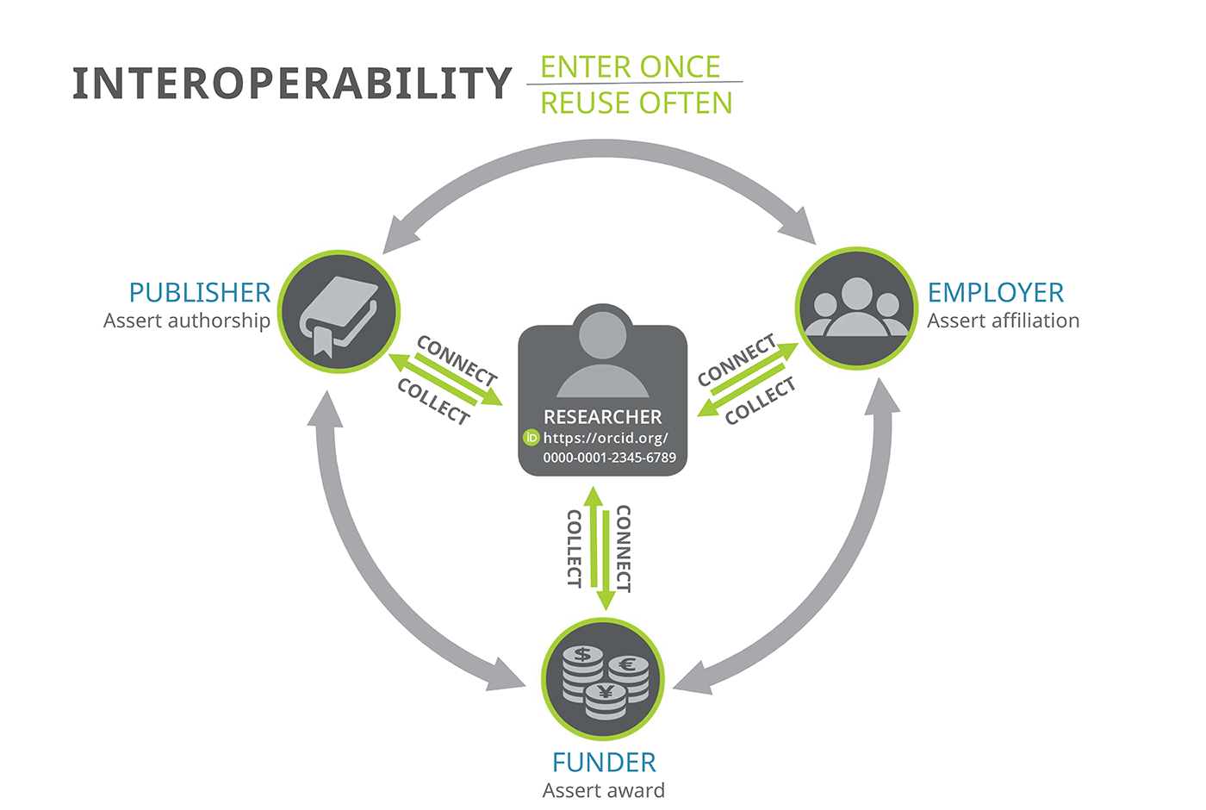
ORCID Ecosystem: Interoperability
ORCID API (Application Programming Interface)
Notes:
Sheila

Slide 5
ORCID API: Application Programming Interface
University
A
Publisher
B
University
C
Funder
E
ORCID API (Application Programming Interface)
Puzzle graphic: https://pixabay.com/en/jigsaw-puzzle-green-last-piece-313587/
Notes:
Sheila

Slide 6
ORCID Adoption
Effective ORCID adoption requires 3 equally important components:
Stakeholder Support
Technical Integration
Outreach & Education
Notes:
Because ORCID is structured like an ecosystem, ALL stakeholders need to be involved in order for everyone to get the most benefit. For research institutions, there are 3 equally important components needed to help both the institution and individual researchers benefit from ORCID: gaining internal stakeholder support to prioritize ORCID adoption, integrating the ORCID API with local systems, and doing outreach to educate researchers about ORCID so they will get and use their ORCID iDs, since researchers are central to the ORCID system

Slide 7
ORCID US Community
Formed in January 2018
National partnership for premium ORCID membership
Any non-profit research institution can join as a member
LYRASIS as lead
Notes:
This group was formed last year when LYRASIS, the Big Ten Academic Alliance, the NorthEast Research Libraries, and the Greater Western Library Alliance came together to form a national partnership to foster a community of practice and provide dedicated support for ORCID at research institutions in the US, with LYRASIS as the administrative home. Any non-profit research institution in the US can join the ORCID US Community.

Slide 8
ORCID US Community
Building a community of practice around ORCID in the US
Substantially reduced fee for ORCID membership
Dedicated resources, technical & community support
Notes:
Sheila

Slide 9
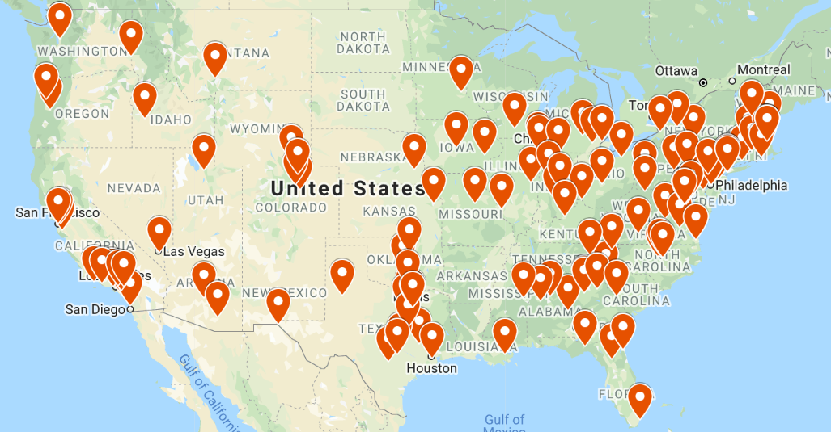
ORCID US Community
140 institutional members!
Notes:
Sheila

Slide 10
ORCID: Americas Region
ORCID in the United States
ORCID Members
257
156 Research Institutions
31 Publishers
27 Associations
26 Government (Federal)
16 Service & Technology Providers
5 Funders
Active ORCID System Integrations
282
Notes:
Bernette

Slide 11
ORCID: Americas Region
THE AMERICAS REGION
CANADA
1 Consortia
42 Members
22 Integrations
US
2 Consortia
257 Members
282 Integrations
Mexico
6 Members
5 Integrations
Brazil
1 Consortia
13 Members
10 Integrations
Chile
2 Members 1 Integration
Colombia
5 Members
2 Integration
Peru
8 Members
2 Integration
Notes:
Bernette

Slide 12
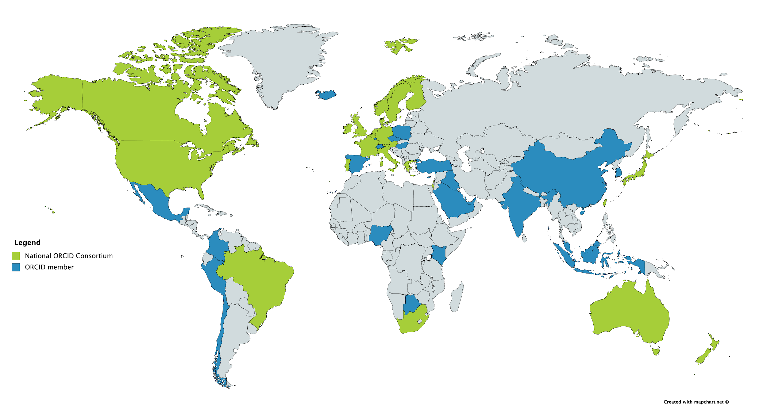
ORCID: Global Picture
8.6 Million ORCID iDs
1147 Members
21 Consortia
862 Integrations
Number of works 55,692,601
Membership by country
Notes:
Bernette

Slide 13
ORCID @ University of Rochester
Notes:
Kevin

Slide 14
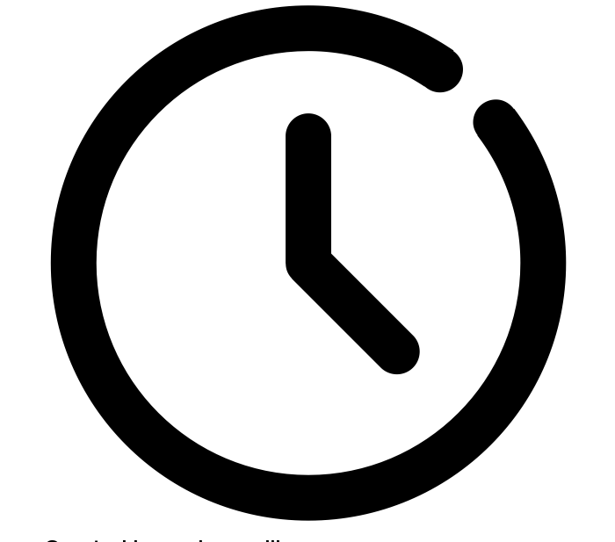
Why ORCID?
Identity and Reputation
Time-Saving Workflows
Meeting Requirements
identity by newstudiodesign10 from the Noun Project
clock by andrewcaliber from the Noun Project
Checklist by RAMA from the Noun Project

Slide 15
Internal Stakeholders
High-level Administrators
Researchers
Domain Experts
Departmental Administrators
Infrastructure

Slide 16
Internal Stakeholders
Focus on stakeholder needs and strengths and highlight partnerships
Time-saving workflows
Integrations with FARS, Web Profiles
Training/outreach to department admin
Identity and reputation
Letter from Provost to all faculty (co-signed by Dean of Libraries and VP Global Engagement)
Graduate requirement
Meeting requirements
ORPA - education around grant requirement
Scholarly Communications Team/ Outreach librarians - publishers

Slide 17
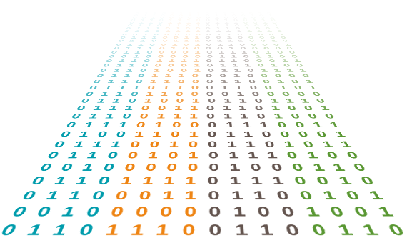
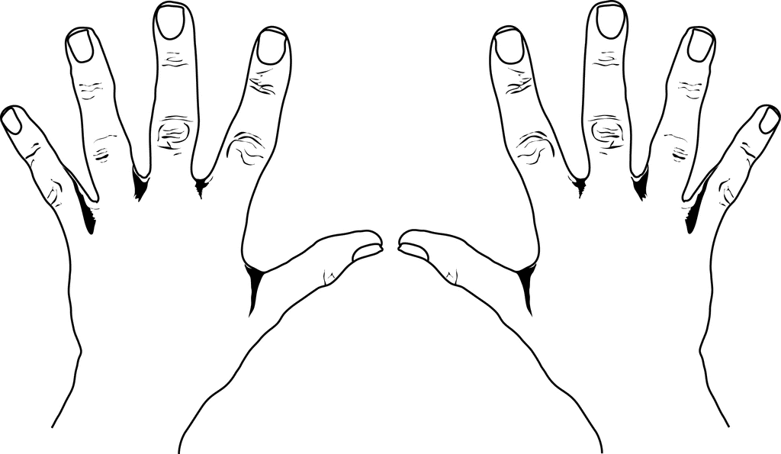
ORCID Integrations
Faculty Activity Reporting System
TEACHING RESEARCH FUNDING
Notes:
Our first ORCID project came out of us hearing about problems with the the FARS system that is run by the School of Arts, Science & Engineering. This is a home-grown activity reporting system that all faculty have to use as part of their annual reviews.
Teaching data is automatically pulled in from Blackboard
Everything else is manual entry

Slide 18
ORCID Integrations
Faculty Activity Reporting System
TEACHING RESEARCH FUNDING
Time consuming! Error prone! Annoying!
Notes:
Faculty hate this because:
No one likes to do extra work for a review process, and it’s
Time consuming
Error prone
Annoying
Administration and leadership hate this because:
Bad data
Lots of complaints
We were interested in this project because FARS, ostensibly, has a lot of the data that would make our lives easier. So we decided to take on this problems and help find a solution.

Slide 19
ORCID Integrations
Faculty Activity Reporting System
TEACHING RESEARCH FUNDING
Notes:
ORCID seemed like a really good fit:
Untether scholarly identity and the creation of profiles from FARS-type reporting--connect it to publishing, grants, etc.
Create a user-vetted data source for research activities that we could pull into FARS, saving faculty and administration time--AND
We can embed library expertise and open tools into university business processes

Slide 20
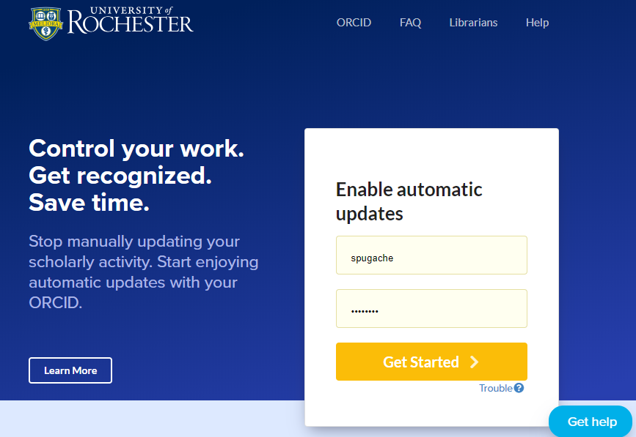
Other Integrations
Institutional Repository - Specifically for ETDs
Web Profiles

Slide 21
ORCID Outreach
Centralize information page
Started small and grew
Outreach librarians as first contact
Developed services around requirements
Embed in other conversations
Targeted for audience

Slide 22
Lessons Learned
Start small but think long-term
Understand needs for different groups
How does ORCID relate?
Will your integrations provide extra incentives?
Curate pitches for different audiences
Accept that not everyone will be on board
Establish yourself/your team as ORCID to-go-person

Slide 23
Get in Touch!
s.pugachev@rochester.edu
Director of Research Initiatives
University of Rochester Libraries

Slide 24
ORCID @
Penn State University
Notes:
Matt

Slide 25
Why are we an ORCID member
Name disambiguation
Reduce faculty burden
Identity Management
M. Reza Mehdizadeh||Hong Weng||Dipendra Gyawali||Liping Tang||Jian Yang

Slide 26
How We Approached Stakeholders
Implementation
Penn State IT
University Libraries
Training and Education
Liaison Librarians
Office of Senior Vice President for Research
The Graduate School

Slide 27
Implementations: Done Link PSU Access ID and ORCiD
Notes:
If you want to unlink your account and link it for additional screen shots, go ahead. I’ve already had mine linked.

Slide 28
Implementations: Done Importing Publications via ORCiD on DM
Notes:
This assumes you’ve logged in and now have linked your PSU ID with your ORCiD, although the link does not create authorization. We will go through that process next. First we are just selecting our import service, in this case ORCiD

Slide 29
Implementations: Done Select publication for import
Notes:
Then the import process is typical import for DM.

Slide 30
Implementations: In Progress

Slide 31
Implementations: In Progress

Slide 32
Implementations: In Progress

Slide 33
Implementations: In Progress

Slide 34
Implementations: In Progress

Slide 35
Implementations: In Progress

Slide 36
Implementations: In Progress

Slide 37
Outreach and lessons learned
Incremental integrations
Find interested partners
Work on integrations that will benefit researchers

Slide 38
ORCID @
Stanford University
Notes:
Matt

Slide 39
Why is Stanford an ORCID member?
Persistent identifiers for researchers have many benefits
ORCID provides cross-institutional research identifiers helping with the name ambiguity problem
ORCID integrates with a growling list of tools, funders and publishers that have a benefit to researchers
Stanford wants to be part of and support the ORCID community

Slide 40
In short...
Names disambiguation is hard

Slide 41
and for that matter …. it’s important to uniquely identify papers, data sets, equipment, institutions, labs, clinical trials, drugs, etc., so that we can connect them together and understand the research knowledge graph

Slide 42
Benefits for Stanford and Stanford Researchers
A growing requirement from funders
A growing requirement from publishers
Integrates with a growing number of tools & utilities (similar to a Google ID)
eRA Commons (NIH), NCBI My Bibliography
SciENcv (NIH, NSF and IES biosketches)
Overleaf
Protocols.io
Electronic Lab Notebooks
Avoids questions of author name ambiguities
Gives researchers credit for their work
Persistent & follows researchers across institutions (even within a large institution like Stanford, which has multiple distinct names)
Streamlined authentication and data integration for connected systems
Better than commercial alternatives (Academia.edu, ResearchGate, Scopus): more likely to endure over the long-term; no profit motivation; no sales pitch

Slide 43
Outreach and Working with Internal Stakeholders
In a distributed way, with librarians, administrators and other support staff local to departments
These “local” staff coordinate across Stanford via regular meetings and email distribution lists
Creating libguides on ORCID and its benefits and uses
Goals are to
promote the use of ORCIDs via outreach and education, highlighting especially benefit to the researcher over benefit to the institution or its systems
Provide guidance & support on appropriate configuration
Coordinate on user experience and data flow among Stanford systems
Advocate for effective ORCID use for Stanford researchers on campus and externally

Slide 44
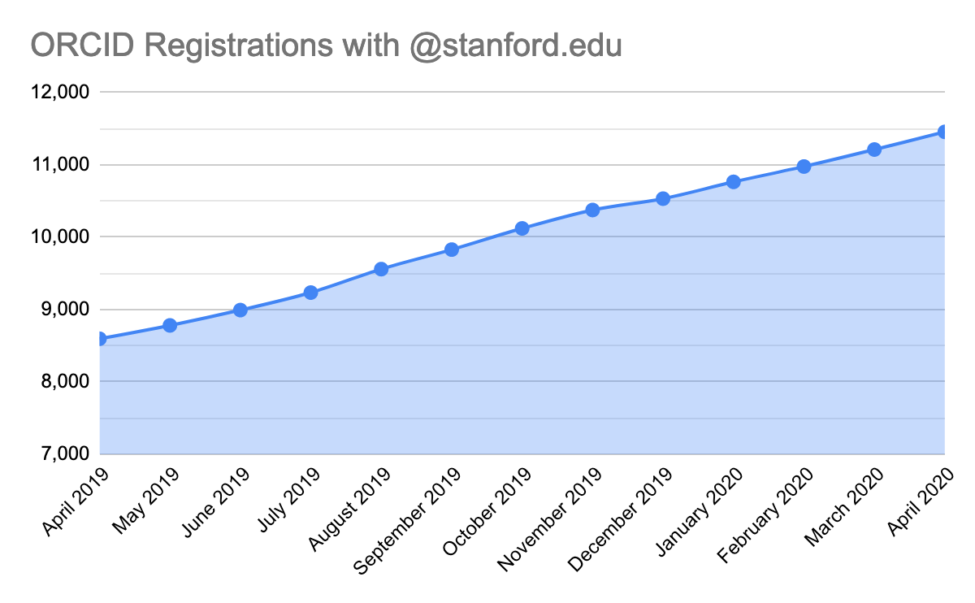
Growth in ORCID Usage at Stanford
~33% increase in one year, with consistent growth (not impacted by COVID-19)

Slide 45
Current ORCID API Implementations at Stanford
Integration moved into production early 2020
Stanford branded user interface to allow Stanford users to link their Stanford identifier (SUNet ID) with an ORCID iD
Uses version 3.0 of ORCID APIs
Requires Stanford SUNet Authentication before access to interface allowed
Stores ORCID iD information in core Stanford Registry
Refresh Token, Access Token, Scope and ORCID iD
Update Person LDAP (eduPerson) with new ORCID iD attributes
Validate Access Token and remove ORCID iD information, if link is removed from either Stanford or ORCID
Make ORCID iD available via standard existing APIs for use in other Stanford systems

Slide 46
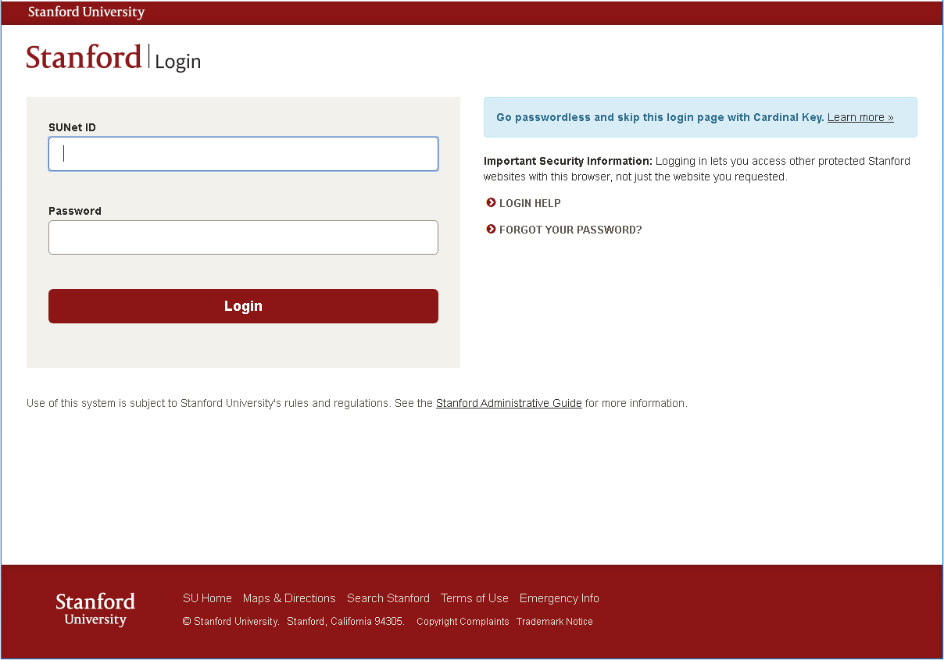
Stanford University Single Sign-on authentication before application can be loaded
Required in order to know what Stanford SuNet ID we are trying to link to what ORCID iD
https://authorize.stanford.edu/orcid/

Slide 47
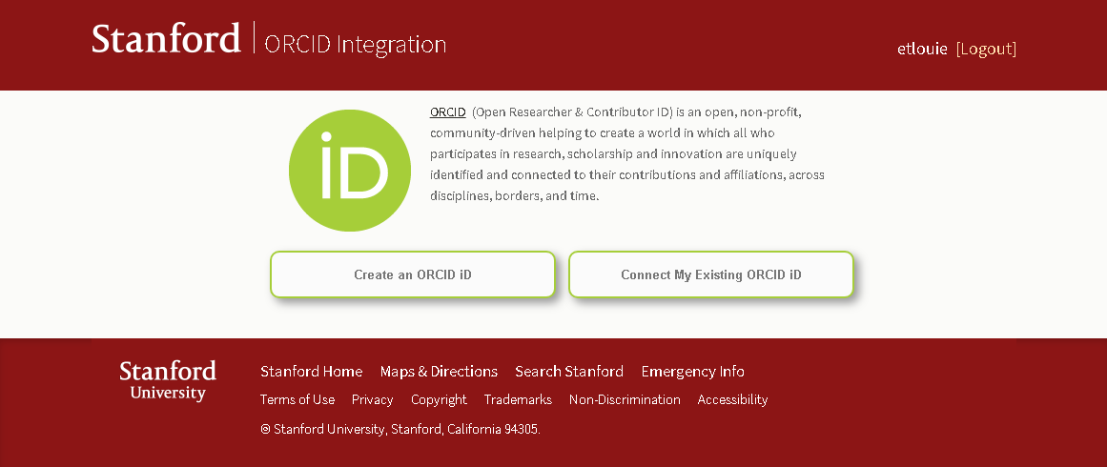
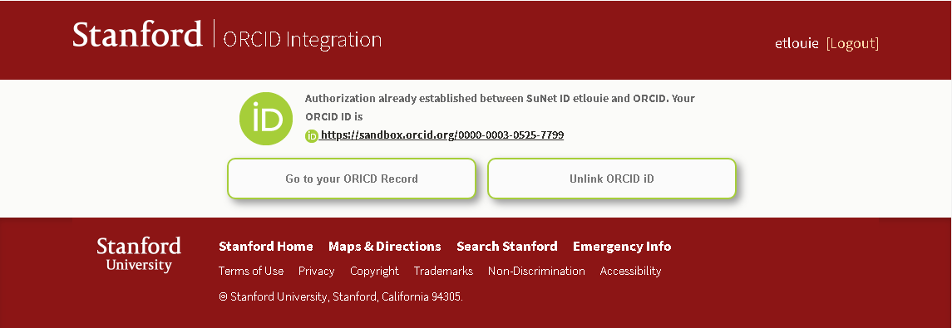
If no ORCID iD is found to be linked to a Stanford SUNet ID, allows user to create or link an ORCID ID
Display ORCID description
Performs an ORCID logout
Checks for any ORCID iD stored in Stanford
Validates the access token for the specific link.
If invalid - attempt to refresh the access token with the refresh token
If still invalid, remove ORCID iD information from Stanford
If user already has an linked ORCID iD, link to their record or allow them to unlink

Slide 48
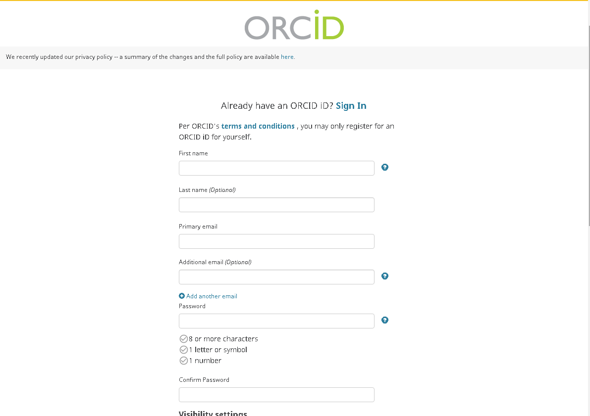
ORCID registration page

Slide 49
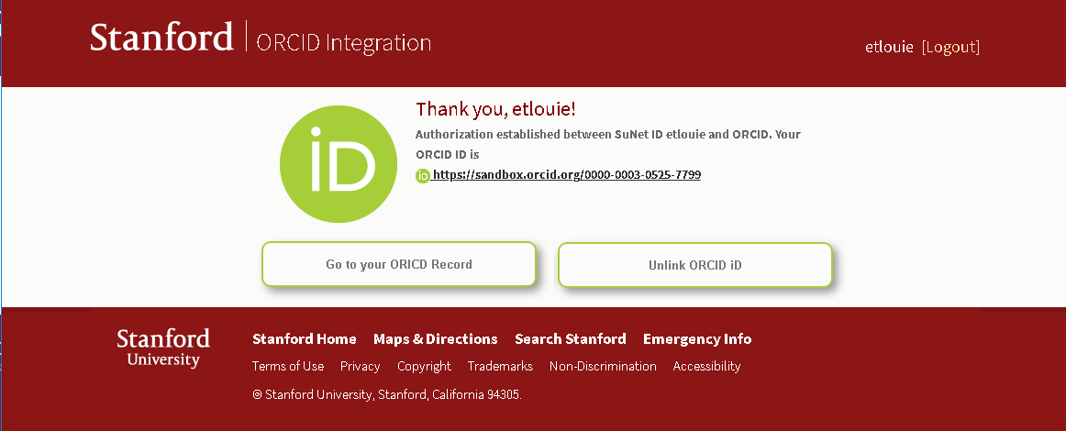
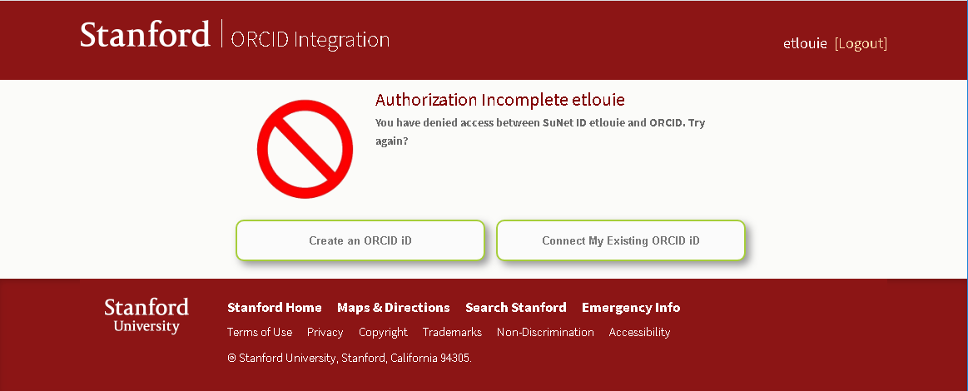
Authorize Stanford University to store the ORCID iD
Deny Stanford University from linking to your ORCID iD

Slide 50
Planned ORCID API Implementations at Stanford
Credentialing integrations:
Connect ORCID and CITI (Collaborative Institutional Training Initiative) training for research projects involving human subjects, and Stanford Population Health Sciences (using a system called Redivis) to provide credit for training
Stanford Profiles integrations:
Utilize ORCID for improved publication retrieval and matching on researcher profiles
Use this connection to allow users to take advantage of SciENcv and Biosketches without having to repopulate all of their publication data
Institutional assertions:
Validate researcher assertions about Stanford affiliations on ORCID profile pages

Slide 51
Lessons Learned
Important to use all available communication channels when doing outreach, as not all people pay attention to the same channels
User interactions must be as simple as possible to minimize friction
Researchers need to understand what’s in it for them (and it needs to actually reduce their burden) to buy in
Need to consider potential problems and consider workarounds, such as users who have multiple ORCIDs and how to deal with these without undue burden or blame to the researcher

Slide 52
Peter Mangiafico
pmangiafico@stanford.edu
Stanford University Libraries

Slide 53
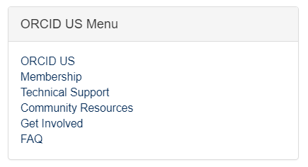
ORCID US Community Resources
Communication Channels:
Website https://orcid-us.org
Email
orcidus@lyrasis.org
Twitter
@USconsortium
Members:
Discussion Forum
Notes:
Sheila

Slide 54
Questions?
Web orcid-us.org
Email orcidus@lyrasis.org
Twitter @USconsortium
Notes:
Sheila moderates

