Slide 1
Building the case
ConstiTuents and Advocates
Notes:
George Allen, first African American graduate at the University of Florida. UF Law 1962. Turned down offers from Harvard and Berkeley. “I’m a native Floridian, and I felt that somebody had to integrate the University of Florida.” Allen passed away in November at the age of 83.

Slide 2
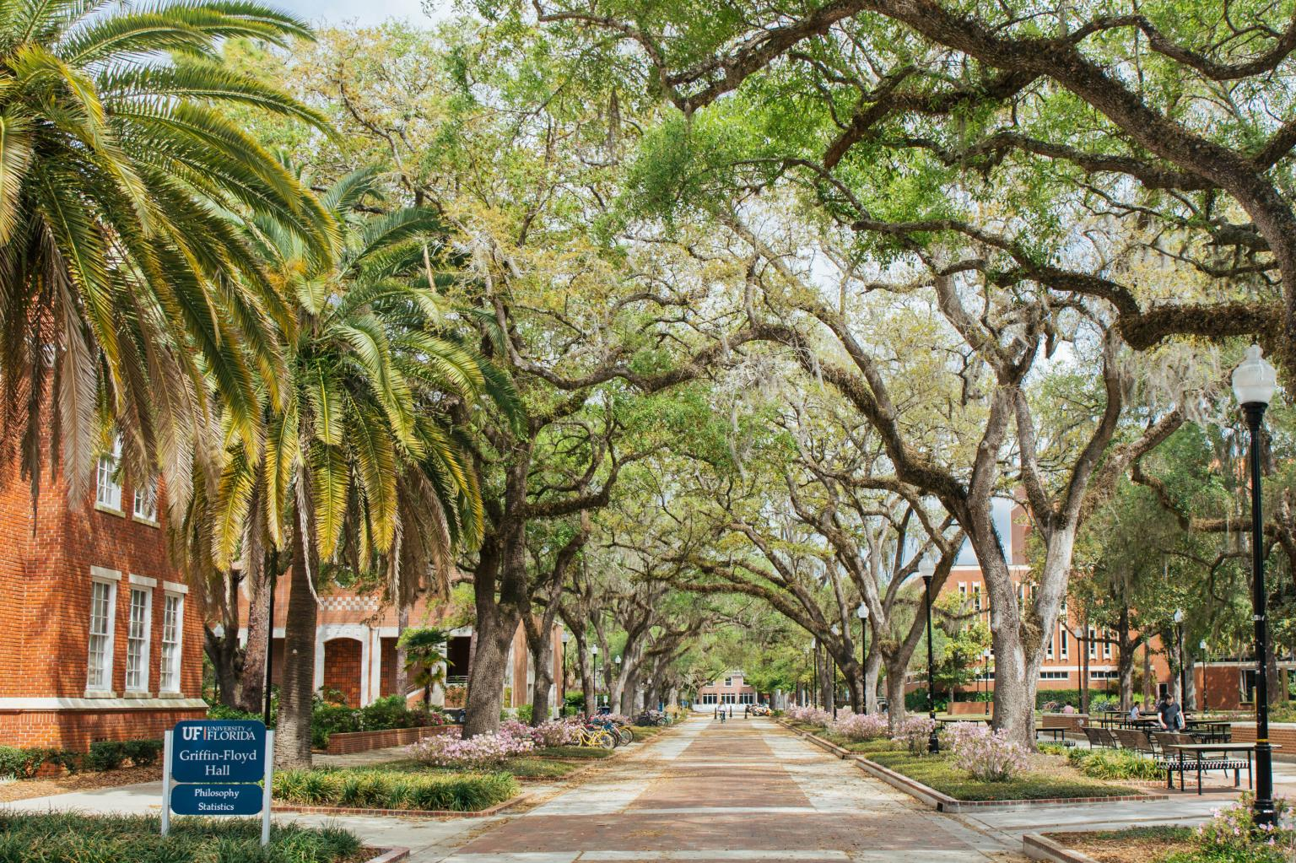
Notes:
Our beautiful campuses are full of experts. Where are the experts? Are they hard to find? They can be, working as they do to advance our knowledge of the world.
Who are the constituents in expert finding and who are the advocates for expert finding? What are they trying to do? How might an expert finding system help them?

Slide 3
Faculty
Play on a winning team
Little/No effort
Democratizing data
Consistent data across the university

Slide 4
Prospective Graduate Students
Find the best Opportunity
Find cross-disciplinary faculty
Understand strengths of the university
Find relevant people and resources

Slide 5
Provost
Build reputation
Attract and retain the best faculty
Attract and retain the best students
Identify leaders in teaching, research, and service

Slide 6
VIce President for Research
Grow Research
Cross-disciplinary research opportunities
Technology transfer
Identifying investment opportunities

Slide 7
Health Center
Achieve National Prominence
Laboratory, clinical, and public health research
Translate research results into improved health care
State, national, international collaboration
Notes:
Larissa Cavallari, UF College of Pharmacy

Slide 8
Strategists
Identify opportunities
Social network analysis
Internal collaboration
External collaboration

Slide 9
Notes:
More advocates and constituents
Library — on the font lines with faculty. Understand data sources
News and Public Affairs — identifying people who can tell the story
Foundation — identifying people who can tell the story

Slide 10
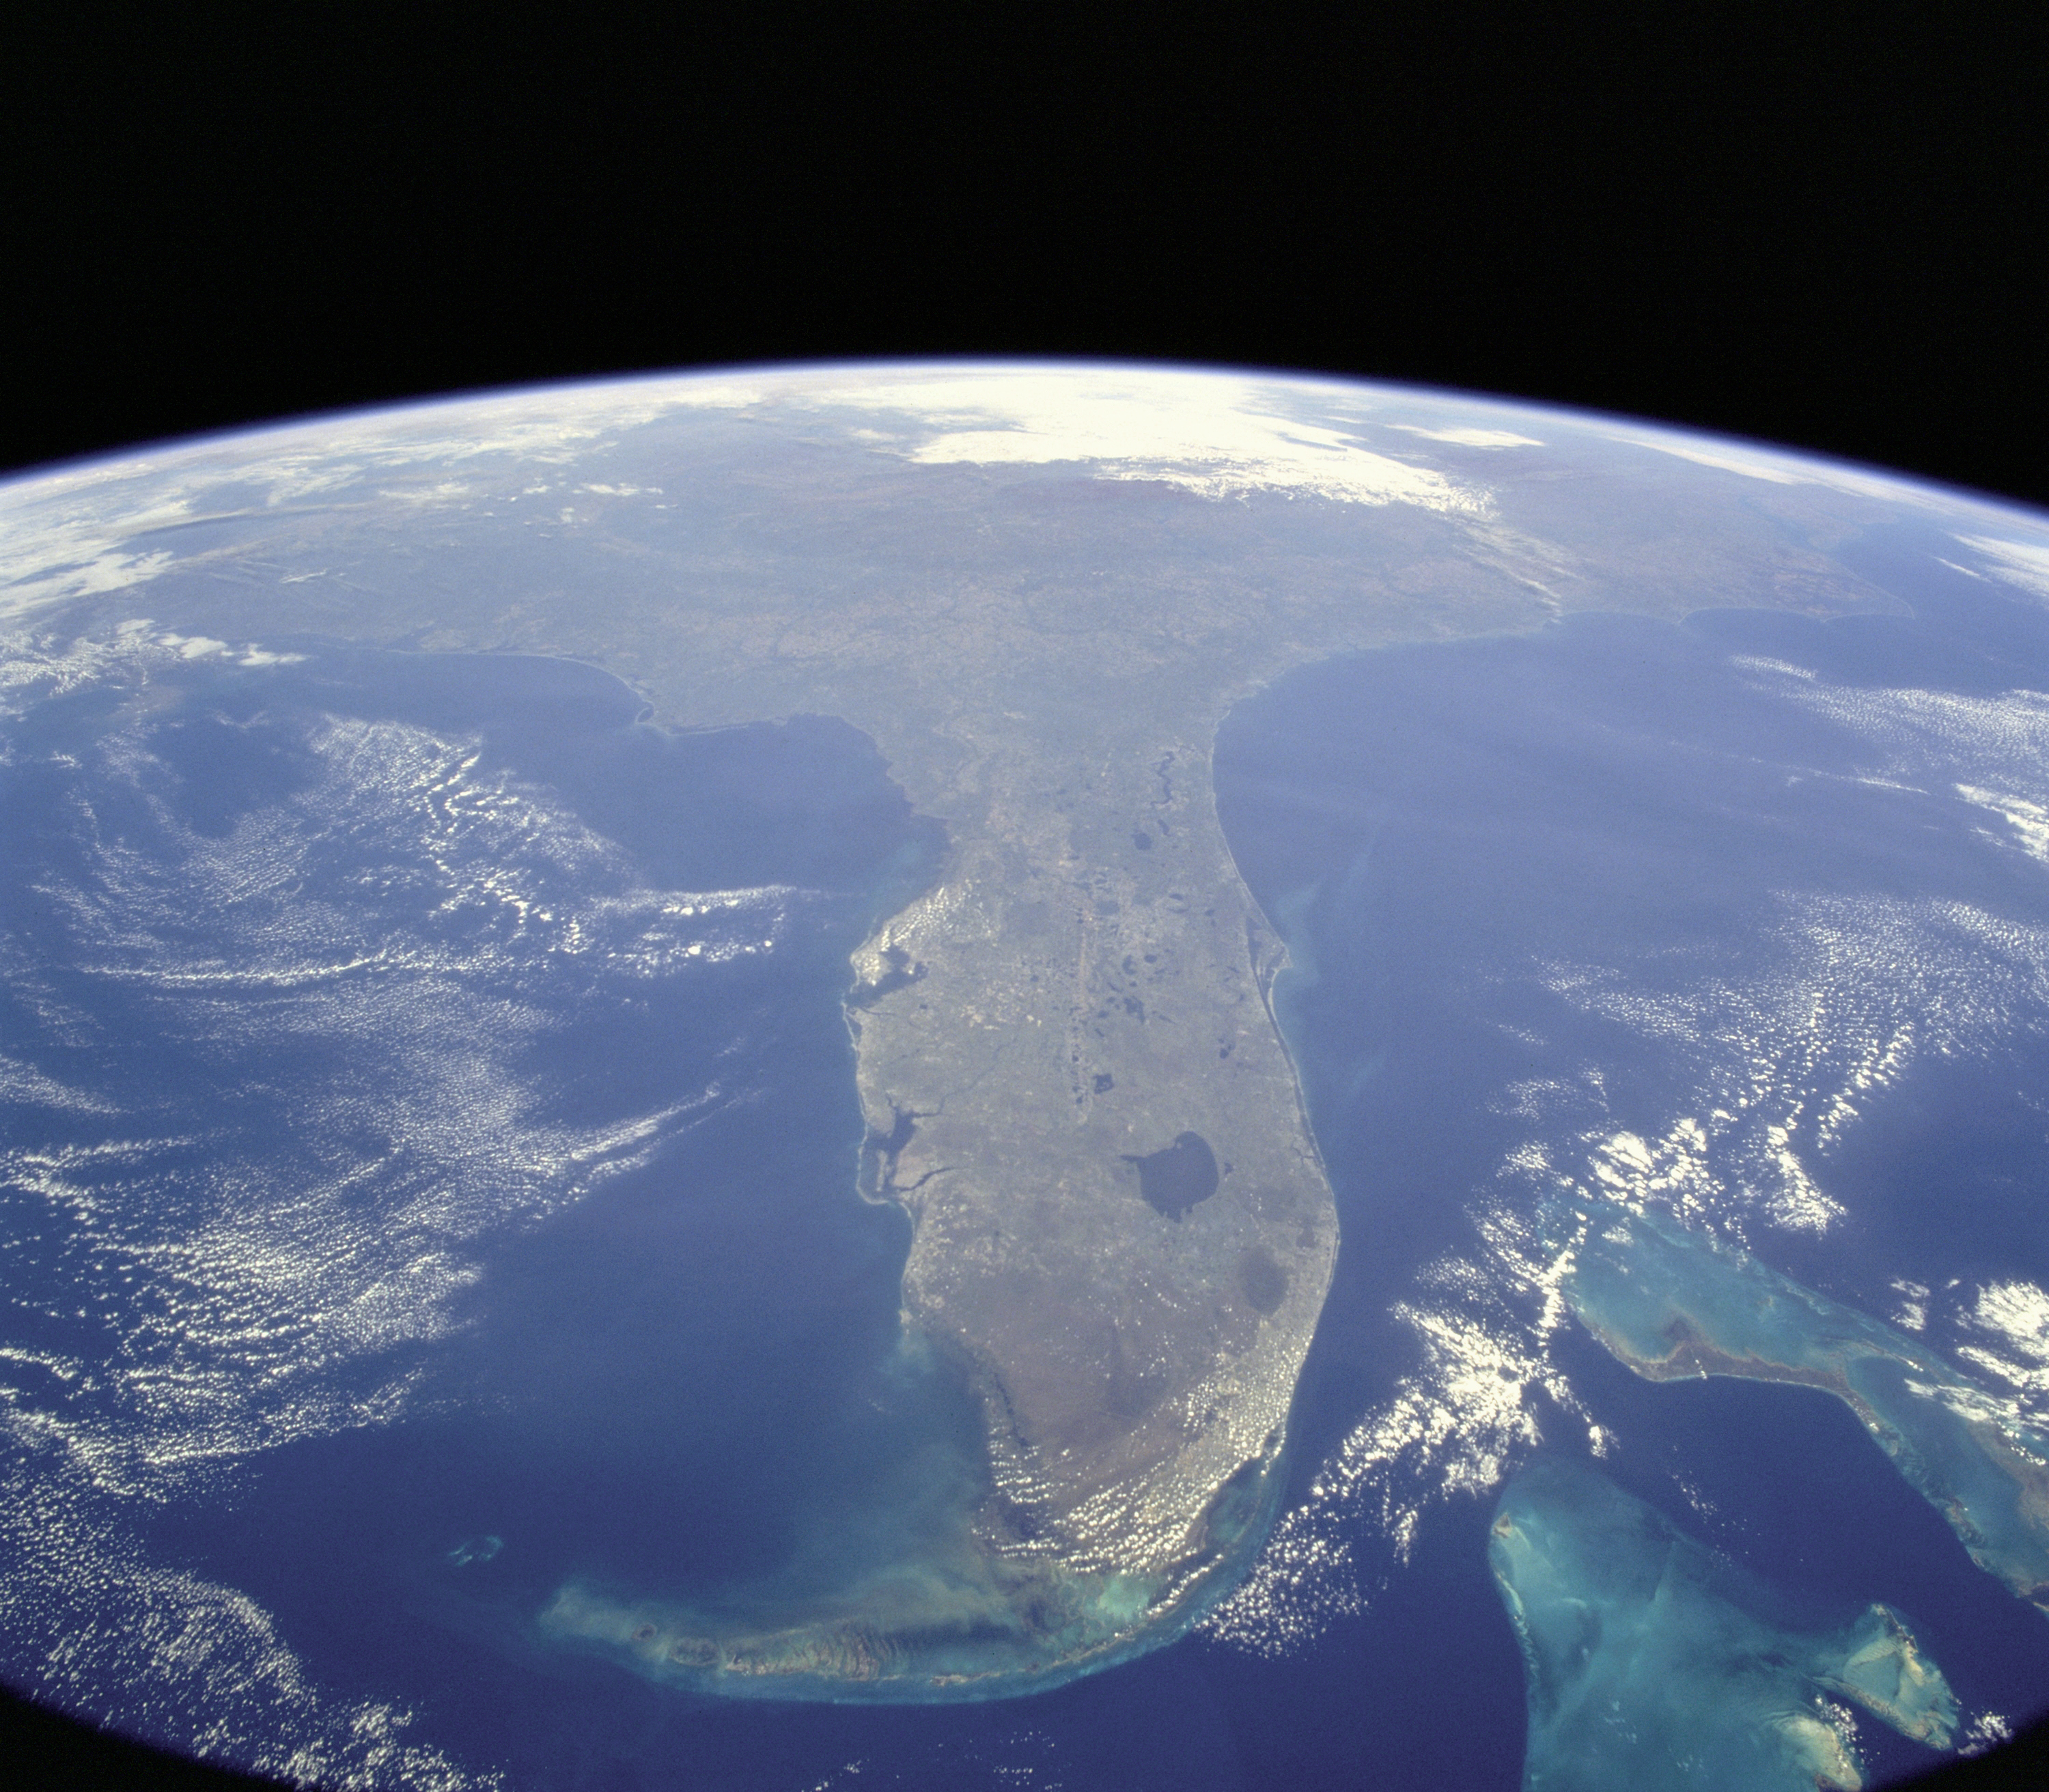
Notes:
We were reminded this past Saturday that our state is a remarkable place. A diverse state of remarkable people. I hope you build a case for expert systems to connect experts to the people who need them. Thank you for listening.

