Slide 1
Good Practice for Research Software Slides: https://doi.org/10.6084/m9.figshare.12401924 1 June 2020, Digital Research Software Seminar: Store and Organise Neil Chue Hong (@npch), Software Sustainability Institute / EPCC ORCID: 0000-0002-8876-7606 | N.ChueHong@software.ac.uk
Supported by:
Notes:
These slides are licensed under CC-BY which means you may use them as you wish, however:
We ask that you do not alter any information, data or figures and pass them off as from the Software Sustainability Institute
All logos of institutions and funders must not be removed or modified

Slide 2
What is research software?
“Software that is used to generate, process or analyse results that you intend to appear in a publication (either in a journal, conference paper, monograph, book or thesis).”
Includes line of code written by yourself to professionally developed software packages
Doesn’t generally include things like word processors or web
In a 2014 survey, 69% of researchers said their research would not be possible without research software [1]
Widely used software includes: Matlab, R, SPSS, and Excel, but there is a huge variety depending on your area of research
[1] https://www.software.ac.uk/blog/2014-12-04-its-impossible-conduct-research-without-software-say-7-out-10-uk-researchers

Slide 3
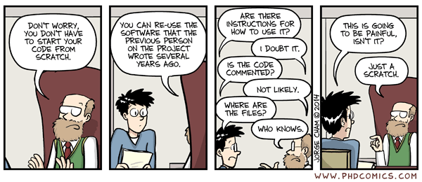
“Research software”
“Piled Higher and Deeper" by Jorge Cham www.phdcomics.com
http://phdcomics.com/comics.php?f=1689
© Jorge Cham, used with permission
Notes:
Everything is legacy code – just wait a few months!

Slide 4
Choosing software (1)
How do you choose the best software for your research?
Functionality and performance
Usage / popularity in your community
Ease of use and well documented
Available on the systems you use
Actively maintained and supporterd
Price and licensing

Slide 5
Choosing software (2)
There are other considerations that are increasingly important:
Use of common, open formats and standards
Ability to integrate with other software
Reproducibility
There is no single “search engine” for software

Slide 6
Good code takes practice
Writing good code is not easy
But there are things that make it easier over time
The key is applying them and practicing their use
Saves you time in the future
Xkcd: Good Code by Randall Munroe
https://xkcd.com/844/

Slide 7
Developing your own code
In many cases, you’ll be developing your own code
Key to managing this is version control
Often known as a code repository
E.g. Github, Bitbucket, Gitlab
Basic functionality is the same, whichever you use

Slide 8
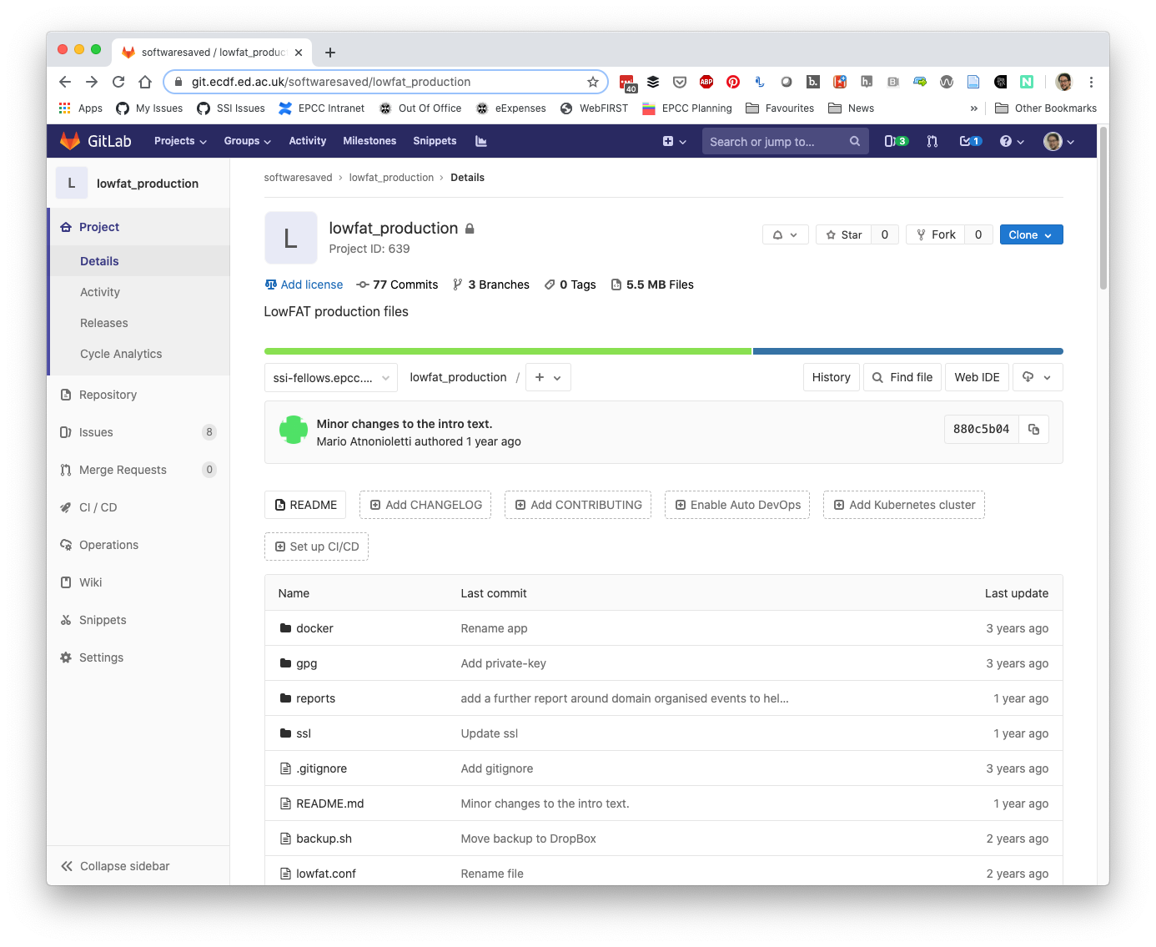
ECDF Gitlab
University provided and supported service
Good for private projects
Less visibility

Slide 9
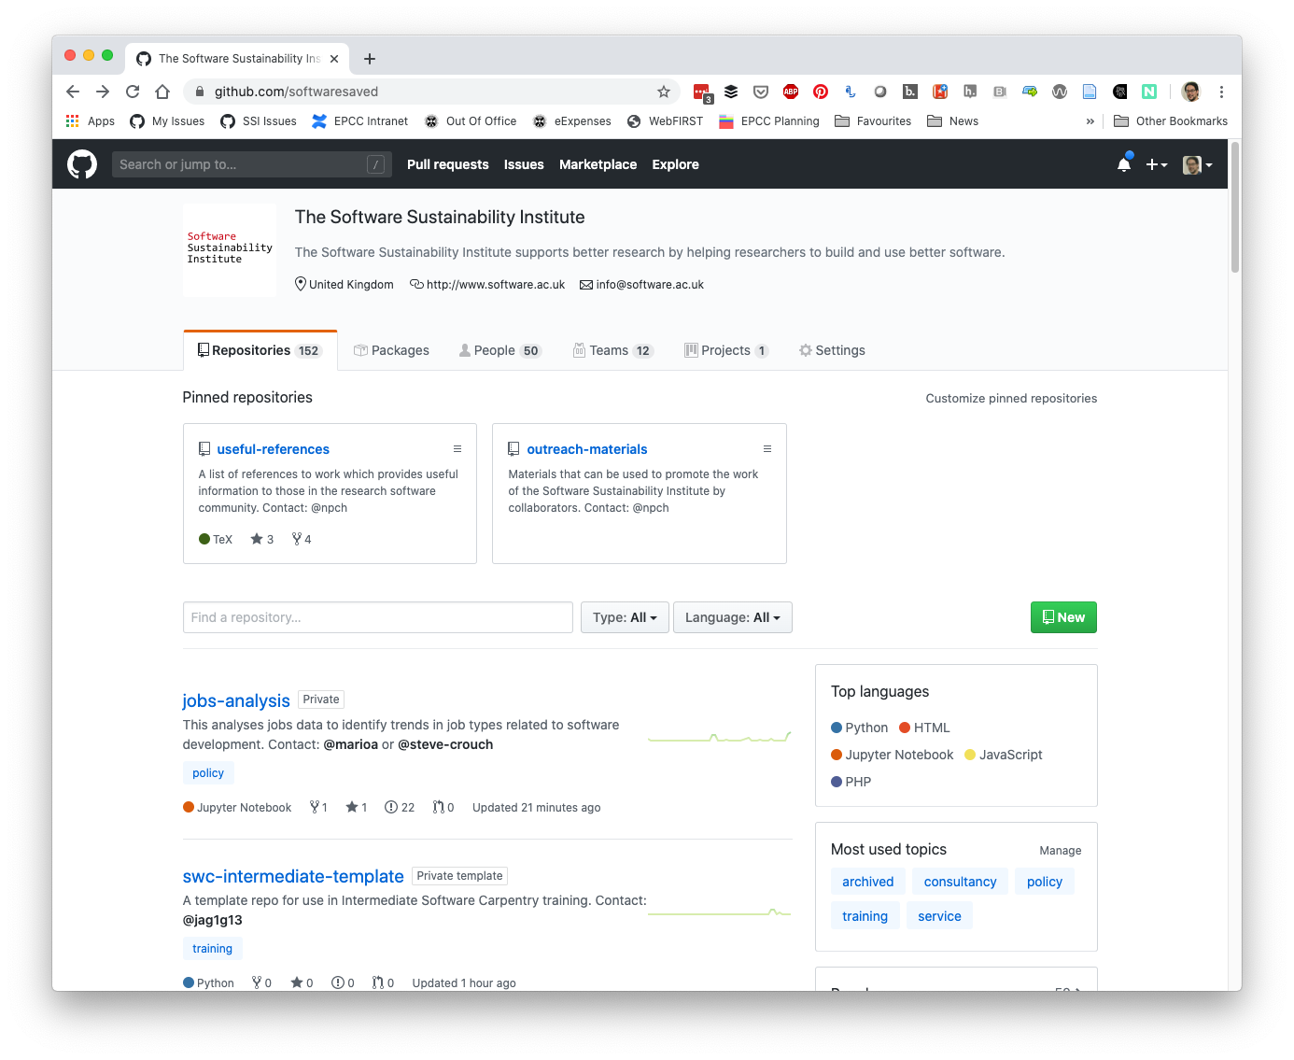
GitHub
Most widely used code repository
Easier to collaborate with externals
Integration with other tools

Slide 10
Learning version control
The Carpentries: https://carpentries.org/
Tailored to researchers, taught by researchers
Regular workshops run as part of Edinburgh Carpentries – look for the Software Carpentry courses on version control
Online general courses through university’s LinkedIn Learning subscription

Slide 11
Software Development
Readable, reusable, testable
Document for your future self
Split into small, modular parts
Use libraries for common functionality
Write the minimum that you need to solve the problem
“Good Enough Practices in Scientific Computing” describes these practices in more detail:
https://doi.org/10.1371/journal.pcbi.1005510

Slide 12
Share your code
Choose a license: https://choosealicense.com/
Get feedback – best way of finding bugs
Get a colleague to use it
Ask a collaborator to contribute
Publish your code (and data)
Deposit in a repository (e.g. DataShare, Zenodo, Figshare)
Cite in your papers
Don’t be afraid to share your code with others

Slide 13
Contribute back
If you use someone else’s code, contribute:
Issues / bug reports / feature requests
Fixes and pull requests
Improved documentation / language localisation
Citations to the software
Money / effort
Shouldn’t expect anything directly in return

Slide 14
Summary
Choose software based on your requirements and what’s used in your community
Use version control (from the start)
Write code to be readable, reusable, testable
Share your code (with friends, publicly)
Contribute back to the software you use

Slide 15
Software Sustainability Institute
“A national facility for cultivating better, more sustainable, research software to enable world-class research”
Providing to the wider community:
expertise, services, tools, events, policy, guidance, data, opportunities, …
Supported by the UK Research Councils through grants EP/H043160/1, EP/N006410/1 and EP/S021779/1, with additional project funding from Jisc A collaboration between the universities of Edinburgh, Manchester, Oxford and Southampton.

Slide 16
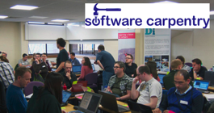
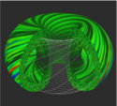
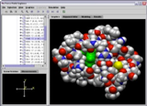
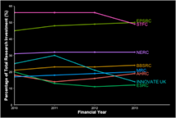
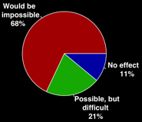
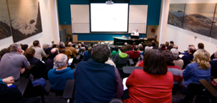
Software
Training
Helping the community to develop software that meets the needs of reliable, reproducible, and reusable research
Delivering essential software skills to researchers via CDTs, institutions & doctoral schools
Outreach
Exploiting our platform to enable engagement, delivery & uptake
Collecting evidence on the community’s software use & sharing with stakeholders
Bringing together the right people to understand and address topical issues
Policy
Community

Slide 17
Acknowledgements
The SSI team/alumni:
Aleksandra Nenadic
Aleksandra Pawlik
Alexander Hay
Arno Proeme
Carole Goble
Claire Wyatt
Clem Hadfield
Dave De Roure
Devasena Prasad
Giacomo Peru
Graeme Smith
Iain Emsley
James Graham
John Robinson
Les Carr
Lucia Michielin
Malcolm Atkinson
Malcolm Illingworth
Mario Antonioletti
Mark Parsons
Mike Jackson
Olivier Philippe
Priyanka Singh
Raniere Silva
Rob Baxter
Robin Wilson
Shoaib Sufi
Simon Hettrick
Stephen Crouch
Tim Parkinson
Toni Collis
Plus the SSI Fellows and RSE community
Scientific software:
Abby Cabunoc-Reyes
Arfon Smith
Dan Katz
Heather Piowowar
James Howison
Jeff Carver
Jennifer Schopf
Kaitlin Thaney
Karthik Ram
Kirstie Whittaker
Martin Fenner
Stephan Druskat
Victoria Stodden
Von Welch
WSSSPE community
Software/Data Carpentry
Greg Wilson
Jonah Duckles
Tracy Teal
Instructor Community
Software Preservation
Daina Bouquin
Digital Preservation Coalition
Software Preservation Network
Supported by the UK Research Councils through grants EP/H043160/1, EP/N006410/1 and EP/S021779/1 . Additional project funding received from Jisc.

