Slide 1
GLOBAL AND PLURALISTIC BIOETHICS IN THE 21ST CENTURY
Joaquim Clotet
PUCRS
2020

Slide 2
SUMMARY
1. INTRODUCTION
2. PRELIMINARY STATEMENTS
3. GLOBAL BIOETHICS
4. THREATS
5. ACTIONS
6. NEW PERSPECTIVES FOR A PLURAL & GLOBAL BIOETHICS

Slide 3
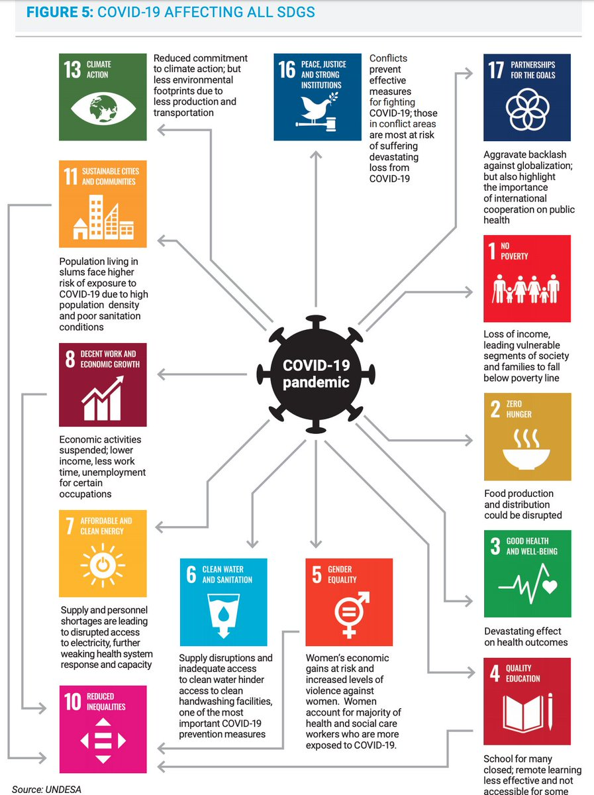
1 INTRODUCTION
COVID-19 AFFECTING ALL SDGS

Slide 4
1 INTRODUCTION
COVID-19 AFFECTING ALL SDGS

Slide 5
1 INTRODUCTION
COVID-19
Countries, Areas or Territories with cases – 215
Confirmed deaths – 254,199

Slide 6
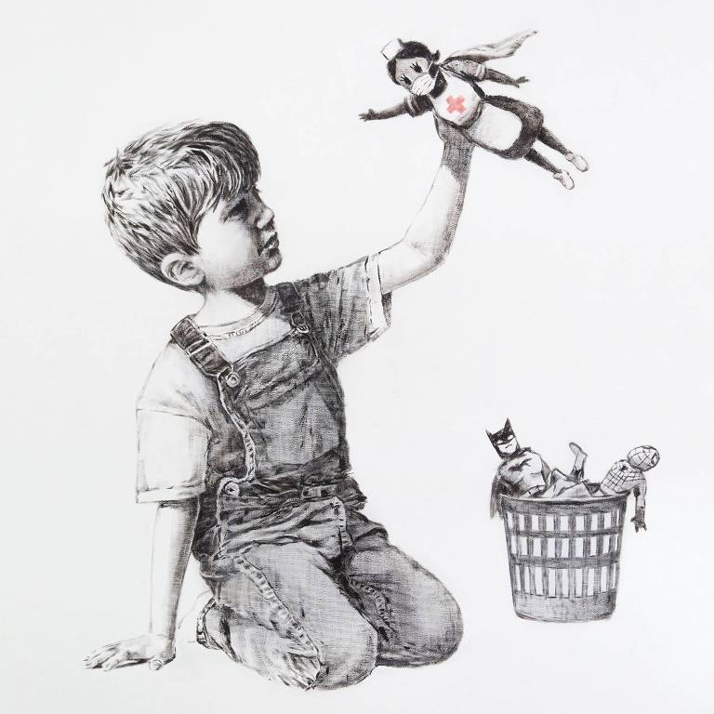
1 INTRODUCTION
Banksy - Game Changer, Southampton General Hospital, 2020.

Slide 7
1 INTRODUCTION
Objectives:
Promote human rights.
Activate political commitment among governments, private sector & health professionals for an inclusive global society.
1 mi people died every year
37 mi infected HIV
“Chase the virus, not people!”

Slide 8
1 INTRODUCTION
New cases of HIV in Eastern Europe & Central Asia increases by 57% every year since 2010.
Mortality rate of AIDS has increased by 38%.
Necessary to overcome discrimination of people who use drugs, men who have sex with men, transgender people, sex workers, youth children & elderly people.
It is time to act together!

Slide 9
1 INTRODUCTION
U.S. BRAIN INITIATIVE (Brain Research through Advancing Innovative Neurotechnologies), 2013.
Key player in the project, the National Institutes of Health (NIH), has invested $559 mi in the research of more than 500 scientists.
Congress continues to support for the project, appropriating close to $400 mi 2018.
20% labs are out of the U.S.
America First?
“We reject globalism and enhance patriotism.” UN, 25 sept. 2018.

Slide 10
2 PRELIMINARY STATEMENTS
Humans part of the ecosystem: soils, waters, plants, animals.
Fixed rules will not suffice to guide ethical choices. (Pinto, A.; Upshur, E. G. An Introduction to Global Health Ethics, 2013)
Collapse of consensus on the major issues of human life. (Engelhardt, H.T. (Ed.). Global Bioethics: the collapse of consensus, 2006)
“Sédation” France: Loi 2005-370 Droits des malades et à la fin de vie. “arrêter tout traitement”. Loi 2016-87, Nouveax Droits en faveur des malades et des personnes en fin de vie. “…sédation profonde et continue” ou “sédation terminale”.
Maintenance of an anencephalic newborn as an organ bank for a perspective organ-deficient newborn seems more abhorrent than a prompt ending of both newborn lives. (Potter, V. R. Global Bioethics, 1988)

Slide 11
3 GLOBAL BIOETHICS 3.1 TOWARDS A GB
Globalization a source of ethical problems. (Ten Have, H. Global Bioethics: an introduction, 2016)
B as western culture individualism & autonomy. (Engelhardt, H.T., 2006)
Despite obvious moral diversity, substantial interests in elaborating global ethics, bioethics, & health care jurisprudence. Id. Equality of voice as a global bioethics. (Ignatieff, M. The Ordinary Virtues, 2017)
Academic disciplines - biology, medicine, philosophy, religious studies, & law - have become involved in ethical development. (Potter, V. R., 1988) Global Ethics Dialogues. (Ignatieff, M., 2017)

Slide 12
3.1 TOWARDS A GB
GLOBAL BIOETHICAL PROBLEMS
Biodiversity loss
Biological & toxic weapons
Climate change
Humanitarian assistance & disaster relief
Inequitable access to treatment & care
Pandemics & emerging infectious diseases
Refugees, displacement
Trafficking organ, tissues, body parts, humans
Wars & violence, repression
Water shortages

Slide 13
3.2 GLOBAL BIOETHICS
Area for study, research, & practice that places a priority on improving health & equity for all people. (Pinto, A.; Upshur, E. G., 2013)
New ethic that will serve the interests of all. (Singer, P. One world now, 2002)
Inspired by human rights. (Ten Have, H., 2016)
Interaction & exchange. Id
Combines recognition of differences & shared values. (Langlois, A. Negotiating Bioethics, 2013)
Priorities: common rather than individual interests; cooperation rather than competition; inclusion rather than exclusion.

Slide 14
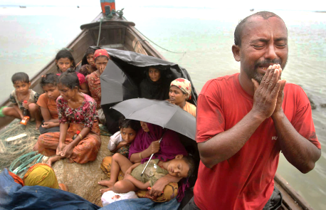
3.2 GLOBAL BIOETHICS
REFUGEES
M B – R – Genocide
900,000 Rohingyas refugees.
Starvation, hygiene, health...
Needed: Medical doctors, Nurses, Nutritionists, Volunteers.
Aung San Suu Kyi, Peace Nobel, 1991.
ONU – India, 08.10.2018.
No peace for Myanmar without justice.
(Yanghee Lee, UN. Rapporteur on Human Rights. TIME on line, 26 Sept. 2018)

Slide 15
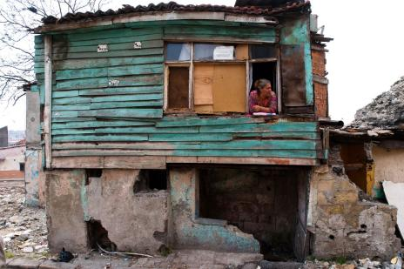
3.2 GLOBAL BIOETHICS
Forum on Sustainable Development, UN, N. York, 11/07/2018. Leilane Farha, UN Human Rights Council
1,600 mi people; inadequate housing, settlements.
Ebola Virus Disease
23.03.2014 Guinea notified WHO of an outbreak of Ebola. 49 cases reported, including 26 deaths.
March, first cases Liberia
April, Sierra Leone
May, Monrovia
August, 2 aid workers infected, world wake up.
WHO: Global Emergency
August 2015, 25,000 cases with over 11,000 deaths.

Slide 16
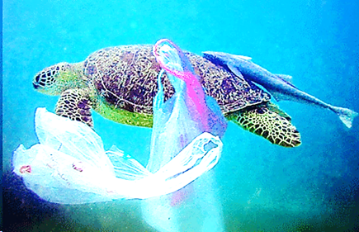
4 THREATS
Violence to the environment due to increasing population.
Up to 13 mi tons of plastic reach the ocean each year.
Americans use 500 mi straws a day.
The Ocean Cleanup. N-P Or., technologies to rid the world’s oceans of plastic.
Clean up half the Great Pacific Garbage Patch in 5 years’ time.

Slide 17
4 THREATS
Plastic pollution in the world's oceans impacting more than 600 marine species & food chain.
Rio de Janeiro, Santa Maria, Rio Grande... Stopped saving single-use straws.
Ensure healthy lives & promote well-being for all at all ages. (Transforming our world: the 2030 Agenda for Sustainable Development - Goal 3, UN, 2015)
“We can all do something.” (Figgener, Christine)

Slide 18
4 THREATS
Humankind simultaneously
World’s 7.6 bi people represent just 0.01% of all living things. Humanity has caused the loss of 83% of all wild mammals & half of plants, while livestock kept by humans abounds. (Yinon M. Bar-On, Rob Phillips, Ron Milo (2018) The biomass distribution on Earth. Proceedings of the National Academy of Sciences 1-6)
insignificant
utterly dominant

Slide 19
5 ACTIONS
Draft Astana Declaration on Primary Health Care
Declaration of Alma-Ata, 1978
Health as a fundamental right of every human being.
Commitment to primary health care.
Health for all, leaving no one behind. For everyone, everywhere.
Ensure primary care workforce (family physicians, nurses, allied health professionals & non-professionals) working closely.
Promote: health, social development & global security.

Slide 20
5 ACTIONS
Moral craft, personal moral frame.
Empirical Bioethics, broadening Bioethics.
The great universal challenges only can be faced with cooperation. (Harari, Y. N. 21 lessons for the 21st century, 2018)
Humankind, a single civilization, all people sharing common challenges & opportunities. Id.
How well we come through the era of globalization will depend on how we respond to the idea that we live in one world. (Singer, P., 2002)

Slide 21
5 ACTIONS
Organizations: Medicus Mundi, Doctors without Borders, Bill & Melinda Gates Foundation (grants to help 20,000 young people afford college), Wellcome Trust, Do Something Good.
People: Madonna: Raising Malawi, Athletes Gone Good: Cristiano Ronaldo, Fund Cancer Center, Portugal, Serena Williams.
Union of Medical Care & Relief Organizations, UOSSM.
Non profit medical organization to support health related needs, non-political & non sectorian.
UOSSM Awarded Innovation Grant to Develop Health Integrated Resilience System in Syria, 20 sept. 2018.

Slide 22
5 ACTIONS
Peter Singer
Effective Altruism: to live an ethical life in the face of the world’s many problems. (Singer, P. The most good you can do, 2015; One world now, 2002)
Living a minimally acceptable ethical life involves using a substantial part of our spare resources to make the world a better place. Id
No longer seem odd for anyone to regard “the most good I can do” as a life goal.

Slide 23
5 ACTIONS
Centre for Effective Altruism
Mission: create a global community by helping others a core part of their lives.
Aims to: wellbeing of all.
80,000 Hours, Ox, 2011.
Help people leading high-impact careers.
One of the biggest decisions ever made.

Slide 24
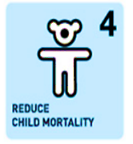
5 ACTIONS
Millennium Development Goals (MDGs) - UN, 2000.

Slide 25
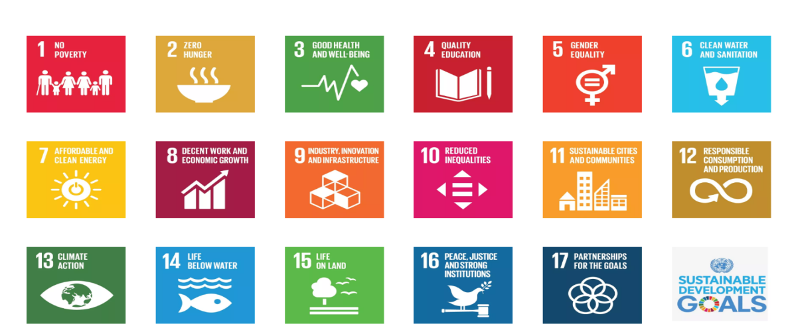
5 ACTIONS
Transforming Our World: The 2030 Agenda for Sustainable Development, UN 2015.
The 17 Sustainable Development Goals (SDGs), UN 2015.

Slide 26
6 NEW PERSPECTIVES FOR A PLURAL GB 6.1 UEHIRO CENTRE
Practical ethics should:
advance knowledge by reflection & dialogue;
change people’s hearts, their own lives & lives of others.
Challenges: climate change, environmental destruction, migration, genetic engineering, artificial intelligence & biomedical means of life extension & cognitive & moral enhancement.
Julian Savulescu

Slide 27
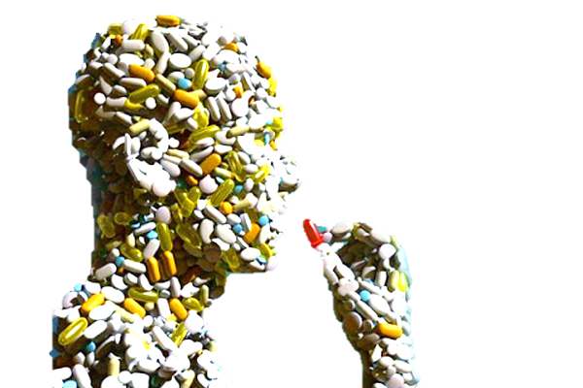
6.1 UEHIRO CENTRE
Enhancement is already occurring. (Savulescu, J. Genetic interventions and the ethics of enhancement of human beings. Gazeta de Antropología, v. 32, n. 2, 2016)
Lack of clarity regarding the term ‘enhancement’. Seven different accounts of ‘enhancement’. (Clark, S.; Savulescu, J. The ethics of human enhancement, 2016)
In sport, human erythropoietin boosts red blood cells. Steroids & growth hormone improve muscle strength.
People seek cognitive enhancement, Ritalin, Modavigil.
Prozac, recreational drugs, & alcohol all enhance mood.
Viagra to improve sexual performance.
We need to shift our frame from health to life enhancement. Options:
Intervention
No intervention

Slide 28
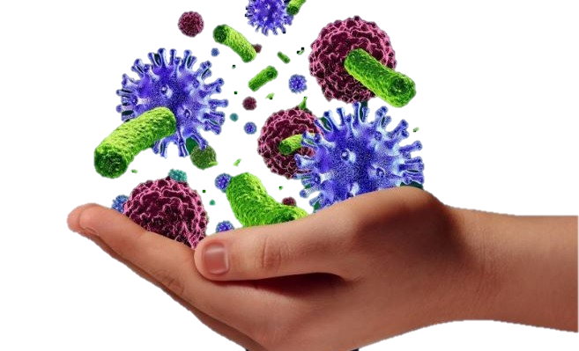
6.1 UEHIRO CENTRE
Intervention
Treating & preventing disease;
supra-prevention disease;
enhancement of well-being.
No intervention, & to remain in a state of nature.
To be human is to strive to be better.
We should be here for a good time, not just a long time.
Enhancement: is something we should aspire to achieve. (Savulescu, J., 2016)

Slide 29
6.1 UEHIRO CENTRE
Biomedical moral enhancement:
The possibility of altering human biology to meet the athical demands of the moral world.
The use of biomedical Technologies - such as neurological, pharmacological. And Genetics interventions – to enhance human moral
capacities, including moral
emotions and morally relevant cognitive abilities.
We do not think that BME is on effective means to enhance the moral character of humanity. (Russell, P.; Buchanan, A. In: Clark, S.; Savulescu, J., 2016)

Slide 30
6.2 FUTURE OF HUMANITY INSTITUTE
Mission: to shed light on crucial considerations that might shape the future.
Mathematics, science, & philosophy will bear on big-picture questions about humanity.
What should we do to ensure the potential for a long flourishing future?
Nick Bostrom

Slide 31
6.2 FUTURE OF HUMANITY INSTITUTE
What we don’t want
Illness
Involuntary death
Memory loss, ignorance, absence of creativity
What we do want
Long healthier lives
Enhanced cognitive capacities
Limitless potential for spiritual/moral/intellectual development

Slide 32
6.2 FUTURE OF HUMANITY INSTITUTE
Human enhancement technologies will offer enormous potential for humanly beneficial uses. (Bostrom, N. In defense of Posthuman Dignity. In: Kuhse, H.; Schüklenk, U.; Singer, P. (Ed.). Bioethics: an anthology, 2016)
Transhumanism: holds to increase human health-span & extend intellectual & physical capacities. Id
Posthuman beings may have indefinite health-spans & greater intellectual faculties. Id

Slide 33
6.2 FUTURE OF HUMANITY INSTITUTE
All of us will be half humans and half machines. CYBORG (cybernetic organism). Once that happens, a human hero could fall in love with a robot. (Harari, Y. N., 2018)

Slide 34
6.2 FUTURE OF HUMANITY INSTITUTE
Post-human condition would eliminate illness, ageing & death, through the “NBIC convergence” (nanotechnology, biotechnology, information technology & cognitive science). (Bostrom, N. Superintelligence: paths, dangers, strategies, 2014)

Slide 35
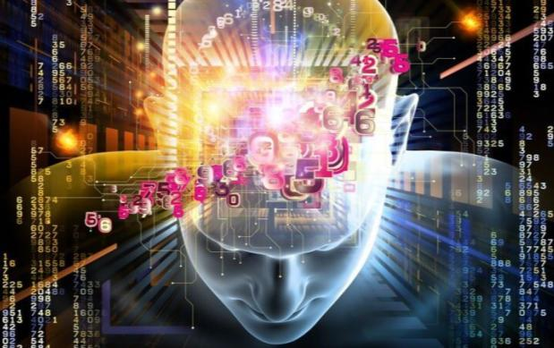
6.2 FUTURE OF HUMANITY INSTITUTE
A path to greater-human intelligence is to enhance the functioning of biological brains. (Bostrom, N., 2014)
Manipulation of genetics will provide a more powerful set of tools than psychopharmacology. Id

Slide 36
6.2 FUTURE OF HUMANITY INSTITUTE
Bioconservatives argue against use of technology to modify human nature. Leon Kass, Francis Fukuyama. (Bostrom, N. In: Kuhse, H.; Schüklenk, U.; Singer, P. (Ed.), 2016)
Transhumanists: we can legitimately reform ourselves & our nature in accordance with human values & personal aspirations. Id
Alarmist pictures of the threat is not the best way to go about it. Id

Slide 37
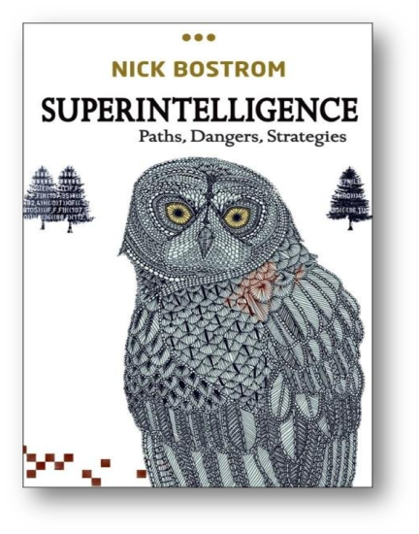
6.2 FUTURE OF HUMANITY INSTITUTE
A “superintelligent” system would exceeds the cognitive performance of humans. (Bostrom, N., 2014)
The fate of the gorillas now depends more on us humans than on the gorillas themselves, so the fate of our species would depend on the actions of the superintelligence machine. Id

Slide 38
6.2 FUTURE OF HUMANITY INSTITUTE
Superintelligence:
Lays the foundation for understanding the future humanity & intelligent life.
What should happen when machines surpass humans in general intelligence?
This is quite possibly the most important project humanity has ever faced. (Bostrom, N., 2014)

Slide 39
6.2 FUTURE OF HUMANITY INSTITUTE
What about human dignity? (Bostrom, N. In: Kuhse, H.; Schüklenk, U.; Singer, P. (Ed.), 2016)
A moral status, the inalienable right to be treated with respect. Id
The quality of being honorable. Id
Something that a posthuman could possess. Id
Bioconservatives: tend to deny posthuman dignity. Id
Transhumanists: human & posthuman dignity compatible & complementary.
Dignity, in its modern sense, consists in that we are & what we have the potential to become. Id

Slide 40
6.2 FUTURE OF HUMANITY INSTITUTE
OLD
Mood-modifiers (caffein, alcohol, nicotine, ...)
Vaccination
Anesthetics
NEW
Pre-implantation and prenatal screening
Growth hormone therapy
Anti-depressants (Prozac, Zoloft, Paxil,...)
HUMAN FUTURE TECHNOLOGIES
Artificial intelligence and superintelligence
Nootropics
Rejuvenation medicine
HUMAN INDIVIDUAL IMPROVEMENT
Special faculties
- Humor
- Eroticism
- Spirituality
HUMAN MODIFICATION TECHNOLOGIES
Intellectual capacity
- Mental energy
- Intelligence
- empathy

Slide 41
6.3 GLOBAL PRIORITIES INSTITUTE
Interdisciplinary foundational research centre.
Population a Global Priority.
Informs the decision-making of individuals & institutions seeking to do as much good as possible.
Hilary Greaves

Slide 42
6.3 GLOBAL PRIORITIES INSTITUTE
World Birth/Death Rates (2016 est.)
Birth Rate | Death Rate
135 million births each year | 56.8 million people die each year
368,600 births each day | 155,500 people die each day
15,360 births each hour | 6,480 people die each hour
258 births each minute | 108 people die each minute
In: <https://www.wholesomewords.org/missions/greatc.html#birdatrate>, 02 oct. 2018.

Slide 43
6.3 GLOBAL PRIORITIES INSTITUTE
POPULATION AS A GLOBAL PRIORITY
1- UN Population Division
2.100: medium projection - 11bi
Low projection: 2.050: 8,7 bi; 2.100: 7,3 bi
2- Questions to stimulate reflections
- Lower projection population
Increases well-being (conventional wisdom)
Help preserve the state of the planet for future generations.
Available tools: - forced sterilization (morally impermissible, incentivation
no coercion);
- tax & benefits (economically, affect reproductive behavior).

Slide 44
6.3 GLOBAL PRIORITIES INSTITUTE
- Higher population would increase extinction risks? decrease? neither?
With more people: more researchers? Faster social progress? Social innovators?
Social progress will generate technological progress?
- Natural resource constraints will have to be evaluated.
Concerns about climate change, environmental degradation & extinction are all potential risks.
Average well-being must be maximised in any case.

Slide 45
FINAL CONSIDERATIONS
If our conclusion is that the fate of humanity might depend on speeding up social progress relative to technological progress, there are likely to be more
direct & effective levers for this than population
size. That seems to merit more thought.

Slide 46
GLOBAL AND PLURALISTIC BIOETHICS IN THE 21ST CENTURY
Joaquim Clotet
PUCRS
2020

