Slide 1
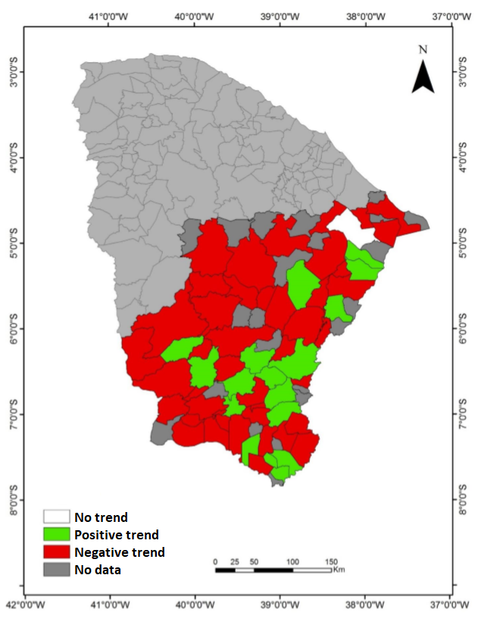
Supplementary material - Figure 1. Annual rainfall trends between 1960 and 2010 at the Jaguaribe River Basin, in Ceará State, NE Brazil, in the dry season. The figure shows a clear decrease in annual rainfall over the basin.

Slide 2
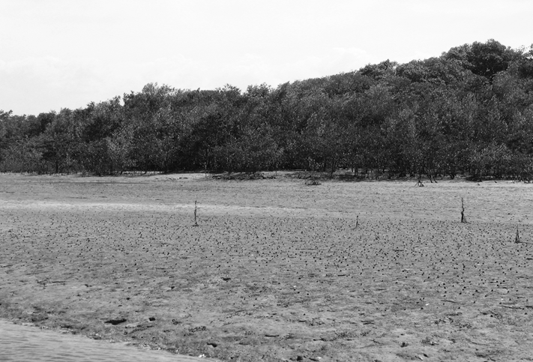
Supplementary material - Figure 2. Sediment accumulation along the Jaguaribe River Estuary, in Ceará State, NE Brazil. Note the first line of mangrove shrubs and the colonization of recent mud deposits by mangrove propagules. Details on mangrove and mud flat dynamics in the Jaguaribe Estuary are detailed in Godoy and Lacerda (2013; 2014) and Godoy et al. (2018).

Slide 3
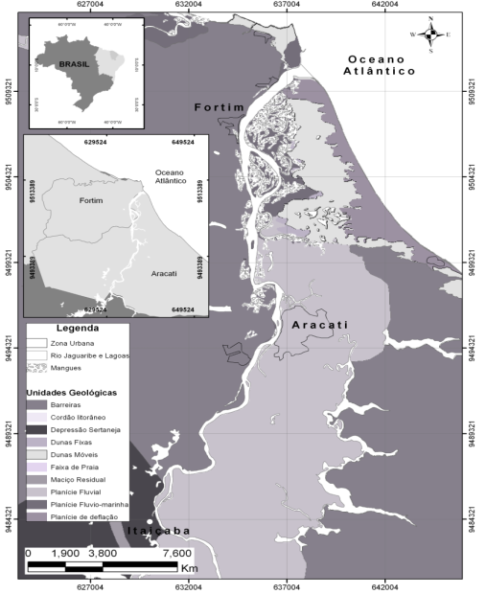
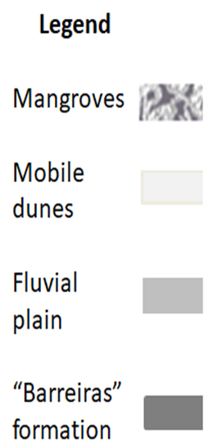
Brazil
Atlantic
Ocean
LE
ME
ME
HE
Supplementary material - Figure 3. The Jaguaribe River Estuary, and boundaries, in Ceará State, NE Brazil. LE – Lower estuary; ME – Middle estuary; HE – Higher estuary. Boundaries defined according to salinity gradients established during years with annual rainfall around the average historical level. Details of the hydrodynamics of the estuary and adjacent shelf can be consulted in Dias et al. (2011; 2013a; 2013b; 2016).

Slide 4
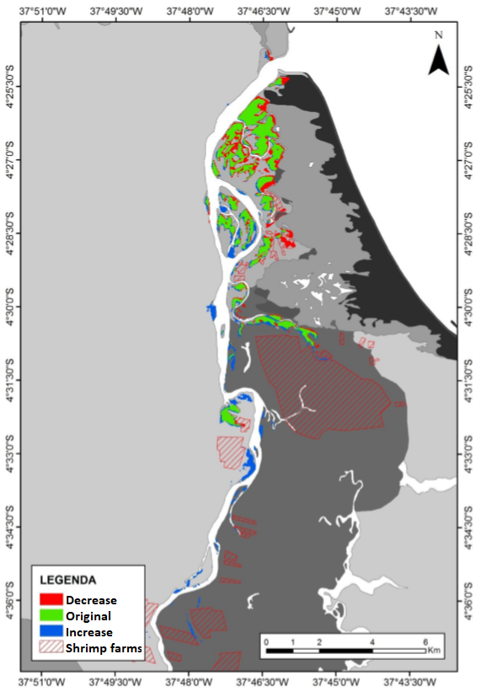
Supplementary material - Figure 4. Mangrove cover changes in the Jaguaribe River Estuary, in Ceará State, NE Brazil, between 1992 and 2010. The increasing trend repeats along the entire semiarid coast of NE Brazil. Total increase of 4.1%; expansion of shrimp farms reduced this augment in mangrove area (Godoy and Lacerda, 2013a,b; Lacerda et al., 2019).

