Slide 1
Extending the LISFLOOD-FP inundation model: highly-parallel solvers for high Froude number flows
James Shaw @hertzsprrrung
Water group seminar May 2020
Slides available at doi.org/dtsp
Notes:
Tell you about the new features I’m adding to lisflood,

Slide 2
About LISFLOOD-FP inundation model
Unsteady overland flow simulation on 2D raster grids
First created in 1999 at University of Bristol
Freely available for teaching and research, visit bit.ly/lisflood-fp
Simple to install, configure, and run on multi-core CPUs
www.fathom.global

Slide 3
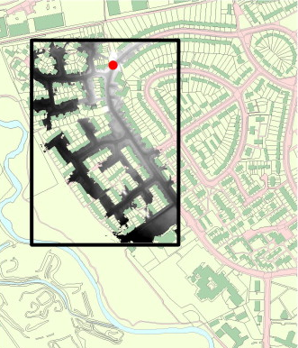
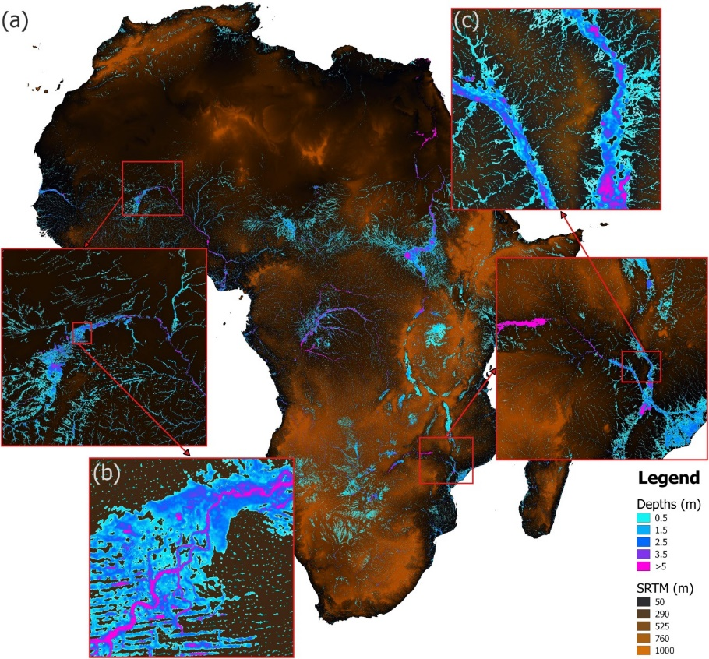
LISFLOOD-FP applications
Urban flood modelling using vehicle-mounted lidar topography data
0.1 km² at 0.1m grid spacing
Sampson et al., 2012 doi.org/dcbk
Continental-scale flood modelling using satellite topography data
30 million km² at 90m grid spacing
Sampson et al., 2015 doi.org/ggjfth
Notes:
Lisflood has been used in a wide variety of modelling studies

Slide 4
LISFLOOD-FP local inertia solver
Derived from the fully nonlinear 2D shallow water equations:
Mass equation:
Momentum equation:
Convective
acceleration
Pressure
gradient
Local inertia solver neglects convective acceleration
Notes:
The current version of lisflood recommends you use the local inertia solver

Slide 5
Limitations of local inertia solver
Local inertia solver is stable:
For Froude numbers < ~0.7
Suitable for fluvial flooding (driven by slowly rising river levels)
Local inertia solver can become unstable for Froude numbers > ~0.7:
Pluvial flooding involving rainwater flowing down mountain slopes
Urban floods over smooth surfaces (Manning's n ~0.01)
Hydraulic jumps in open channels, dam break scenarios
www.fathom.global
Notes:
Model studies have found the approximation is valid for…

Slide 6
New fully nonlinear 2D shallow water solvers
Available in the next LISFLOOD-FP release later in 2020:
2nd-order-accurate Discontinuous Galerkin (DG2) scheme
1st-order-accurate Finite Volume (FV1) variant of the same scheme
FV1 and DG2 solvers can be configured for:
Multi-core CPU (tested up to 16 CPU cores)
Many-core GPU (tested up to 5120 GPU cores)
www.fathom.global

Slide 7
Circular shock wave
Standard benchmark test, Toro 2001
t = 0.7 s
Initial condition
0.5 m
t = 1.4 s
20 m
2.5 m
t = 4.7 s
20 m
200×200 cells (0.1 m grid spacing)
www.fathom.global

Slide 8
Circular shock wave after 4.7 seconds
Local inertia
(standard solver)
FV1
(new solver)
DG2
(new solver)
Water surface elevation
0m
1.5m
www.fathom.global

Slide 9
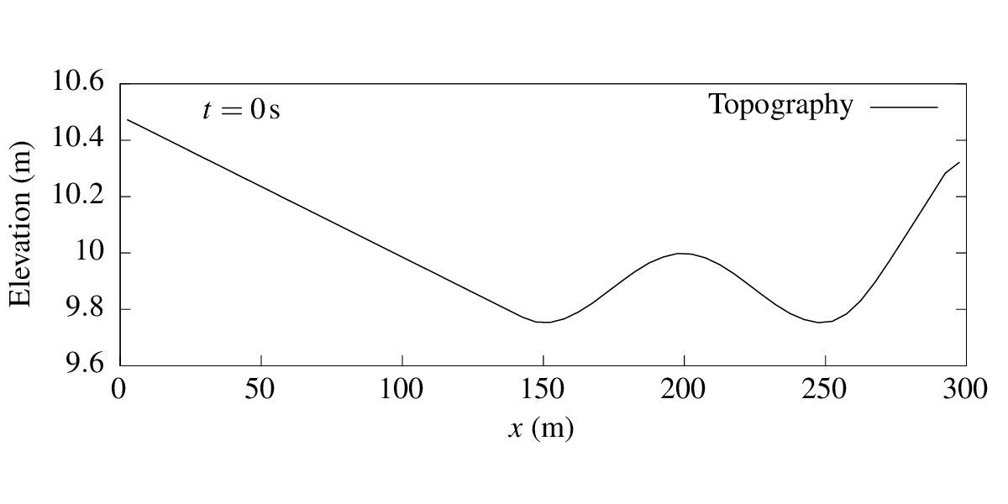
Downhill flow over a dry domain
Environment Agency benchmark test, Néelz and Pender 2013
Manning’s n = 0.01 — too low for local inertia solver
Test setup (topography varies in x-direction only)
Inflow at boundary
2D domain: 300m×100m, 5m grid spacing
www.fathom.global
Notes:
Local inertia solver cannot run this test: the solver is unstable

Slide 10
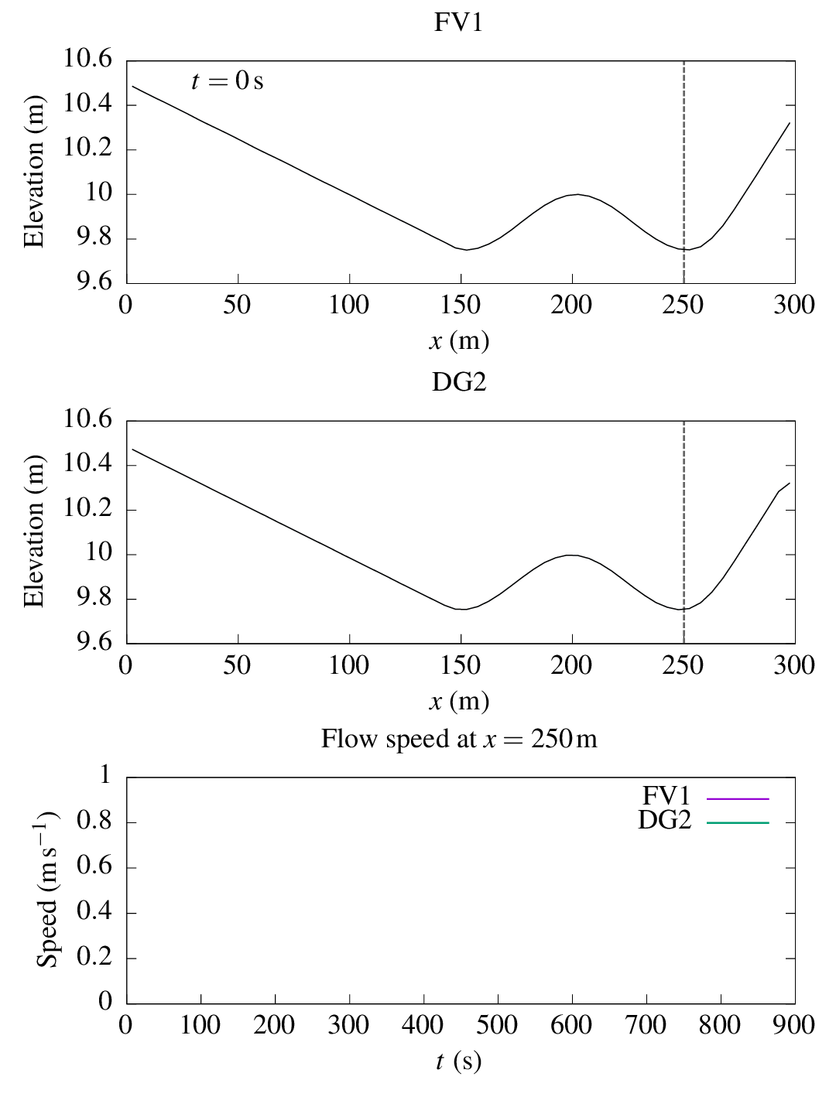
Downhill flow: flow behaviour
Brief period of inflow at the boundary
Most water remains in valley at 150m
Momentum carries some water into valley at 250m
www.fathom.global

Slide 11
Downhill flow: flow speed predictions
FV1 rapidly loses energy due to numerical diffusion errors
DG2 preserves long-lived sloshing motions resulting from very weak friction force
www.fathom.global

Slide 12
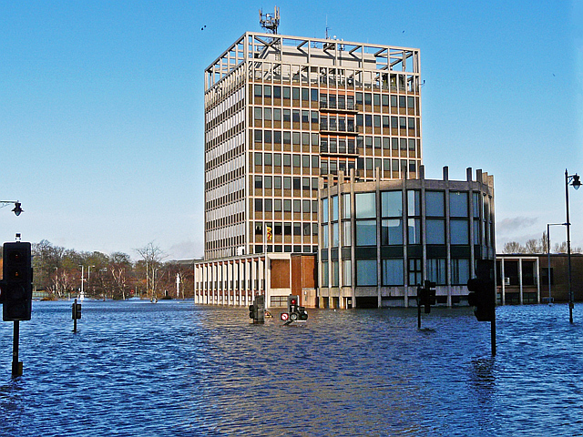
Storm Desmond 2015 simulation
Eden catchment, 2500 km² over Cumbria
Validation data from 16 river level monitoring stations
Originally simulated by Xia et al., 2019 doi.org/dtpm
Carlisle Civic Centre
6 Dec 2015
Rose and Trev Clough CC BY-SA 2.0
www.fathom.global

Slide 13
FV1 model configuration
Floodplain topography and channel bathymetry at 20m grid spacing (~6 million cells)
River and floodplain flows entirely driven by radar rainfall data (every 5min, 1km² resolution)
Impermeable surface (no infiltration)
Water drains out into Solway Firth
Solway Firth
www.fathom.global
Notes:
Fully 2D model

Slide 15
Storm Desmond FV1 model runtimes
All simulations run on Bessemer, TUoS HPC platform
Duration of storm event: 132 hours (5.5 days)
FV1 solver on 16-core CPU: 56.3 hours (2.3× real time)
FV1 solver on Tesla V100 GPU: 5.75 hours (23× real time)
GPU gives 10×speed-up over 16-core CPU
www.fathom.global
Notes:
Tesla has 5120 CUDA cores (not directly comparable to CPU cores)

Slide 16
Summary
Coming late 2020, next LISFLOOD-FP release includes new FV1 and DG2 solvers:
For simulating fast flows, low friction surfaces, fine-scale flow features
Dynamic rain-on-grid functionality for simulating storm events
Supports multi-core CPUs and many-core GPUs
Freely available for academic use, please contact me for further information!
Slides available at doi.org/dtsp

