Slide 1
Sharing, Discovering, and Citing COVID-19 Data and Code
Mark Hahnel, CEO
@MarkHahnel

Slide 2
Why care?

Slide 3
Good for humanity
Good for your career

Slide 4
Figshare.com

Slide 5
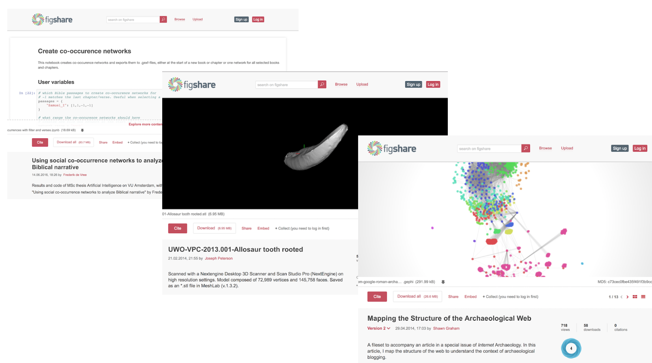

Slide 6
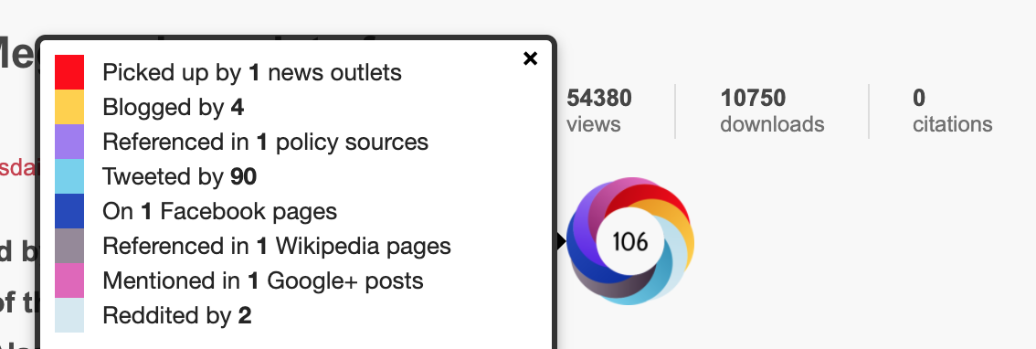
Citations
Altmetrics

Slide 7
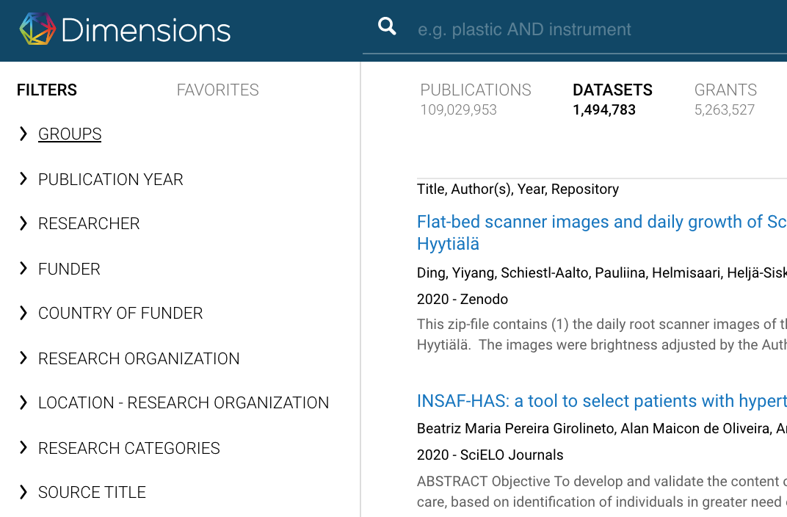
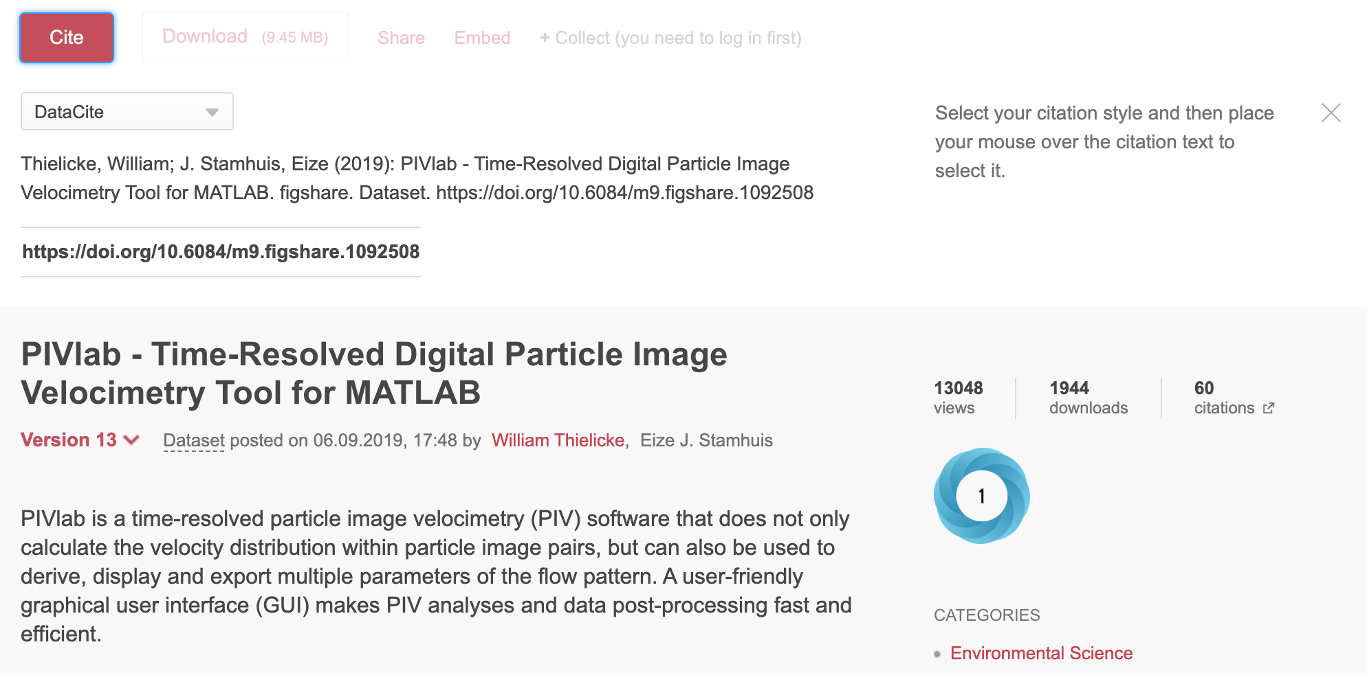
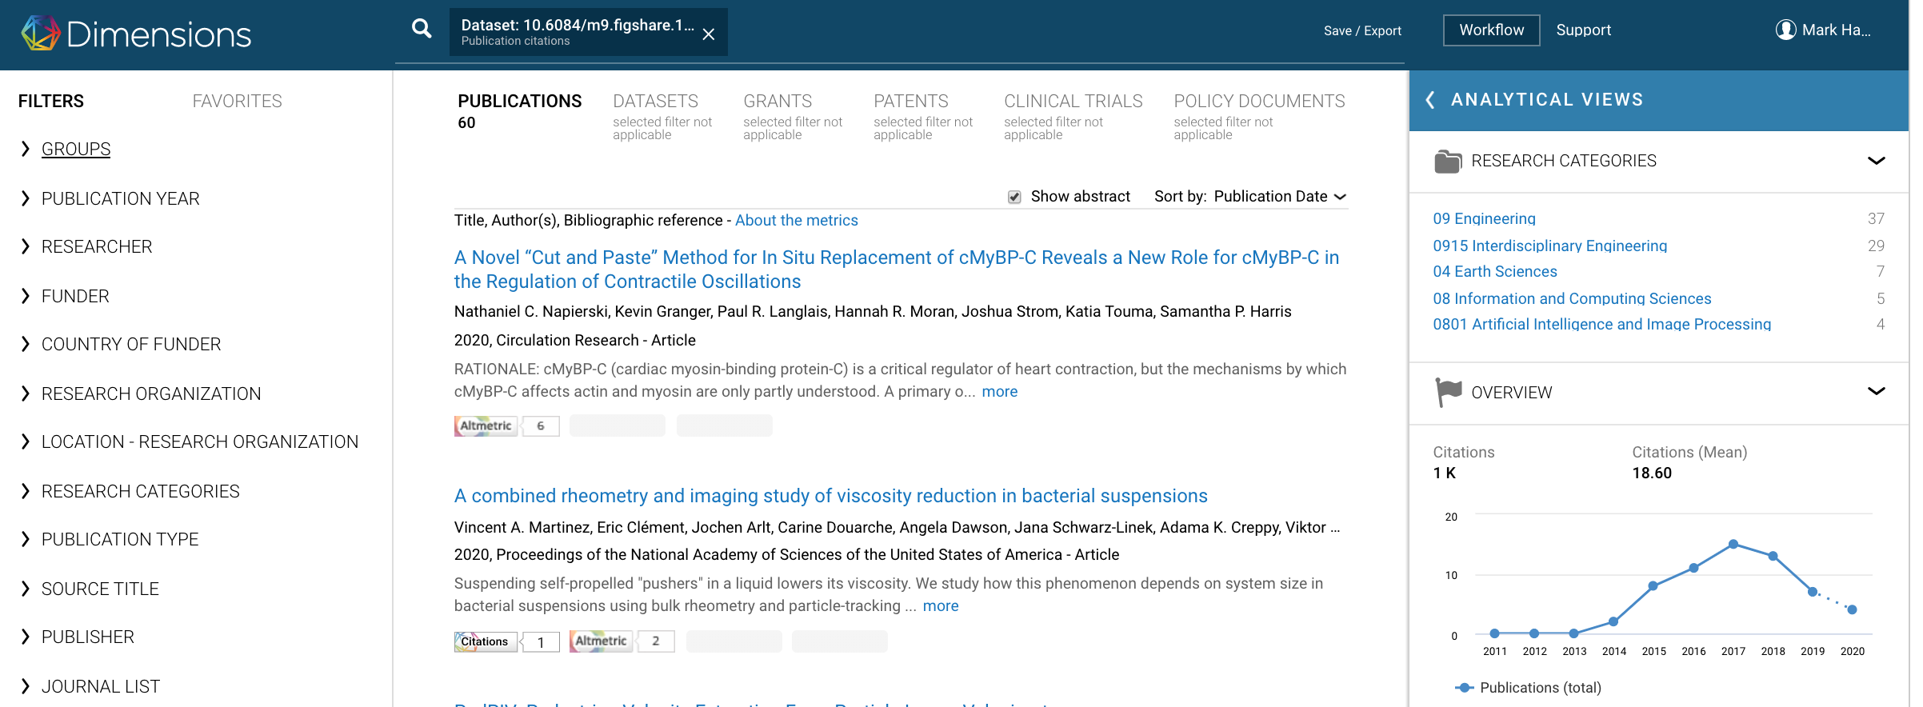

Slide 9
NIH Figshare Instance

Slide 10
NIH Figshare Instance
https://nih.figshare.com/
Free
Support for larger datasets and data files of any type
Detailed, NIH-specific metadata to improve discoverability of your research and direct links to NIH funding sources and publications
User support from a Figshare team member with expertise in data curation and biomedical research, including complimentary review of data files and description to ensure highest quality and greatest discoverability

Slide 11
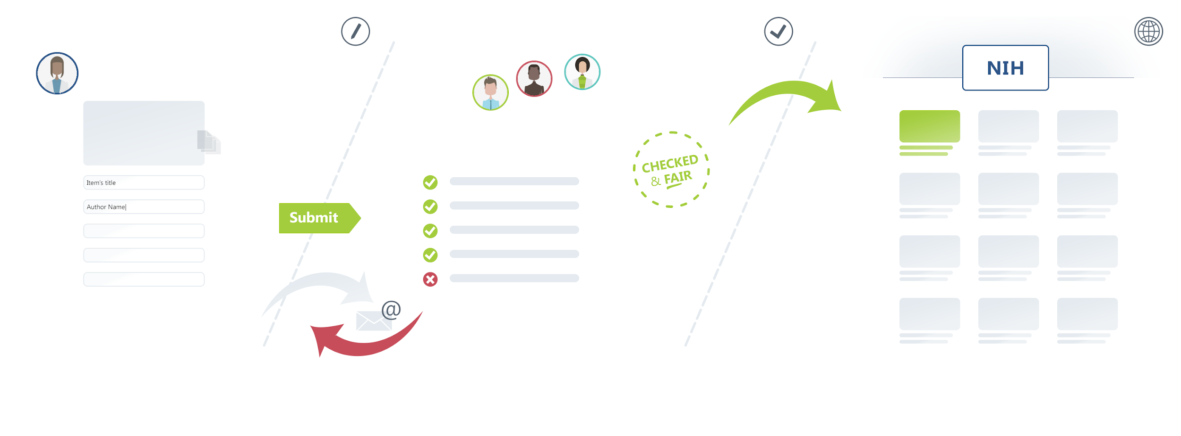
NIH Figshare Instance
https://nih.figshare.com/

Slide 12
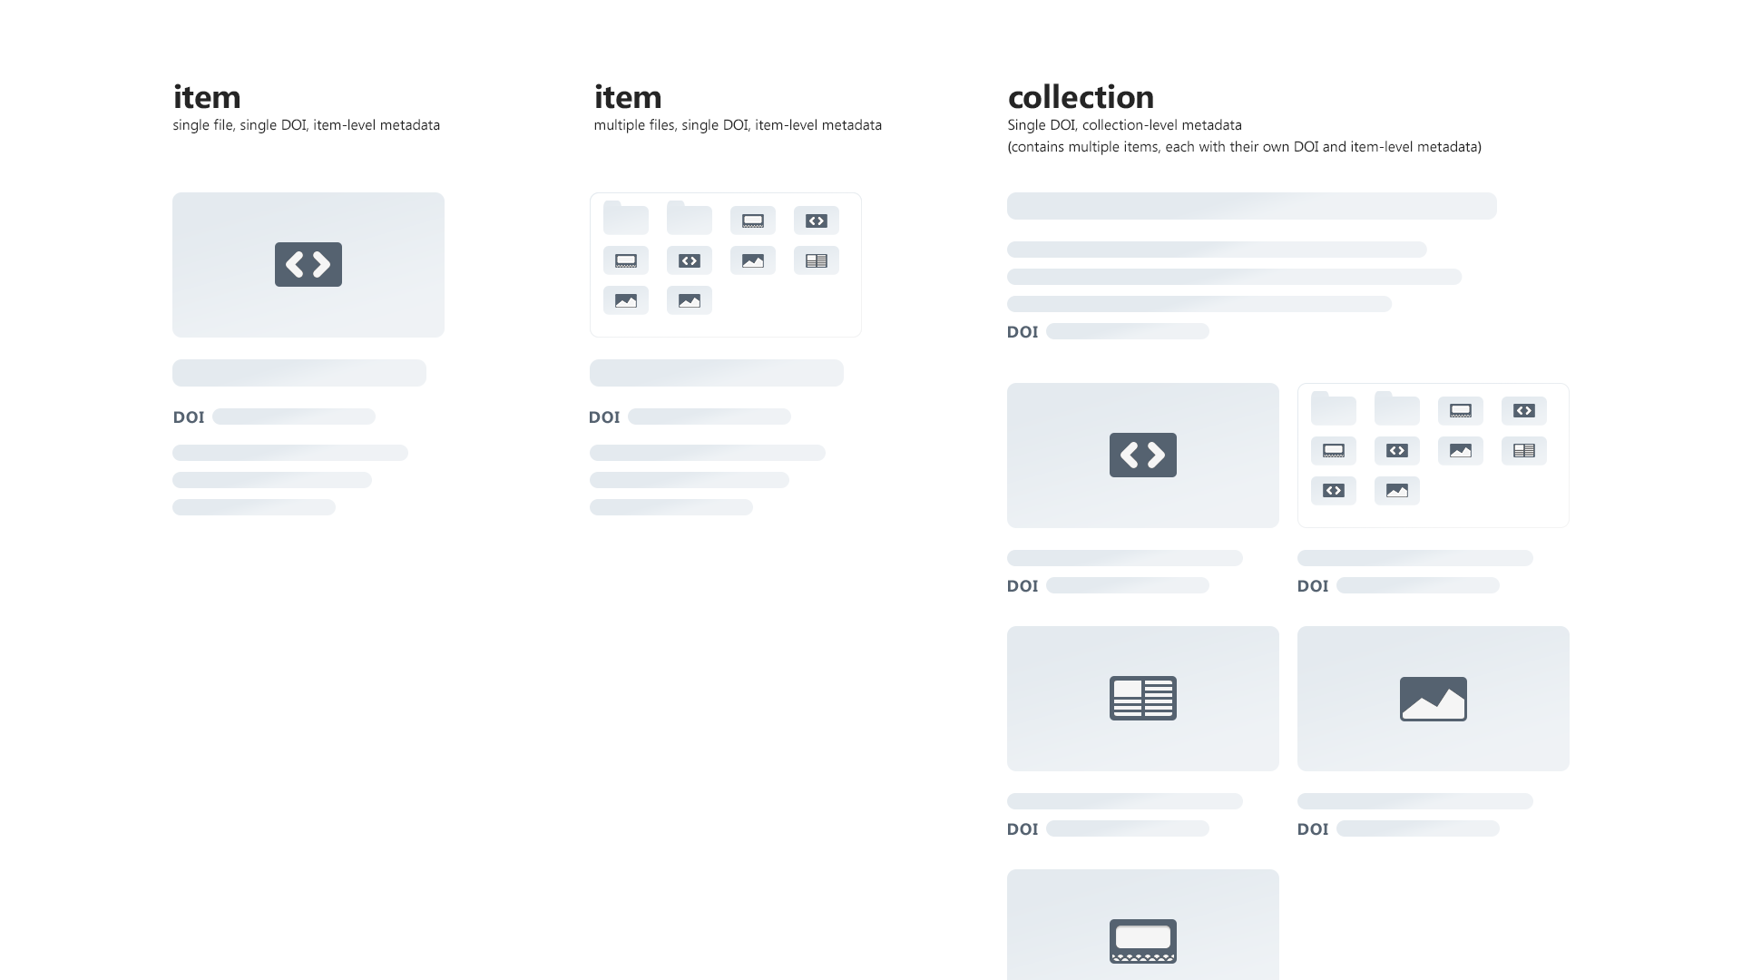
NIH Figshare Instance
https://nih.figshare.com/

Slide 13
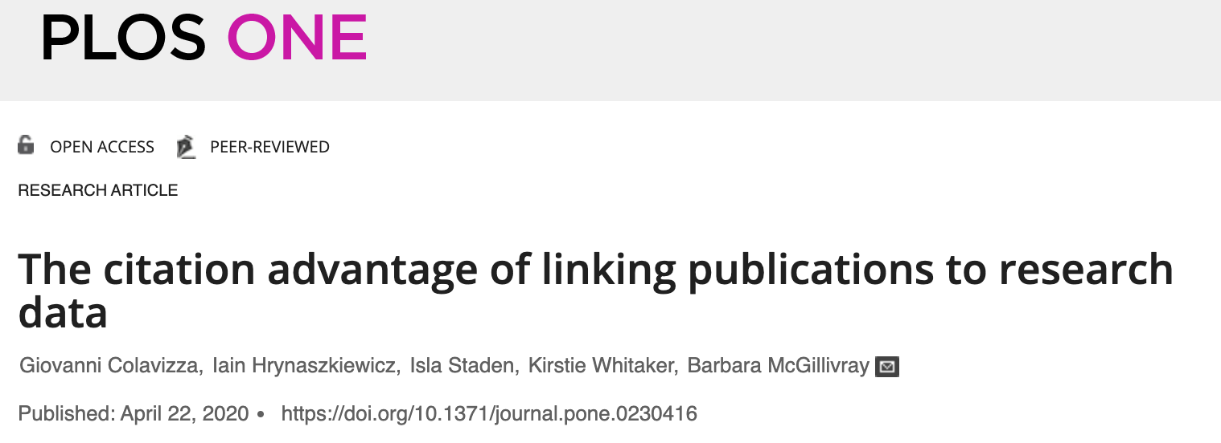
25% more citations to your papers
We also find an association between articles that include statements that link to data in a repository and up to 25.36% (± 1.07%) higher citation impact on average, using a citation prediction model.
https://doi.org/10.1371/journal.pone.0230416

Slide 14
Broader Reach

Slide 15
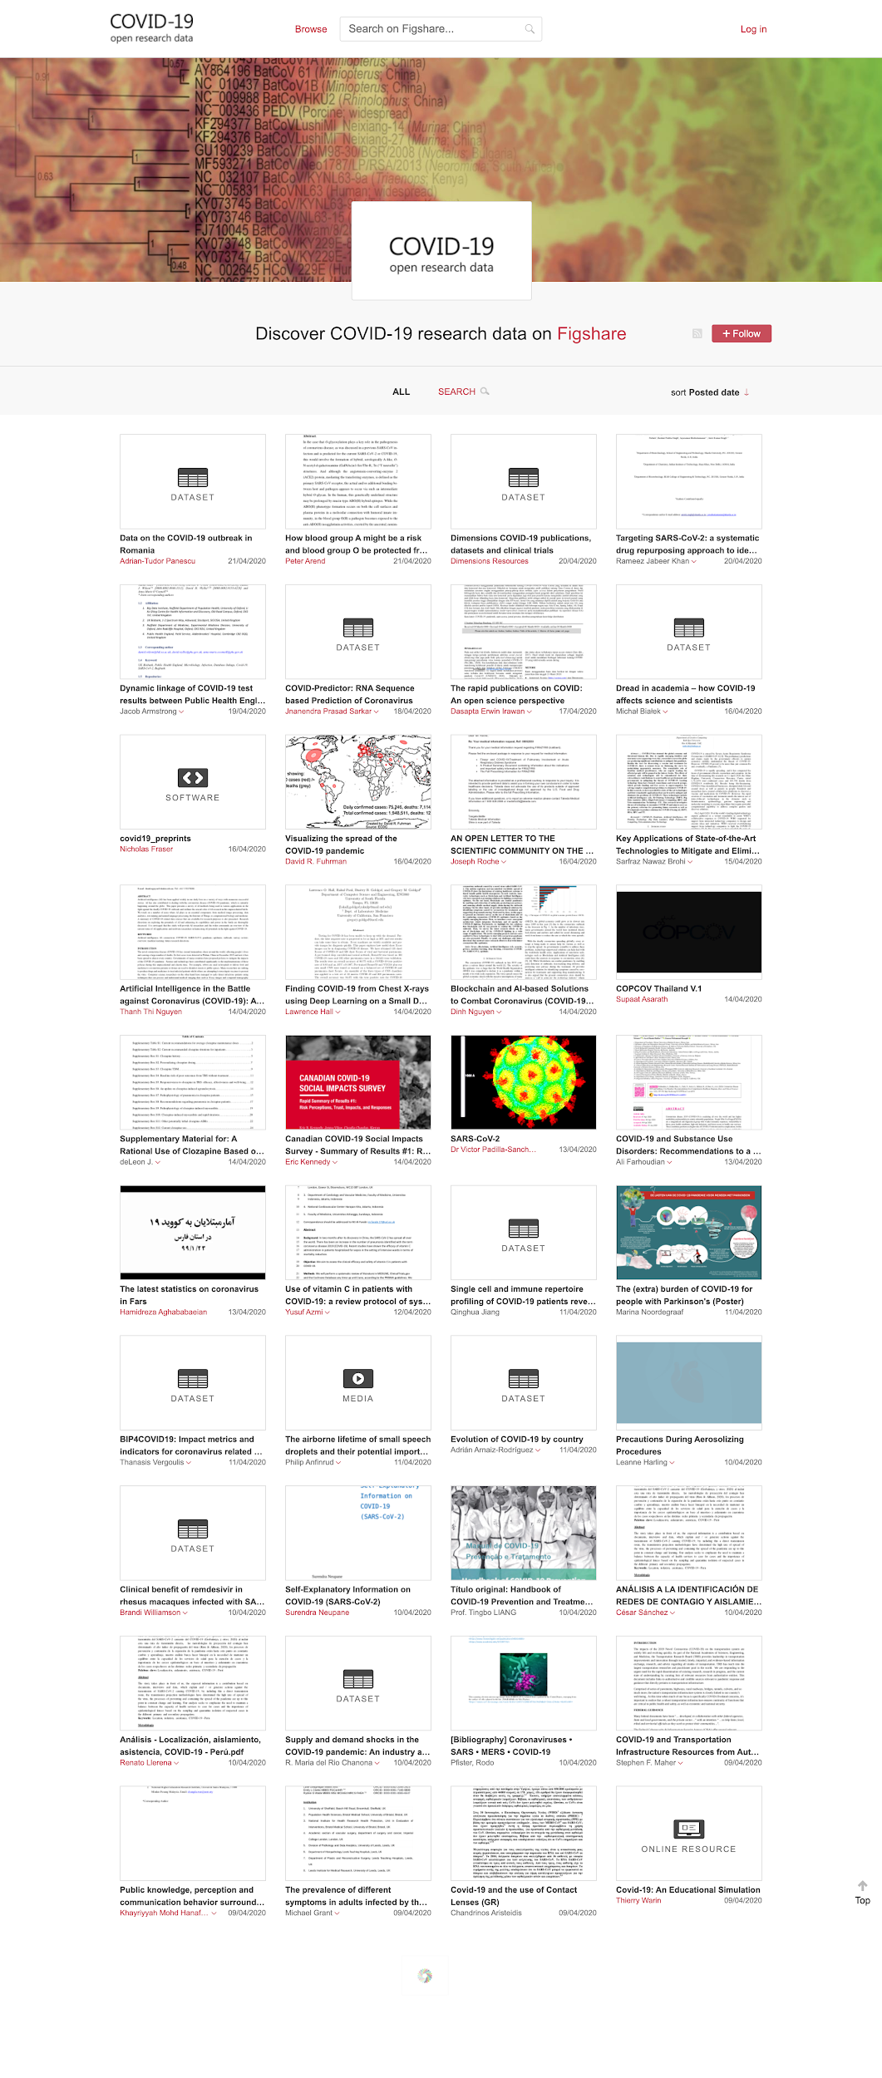
https://covid19.figshare.com/
Upload data at
NIH.Figshare.com
Institutional Data Repo
Figshare.com
Tags
2019-nCoV
2019nCoV
COVID-19
COVID19
Coronavirus
Corona virus
SARS-CoV-2
SARSCoV2
Covid2019
covid_19

Slide 16
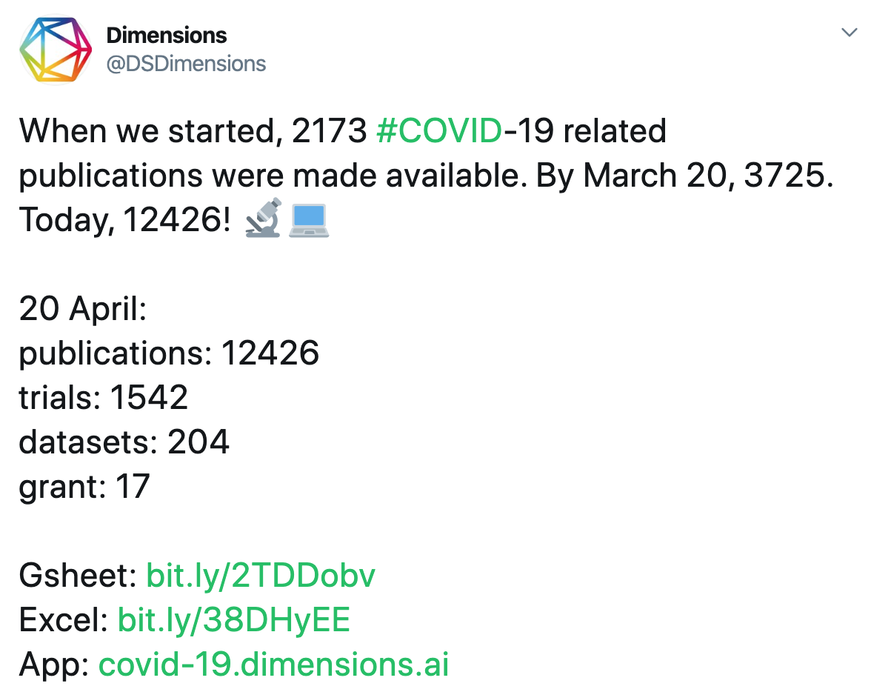
https://covid-19.dimensions.ai/

Slide 17
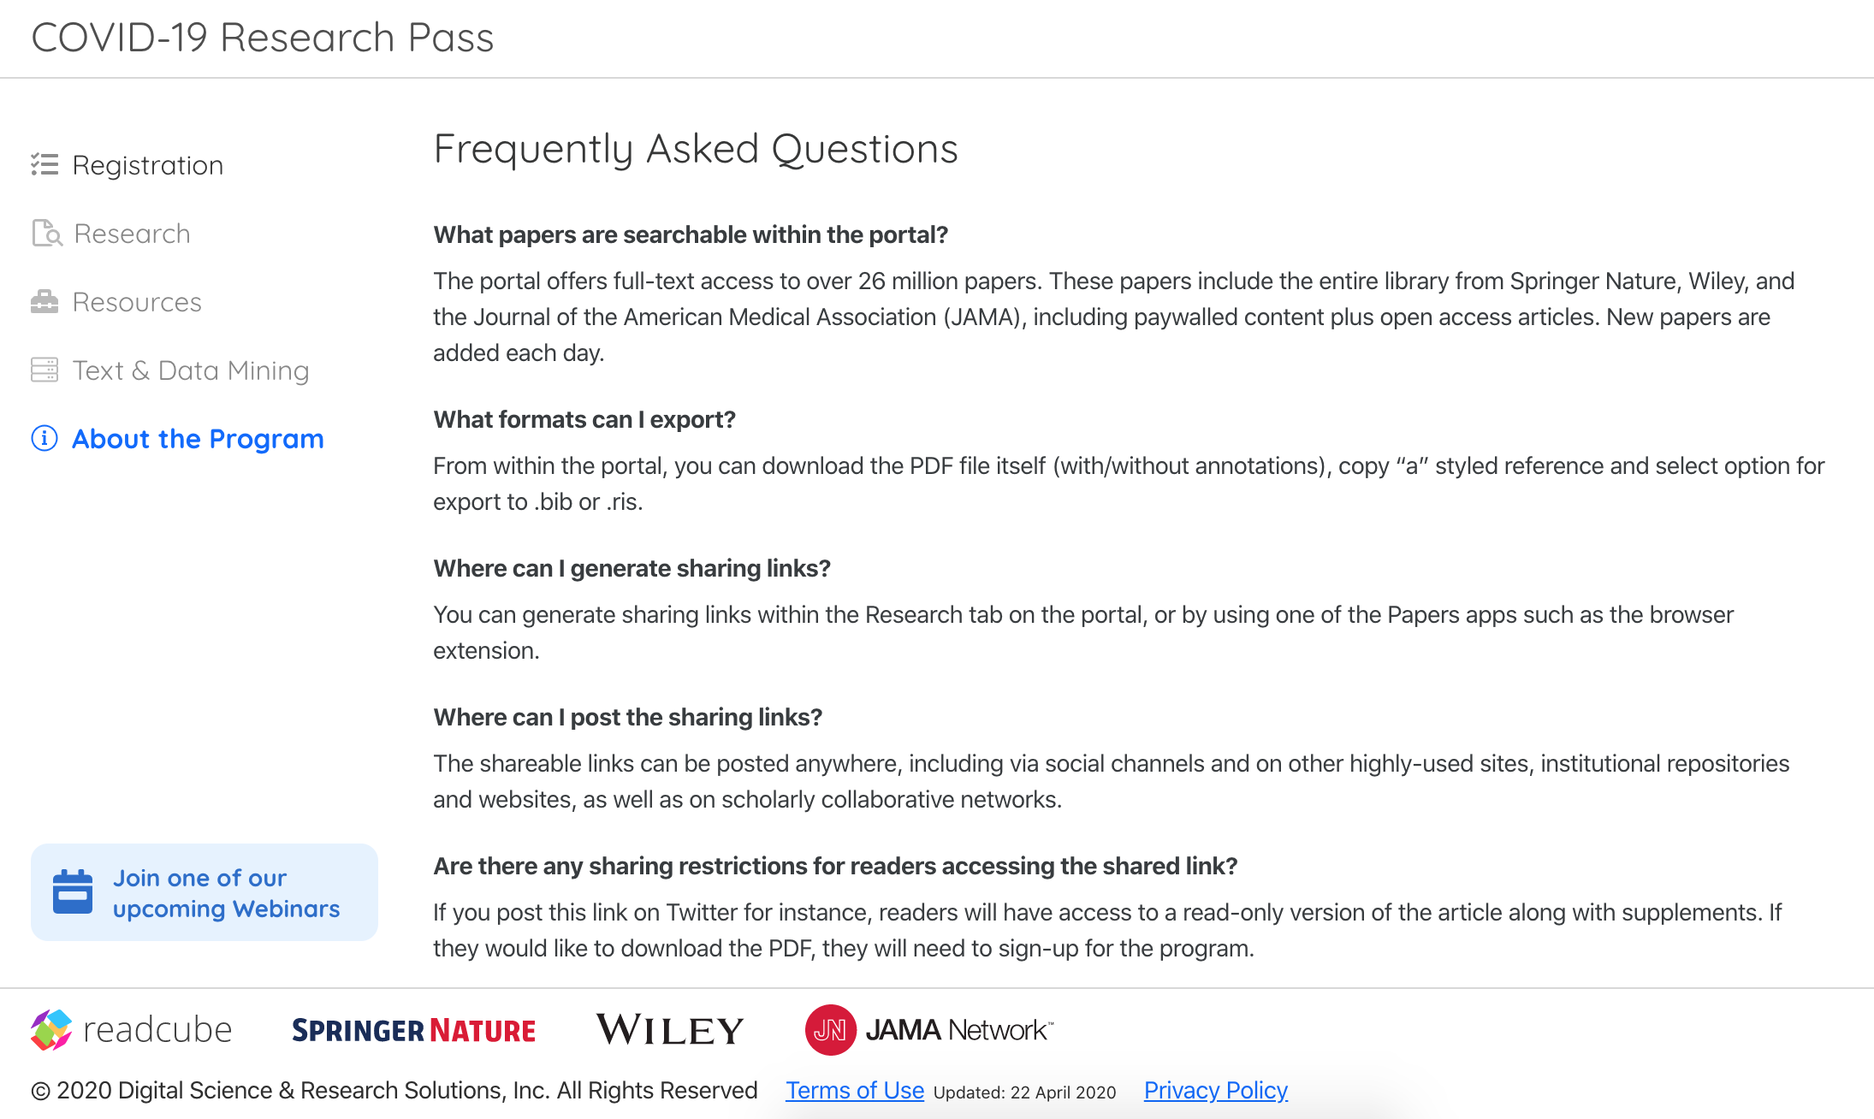
https://covid19.readcube.com/

Slide 18
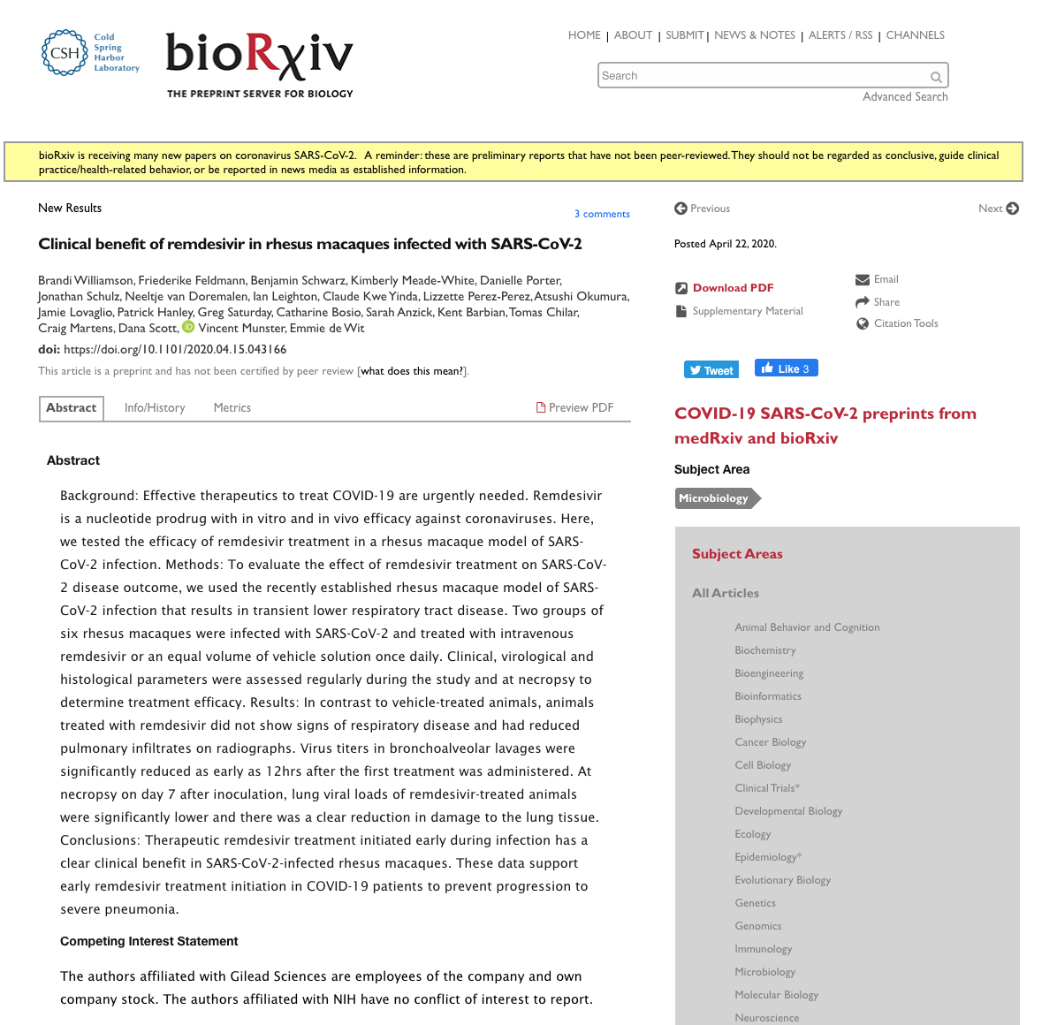
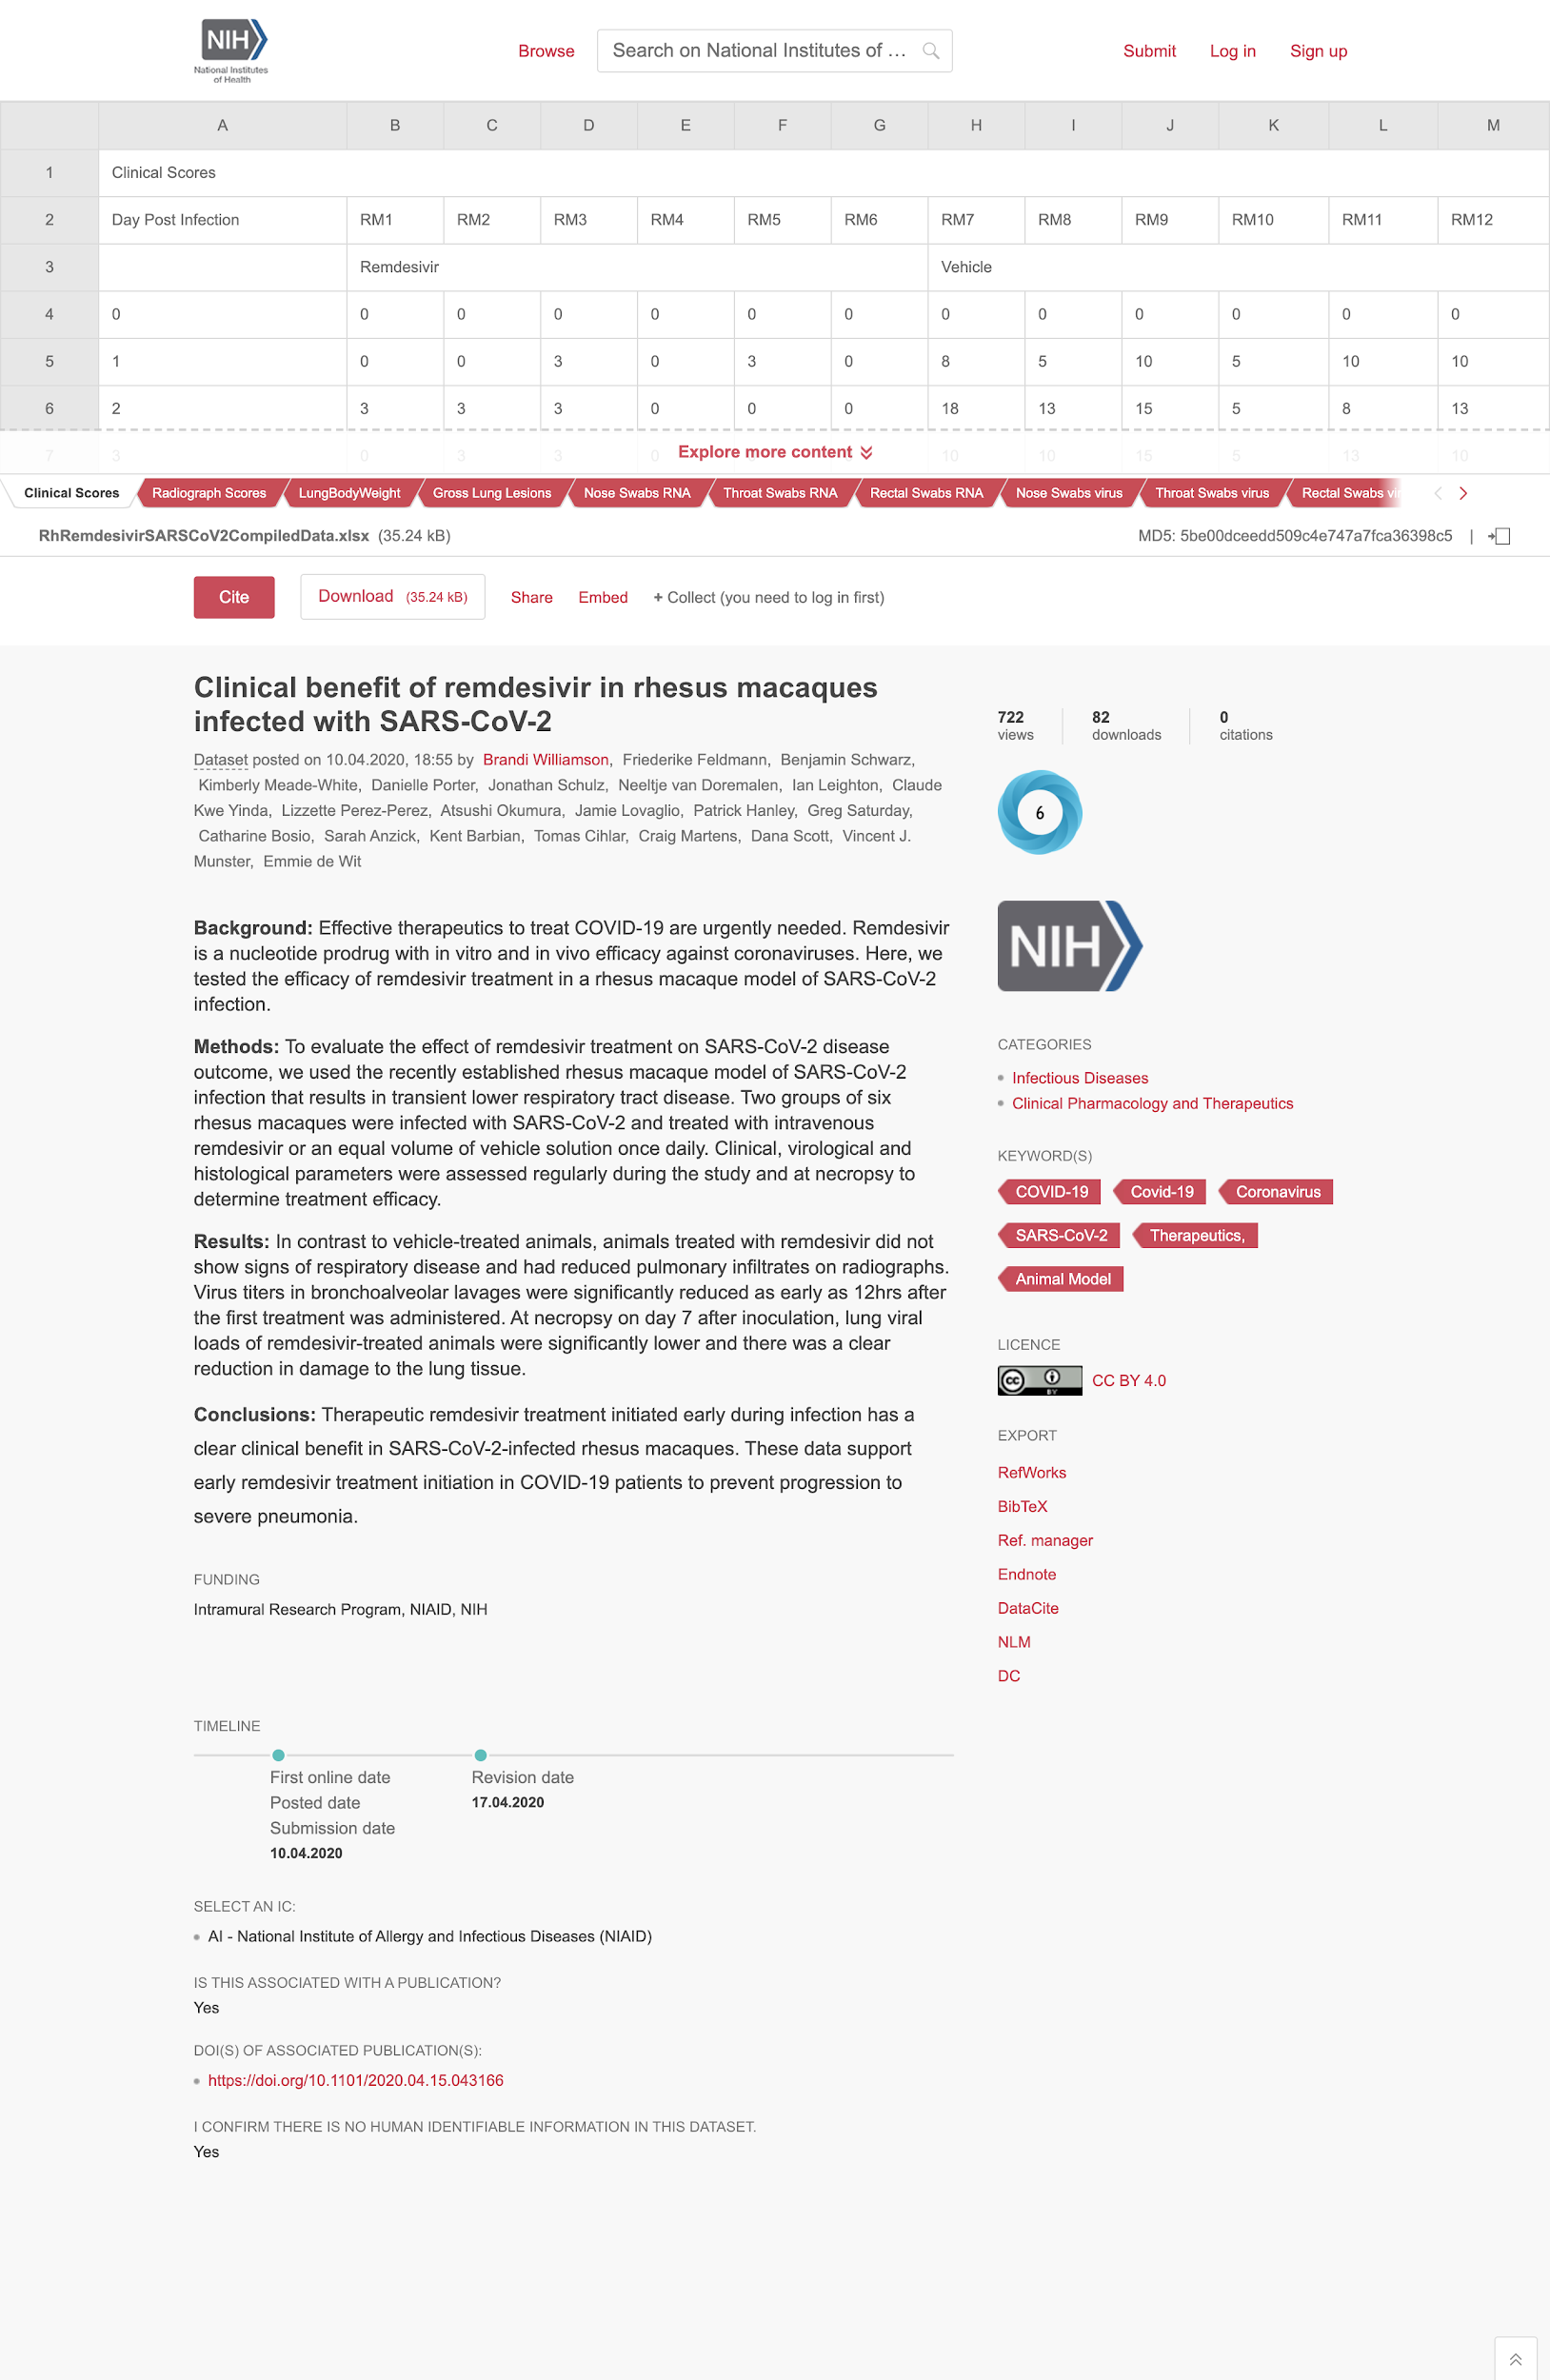
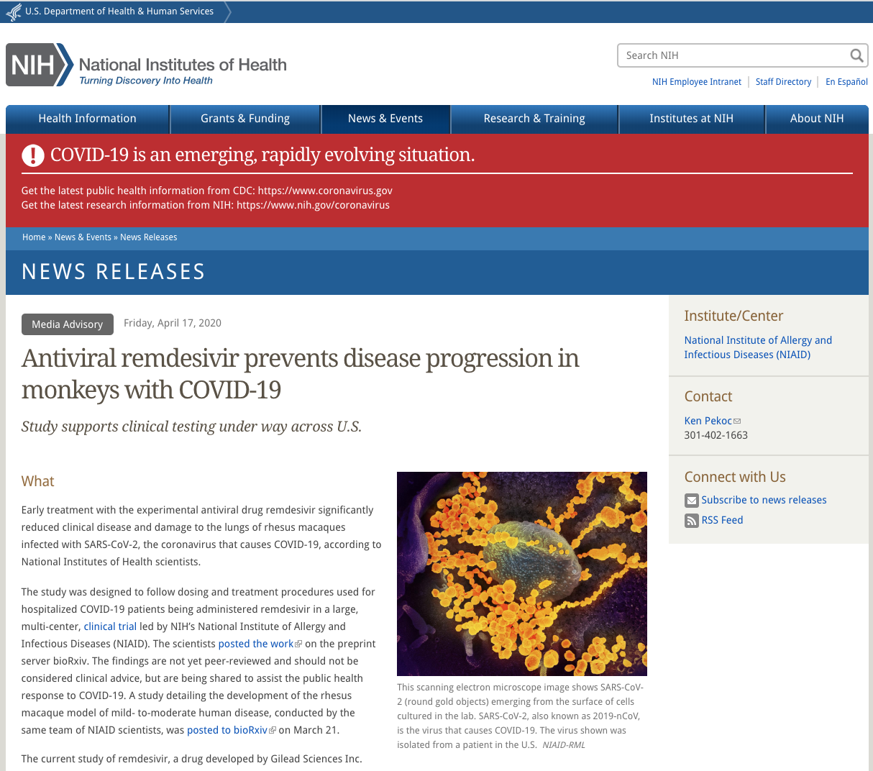

Slide 19
Mark Hahnel
Function: CEO Figshare
Email: mark@figshare.com
Upload Data
https://NIH.figshare.com/
Institutional Data Repository
https://Figshare.com/
Discover Data & Papers
https://covid19.figshare.com/
https://covid-19.dimensions.ai/
https://covid19.readcube.com/

