Slide 1
Beyond Altmetrics: What’s next in the world of information metrics?
Adrian Stanley, Digital Science
@DigitalSci @AdrianStanley13
Ann Michael, PLOS
@PLOS @annmichael

Slide 2
Agenda
A brief history of metrics
Why use metrics?
What are our critical questions?
How might we answer them in the future?

Slide 3
History

Slide 4
From Journal Impact Factor …
1955 - First mention of Impact Factor, Eugene Garfield/ NIH published Genetics Citation Index
1960 – founding of Institute for Scientific Information (ISI) an academic publishing service
1961 - Publication of Science Citation Index (SCI)
1975 - Impact Factors calculated yearly for journals listed in Journal Citations Report (JCR)
1989/1990 – World Wide Web developed by Sir Tim Berners-Lee
1992 - ISI acquired by Thomson Scientific & Healthcare (Clarivate)
late 90’s - 2004 - web 1.0; webometrics as a field of study.. Project Counter (2002)
Notes:
1955 - First mention of the idea of Impact Factor, Eugene Garfield, with support from NIH published the experimental Genetics Citation Index
1960 - Institute for Scientific Information (ISI) an academic publishing service, founded by Eugene Garfield in Philadelphia
1961 - Publication of the Science Citation Index (SCI)
1975 - Impact Factors calculated yearly for journals listed in Journal Citations Report (JCR)
1989/1990 – World Wide Web developed by Sir Tim Berners-Lee
1992 - ISI was acquired by Thomson Scientific & Healthcare (Clarivate)
late 90’s - 2004 - web 1.0 and development of webometrics as a field of study
Project Counter https://www.niso.org/niso-io/2016/12/brief-history-counter-and-sushi

Slide 5
…To Altmetrics and more
2004 –
Web 2.0; FaceBook;
Scopus launched
2005 - H-Index author level metric measuring productivity/ citation impact
2006 - Twitter founded,
2009 - PLOS introduced article-level metrics for all articles
2010/2011 – Altmetric, Impact Story, & Plum Analytics founded
2014 -Leiden
Manifesto ten principles for sciento-metricians
2012 – DORA developed at Annual Meeting of the ASCB
Notes:
https://www.nature.com/news/bibliometrics-the-leiden-manifesto-for-research-metrics-1.17351
http://garfield.library.upenn.edu/papers/science1955.pdf
2002 Counter https://www.niso.org/niso-io/2016/12/brief-history-counter-and-sushi
2004 - Web 2.0/FaceBook new innovative constructs to measure the broad scientific impact of scholarly work
2004 Scopus launched https://en.wikipedia.org/wiki/Scopus
2005 - H-Index author level metric measuring productivity/citation impact suggested by Jorge E. Hirsch
2006 - Twitter founded, Jack Dorsey, Noah Glass, Biz Stone, and Evan Williams
2008 - Journal of Medical Internet Research started to systematically collect tweets about its articles
2009 - Public Library of Science (PLOS) introduced article-level metrics for all articles
2009 - Streamosphere developed by Euan Aide, later to be named/launched as Altmetric (2011)
2010 - Altmetrics - a manifesto published J. Priem, D. Taraborelli, P. Groth, C. Neylon
2011 - Impact Story founded, Jason Priem, Heather Piwowar
2011 - Plum Analytics Founded by Andrea Michalek, (acquired by Elsevier 2017)
2012 – DORA – the Declaration of Research Assessment, developed at Annual Meeting of the American Society for Cell Biology in San Francisco.
2014 - Leiden Manifesto ten principles for scientometricians
2014 - European Commissioner Máire Geoghegan-Quinn recognized Altmetric as a company challenging the traditional reputation systems
COS TOP factor launched TOP Factor https://cos.io/top/
2017. Digital Science Dimensions https://www.digital-science.com/press-releases/digital-science-launches-dimensions-next-generation-research-discovery-platform-linking-124-million-documents-providing-free-search-citation-data-across-86-million-articles/

Slide 6
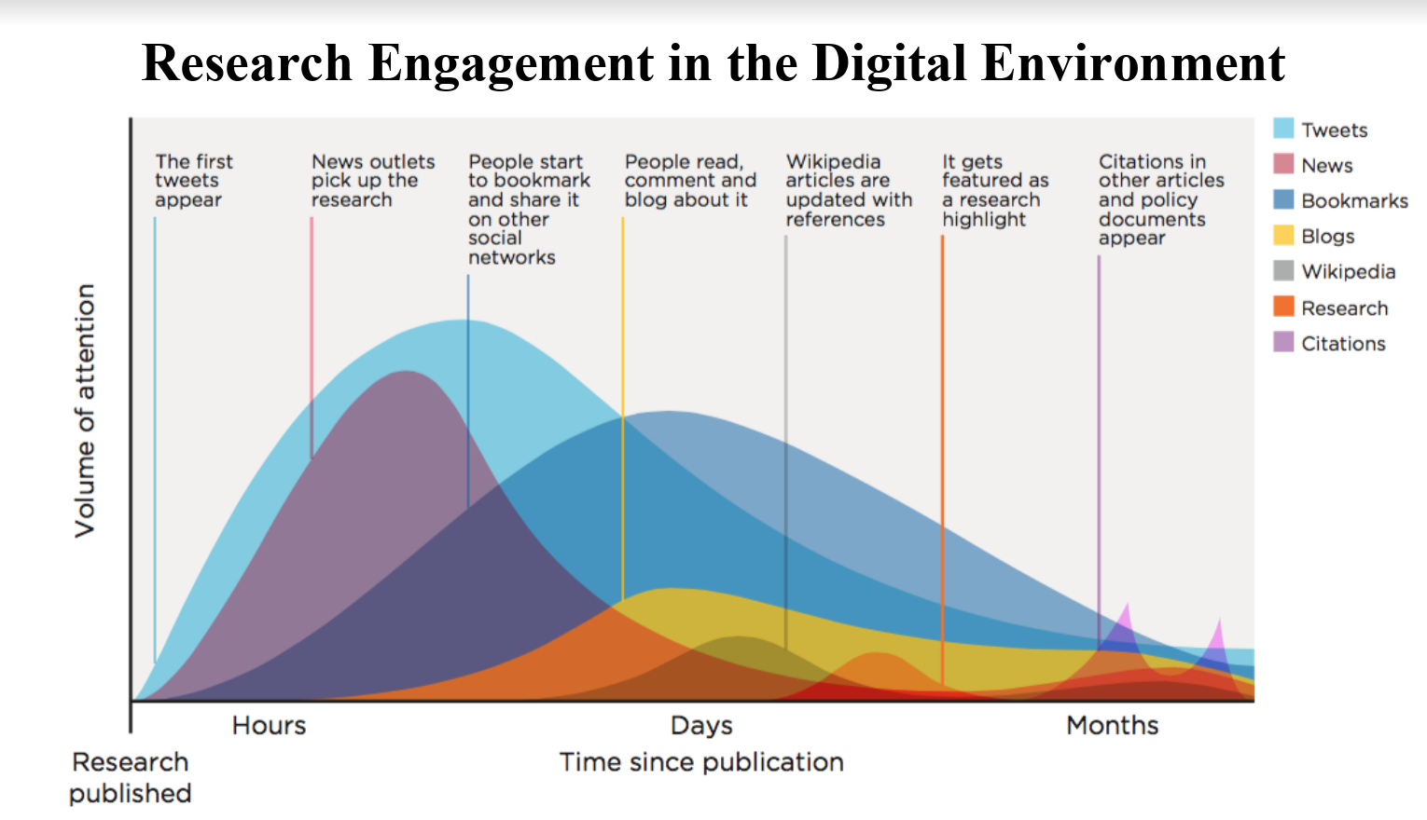
NOTE TAKER - SOMEONE TO PULL IN AUDIENCE INPUT

Slide 7
Additional perspectives on impact
Journal Impact Factor
Citation counts
Mentions in:
News, Social media, Blogs
Patent citations
Policy Citations
ACADEMIC IMPACT
SOCIETAL IMPACT
+
Traditional metrics
(Journal Level)
Alternative metrics
(Article Level)
Notes:
https://www.nature.com/news/bibliometrics-the-leiden-manifesto-for-research-metrics-1.17351
http://garfield.library.upenn.edu/papers/science1955.pdf

Slide 8
Why use metrics?

Slide 10
Why use metrics?
LIBRARIAN
PUBLISHER
Which journals should be in our collection?
What % of our hybrid journals are OA?
Do our Editors select the most impactful research?
How is the market changing?
…to answer questions or gain perspective
FUNDER
RESEARCHER
How impactful is the research I’m funding?
Which researchers should I fund?
Where should I submit my research?
What are the policies of my targeted journal?

Slide 11
What are your critical questions?

Slide 12
If you could see into the future, what would you do with that insight?
What questions would you ask?

Slide 13
What if you could predict the impact and novelty of articles for your journal?
Would you change business practices?
Can you see any pitfalls with this approach?

Slide 14
What if you knew social media attention correlated to improved sales?
Would you consider changing your marketing strategy?
Notes:
https://app.dimensions.ai/details/publication/pub.1101762503?order=date&or_facet_researcher=ur.010706033475.66 Mike Thelwall

Slide 15
Are publishers and librarians looking at the same data points to make decisions on how transformative agreements work?

Slide 16
How can the library audit and benchmark RAP and PAR deals?

Slide 17
As a funder, how do I measure the impact and efficacy of my program?

Slide 18
The future of analytics: Metrics + Analytics

Slide 19
What’s the difference between metrics
and analytics?
Notes:
METRICS are a method of measuring something or the results obtained from doing so. Metrics represent the values of what you’re measuring. When applied to business, the most important metrics —the indicators of business performance—are called key performance indicators (KPIs)
ANALYTICS can be defined as the discovery, interpretation, and communication of meaningful patterns in data and applying those patterns toward effective decision-making.
https://www.ge.com/digital/blog/metrics-versus-analytics-scorekeeping-scoring – definitions I liked ☺

Slide 20
Why?
What data do we have?
Where do we get it?
Is it interoperable?
What questions can’t we answer now?

Slide 21
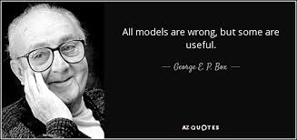

Slide 22
Data Quality & Consistency

Slide 23
Can we improve data quality?

Slide 24
What’s next?
Democratization of analytics across stakeholders and within organizations
Exploratory and predictive use of data and metrics
Data quality, consistency, and availability REQUIRED

Slide 25
What can we work on together?

