Slide 1

Working together to apply the standard standardly
Melissa Harrison – JATS4R Chair
m.harrison@elifesciences.org

Slide 2



Who am I?
Photo by Science in HD on Unsplash
I am NOT
  An XML or JATS expert
  A developer or technologist
  A researcher
  A website designer
I am
  A (open access) publisher
  Working for a mission-driven organization
  A workflow person
  A big fan of XML and JATS
  Connected
Photo by Tracy Adams on Unsplash
Photo by Bryson Hammer on Unsplash
https://jats4r.org/

Slide 3



Prefacing JATS4R
Small organisation
No formal funding
Passion and commitment of a few people, coupled with the voluntary time commitment of others within the JATS "community
https://jats4r.org/

Slide 4


What’s the difference between JATS and JATS4R?
THE RULES
JATS is a NISO standard that defines a set of XML elements and attributes
PLEASE DO THIS
JATS4R is about optimising the reusability of scholarly content by developing best-practice recommendations for tagging content in JATS XML
Photo by Adam Griffith on Unsplash
Photo by Mark Duffel on Unsplash
https://jats4r.org/

Slide 5
What’s the point?
Paper presented at JATScon 2014:
Inconsistent XML as a Barrier to Reuse of Open Access Content
http://www.ncbi.nlm.nih.gov/books/NBK159964/
https://analyticsindiamag.com/6-tasks-data-scientists-spend-the-most-time-doing/
https://jats4r.org/

Slide 6
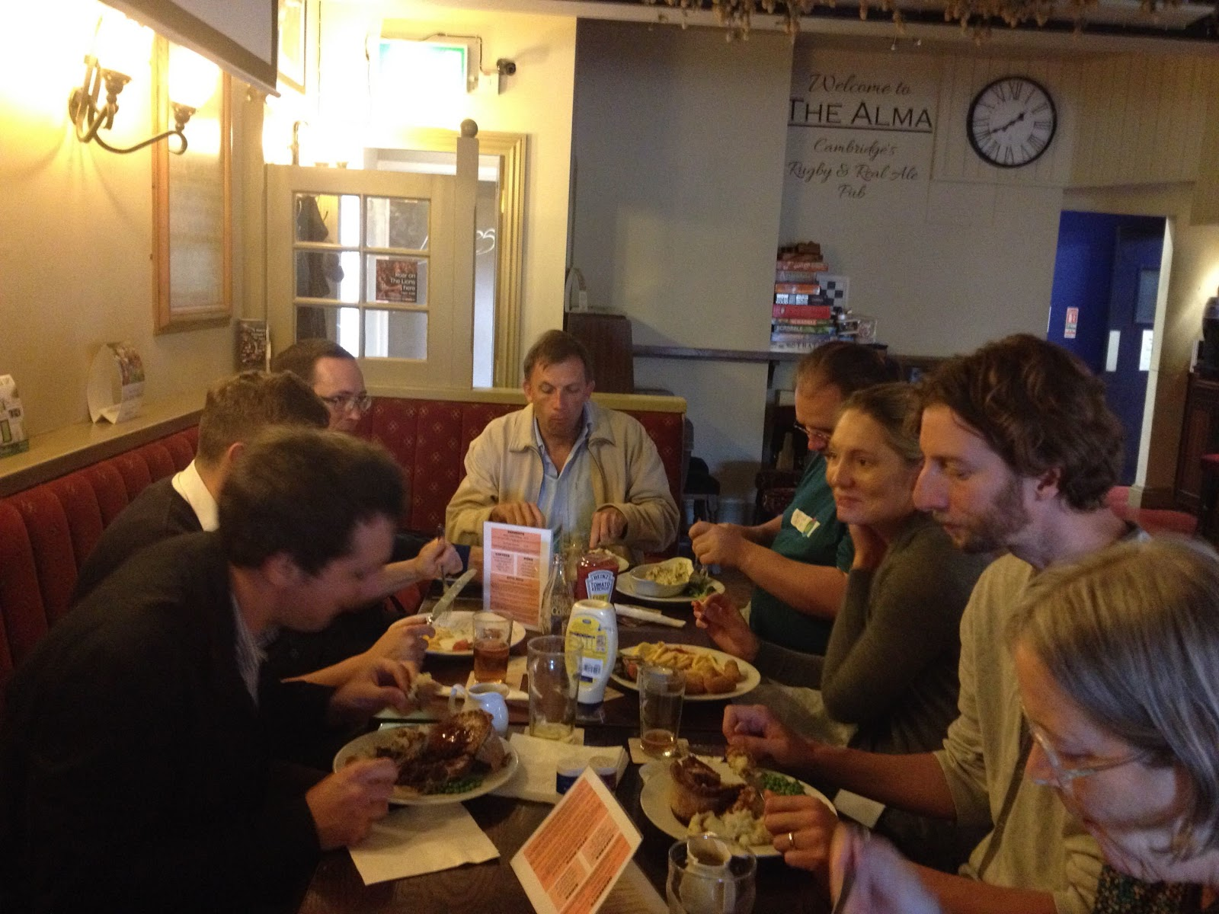
How did JATS4R come about
Open session at JATScon 2014 - Jeff Beck sent out a plea
Set of Open Access publishers and interested parties responded and formed the group
Launch in 2013
Bi-weekly calls with varying attendees
2017 – went through a process review:
  Steering Committee
  Sub-groups
2018 – became NISO Working Group
https://jats4r.org/
Photo from first meeting - lunch in the pub

Slide 7





JATS4R steering committee
Melissa Harrison
(chair)
eLife
Kevin Lawson
Sheridan Journal Services
Nick Nunes
HighWire Press
Lucie Senn
Frontiers
Jeff Beck
NCBI
Stephen Laverick
Green Fifteen Publishing Consultancy
https://jats4r.org/

Slide 8

















Who supports us
https://jats4r.org/

Slide 9
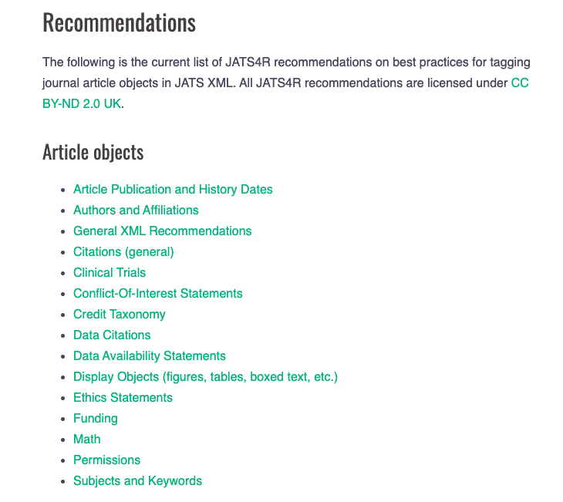
Recommendations
https://jats4r.org/

Slide 10
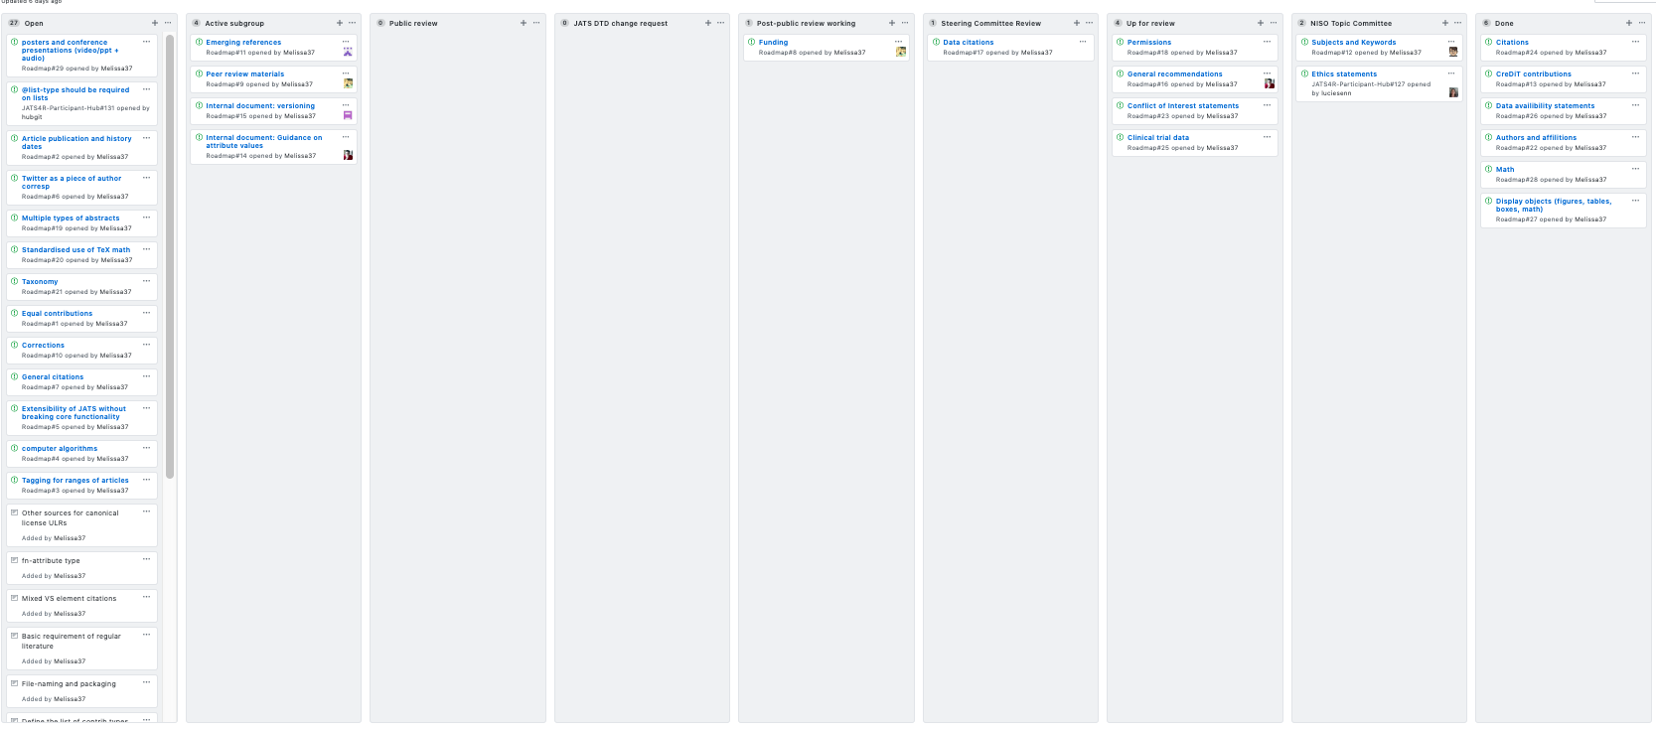
Roadmap
https://jats4r.org/

Slide 11
Mixture of recommendations
Long established practices OLD
+ plenty of examples
- trying to get people to agree!
New initiatives NEW
- not much to go on
- trying to get people to agree
+ establish a practice before the variety set in
https://jats4r.org/

Slide 12








Jack of all trades but master of none
Has its benefits
I know a bit about lots of things – know the people who should be involved
https://jats4r.org/

Slide 13
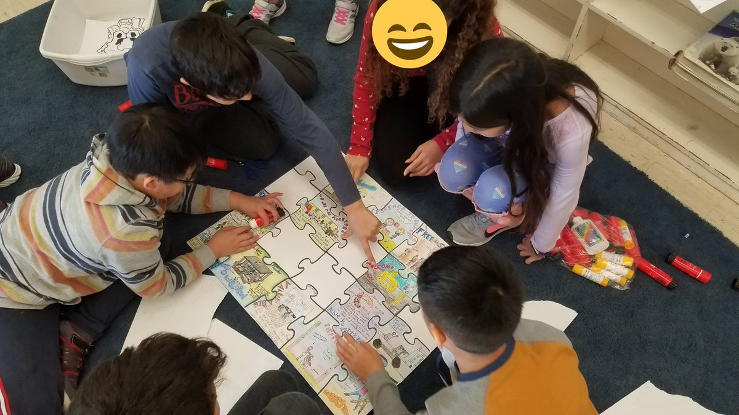
Connecting people
JATS4R working group on peer review materials
Learning together and from each other
https://jats4r.org/

Slide 14
How to get involved
Volunteer on subgroups
Peer review recommendations when they are released for public comment
Suggest topics for the group to cover
Generate discussion on the roadmap
Publicize
Email: info@jats4r.org
Twitter: @JATS4R
Googlegroup: jats4r@googlegroups.com
Googledrive: https://drive.google.com/drive/folders/0B8n-nWqCI5WmdExlY1Zmd2N0QW8
Website: https://jats4r.org/
GitHub : https://github.com/JATS4R
https://jats4r.org/

