Slide 1
Evolutionary biology of novel coronavirus SARS-CoV-2
Where did COVID-19 come from? Vaughn Cooper, Ph.D
Professor, Microbiology and Molecular Genetics University of Pittsburgh, School of Medicine
Notes:
Hi, my name is Vaughn Cooper and I’m a Professor at the University of Pittsburgh in the School of Medicine. I’m an evolutionary biologist and a microbiologist and a co-founder of our Center for Evolutionary Biology and Medicine.
One of our major goals in the Center is to communicate how evolution is important for medicine, and this is especially true for this ongoing COVID epidemic.
The goal of this short video is to explain some key features of the evolution of this novel coronavirus known as SARS-CoV-2

Slide 2
Where did this virus come from?
Family tree of cats
Notes:
The first question on most of our mind is, where did this virus come from? What let the cat out of the bag and caused this pandemic?
To help explain, let’s first consider a family tree of cats.

Slide 3
Evolutionary family tree
Family tree of cats
12 million years ago
Diverged 3.4mya
Notes:
I’m showing a family tree of cats as an example. This is an evolutionary family tree, or a phylogeny, which is a scientific model of relatedness based on the complete genomes of these different species.
This figure indicates a series of nested groupings among cat species. CLICK
At the far left, we see that the lineage that gave rise to these big cats diverged from the domestic housecat lineage about 12 million years ago.
Over on the right CLICK,
notice that the Snow Leopard and the Tiger are actually sister species that diverged from one another about 3.4 million years ago, meaning that snow leopards are more closely related to tigers than they are to leopards. This is pretty cool! In any case, we can use the same rationale to infer genetic relationships between different kinds of viruses isolated from different host animails.

Slide 4
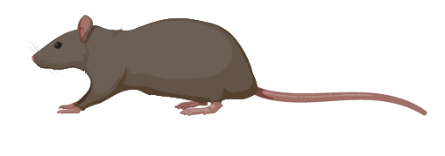
Family tree of coronaviruses
Notes:
Here is the latest family tree of coronaviruses, including the cause of COVID-19, SARS-CoV-2. The orange arrow points to this virus. You may note that it is part of a closely-related cluster that includes the cause of the SARS epidemic in 2002-3. Together, this group is known as the Severe Acute Respiratory Syndrome-related Coronaviruses.
Now I’ve highlighted all of the coronaviruses known to cause human disease. At the bottom, here are several coronaviruses that cause a common cold. Their nearest neighbors are viruses found in rodents: mice and rats.
But above are the other coronaviruses that caused severe epidemics in the last 20 years: MERS, SARS, and now SARS-2. All of these are very closely related to viruses isolated from bats. You may also see this creature, the masked palm civet, IN WHICH a close relative of the original SARS epidemic virus was isolated. However the civet certainly was infected by a bat relatively recently beforehand. So, all of the severe coronaviruses trace their very recent ancestry to bats, but it’s possible they passed through another animal immediately prior to infecting humans.

Slide 5
Why are bats the reservoir for new human coronaviruses?
20% of all mammals are bats
Excellent metabolic defenses because flight is costly
Bat antiviral immune responses are dampened
Notes:
So what makes bats so special, as hosts of viruses that cause human epidemics?
The first explanation is that one-fifth of all mammals are bats, so this makes them a pretty sizable and mobile reservoir of viruses that could infect other mammals.
The second is that bats have evolved a broad range of metabolic capacities that enable their success as fast-flying predators and their long lives. Bats can live several decades, so they have exceptional defenses against byproducts of their high metabolism.
The last is that their antiviral responses, ironically through a pathway known as STING, are dampened, so their immune responses to viral infections are measured and not as damaging to the bat. They can tolerate and manage viral infections better than we can.

Slide 6
Ok, so this coronavirus came from bats. Is it evolving in humans now?
Newscientist.com and lots of social media
Notes:
Ok, so we know that this novel virus came from bats, like the other two coronavirus outbreaks. Is it evolving in humans now?
And, as many of you may have seen on social media, are there now two strains, which differ in their virulence and perhaps ultimately, their ability to be controlled by vaccines?

Slide 7
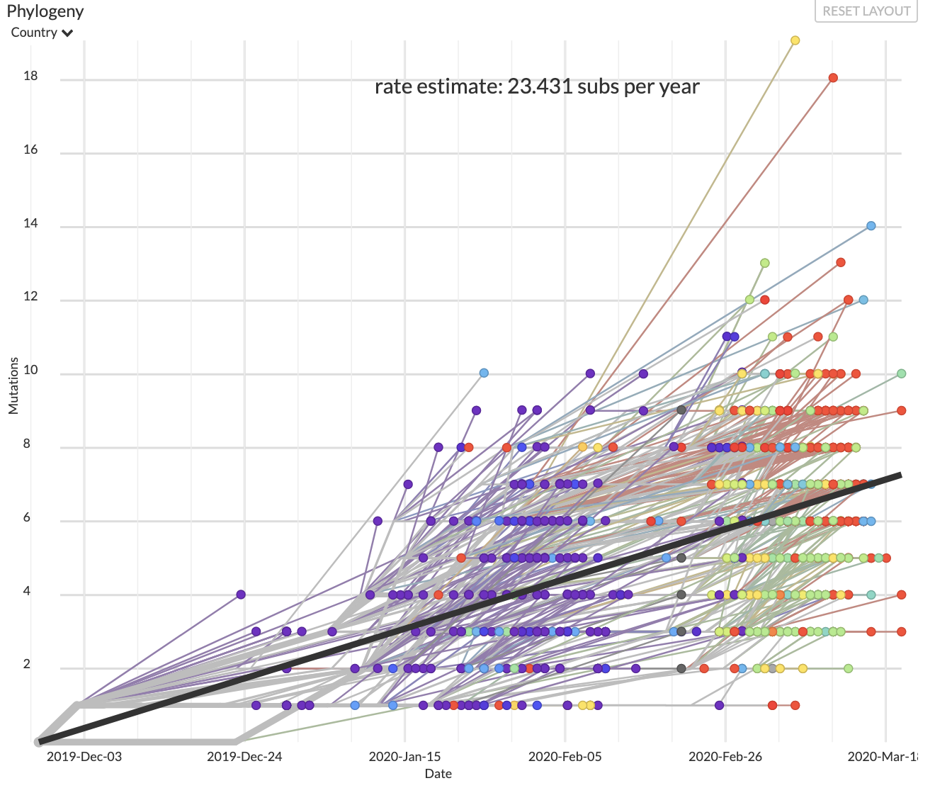
Is SARS-CoV-2 currently evolving?
YES….
# mutation differences out of 29846 nucleotides
of 887 virus genomes
Average difference =
6 mutations
http://nextstrain.org
Time (December 2019 -> March 2020)
Notes:
Well yes, the virus is indeed evolving, but not just in two strains. In fact, this novel coronavirus is now a population of hundreds of thousands of cases, and these viruses are no longer identical. In fact they began to diversify as the epidemic in China began to spread.
These changes have been captured and analyzed beautifully by the group who built and run Nextstrain.org, which provides near real-time visualization of genetic differences evolving within epidemics, like influenza, Ebola, and now COVID-19.
On this graph, the x-axis is time.
Over the first four months of this epidemic, genetic diversity has randomly arisen by mutations and we can plot their accumulation over time.
This is the y-axis, the number of mutations detected out of the nearly 30,000 nucleotide bases in the RNA genome of this coronavirus. They are accumulating, on average, at a rate of 23 changes (less than 1 in 1000), per year. On average viral isolates differ from the initial isolate sequenced in China by about 6 mutations

Slide 8
SARS-CoV-2 vs seasonal influenza
Flu evolves faster
Smaller genome
No RNA proofreading, unlike coronavirus
http://nextstrain.org
Notes:
This may sound like a lot, but thanks to the good folks at Nextstrain, we can compare these differences with seasonal influenza, the one we ought to be vaccinated against each year.
This a plot of the genetic diversity in just one gene of the major influenza A strain, H3N2, over the past 7 years. It is evolving even faster despite a smaller genome.
There are two reasons: human immunity continues to select against common flu strains, requiring the virus to evolve, and also, the mutation rate of influenza is higher because it doesn’t have a proofreading function in its genome, which coronaviruses do.

Slide 9
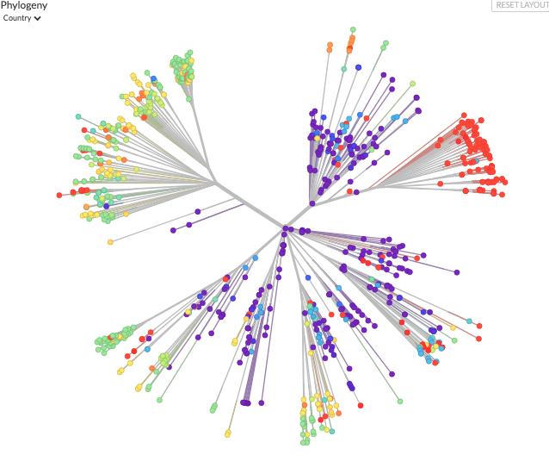
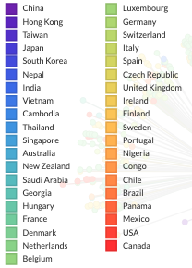
Is SARS-CoV-2 currently evolving?
…but not yet likely affecting transmission or virulence
Notes:
With all of this genetic variation evolving within these viruses, we wonder if they are changing their functions, perhaps to become harder to fight off or treat.
If we plot this family tree of coronaviruses a different way, and label each genome by its country of isolation, we see that viruses are generally “isolated by distance”, meaning that as new infections arise in new regions with human migration, they randomly acquire subtle differences and then these differences are shared by community spread.
For example, this red cluster corresponds to viruses isolated from USA and Canada, and they trace from strains that originated in China (in purple).
However, there is NO evidence that these differences affect the rate of COVID transmission or their severity. These are just chance differences associated with local epidemics, and these regional associations are disappearing as humans move around.

Slide 10
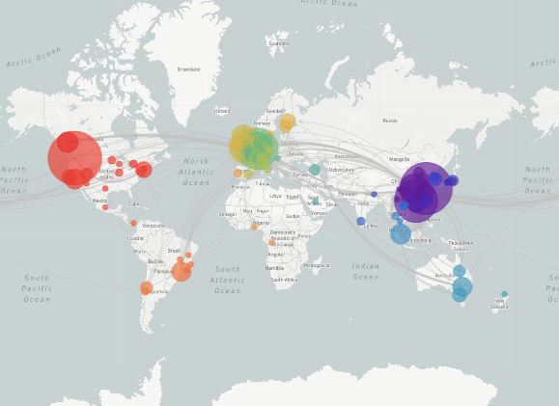
Most genetic variation in SARS-CoV-2 is randomly associated with geography
This is the so-called “founder effect”
http://nextstrain.org
Notes:
So, to conclude, up to this point, in March 2020, most of the genetic variation in the SARS-2 coronavirus is randomly associated with different geographic regions. We call this variation, the founder effect, where random differences in a founding population cause organisms in different regions to have slightly different genetic makeup. In this case, the 0-

Slide 11
Could this coronavirus adapt to humans and become more or less virulent?
Notes:
A big question that many people are rightly asking is what will happen in the future for the novel coronavirus. There’s a theory that pathogens obey a tradeoff between virulelnce – how sick they make you – and transmissibility – their probability of causing a new infection and making new offspring.
The idea is that more severe, virulent pathogens might make more offspring in one host, but since that host might be bedridden, they might have less chance for transmission.
On the other hand, less virulent pathogens might allow the host to be more mobile and interact with more susceptible hosts, so they would have a greater chance of being transmitted.

Slide 12
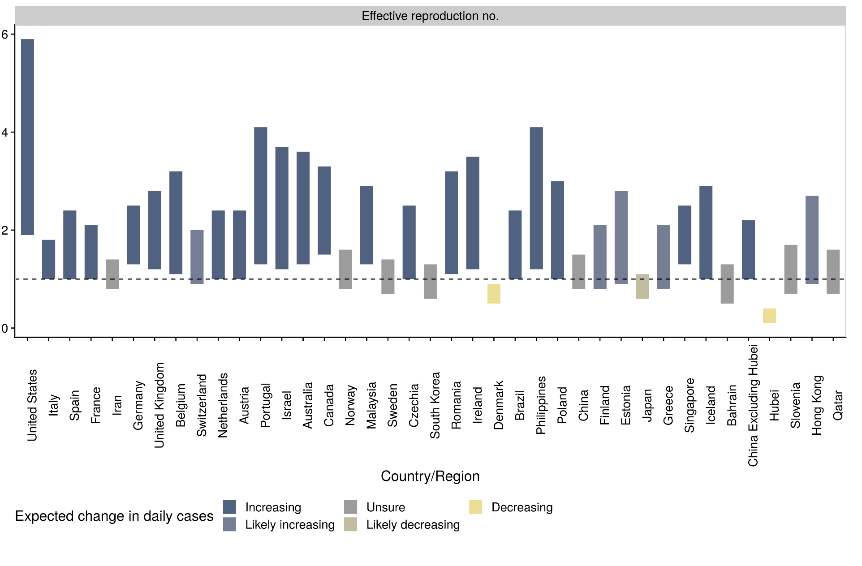
Virus fitness depends on transmission, which is accelerating for SARS-CoV-2
R₀ = reproduction number = 2. R₀ < 1, epidemic slows
No selection for mildness now, or for quite some time
Update 20 March 20
Notes:
The key to this tradeoff model is whether virulence affects transmission. As you probably know, transmission is definitely not limiting for this novel coronavirus. In fact it’s accelerating.
I show an example of transmission where one infected person infects two other people. This represents a reproductive number for the virus of 2. To slow an epidemic, we need to reduce this number below 1, so that each infection on average produces less than 1 new infection.
Current estimates show that this number is significantly greater than 1 in nearly all regions, except for the severely quarantined region of Hubei, China, and perhaps also Japan and Denmark.
So there is currently little or no selection for more mild, transmissible forms of the novel coronavirus, and there won’t likely be any for quite some time

Slide 13
Experts agree: little selection to increase transmissibility
Notes:
These are two recent tweets from experts Carl Bergstrom of the University of Washington and Trevor Bedford from Fred Hutch. They agree that the SARS-2 is unlikely to evolve to become more transmissible.
Carl relies on experience as a theoretical modeler of epidemics and Trevor, who helped build these beautiful NextStrain plots of viral evolution, points to lots of experience with seasonal influenza, which has not evolved to become more or less transmissible in the last 50 years.
Still, we are still looking.

Slide 14
One possible example of human adaptation?
Deletion of part of the ORF8 gene, known to be under selection during animal-human transmission
Notes:
There is one example that is currently under peer review, showing that a lineage of viruses isolated from Singapore during the early weeks of the epidemic evolved a deletion of a gene involved in virulence. It’s known to be under selection in other coronaviruses like the original SARS virus during transmission from animals to humans. This deletion does have a functional consequence, but its broader effects on human infections are unclear.
This is the sort of change we will be looking for in months to come.

Slide 15
Evolution of SARS-CoV-2 is ongoing
but the evolution and spread of a new COVID trait is fairly unlikely, and would require
more infections,
more time
perhaps: selection for altered transmission following human interventions that limit spread or vaccination
Notes:
To summarize, I hope I’ve shown you how that the novel coronavirus is indeed evolving, like all viruses and indeed all organisms do.
However it is not likely changing in any significant way to affect its virulence. It remains very virulent and transmissible and seems likely to remain so for quite some time.
If it did eventually evolve altered transmissibility, more infections would be required, over more time, and perhaps, in response to selection that limit human interactions or vaccination.

Slide 16
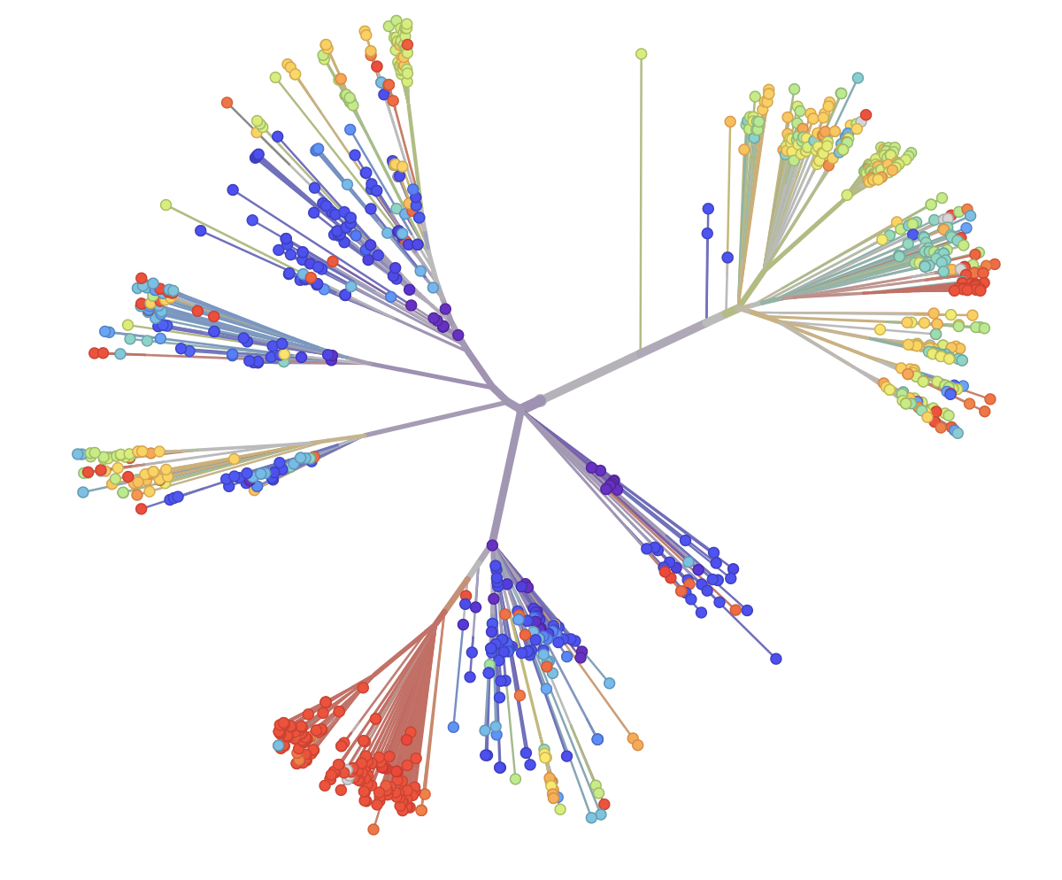
Evolution is our friend: subtle changes in SARS-CoV-2 genomes helps epidemiology!
The real value of these genetic differences is that they allow us to follow the virus and learn how to contain it!
Notes:
For now, evolution is our friend because it helps us do better epidemiology!

Slide 17
references
https://advances.sciencemag.org/content/3/7/e1700299/
https://doi.org/10.1016/j.bsheal.2019.10.004
https://doi.org/10.1016/j.chom.2018.01.006
https://www.youtube.com/watch?time_continue=24&v=sPXS1t8CQww&feature=emb_logo
https://www.npr.org/sections/goatsandsoda/2020/02/09/803543244/bats-carry-many-viruses-so-why-dont-they-get-sick
https://evolution.berkeley.edu
https://cmmid.github.io/topics/covid19/
https://doi.org/10.1101/2020.03.11.987222
Thanks to the amazing http://nextstrain.org team!

