Slide 1
What YOU can do with Dimensions

Slide 2
Last session and time to get hands on!

Slide 3
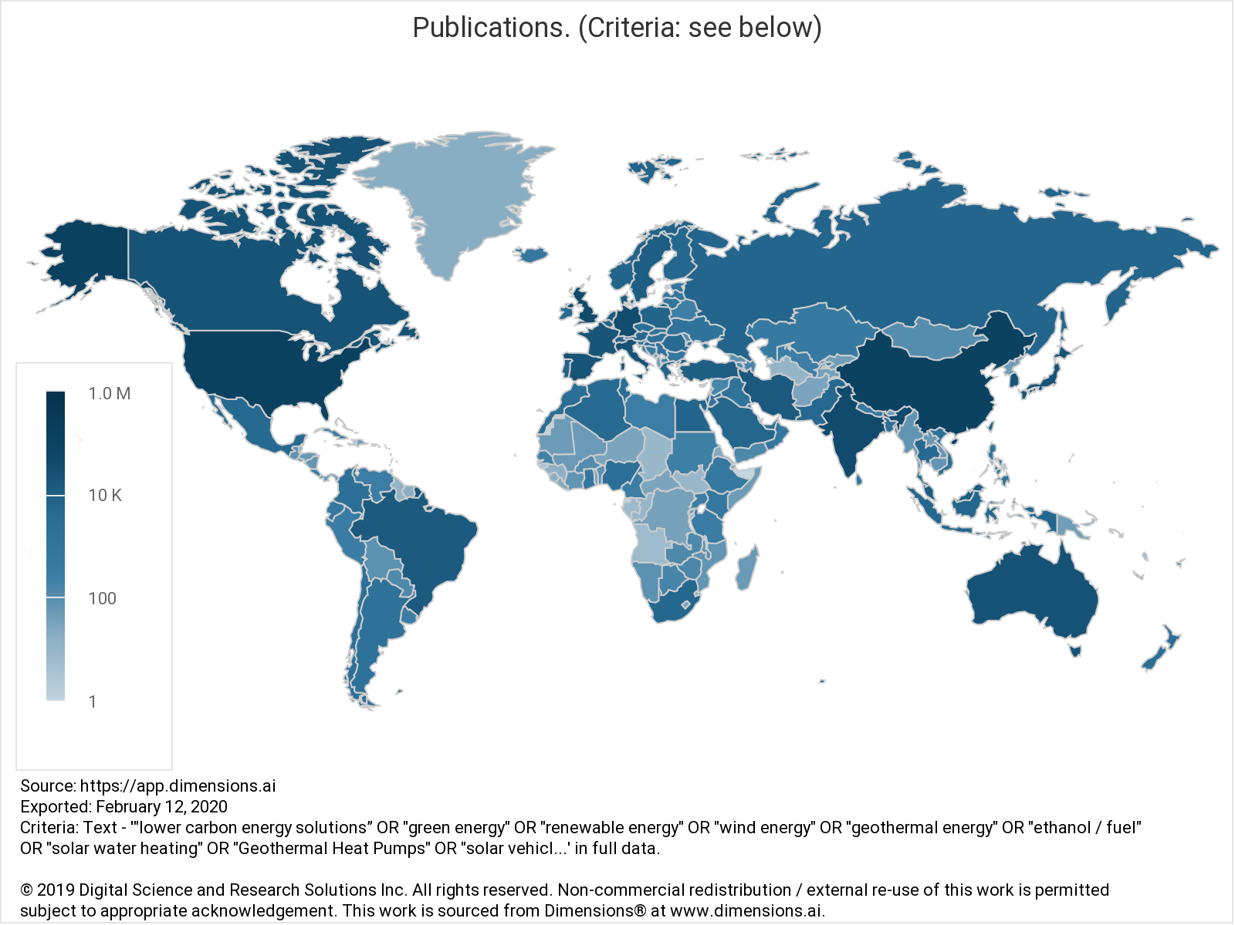
Challenge 1
Which OA type has had the most growth in the last 10 years for publications in green energy?
Build a geomap of the world’s impact (FCR) in green energy
Notes:
The 1st step is of course defining green energy. Their result might be different to this but the goal is to get them to build complex booleans and look for the timeline
Dimensions has a geomap based on number of publications. The data needs to be downloaded and put in excel/ google sheets. The main challenge with building this kind of map is that countries with few pubs but with strong collaborators will have a huge impact and mess up with the visualization. When creating it, screening the data and adding a limitation on minimum number of pubs per country help balance it out or just focus of the group of countries they need. The map is an easy way to show data without having a cluttered chart. The role of this exercise is to also open discussion around the important role of how we choose to visualize the data

Slide 4
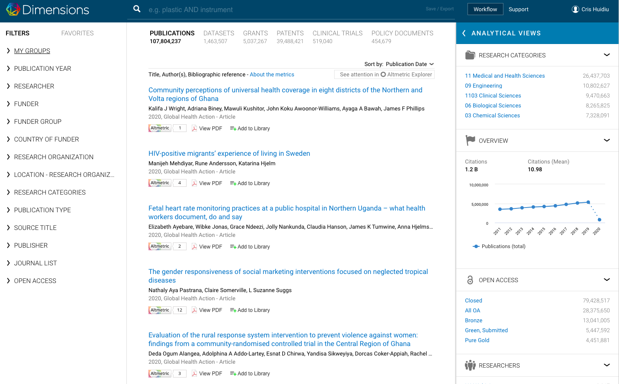
Challenge 2
What percentage of their total budget has NHMRC spent on lung cancer in 2018?
Which Australian University had access to the highest funding amounts (all time)

Slide 5
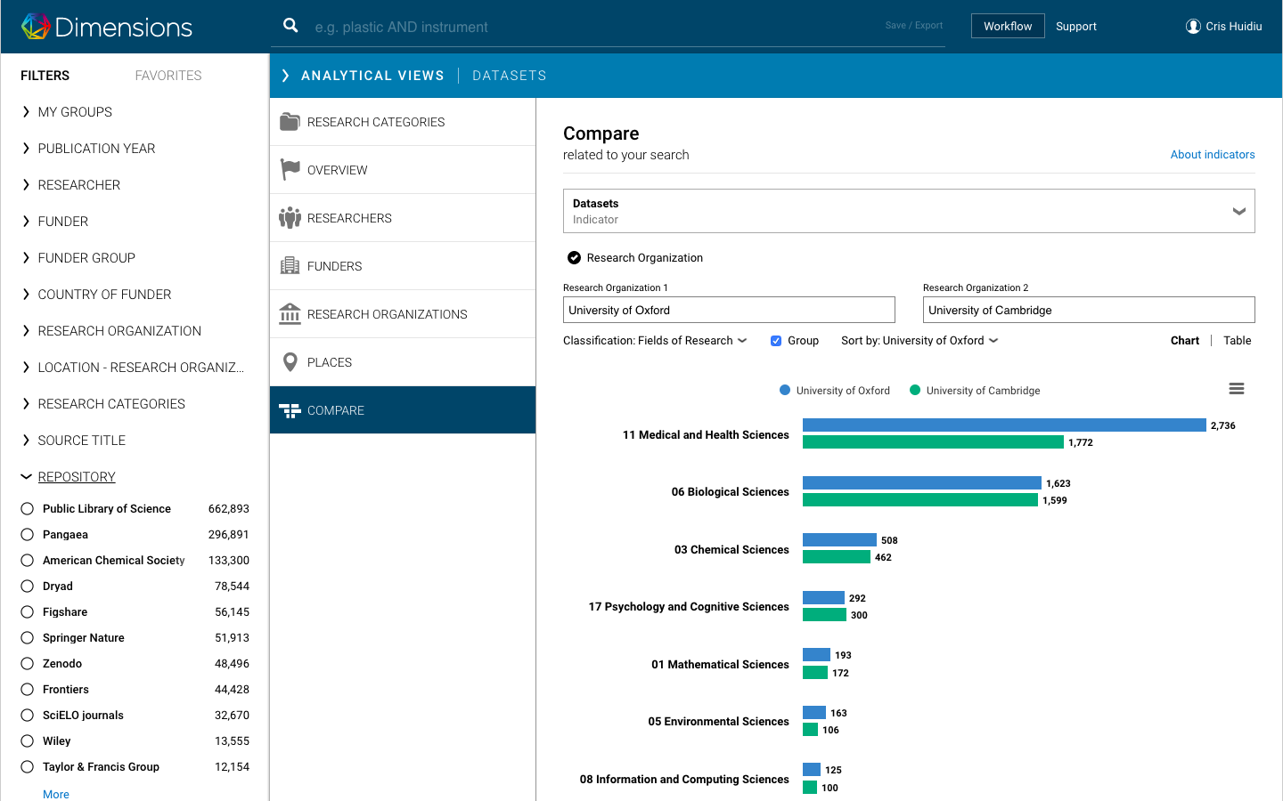
Challenge 3
How many datasets have been funded by Merck (Germany)
Compare 2 organizations based on their dataset output

Slide 6
Challenge 4
What is the OA advantage of Australian publications from 2010-2020 by publisher

