Slide 1
Workshop: Using Dimensions
Re-imagining discovery and access to research:
Grants, publications, citations, clinical trials and patents in one place
From Idea to Impact: the Next Evolution in Linked Scholarly Information

Slide 2
Welcome back, we’re here now :-)

Slide 3
The data and links driving Dimensions...
108m
Publications improved metadata
of 75m
980k links
519k
Clinical trials
346k links
11m links
1.2bn links
120m
Altmetric data
points
10m links
39m
Patents
24k links
230k to funders
1.5m links
960k links
14m links 19m to funders
220m links
169k links
232k to funders
455k
Policy documents
5m
Grants
$1.6 trillion in funding
1.5m
Datasets
351k links
565k to funders
Status: February 2020

Slide 4
Building a search
Basic search: “autoimmune disease”
Refining your search using Booleans:
Step 1: add AND: “autoimmune disease” AND "genetic susceptibility"
Step 2: add NOT: (“autoimmune disease” AND "genetic susceptibility") NOT plant*
Step 3: add NEAR: (autoimmune ~3 disease AND "genetic susceptibility") NOT plant*
Test NEAR to make sure you’re getting the right amount of results by:
Increasing or decreasing the number of words (~4; ~2 etc)
Exclude variants to spot check results to make sure the increased number still returns relevant results: ((autoimmune ~2 disease NOT ("autoimmune disease")) AND "genetic susceptibility") NOT plant*
Add additional filters from the left hand side: example, add Pfizer as funder of publications

Slide 5
UI hacks
Top 1% highly cited Australian researchers. Top 5%? Top 10%?
Corporate collaborations on publications?
Funder not in Dimensions? Search for the name in the acknowledgement section.
Notes:
Examples of things to show:
For the top x% high cited slide into analytical views and show universities and then click on heatmap. It would show funders by default. Open the list to edit and choose anything else. I’d suggest OA because the FoR mixes 2 and 4 level so it’s easier to see the FoR heatmap starting in research categories so you have them on the vertical axes and when you download the data you can filter on the level you need.
For corporate collaboration - refine it with a basic keyword. The search would then be: aff_org_types:Company AND "cardiology". Our hack integrates like any other keyword search
Funder not in Dimensions: go to Analytical Views -> Research categories -> Timeline. Show how to edit it and get data out

Slide 6
Dimensions export
Results export - up to 50k results (.xslx or .csv)
Analytical views exports:
aggregated data, up to 500 results
Charts: in various formats including .png, .jpg & .xlx as well as direct copy/paste
Edit the currency from your settings (My account -> Set currency)

Slide 7
API & API lab
API UI - JSON export
Use skip functions to get all 50k results (add limit 1000 skip x000 at the end of your query; example:
search publications in full_data_exact for “11-aa return publications limit 1000
search publications in full_data_exact for “11-aa return publications limit 1000 skip 1000
search publications in full_data_exact for “11-aa return publications limit 1000 skip 2000
Use of of the free tools to turn JSON to CSV like jsontocsv or convertcsv
List of all facets available in the API are in the API documentation
Examples of queries based on the API can also be found in the documentation
API Lab - get complicated answers through easy solutions
Google Collab is a free tool, doesn’t require any installation & it syncs with your Google Drive account
The Notebooks are written in Python
Notes:
Use https://api-lab.dimensions.ai/cookbooks/5-patents/1-Patents-referencing-a-Research-Organization.html as an example. Open in google collab. Inputing your username and password will be visible to everyone so you might want to use one of the test/ demo accounts. Every step is explained in th notebook. To make it more interesting choose a funder GRID and show them how to edit the query so they get publications funded by x funder mentioned in patents. The code that needs to be changed is under
1 - Prerequisite: Extracting Publications Data
q = f"""search publications
where research_orgs.id="{GRIDID}"
and year in [{YEAR_START}:{YEAR_END}]
return publications[basics+category_for+times_cited]"""
Here hange research_orgs.id with funders.id . The idea is to get them to think of different ways they could adapt these notebooks to their own needs without having to build another one from scratch. Also, by being very confident in writing queries in the API UI will make is even easier to adapt python books

Slide 8
API limitations
The Dimensions API is not a runtime API and there are some limitations in place:
Default limitation 20 results.
Customize number of returned results by setting a limit. Can be any number between 1 and 1000. To return more than 1000 use a skip function
For all the main data sources (Publications, Grants, Patents, Clinical Trials, Policy documents, Researchers, Organizations) the max return limit with skip functions is 50k results
For all other facets there is a hard limit of 1000 results. No skip function enabled.
The Dimensions Analytics API is limited to 30 requests per IP address per minute

Slide 9
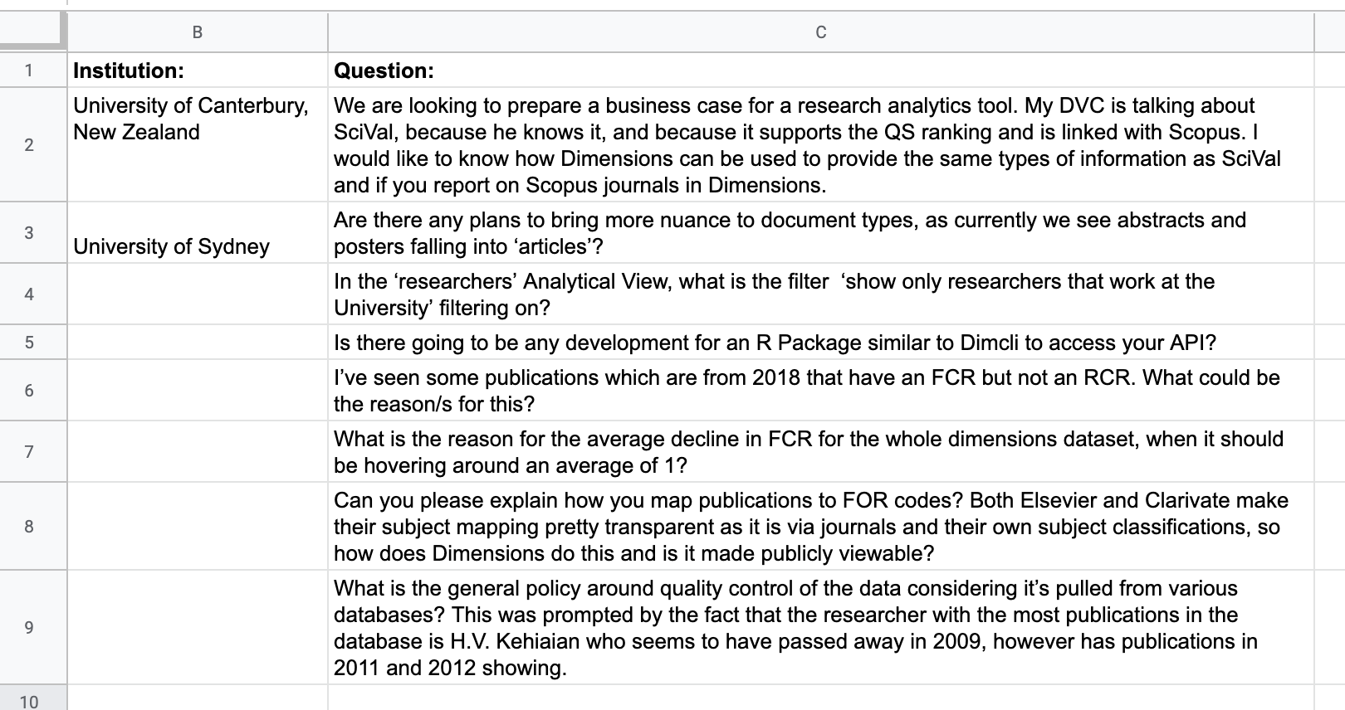
We also got some questions

