Slide 1
What’s new in Dimensions since last year?
The best new features since the last showcase, a few report prototypes, difference with other systems, etc.

Slide 2
This one

Slide 3
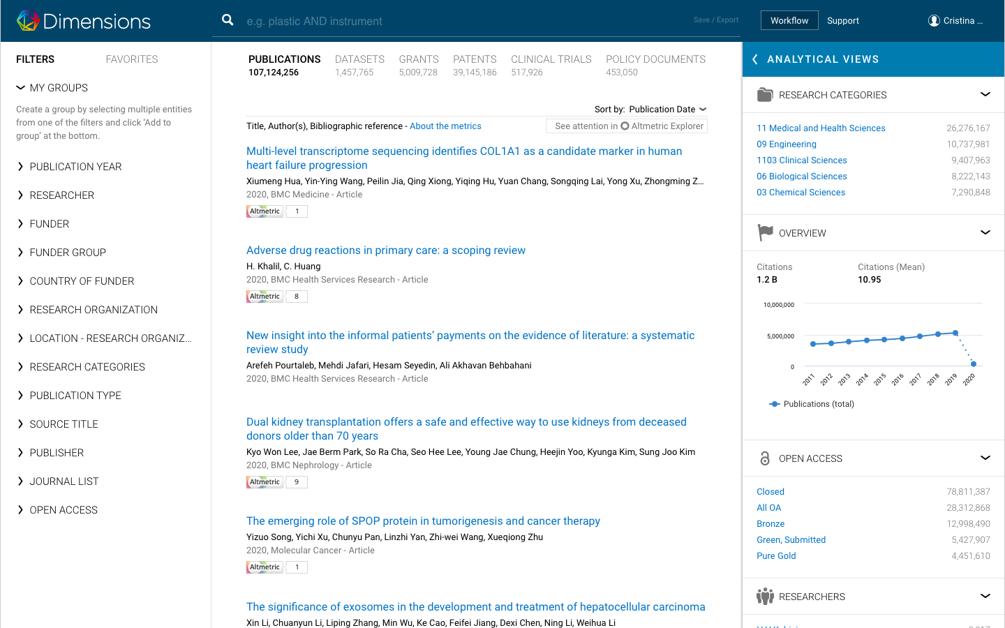
Content
Over 107 million publications
Over 1.4 million datasets
Over 5 million grants
Over 39 million patents
Over 500k clinical trials
Over 450k policy documents
Over 500 funders with awarded grant information
Over 80 policy publishers
8 currencies

Slide 4
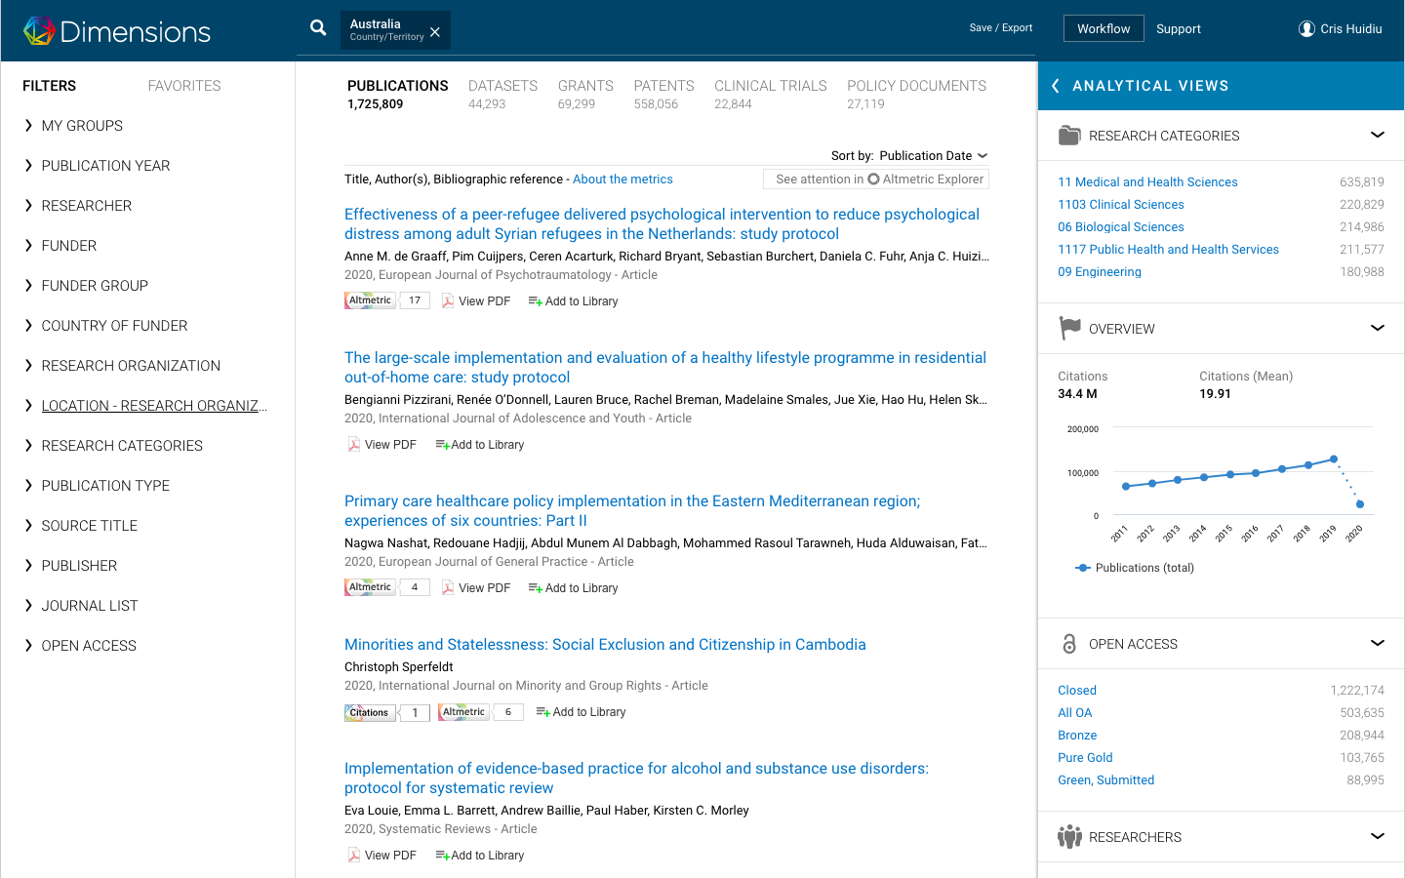
Content Australia
Funding data:
31 funders
60,948 grants
A total awarded amount of $29,236.3M
Now approaching 34 more funders (ACGR list)
Australia in numbers:
Publications 1,728,412
Datasets 44,289
Grants 69,299
Patents 558,056
Clinical Trials 22,844
Policy Documents 27,140
Notes:
ACGR funders (list of 35):
AgriFutures Australia
Australian and New Zealand College of Anaesthetists
Australian Antarctic Division
Australian Centre for International Agricultural Research
Australian Eggs Limited
Australian Grape and Wine Authority
Australian Housing and Urban Research Institute Ltd
Australian Institute of Nuclear Science and Engineering (AINSE)
Australian Pork Limited
Australian Renewable Energy Agency
Australian Rotary Health
Cancer Australia
Cotton Research and Development Corporation
Dairy Australia
Department of Agriculture and Water Resources
Department of Defence (Federal)
Department of Education and Training
Department of Foreign Affairs and Trade
Department of Health (Federal) - MRFF
Department of Industry, Innovation and Science
Department of the Environment and Energy
Fisheries Research and Development Corporation
Forest and Wood Products Australia Ltd
Grains Research and Development Corporation
Horticulture Innovation Australia Limited
Juvenile Diabetes Research Foundation (Australia)
Meat and Livestock Australia
Multiple Sclerosis Research Australia
National Breast Cancer Foundation
National Climate Change Adaptation Research Facility
National Health and Medical Research Council (NHMRC)
National Heart Foundation of Australia
The Garnett Passe & Rodney Williams Memorial Foundation
The Leukaemia Foundation of Australia Limited

Slide 5
User interface - new features and updates
3 new classification systems:
ICRP Common Scientific Outline (CSO)
ICRP Cancer types
Units of assessment (UoA)
Updated FoR (2 and 4 digit subcategories)
Researcher profiles in Clinical trials
New content type - datasets
Researcher profiles in patents
Altmetric integration
New journal lists:
Nature Index journals
VABB-SHW (Flemish journal list)
ERIH-PLUS (SSH journals)
Corresponding author
arXiv as publications source
Researcher Analytical View with filter for current affiliation
Ability to search for DOIs (up to 400)
Advanced analytics for OA information
Group feature
Export tables in Analytical Views
Links from / to Clinical trials
Editable time ranges
Improved metrics and metrics display

Slide 6
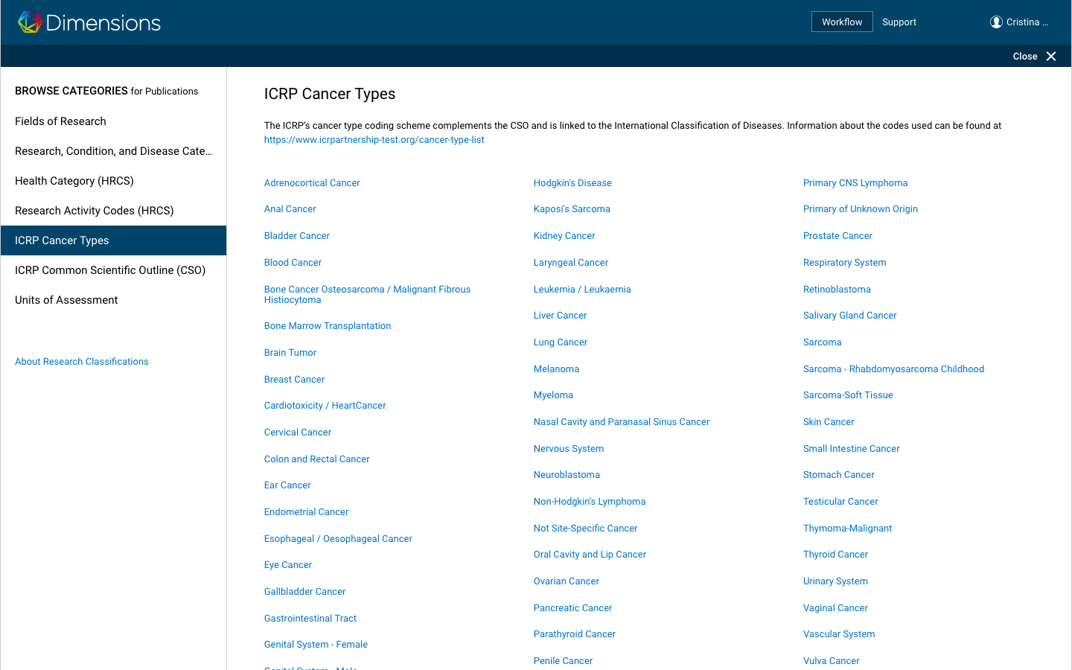
The new classification systems enable:
more in depth analyses of cancer research
Who is awarding more funding for lung cancer? Who has the most IP? Who has the most impactful papers per awarded $?
Overview analysis at class/ sub class level for FoR
Our university is leading in (09) Engineering but which sub category is awarded more funding? Is this in line with international trends? Is there a niche we could use to increase our funding?

Slide 7
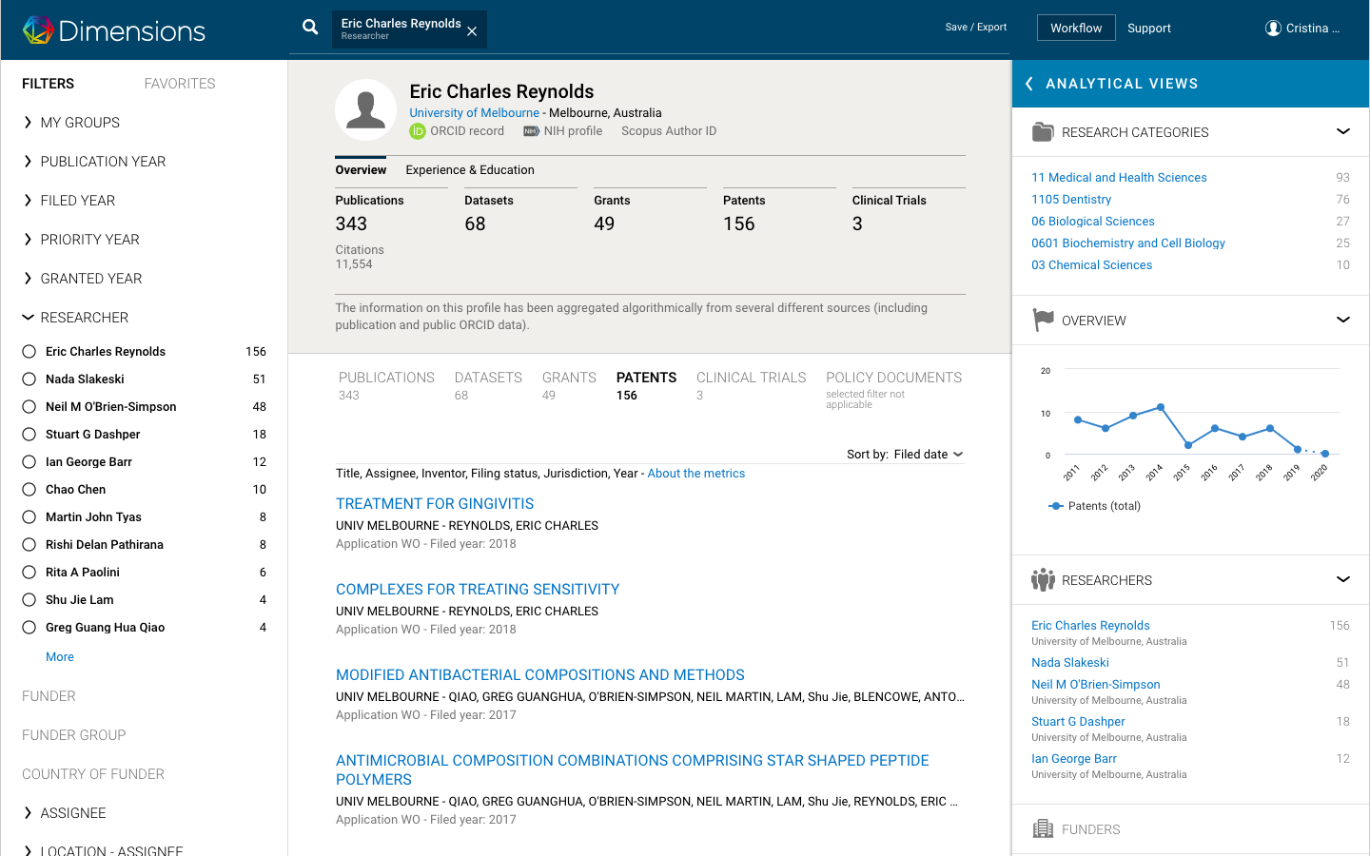
Disambiguated inventors and CT investigators
Have a full picture of a researcher’s footprint in research and innovation
Enables you to find researchers who collaborate with companies or have significantly influenced their field through breakthrough innovation
Notes:
We don’t disambiguate patent inventors that are corporate employees - which means about 38 million patents don’t have disambiguated

Slide 8
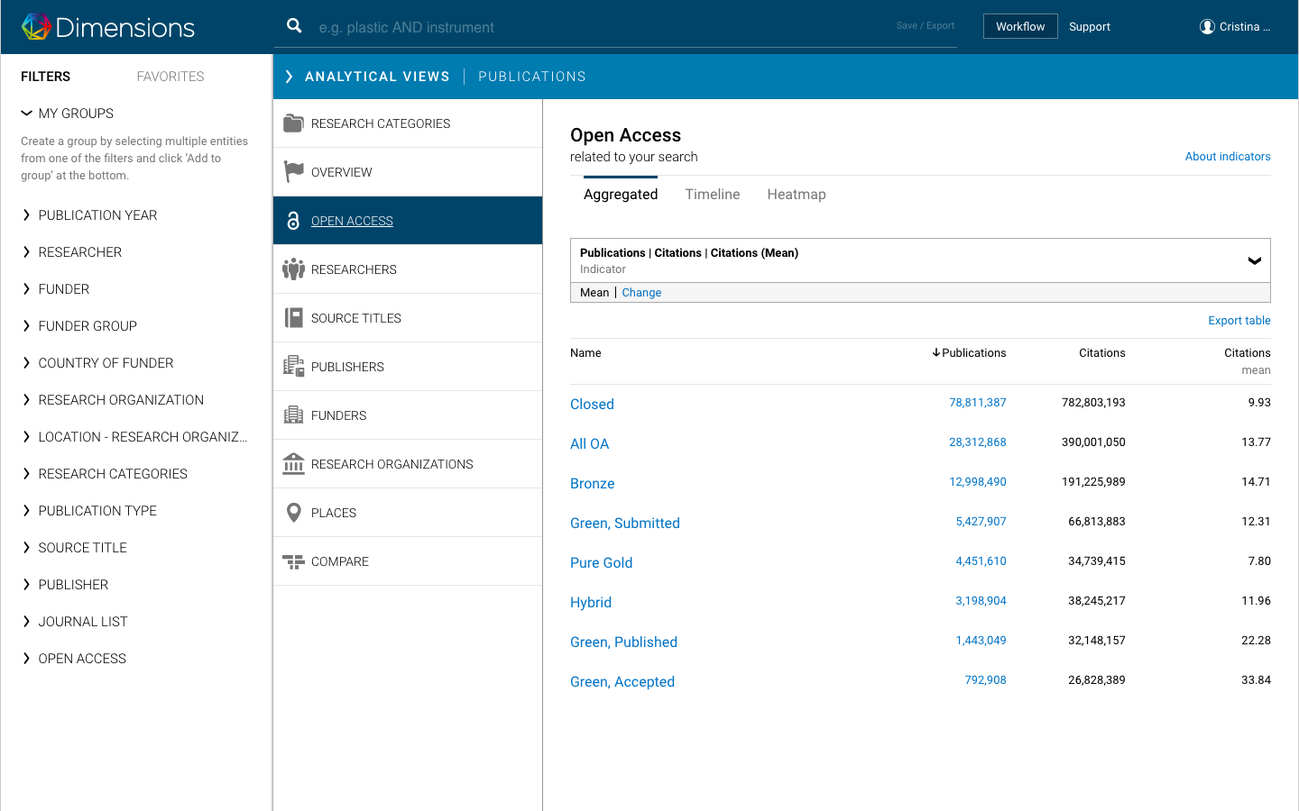
Enhanced analytical capabilities in Analytical views
What are the OA trends at your institution
Define impact and see trends within your institution or compared to country/ region/ world
Which topics tend to have more OA publications?
Which publishers have more impact for their OA publications?
Are our major funders awarding more to projects who publish their findings as OA?
Are there differences between all the different types of OA?

Slide 9
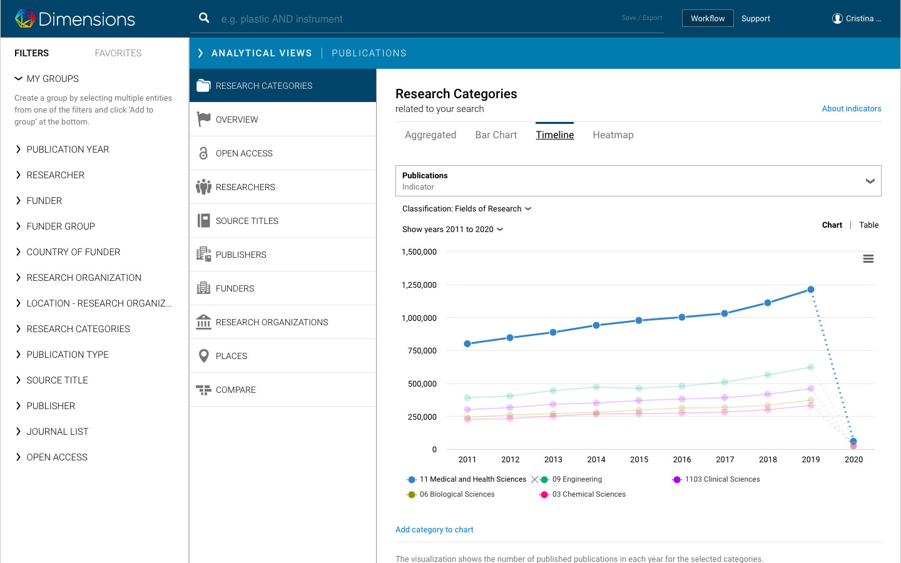
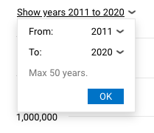
Enhanced analytical capabilities in Analytical views
Define timelines, as long as 50 years
Edit timelines to includes data fields that are of interest:
Are there significant gowth/impact differences between fields/ funders/ researchers/institutions?
Download the data to slice and dice further

Slide 10
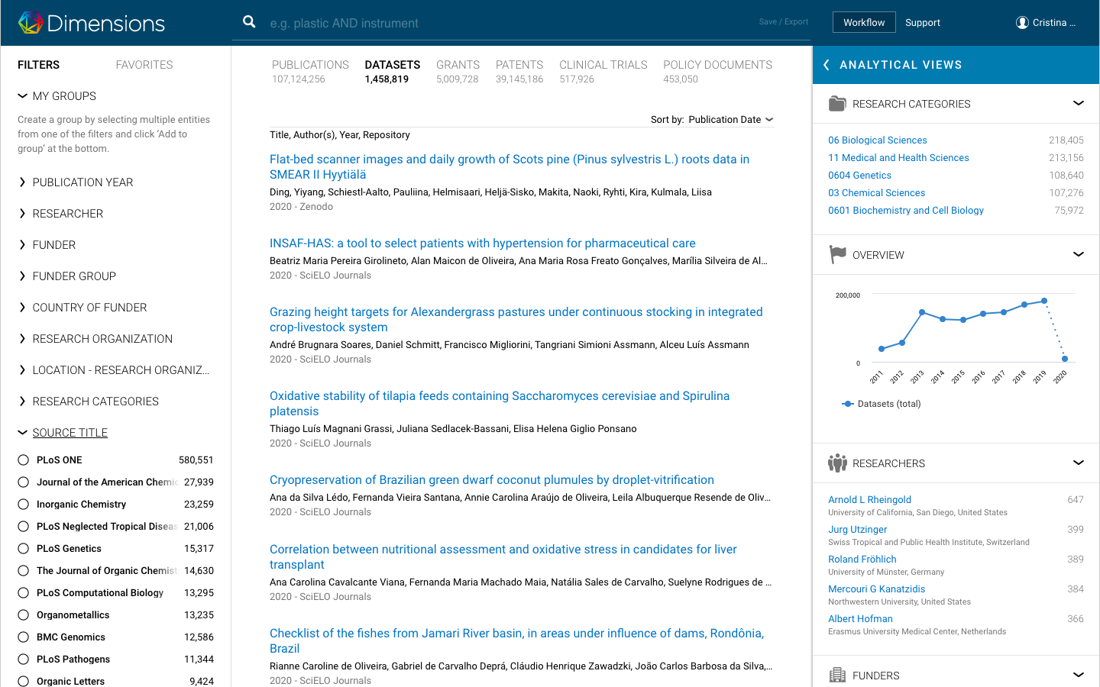
New content types - Datasets
Enables recreating lab results
Checking an institution’s footprint
Checking if funder mandates are being met
Which institutions have a significant number of datasets and in which field(s)
Enables complex analyses like:
Do publications with datasets have more or less impact?
Do publications with datasets have more funding?

Slide 11
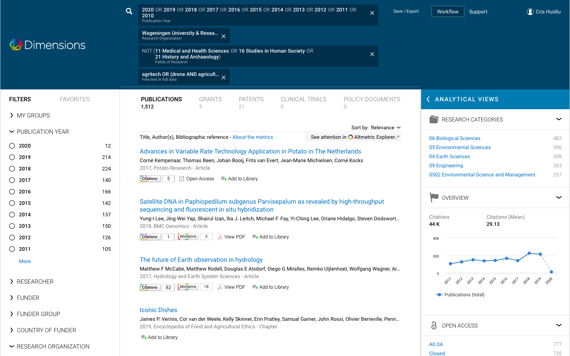
Altmetric integration
Get additional information about the social impact of your research
Use the powerful Dimensions search engine, facets and categorizations to tailor your search and move it to Altmetric to build strong research communications strategies or to enhance your grant application

Slide 12
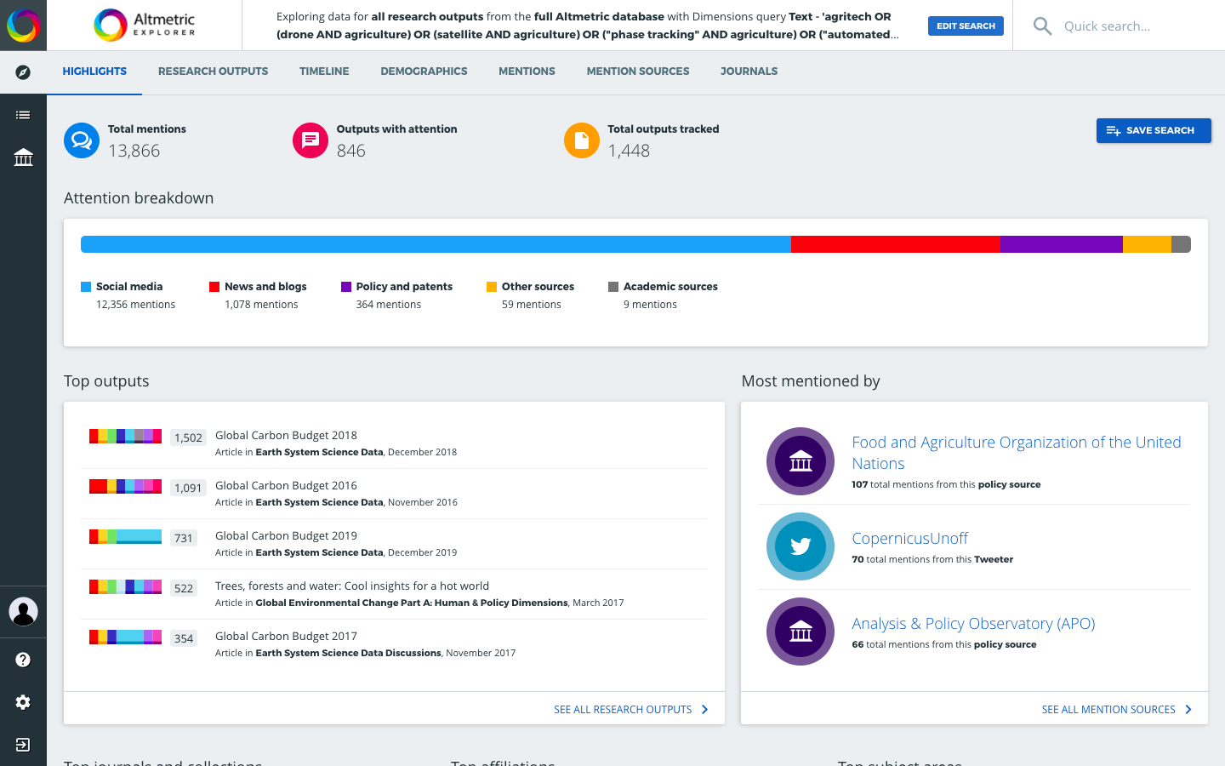
Altmetric integration
altmetric.com
Get additional information about the social impact of your research
Use the powerful Dimensions search engine, facets and categorizations to tailor your search and move it to Altmetric to build strong research communications strategies or to enhance your grant application

Slide 13
API - new features and updates
Select filters/ sources/ facets
Select improvements
Making it easy for non data scientists
empty filters supported across all content types
Check_researcher_ids
extract_grants
Classify function
New source researchers
New source organizations
extract_terms()
full_data_exact
extract_affiliations
Enhanced support for full-text queries, including support for wildcard and proximity search
Allowed filtering in researchers source by orcid_id
API lab
Everything the UI can do and more

Slide 14
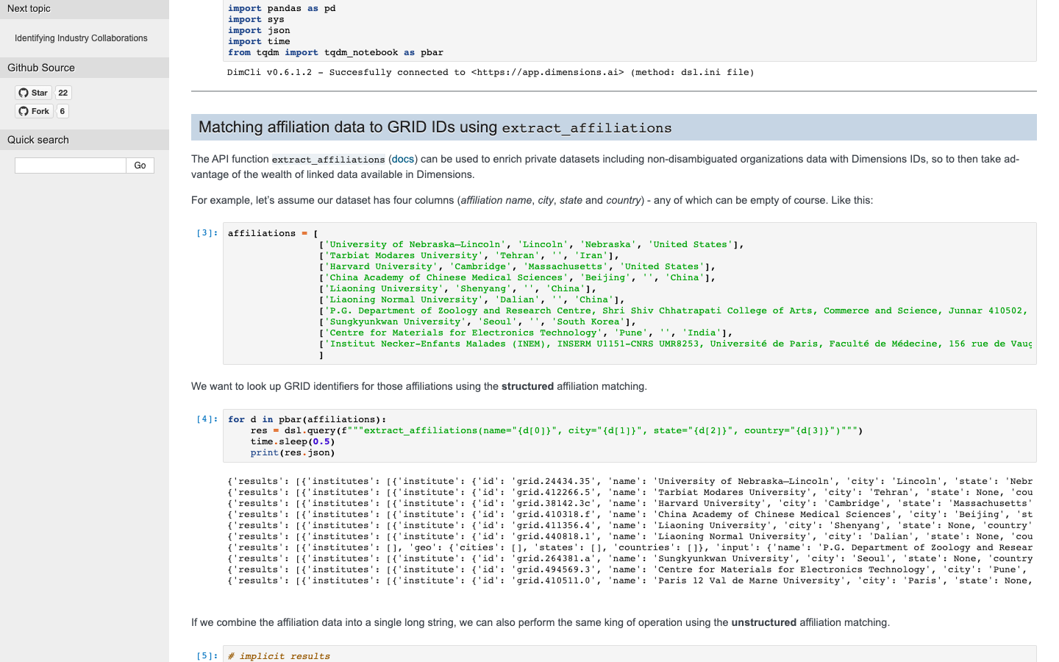
Select filters/ sources/ facets
Automatically classify all of your holdings with any of the Dimensions classification systems
Create automated reports focused on researchers
Full_data_exact enables searches for gene names or words that include special characters
Organizations as a source and extract_affiliations - possible with GRID integration. All of GRID’s additional metadata fields such as org type and all the name variations used to disambiguate organizations are now fully searchable with Dimensions API

Slide 15
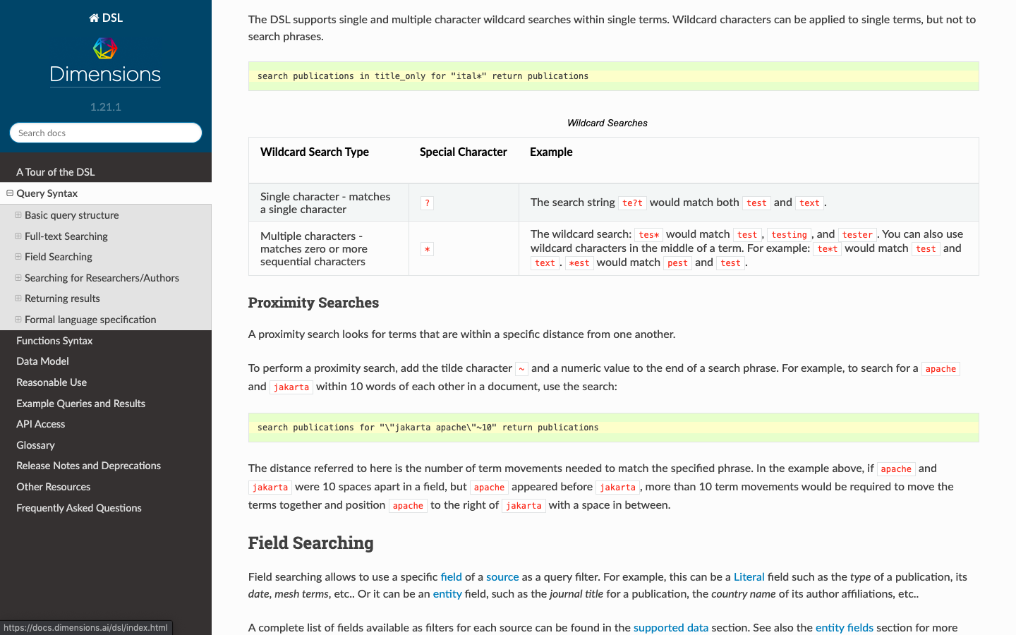
Select improvements
Search in the API can be just as granular as the UI, allowing users to be as flexible as possible in their searches
ORCID_id as a filter in Researchers (source) enables faster and easier automated reports, leveraging existing ORCID_ids

Slide 16
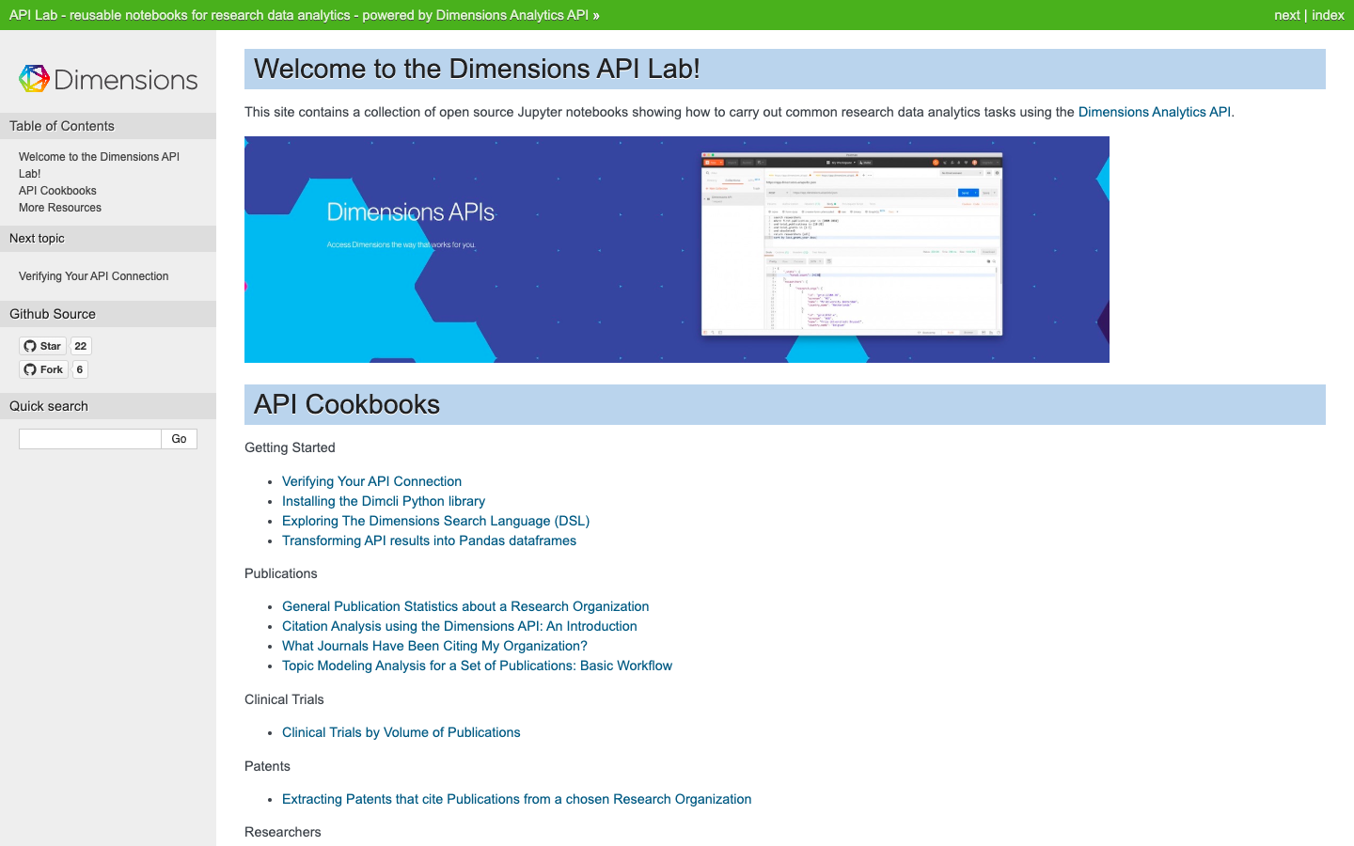
Making it easy for non data scientists
Enable everyone to take advantage of the API
Continuously adding new python books based on user feedback
Python books written to run out of the box with Google collaboratory

Slide 17
ACGR funders
https://docs.google.com/spreadsheets/d/1l4MQgY_8c37M_zaIqmMjLaazqHj0I2LkDYDk7aLNRzw/edit?usp=sharing

