Slide 1
Dimensions for Australian research
Examples of national-level insights based on Dimensions data for inspiration - and further work!

Slide 2
Now it’s this one
Please ask right away if you have a question or an idea for further work!

Slide 3
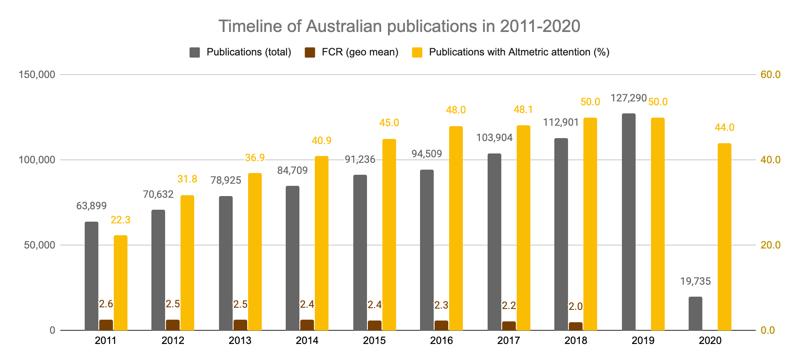
Timeline of Australian publications

Slide 4
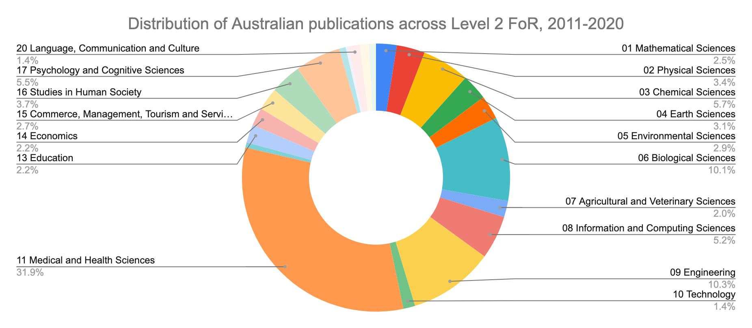
What is the distribution across FoRs?

Slide 5
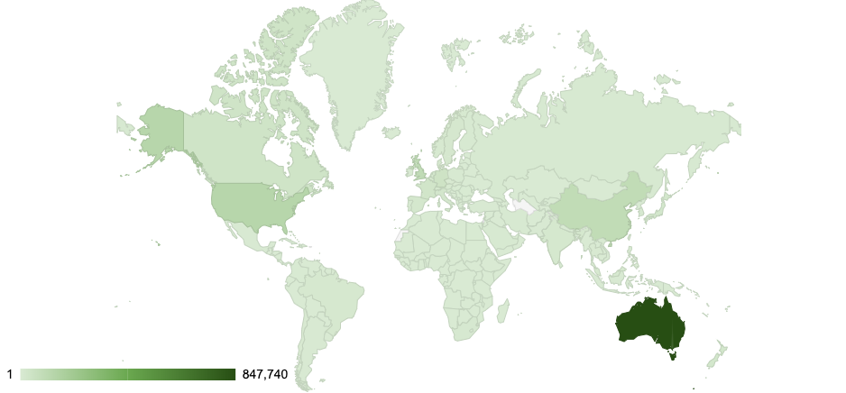
Collaboration map - Australian publications from 2011-2020
Notes:
Your main three other countries of collaborators are the US, China, and the UK

Slide 6
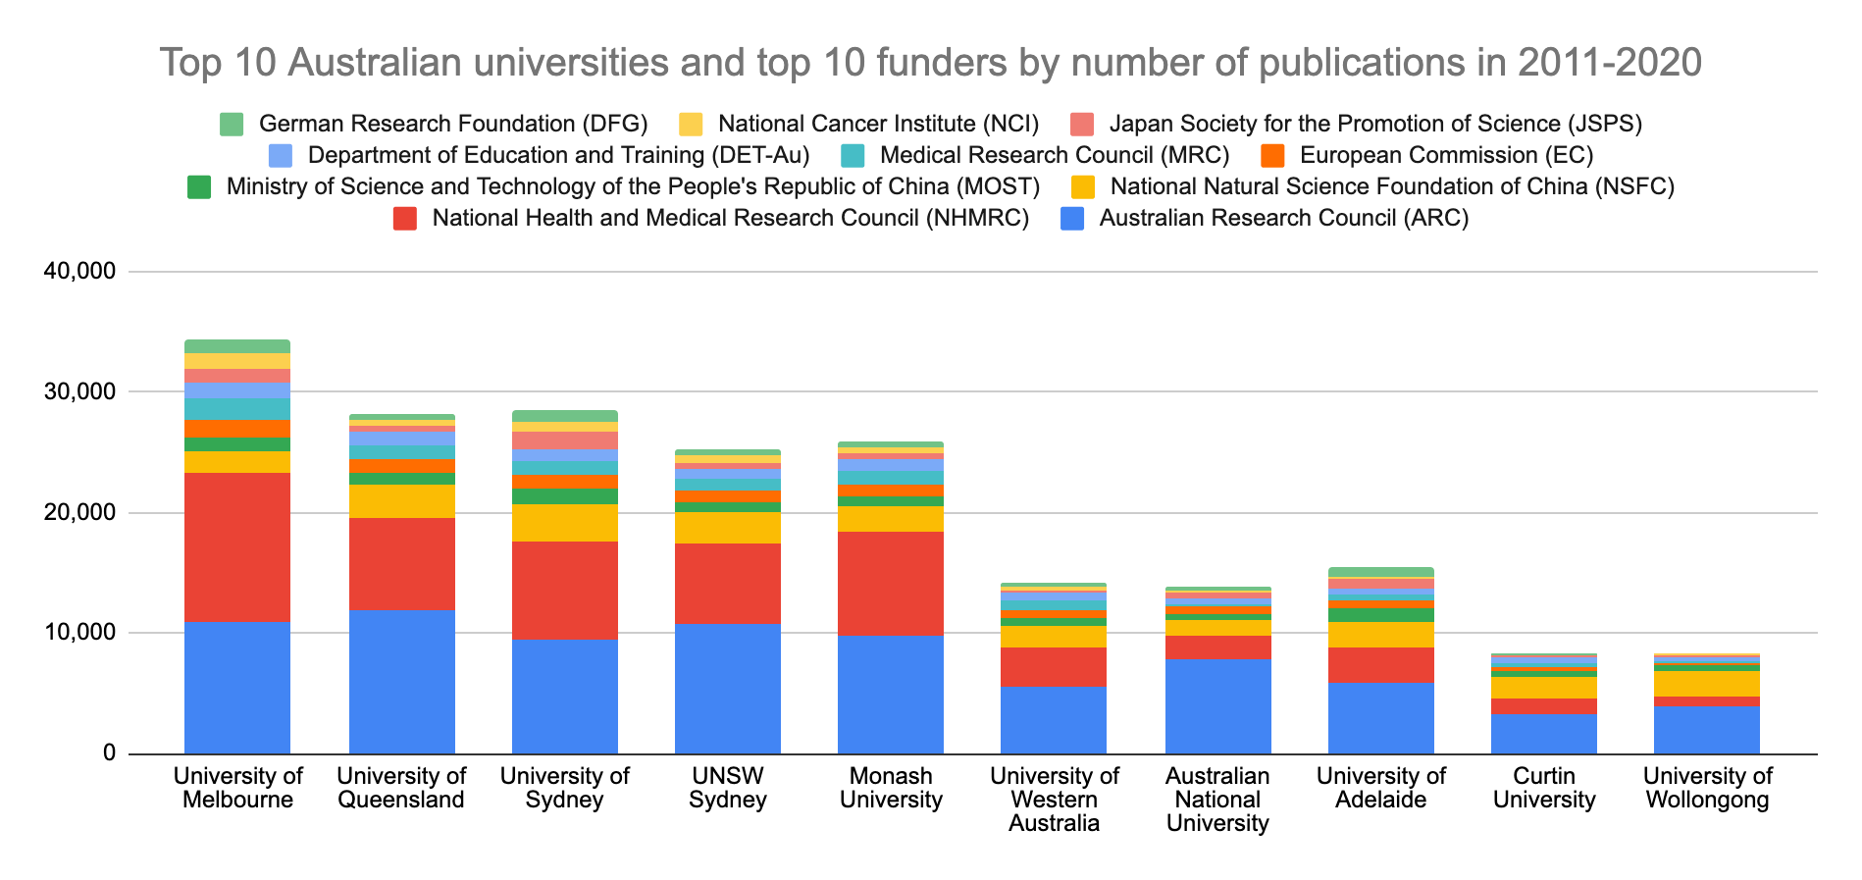
Publications insights
* Indicative data based on acknowledgement sections and links to the grants data core
August 2019!
Notes:
Add asterix that this is indicative data

Slide 7
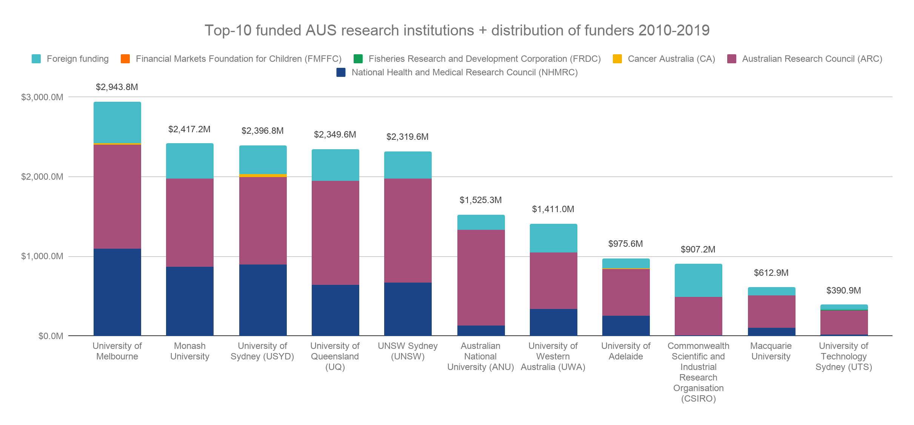
Example insights based on that data
August 2019!
Notes:
University of Technology Sydney (UTS)
598
NZD 436.4 M

Slide 8
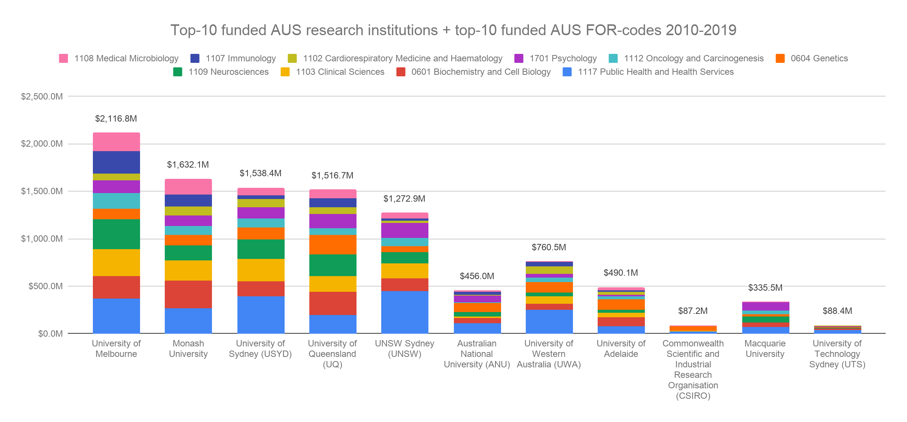
Example insights based on that data
August 2019!
Notes:
University of Technology Sydney (UTS)
598
NZD 436.4 M

Slide 9
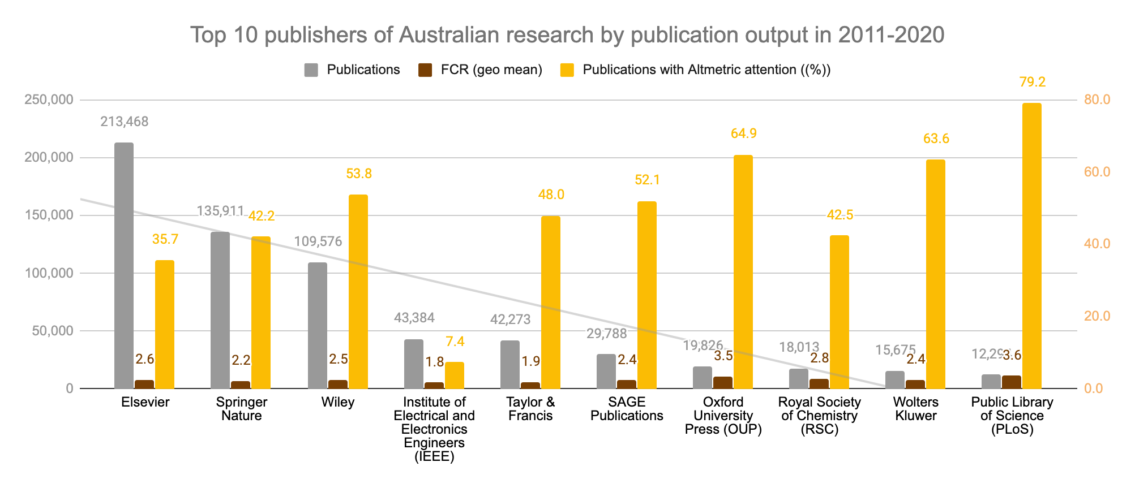
Publisher insights
Notes:
Interesting that PLoS has the highest CR and the highest share of attention

Slide 10
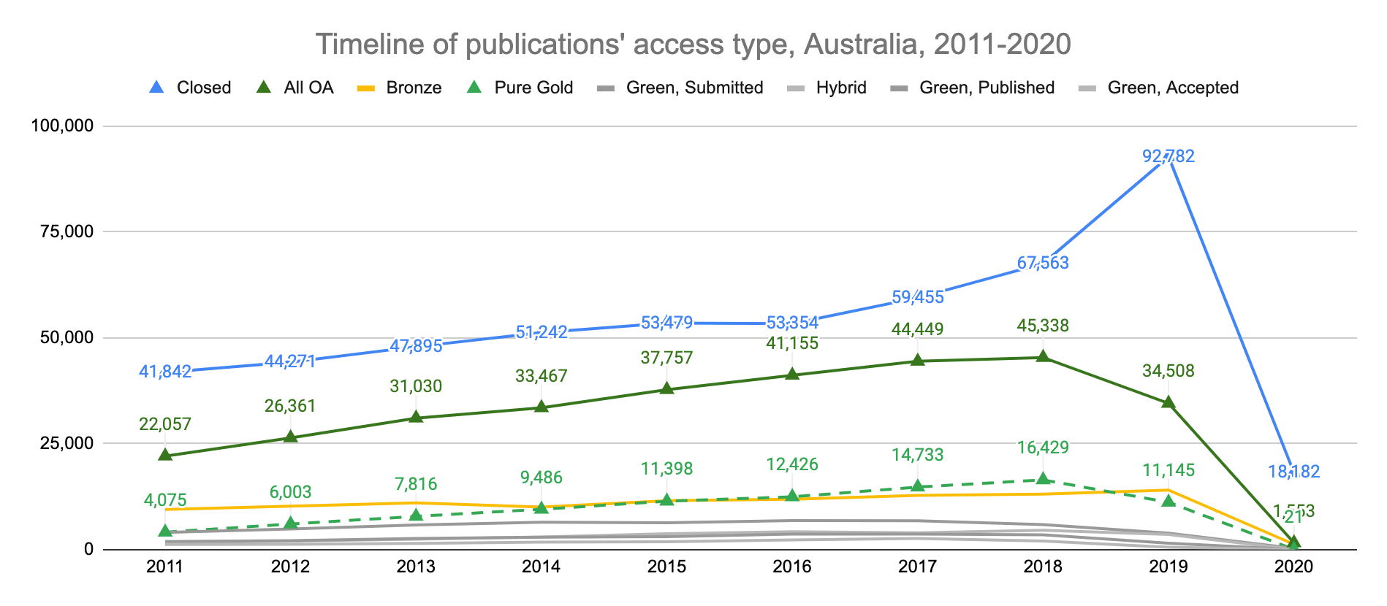
Publisher insights

Slide 11
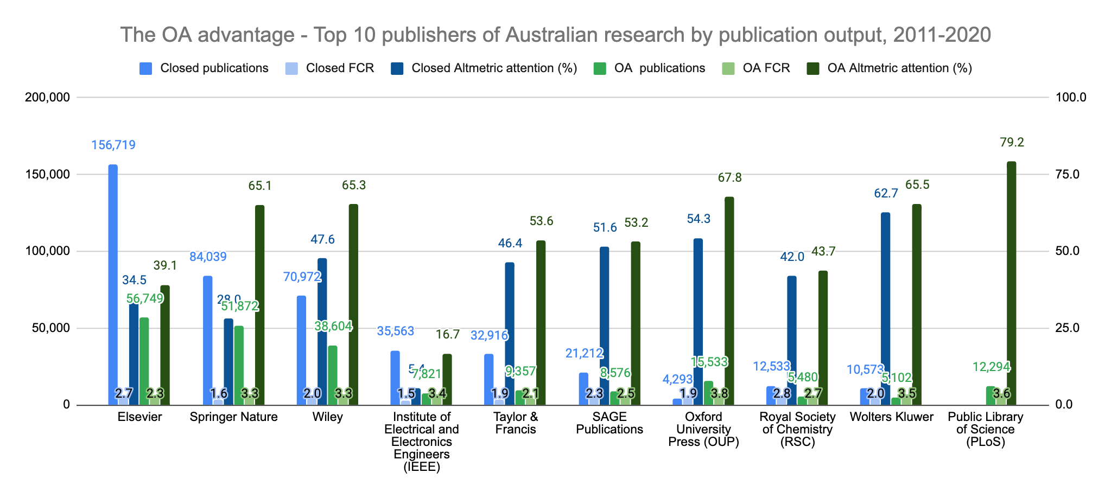
Publisher insights
https://docs.google.com/presentation/d/1w6SMXdUGMiAv0FovuzwuGFB1xuCNx85AxlxNrVFZIHY/edit#slide=id.p28
-16.7%
111.6%
62.8%
126.5%
14.0%
6.8%
98.4%
-2.2%
72.5%
Notes:
E.g. if Australia publishes with The Lancet a lot, which is closed (like Nature) and want to keep doing that, there is no need to look for OA alternatives within elsevier, because there is no advantage. But if they wanted to move towards AO, a change to SN could be an option

Slide 12
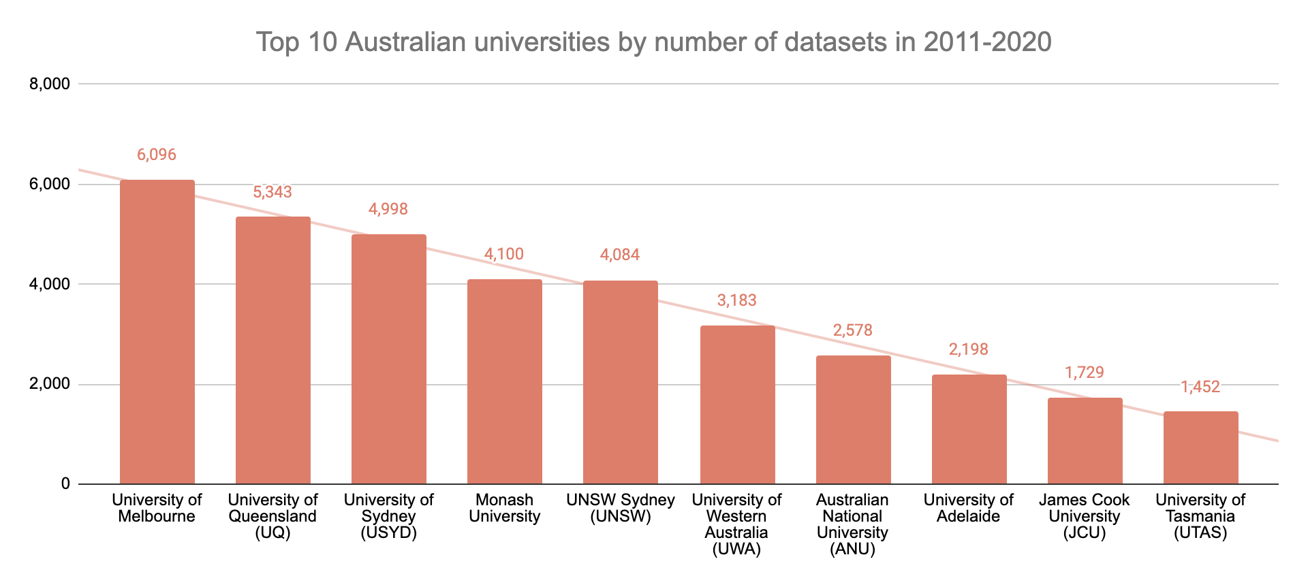
An important part of the open science movement
Notes:
Just admit not very interesting but a display of data that just became available

Slide 13
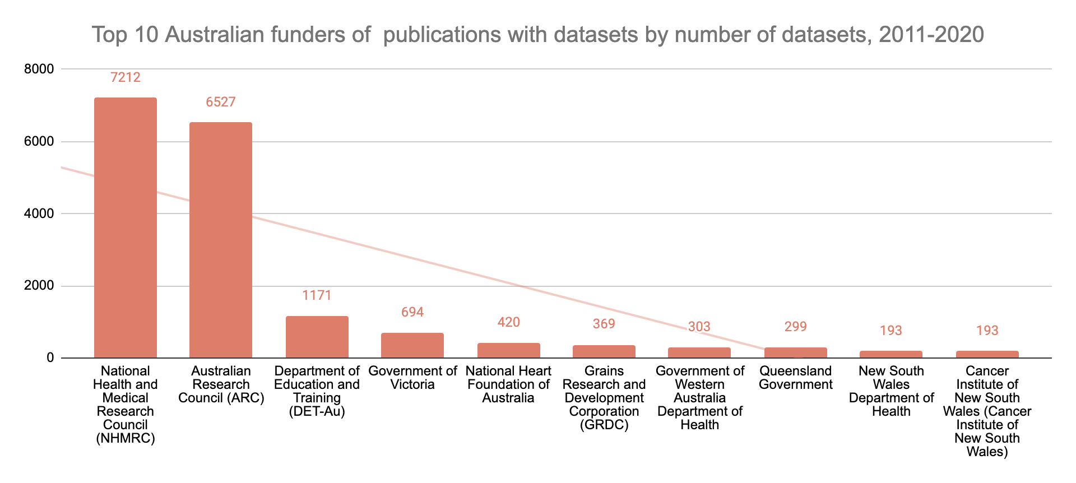
An important part of the open science movement
Notes:
Indicative data + we only yet have 1.5 million - so a double limitation

Slide 14
Funding of Australian universities
Notes:
University of Technology Sydney (UTS)
598
NZD 436.4 M

Slide 15
Funding insights

Slide 16
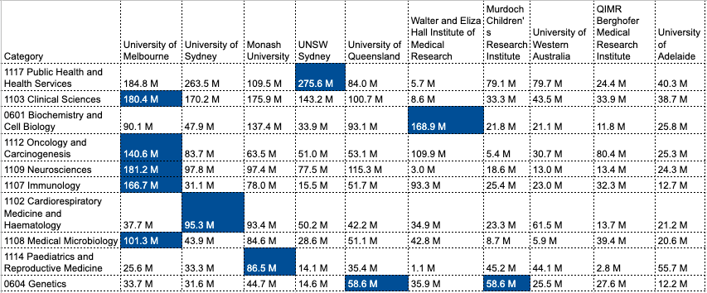
National Health and Medical Research Council (NHMRC) - top awardees and top FoRs, starting grants 2011-2020
Notes:
Highlight: Who gets the most money for FORs

Slide 17
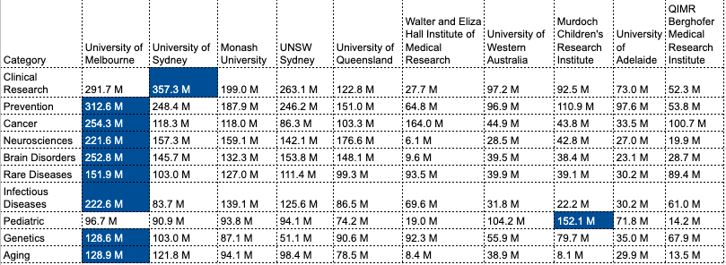
National Health and Medical Research Council (NHMRC) - top awardees and top RCDCs, starting grants 2011-2020
Notes:
Highlight: Who gets the most money for RCDCs

Slide 18
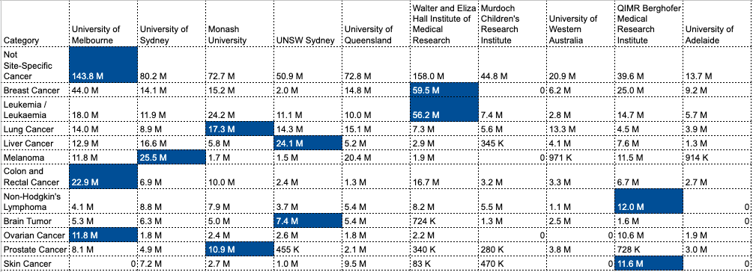
National Health and Medical Research Council (NHMRC) - top awardees and top ICRP Cancer Types, starting grants 2011-2020
Notes:
Highlight: Who gets the most money for ICRPs

Slide 19
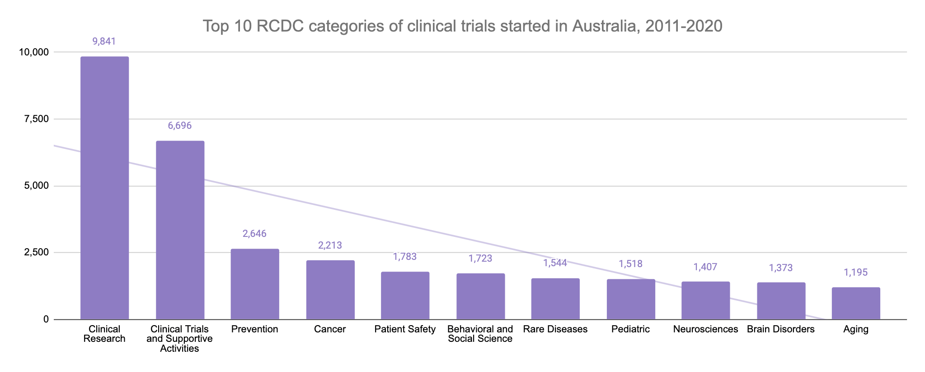
Clinical trials insights
Notes:
The top RCDC for clinical trials match to a high degree the focus of National Health and Medical Research Council (NHMRC) funding as well.

Slide 20
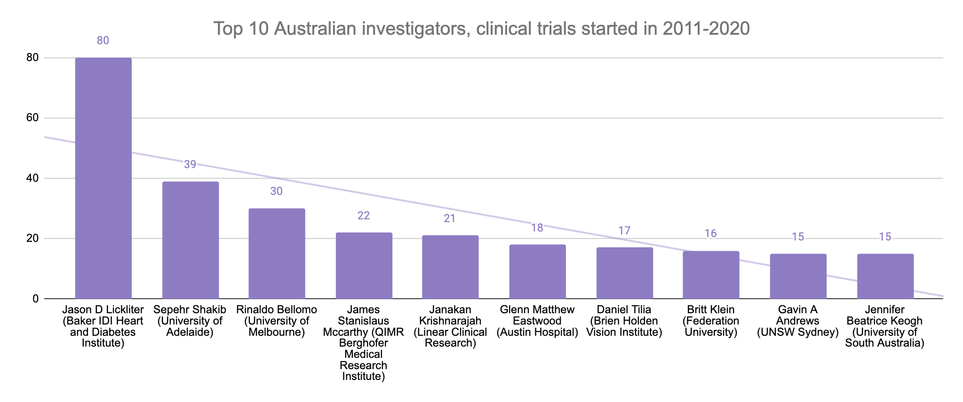
Clinical trials insights

Slide 21
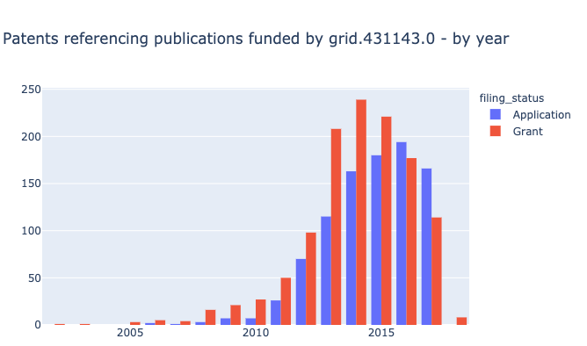
National Health and Medical Research Council (NHMRC) funded publications mentioned in patents

Slide 22
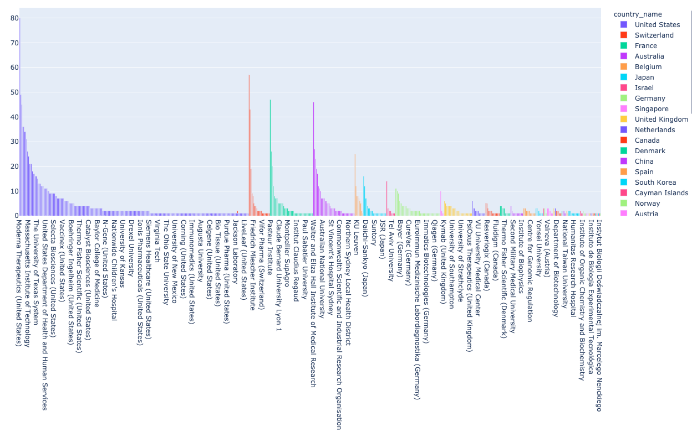
Assignees of patents mentioning NHMRC funded publications from 2011-2020

