Slide 1
Why Do We Exist?
Campus ICT and the unique value to the organizations it serves

Slide 2

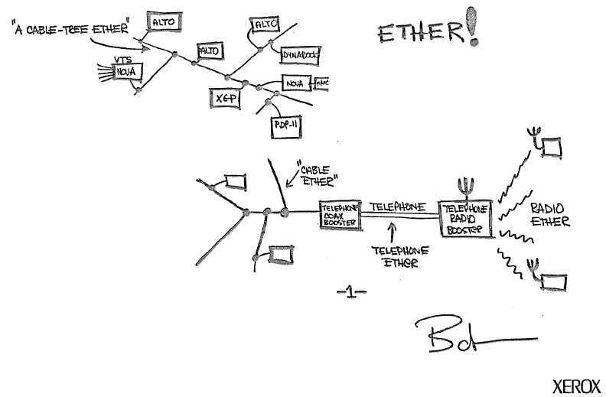






Wallace A. Chase
Technical Engagement Manager
wallace.chase@reannz.co.nz
@bmtfr

Slide 3

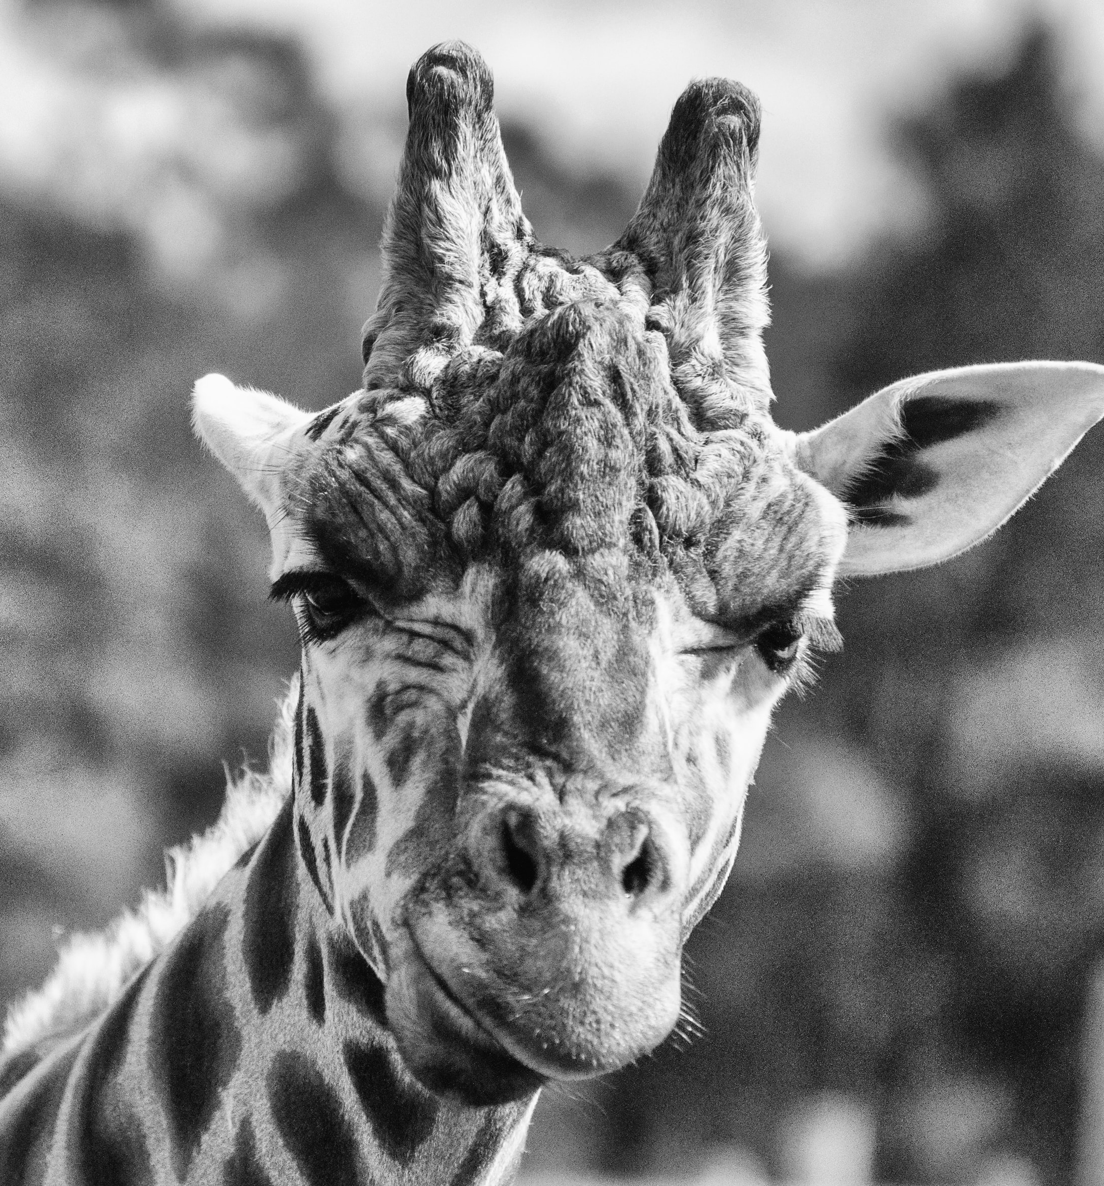
So…
Why do campus ICT departments exist?

Slide 4
Well…
As any engineer will tell you…

Slide 5
Some of what we do is plumbing
Notes:
We need to admit it. Some of what we do is. That is NOT to say it’s a bad thing… But it is repeatable and contractible…

Slide 6
At that point it’s just a simple maths problem
- Repeatable with a singular solution
5+5+5+5+5 = 55555

Slide 7
The plumbing must work. Always.

Slide 8
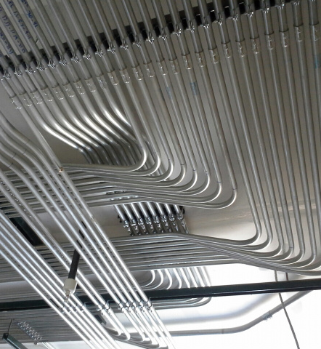
So is that a bad thing?
Notes:
No way! Plumbing is one of the most important parts of modern society. It’s a skill to do it right and is in high demand. I would dare even say it is harder to get a good plumber than it is to get a good engineer!
- Stopping to admire good conduit work – It’s a thing…

Slide 10
“Smoking radar facility UPS halts NZ flights”
36 flights delayed, and three made to turn around and land again.
New Zealand's national air traffic system suffered a serious fault today that led departing flights within the country's airspace being halted.
State-owned enterprise Airways, which manages New Zeealand's air traffic systems, said the fault was caused by a fire alarm being set off by smoke from one of its uninterruptible power supplies that had failed.
The fault occurred at approximately 1.20 pm New Zealand time at the Airways' Andy Herd Building in Christchurch that houses its main radar facility.
Airways said the fire alarm led to its radar and communications systems reverting to back-up system mode.
Airways chief executive Graeme Sumner apologised for the travel delays caused by the smoke from the UPS.
Juha Saarinen
Sep 30 2019
12:58PM
https://www.itnews.com.au/news/smoking-radar-facility-ups-halts-nz-flights-531655

Slide 11
Ok, so we can’t have the plumbing fail.
Plumbing requires skill and talent to do correctly.
Is that why we exist? Is that our value?

Slide 12
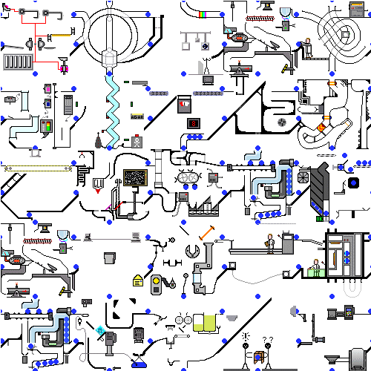
Operations can be done by others.
I would argue that a great measure of operational excellence is the ability to pick it up and have someone else do it.

Slide 13
Have someone else do those!
Your understanding of the institution is far more valuable than your specific technology skills…
What parts of your job are repeatable and standardized? (or should be…)

Slide 14

Easier said than done…
Can sometimes reduce but does not eliminate internal staff
…and it changes the skills required
Soft skills, project management, procurement, contact management, integration, architecture
Notes:
Those are the easy ones to remember – if you don’t have them often the failure is immediate and makes a splash

Slide 15


Stop spending so much time on solved problems.
We are lucky in that we can be a community
But who is getting the benefits of community?

Slide 16

Architecture
Photo by Daniel McCullough on Unsplash

Slide 17
The architect
Knows the institution
Knows the consumers of services
In tune with the strategic direction of the institution
Can see across systems and boundaries
Designs systems that will determine the path of the institution for years to come

Slide 18

The IT department as a multidisciplinary team of architects

Slide 19

Are you reaching across the whole institution?
Its easy to get stuck in the business systems, there is plenty to do…
Business systems tend to be fairly “enterprise” and we can relate to them much easier
Business system down = angry people with your boss
But they are a given, everyone has them, everyone expects them to just work…
Who might you be missing?

Slide 20

The Mindset Gap
Photo by Rahul Chakraborty on Unsplash
In the olden days – say, 10 years ago – we used to say that our typical new technology user came from a Windows desktop or laptop background.
  Those days are long gone ….
Nowadays, we say that our typical new user comes from an iOS or Android background.
How has that changed the services we deliver?

Slide 21

Translation

Slide 22
Is Oxygen a Metal?
How many of you believe that oxygen is a metal?

Slide 23

In real life…
Atomic number 8
Chalcogen
Key element in life
Also fire, rust, water etc
Necessary for our breathing
http://en.wikipedia.org/wiki/Oxygen
Photo by ian dooley on Unsplash

Slide 24
https://sciencenotes.org/colored-periodic-table/

Slide 25

Oxygen in Astronomy
The universe is made of the following:
  Hydrogen
    Atomic number 1
    75% of all baryonic mass
    Most stars are made of hydrogen plasma
  Helium
    Atomic number 2
    Noble gas (inert)
    24% of total elemental mass
  Other: ~1%
http://en.wikipedia.org/wiki/Hydrogen
http://en.wikipedia.org/wiki/Helium
Photo by Andy Holmes on Unsplash

Slide 26
What are planets made of?
Cores of iron, nickel etc
  Earth’s core is 89% iron, 6% nickel, 5% other
Mantles of silicates
http://en.wikipedia.org/wiki/Planets#Mass
http://en.wikipedia.org/wiki/Earth
Rose Eveleth, “Barns Are Painted Red Because of the Physics of Dying Stars.”
http://www.smithsonianmag.com/smart-news/barns-are-painted-red-because-of-the-physics-of-dying-stars-58185724/?utm_source=keywee-facebook.com&utm_medium=socialmedia&utm_campaign=keywee&kwp_0=283306&kwp_4=1091891&kwp_1=506963

Slide 27
Astronomers refer to all the chemical elements heavier than hydrogen and helium as ‘metals’, even though this includes elements such as carbon and oxygen which are not considered metals in the normal sense.
For example, stars and nebulae with relatively high abundances of carbon, nitrogen, oxygen, and neon are called "metal-rich" in astrophysical terms, even though those elements are non-metals in chemistry.
http://astronomy.swin.edu.au/cosmos/M/Metals

Slide 28
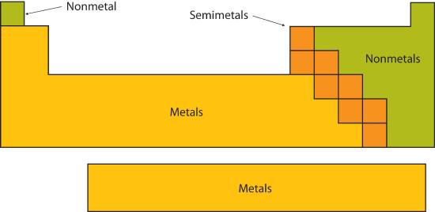
So what IS a metal?!?
To a chemist, “metals” have a very specific chemical definition.
But, to an astronomer (especially a cosmologist), “metals” are anything that isn’t hydrogen or helium.
http://astronomy.swin.edu.au/cosmos/M/Metals
https://chem.libretexts.org/Courses/College_of_Marin/Marin%3A_CHEM_114_-_Introductory_Chemistry_(Daubenmire)/04%3A_Atoms_and_Elements/4.6%3A_Looking_for_Patterns%3A_The_Periodic_Law_and_the_Periodic_Table

Slide 29

Scale
At quantum scale during femtoseconds, how much does gravity matter?
How about at cosmological scale over eons?
Photo by Kelly Sikkema on Unsplash

Slide 30
Projection
What happens if you put a mathematician, a psychologist and a movie producer into a room and ask them to discuss projection?

Slide 31
How well do you know your institution?
What is the overall unique value?
Are you asking the right questions?
Are you speaking the same language?

Slide 32
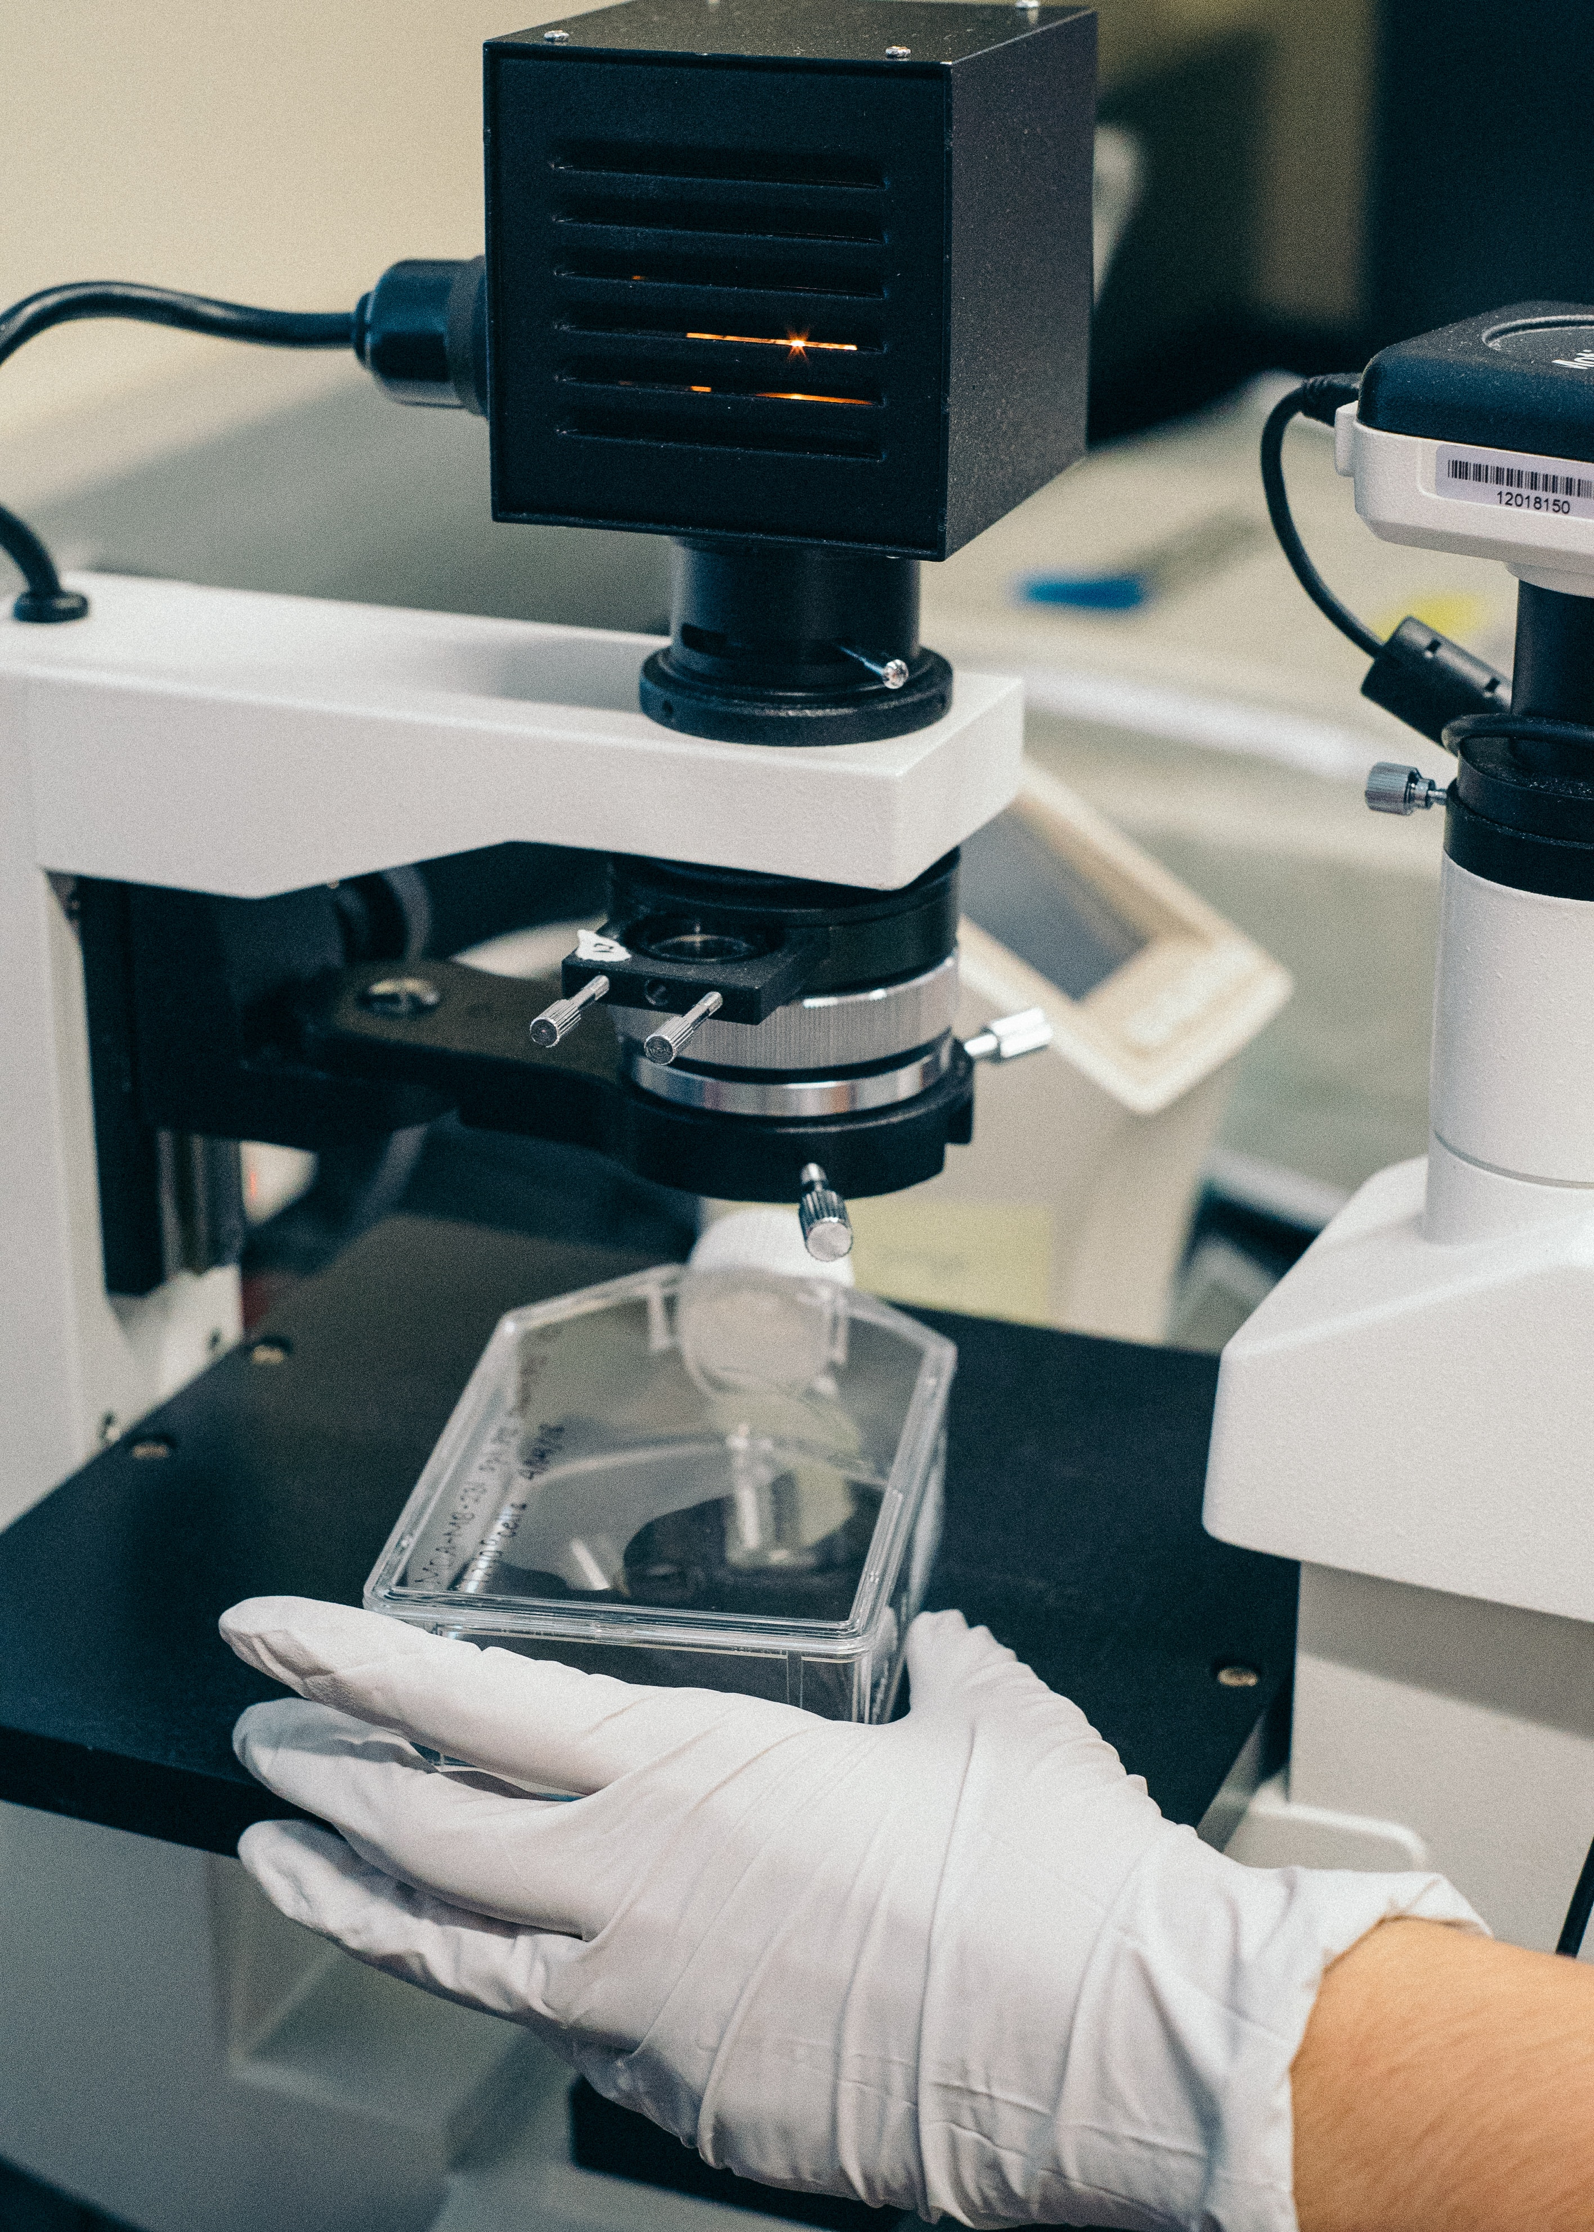
Innovative researchers and educators are often trying to do things that have never been done before.
To expect things they need to always neatly fit into existing services, products and categories will only frustrate everyone…
Photo by Jaron Nix on Unsplash

Slide 33
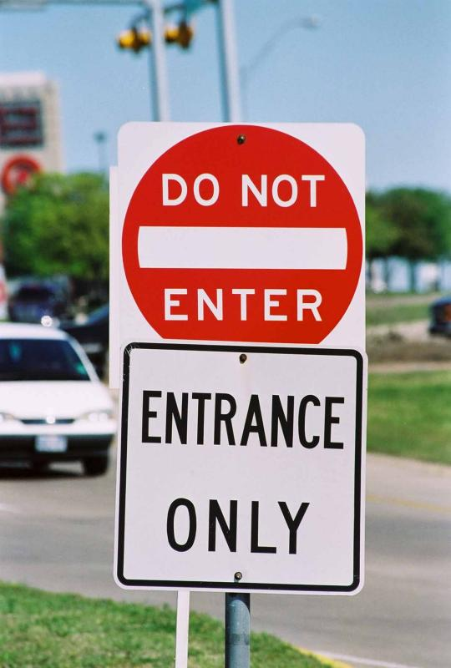
Change the way we look at our mission

Slide 34
Change the way we look at our mission
Change the way you look at your role

Slide 35
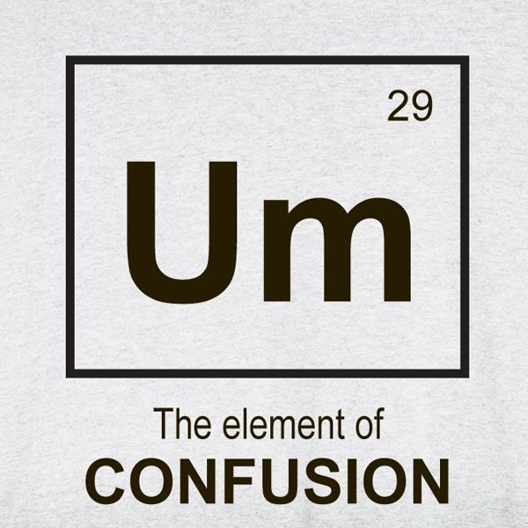
We are the experts in our field

Slide 36


Slide 37
Campus ICT exists to make sense of the complexity, to match the institutional strategy with technology and to ensure the successful deployment of those technology services.

Slide 38

We are integrators and we are architects

Slide 39
We serve an amazing community of educators, scientists, students and innovators
Are we bringing our expertise to the table in support of their goals and ideas?
Where are we spending most of our (valuable) time?
Notes:
Everyone has the same enterprise systems in the end, what are we doing different?

Slide 40
What are you doing to enable your innovators?

